Slide 1


Slide 2


CODE-M
Flux Balance Analysis (FBA) Workshop
Dr Stephen Chapman
stephen.chapman@liverpool.ac.uk
350 Biosciences Building
Notes:
Talk to you today about an area of biology called Bioinformatics, or otherwise known as computational biology. All about how to get ocmoiuters to work for us enhance biological knowledge.

Slide 3
Aims:
Perform FBA on an E. Coli metabolic model using COBRApy
Predict Biomass of E. Coli grown aerobically
Visualise fluxes using Escher

Slide 4
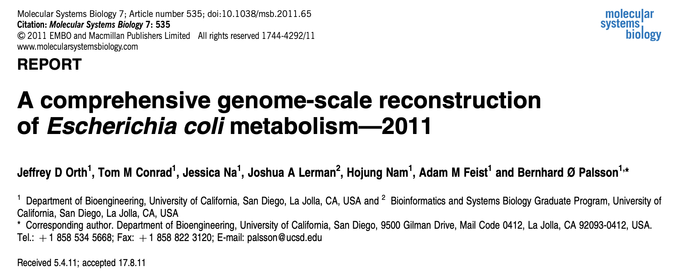
Metabolic modelling of E. Coli: iJO1366

Slide 5
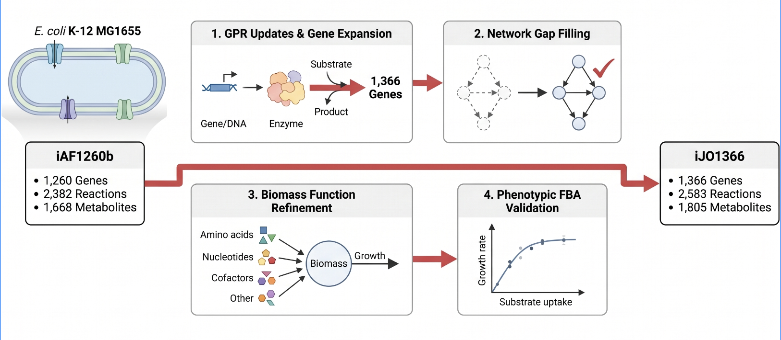
iJO1366 constructed from iAF1260b

Slide 6
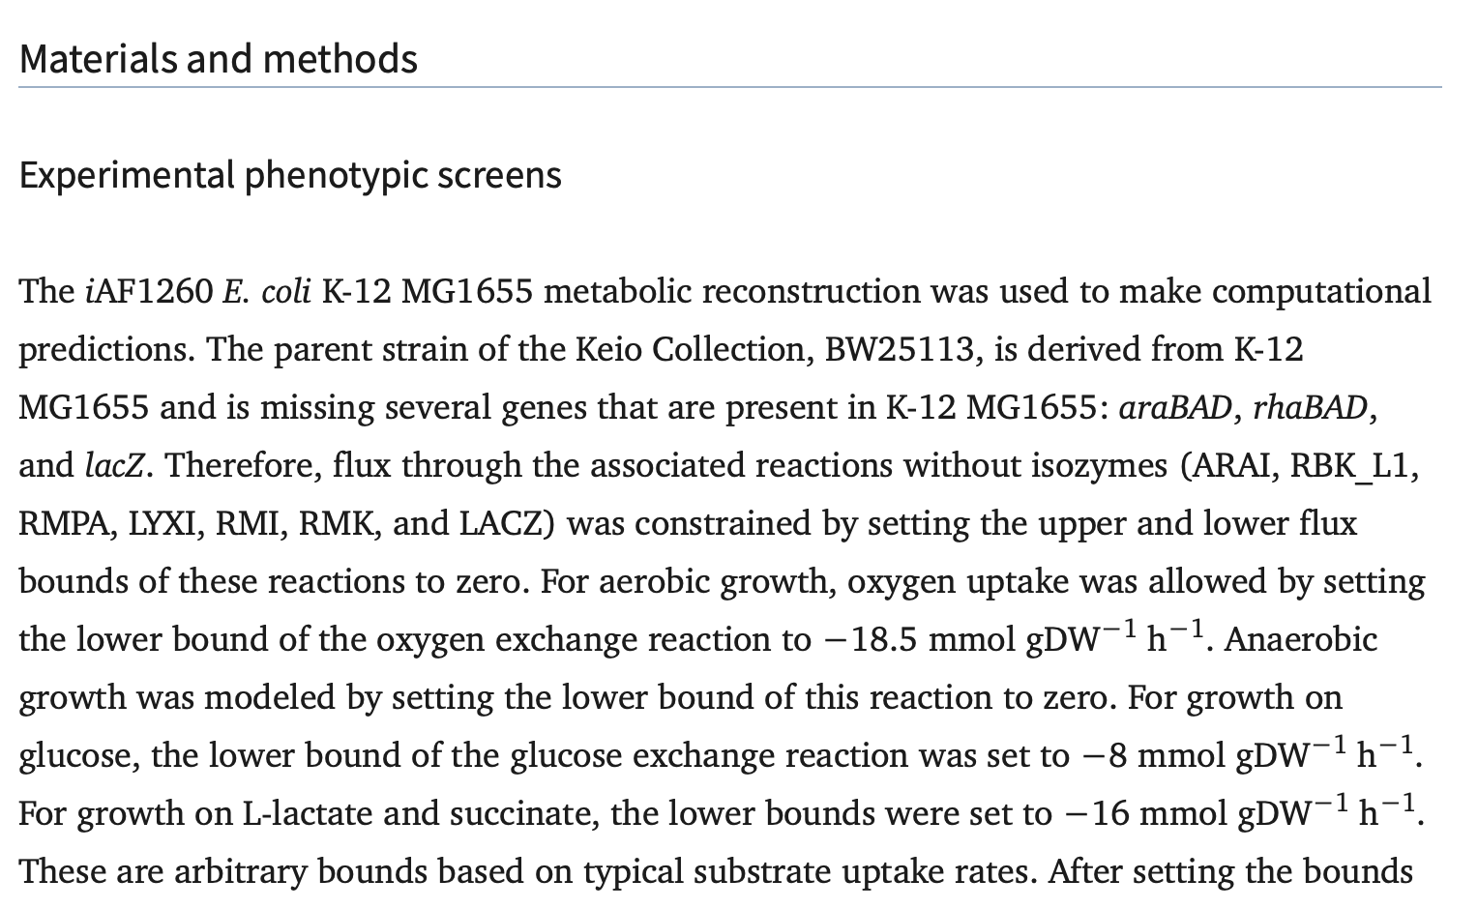


Model constraints: oxygen and glucose for aerobic growth
Oxygen uptake limit: 18.5 mmol gDW⁻¹ h⁻¹
Glucose uptake limit: 8 mmol gDW⁻¹ h⁻¹

Slide 7
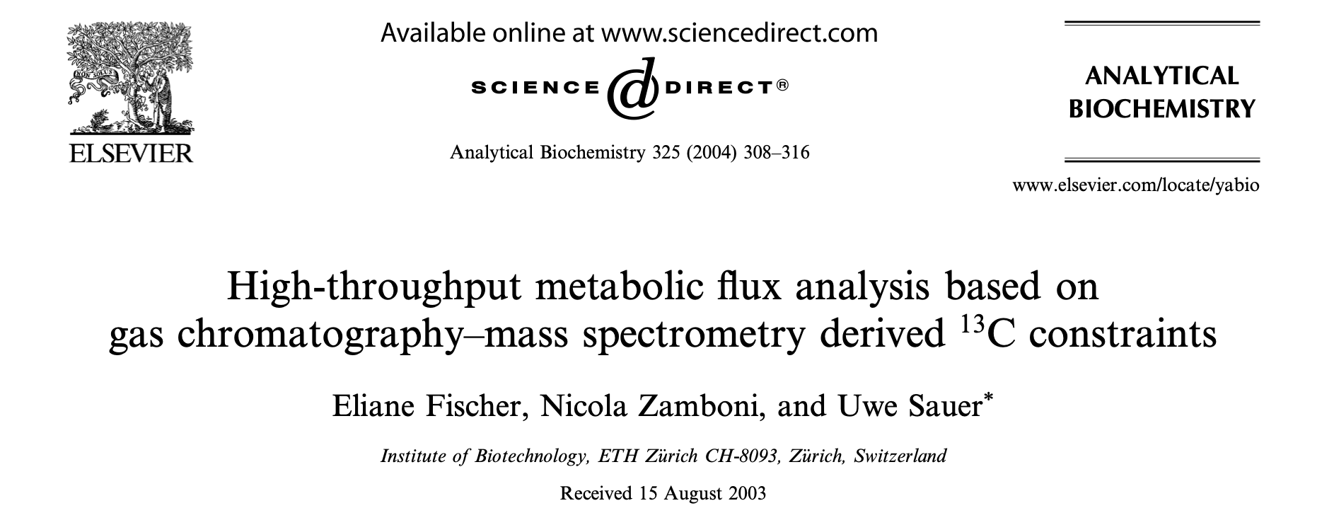
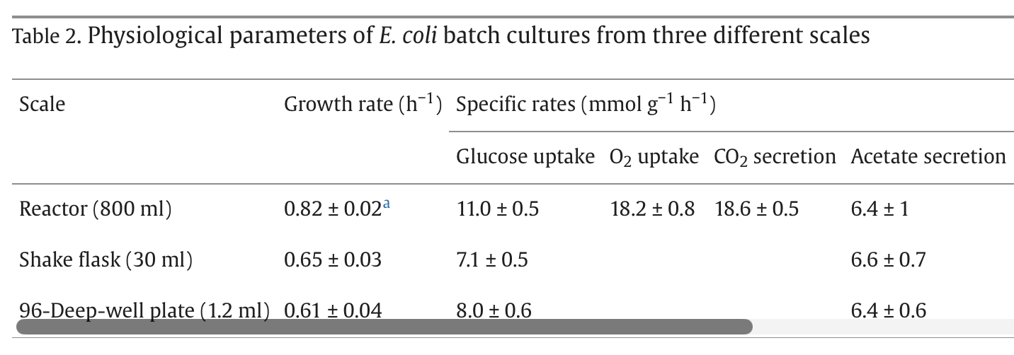


Calculation of ‘arbituray uptake rates’
Fischer et al., (2004)

Slide 8
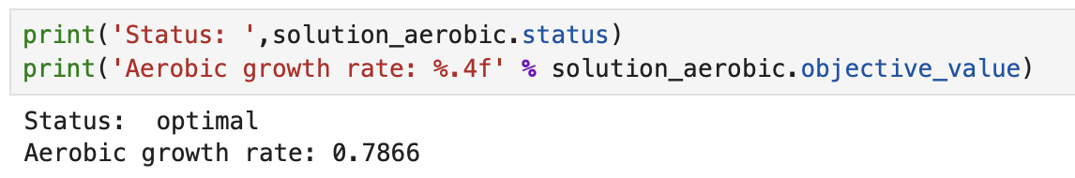


Predicted growth rate matches experimentally calculated growth rate

Slide 9
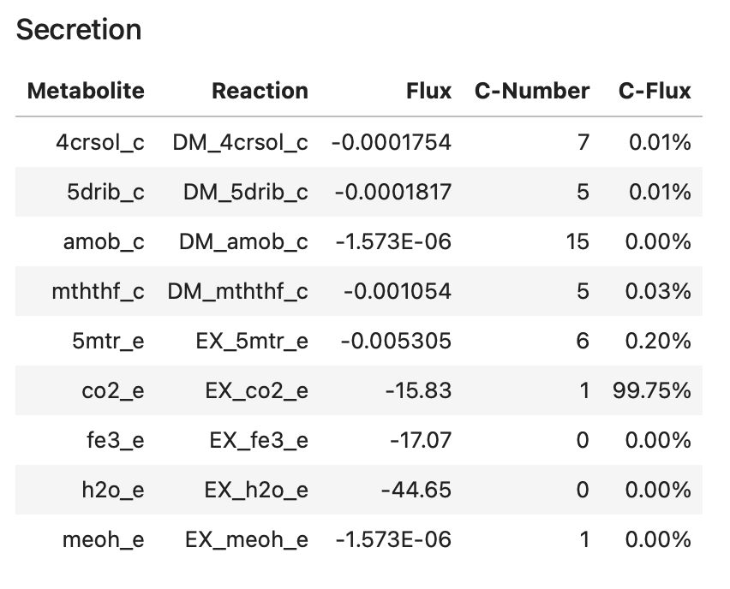



Aerobic growth predicted CO₂ export that almost matches experimental data

Slide 10
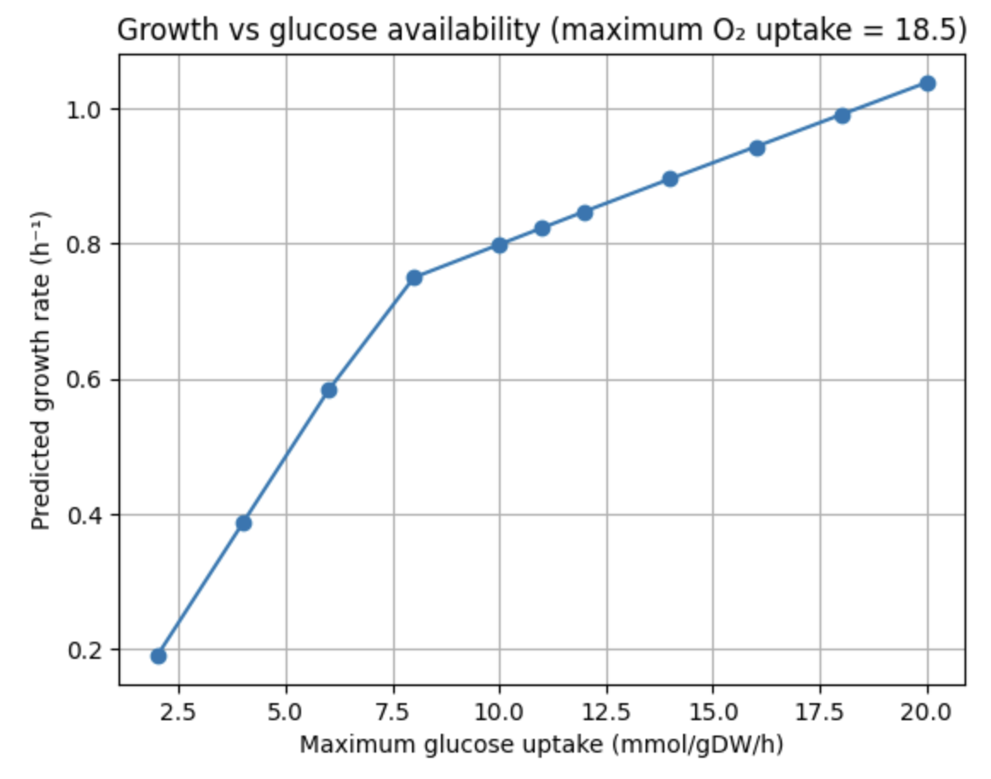
Growth increases whilst increasing glucose uptake

Slide 11
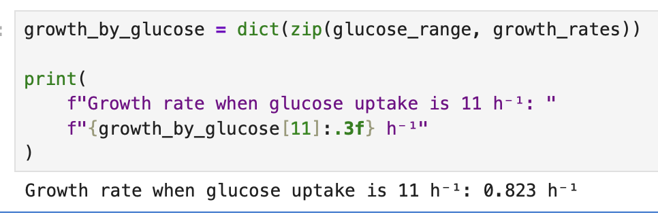

Increasing glucose uptake increases growth

Slide 12
Extension activity: Modelling S. cerevisiae metabolism
Load the iMM904.xml model provided.
How many genes, reactions and metabolites does this model contain?
Print the exchange reactions and the growth medium
Using FBA, simulate the maximum aerobic growth rate
Plot fluxes using Escher
Perform a robustness analyses to investigate how oxygen uptake effects the growth

