Slide 1


Slide 2


CODE-M
#2 Genome-Scale Metabolic Models (GSMMs)
Dr Stephen Chapman
stephen.chapman@liverpool.ac.uk
350 Biosciences Building
Notes:
Talk to you today about an area of biology called Bioinformatics, or otherwise known as computational biology. All about how to get ocmoiuters to work for us enhance biological knowledge.

Slide 3
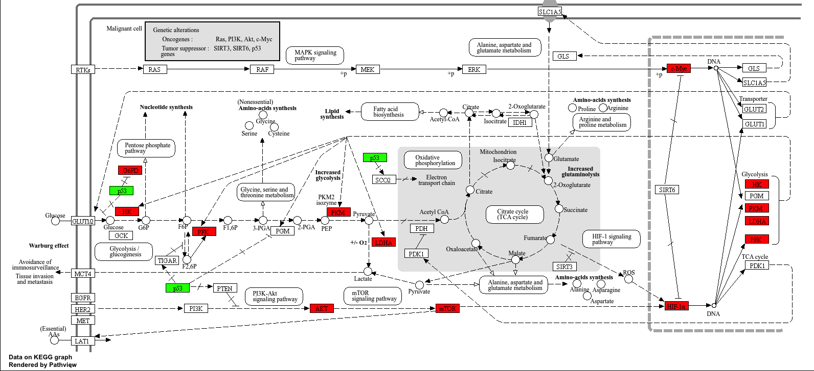
Last time we talked about about
Systems Biology as a non reductionist / holistic approach to understand complex biological systems
Metabolism dictates the phenotype as it sits downstream of regulation
KEGG is a database of biological systems
Map omics data to
metabolic pathways
Can’t make in silico predictions
KEGG pathways are static
Possible with GSMMs

Slide 4
Today we will talk about…
Genome scale metabolic models
Variety of genome scale metabolic models
Where to get genome scale metabolomic models
SBML file format of genome scale metabolic models
How to load a genome scale metabolic model into COBRApy
Contents of a genome scale metabolic model

Slide 5
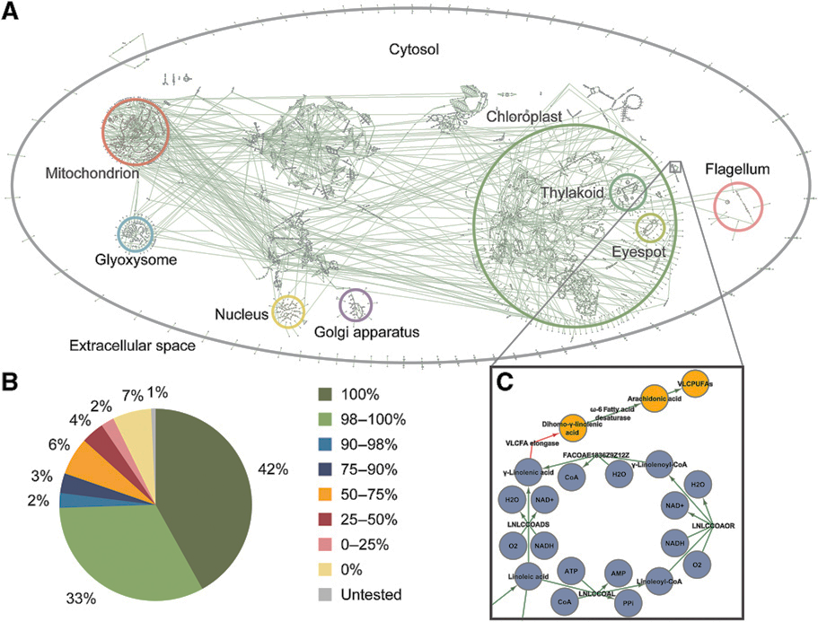
A Genome Scale Metabolic Model (GSMM)…
metabolic reactions
… a collection of an organisms’ metabolism

Slide 6
iRC1080 – a GSMM of C. reinhardtii
2190 reactions
1068 metabolites
1080 genes
45 metabolic inputs
acetate
CO₂
H₂O
photons
(Chang et al., 2011)

Slide 7
Genome scale metabolic models are constructed from genome annotations
Computational representation of system wide metabolism
Contain all annotated metabolic genes
Describes the metabolic role of each metabolic gene
Describes the substrates and products of each metabolic reaction
Interconnect metabolism: The product of one reaction is a substrate for the next reaction

Slide 8
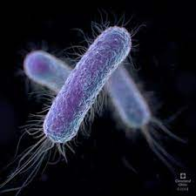

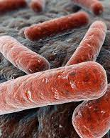

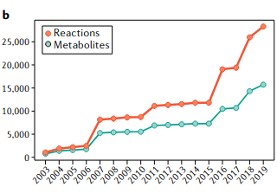
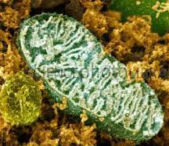
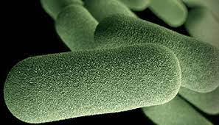
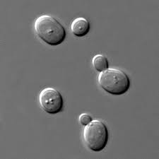

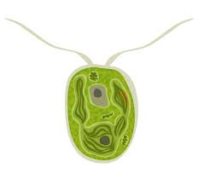
Evolution of genome scale metabolic models
E. coli
M. tuberculosis
A. thaliana
M. musculus
human mitochondrion
H. influenza
2004
2011
1999
2002
2005
2007
2010
2017
S. cerevisiae
C. reinhardtii
H. sapiens

Slide 9
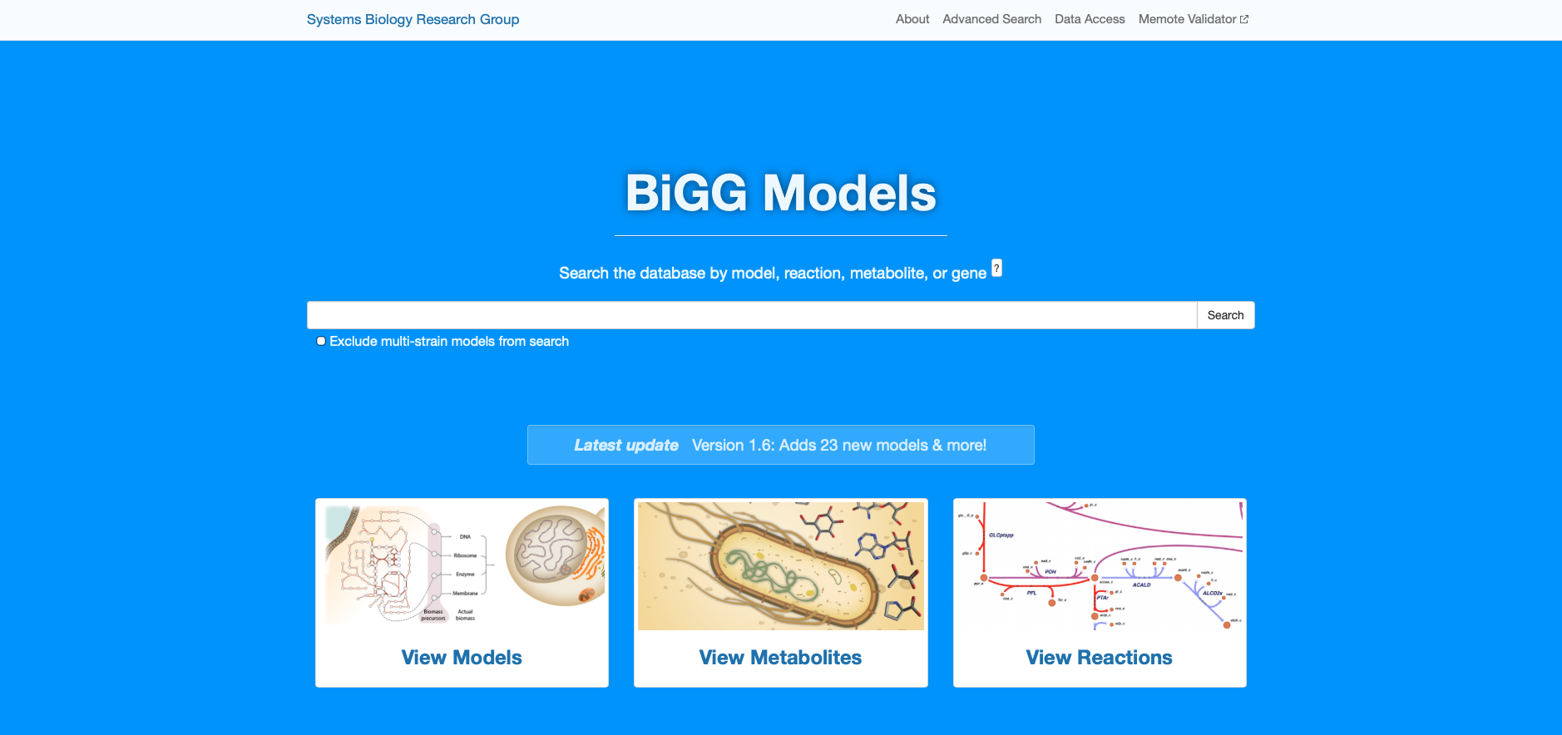
Metabolic models are stored in BIGG Models

Slide 10
Metabolic models are stored in SBML format
<sbml>
<model id=”metabolic_model">
<listOfCompartments>
<...>
</listOfCompartments>
<listOfSpecies>
<...>
</listOfSpecies>
<geneProduct>
<...>
</geneProduct>
<listOfReactions>
<...>
<listOfReactants>
<...>
</listOfReactants>
<listOfProducts>
<...>
</listOfProducts>
<geneProductAssociation>
<...>
</geneProductAssociation>
</listOfReactions>
</model>
</sbml>

Slide 11
Metabolic models are stored in SBML format
<sbml>
<model id=”metabolic_model">
<listOfCompartments>
<...>
</listOfCompartments>
<listOfSpecies>
<...>
</listOfSpecies>
<geneProduct>
<...>
</geneProduct>
<listOfReactions>
<...>
<listOfReactants>
<...>
</listOfReactants>
<listOfProducts>
<...>
</listOfProducts>
<geneProductAssociation>
<...>
</geneProductAssociation>
</listOfReactions>
</model>
</sbml>
id=“c” name=”cytoplasm”
species id=”M_glc_D_e” name"D-Glucose”
resource ”kegg.compound/C00031"
id="G_b4232" label="b4232" name=”hex1”
id="G_b4233" label="b4233" name=”hex2
reaction id=”R_Hex1”, reversible=“F” name = “hexokinase”
resource ”kegg.reaction/R00299”
resource ”identifiers.org/uniprot/P19367”
lowerBound = 0
upperBound = 1000
species="M_atp_c" stoichiometry="1"
species=“M_glc_D_c” stoichiometry="1"
species="M_adp_c" stoichiometry="1"
species= “M_g6p_c” stoichiometry="1"
<fbc:or>
<fbc:geneProductRef fbc:geneProduct="G_ b4232 "/>
<fbc:geneProductRef fbc:geneProduct="G_ b42323"/>
</fbc:or>

Slide 12
Metabolic models consist of reactions, metabolites and attributes
Reaction:
Hexokinase
unique reaction ID | R_HEX1
reaction name | hexokinase
equation | M_atp_c + M_glc_D_c M_adp_c + M_g6p_c + M_H_c
Gene-Protein-Reaction | ENSG00000106633 or ENSG00000156515 or ENSG00000159399 or ENSG00000160883
reaction upper bound | 1000.0
reaction lower bound | 0
Metabolite:
Glucose
unique species identifier | M_glc_D_c
name | D_glucose
compartment | Cytosol
chemical formula | C6H1206
KEGG ID | C00031
Charge | 0
Notes:
If reactions are reversible, then indeed, the reaction lower bound can be constrained to a negative value to reflect the directionality/

Slide 13
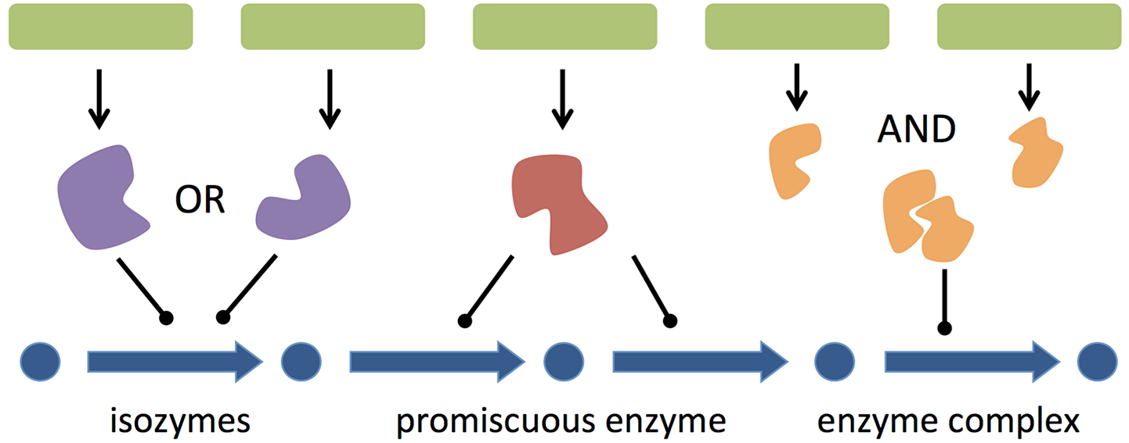
Gene-Protein Reaction rules
GPR rules are used to logically map genes/proteins to reactions
Image from Machado D, et al. (2016) PLoS Computational Biology

Slide 14
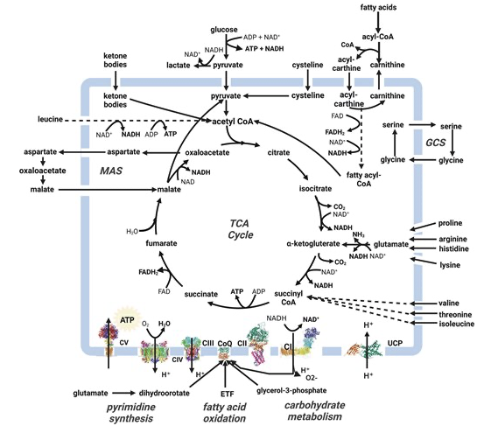
Exchange reactions allow metabolite uptake / exit
Chapman et al., 2025

Slide 15
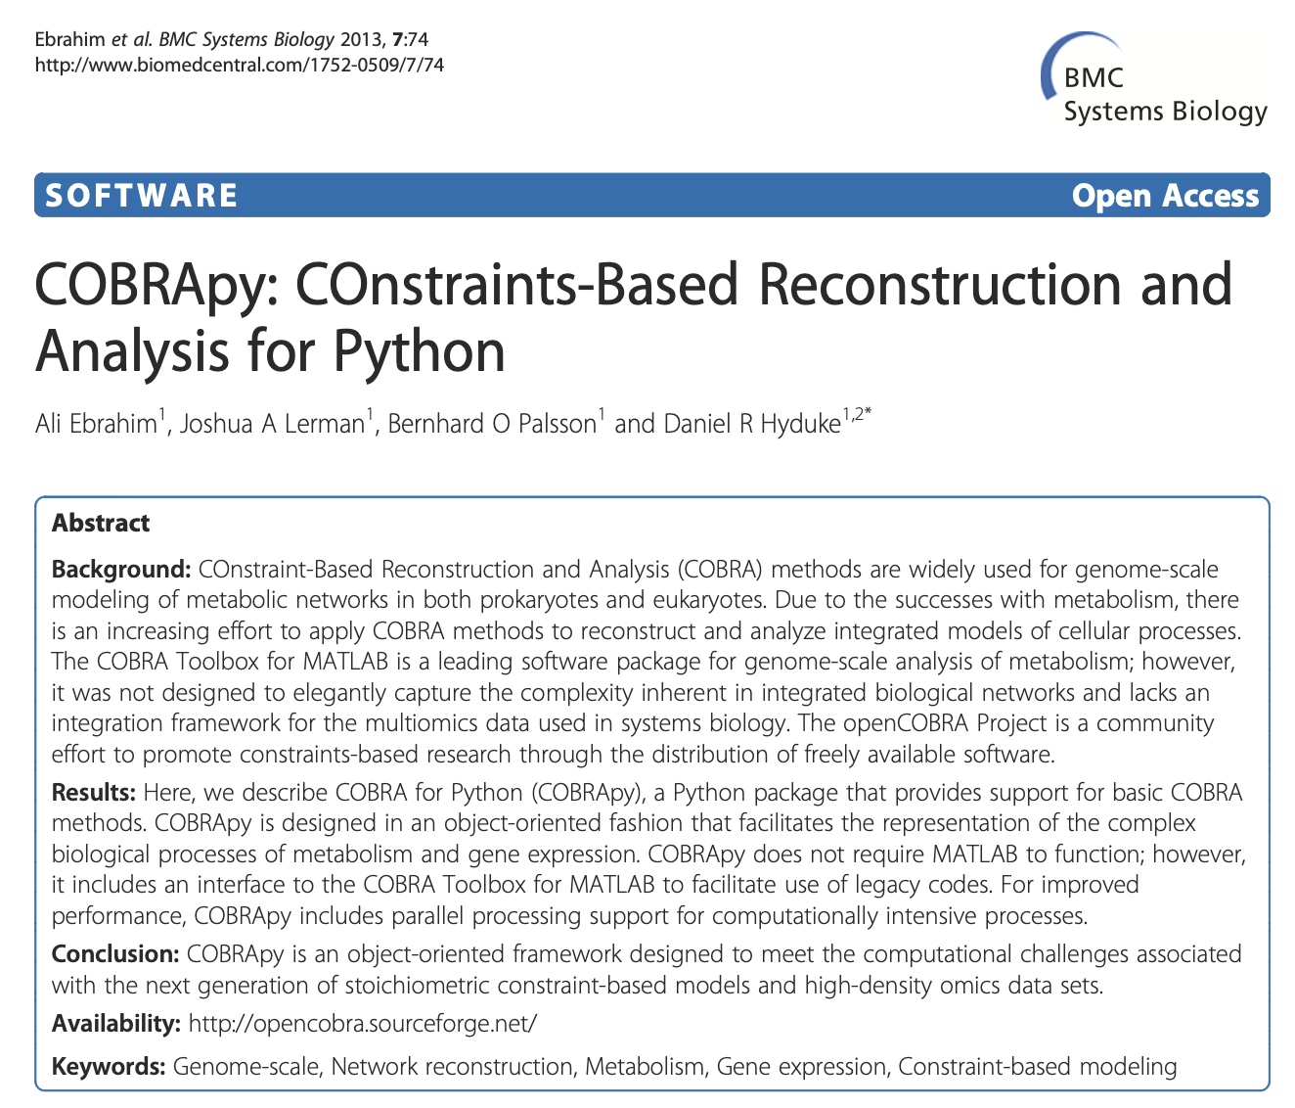
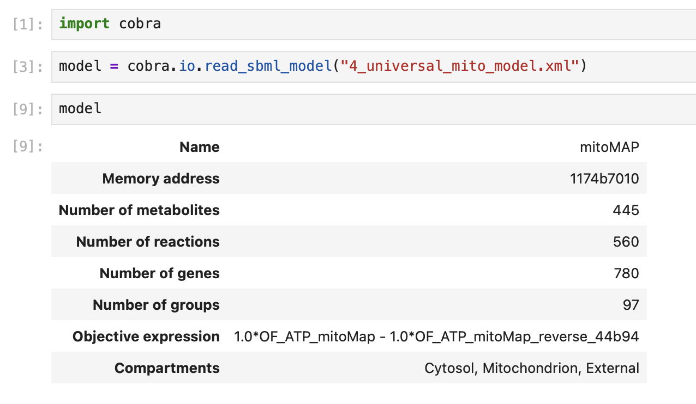
COBRApy is the most used Python package to analsye and simulate metabolic models
Constraint-Based Reconstruction and Analysis
https://link.springer.com/article/10.1186/1752-0509-7-74

Slide 16
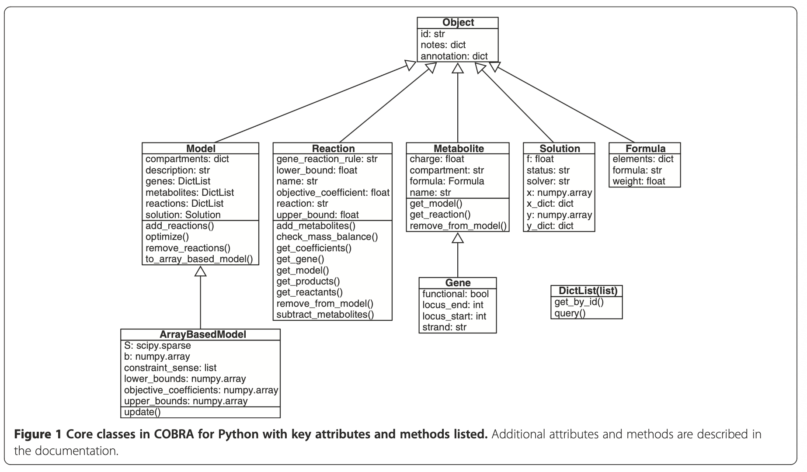
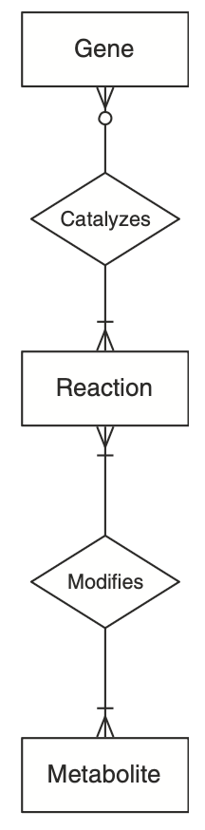

cobra.io_read_sbml_model(): creates a model object with 3 core classes
https://link.springer.com/article/10.1186/1752-0509-7-74

Slide 17
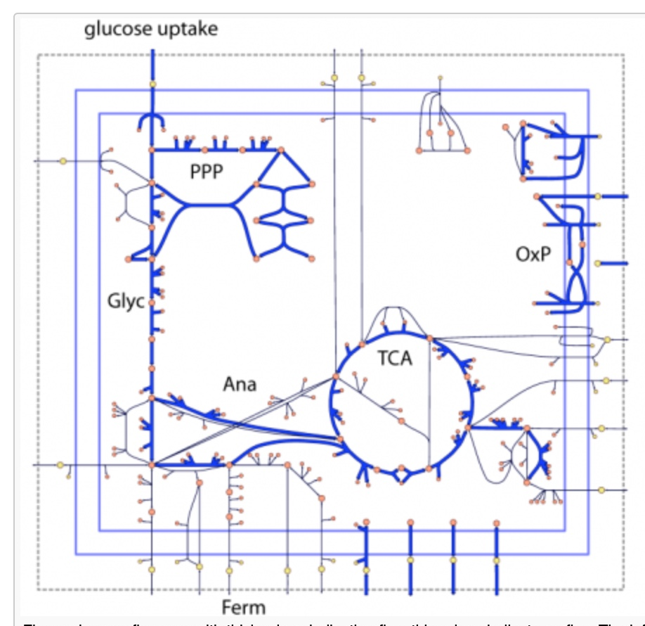
Metabolic models are simulated using…
Flux Balance Analysis
FBA implements linear programming on the metabolic model…
… to predict steady state metabolic fluxes…
… subject to imposed constraints of each reaction!

Slide 18
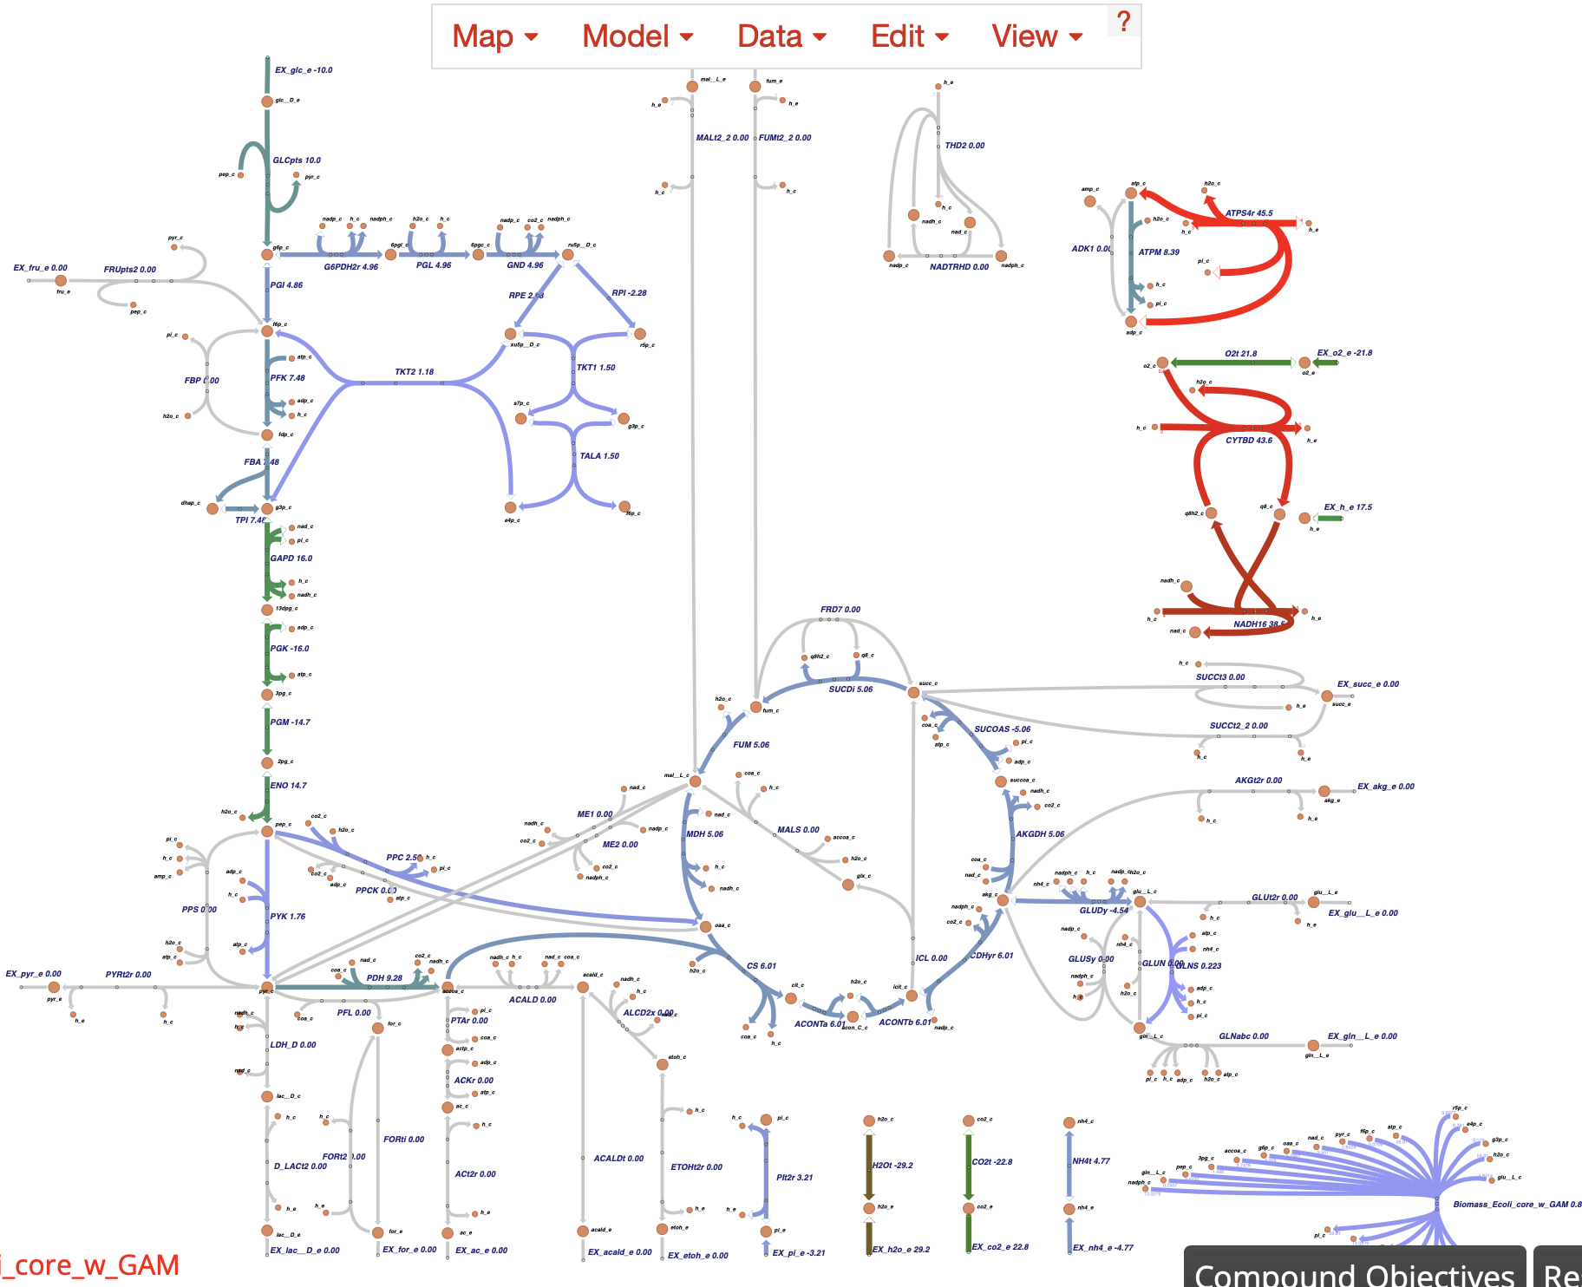
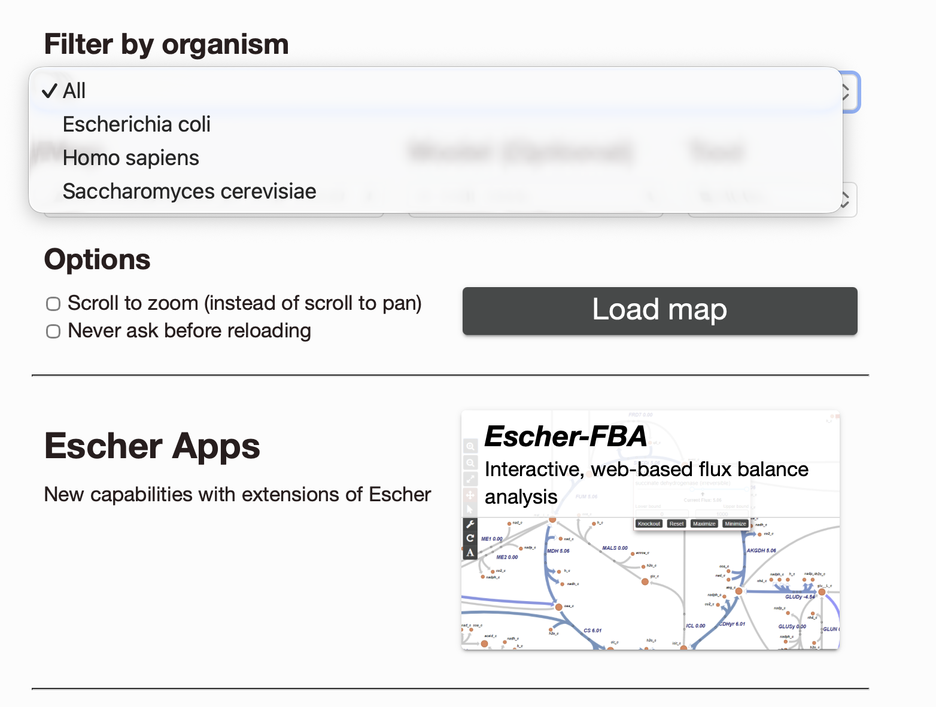
Visualising flux distributions with Escher
https://escher.github.io – automates flux visulisation for a few pathways for a few organisms

Slide 19
Demonstration: uploading and inspecting a GEM using COBRApy
1. Installed Anaconda NavigatorCreated a Conda environment using Terminal (Mac) An environment allows to install specific packages to be used within that environment$
$ conda create -n cobra_env python=3.11
$ conda activate cobra_env
2. Installed COBRApy into environment
$ pip install cobra
$ pip install cobra escher
$ pip install matplotlib
3. Installed jupyter notebooks into the environment
$ pip install notebook ipykernal
3.
45.
Instal cobra
  3. $ conda create -n cobra_env python=3.11
$
$ $
Paste these commands into the
terminal / Conda prompt
  $
  $ conda activate cobra_env
Python 3.11
install COBRApy
install jupyter notebooks
cobra_env

Slide 20
Conclusions
A genome scale model is a collection of an organism's metabolism
Many GSMM modes exist for different species
Downloaded from BIGG database
Stored In SBML format which lists compartments, metabolites, reactions, genes and gene-protein reaction rules
Each reaction has a set of bounds that determines that reactions activity
GSMMs can be loaded and analysed using COBRApy package
They can be simulated using Flux Balance Analysis
Any questions?

