Slide 1


Slide 2


CODE-M
#4 Integrating omics as constraints into metabolic models
Dr Stephen Chapman
stephen.chapman@liverpool.ac.uk
Notes:
Talk to you today about an area of biology called Bioinformatics, or otherwise known as computational biology. All about how to get ocmoiuters to work for us enhance biological knowledge.

Slide 3
Last time we talked about about
A genome scale model is a collection of an organism's metabolism
Many GEM modes exist for different species
Stored in SBML format which lists compartments, metabolites, reactions, genes and gene-protein reaction rules
Downloaded from BIGG database
GSMMs can be loaded and analyzed using the COBRApy package
They can be simulated using Flux Balance Analysis
FBA optimises an ‘objective’ reaction, to produce a flux distribution…
Subject to imposed constrains

Slide 4
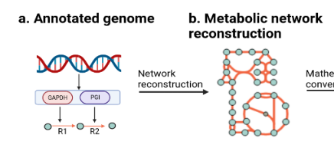
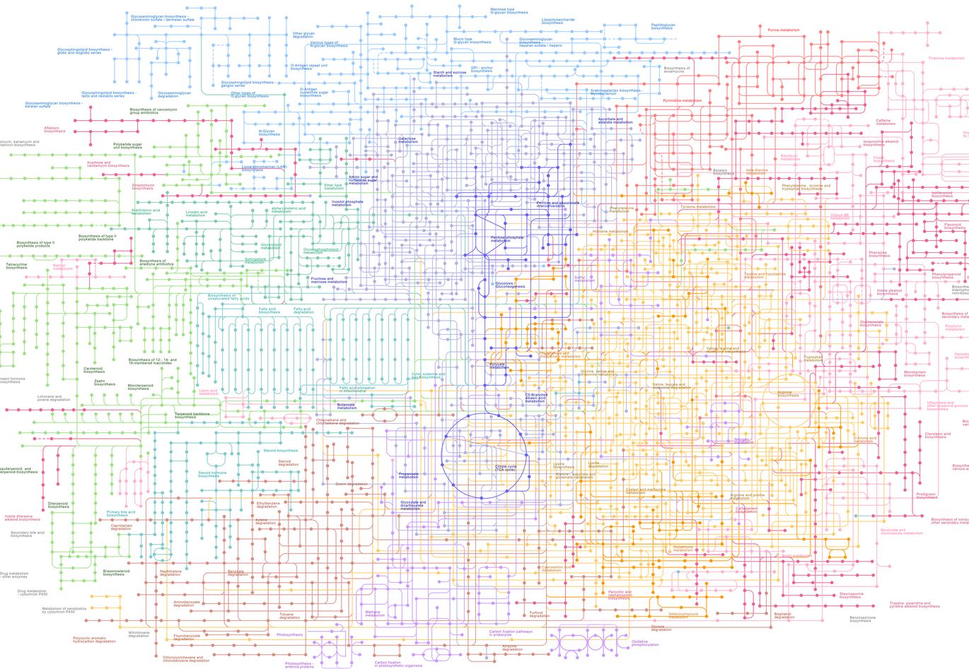
Genome annotation allows to associate metabolic functions with genes /proteins – on the systems level
a. Annotated genome
c. Networks of holistic metabolism
b. Metabolic pathway

Slide 5
Metabolic models are stored in SBML format
<sbml>
<model id=”metabolic_model">
<listOfCompartments>
<...>
</listOfCompartments>
<listOfSpecies>
<...>
</listOfSpecies>
<geneProduct>
<...>
</geneProduct>
<listOfReactions>
<...>
<listOfReactants>
<...>
</listOfReactants>
<listOfProducts>
<...>
</listOfProducts>
<geneProductAssociation>
<...>
</geneProductAssociation>
</listOfReactions>
</model>
</sbml>
id=“c” name=”cytoplasm”
species id=”M_glc_D_e” name"D-Glucose”
resource ”kegg.compound/C00031"
id="G_b4232" label="b4232" name=”hex1”
id="G_b4233" label="b4233" name=”hex2
reaction id=”R_Hex1”, reversible=“F” name = “hexokinase”
resource ”kegg.reaction/R00299”
resource ”identifiers.org/uniprot/P19367”
lowerBound = 0
upperBound = 1000
species="M_atp_c" stoichiometry="1"
species=“M_glc_D_c” stoichiometry="1"
species="M_adp_c" stoichiometry="1"
species= “M_g6p_c” stoichiometry="1"
<fbc:or>
<fbc:geneProductRef fbc:geneProduct="G_ b4232 "/>
<fbc:geneProductRef fbc:geneProduct="G_ b42323"/>
</fbc:or>

Slide 6
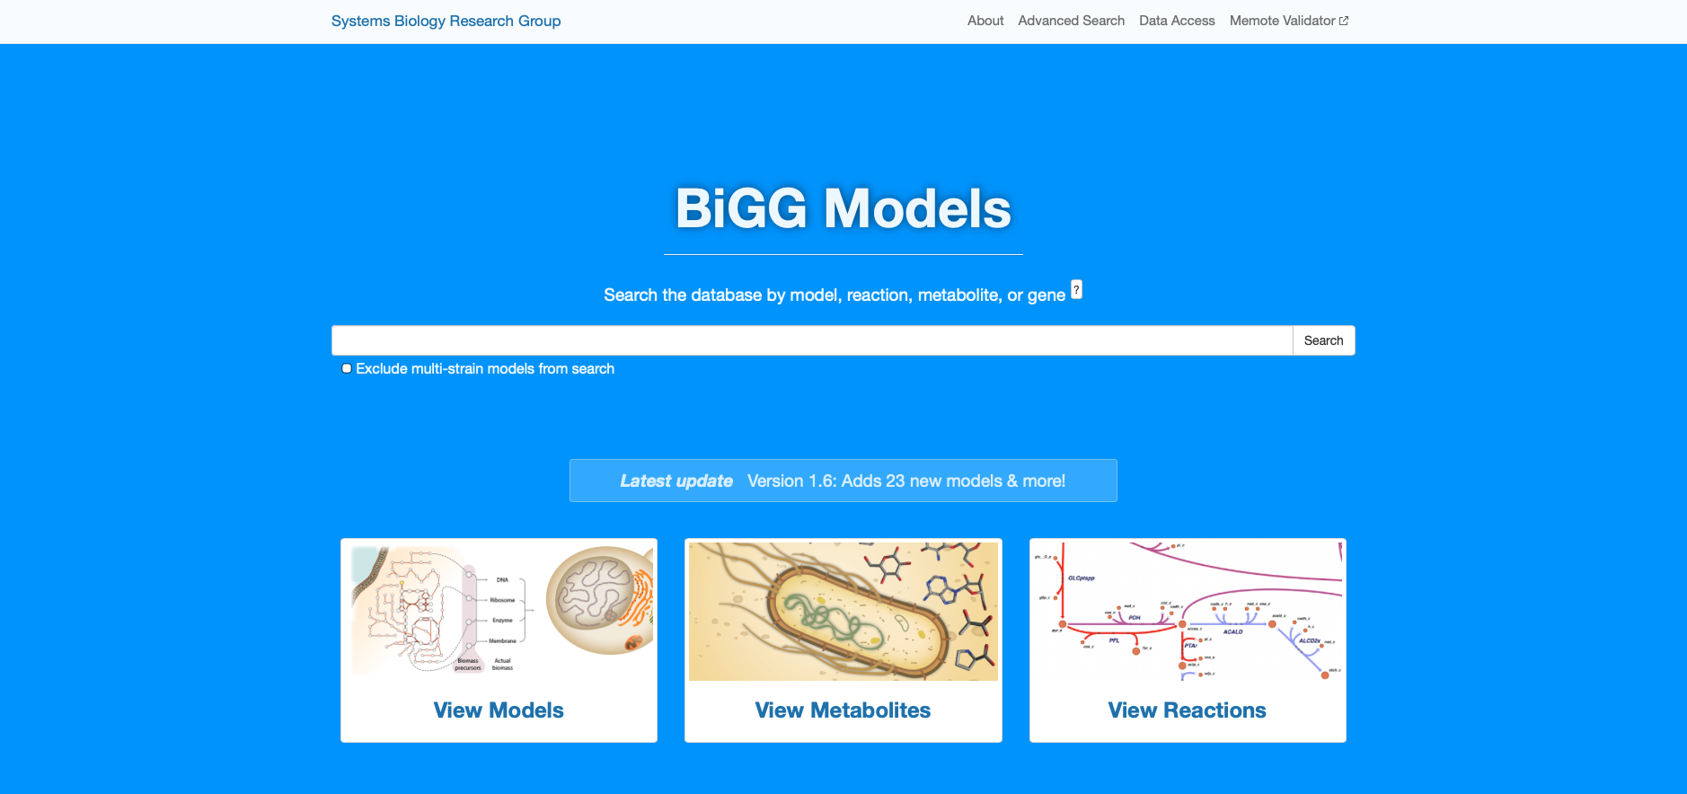
Metabolic models are stored in BIGG Models

Slide 7
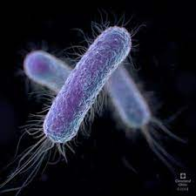

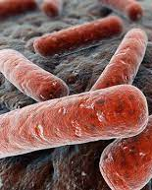

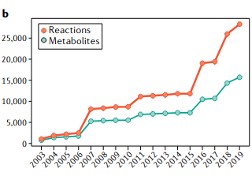
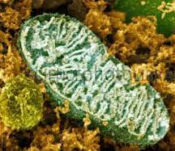
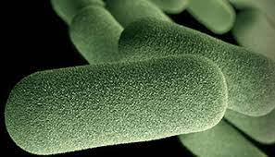
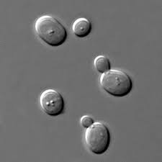

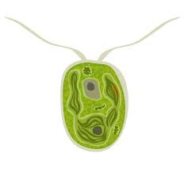
Evolution of genome scale metabolic models
E. coli
M. tuberculosis
A. thaliana
M. musculus
human mitochondrion
H. influenza
2004
2011
1999
2002
2005
2007
2010
2017
S. cerevisiae
C. reinhardtii
H. sapiens

Slide 8



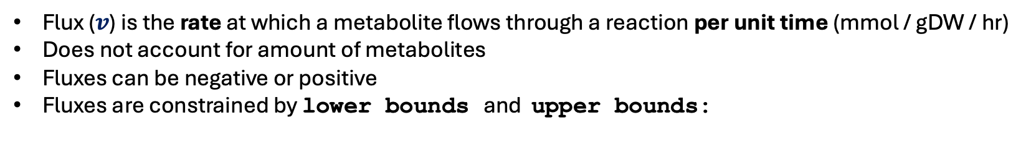




Reaction bounds define allowable flux through a reaction
Flux ($v$) is the rate at which a metabolite flows through a reaction per unit time (mmol / gDW / hr)
Does not account for amount of metabolites
Fluxes can be negative or positive
Fluxes are constrained by lower bounds and upper bounds:
lb ≤ $v$​ ≤ ub
Lower_Bound = 10
Upper_Bound = 10
lower_bound = -10
upper_bound = 0
substrate product
substrate product
reaction
reaction
$v$ = 10
$v$ = (-10 … 0)
Lower_Bound = 0
Upper_Bound = 10
lower_bound = -10
upper_bound = -10
substrate product
substrate product
reaction
reaction
$v$ = (0 … 10)
$v$ = (– 10)
Lower_Bound = 0
Upper_Bound = 0
lower_bound = -10
upper_bound = 10
substrate product
substrate product
reaction
reaction
$v$ = 0
$v$ = (-10 … 10)

Slide 9
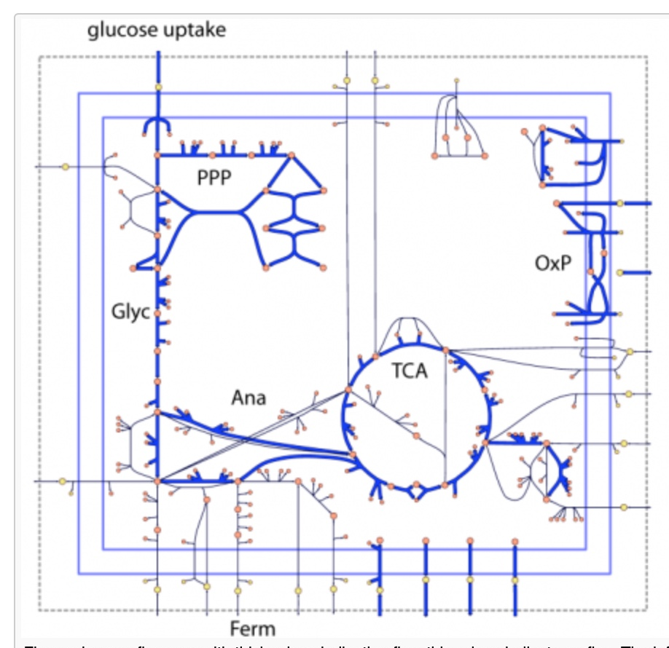
GSMM’s are simulated using…
Flux Balance Analysis
FBA implements linear programming on the GSMM…
… to predict steady state, metabolic fluxes through the GSMM….
… subject to the constraints

Slide 10
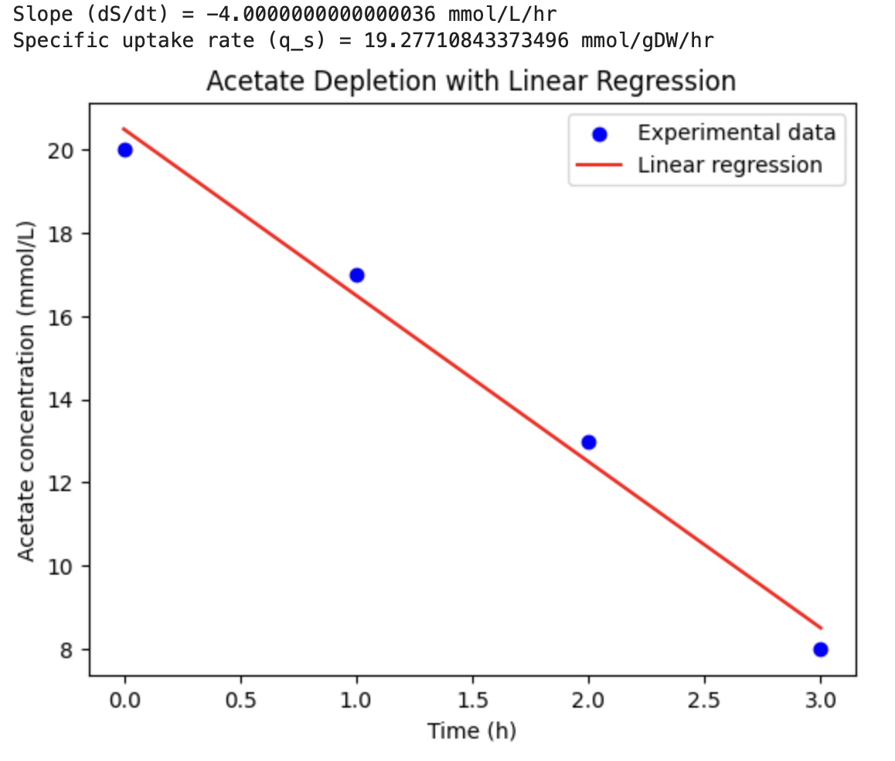
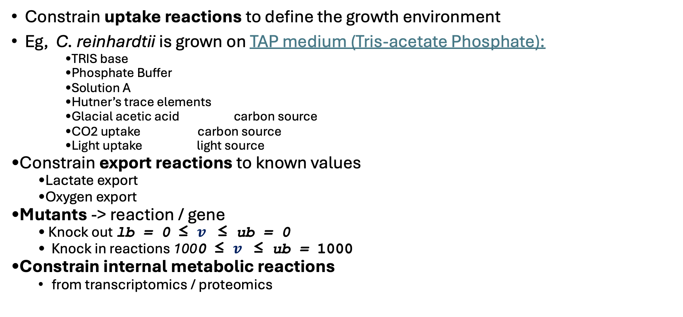

What reactions to constrain?
Constrain uptake reactions to define the growth environment
Eg, C. reinhardtii is grown on TAP medium (Tris-acetate Phosphate):
    TRIS base
    Phosphate Buffer
    Solution A
    Hutner’s trace elements
    Glacial acetic acid carbon source
    CO2 uptake carbon source
    Light uptake light source
Constrain export reactions to known values
  Lactate export
  Oxygen export
Mutants -> reaction / gene
  Knock out lb = 0 ≤ $v$​ ≤ ub = 0
  Knock in reactions 1000 ≤ $v$​ ≤ ub = 1000
Constrain internal metabolic reactions
  from transcriptomics / proteomics

Slide 11
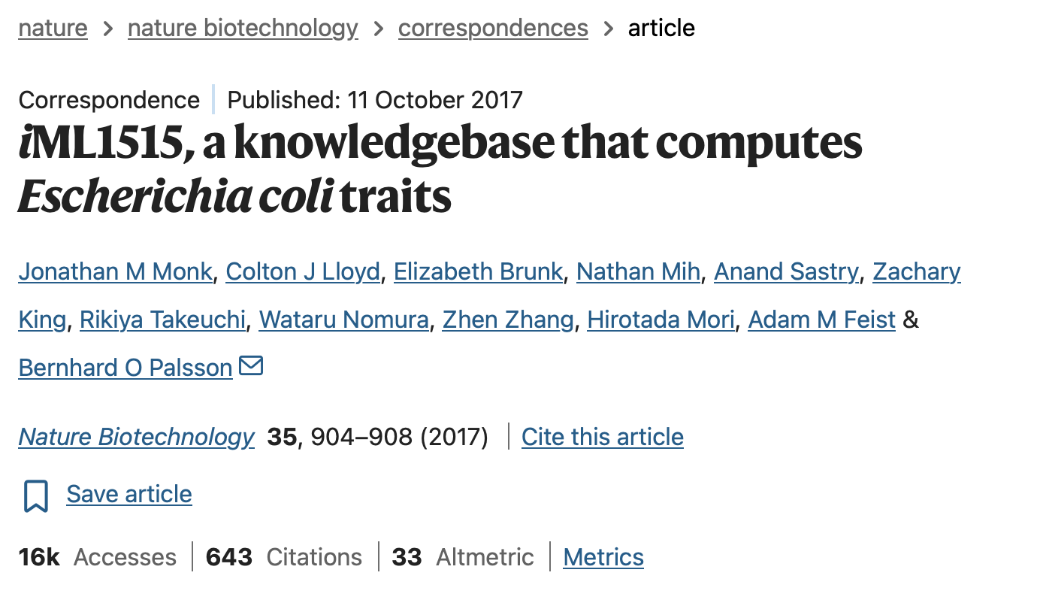
Why not constrain reactions individually?
Monk, J. M., et al., (2017). iML1515, a knowledgebase that computes Escherichia coli traits. Nature biotechnology, 35(10), 904-908.

Slide 12
Why not constrain reactions individually?
genes
1515
reactions
2719
metabolites
1877
Monk, J. M., et al., (2017). iML1515, a knowledgebase that computes Escherichia coli traits. Nature biotechnology, 35(10), 904-908.

Slide 13
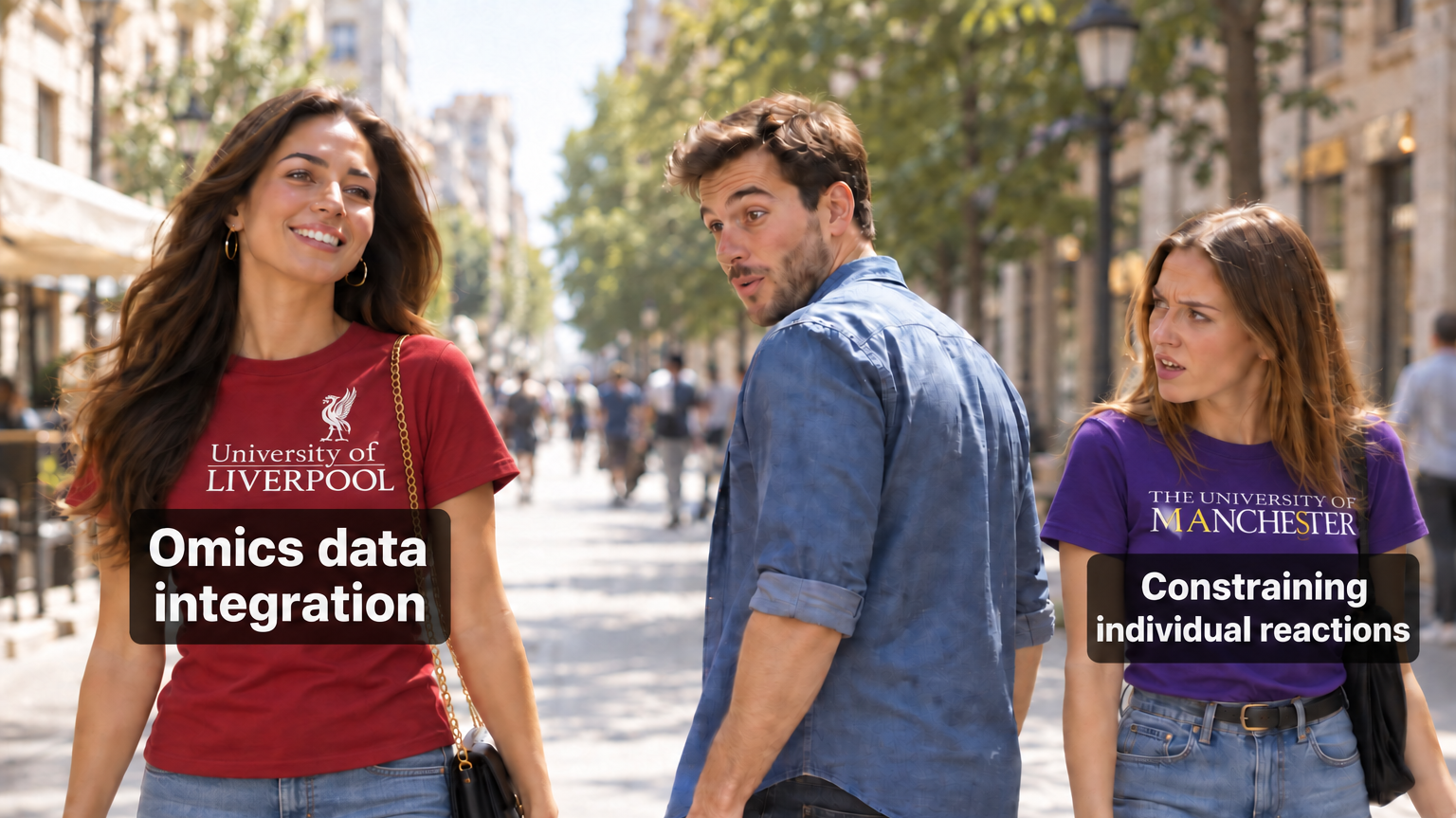

Slide 14
In this lecture:
Explain why metabolic models need to be constrained
Evaluate GPR rules to infer omic’s measurements into metabolic reaction activity
Explain how the integration algorithms constrain metabolic models: Åkesson-04, GIMME, iMAT, E-FLUX and MADE
Choose and justify an algorithm to integrate omics data
Understand that gene activity does not automatically correlate with enzyme activity but is better than nothing

Slide 15
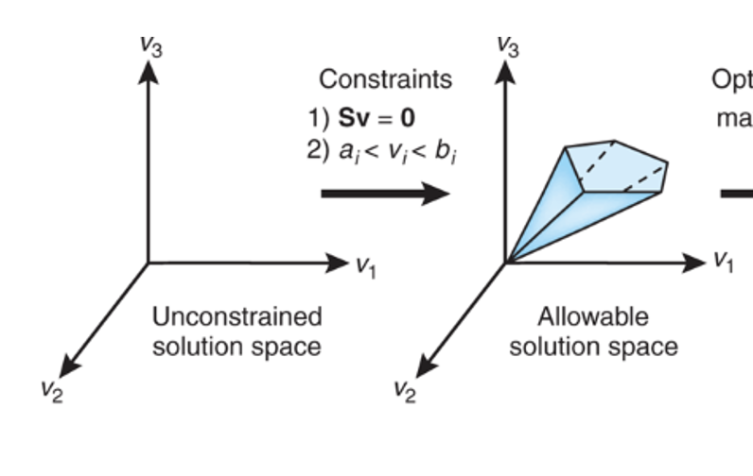
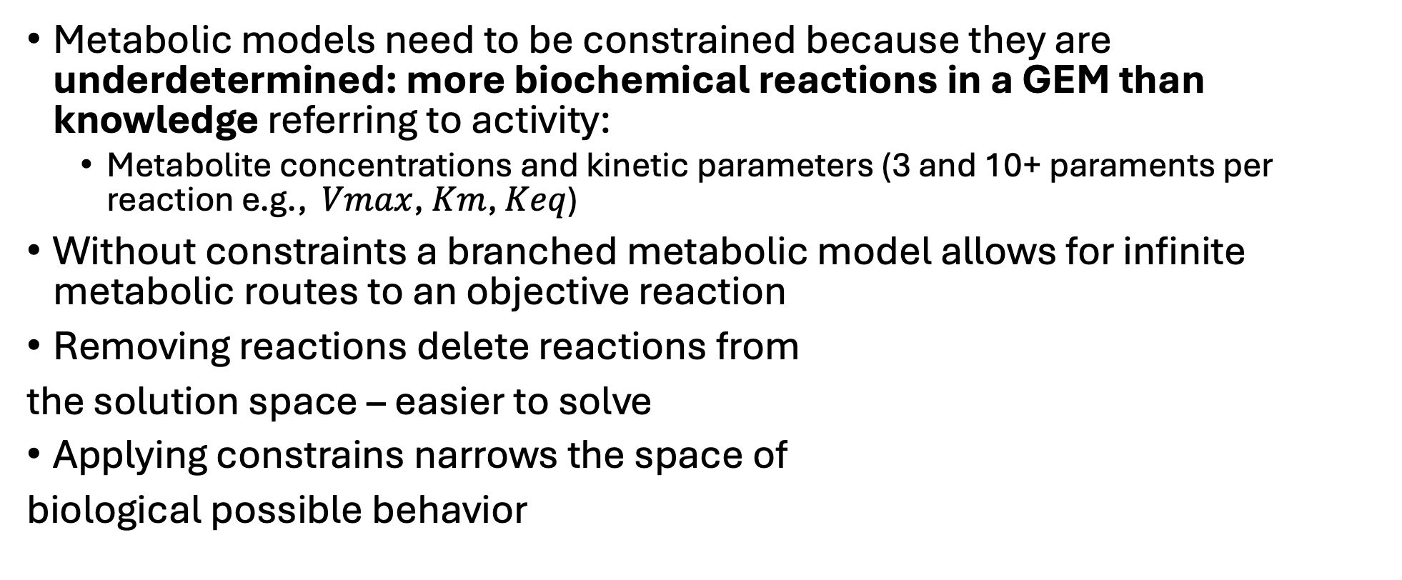
Metabolic models are undetermined and need to be constrained
Metabolic models need to be constrained because they are underdetermined: more biochemical reactions in a GEM than knowledge referring to activity:
  Metabolite concentrations and kinetic parameters (3 and 10+ paraments per reaction e.g., $Vmax$, $Km$, $Keq$)
Without constraints a branched metabolic model allows for infinite metabolic routes to an objective reaction
Removing reactions delete reactions from
the solution space – easier to solve
Applying constrains narrows the space of
biological possible behavior

Slide 16
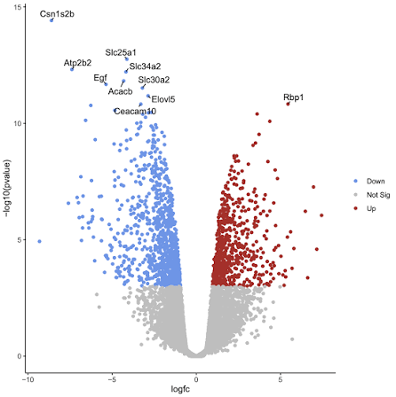
Omics produces data abundance on the level of the genome / proteome
expression data
metabolic model
determine genes / proteins that are expressed
constrain corresponding reactions
Perform Flux Balance Analysis

Slide 17
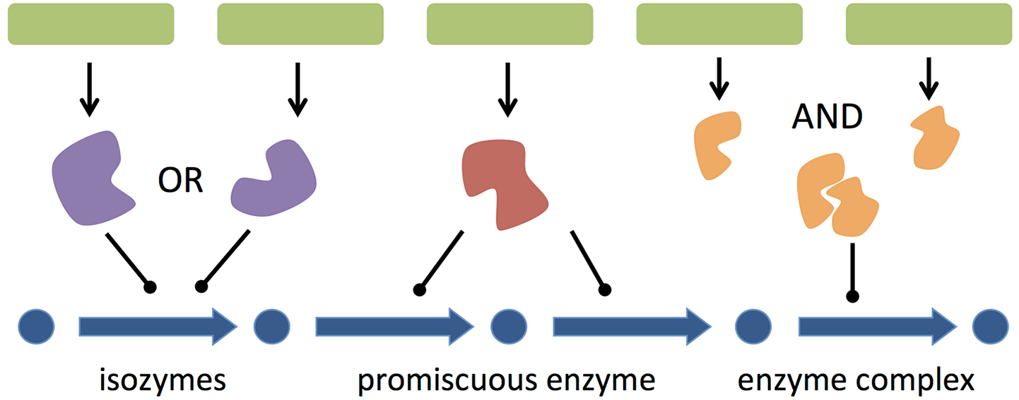
Gene-Protein Reaction rules to map omics to reactions
GPR rules are used to logically map genes/proteins to reactions
Image from Machado D, et al. (2016) PLoS Computational Biology

Slide 18
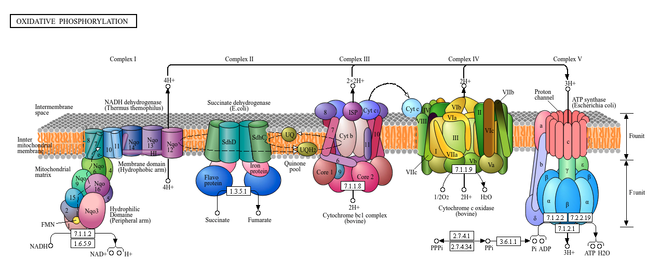
GPR rules: multi-subunit proteins are complex

Slide 19
Gene-Protein Reaction rules to map omics to reactions
geneA = 8
geneB= 3
geneC = 6
geneD = 2
sum(6,2) = 8
All expresses isoenzymes
contribute additively to reaction capacity
min(8,3) = 3
max(6,2) = 6
Dominant enzyme represents the reactions expression
Image from Machado D, et al. (2016) PLoS Computational Biology

Slide 20
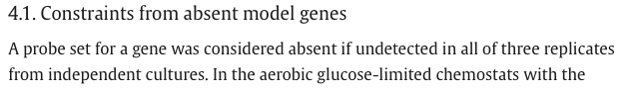
Åkesson-04 et al., 2004
First published method and the simplest approach
If genes are expressed at low thresholds, the corresponding reactions were constraining to zero
Discrete binary integration: Genes on / off depending on gene expression
Åkesson, M., Förster, J., & Nielsen, J. (2004). Integration of gene expression data into genome-scale metabolic models. Metabolic engineering, 6(4), 285-293

Slide 21
Toy model and Toy data
G₁
G₂
G₃
G₁
0.00
0.20
0.93
objective
G₂
0.00
0.00
0.00
R₁
R₂
R₃
R₄
G₃
0.55
0.83
0.77
R₇
G₇
R₅
R₆
G₆
0.87
0.65
0.07
R₈
G₇
0.55
0.49
0.52
G₆

Slide 22
Åkesson-04 et al., 2004
constrains reactions to zero when genes in all replicates are absent / undetected
G₁
G₂
G₃
G₁
0.00
0.20
0.93
objective
G₂
0.00
0.00
0.00
R₁
R₂
R₃
R₄
G₃
0.55
0.83
0.77
R₇
G₇
R₅
R₆
G₆
0.87
0.65
0.07
R₈
G₇
0.55
0.49
0.52
G₆

Slide 23
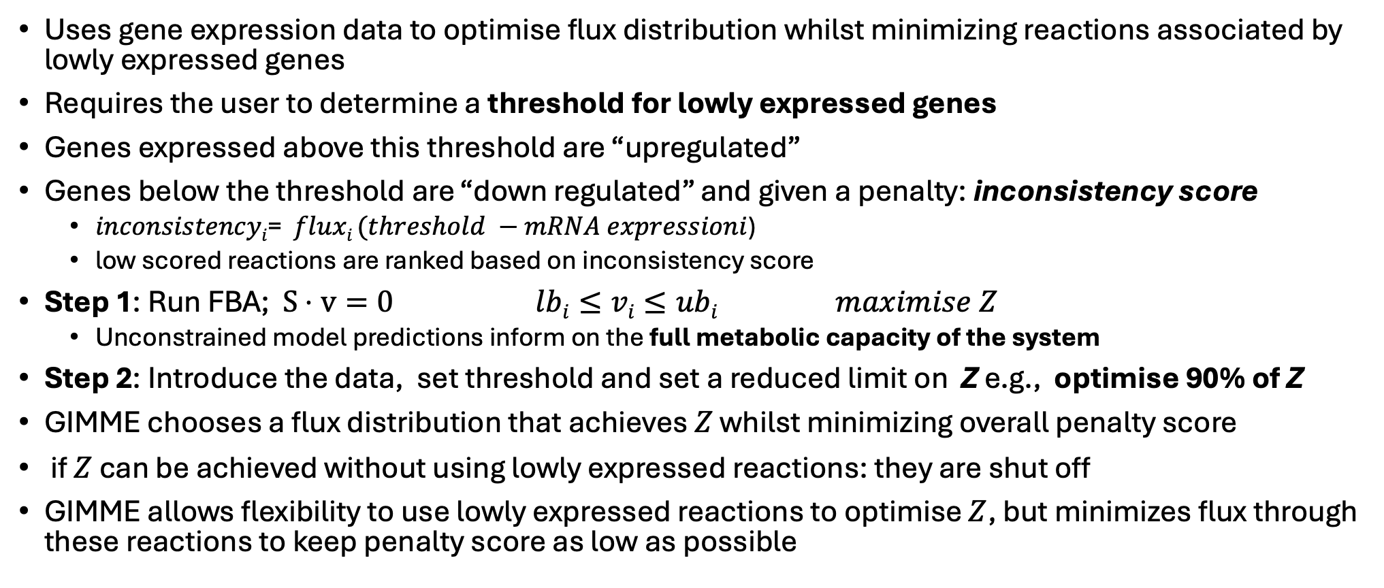
GIMME (2008): Gene Inactivity Moderated by Metabolism and Expression
Uses gene expression data to optimise flux distribution whilst minimizing reactions associated by lowly expressed genes
Requires the user to determine a threshold for lowly expressed genes
Genes expressed above this threshold are “upregulated”
Genes below the threshold are “down regulated” and given a penalty: inconsistency score
  $inconsistencyi$= $fluxi (threshold −mRNA expressioni$)
  low scored reactions are ranked based on inconsistency score
Step 1: Run FBA; $S⋅v=0$ $lbi≤vi≤ubi$ $maximise Z$
  Unconstrained model predictions inform on the full metabolic capacity of the system
Step 2: Introduce the data, set threshold and set a reduced limit on Z e.g., optimise 90% of Z
GIMME chooses a flux distribution that achieves $Z$ whilst minimizing overall penalty score
if $Z$ can be achieved without using lowly expressed reactions: they are shut off
GIMME allows flexibility to use lowly expressed reactions to optimise $Z$, but minimizes flux through these reactions to keep penalty score as low as possible

Slide 24
GIMME (2008): Gene Inactivity Moderated by Metabolism and Expression
G₁
G₂
G₃
Reaction added back
G₁
0.00
R₁
R₂
R₃
objective
G₂
0.00
R₄
G₃
0.55
threshold = 0.6
R₇
G₇
R₅
R₆
G₆
0.87
R₈
G₇
0.55
G₆

Slide 25
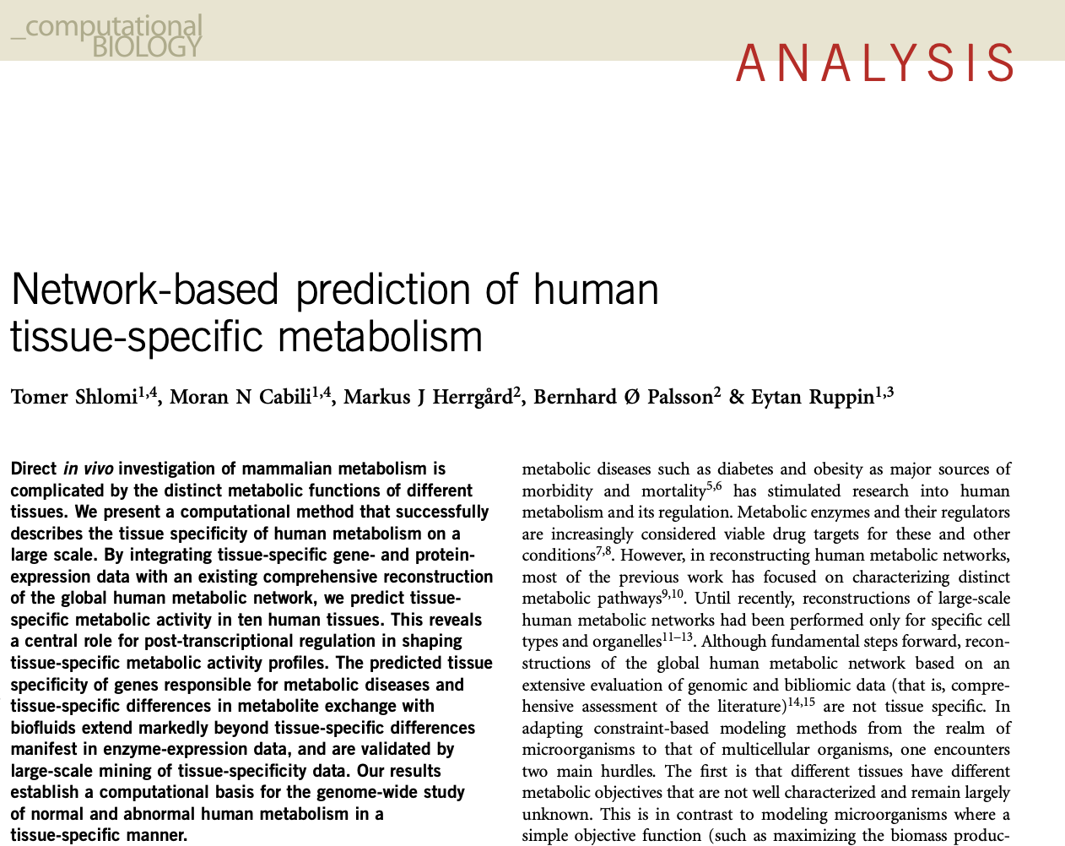
iMAT (2008): integrative Metabolic Analysis Tool
iMAT discretises expression data into three categories:
high expression (+1), low expression (-1) and moderate (0)
Uses Boolean logic to map gene states to corresponding metabolic reactions: labels reactions activity as high, low or moderate
iMAT finds a steady-state flux distribution using MILP that is consistent with defined gene classification - that maximises use of highly active reactions and minimises low activity reactions
produces a final functional optimised model
No requirement to define an objective reaction
Shlomi, T., et al., (2008). Network-based prediction of human tissue-specific metabolism. Nat, biotechnology, 26(9), 1003-1010.

Slide 26
iMAT (2008): integrative Metabolic Analysis Tool
G₁
G₂
G₃
Reaction added back
G₁
0.00
R₁
R₂
R₃
R₄
G₂
0.00
G₃
0.55
low threshold = 0.25
high threshold = 0.75
R₇
G₇
R₅
R₆
G₆
0.87
R₈
G₇
0.55
G₆

Slide 27
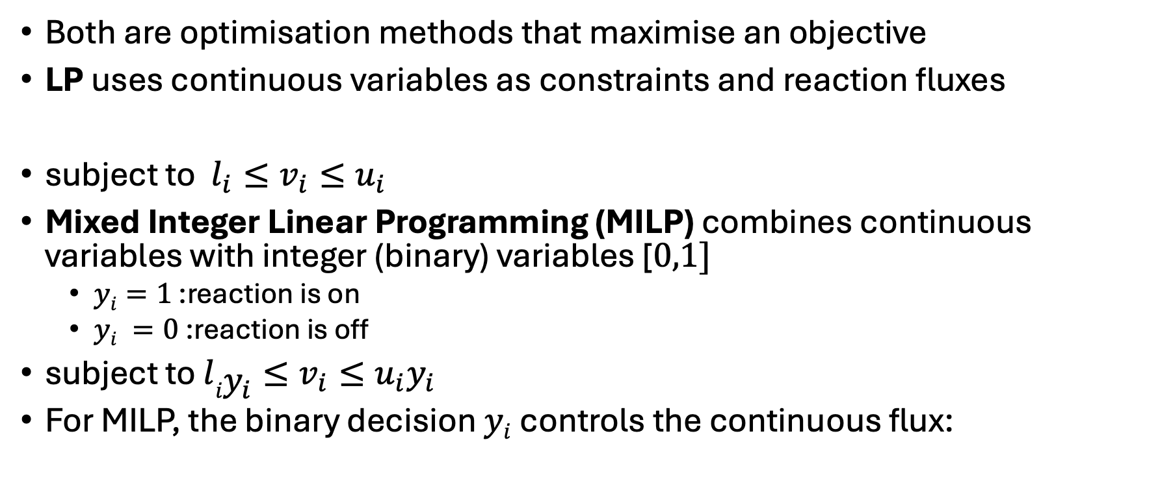
Mixed Integer Linear Programming VS LP
Both are optimisation methods that maximise an objective
LP uses continuous variables as constraints and reaction fluxes
subject to $l_{i}≤v_{i}≤u_{i}$
Mixed Integer Linear Programming (MILP) combines continuous variables with integer (binary) variables [$0,1]$
  $yi=1$ :reaction is on
  $yi =0$:reaction is off
subject to $l{iy}_{i}≤v_{i}≤u_{i}y_{i}$
For MILP, the binary decision $yi$controls the continuous flux:

Slide 28
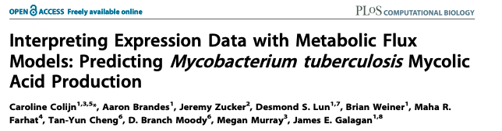
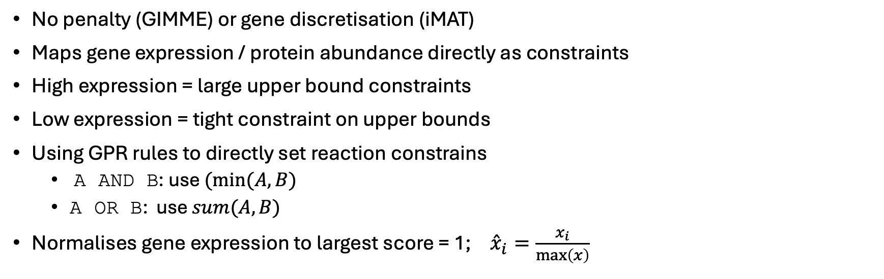
E-FLUX (2009)
No penalty (GIMME) or gene discretisation (iMAT)
Maps gene expression / protein abundance directly as constraints
High expression = large upper bound constraints
Low expression = tight constraint on upper bounds
Using GPR rules to directly set reaction constrains
  A AND B: use $(min⁡(A,B)$
  A OR B: use $sum(A,B)$
Normalises gene expression to largest score = 1;${\overset{ˆ}{x}}_{i}=\frac{x_{i}}{\max\left(x\right)}$

Slide 29
E-FLUX (2009)
G₁
G₂
G₃
G₁
0.00
R₁
0.00
objective
R₁
R₂
R₃
R₄
G₂
0.00
R₂
0.00
R₇
G₇
G₃
0.55
R₃
0.632
R₆
R₅
G₆
0.87
R₆
1.000
R₈
G₇
0.55
R₇
0.632
G₆

Slide 30
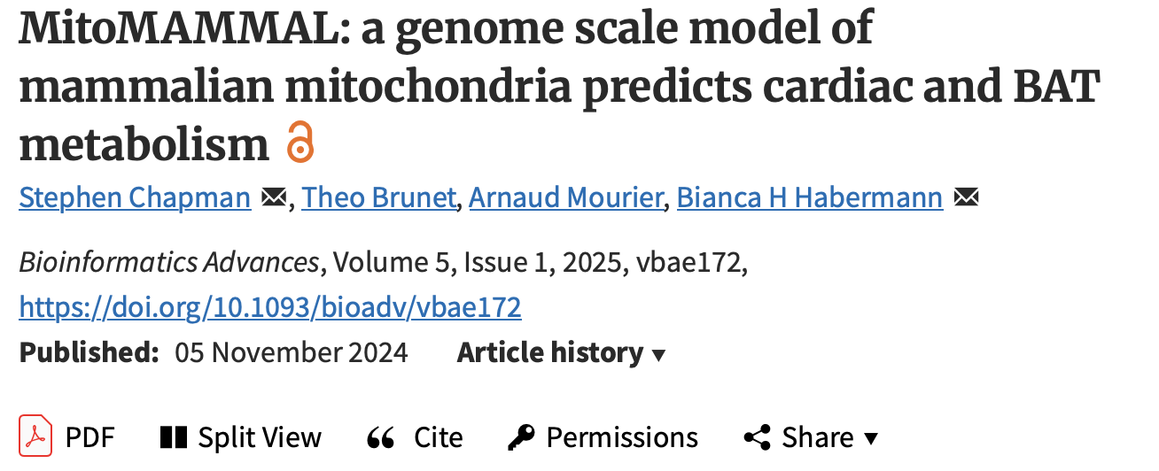
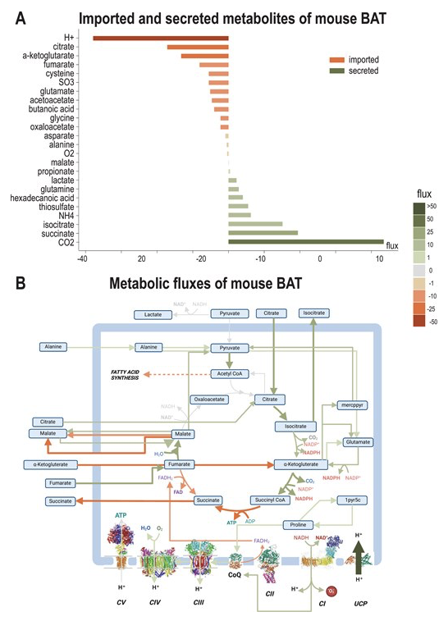
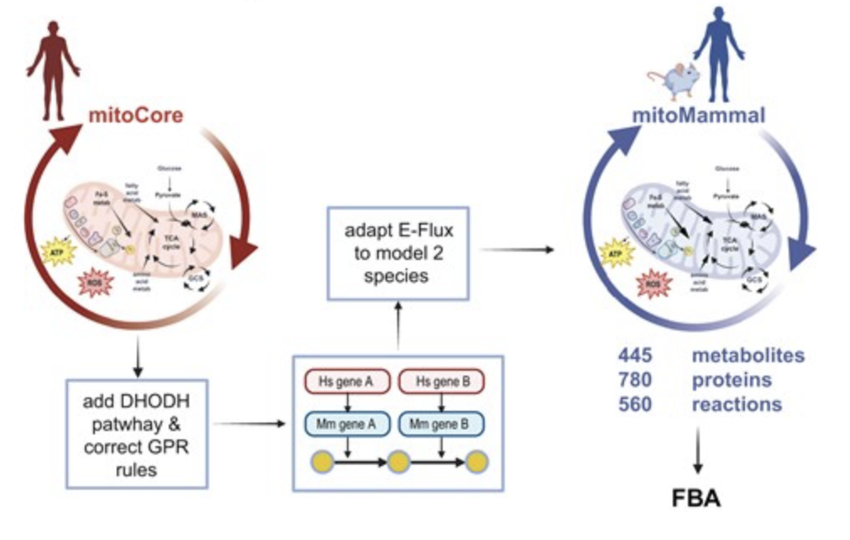

Slide 31
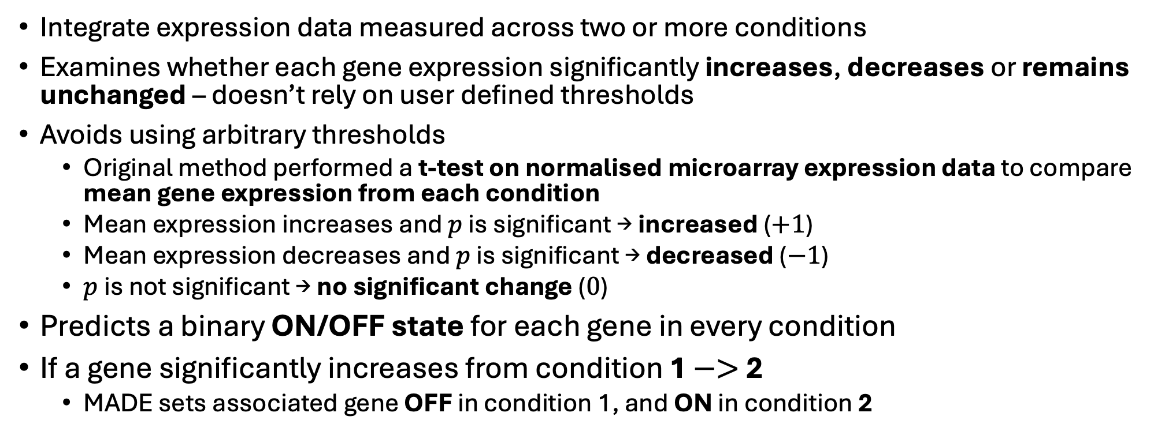
MADE: Metabolic Adjustment by Differential Expression (2011)
Integrate expression data measured across two or more conditions
Examines whether each gene expression significantly increases, decreases or remains unchanged – doesn’t rely on user defined thresholds
Avoids using arbitrary thresholds
  Original method performed a t-test on normalised microarray expression data to compare mean gene expression from each condition
  Mean expression increases and $p$ is significant → increased ($+1$)
  Mean expression decreases and $p$ is significant → decreased ($−1$)
  $p$ is not significant → no significant change ($0$)
Predicts a binary ON/OFF state for each gene in every condition
If a gene significantly increases from condition 1 $−>$ 2
  MADE sets associated gene OFF in condition 1, and ON in condition 2
Jensen, & Papin (2011). Bioinformatics, 27(4), 541-547.

Slide 32
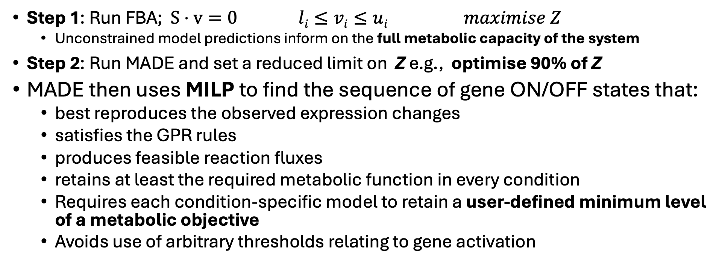
MADE: Metabolic Adjustment by Differential Expression (2011)
Step 1: Run FBA; $S⋅v=0$ $li≤vi≤ui$ $maximise Z$
  Unconstrained model predictions inform on the full metabolic capacity of the system
Step 2: Run MADE and set a reduced limit on Z e.g., optimise 90% of Z
MADE then uses MILP to find the sequence of gene ON/OFF states that:
  best reproduces the observed expression changes
  satisfies the GPR rules
  produces feasible reaction fluxes
  retains at least the required metabolic function in every condition
  Requires each condition-specific model to retain a user-defined minimum level of a metabolic objective
  Avoids use of arbitrary thresholds relating to gene activation

Slide 33
MADE (2011)
gene expression matrix
binary expression state matrix
G₁
0.00
0.20
0.93
G₁
0
0
1
G₂
0.00
0.00
0.00
G₂
0
0
0
G₃
0.55
0.83
0.77
G₃
1
1
1
G₆
0.87
0.65
0.07
G₆
1
1
0
G₇
0.55
0.49
0.52
G₇
1
0
1

Slide 34
MADE (2011)
G₁
G₂
G₃
binary expression state matrix
G₁
0
0
1
objective
R₁
R₂
R₃
R₄
G₂
0
0
0
G₃
1
1
1
R₇
G₇
R₅
R₆
G₆
1
1
0
R₈
G₇
1
0
1
G₆

Slide 35
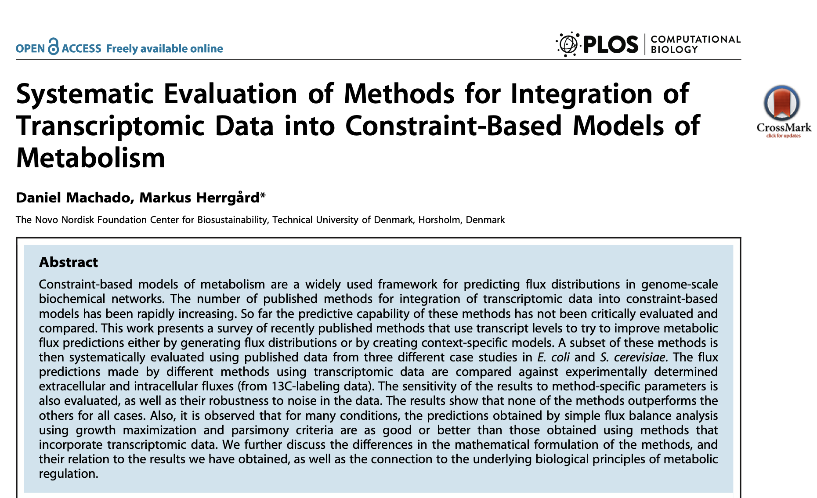
Which data algorithm should you use?
Machado & Herrgård. 2014, PLoS computational biology, 10(4), e1003580.

Slide 36
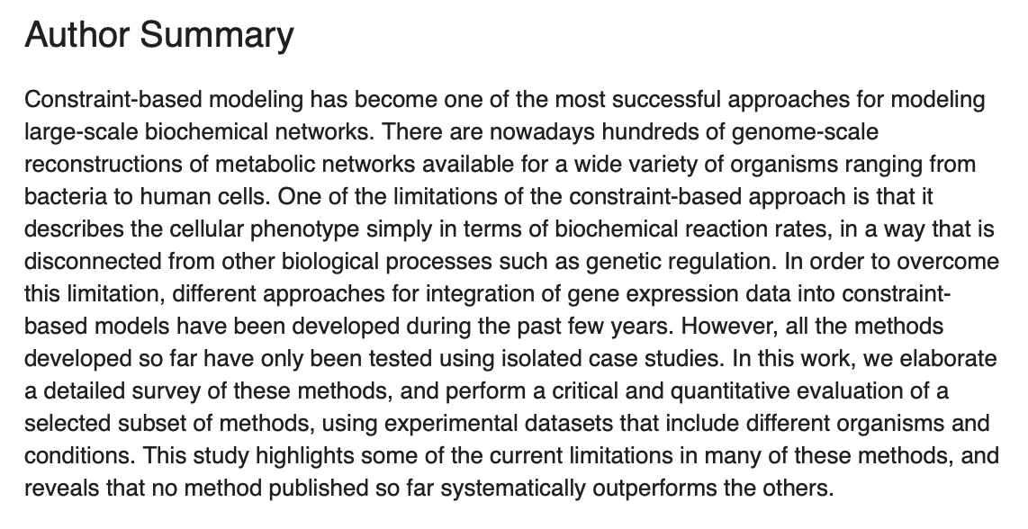



Which data algorithm should you use?
Machado & Herrgård. 2014, PLoS computational biology, 10(4), e1003580.

Slide 37
Challenges of data integration
GIMME and iMAT rely on arbitrary thresholding to determine gene inactivity
MADE turns reactions off if gene expression is significantly downregulated
EFLUX assumes a direct correlation between gene abundance and metabolic flux
Low gene-expression counts may reflect technical noise, limited sequencing depth or measurement failure rather than genuinely low transcript abundance
Constraining a model helps linear programming find a mathematical solution
Gene expression does not correlate with metabolic flux…

Slide 38
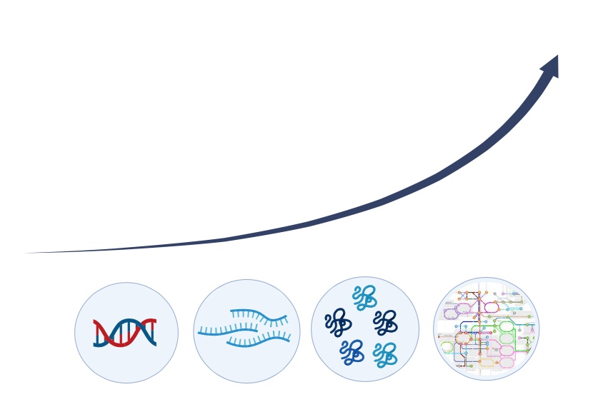
Central dogma of molecular biology: gene -> protein -> function
DNA
mRNA
protein
transcription
translation
genome
transcriptome
proteome

Slide 39

Gene expression $≠$ protein abundance $≠$ metabolic flux
Epigenetic regulation
DNA methylation
Signaling feedback
positive
negative
Metabolic regulation
allosteric regulation
DNA
mRNA
protein
transcription
translation
genome
transcriptome
proteome
Post transcriptional modification of mRNA:
5’ capping
3’ polyadenylation -> poly-A tail
RNA splicing
Alternative splicing
Post translational modification of proteins:
phosphorylation
methylation

Slide 40
Why bother integrate omics data?
Considering there is no relationship between gene / mRNA/ protein with metabolic flux….
…We should think of these omics layers as ‘soft constraints’…
Set hard constraints to input / output reactions
  Reactions that can experimentally quantified
All predictions need to biological validated
"All models are wrong, but some are useful" (George Box., 1976)
Correct choice of model AND objective function are more important than integration algorithm
Questions?

