Slide 1

SteadyForum
The future of working out
without getting hurt
Notes:
iPhone 15 Pro model by Sketcher (@jnanbr07), CC BY 4.0. Source: https://sketchfab.com/3d-models/iphone-15-pro-9e045e469d514fea9dda2ccd161f5fa3. Licensed mesh sourced through https://github.com/quentin-pla/phone-mockup-studio. Modified by replacing the display texture with IMG_6540.PNG and adding lighting and animation. Product screenshot supplied by presenter.

Slide 2
SteadyForum
The future of working out
without getting hurt
Notes:
iPhone 15 Pro model by Sketcher (@jnanbr07), CC BY 4.0. Source: https://sketchfab.com/3d-models/iphone-15-pro-9e045e469d514fea9dda2ccd161f5fa3. Licensed mesh sourced through https://github.com/quentin-pla/phone-mockup-studio. Modified by replacing the display texture with IMG_6540.PNG and adding lighting and animation. Product screenshot supplied by presenter.

Slide 3
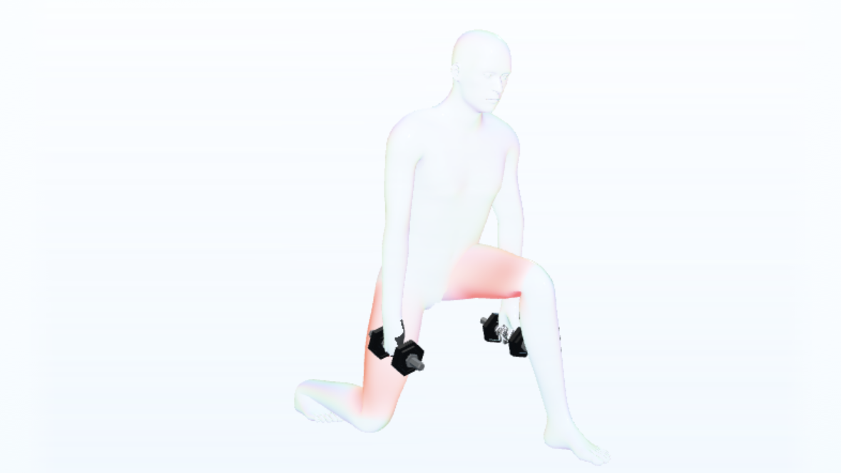

Notes:
iPhone 15 Pro model by Sketcher (@jnanbr07), CC BY 4.0. Source: https://sketchfab.com/3d-models/iphone-15-pro-9e045e469d514fea9dda2ccd161f5fa3. Licensed mesh sourced through https://github.com/quentin-pla/phone-mockup-studio. Modified by replacing the display texture with IMG_6540.PNG and adding lighting and animation. Product screenshot supplied by presenter.

