Slide 1
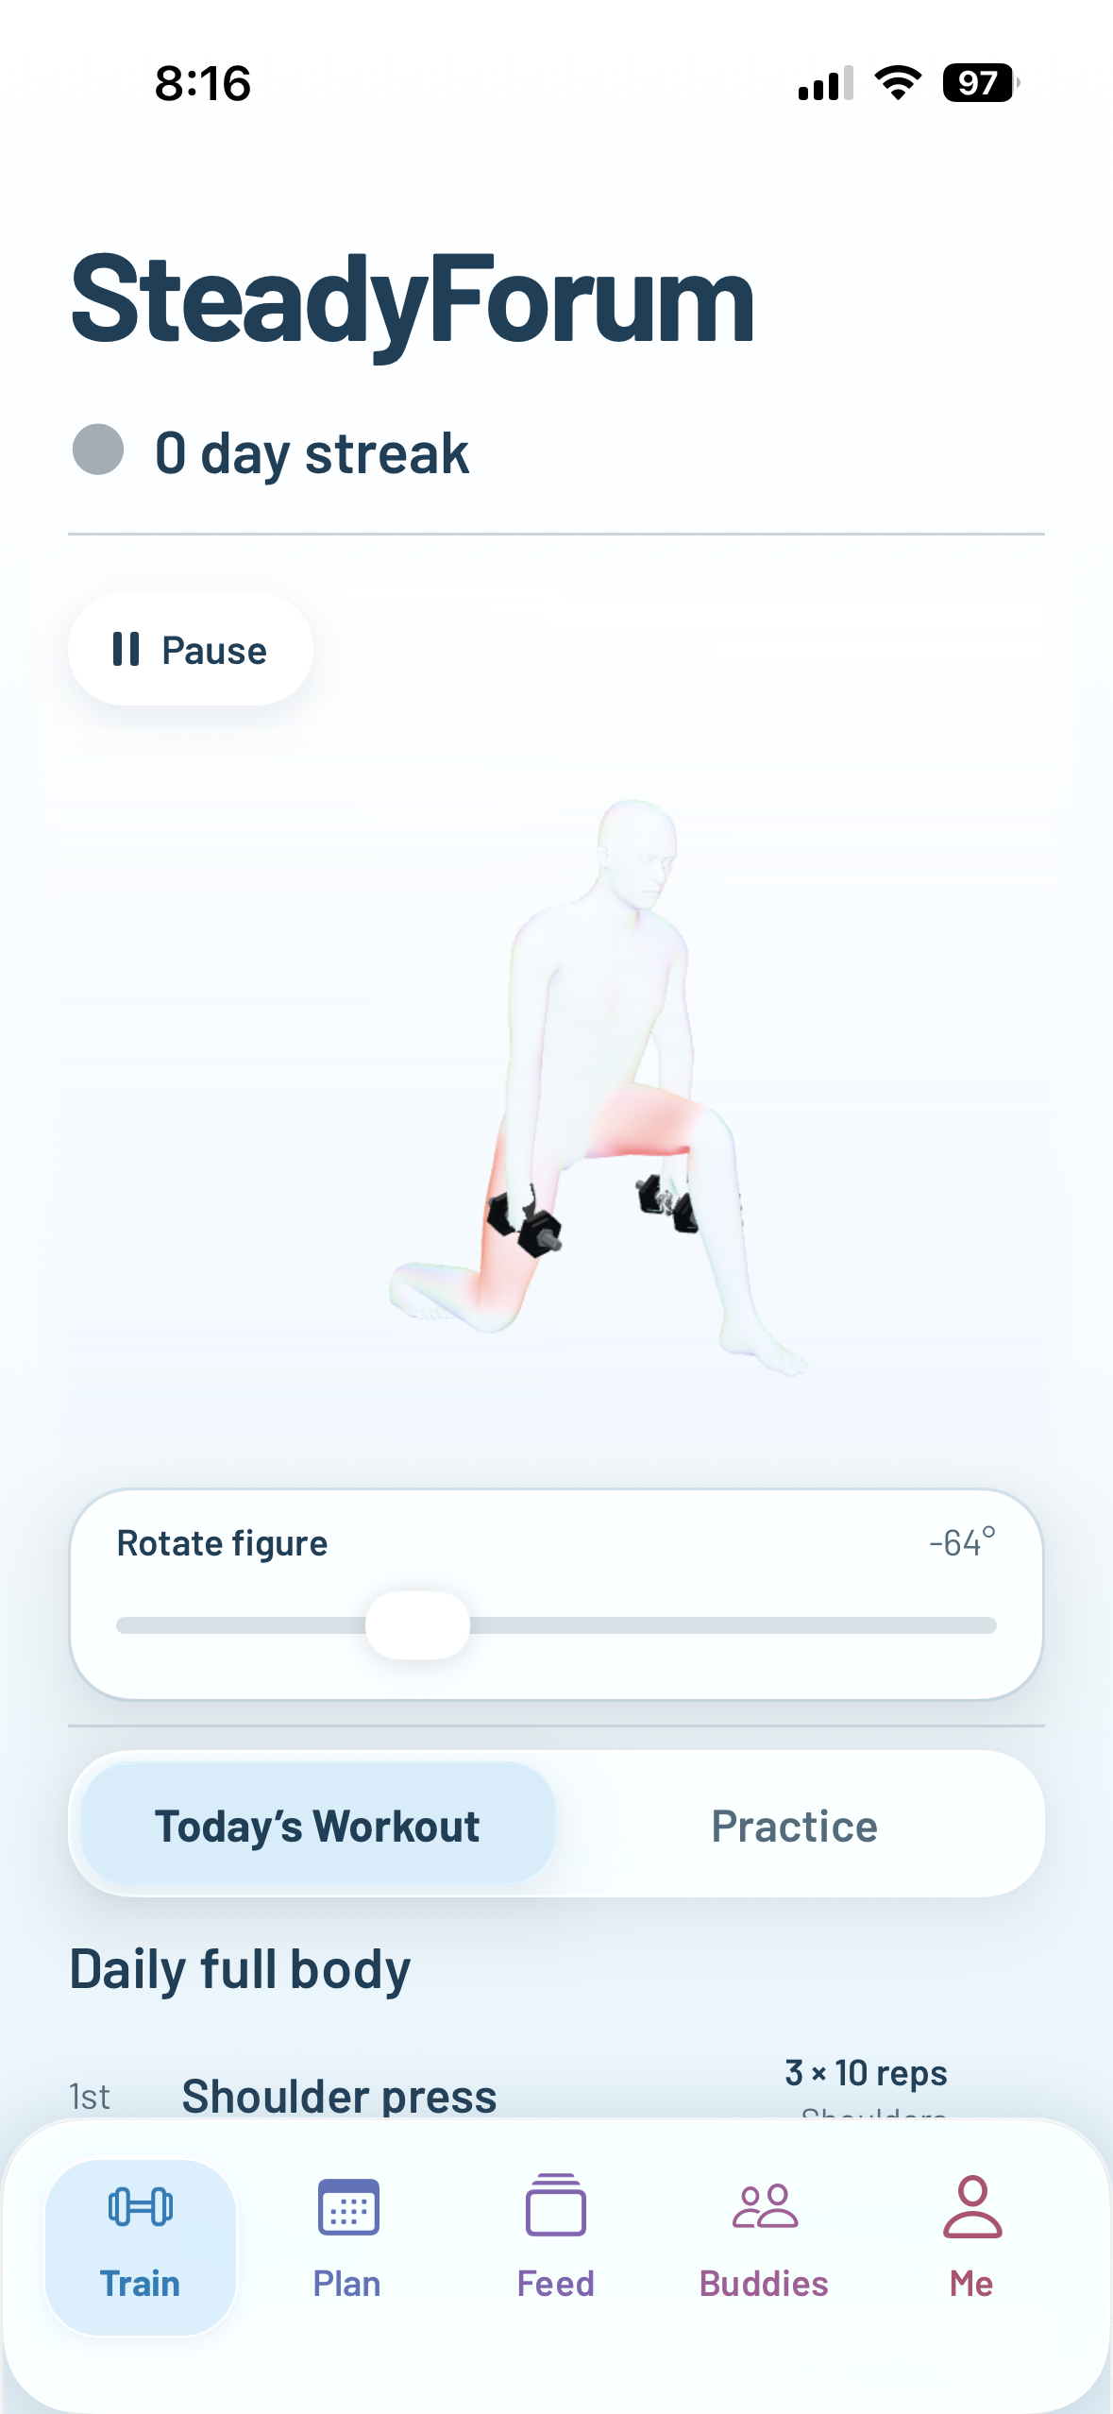
SteadyForum
The future of working out without getting hurt
Notes:
Product screen supplied by the presenter: IMG_6540.PNG. Morph object matching and rotation follow Microsoft PowerPoint Morph guidance: https://support.microsoft.com/en-us/powerpoint/morph-transition-tips-and-tricks

Slide 2
SteadyForum
The future of working out
without getting hurt
Notes:
Product screen supplied by the presenter: IMG_6540.PNG. Morph object matching and rotation follow Microsoft PowerPoint Morph guidance: https://support.microsoft.com/en-us/powerpoint/morph-transition-tips-and-tricks

Slide 3
SteadyForum
The future of working out
without getting hurt
Notes:
Product screen supplied by the presenter: IMG_6540.PNG. Morph object matching and rotation follow Microsoft PowerPoint Morph guidance: https://support.microsoft.com/en-us/powerpoint/morph-transition-tips-and-tricks

