Slide 1

MACHINE LEARNING WITH THUNKABLE APP
By : Delveer Singh

Slide 2
What we will be covering today:
1)Using Thunkable
2)Image Recognition
2)Speech recognition
3)Bluetooth communication with the Arduino.

Slide 3
Short Intro…
Why Thunkable:
No coding experience required.
It is simply drag and drop.
Gives the idea and thought process.
Easy to use

Slide 4
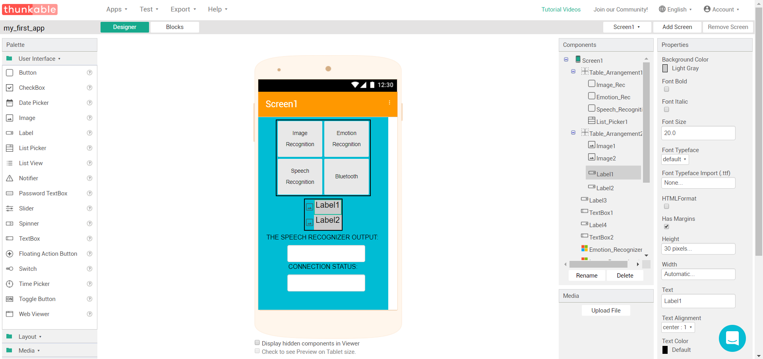
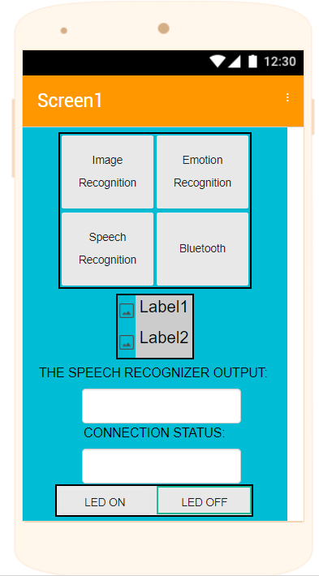
Using Thunkable
Items to select and place into the app.
The editor to preview how the design looks
The component editor
This is to adjust the elements in the
components tab

Slide 5
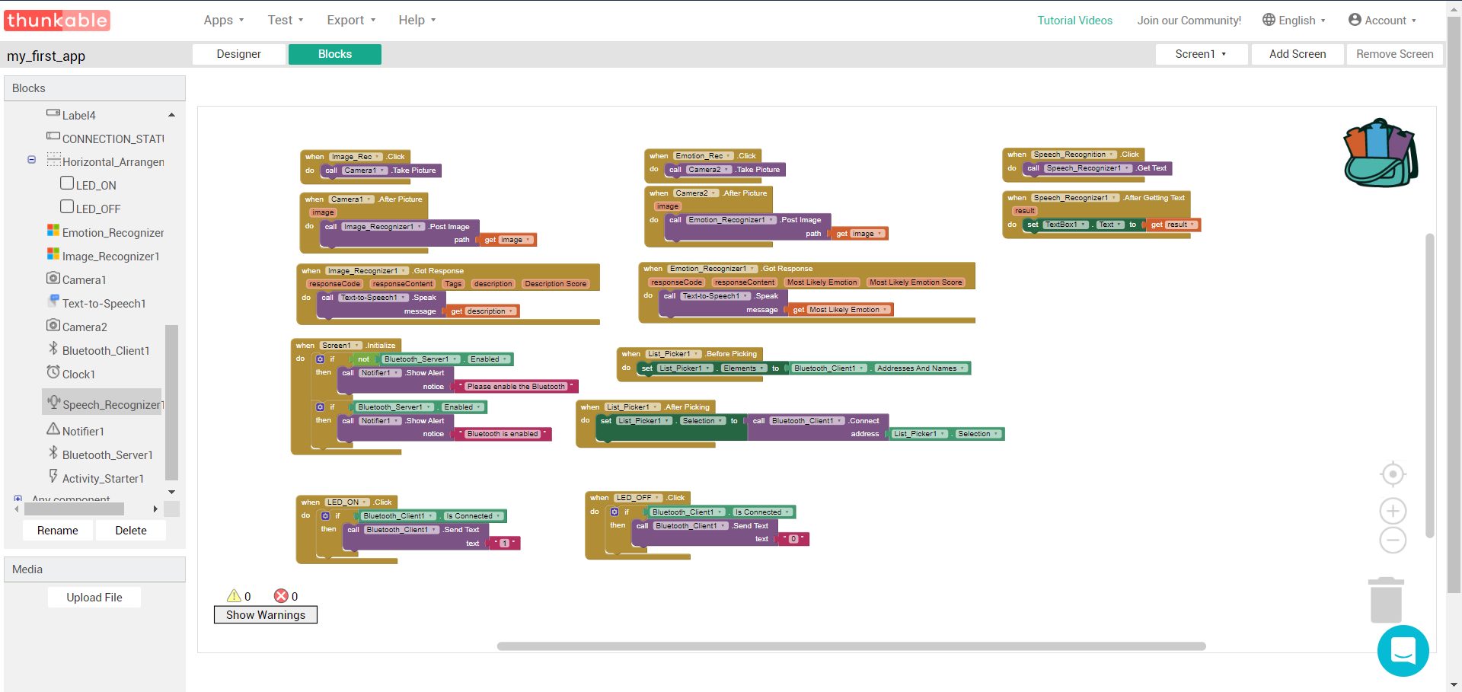
Using Thunkable
Things we can use to program
Block editor for us to use and program. Note that the blocks appear for drag and drop when we click things in the Blocks column

Slide 6
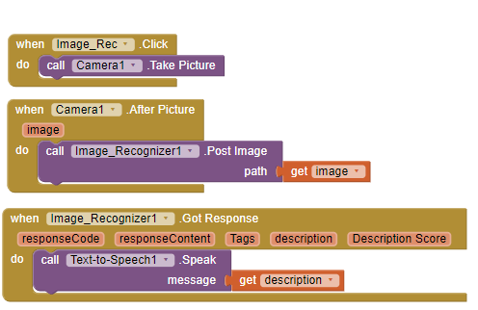
Image Recognition
When we click a button take a picture
After taking the picture, send it to the image recognition API.
Get the description back from the API

Slide 7
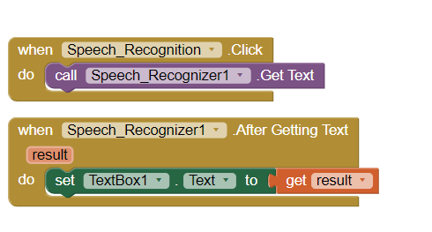
Speech Recognition
When clicked, calls the speech recognizer
Update the textbox with the result

Slide 8
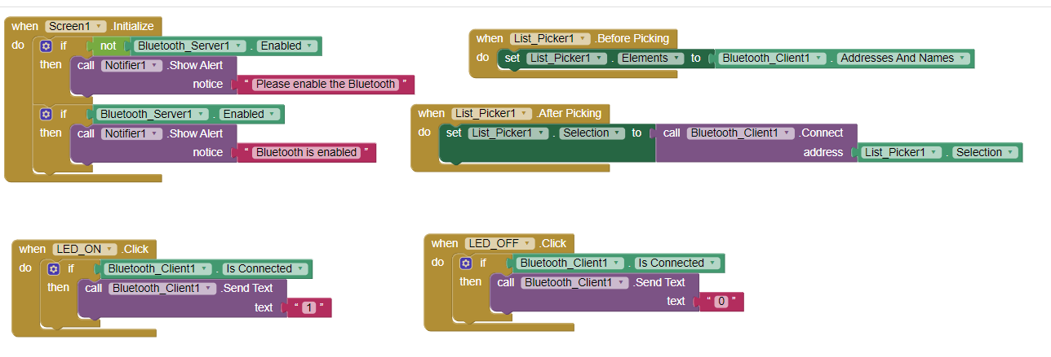
Bluetooth Communication with the Arduino
Lists all of the devices that we can connect to
This is just to ensure Bluetooth is enabled on the phone when screen is initialised
Connect to the address we selected
When this button is clicked, sends a “1”
When this button is clicked, sends a “0”

Slide 9
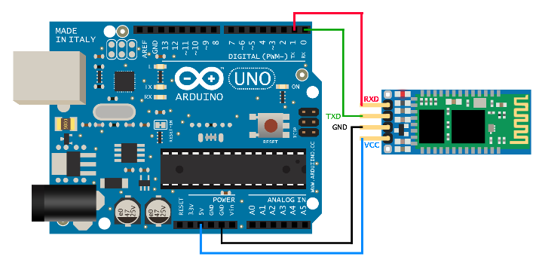
Bluetooth Communication with the Arduino
Make sure you connect the Bluetooth Module like this:

Slide 10
Bluetooth Communication with the Arduino
Great! Now, We need to program the Arduino and LED’s to use the data sent via Bluetooth to do something.
Open Up the Arduino IDE
Then, Follow me.

Slide 11
Test What you have made
Login into the Thunkable app
Connect to your project
Test to see if it works
There you have it!

Slide 12
Thank You!!

