Slide 1
BASIC IMAGE EDITOR
Using GDI+ in C#
-John Deliveis

Slide 2
Contents
Introduction
GDI+ & The Graphics Class
Other Classes and Assets
The Application
  Concept
  Implementation of Functions
  Problems and Workarounds
Conclusions
Reference

Slide 3
Purpose of the Project
This project has set off to create a very basic image editor in order to;
Showcase the capabilities of the GDI+ API
Demonstrate some of it's weaknesses and ways to work around them
Assess it's value and viability as a tool for developers who wish to develop image editing software

Slide 4
What is GDI+?
The Graphics Device Interface(GDI) API enables applications to use graphics in Microsoft Windows.
It is not directly connected to the graphics hardware as it's functions make the appropriate calls to the hardware's drivers
Essentially it's a free collection of functions and classes for developers to utilize in their windows applications
It's services include
2D Vector Graphics, shapes, consisting of lines and curves specified by coordinates
Imaging, more complex images stored into bitmap files
Typography

Slide 5
The Graphics class
Graphics is the class which handles the drawing of the GDI components
It is utilized by creating a Graphics object and invoking the class' function with It
A lot of .NET controls implement the CreateGraphics() function, making it possible to manipulate their visual style or, potentially, turning them into a canvas
A Graphics object created based on a control is very temporary and, therefore, has to exported to a more permanent form

Slide 6
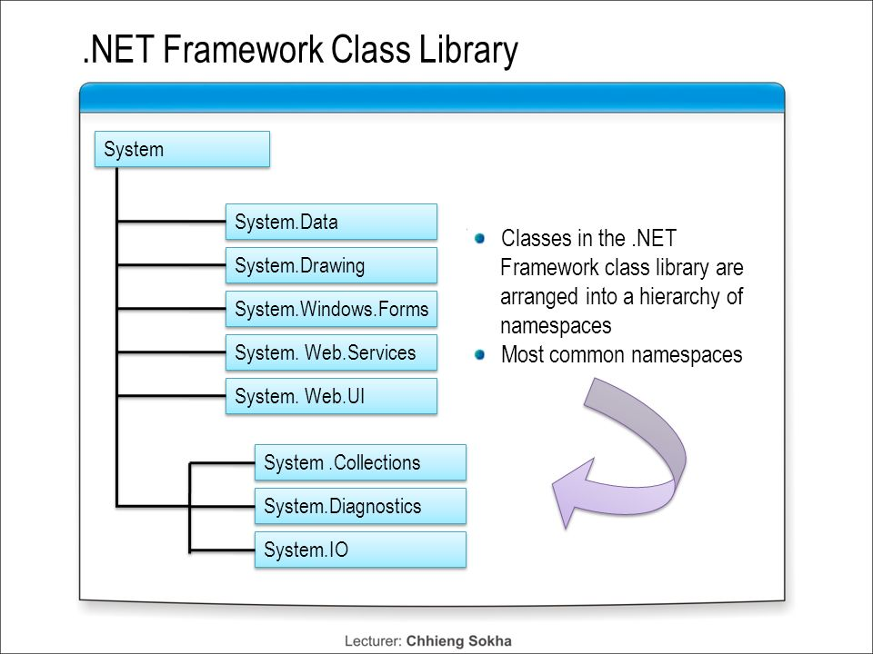
.NET Hierarchy

Slide 7
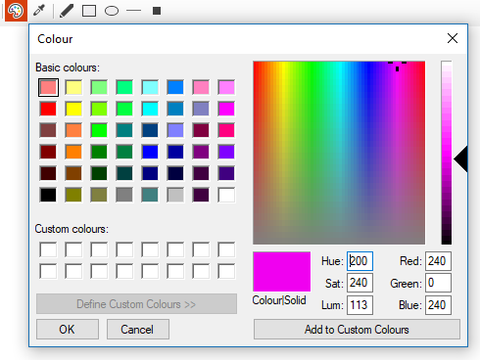
Color
Color represents a color defined by ARGB (alpha, red green, blue) values, maximum of 255 each.

Slide 8
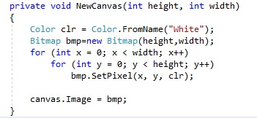
Bitmap
Bitmap an object containing data for a graphics image. It's like an array of pixels where each pixel is defined by it's coordinates and it's Color value
Bitmaps can be manipulated, pixel by pixel.
Each time a fresh canvas is created, it is set with the default white image of the specified dimensions.

Slide 9
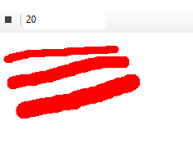
Brush & Pen
Brush is an object used to draw 2D vector Graphics with, defined by Color.
Pen is an object used to draw lines with, defined by Brush and size.
Lines of 10, 15 and 20 width

Slide 10
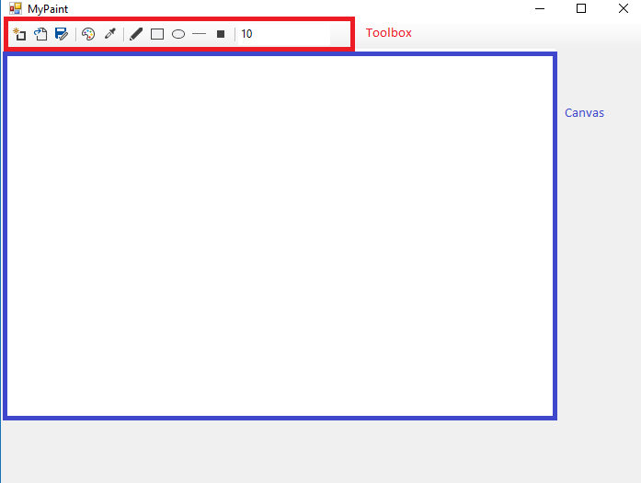
The Application(UI)

Slide 11
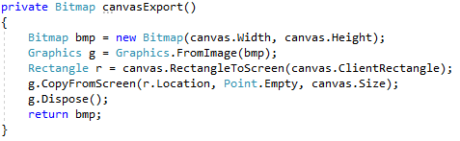

Save
In order to fulfil the purpose of an image editor, to generate new images, the temporary nature of a Graphics object based on a control has to be overcome.
The method CopyFromScreen(), which writes pixel data from a specified area on the screen on a Graphics object, essentially creating a screenshot, helps export the contents of the canvas into a Bitmap object, which can then be saved.

Slide 12
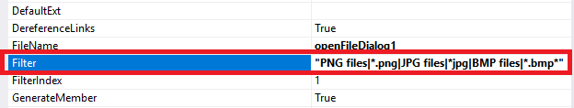
File Extensions
The OpenFileDialog and SaveFileDialog components include a “filter” attribute used to specify the types of files used by the program.

Slide 13
Concept
Think of the artist's movement; they place their brush upon the canvas, drag it through it to draw their desired shape and release it when that shape is done. This movement we seek to replicate here, using the following events with the canvas and a flag that indicates whether drawing is on.
1. MouseDown flag = true
2. MouseUp flag = false
3. MouseMove if flag == true draw

Slide 14
Implementation
Variables:
draw; determines whether the mouse is clicked
C; the selected color
s; the selected size
x,y; the coordinates of the click (e.X, e.Y being the coordinates where the correstponding event took place)
mode; current operation, changed using the toolbar controls

Slide 15
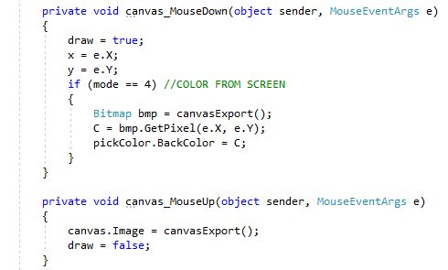
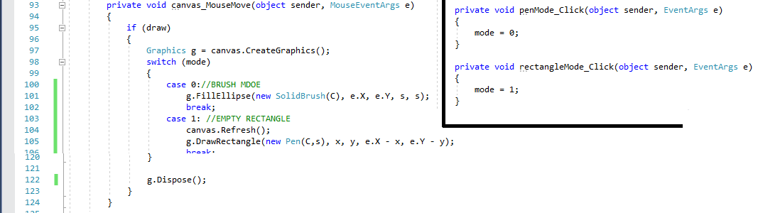
Code Snippets

Slide 16
Shapes
Graphics functions are used to create basic shapes.
Draw type functions will draw shapes consisting of lines using coordinates and a Pen object.
Drawline() will create a line defined by two points
DrawRectangle() will create a rectangle defined by its upper left point and it's size
DrawEllipse() will create an ellipse defined by a rectangle where the centre of each side is touching the circle
Other draw functions; DrawArc(), DrawBezier(), DrawCurve(), DrawPath(), DrawPolygon()

Slide 17
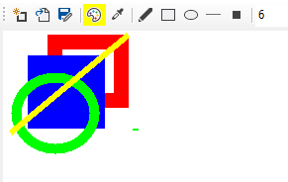
Shapes
Fill type functions are used to create solid shapes such as FillEllipse(), FillRectangle() etc.

Slide 18
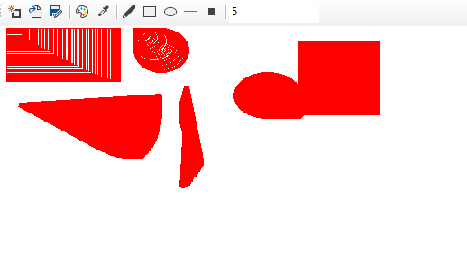
Problem and Workaround
These tools aren't without shortcomings and creating a fully functional image editing program is a hard task, often requiring workourounds to such shortcomings. Below is an example of a problem and a workaround to it.

Slide 19
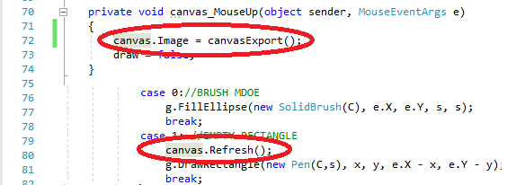
Problem and Workaround
1. Every time an operation is finished the canvas' Image is updated with the graphic
2. The canvas is Continuously refreshed during the operations
Those ensure that the shapes are previewed properly and that there is no unwanted residue

Slide 20
Conclusions
The GDI+ is an easy to learn library with a basic selection of tools.
There are certainly more limitations than on a custom platform or engine.
When developing using GDI+ a lot of time is expected to be dedicated in finding workarounds for said limitations.
Workarounds may not only be hard to come up with but, also, consume system resources.
The GDI+ API is definitely usable for rudimentary image editors with limited capabilities, stand-alone or embedded in other applications.
More research would be required to determine appropriate ways to develop heavy duty image editing software.

Slide 21
Reference
Most come from Microsoft's .NET documentation
https://msdn.microsoft.com/en-us/library/windows/desktop/ms534453(v=vs.85).aspx
https://archive.org/stream/byte-magazine-1983-12/1983_12_BYTE_08-12_Easy_Software#page/n49/mode/2up

Slide 22
End of Presentation
~Thanks for your time~

