Slide 1
TECHSTORESys
IT Directorate Tech Stores - System Overview
Zimbabwe National Army | v2.2 | 01 September 2026
107 screens - stores, GL, procurement portals, ZNA Q forms, role workspaces

Slide 2
Contents
1. Login & shell
2. Role-based home dashboards
3. Role-based navigation (sidebar)
4. Dashboard & communications
5. IT Dir department desks
6. Stakeholder portals
7. General ledger & stores
8. Equipment, loans & returns
9. Procurement & creditors
10. Workshop & compare tools
11. ZNA Q forms index
12. ZNA Q & SVCS forms
13. Administration & help

Slide 3
Login & shell

Slide 4
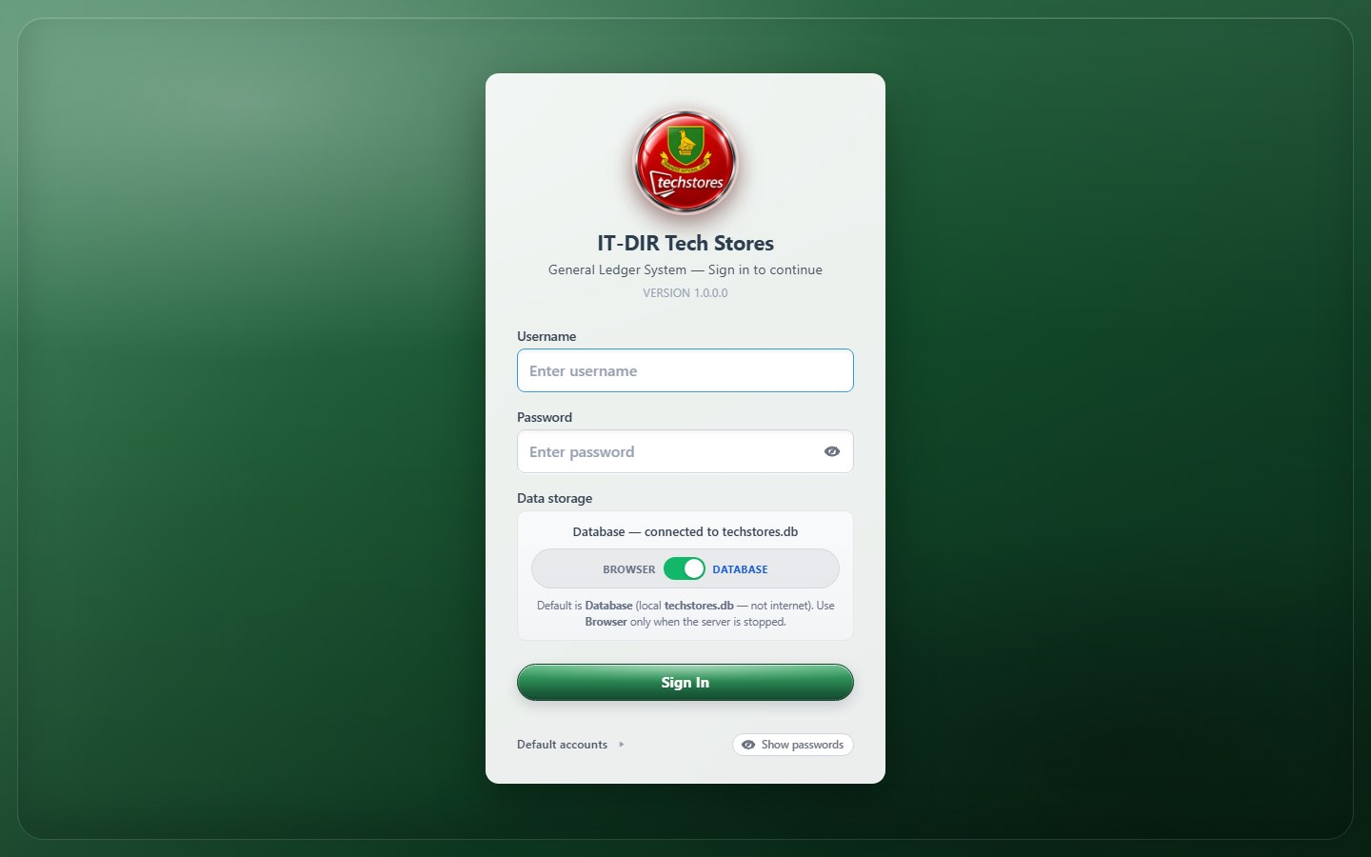
Login screen
What it is: Sign-in screen for TECHSTORESys. Controls who sees which modules and whether data saves to the local database.
How it works: Enter username and password. Default mode is Database (techstores.db). After sign-in the sidebar and dashboard match your role.

Slide 5
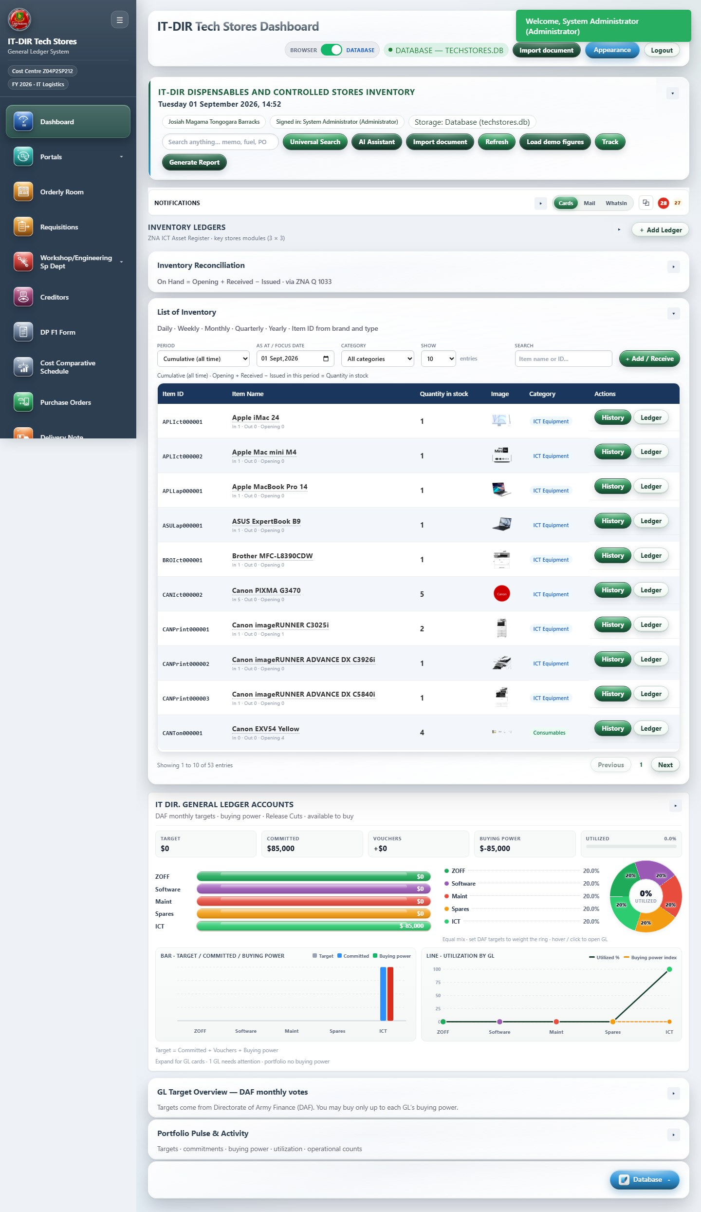
Application shell (sidebar + header)
Module: dashboard
What it is: Main application layout: sidebar navigation, header bar, and content area.
How it works: Sidebar groups modules (Dashboard, GL, Stores, Portals, ZNA Q, etc.). Header has Import document, Appearance, Logout. Content area shows the active module.

Slide 6
Role-based home dashboards

Slide 7
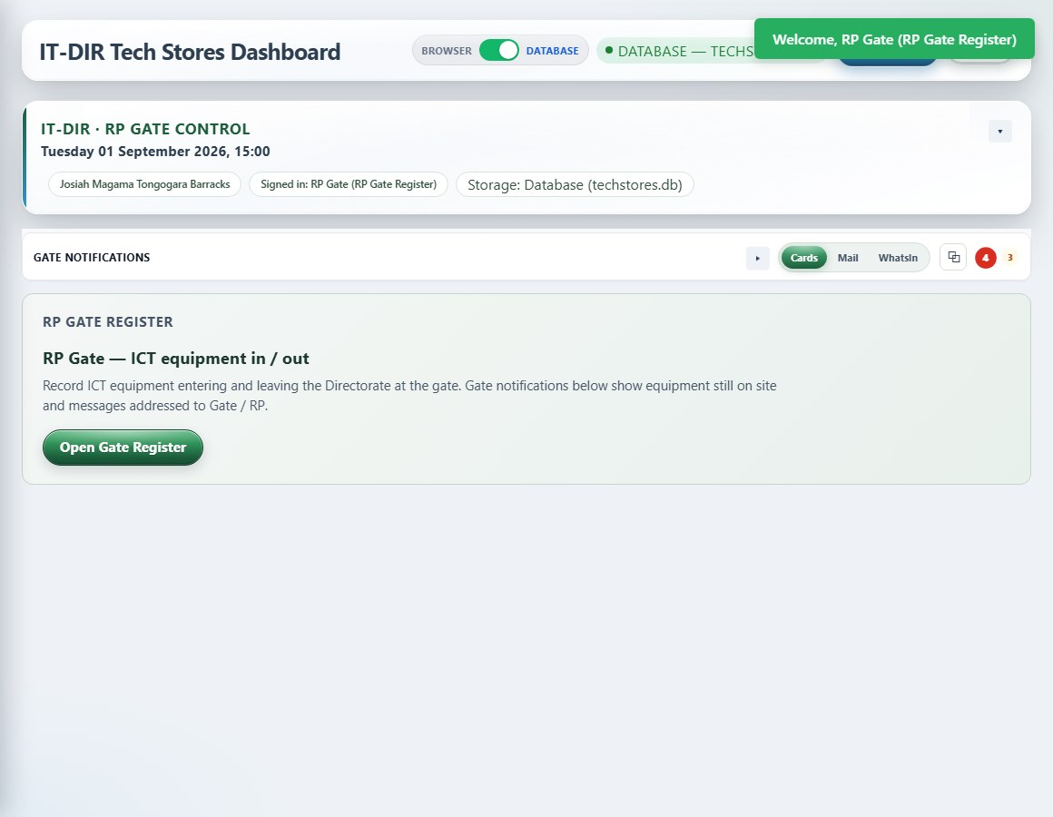
RP Gate - home dashboard
Login: rp
What it is: Tailored home for RP Gate — shortcuts to Gate Register only.
How it works: Login as rp. Dashboard kicker changes to gate context. Only Gate Register appears in sidebar.

Slide 8
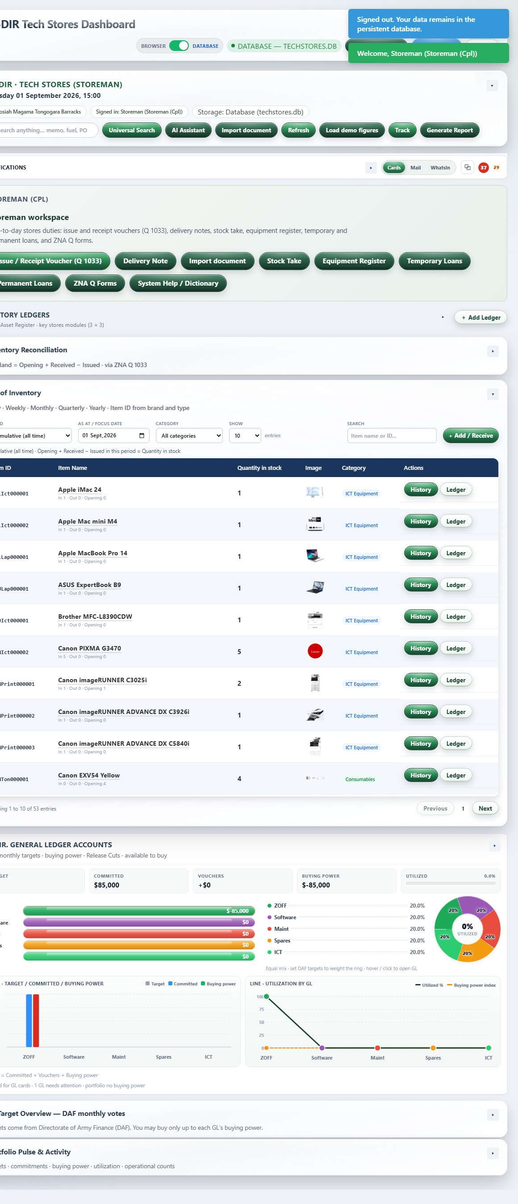
Storeman - home dashboard
Login: storeman
What it is: Tailored home for Storeman — Q 1033, stock take, loans, ZNA Q forms.
How it works: Login as storeman. Shortcut buttons open daily stores forms without browsing full GL menu.

Slide 9
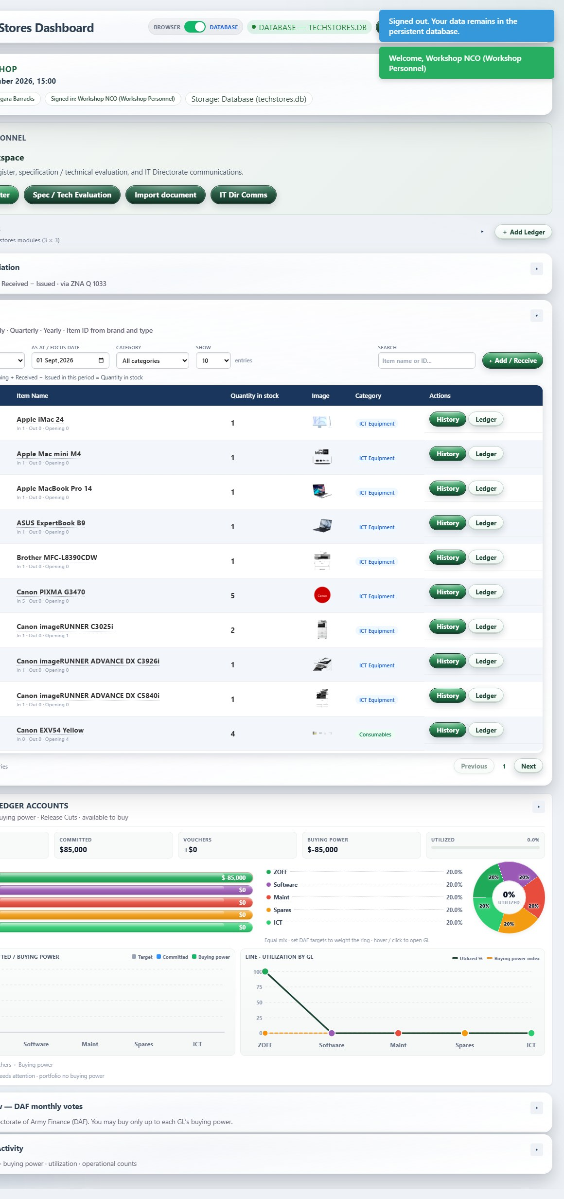
Workshop - home dashboard
Login: workshop
What it is: Tailored home for Workshop — repairs register, spec eval, comms.
How it works: Login as workshop. Primary button opens Workshop Register; spec eval and comms secondary.

Slide 10
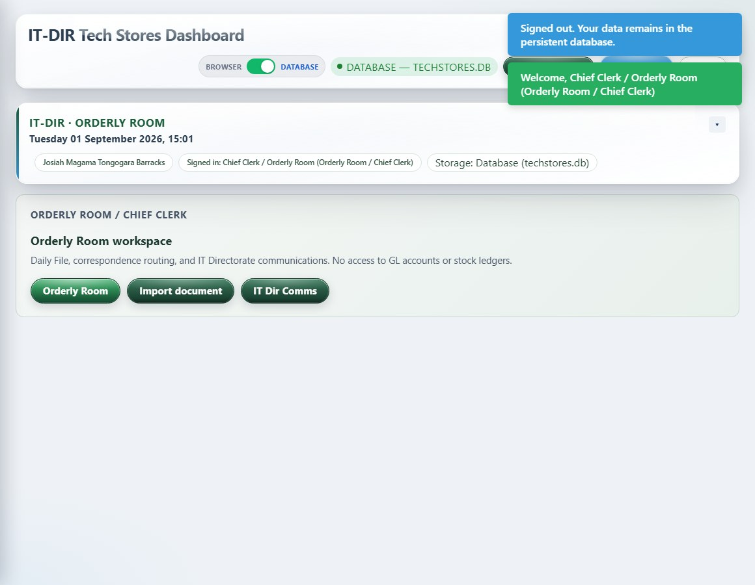
Orderly Room - home dashboard
Login: orderly
What it is: Tailored home for Orderly Room — Daily File, doc import, comms.
How it works: Login as orderly. Opens Orderly Room and correspondence workflows; no GL ledgers.

Slide 11
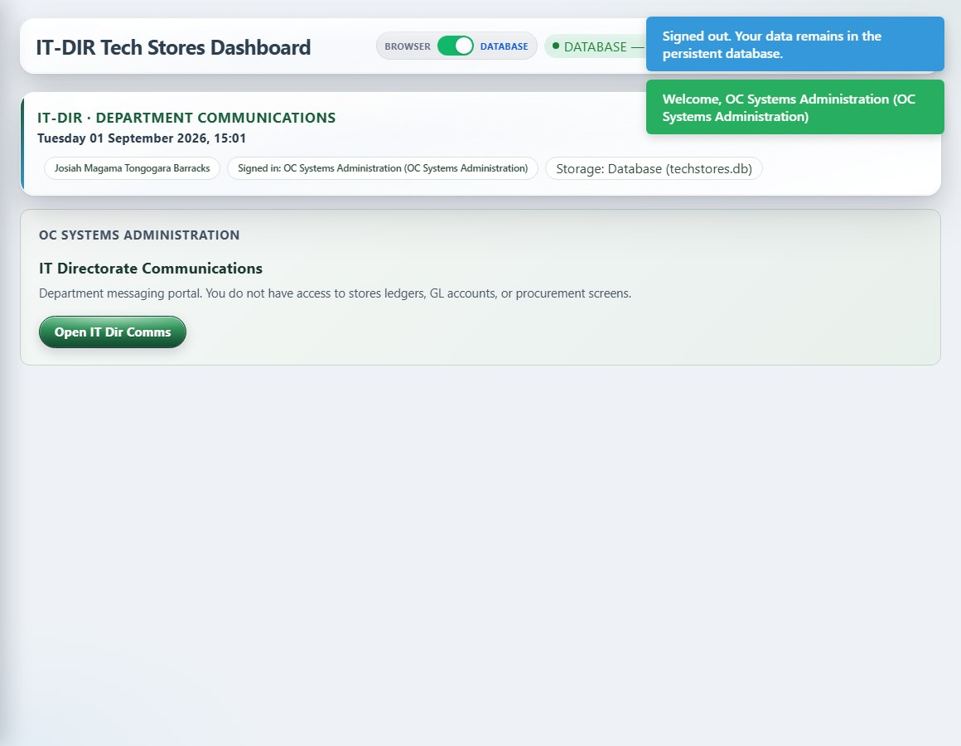
Department comms (SysAdmin) - home dashboard
Login: sysadmin
What it is: Tailored home for department OC — IT Dir Comms only.
How it works: Login as sysadmin/dba/etc. Single comms shortcut; sidebar hides stores and procurement.

Slide 12
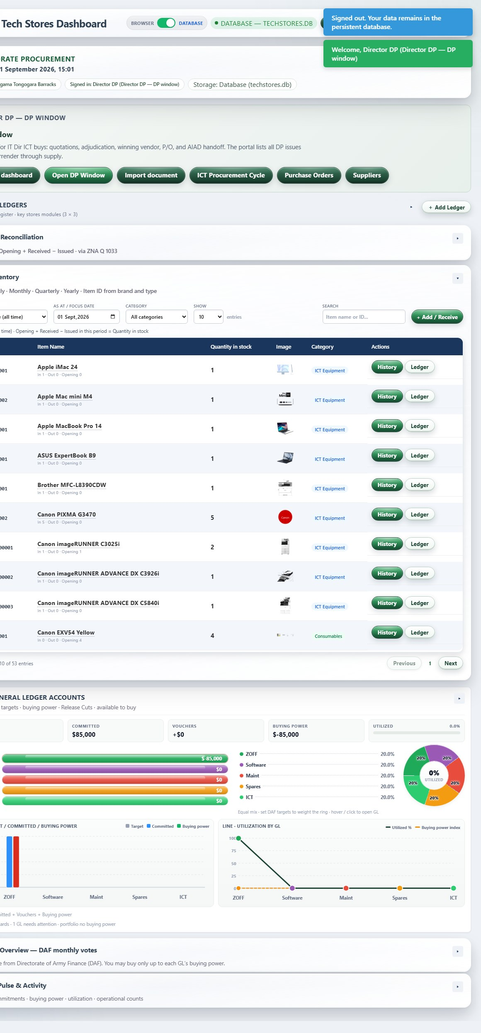
Directorate Procurement (DP) - home dashboard
Login: dp
What it is: Tailored home for DP — portals board, DP window, PO, suppliers.
How it works: Login as dp. Buttons open DP portal and procurement cycle; no stores ledgers visible.

Slide 13
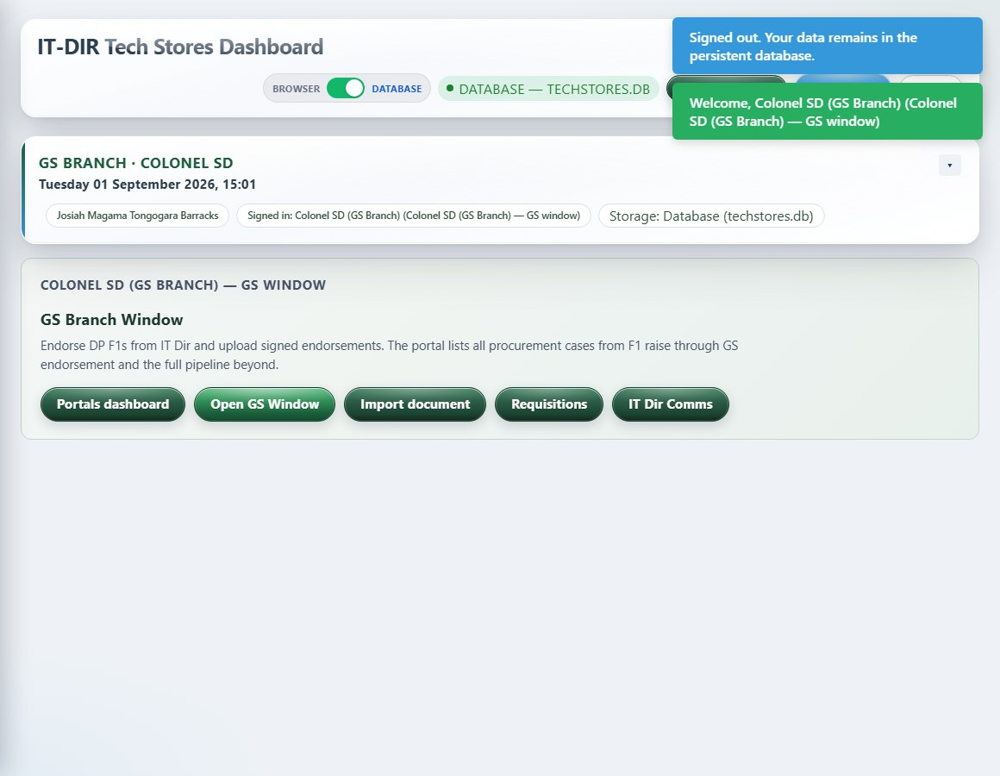
GS Branch - home dashboard
Login: gsdesk
What it is: Tailored home for GS Branch — portals, GS window, requisitions.
How it works: Login as gsdesk. GS Window endorses F1s; sees requisitions for awareness.

Slide 14
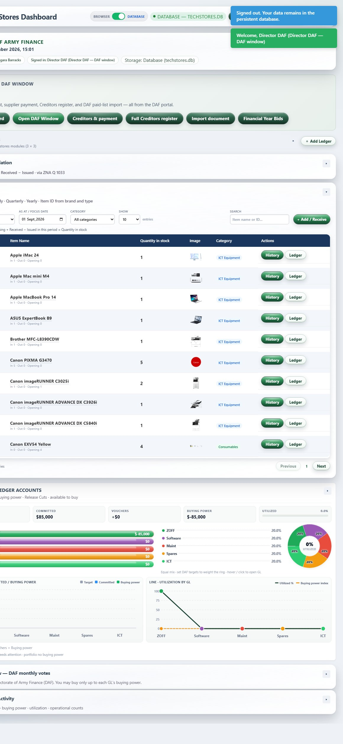
DAF / MANAC - home dashboard
Login: daf
What it is: Tailored home for DAF — portals, MANAC, Creditors, FY bids.
How it works: Login as daf. Creditors and payment shortcuts on home; second tab for creditor import.

Slide 15
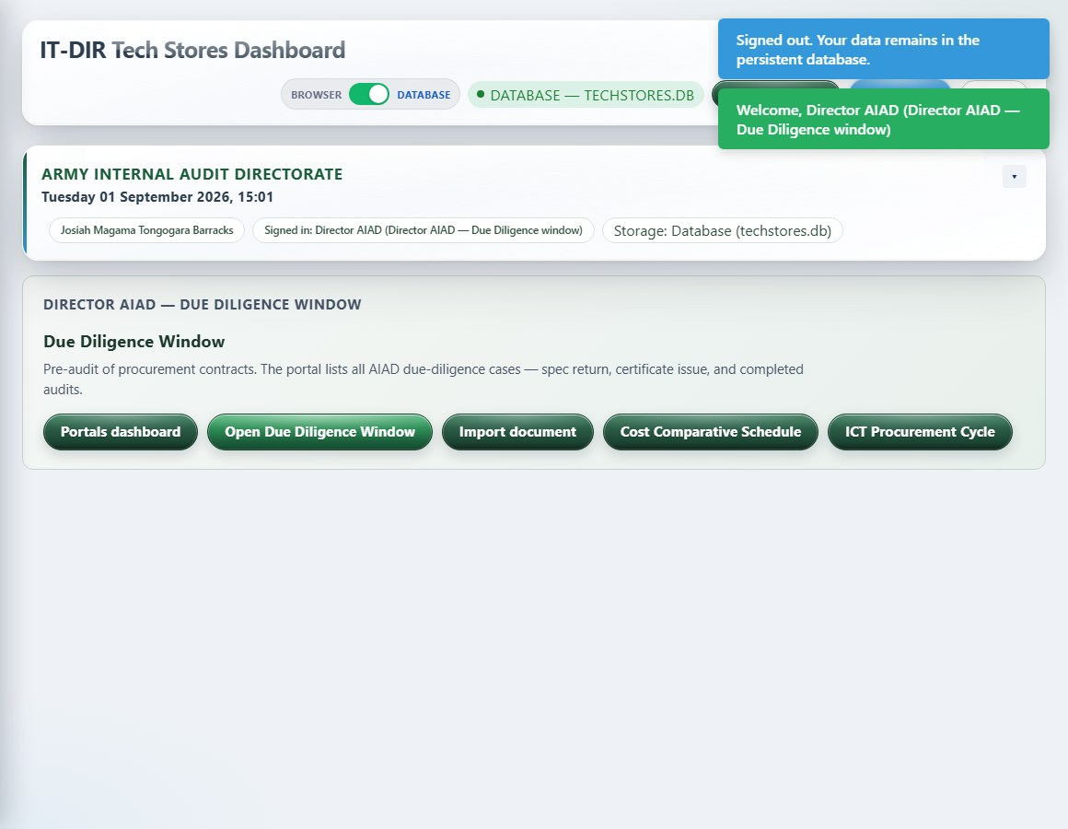
AIAD Due Diligence - home dashboard
Login: aiad
What it is: Tailored home for AIAD — due diligence window and cost comparative.
How it works: Login as aiad. Due diligence queue and cost comparative access from home.

Slide 16
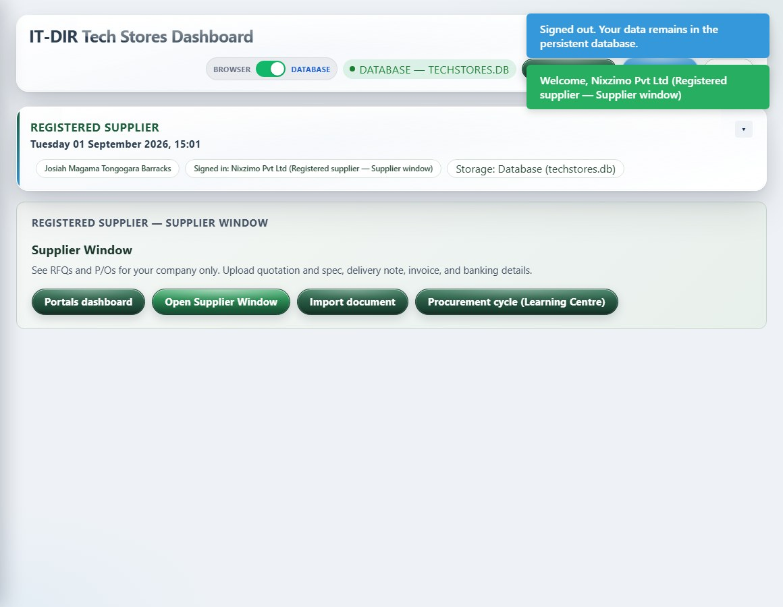
Supplier (Nixzimo) - home dashboard
Login: nixzimo
What it is: Tailored home for Supplier — supplier window and doc import.
How it works: Login as nixzimo. Supplier portal only — RFQ/PO response upload.

Slide 17
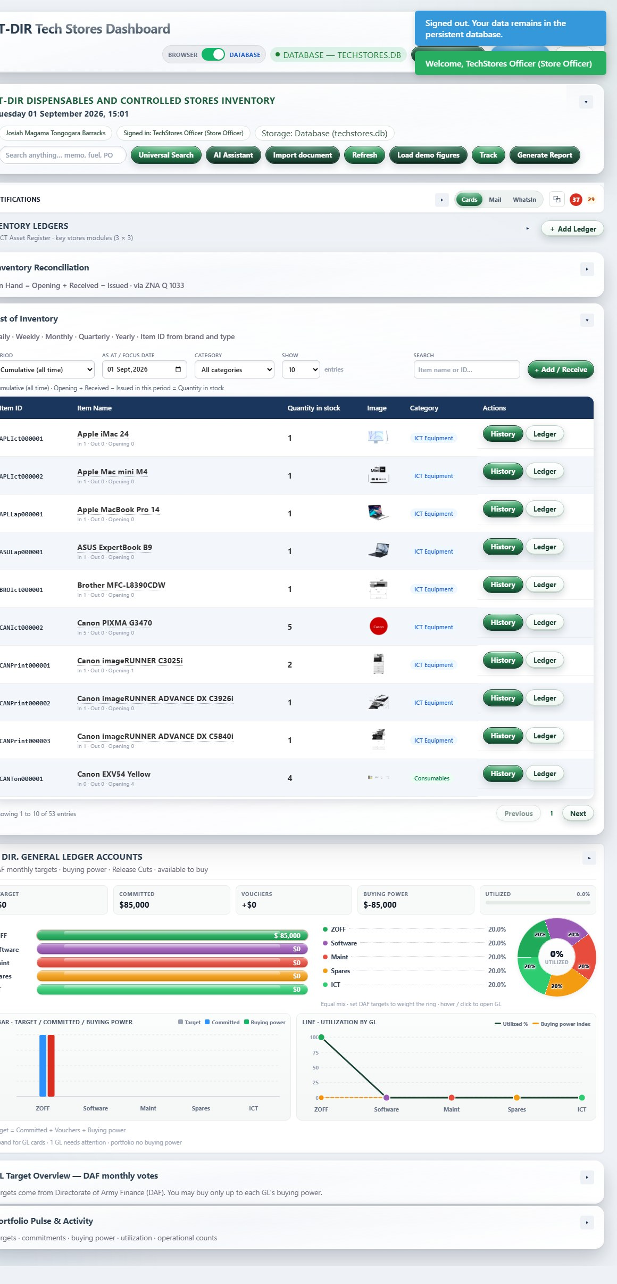
Store Officer (full ledgers) - home dashboard
Login: store
What it is: Store Officer home — full GL and stores dashboard (no role card; standard KPI dashboard).
How it works: Login as store. Full sidebar with all five GL ledgers and operational registers.

Slide 18
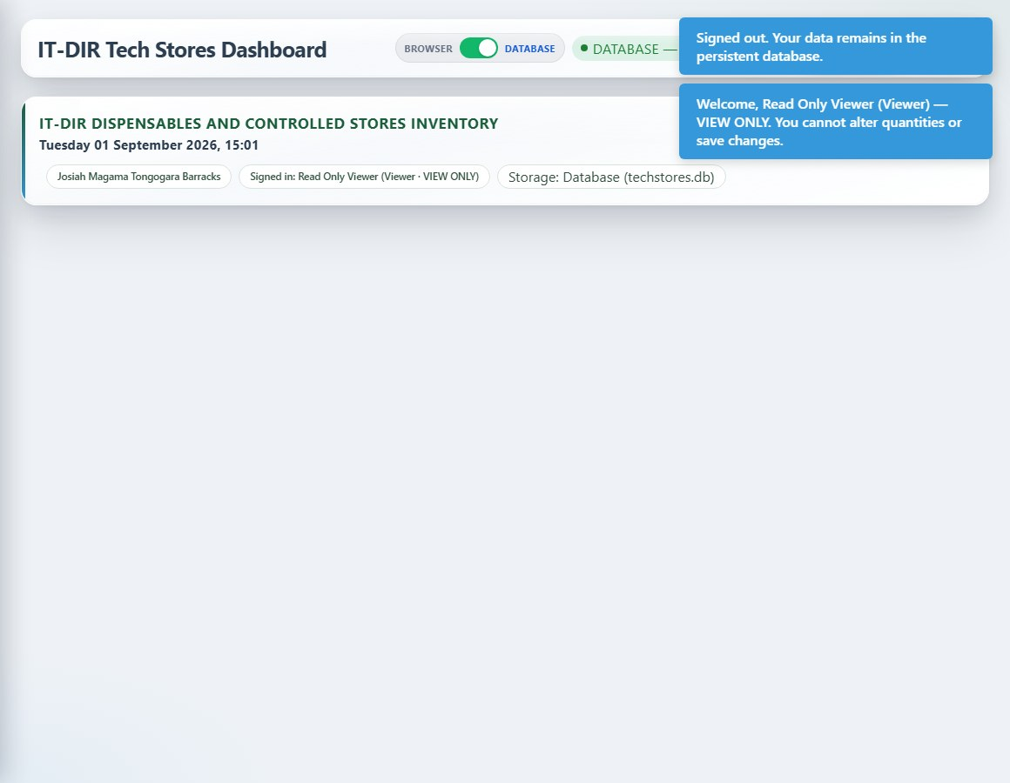
Viewer (read-only) - home dashboard
Login: viewer
What it is: Viewer home — read-only dashboard with limited module access.
How it works: Login as viewer. Dashboard and help only; save buttons disabled across modules.

Slide 19
Role-based navigation (sidebar)

Slide 20
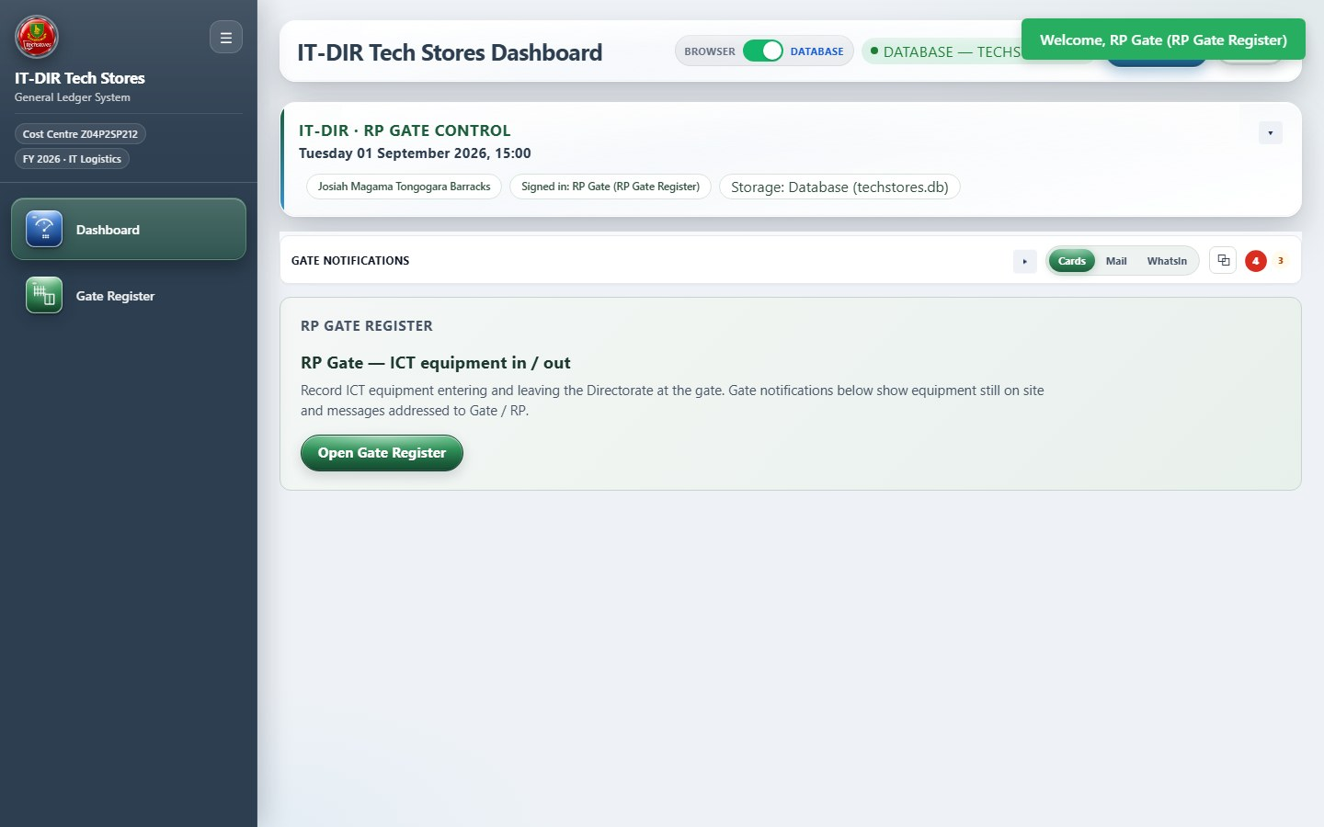
RP Gate - sidebar navigation
Login: rp
What it is: Sidebar navigation visible to RP Gate after login.
How it works: Only modules allowed by config.js role bundle appear. Submenus (Portals, GL, ZNA Q) expand on click. Compare across roles to see access control.

Slide 21
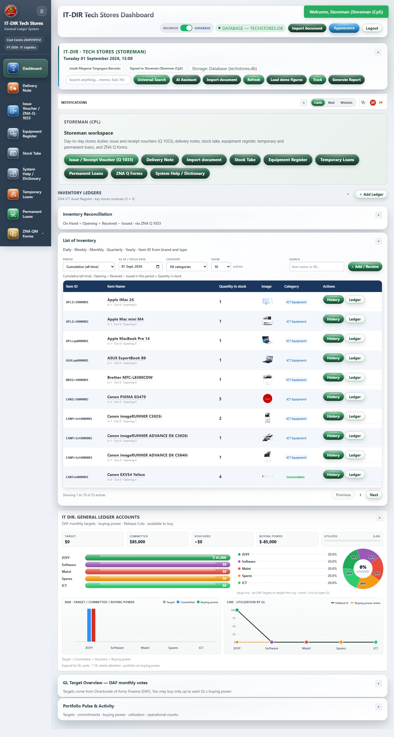
Storeman - sidebar navigation
Login: storeman
What it is: Sidebar navigation visible to Storeman after login.
How it works: Only modules allowed by config.js role bundle appear. Submenus (Portals, GL, ZNA Q) expand on click. Compare across roles to see access control.

Slide 22
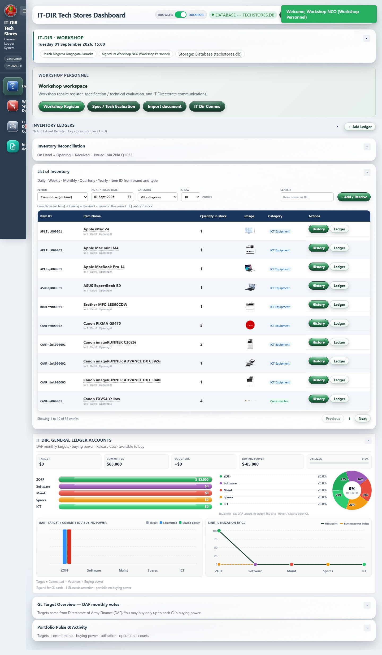
Workshop - sidebar navigation
Login: workshop
What it is: Sidebar navigation visible to Workshop after login.
How it works: Only modules allowed by config.js role bundle appear. Submenus (Portals, GL, ZNA Q) expand on click. Compare across roles to see access control.

Slide 23
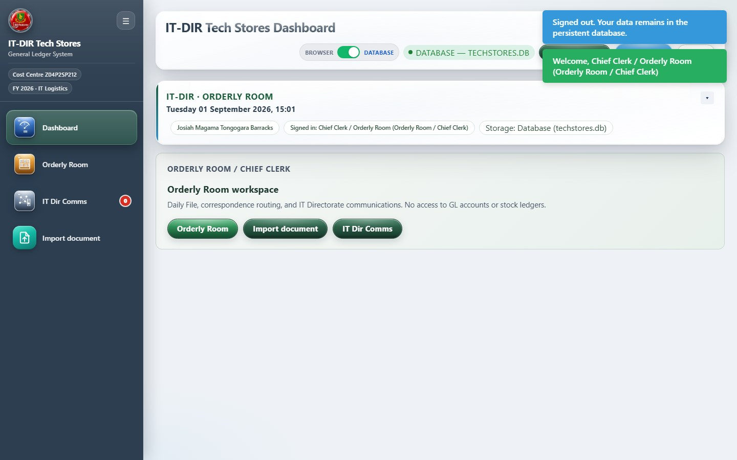
Orderly Room - sidebar navigation
Login: orderly
What it is: Sidebar navigation visible to Orderly Room after login.
How it works: Only modules allowed by config.js role bundle appear. Submenus (Portals, GL, ZNA Q) expand on click. Compare across roles to see access control.

Slide 24
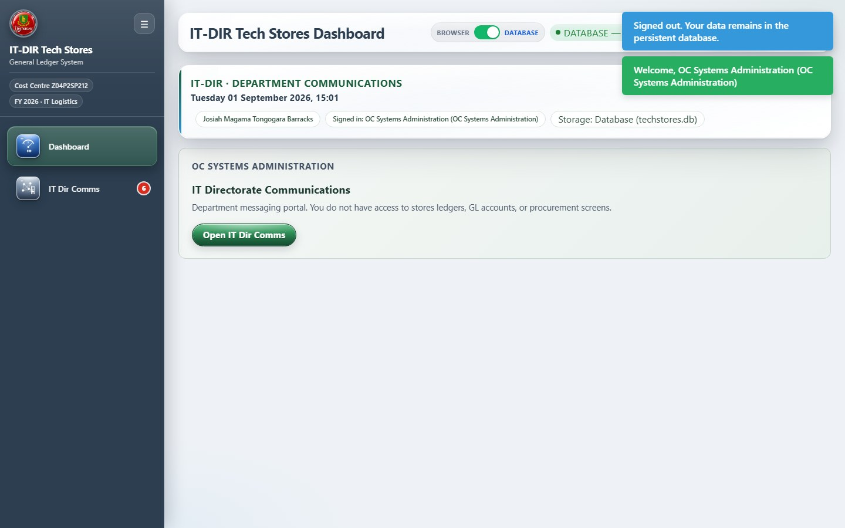
Department comms (SysAdmin) - sidebar navigation
Login: sysadmin
What it is: Sidebar navigation visible to Department comms after login.
How it works: Only modules allowed by config.js role bundle appear. Submenus (Portals, GL, ZNA Q) expand on click. Compare across roles to see access control.

Slide 25
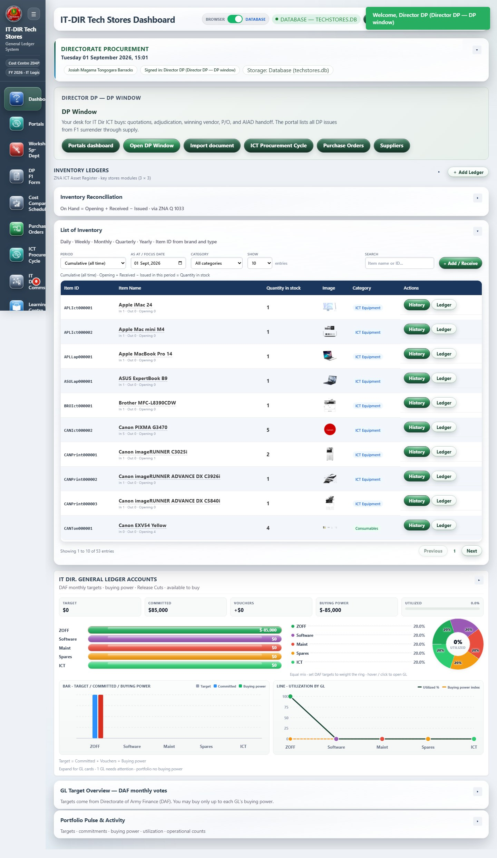
Directorate Procurement (DP) - sidebar navigation
Login: dp
What it is: Sidebar navigation visible to DP after login.
How it works: Only modules allowed by config.js role bundle appear. Submenus (Portals, GL, ZNA Q) expand on click. Compare across roles to see access control.

Slide 26
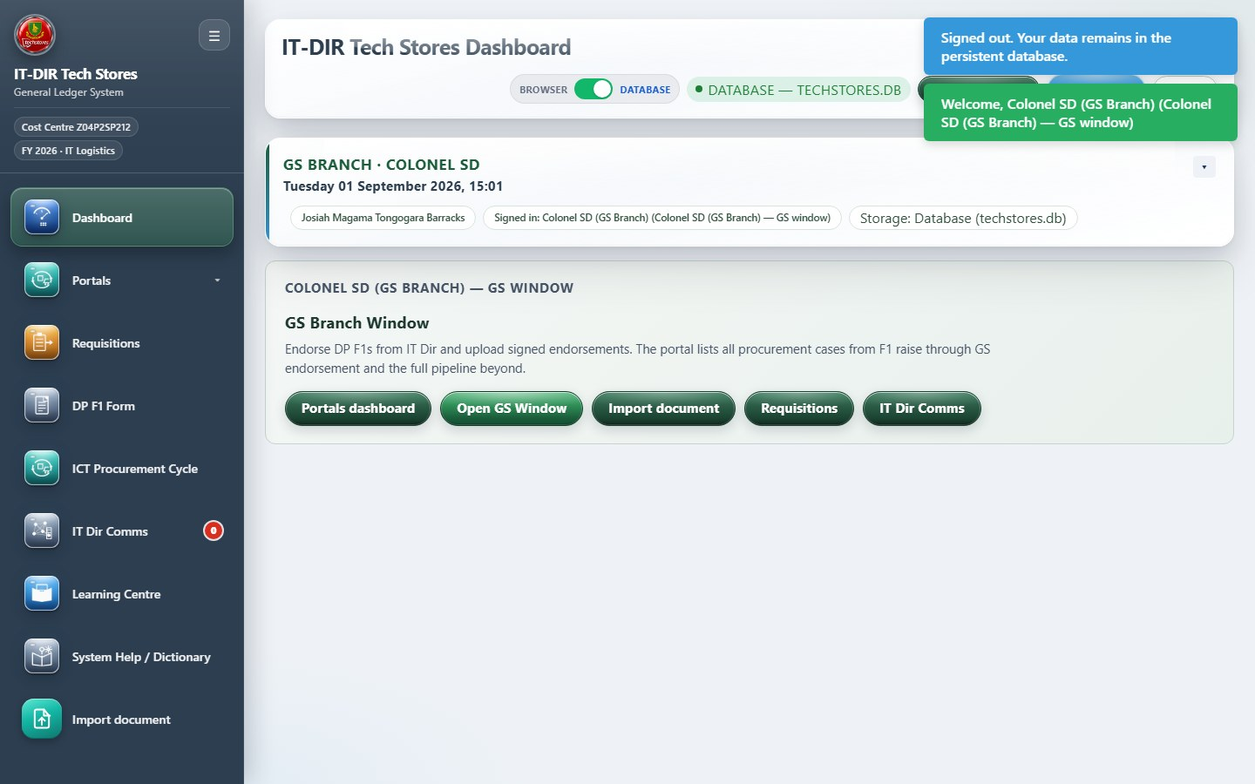
GS Branch - sidebar navigation
Login: gsdesk
What it is: Sidebar navigation visible to GS Branch after login.
How it works: Only modules allowed by config.js role bundle appear. Submenus (Portals, GL, ZNA Q) expand on click. Compare across roles to see access control.

Slide 27
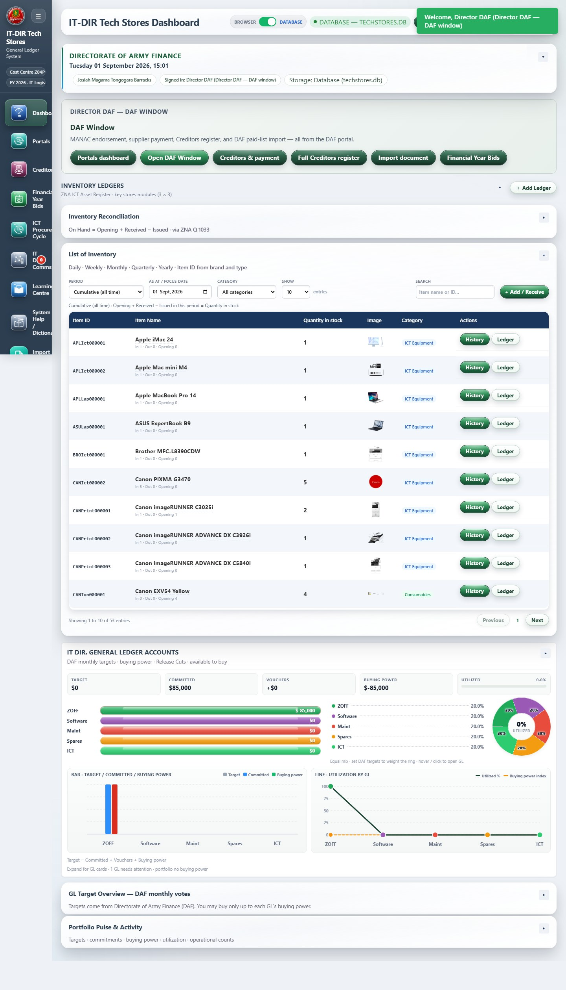
DAF / MANAC - sidebar navigation
Login: daf
What it is: Sidebar navigation visible to DAF after login.
How it works: Only modules allowed by config.js role bundle appear. Submenus (Portals, GL, ZNA Q) expand on click. Compare across roles to see access control.

Slide 28
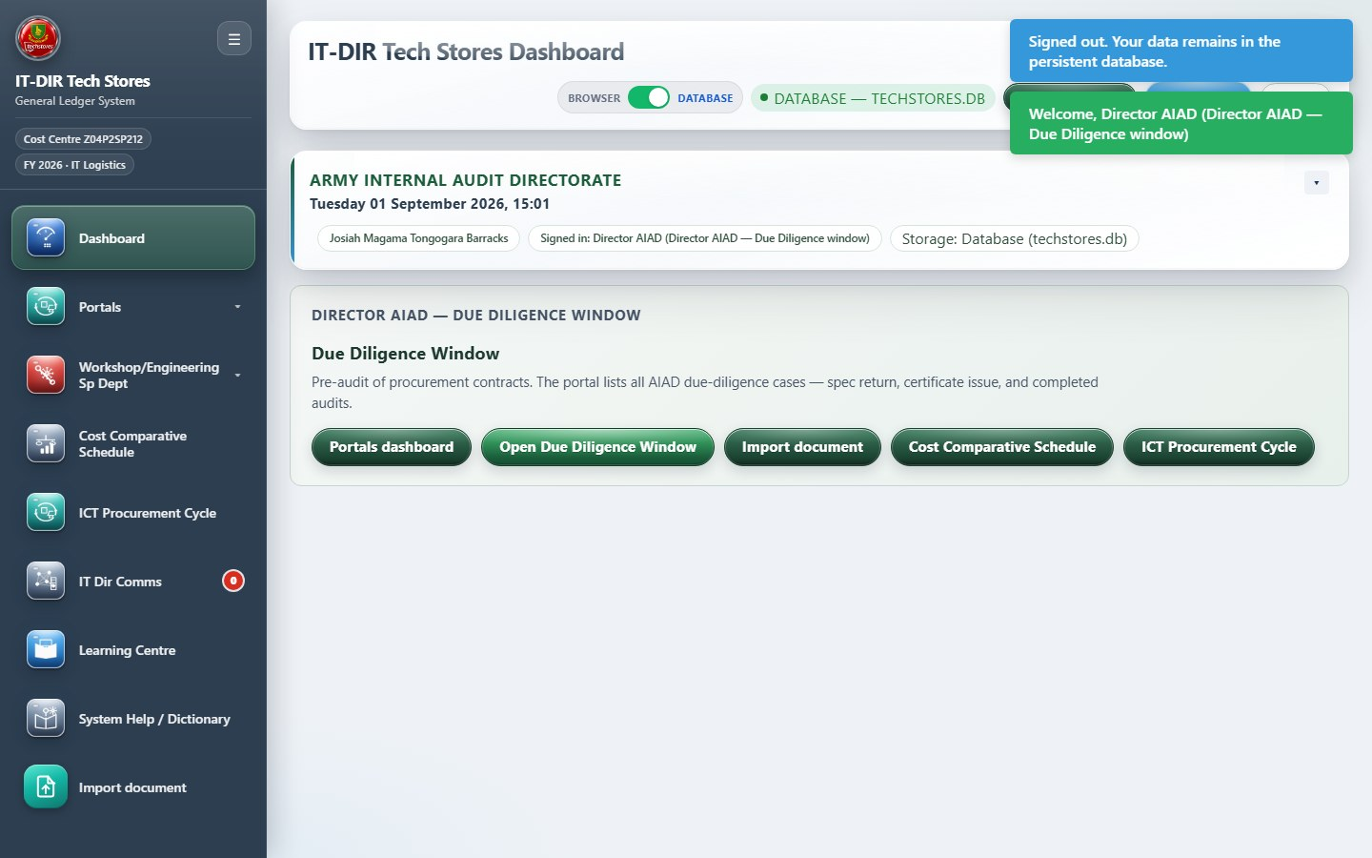
AIAD Due Diligence - sidebar navigation
Login: aiad
What it is: Sidebar navigation visible to AIAD after login.
How it works: Only modules allowed by config.js role bundle appear. Submenus (Portals, GL, ZNA Q) expand on click. Compare across roles to see access control.

Slide 29
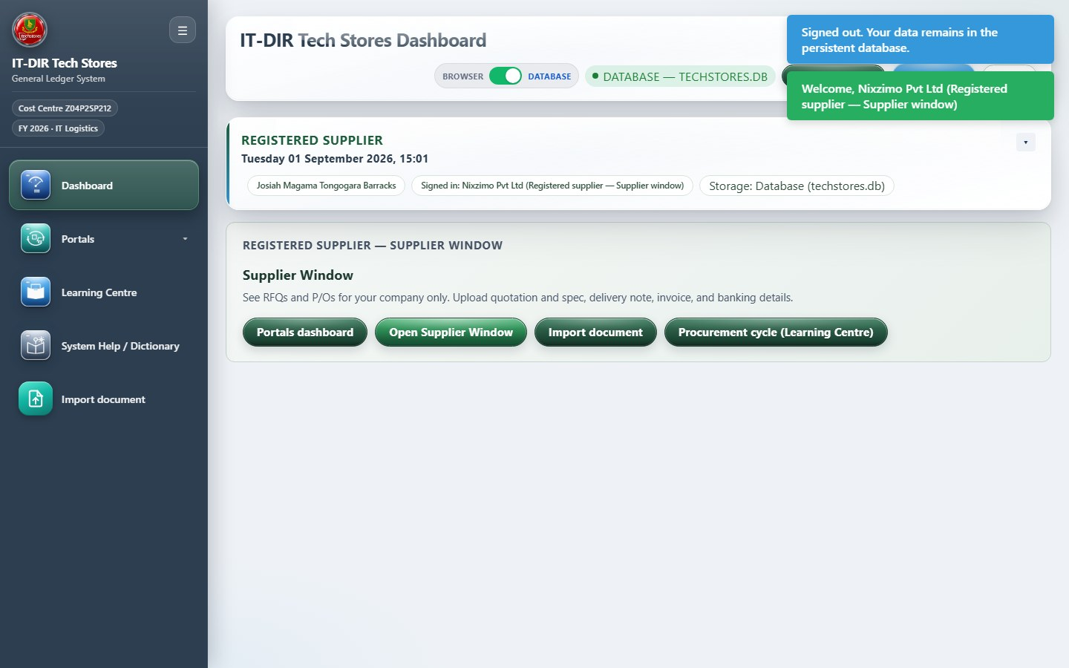
Supplier (Nixzimo) - sidebar navigation
Login: nixzimo
What it is: Sidebar navigation visible to Supplier after login.
How it works: Only modules allowed by config.js role bundle appear. Submenus (Portals, GL, ZNA Q) expand on click. Compare across roles to see access control.

Slide 30
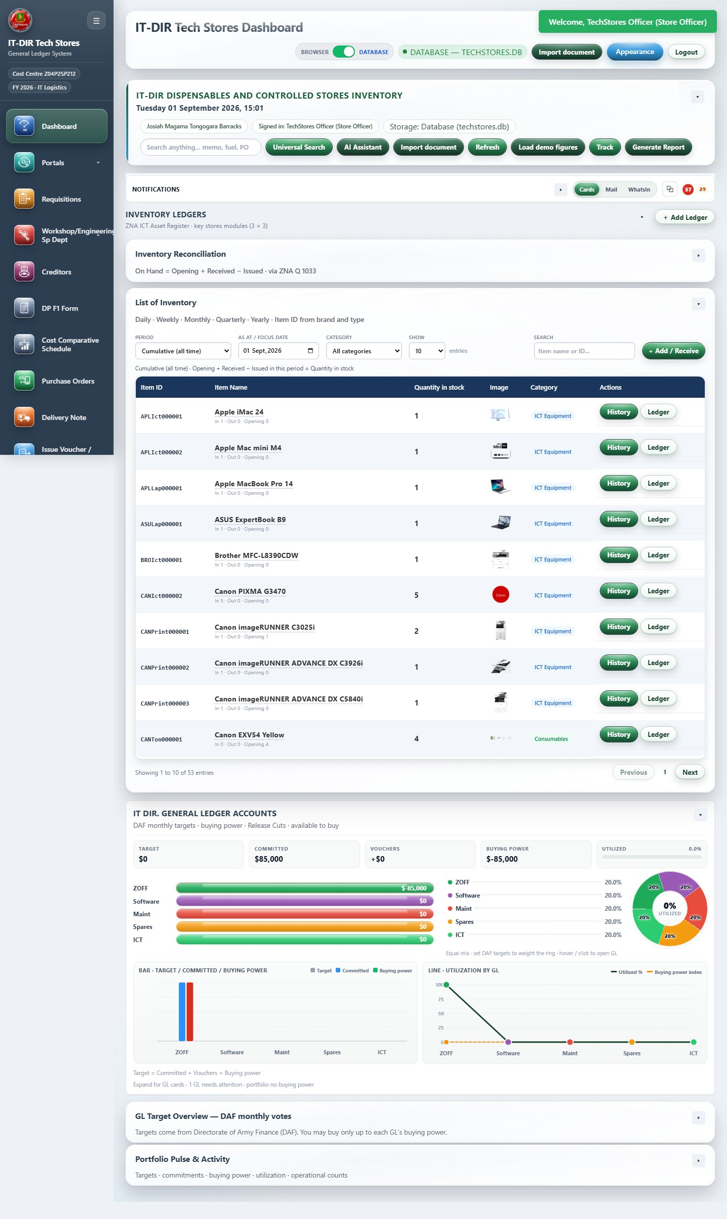
Store Officer (full ledgers) - sidebar navigation
Login: store
What it is: Sidebar navigation visible to Store Officer after login.
How it works: Only modules allowed by config.js role bundle appear. Submenus (Portals, GL, ZNA Q) expand on click. Compare across roles to see access control.

Slide 31
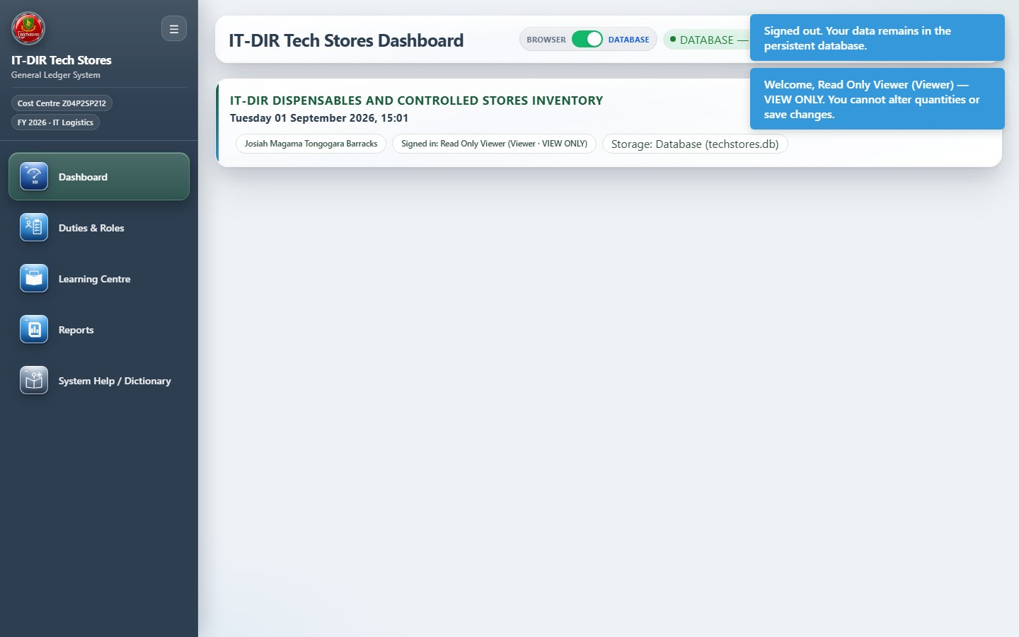
Viewer (read-only) - sidebar navigation
Login: viewer
What it is: Sidebar navigation visible to Viewer after login.
How it works: Only modules allowed by config.js role bundle appear. Submenus (Portals, GL, ZNA Q) expand on click. Compare across roles to see access control.

Slide 32
Dashboard & communications

Slide 33
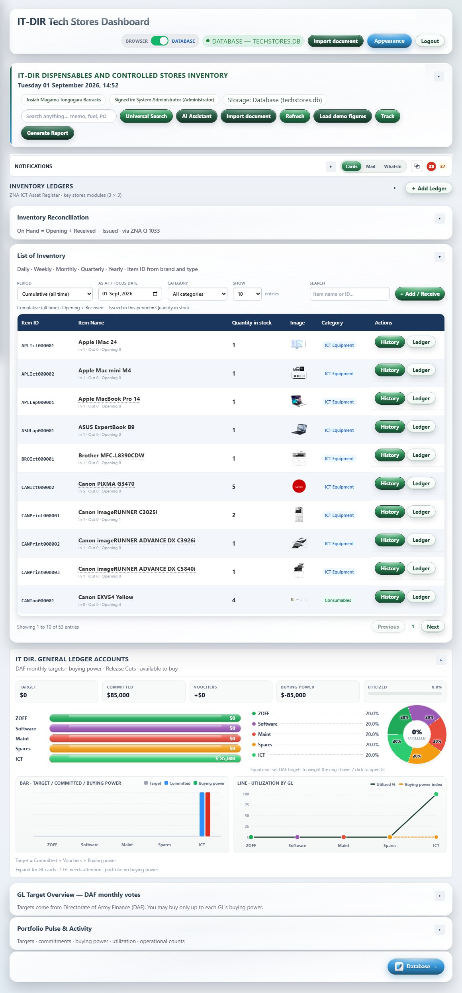
Dashboard Overview
Module: dashboard
What it is: Operations overview: KPI cards, alerts, universal search, and quick links.
How it works: Open from sidebar Home. Cards link to ledgers and registers. Alerts flag overdue items (Creditors, undelivered, loans). Search jumps to any allowed module.

Slide 34
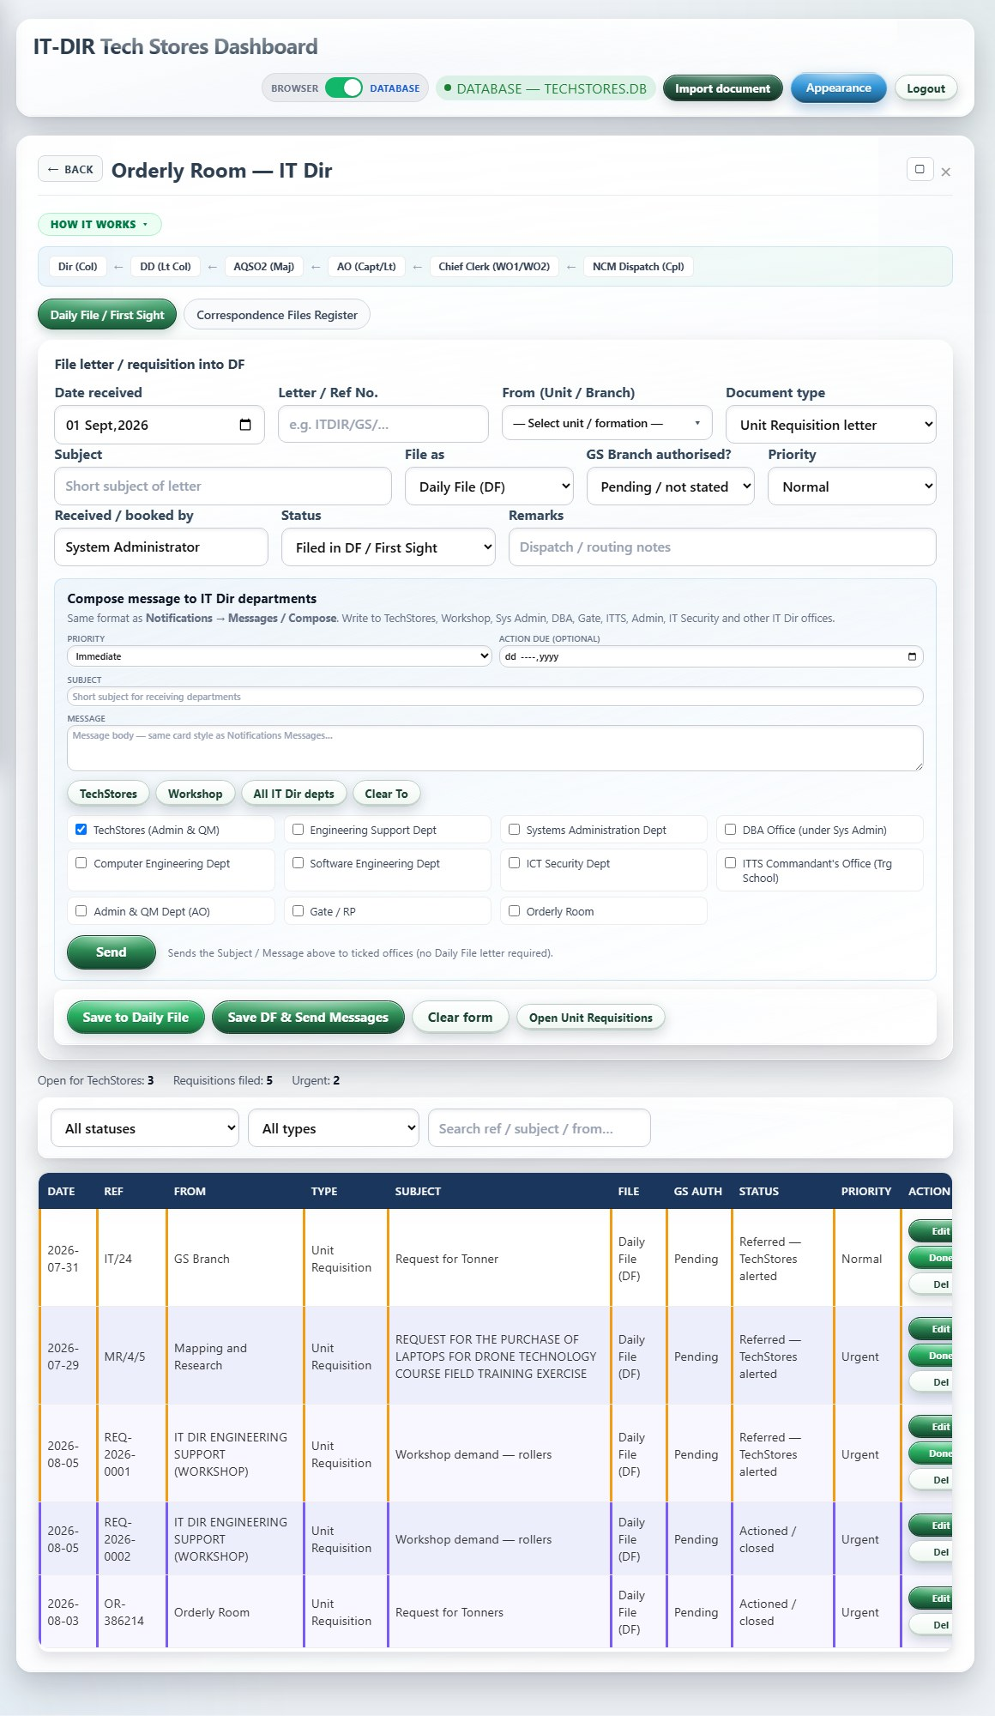
Orderly Room - DF & Correspondence Files
Module: orderly-room
What it is: Orderly Room Daily File and correspondence routing mirror.
How it works: Clerk logs incoming/outgoing correspondence and mirrors requisitions. Links to correspondence files. Used by Orderly Room and Admin AO roles.

Slide 35
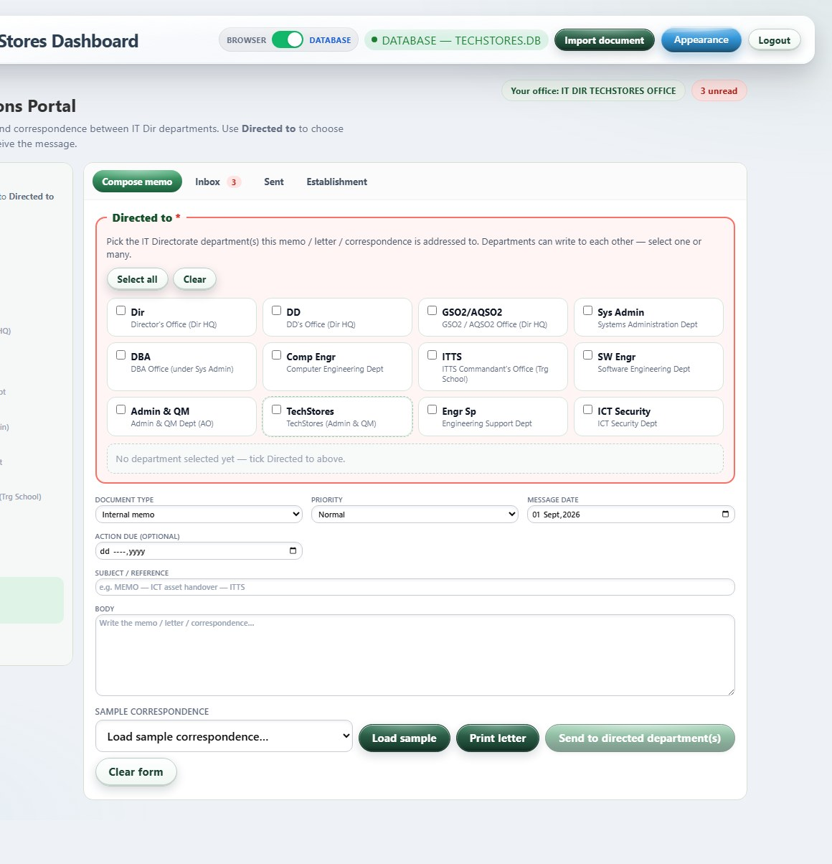
IT Directorate - Communications Portal
Module: it-dir-comms
What it is: Internal IT Directorate messaging between departments and command.
How it works: Departments post demands and replies. OC desks and workshop/orderly roles use this instead of GL screens. Inbox filters by office.

Slide 36
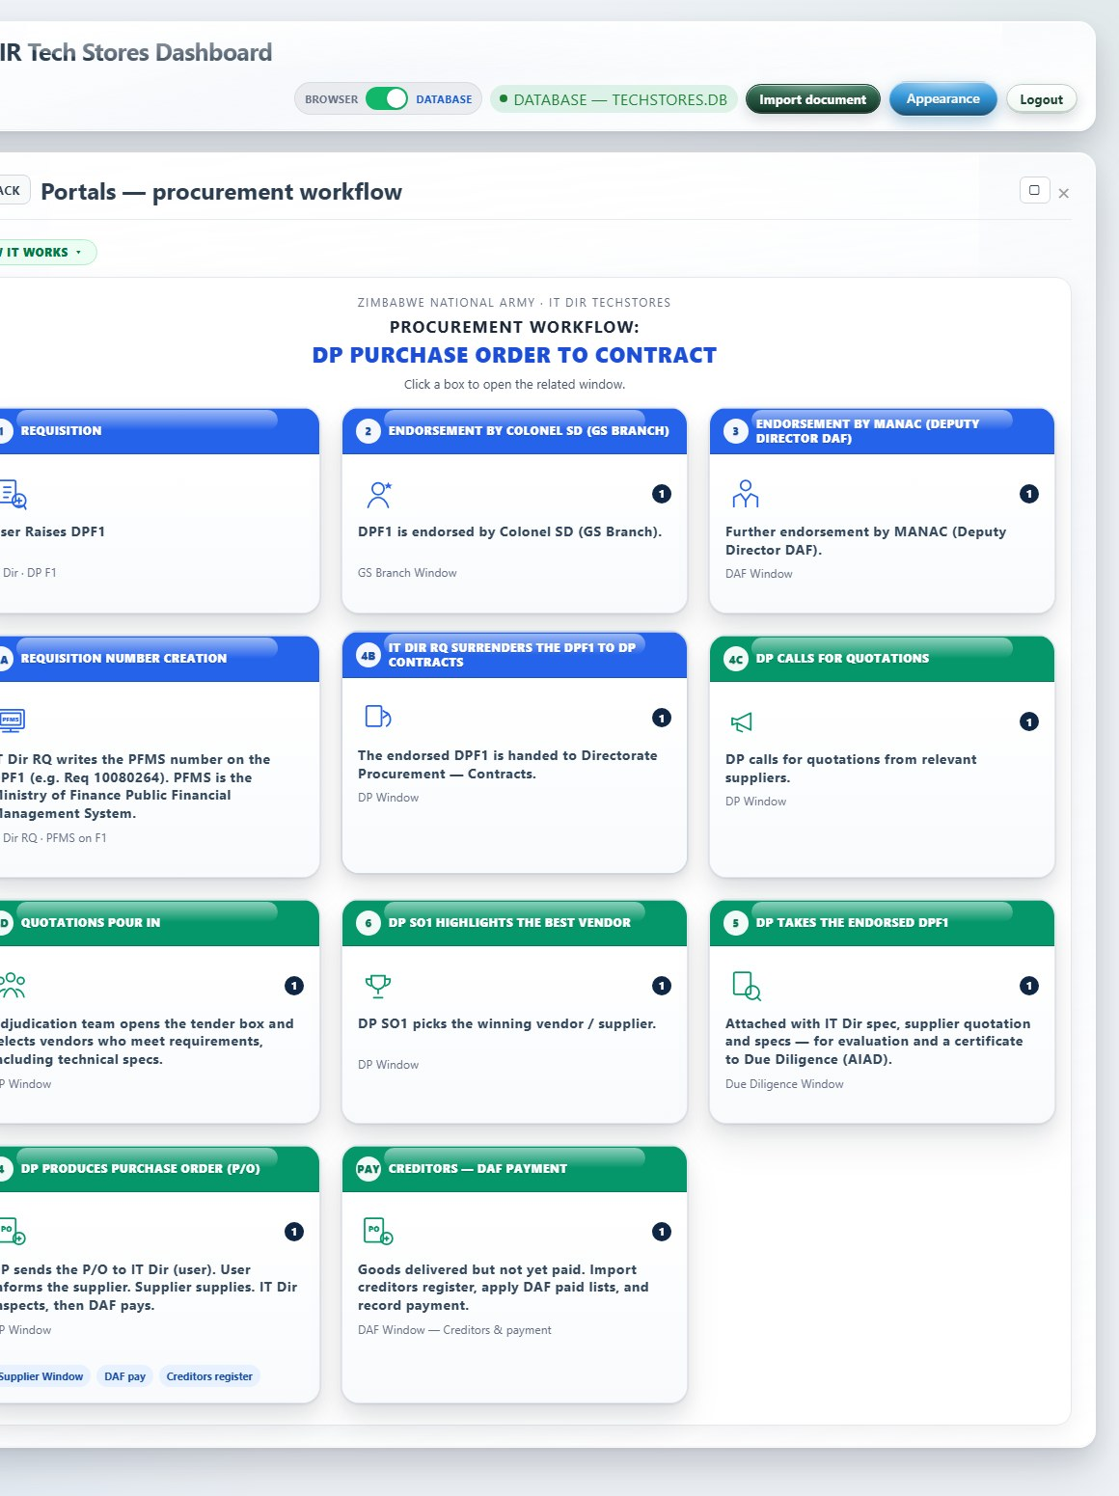
Portals - procurement workflow dashboard
Module: portals-board
What it is: Visual map of the ICT procurement workflow from F1 raise through supply and payment.
How it works: Click a stage tile to open the matching portal desk or register. Shows counts per stage. Entry point for DP, GS, DAF, AIAD, and Supplier users.

Slide 37
IT Dir department desks

Slide 38
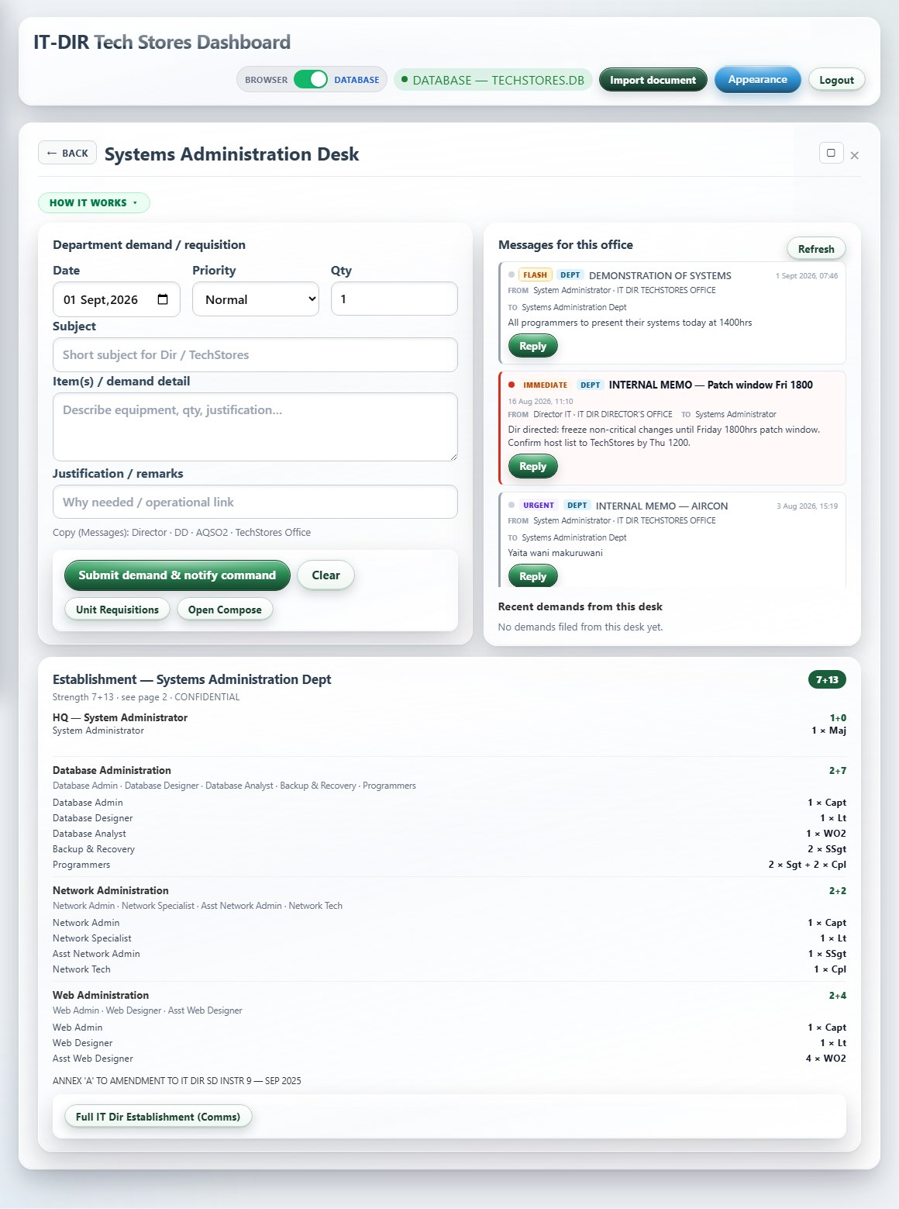
Dept Desk - Systems Administration
Module: dept-sysadmin
What it is: Systems Administration department desk: demand form, inbox, and establishment view.
How it works: Submit ICT demands CC Director, DD, AQSO2 and TechStores. Inbox shows office messages. Establishment panel lists posts and equipment entitlements.

Slide 39
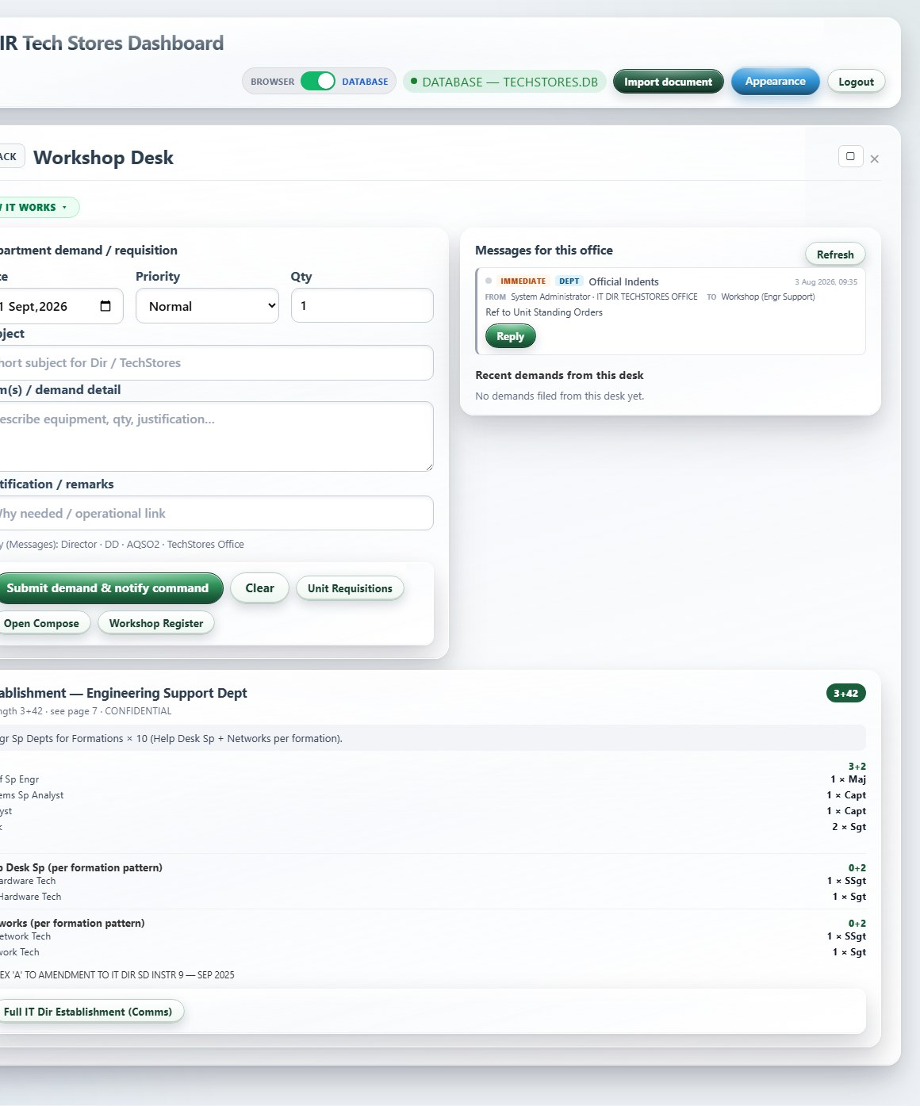
Dept Desk - Workshop
Module: dept-workshop
What it is: Workshop department desk for spares, tools, and repair support requests.
How it works: Same desk pattern as other departments. Primary link is Workshop Register. Demands notify command and TechStores.

Slide 40
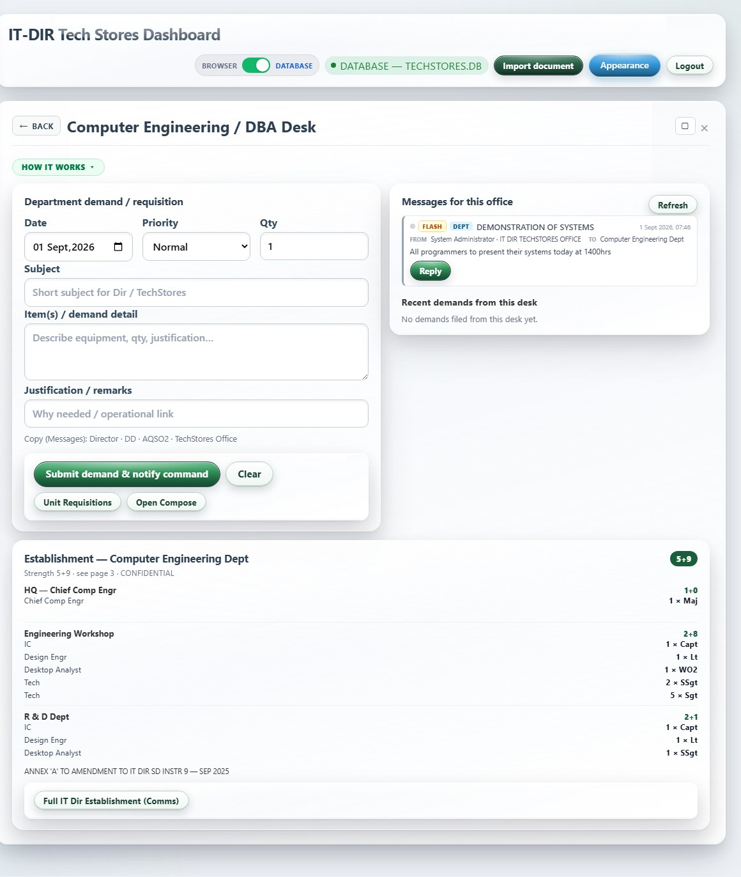
Dept Desk - Computer Engineering
Module: dept-compengr
What it is: Computer Engineering / DBA desk for servers, storage, and network items.
How it works: Raise structured demands for infrastructure. Tracks inbox replies and establishment data for the Comp Eng office.

Slide 41
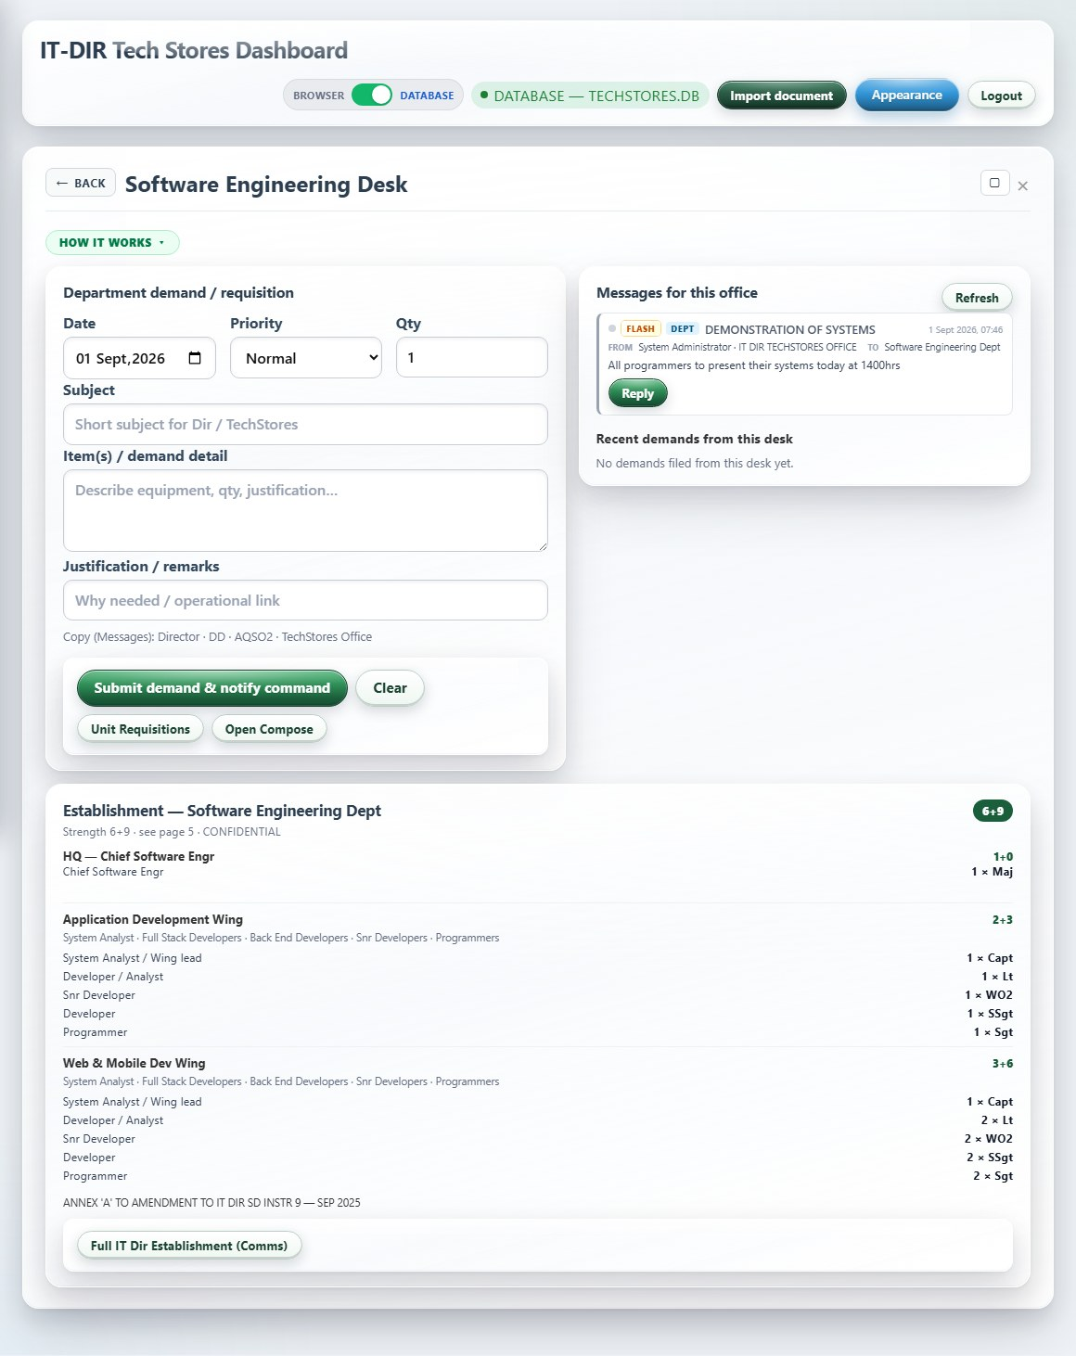
Dept Desk - Software Engineering
Module: dept-swengr
What it is: Software Engineering desk for dev tools, licences, and project support.
How it works: Submit software and licence needs through the demand form. Messages flow through IT Dir Comms to TechStores procurement when needed.

Slide 42
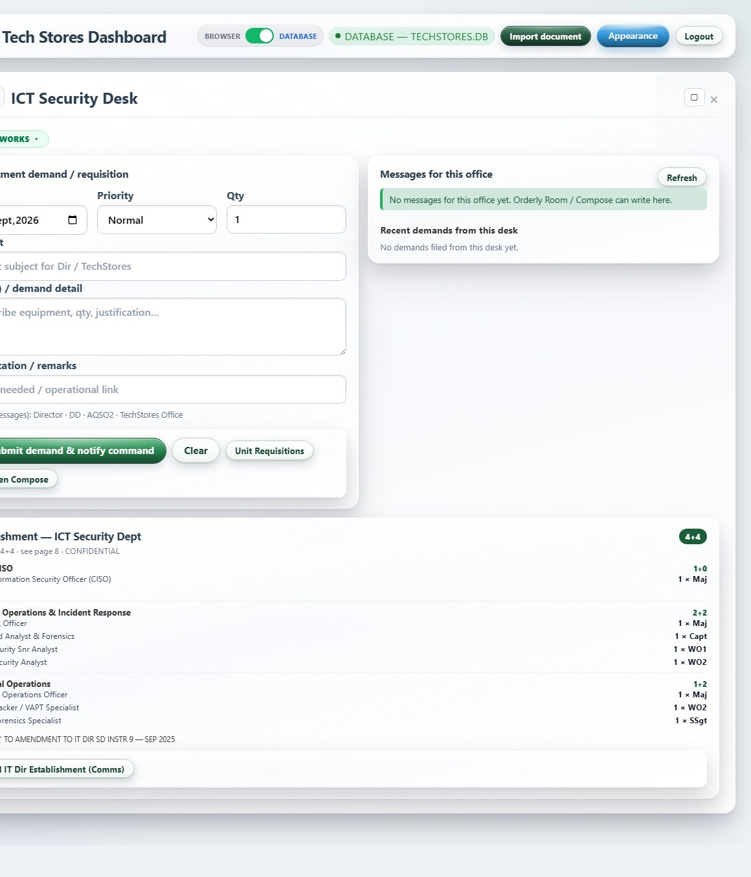
Dept Desk - ICT Security
Module: dept-ictsec
What it is: ICT Security desk for security appliances, certificates, and tools.
How it works: Department-specific demand and inbox. Used by OC ICT Security for authorised security-related ICT requirements.

Slide 43
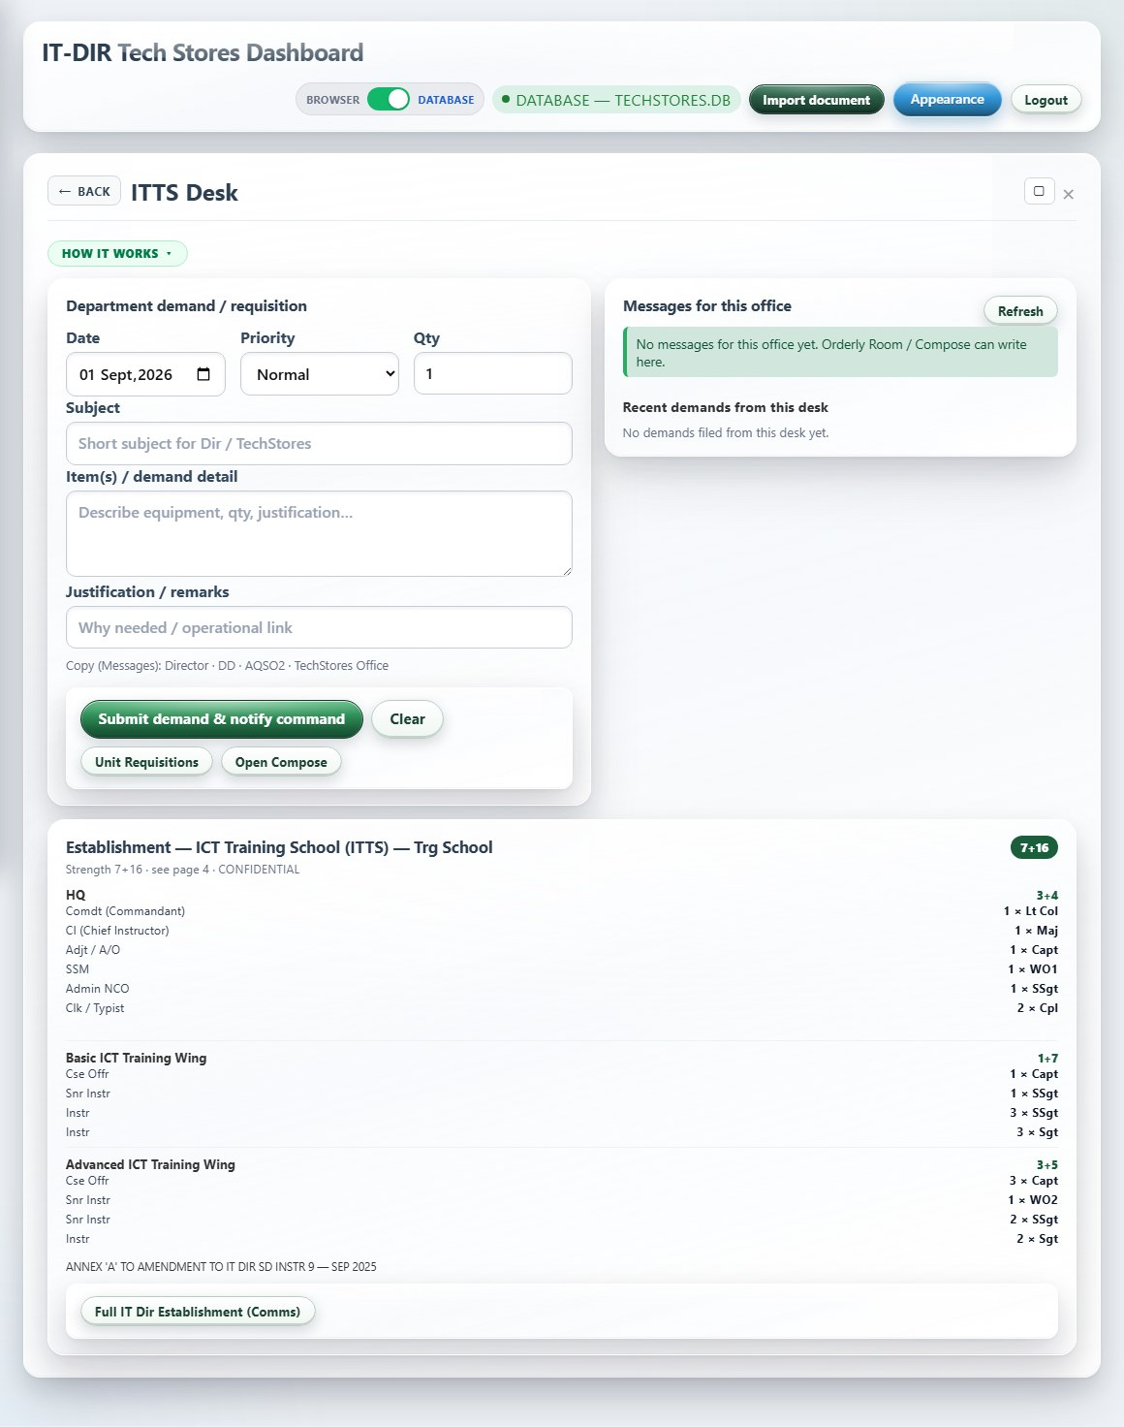
Dept Desk - ITTS
Module: dept-itts
What it is: IT Training School desk for training equipment and media.
How it works: Raise demands for school ICT. Establishment panel shows ITTS posts. Does not expose full stores ledgers.

Slide 44
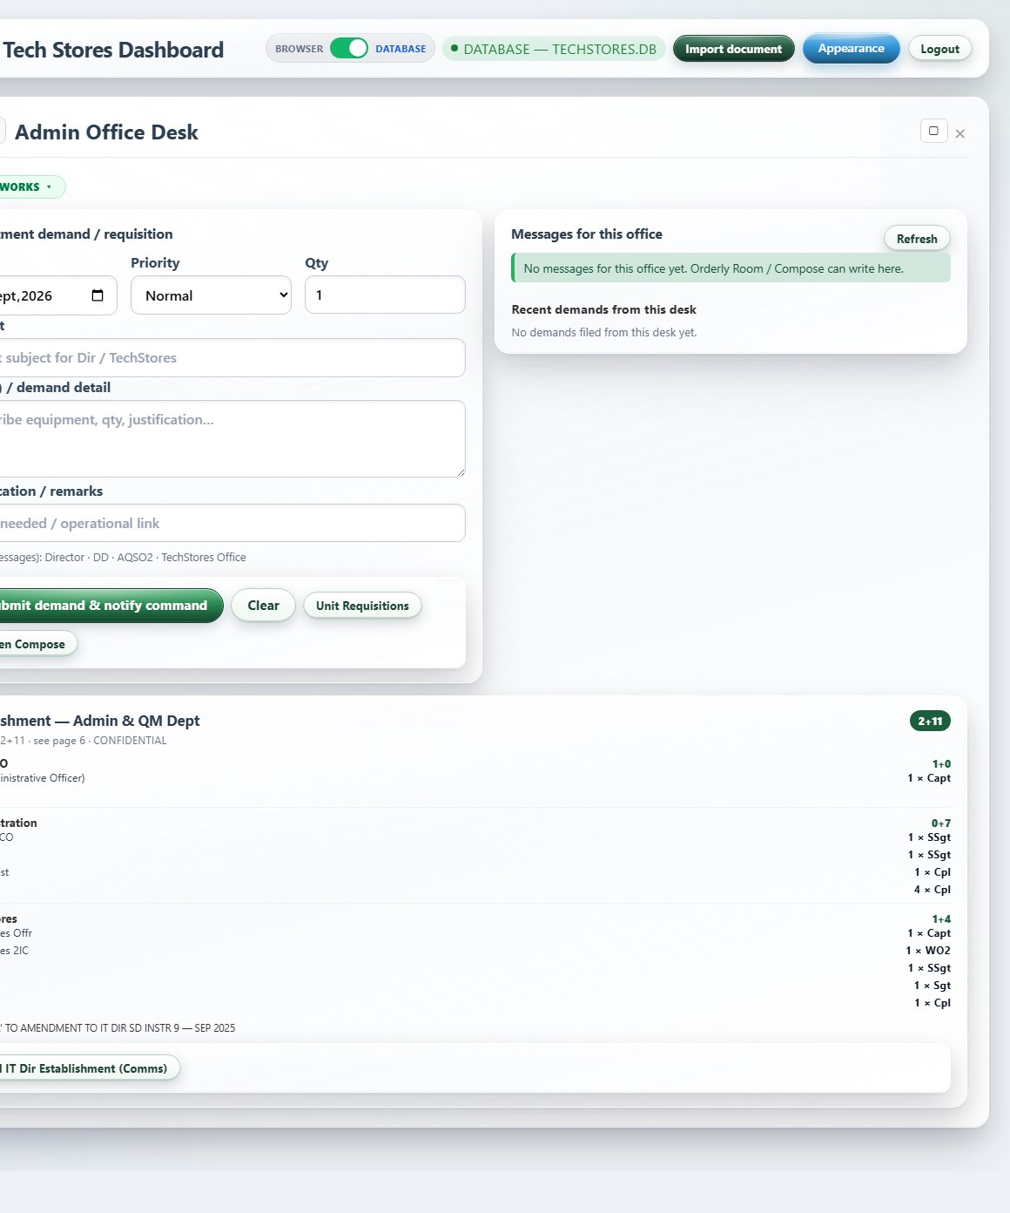
Dept Desk - Admin Office
Module: dept-admin
What it is: Admin Office desk for general admin ICT and internal requirements.
How it works: Demand form and inbox for Admin Office staff. Shortcuts to orderly and comms workflows from role home.

Slide 45
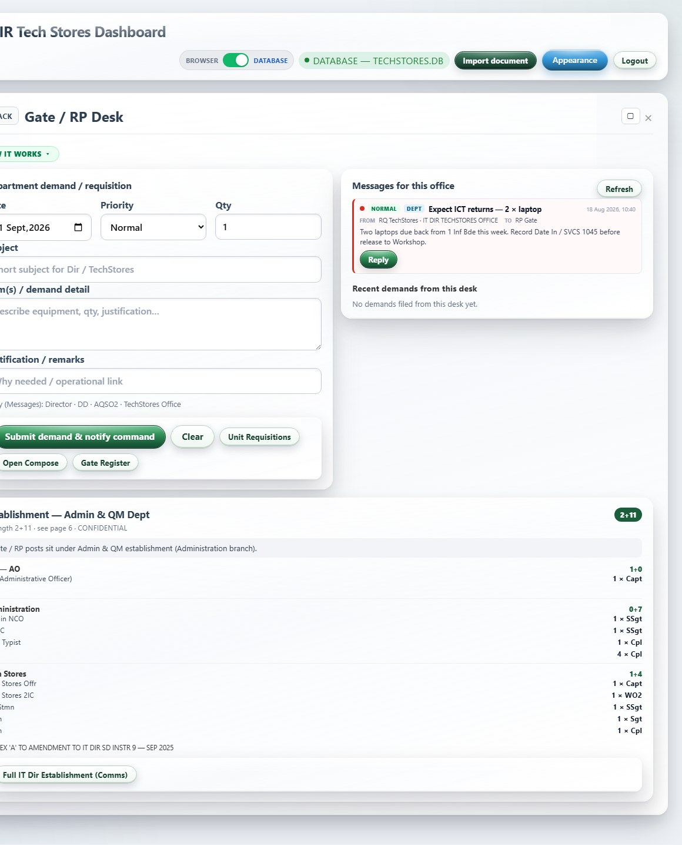
Dept Desk - Gate / RP
Module: dept-gate
What it is: Gate / RP desk for gate equipment demands.
How it works: Links to Gate Register from shortcuts. Used when RP needs to request gate-related ICT items through command channels.

Slide 46
Stakeholder portals

Slide 47
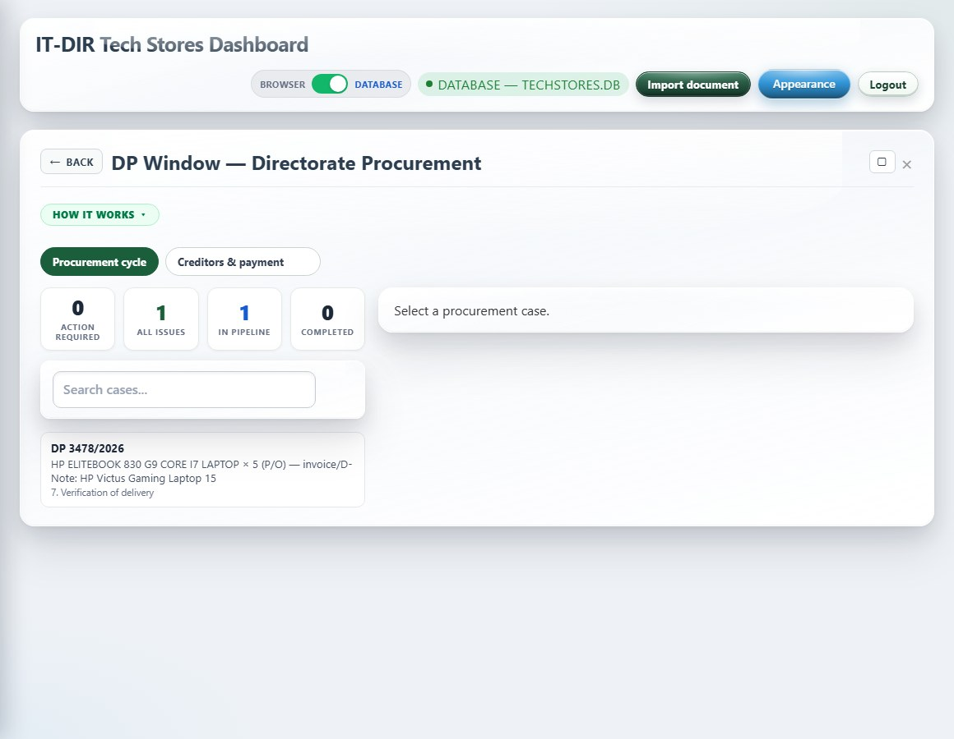
DP Window - procurement portal
Module: stakeholder-desk
What it is: DP Window — Directorate Procurement portal for quotations, adjudication, and PO.
How it works: Case list shows all DP pipeline items. Open a case to upload quotes, record winner, raise PO, hand to AIAD. Summary stats: action, pipeline, done.

Slide 48
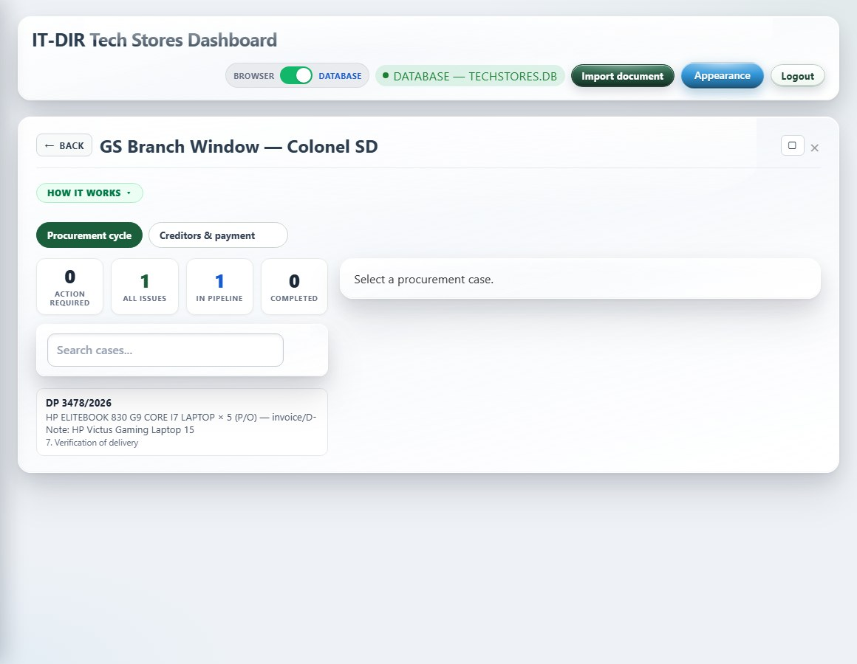
GS Branch Window - F1 endorsement
Module: stakeholder-desk
What it is: GS Branch Window — Colonel SD endorsement of DP F1 forms.
How it works: Queue of cases awaiting GS endorsement. Upload signed endorsement scan. Sees full pipeline from F1 raise onward.

Slide 49
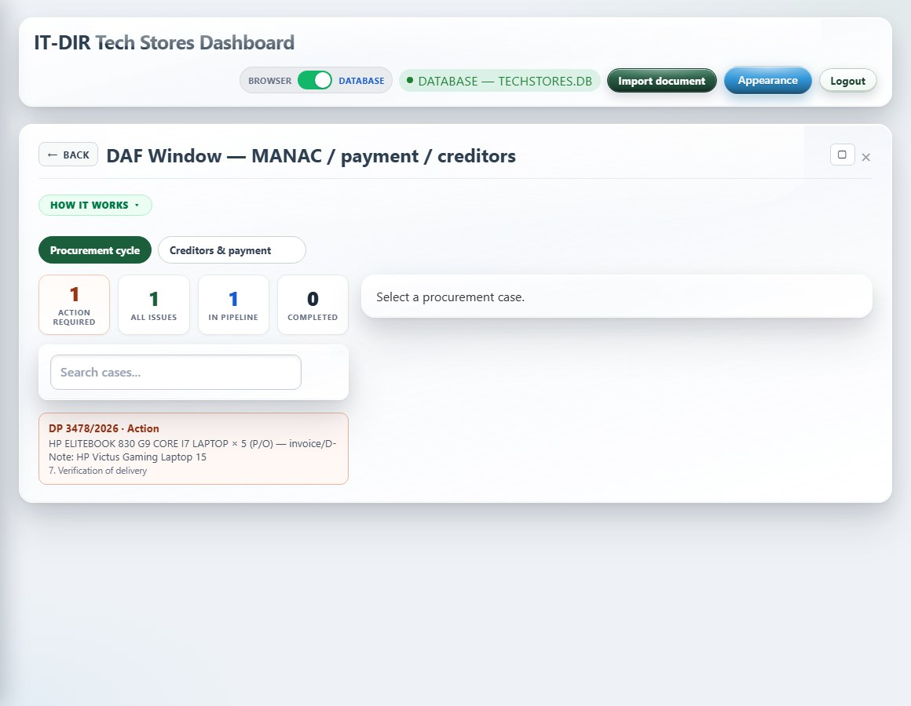
DAF Window - MANAC / supplier payment
Module: stakeholder-desk
What it is: DAF Window — MANAC endorsement and supplier payment tab.
How it works: Endorse F1 for funds (MANAC). Record payment vouchers after delivery inspection. First tab of DAF portal.

Slide 50
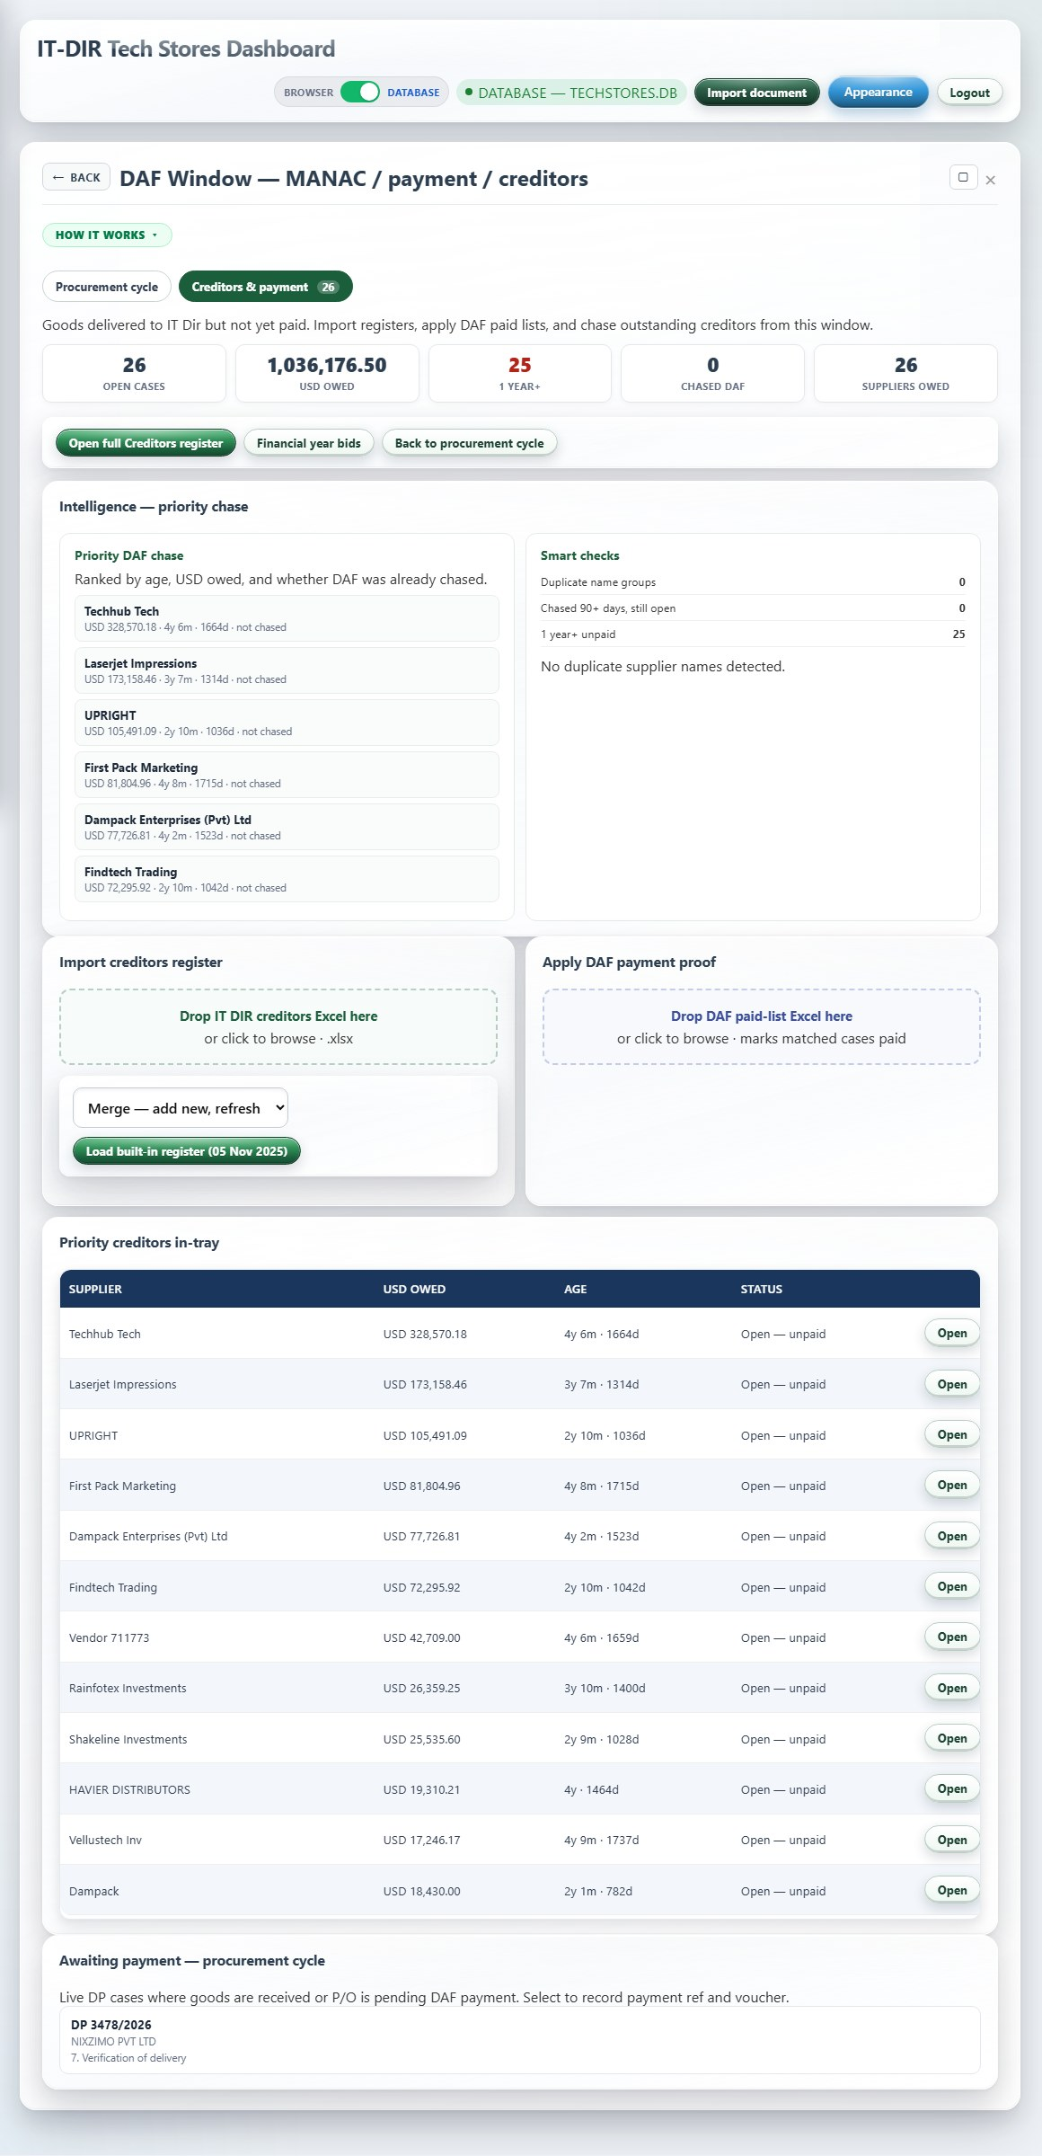
DAF Window - Creditors import & chase
Module: stakeholder-desk
What it is: DAF Window — Creditors tab for import and payment chase.
How it works: Import DAF creditor/paid lists via drag-drop. Match to TechStores Creditors register. Pay queue links to supplier debts records.

Slide 51
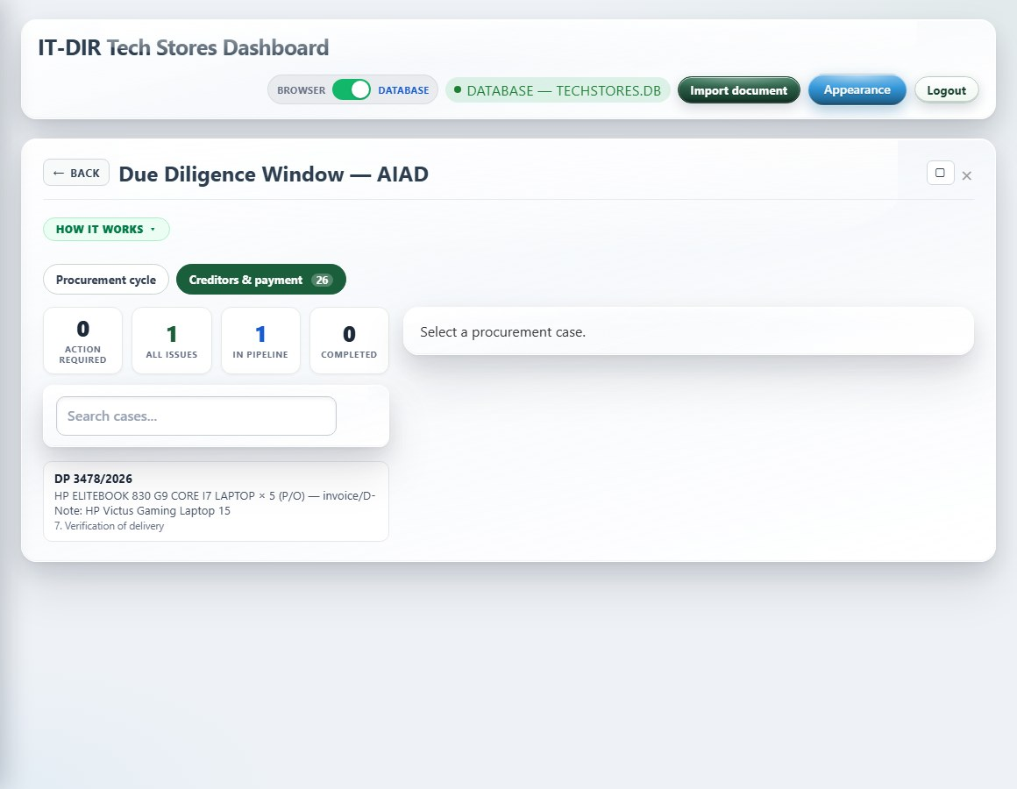
Due Diligence Window - AIAD
Module: stakeholder-desk
What it is: Due Diligence Window — AIAD price audit before contract award.
How it works: Review F1, spec, and quotes. Issue Price Due Diligence certificate. Upload signed certificate. Full AIAD pipeline visible.

Slide 52
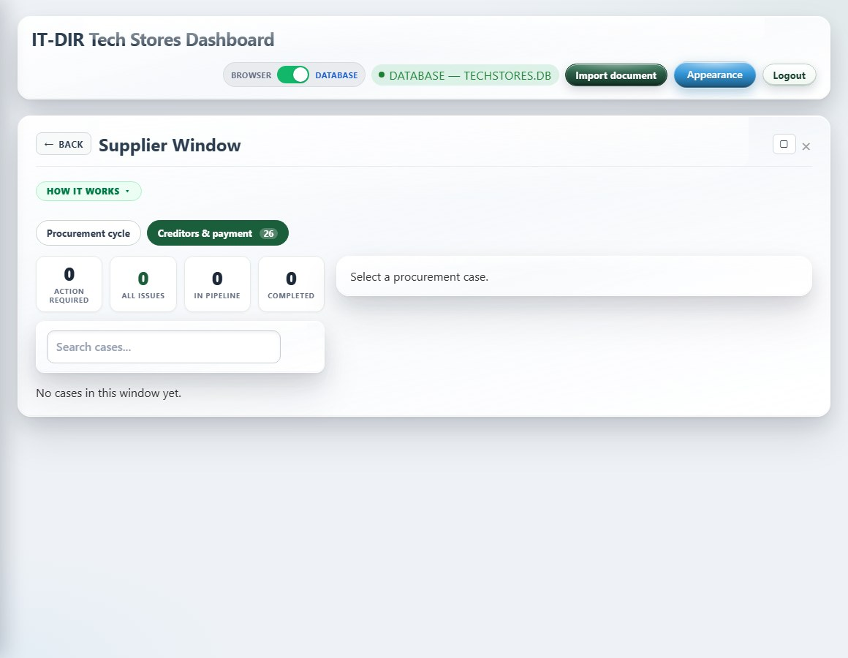
Supplier Window
Module: stakeholder-desk
What it is: Supplier Window — Nixzimo and registered suppliers respond to RFQs and POs.
How it works: See assigned cases only. Upload quotation, spec compliance, delivery note, invoice, banking. No access to internal ledgers.

Slide 53
General ledger & stores

Slide 54
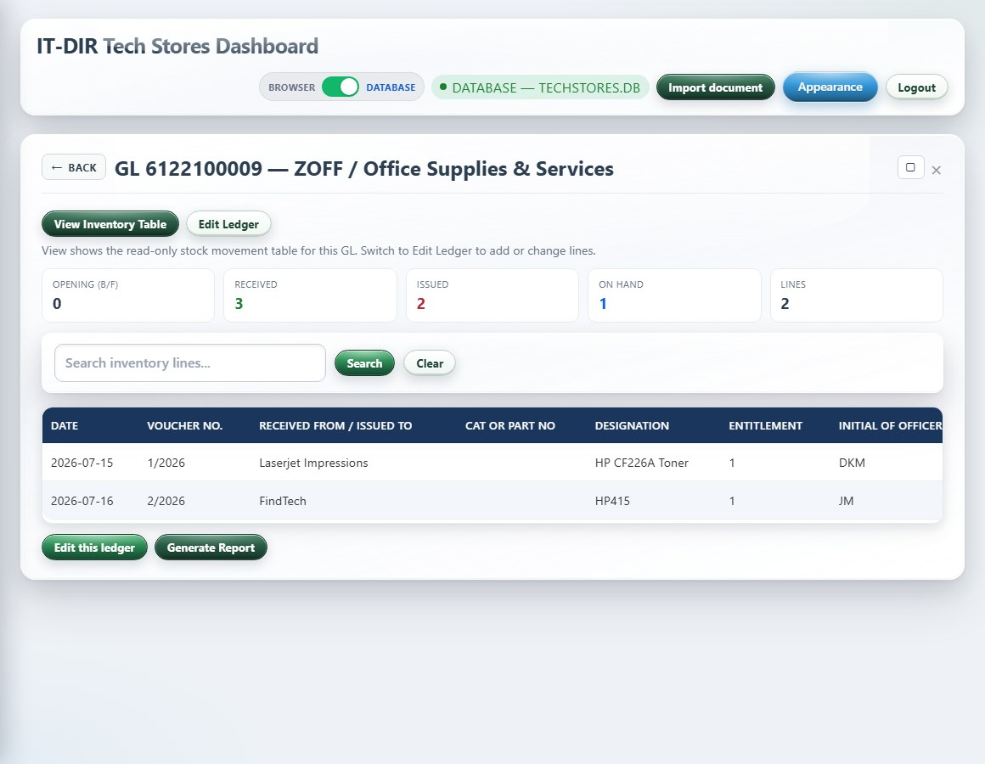
GL 6122100009 - ZOFF / Office Supplies & Services
Module: gl-2200600002
What it is: GL vote for office supplies and services (ZOFF / 6122100009).
How it works: Track monthly target, receipts, issues, and balance for this vote. Store officer edits; directorate roles view-only. Feeds dashboard KPIs.

Slide 55
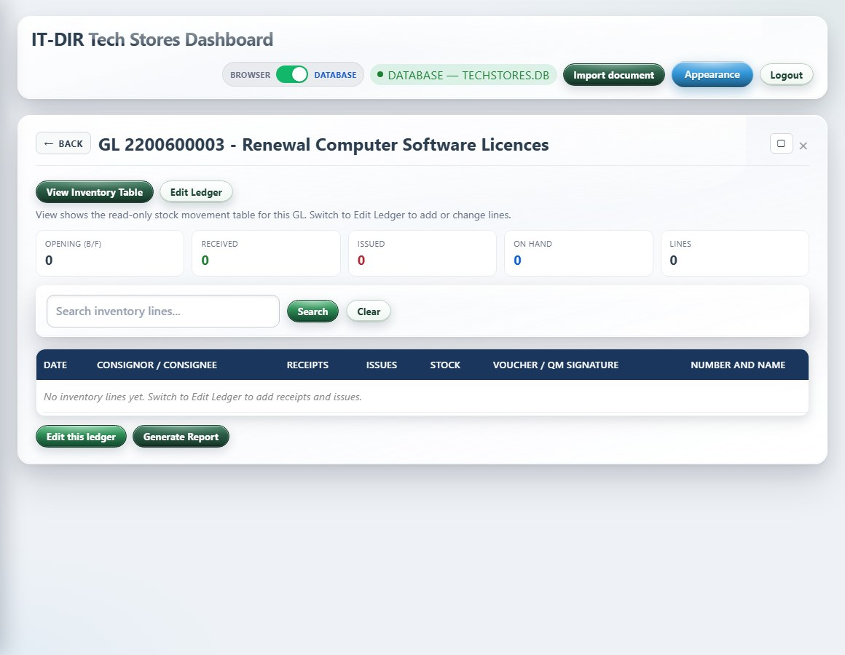
GL 2200600003 - Software Licenses
Module: gl-2200600003
What it is: GL vote for software licences.
How it works: Records licence purchases and issues against the software vote. Used when procuring or issuing licensed software.

Slide 56
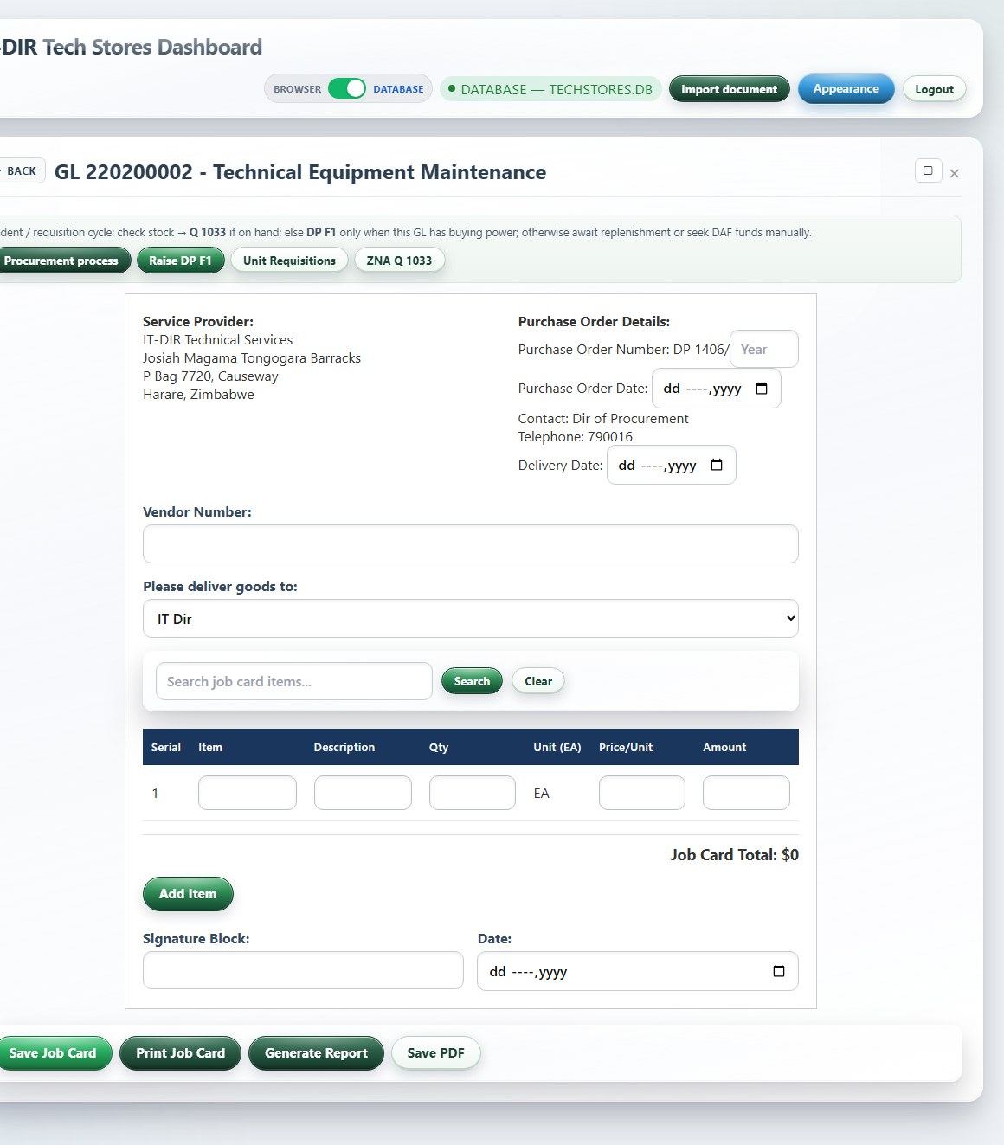
GL 220200002 - Tech Equipment Maintenance
Module: gl-220200002
What it is: GL vote for tech equipment maintenance contracts and spend.
How it works: Tracks maintenance-related expenditure and movements for ICT equipment upkeep.

Slide 57
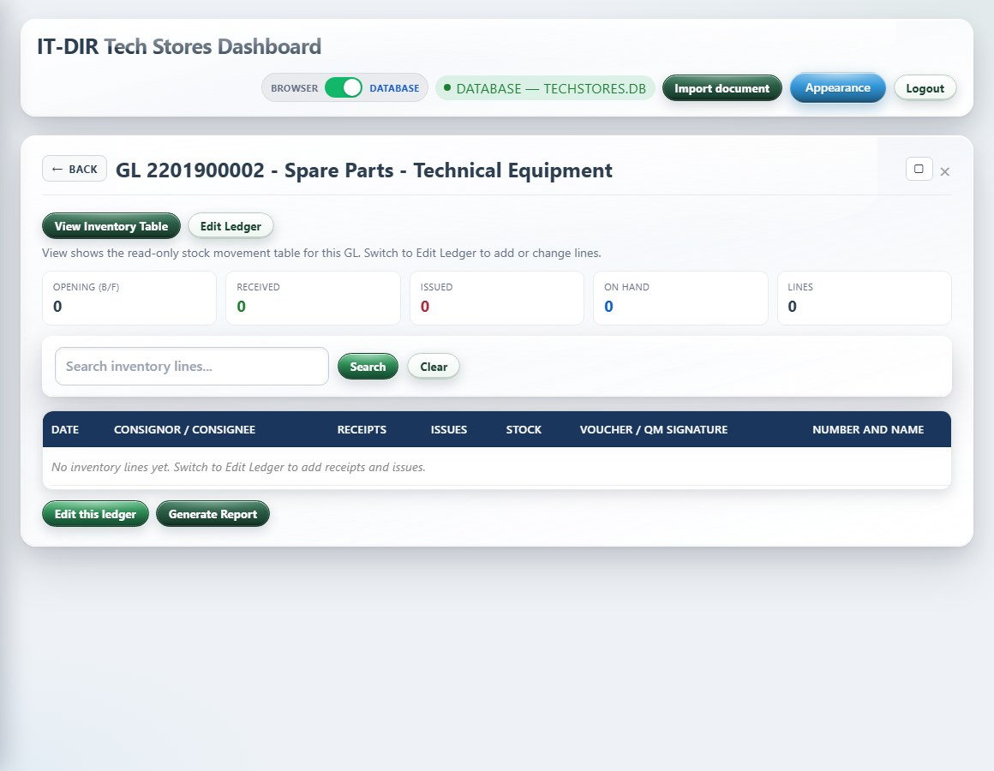
GL 2201900002 - Spare Parts
Module: gl-2201900002
What it is: GL vote for spare parts and consumables.
How it works: Ledger for spare parts issues and receipts linked to workshop and stores operations.

Slide 58
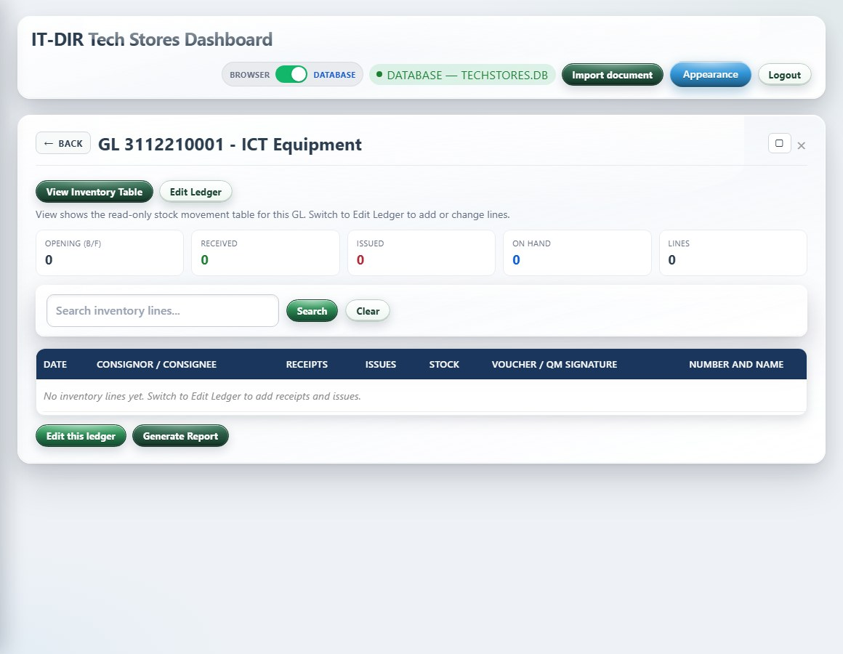
GL 3112210001 - ICT Equipment
Module: gl-3112210001
What it is: GL vote for ICT equipment capital purchases.
How it works: Primary capital vote for laptops, desktops, servers, and major ICT buys. Links to procurement and accountability registers.

Slide 59
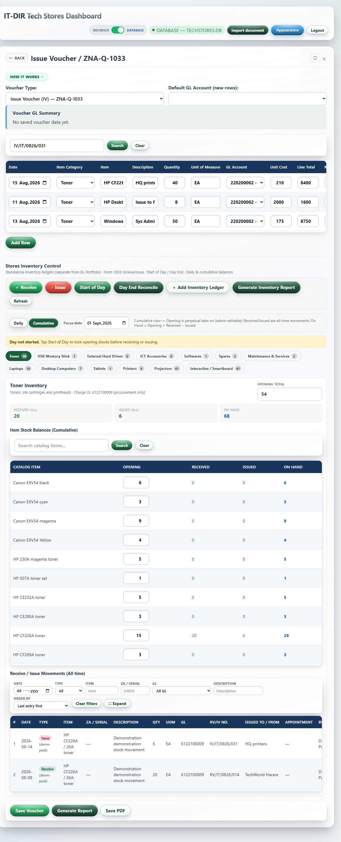
Issue Voucher / ZNA-Q-1033
Module: voucher-module
What it is: Shortcut to ZNA Q 1033 Issue and Receipt Voucher — the main daily stores movement form.
How it works: Same form as zna-q-1033. Storeman selects items from catalog, records issue/receipt, prints voucher. Updates stock balances.

Slide 60

Stock Take - Full Stores Inventory
Module: stock-take
What it is: Full stores inventory count and variance recording.
How it works: Start a stock take, enter counted quantities, compare to system balance, and record discrepancies. Supports print/export of results.

Slide 61

Unit Check Log - ASO Ch 28
Module: unit-checks
What it is: Unit check log per ASO Chapter 28 requirements.
How it works: Record periodic checks of stores held at units/formations. Audit trail for compliance visits.

Slide 62

Inventory of Accommodation Stores
Module: accommodation-stores
What it is: Inventory of accommodation stores (non-ICT accommodation items).
How it works: Separate ledger for accommodation store items. Same movement patterns as main stores where applicable.

Slide 63
Financial Year Bids
Module: financial-year-bids
What it is: Annual financial year bid submissions and vote planning.
How it works: Enter bid lines per GL vote for the upcoming FY. Used by TechStores and DAF for planning. Import/export bid packs.

Slide 64
Equipment, loans & returns

Slide 65

Unit Equipment
Module: unit-equipment
What it is: Unit-level equipment holdings summary.
How it works: View equipment allocated to units/formations. Supports reconciliation with ICT accountability and distribution lists.

Slide 66

ZNA ICT Asset Register
Module: ict-accountability
What it is: ZNA ICT Asset Register — equipment accountability by unit and holder.
How it works: Add/edit assets with ZA number, unit, holder, and status. Filter by unit. Struck-off and transfer actions. Core audit register.

Slide 67

ICT Equipment Distribution Lists
Module: ict-distribution
What it is: ICT equipment distribution lists for bulk issues to units.
How it works: Manage named distribution waves (e.g. laptop programmes). Track which units received which tranche.

Slide 68

Temporary Loans - Controlled Stores
Module: temporary-loans
What it is: Temporary loans of controlled stores (typically 14-day limit).
How it works: Issue on loan with return date. Alerts when overdue. Separate from permanent loans and Q 1033 permanent issues.

Slide 69

Permanent Loans - Laptops & iPads
Module: permanent-loans
What it is: Permanent loans of laptops and iPads under Comd/34 authority.
How it works: Long-term personal issue register. Tracks holder, unit, and loan authority. Distinct from temporary loans.

Slide 70

Monthly Returns - Unit ICT Equipment
Module: monthly-returns
What it is: Monthly returns of unit ICT equipment status.
How it works: Units report equipment held, serviceability, and changes each month. TechStores consolidates for command returns.

Slide 71

TechStores Equipment Register
Module: techstores-equipment-register
What it is: TechStores equipment register — internal equipment asset list.
How it works: Catalogue of equipment types and serials held by TechStores. Complements ICT accountability for store-held stock.

Slide 72
Procurement & creditors

Slide 73

Requisitions - In-tray
Module: unit-requisitions
What it is: Requisitions in-tray — incoming unit and formation requests.
How it works: Units submit requirements; TechStores triages, endorses, or converts to procurement. Age strip shows backlog. Links to PFMS numbers.

Slide 74

Import Document
Module: doc-import
What it is: Import document — upload or paste scans to auto-fill forms.
How it works: Drop PDF/image or paste text. Server parses minute, quotation, PO, F1, spec, or D-note and applies fields to the matching module.

Slide 75

DP F1 Form
Module: dp-f1-form
What it is: DP F1 ITDIR Form — official authority to procure ICT items.
How it works: Complete F1 indent, attach spec, route through GS endorsement and DAF MANAC. Print official layout. Central procurement document.

Slide 76

Cost Comparative Schedule
Module: cost-comparative-schedule
What it is: Cost comparative schedule — grid comparing vendor prices for the same requirement.
How it works: Enter vendor columns and line prices. Supports AIAD due diligence and DP adjudication. Print for file.

Slide 77

Spec/Tech Evaluation
Module: spec-evaluation
What it is: Specification and technical evaluation of supplier quotations.
How it works: Score quotes against required spec. Record evaluation committee findings. Used before DP adjudication and AIAD diligence.

Slide 78

Rough Guide Quotation
Module: guide-quotation
What it is: Rough guide quotation — quick cost estimate before formal quotes.
How it works: Build indicative pricing from catalog and benchmarks. Used early in procurement planning. Not a formal DP document.

Slide 79

ICT Procurement Cycle
Module: dp-procurement
What it is: ICT Procurement Cycle — eight-step tracker for every DP case.
How it works: Each case moves F1 → GS → MANAC → quote → eval → PO → delivery → payment. Status filters and case detail. All portals read this pipeline.

Slide 80

Purchase Orders
Module: purchase-orders
What it is: Purchase order register — electronic and manual/DAF POs.
How it works: Create and track POs through the procurement cycle. Upload signed PO scans. Supplier portal sees assigned POs.

Slide 81

Delivery Note
Module: delivery-note
What it is: Supplier delivery note capture for goods inward.
How it works: Record delivery note details against PO/supplier. Supports doc import from scanned D-note. Feeds Creditors when unpaid.

Slide 82

Undelivered Items
Module: undelivered-orders
What it is: Orders placed with suppliers but goods not yet received.
How it works: Track PO lines awaiting delivery. Age analysis and chase actions. Links to procurement cycle and Creditors when goods arrive.

Slide 83

Creditors - non-paid goods / DAF payment register
Module: supplier-debts
What it is: Creditors register — goods received but not yet paid.
How it works: Record GRN against supplier, amount, age of debt. DAF chases payment. Import DAF creditor lists. Intelligence panel flags duplicates.

Slide 84

Suppliers and Contracts
Module: suppliers-contracts
What it is: Suppliers and contracts register.
How it works: Maintain supplier master data, contracts, and banking details. Used when raising POs and supplier portal routing.

Slide 85
Workshop & compare tools

Slide 86

Workshop Register
Module: workshop-repairs
What it is: Workshop Register — repairs intake, status, and completion.
How it works: Log faulty equipment, track repair progress, assign technician. Links to receipt cert on return. Workshop role primary screen.

Slide 87

Workshop Receipt Certificate
Module: workshop-receipt-cert
What it is: Workshop receipt certificate for repaired items returned to holder.
How it works: Certify workshop completed repair and item returned. Print certificate. Links to Workshop Register repair record.

Slide 88

Laptop Compare - buy the winner
Module: laptop-compare
What it is: Laptop Compare — rank catalog laptops by duty profile and pick the best buy.
How it works: Select duty profile (e.g. HQ staff, field). System scores RAM, CPU, price. Recommended buy banner and bar chart. For workshop/procurement.

Slide 89

H2H ICT Comparison - crawl & compare
Module: ict-compare
What it is: H2H ICT Comparison — crawl web specs and compare machines head-to-head.
How it works: Search category, select up to several models, side-by-side spec table with winner highlighting. Buy-score chart ranks value for duty.

Slide 90

Gate Register (RP)
Module: gate-register
What it is: Gate Register — ICT equipment in/out at the Directorate gate (RP).
How it works: Record serial, holder, direction in/out, timestamps. Shows equipment still on site. RP Gate role primary screen.

Slide 91
ZNA Q forms index

Slide 92

SUMMARY OF Q FORMS - Index
Module: zna-q-forms-index
What it is: Index of all ZNA Q and SVCS forms — implemented and reference-only.
How it works: Browse ASO form catalogue. Green links open fillable modules; grey entries are paper-only reference. Storeman primary entry to Q forms.

Slide 93
ZNA Q & SVCS forms

Slide 94

ZNA Q 982 - Combined Indent
Module: zna-q-982
What it is: Digital ZNA Q 982: Combined indent and voucher for stores. Official stores form in Annex A Sec 1 Ch 7 layout.
How it works: Complete fields on screen, Save stores to database, Print for signature/file. Open from ZNA Q submenu or storeman home. Doc Import can pre-fill from scanned copies.

Slide 95

ZNA Q 178 - Sub Ledger Sheet
Module: zna-q-178
What it is: Digital ZNA Q 178: Ledger (sub / distribution ledger sheet). Official stores form in Annex A Sec 1 Ch 7 layout.
How it works: Complete fields on screen, Save stores to database, Print for signature/file. Open from ZNA Q submenu or storeman home. Doc Import can pre-fill from scanned copies.

Slide 96

ZNA Q 1033 - Issue & Receipt Voucher
Module: zna-q-1033
What it is: Digital ZNA Q 1033: Issue and receipt voucher (large and small). Official stores form in Annex A Sec 1 Ch 7 layout.
How it works: Complete fields on screen, Save stores to database, Print for signature/file. Open from ZNA Q submenu or storeman home. Doc Import can pre-fill from scanned copies.

Slide 97

ZNA Q 1043 - Condemnation Certificate
Module: zna-q-1043
What it is: Digital ZNA Q 1043: Report on stores and condemnation certificate. Official stores form in Annex A Sec 1 Ch 7 layout.
How it works: Complete fields on screen, Save stores to database, Print for signature/file. Open from ZNA Q submenu or storeman home. Doc Import can pre-fill from scanned copies.

Slide 98

ZNA Q 80 - Ledger Sheet
Module: zna-q-80
What it is: Digital ZNA Q 80: Schedule of stores boarded / Ledger sheet. Official stores form in Annex A Sec 1 Ch 7 layout.
How it works: Complete fields on screen, Save stores to database, Print for signature/file. Open from ZNA Q submenu or storeman home. Doc Import can pre-fill from scanned copies.

Slide 99

ZNA SVCS/890 - Demand / Issue
Module: zna-svcs-890
What it is: Digital ZNA SVCS 890: Demand / Issue. Official stores form in Annex A Sec 1 Ch 7 layout.
How it works: Complete fields on screen, Save stores to database, Print for signature/file. Open from ZNA Q submenu or storeman home. Doc Import can pre-fill from scanned copies.

Slide 100

ZNA Q 1179 - Clothing Issue Voucher
Module: zna-q-1179
What it is: Digital ZNA Q 1179: Clothing and necessaries issue voucher. Official stores form in Annex A Sec 1 Ch 7 layout.
How it works: Complete fields on screen, Save stores to database, Print for signature/file. Open from ZNA Q submenu or storeman home. Doc Import can pre-fill from scanned copies.

Slide 101

ZNA Q 987 - Stocktaking Certificate
Module: zna-q-987
What it is: Digital ZNA Q 987: Certificate of stocktaking. Official stores form in Annex A Sec 1 Ch 7 layout.
How it works: Complete fields on screen, Save stores to database, Print for signature/file. Open from ZNA Q submenu or storeman home. Doc Import can pre-fill from scanned copies.

Slide 102

ZNA Q 3977 - Neglect / Damage Report
Module: zna-q-3977
What it is: Digital ZNA Q 3977: Equipment/vehicle neglect, misuse and damage report. Official stores form in Annex A Sec 1 Ch 7 layout.
How it works: Complete fields on screen, Save stores to database, Print for signature/file. Open from ZNA Q submenu or storeman home. Doc Import can pre-fill from scanned copies.

Slide 103

ZNA Q 1157 - Clothing & Equipment Record
Module: zna-q-1157
What it is: Digital ZNA Q 1157: Clothing and personal equipment record. Official stores form in Annex A Sec 1 Ch 7 layout.
How it works: Complete fields on screen, Save stores to database, Print for signature/file. Open from ZNA Q submenu or storeman home. Doc Import can pre-fill from scanned copies.

Slide 104

ZNA Q 985 - Discrepancy Report
Module: zna-q-985
What it is: Digital ZNA Q 985: Discrepancy report. Official stores form in Annex A Sec 1 Ch 7 layout.
How it works: Complete fields on screen, Save stores to database, Print for signature/file. Open from ZNA Q submenu or storeman home. Doc Import can pre-fill from scanned copies.

Slide 105

ZNA Q 1 - Stores lost/damaged write-off
Module: zna-q-1
What it is: Digital ZNA Q 1: Statement of stores lost or damaged to be written off. Official stores form in Annex A Sec 1 Ch 7 layout.
How it works: Complete fields on screen, Save stores to database, Print for signature/file. Open from ZNA Q submenu or storeman home. Doc Import can pre-fill from scanned copies.

Slide 106

ZNA Q 998 - Loss / Damage / Destruction
Module: zna-q-998
What it is: Digital ZNA Q 998: Statement of loss, damage or destruction. Official stores form in Annex A Sec 1 Ch 7 layout.
How it works: Complete fields on screen, Save stores to database, Print for signature/file. Open from ZNA Q submenu or storeman home. Doc Import can pre-fill from scanned copies.

Slide 107

ZNA Q 1680 - Miscellaneous credit/debit voucher
Module: zna-q-1680
What it is: Digital ZNA Q 1680: Miscellaneous credit/debit voucher. Official stores form in Annex A Sec 1 Ch 7 layout.
How it works: Complete fields on screen, Save stores to database, Print for signature/file. Open from ZNA Q submenu or storeman home. Doc Import can pre-fill from scanned copies.

Slide 108

ZNA Q 3 - Issue on repayment
Module: zna-q-3
What it is: Digital ZNA Q 3: Issue to a Government department on repayment. Official stores form in Annex A Sec 1 Ch 7 layout.
How it works: Complete fields on screen, Save stores to database, Print for signature/file. Open from ZNA Q submenu or storeman home. Doc Import can pre-fill from scanned copies.

Slide 109

ZNA Q 31 - Cash purchase / receipt
Module: zna-q-31
What it is: Digital ZNA Q 31: Cash purchase/receipt. Official stores form in Annex A Sec 1 Ch 7 layout.
How it works: Complete fields on screen, Save stores to database, Print for signature/file. Open from ZNA Q submenu or storeman home. Doc Import can pre-fill from scanned copies.

Slide 110

ZNA Q 40 - Artisan tools list
Module: zna-q-40
What it is: Digital ZNA Q 40: Artisan tools list. Official stores form in Annex A Sec 1 Ch 7 layout.
How it works: Complete fields on screen, Save stores to database, Print for signature/file. Open from ZNA Q submenu or storeman home. Doc Import can pre-fill from scanned copies.

Slide 111

ZNA Q 1049 - Transfer voucher
Module: zna-q-1049
What it is: Digital ZNA Q 1049: Transfer voucher. Official stores form in Annex A Sec 1 Ch 7 layout.
How it works: Complete fields on screen, Save stores to database, Print for signature/file. Open from ZNA Q submenu or storeman home. Doc Import can pre-fill from scanned copies.

Slide 112

ZNA Q 1229 - Accidental breakage certificate
Module: zna-q-1229
What it is: Digital ZNA Q 1229: Certificate of accidental breakage. Official stores form in Annex A Sec 1 Ch 7 layout.
How it works: Complete fields on screen, Save stores to database, Print for signature/file. Open from ZNA Q submenu or storeman home. Doc Import can pre-fill from scanned copies.

Slide 113

ZNA Q 1571 - Debit voucher
Module: zna-q-1571
What it is: Digital ZNA Q 1571: Debit voucher. Official stores form in Annex A Sec 1 Ch 7 layout.
How it works: Complete fields on screen, Save stores to database, Print for signature/file. Open from ZNA Q submenu or storeman home. Doc Import can pre-fill from scanned copies.

Slide 114

ZNA Q 1954 - Recoveries from individuals
Module: zna-q-1954
What it is: Digital ZNA Q 1954: Recoveries from individuals. Official stores form in Annex A Sec 1 Ch 7 layout.
How it works: Complete fields on screen, Save stores to database, Print for signature/file. Open from ZNA Q submenu or storeman home. Doc Import can pre-fill from scanned copies.

Slide 115

ZNA SVCS 1045 - Workshop Indent
Module: zna-svcs-1045
What it is: Digital ZNA SVCS 1045: Workshop indent. Official stores form in Annex A Sec 1 Ch 7 layout.
How it works: Complete fields on screen, Save stores to database, Print for signature/file. Open from ZNA Q submenu or storeman home. Doc Import can pre-fill from scanned copies.

Slide 116
Administration & help

Slide 117

Duties & Roles
Module: duties-roles
What it is: Duties and roles reference for TechStores organisation.
How it works: Read-only reference of posts, duties, and system role mappings. Used for onboarding and audits.

Slide 118

Learning Centre - Process & Charts
Module: process-guides
What it is: Learning Centre — process charts and procurement cycle guides.
How it works: Visual flowcharts for stores, procurement, and portals. Supplier and staff training material.

Slide 119

System Help / Dictionary
Module: system-help
What it is: System help and dictionary of terms.
How it works: Searchable glossary and how-to notes. Available to all roles including storeman and viewer.

Slide 120

Reports
Module: reports-module
What it is: Reports — export and summary views across registers.
How it works: Generate summary reports from ledgers, loans, procurement, and accountability. Print or copy for command briefs.

Slide 121

User Management
Module: user-management
What it is: User management — admin only.
How it works: Create users, assign roles, reset access. Admin role only. Changes audit-logged.

Slide 122

Release Cut
Module: release-cut
What it is: Release cut — transfer buying power between GL votes.
How it works: Admin tool to move unspent allocation from one vote to another within the FY. Requires authority and audit trail.

