Slide 1
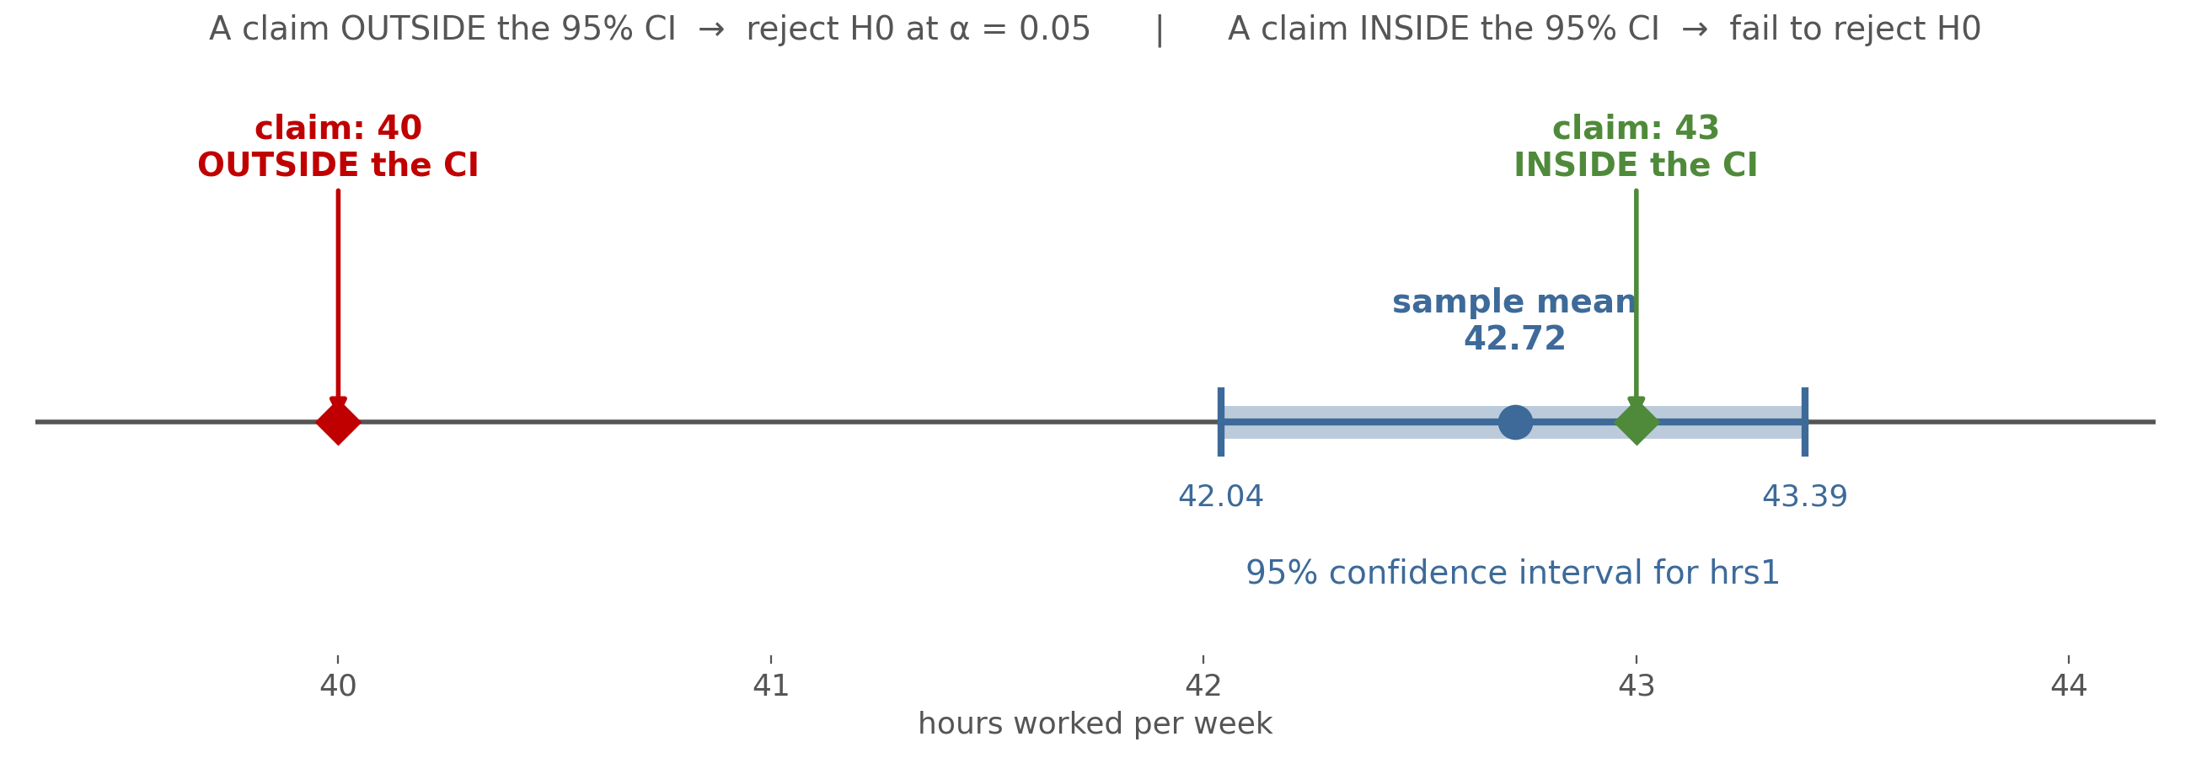
The CI Already Shows the Decision
after slide 7
HW7 used the same sample twice: the claim of 40 falls outside the 95% CI, the claim of 43 falls inside. The tests agree with the picture.
Notes:
INSERT after slide 7. Use while reviewing HW7 Q2. Ask: 'Without any calculation, which claim will we reject?' This also previews why CI and test always agree. Delete the yellow 'insert after' tag before presenting.

Slide 2
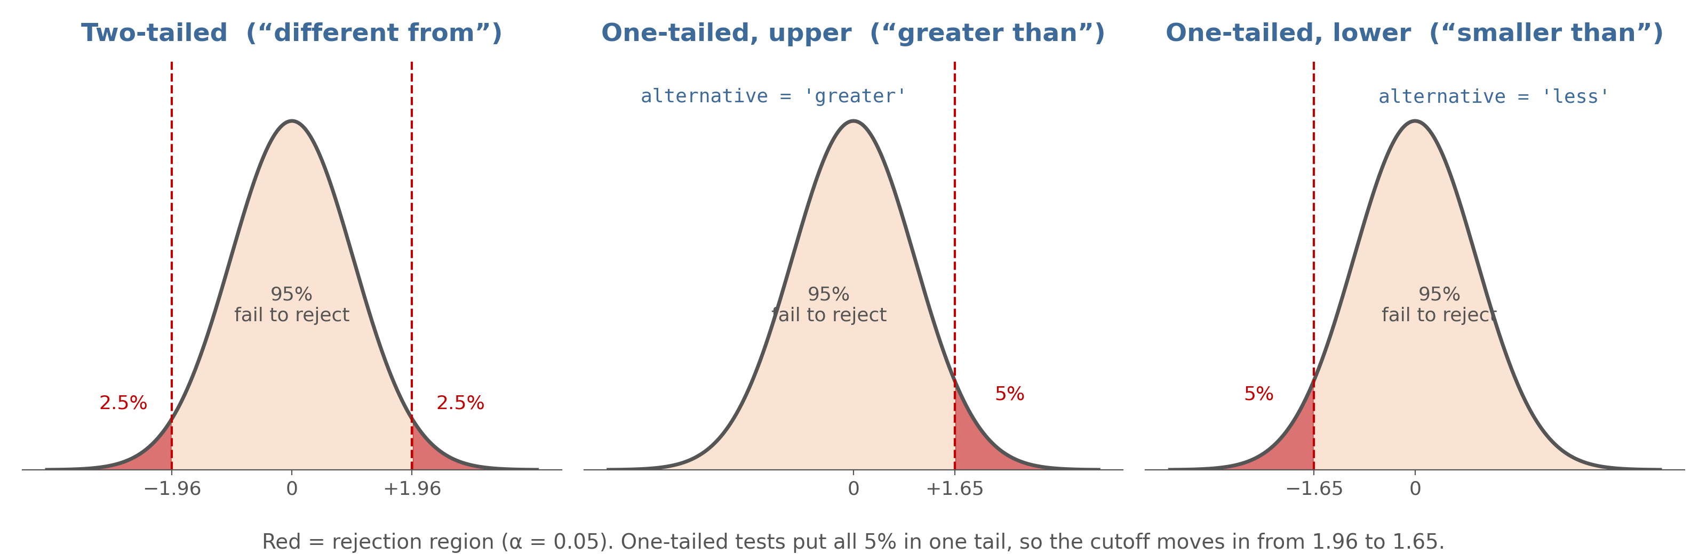
Where the 5% Goes
after slide 12
Same alpha, different shape. Splitting 5% into two tails pushes the cutoff out to 1.96; one tail keeps it at 1.65.
Notes:
INSERT after slide 12. Point to the red regions. Ask: 'Why is 1.65 smaller than 1.96?' Answer: all 5% is in one tail, so you don't have to go as far out. Delete the yellow 'insert after' tag before presenting.

Slide 3
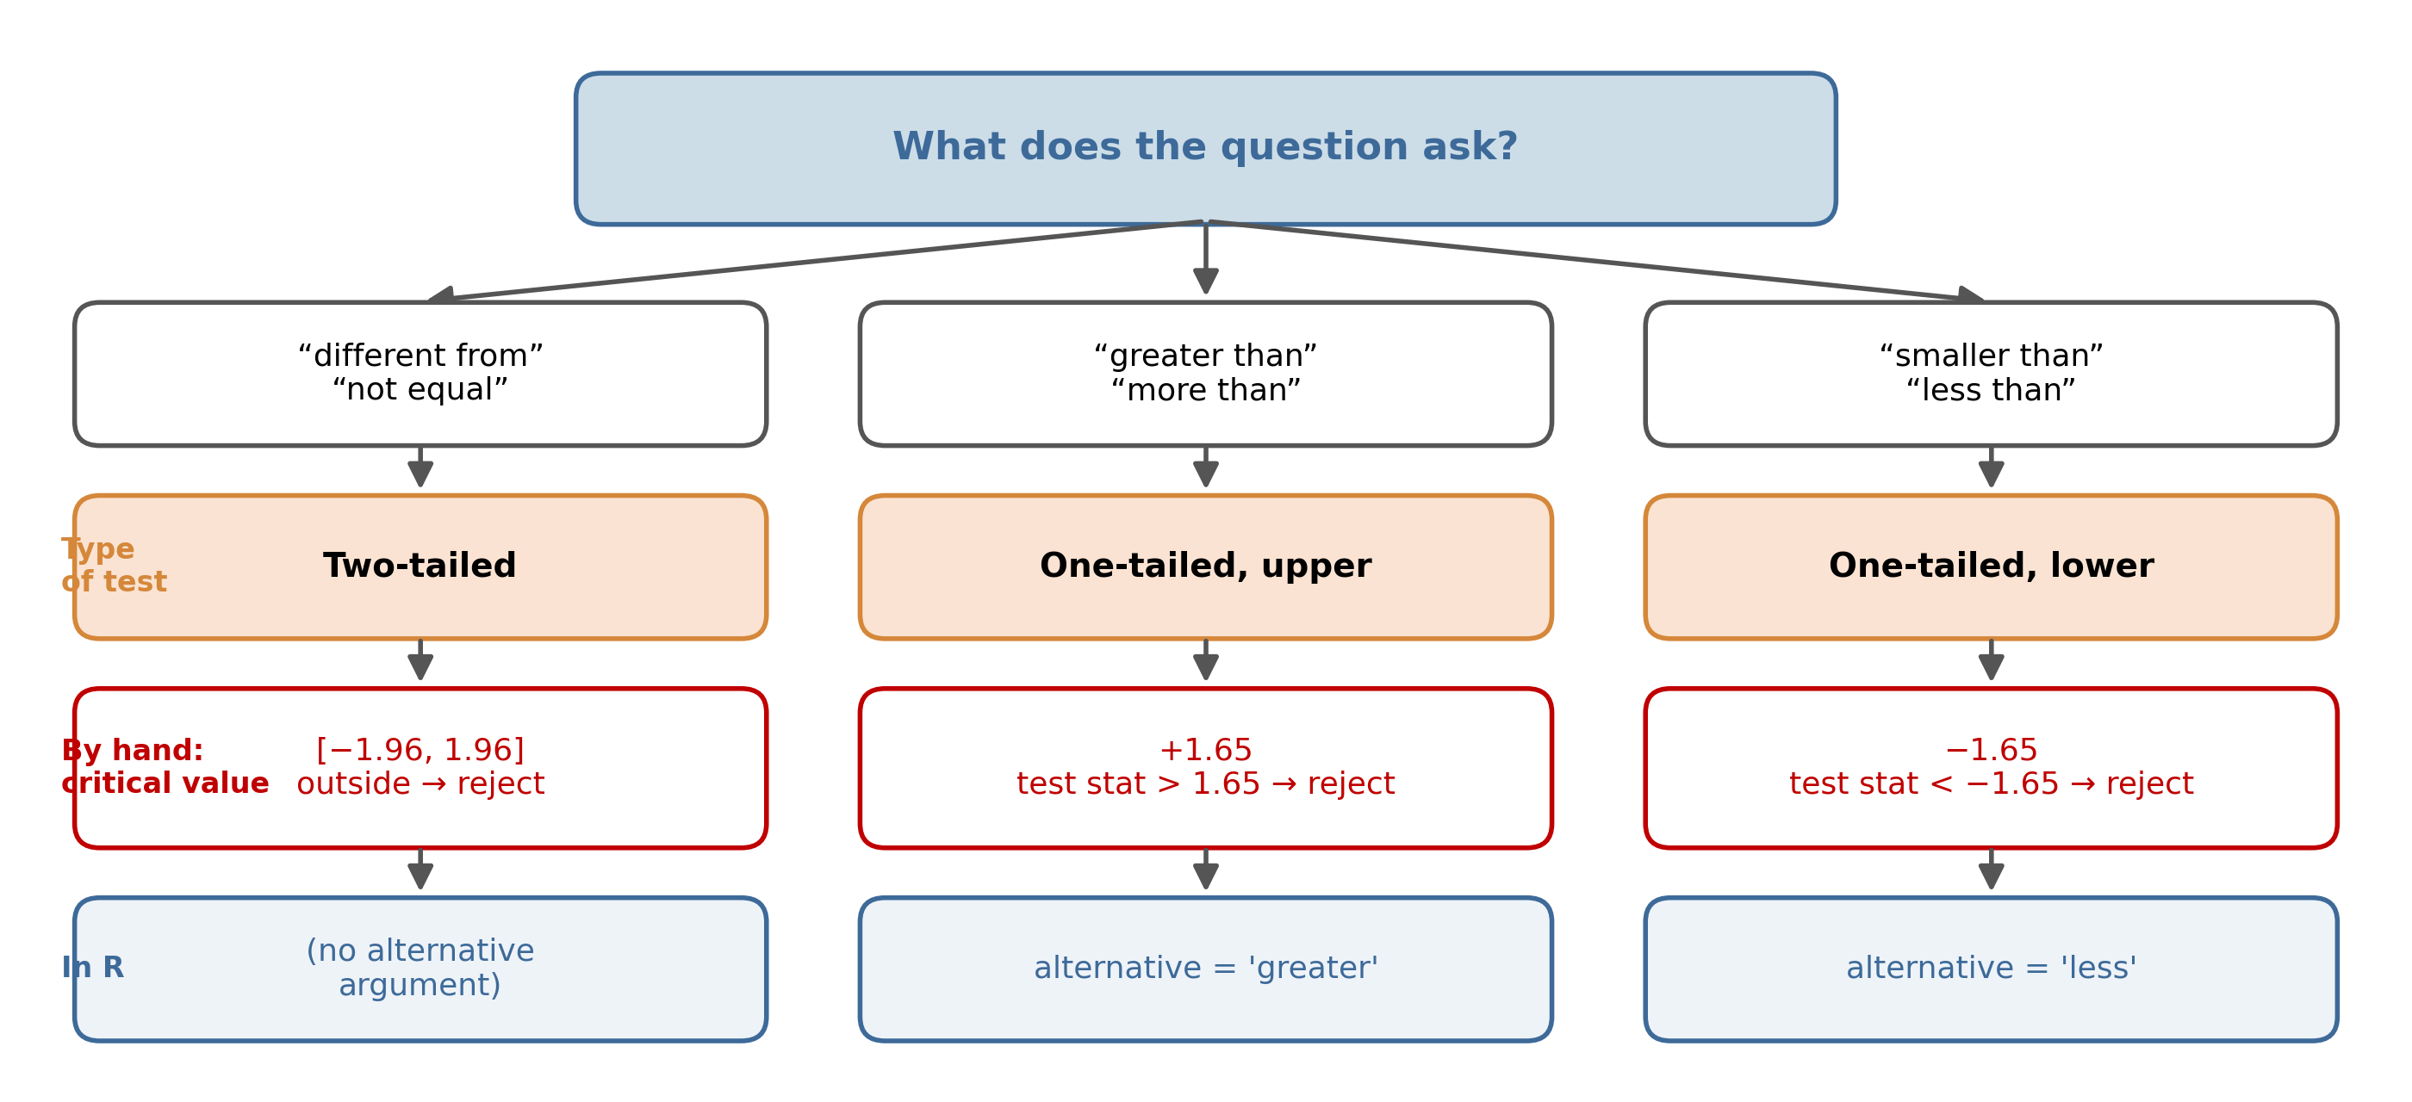
From Question Wording to Test
after slide 13
Read the question's wording first. It decides the type of test, the critical value by hand, and the alternative argument in R.
Notes:
INSERT after slide 13. Walk down one column at a time. Students who get the top box right get everything below it right; the common error is skipping it and defaulting to ±1.96. Delete the yellow 'insert after' tag before presenting.

Slide 4
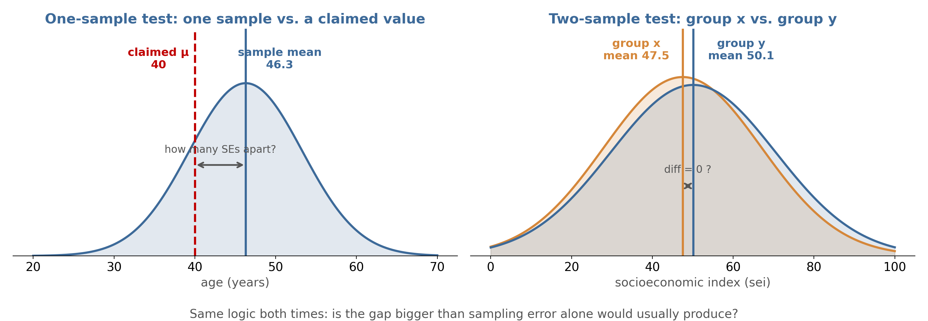
One Sample vs. Two Samples
after slide 15
One-sample: how far is our sample mean from a claimed value? Two-sample: how far apart are two group means? Both ask whether the gap beats sampling error.
Notes:
INSERT after slide 15. Left panel uses the lecture's age example (claimed 40). Right panel uses Demo 2 (sei by sex). Emphasize that 'diff = 0' is the two-sample H0. Delete the yellow 'insert after' tag before presenting.

Slide 5
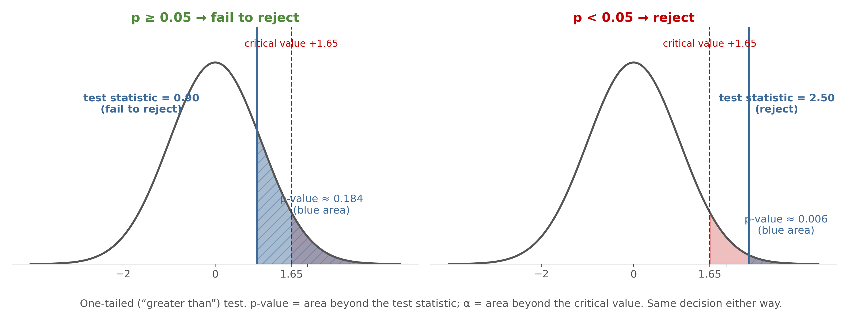
p-value and Alpha Are Areas
after slide 18 (or before slide 20)
The p-value is the area beyond your test statistic; alpha is the area beyond the critical value. If the statistic is past the cutoff, the p-value is smaller than alpha.
Notes:
INSERT after slide 18 (or before slide 20). Values are illustrative (0.90 and 2.50 on a one-tailed test) and deliberately do not match either HW8 question. Use it to connect the by-hand method with the R method. Delete the yellow 'insert after' tag before presenting.

