Slide 1
Lab Section #10: Hypothesis Testing II
Homework 7 review · One-tailed and two-sample tests · Preparing for Homework 8

Slide 2
Today’s Content
Homework 7
Review
Review Concepts
from Lecture
Using Posit Cloud for
Hypothesis Testing
Preparing for
Homework 8

Slide 3
Homework 7 Review
Hypothesis testing by hand, then with R

Slide 4

HW7: What the Assignment Asked
Information R gave you about hrs1:
sd(gss$hrs1) = 10.87884 (sample SD, s)
length(gss$hrs1) = 1000 (sample size, n)
mean(gss$hrs1) = 42.717 (the one line you wrote)
Q1 — by hand: a researcher hypothesized that the American adult population worked 40 hours a week on average in 2006. Population SD unknown. Test at the 0.05 level, all 6 steps.
Q2 — with R: another researcher hypothesized 43 hours. Read the t.test() output and interpret it.
Both are one-sample, two-tailed tests. Keep that in mind: HW8 changes both of those things.

Slide 5
HW7 Q1: Steps 0–2 (by hand)
Work each step with your neighbor before I reveal it.
(0) Organize
Sample: x̄ = 42.717, s = 10.879, n = 1,000.
Population: μ = 40 (claimed), σ unknown.
α = 0.05.
(2) Critical values
n ≥ 100? [?]
Significance level [?]
So the critical value interval is [?]
(1) Hypotheses — TWO comprehensive statements, not just equations
H0: There is no actual difference between the sample mean ([?] hours) and the hypothesized population mean ([?] hours). The hypothesized population mean is likely to be [?] hours → “fail to reject the null hypothesis”.
H1: There is a significant difference between the sample mean and the hypothesized population mean. The hypothesized population mean is likely NOT [?] hours → “reject the null hypothesis”.
Rubric note: “H0: μ = 40” alone is not a full answer. The question asked for two comprehensive statements. Use the interpretation template from Lab 9 slide pps.15-16 .
Notes:
ANSWERS (not on slide): n = 1000 >= 100 -> Z-scores; two-tailed because the claim is 'worked 40 hours' with no direction; critical value interval [-1.96, 1.96]. H0 fills: 42.72 and 40. Professor's wording from Lecture 11 slide 6.

Slide 6
HW7 Q1: Steps 3–6 (by hand)
(3) Test statistic — show the process
SE = s / √n = 10.879 / √1000 = 10.879 / 31.62 = [?]
t = (x̄ − μ) / SE = (42.717 − 40) / SE = [?]
(4) Compare: is the test statistic within or outside [?]?
(5) Decision: [?] H0, because the test statistic falls [?] the critical value interval.
What does the test statistic mean in plain words? “The sample mean is ___ standard errors away from 40.”
(6) Interpretation template (lecture slide 7)
At the 0.05 significance level (OR: with a 95% confidence level), we [?] the null hypothesis and conclude that there [is or is NOT?] an actual difference between the hypothesized population mean (40 hours) and the sample mean ([?] hours) based on the sample we took. In other words, we are 95% confident that the true population mean [is or is NOT?] 40 hours.
The test statistic falls [?] of the critical value interval [ , ]. Therefore, we [?] the null hypothesis at the 0.05 significance level (or 95% confidence level).

Slide 7
HW7 Q2: Reading the R Output
t.test(gss$hrs1, mu=43)
Find each answer in the output
1) H0 and H1: R prints H1 (“true mean is not equal to 43”). You write both as full statements.
2) Test statistic: the number after t = → [?]
3) p-value: [?], compared to [?]
4) Decision: p [?] 0.05, so [?] H0
5) 95 percent confidence interval: 42.04 to 43.39 — the 95% CI of hrs1 (the same interval you built in HW6)
6) mean of x: 42.717 — the sample mean of hrs1 (the number your one line of code produced)
##
## One Sample t-test
##
## data: gss$hrs1
## t = -0.82263, df = 999, p-value = 0.4109
## alternative hypothesis: true mean is not equal to 43
## 95 percent confidence interval:
## 42.04192 43.39208
## sample estimates:
## mean of x
## 42.717

Slide 8
HW7 Q2: Summary Paragraph
5) Write a short paragraph following the template in the lecture slides.
At the 0.05 significance level (OR: with a 95% confidence level), we [?] the null hypothesis and conclude that there [is or is NOT?] an actual difference between the hypothesized population mean (43 hours) and the sample mean ([?] hours) based on the sample we took. In other words, we are 95% confident that the true population mean [is or is NOT?] 43 hours.
Two things the rubric looks for: the decision word (reject H0 v.s. fail to reject H0 or find support for H0) and the population conclusion. A paragraph that only repeats the numbers is incomplete.
Notice: Q1 and Q2 used the same sample. Only the claim changed (40 vs. 43), and the decision changed with it. The test is always about the claim.

Slide 9
HW7: Common Mistakes to Avoid
What went wrong | Why it lost points | Do this instead
Hypotheses written only as equations (μ = 40) | The question asked for two comprehensive statements | Write the full statements following the templates
Critical value stated without a reason | Step 2 asks “which, and why?” | “alpha level 0.05 → ±1.96”
Critical value stated as 1.96 only | For two-tailed test, it is [-1.96, 1.96] | Write both – and + 1.96 (or -/+ 2.58 for 99% level)
Test statistic without the process | Step 3 asks you to show the calculation | Write the SE line, then the t line, then the result
Paragraph missing the template parts | Template has 4 parts: level, decision, comparison, population conclusion | Fill the template, then read it back to check all four
Every one of these also applies to HW8.

Slide 10
Review: Lecture Concepts
One-tailed vs. two-tailed · One-sample vs. two-sample

Slide 11

Review: Lecture Concepts
Recap: hypothesis testing in a nutshell
To perform a hypothesis testing is to compare a hypothesized population parameter (a guess) to the sample statistic (observed data, used as “ground truth”).
If they are significantly different, i.e., the test statistic (the Z-score of the sample mean/proportion) falls outside the critical value interval → reject H0.
If the test statistic falls within the critical value interval, we fail to reject (or find support for) H0.
Two methods, same decision:
by hand, compare the test statistic to the critical values (Z-scores).
With R, compare the p-value to the alpha level (0.05 or 0.01).
Use one or the other, not both.

Slide 12
Review: Lecture Concepts
Extension 1: one-tailed vs. two-tailed tests
Two-tailed (non-directional)
H1: the two values are not equal. We do not care about the direction of the difference.
The rejection region is split: 2.5% in each tail.
More common. (HW7 was all two-tailed.)
One-tailed (directional)
H1: the sample statistic is greater (or smaller) than the hypothesized parameter.
All 5% sits in one tail, so the critical value moves in.
Alpha | Two-tailed | One-tailed, upper (“greater than”) | One-tailed, lower (“smaller than”)
0.05 | [−1.96, 1.96] | > 1.65 | < −1.65
0.01 | [−2.58, 2.58] | > 2.33 | < −2.33

Slide 13
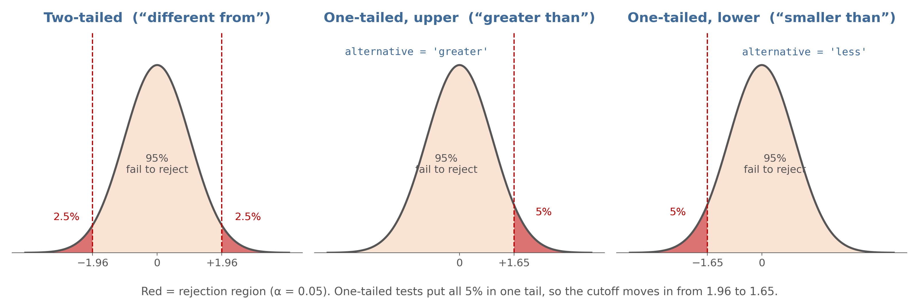
Where the 5% Goes
Same alpha, different shape. Splitting 5% into two tails pushes the cutoff out to 1.96; one tail keeps it at 1.65.
Notes:
Point to the red regions. Ask: 'Why is 1.65 smaller than 1.96?' Answer: all 5% is in one tail, so you don't have to go as far out.

Slide 14
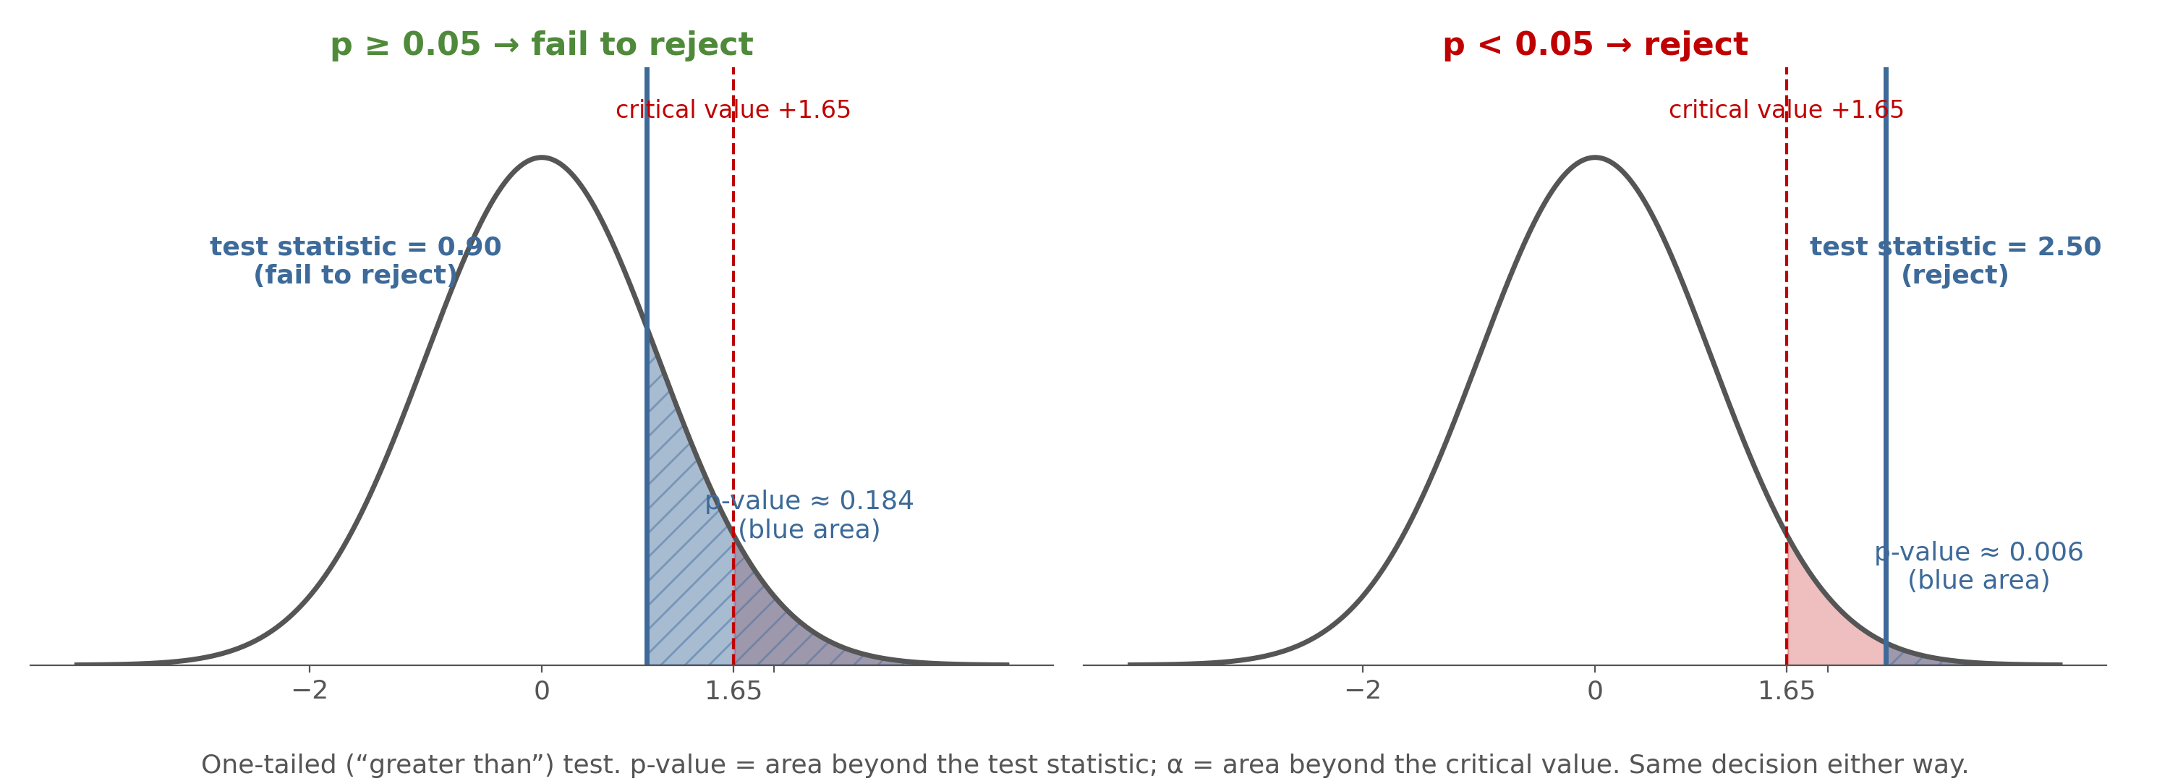
Review: p-value and alpha are areas
The p-value is the area beyond your test statistic (in blue); alpha is the area beyond the critical value (in red). When the test statistic is past the cutoff critical value, the p-value is also smaller than alpha.
Notes:
Values are illustrative (0.90 and 2.50 on a one-tailed test) and deliberately do not match either HW8 question. Use it to connect the by-hand method with the R method.

Slide 15
Review: Lecture Concepts
One-tailed tests: which end, and how to tell it from R code
Question says… | H1 | Critical value interval (α = .05) | If by hand, reject H0 if… | If with R, reject H0 if… | R argument
“smaller than” / “less than” | x̄ < μ | [−1.65, positive infinity] | test statistic < −1.65 | p-value < 0.05 | alternative='less'
“greater than” / “more than” | x̄ > μ | [negative infinity, 1.65] | test statistic > 1.65 | p-value < 0.05 | alternative='greater'
“different from” / “not equal” | x̄ ≠ μ | [−1.96, 1.96] | outside the interval | p-value < 0.05 | (leave it out)

Slide 16
Review: Lecture Concepts
Lecture Example 1: a one-tailed test by hand
100 coin flips: 45 heads, 55 tails. Can we accept the hypothesis that the coin has LESS than a 50% chance of landing on heads, at the 0.05 alpha level?
(0) Sample: p = 45%, N = 100. Population: π = 50%. α = 0.05.
(1) H0: p = π (same as π = 50%). H1: p < π (same as π < 50%).
(2) N ≥ 100 → Z. “Smaller than” → lower end. Critical value interval = [−1.65, positive infinity].
(3) Test statistic = (p% − π%) / √( p%(100 − p%) / n ) → (45 − 50) / √(45 × 55 / 100) = −5 / 4.97 ≈ −1.0
(4–5) −1.0 > −1.65 → within the interval → fail to reject H0 (find support for H0).
(6) Interpretation (lecture wording)
At the 0.05 significance level (OR: with a 95% confidence level), we fail to reject the null hypothesis and conclude that the sample percentage (45%) of landing on heads in the 100 coin-flips we took is NOT significantly smaller than the hypothesized percentage (50%). In other words, we are 95% confident that the true probability of a coin flip landing on heads is at least 50%.
If we had rejected H0: “…is smaller than 50%.”

Slide 17
Review: Lecture Concepts
Extension 2: one-sample vs. two-sample tests (A/B tests)
One-sample test: compare one sample statistic to a hypothesized population parameter.
Two-sample test: compare sample 1 to sample 2. Is there a significant difference between two groups on the population level?
E.g., boys’ vs. girls’ heights; home page design A vs. B.
In this class: one-sample tests by hand AND with R; two-sample tests with R only.

Slide 18
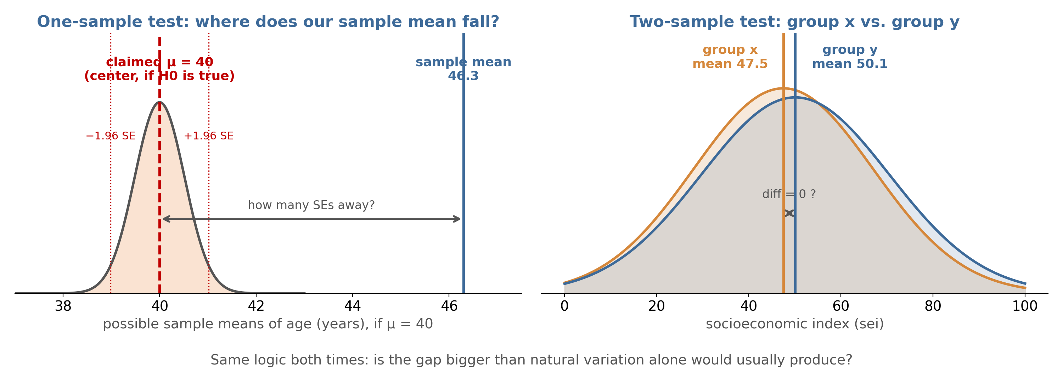
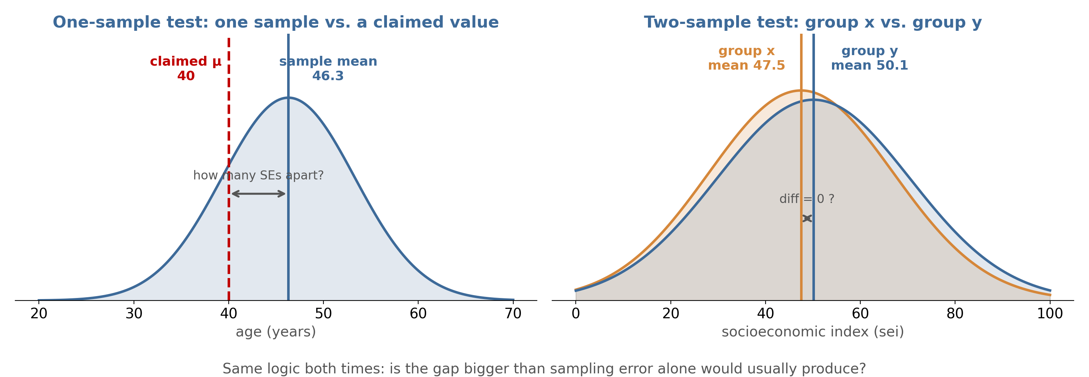
One Sample vs. Two Samples
One-sample: the curve is centered on the claimed μ. Our sample mean lands far outside it → unlikely if H0 were true.
Two-sample: how far apart are two group means?
Both ask whether the gap beats natural variation.
Notes:
Left panel: the curve is the sampling distribution IF the claimed mu (40) were true, so 40 sits at the center and the sample mean (46.3) lands far outside ±1.96 SE. Right panel uses Demo 2 (sei by sex). Emphasize that 'diff = 0' is the two-sample H0.

Slide 19
Review: Lecture Concepts
Lecture example: two-sample test in R (educ by sex)
H0: no diff. between F and M’s educ level.
H1: significant diff. b/t F and M’s educ level.
p-value: 0.19 >> 0.05
Decision: fail to reject H0.
Interpretation: With a 95% confidence level (OR: at the 0.05 significance level), we fail to reject the null hypothesis and conclude that there is NO significant gender difference in terms of educational levels in the American population in 2006.
> t.test(gss$educ[gss$sex=='Female'], # group x
gss$educ[gss$sex=='Male']) # group y
Welch Two Sample t-test
t = -1.3095, df = 812.54, p-value = 0.1907
alternative hypothesis: true difference in
means is not equal to 0
95 percent confidence interval:
-0.7090340 0.1415686
mean of x mean of y
13.33934 13.62308
What do we look for in the R output?
p-value = ?
mean of x = sample mean of group x = ?
mean of y = sample mean of group y = ?
Which group is x? Whichever typed first in the R code. Here, Female.

Slide 20
Review: Lecture Concepts
Recap: types of hypothesis tests
Types of test | Two-tailed | One-tailed | Test statistic
One-sample test | H1: mean ≠ hypothesized value; critical values ±1.96 (or ±2.58) | H1: greater or smaller; critical value 1.65 (or 2.33), one side | t-score (z-score is a special case of t-score)
Two-sample test (A/B test) | H1: diff ≠ 0 (the usual case) | rarely used in this class | t-score
By hand: compare the test statistic to the critical values at the 95% (or 99%) level.
With R: compare the p-value to 0.05 (or 0.01).
- p < 0.05: reject H0.
- p >= 0.05: fail to reject (or find support for) H0.

Slide 21
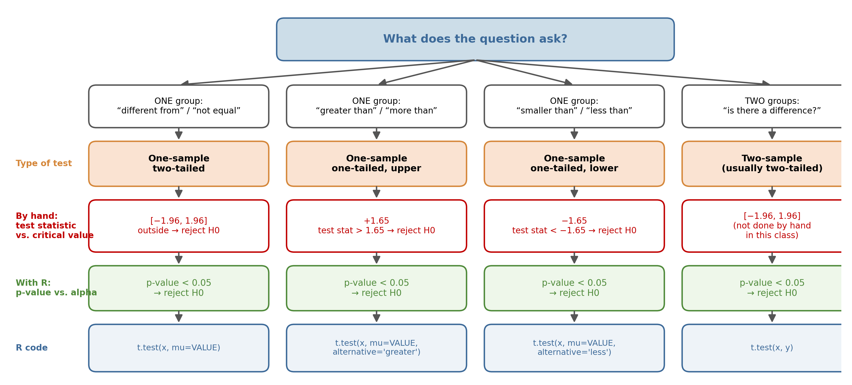
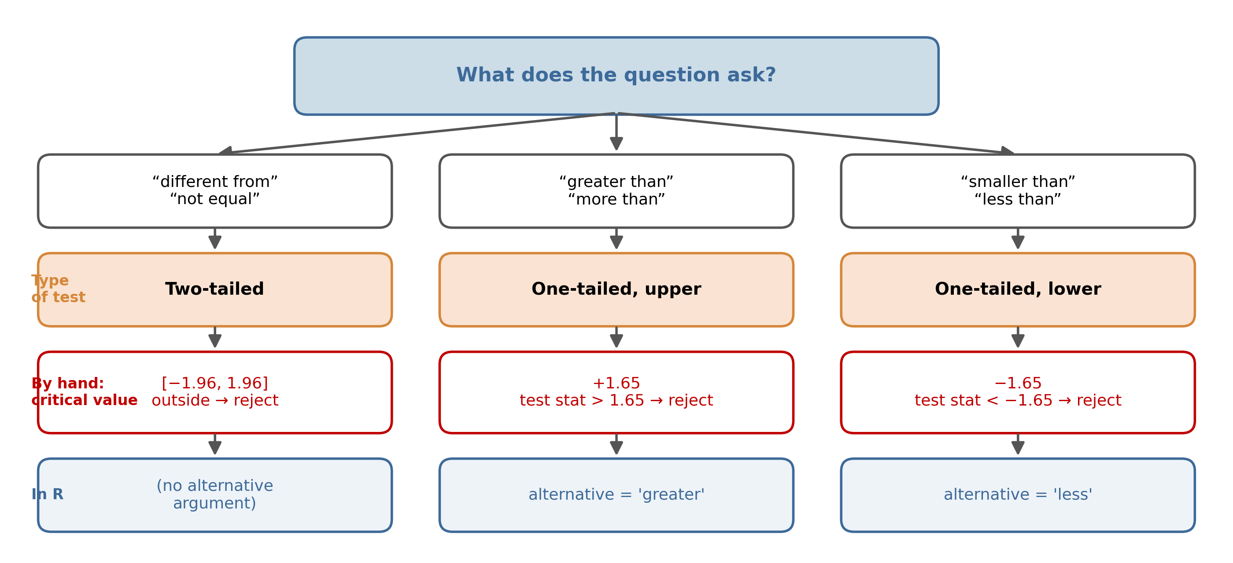
From Question Wording to Test
Read the question's wording first. It decides the type of test, what to compare by hand (test statistic vs. critical value), what to compare in R (p-value vs. alpha), and the R code.
Notes:
Decision tree. Walk down one column at a time. Emphasize the two 'compare' rows: by hand you compare a z/t-score to a critical value; with R you compare a p-value to alpha. Never cross them. The fourth column (two-sample) is R-only in this class.

Slide 22
Using Posit Cloud for Hypothesis Testing
The two new R patterns you will see this week, demonstrated on different variables

Slide 23
Two New Patterns in t.test()
Code pattern | What it does | Key detail
t.test(variable, mu=VALUE, alternative='greater') | One-sample ONE-tailed test: is the population mean greater than VALUE? | alternative = 'greater' or 'less'. Leave it out for a two-tailed test.
variable[group=='A'] | Picks out the values for group A only | “A” is the group label (e.g. females, males)
t.test(x, y) | Two-sample test comparing group x with group y | First group listed = group x; second = group y
You will not write this code for HW8, but you must be able to read what it produced. The next slides practice that on variables that are NOT in HW8.

Slide 24
Demonstrate a
One-Tailed Test (age)
Question: did American adults have an average age GREATER than 45 in 2006? (α = 0.05)
t.test(gss$age, mu=45, alternative='greater')
Read it together
H1 (printed by R): true mean is greater than 45 → one-tailed, upper end
H0 (you write it): mu = 45
Test statistic: t = 2.4991. If by hand, compare to [?]
p-value: 0.006306, compare to 0.05
Decision: [?]
mean of x: 46.295. the sample mean of age.
##
## One Sample t-test
##
## data: gss$age
## t = 2.4991, df = 999, p-value = 0.006306
## alternative hypothesis: true mean is greater than 45
## 95 percent confidence interval:
## 45.44186 Inf
## sample estimates:
## mean of x
## 46.295

Slide 25
Writing It Up
One-tailed interpretation follows the lecture pattern (slide 22), with the direction word included.
At the 0.05 significance level (OR: with a 95% confidence level), we [?] the null hypothesis and conclude that the sample mean age (46.30 years) [is or is NOT?] significantly greater than the hypothesized population mean (45 years). In other words, we are 95% confident that the true average age of American adults in 2006 [is or is NOT?] greater than 45 years.
Three things that must appear in a one-tailed write-up: the decision, the DIRECTION word (greater / smaller), and the population conclusion.
If we had failed to reject: “…is NOT significantly greater than… we are 95% confident that the true average age is not greater than 45.”

Slide 26
Demonstrate a
Two-Sample Test (sei by sex)
Question: is there a significant difference between women’s and men’s socioeconomic index scores? (α = 0.05)
t.test(gss$sei[gss$sex=='Female'],
gss$sei[gss$sex=='Male'])
Let's read it together
mean of x: 47.53 → [which group?] (typed 1st)
mean of y: 50.13 → [which group?] (typed 2nd)
H0: diff = 0
H1: diff ≠ 0 (two-tailed)
p-value: 0.04659 vs. 0.05 → [?]
Decision: ?
CI of the difference: −5.15 to −0.04. Does it include 0? [?]
##
## Welch Two Sample t-test
##
## data: gss$sei[gss$sex == "Female"] and gss$sei[gss$sex == "Male"]
## t = -1.993, df = 802.5, p-value = 0.04659
## alternative hypothesis: true difference in means is not equal to 0
## 95 percent confidence interval:
## -5.15219867 -0.03923471
## sample estimates:
## mean of x mean of y
## 47.53377 50.12949

Slide 27
Writing It Up
Two-sample interpretation follows the lecture pattern (slide 33).
With a 95% confidence level (OR: at the 0.05 significance level), we [?] the null hypothesis and conclude that there [is or is NOT?] a significant difference between women’s and men’s socioeconomic index scores in the American population in 2006.
Must appear: the level, the decision, the two groups, and the population conclusion.
Reminder: the test says the groups differ; it does not say WHY. No causal claims.

Slide 28
Common Errors to Avoid
Common error | ✗ What students write | ✓ Write this instead | Why
Two-tailed critical value on a one-tailed test | “Compare the test statistic to ±1.96.” (for a ‘greater than’ question) | “Compare the test statistic to +1.65 (one-tailed, upper end).” | One-tailed tests put all 5% in one tail, so the cutoff moves in to 1.65 (lecture slide 15).
Comparing the p-value(probability) to critical values (z-scores), or comparing test statistic (z-score )to alpha level (probability) | “t = 2.50 is bigger than 0.05, so reject.” or “p = 0.006 is less than 1.65, so fail to reject.” | Compare like with like: p-value vs. alpha (0.05), both probabilities; test statistic vs. critical value (±1.96 / 1.65), both z-scores. | A p-value is always between 0 and 1; a z-score can be any size. Mixing them gives a comparison that means nothing.
Mixing up x and y in a two-sample test | Assigning ‘mean of x’ to whichever group is mentioned first in the question | “x is the group typed FIRST inside t.test(); y is the second.” | R labels groups in the order you typed them, not the order in the question.
All three will matter on HW8.

Slide 29
Preparing for Homework 8
What it asks, and which slide to look back at

Slide 30

HW8: What to Expect
Link: [https://posit.cloud/content/7130283]
Save as a permanent project, rename it, open HW8.Rmd, resize the panes. Run ALL chunks in order.
First code chunk: loads two packages
Second code chunk: reads the GSS data (1,000 rows, 55 columns)
Third code chunk: a one-sample ONE-TAILED test on hrs1 (Q1)
Fourth code chunk: a TWO-SAMPLE test on sei between liberals and conservatives (Q2)
No code to write. Optional: insert a chunk and try the two-tailed version or alternative='less'.
Then: change author and date, knit to PDF, answer on BrightSpace, upload the PDF. Wrong or missing PDF = −0.5 points.

Slide 31
HW8: Which Slide Answers Which Part
HW8 part | What it asks | Look back at
Q1 part 1 | H0 and H1 for a one-tailed test (“more than 43”) | Demo 1 (slide 24) and the which-end table (slide 15) and the decision tree (slide 21)
Q1 part 2 | Test statistic from the output; which critical value by hand | Demo 1; one-tailed critical values (slides 12–13). Hint: not ±1.96
Q1 parts 3–4 | p-value, what to compare it to, and the decision | Demo 1; p-value vs. alpha (slide 14); recap (slide 20)
Q1 part 5 | Summary paragraph with the direction word | Demo 1 write-up (slide 25)
Q2 part 1 | Sample mean of each group: which is x, which is y | Demo 2 (slide 26); common error 3
Q2 parts 2–4 | H0 / H1 for two groups, p-value, decision | Demo 2; two-sample tests (slides 17–18)
Q2 part 5 | Summary paragraph for a two-sample test | Demo 2 write-up (slide 27); lecture educ example (slide 19)
Before you submit: did every step name a number from the output AND a decision word?

Slide 32
Check Your Understanding
A one-tailed test asks whether a mean is SMALLER than 50 at the 0.05 level. The test statistic is −1.80. Decision?
Hint: Which end? Which critical value?
1
2
A two-sample test gives p-value = 0.043. Decision at the 0.05 level? At the 0.01 level?
Hint: Compare p to each alpha

