Slide 1
Lab Section #11: Hypothesis Testing II
Homework 8 walkthrough · One-tailed tests · Two-sample tests
Notes:
LOGISTICS: lab number is a placeholder. Lecture file is 'Lecture11' but its title slide says 'Lecture 10' — ask the professor which number to use.

Slide 2
Today’s Content
Homework 8
Review
Right & Wrong
Wordings
Reminders about
Posit Cloud
Review Concepts
from Lecture

Slide 3
Homework 8 Walkthrough
One-sample one-tailed test · Two-sample two-tailed test

Slide 4

Demonstration of HW8
Link: [insert HW8 Posit Cloud project link]
Use the link to the project & save it as a permanent project in your account
Rename the project
Open the markdown file (HW8.Rmd) and resize the panes
Read all comments and follow the steps in the markdown file:
First code chunk will load two packages (tidyverse, readxl)
Second code chunk will read in the GSS file and count rows & columns
Third code chunk will run a one-sample ONE-TAILED t-test on hrs1 (Q1)
Fourth code chunk will run a TWO-SAMPLE t-test on sei by libconsv (Q2)
No code to write this week. Optional practice: insert a chunk and try the two-tailed version.
You need to run ALL code chunks in the exact order provided.
Notes:
The Rmd text says 'answer the questions on Blackboard' while the Finally section says BrightSpace. Tell students: BrightSpace.

Slide 5

Demonstration of HW8
Link: [insert HW8 Posit Cloud project link]
Change the author (line 3) and date (line 4) of the markdown file
Do NOT change any other lines in the header — editing them may stop the PDF from knitting
Answer Q1 (five parts) and Q2 (five parts) on BrightSpace
Knit the Markdown file as a PDF and save it to your computer/device
Upload the PDF as a response to Homework 8. Failure to submit the correct PDF = −0.5 points

Slide 6
HW8: New R Code at a Glance
Code | What it does | Key detail
t.test(gss$hrs1, mu=43, alternative='greater') | One-sample ONE-tailed test: is the population mean greater than 43? | alternative = 'greater' or 'less' (lowercase, in quotes). Leave it out for a two-tailed test.
gss$sei[gss$libconsv=='Liberal'] | Picks out the SEI scores of liberals only | Square brackets filter rows; == means 'is equal to'
t.test(x, y) | Two-sample test comparing group x with group y | First group listed = mean of x; second = mean of y
Welch Two Sample t-test | R's default two-sample test | Allows the two groups to have different spreads; that's why df is not a whole number
Students will not write this code — but knowing what each line does makes the output much easier to read.

Slide 7
HW8 Q1: Reading the R Output
t.test(gss$hrs1, mu=43, alternative='greater')
Where to look
alternative hypothesis: “true mean is greater than 43” → this is H1, one-tailed, upper end
t = −0.82263: the test statistic
df = 999: sample size − 1 (n = 1,000)
p-value = 0.7945: compare to 0.05
mean of x = 42.717: the sample mean, slightly BELOW 43
CI 42.15 to Inf: one-tailed, so only a lower bound is given
##
## One Sample t-test
##
## data: gss$hrs1
## t = -0.82263, df = 999, p-value = 0.7945
## alternative hypothesis: true mean is greater than 43
## 95 percent confidence interval:
## 42.15061 Inf
## sample estimates:
## mean of x
## 42.717
Notes:
Verified against GSS2006.xlsx: hrs1 has 1,000 non-missing values, mean 42.717, SD 10.879, t = -0.8226, p = 0.7945. Point out the sample mean is below 43 before any calculation: the data point the opposite way from H1, so a large p-value is expected.

Slide 8
HW8 Q1: Hypotheses
1) What is the null hypothesis and alternative hypothesis?
H0 : mu = 43 (or mu <= 43)
There is no actual difference between the sample mean (42.72 hours) and the hypothesized population mean (43 hours). The American adult population did not work more than 43 hours a week on average.
H1 : mu > 43
The American adult population worked MORE than 43 hours a week on average. (One-tailed, “greater than” → upper end.)
Lecture pattern: H0: mu = 40 (or mu >= 40); H1: mu < 40. Here the direction flips because HW8 asks “more than.”
Notes:
Professor's notation from Lecture slide 31 adapted to 'greater'. Students often write H1 as 'not equal to 43' out of habit from HW7; remind them the question says 'more than'.

Slide 9
HW8 Q1: Test Statistic & Critical Value
2) What is the test statistic? If we conduct the test by hand, which critical value should we compare it to?
Test statistic (from R): t = −0.82
Check it by hand:
SE = 10.88 / √1000 = 10.88 / 31.62 = 0.344
t = (42.717 − 43) / 0.344 = −0.283 / 0.344 = −0.82
In words: the sample mean is 0.82 standard errors BELOW 43.
Critical value
n = 1,000 ≥ 100 → Z-scores
alpha = 0.05, one-tailed
“greater than” → upper end
Critical value = +1.65
Critical value interval: [negative infinity, 1.65]
Reject H0 only if the test statistic > 1.65. Here −0.82 is nowhere near it.
Notes:
Common error: using ±1.96 from the two-tailed tests in HW7. One-tailed at 0.05 uses 1.65 on ONE side only (lecture slide 15). SD of hrs1 = 10.879, so SE = 0.344; (42.717 - 43)/0.344 = -0.8226, matching R.

Slide 10
HW8 Q1: The p-value
3) What is the p-value? When we conduct the test with R, which value should we compare the p-value to?
1. p-value
0.7945
2. Compare to
alpha = 0.05
3. Result
0.7945 ≥ 0.05
What 0.7945 means (lecture wording): the probability of obtaining the sample mean if H0 were true.
It is a plain decimal this time, not scientific notation. No conversion needed.
A p-value this large happens because the sample mean (42.72) sits on the OPPOSITE side of 43 from the direction H1 predicts.

Slide 11
HW8 Q1: Decision
4) Based on the p-value, please explain your decision about the null hypothesis (reject or fail to reject, why?).
Decision rule from lecture:
p-value < 0.05: reject H0
p-value >= 0.05: fail to reject H0 (“accept” H0)
Decision: 0.7945 ≥ 0.05, so we fail to reject H0.
Why: it is likely (79% chance) to get a sample mean of 42.72 if the true population mean is 43. The difference is just natural variation. The sample mean is NOT significantly greater than 43.
By hand, same decision: −0.82 is within [negative infinity, 1.65].

Slide 12
HW8 Q1: Summary Paragraph
5) Write a short paragraph to interpret/summarize the result of the test, following the template in the lecture slides.
At the 0.05 significance level (OR: with a 95% confidence level), we fail to reject the null hypothesis and conclude that the sample mean of hours worked per week (42.72 hours) is NOT significantly greater than the hypothesized population mean (43 hours) based on the sample we took. In other words, we are 95% confident that the American adult population did not work more than 43 hours a week on average in 2006.
Checklist: significance level ✓ decision ✓ sample mean & hypothesized mean ✓ direction (“greater than”) ✓ population conclusion ✓
Lecture template (slide 7): “…we reject (or fail to reject) the null hypothesis and conclude that there is (or is NO) actual difference between the hypothesized population mean AAA, and the sample mean BBB…”
Notes:
Follows the professor's Lecture 11 slide 22 one-tailed pattern. See the Wordings section for the 'not enough evidence' alternative.

Slide 13
HW8 Q1: Optional Practice — Same Data, Three Tests
Changing the alternative argument changes H1, the p-value, and the critical value. The sample mean (42.72) and t (−0.82) never change.
alternative = | H1 | p-value | Critical value(s) | Decision
(left out) two-tailed | mu ≠ 43 | 0.4109 | [−1.96, 1.96] | fail to reject
'greater' (HW8) | mu > 43 | 0.7945 | > 1.65 | fail to reject
'less' | mu < 43 | 0.2055 | < −1.65 | fail to reject
Pattern: the one-tailed p-value in the direction the data lean (‘less’) is half of the two-tailed p-value; the other direction (‘greater’) is 1 − that half. None reaches 0.05.
Notes:
Values computed from GSS2006.xlsx with the same t-test: two-tailed p = 0.4109; less p = 0.2055; greater p = 0.7945. 0.2055 + 0.7945 = 1.

Slide 14
HW8 Q2: Reading the R Output
t.test(gss$sei[gss$libconsv=='Liberal'],
gss$sei[gss$libconsv=='Conservative'])
Where to look
mean of x = 51.73: liberals’ average SEI (listed first)
mean of y = 47.45: conservatives’ average SEI (listed second)
alternative: “true difference in means is not equal to 0” → two-tailed H1
t = 2.4383, df = 534.82: Welch df is a decimal; that’s normal
p-value = 0.01508: compare to 0.05
CI 0.83 to 7.72: the difference between the means; it does not include 0
##
## Welch Two Sample t-test
##
## data: gss$sei[gss$libconsv == "Liberal"] and
## gss$sei[gss$libconsv == "Conservative"]
## t = 2.4383, df = 534.82, p-value = 0.01508
## alternative hypothesis: true difference in means is not equal to 0
## 95 percent confidence interval:
## 0.8313626 7.7241280
## sample estimates:
## mean of x mean of y
## 51.72657 47.44883
Notes:
Verified against the data: 286 liberals (mean 51.73, SD 20.53), 256 conservatives (mean 47.45, SD 20.27). Difference = 4.28; SE of the difference = 1.754; t = 2.438; Welch df = 534.8; p = 0.0151. Lecture slide 28 gives df = (n1-1)+(n2-1) = 540; R's Welch df is 534.82. Both lead to the same critical value (1.96).

Slide 15
HW8 Q2: Means and Hypotheses
1) What is the sample mean of the liberals’ SEIs? And of the conservatives’ SEIs? 2) What is the null hypothesis, and what is the alternative hypothesis?
Group | Sample mean SEI | n
Liberals (x) | 51.73 | 286
Conservatives (y) | 47.45 | 256
H0 : diff = 0
There is no significant difference between the two groups: liberals and conservatives have the same average SEI in the American population.
Difference in the sample: 51.73 − 47.45 = 4.28 points
H1 : diff ≠ 0
There is a significant difference between the two groups’ average SEI in the American population. (A two-sample test is usually two-tailed.)
Notes:
Professor's wording from Lecture slide 26. Watch for students swapping x and y: whichever group is typed first is 'mean of x'.

Slide 16
HW8 Q2: p-value and Decision
3) What is the p-value, and which value should we compare it to? 4) Based on the p-value, explain your decision about the null hypothesis.
1. p-value
0.01508
2. Compare to
alpha = 0.05
3. Result
0.01508 < 0.05
Decision: 0.01508 < 0.05, so we reject H0.
Why: if liberals and conservatives really had the same average SEI, a gap of 4.28 points would happen only about 1.5% of the time. That is too small (less than 5%), so H0 is likely NOT true.
Consistent with the CI: 0.83 to 7.72 does not include 0.
Notes:
Also: 0.01508 is NOT smaller than 0.01, so at the 0.01 level we would fail to reject. Good 'what if' question if time allows.

Slide 17
HW8 Q2: Summary Paragraph
5) Write a short paragraph to interpret/summarize the result of the test.
With a 95% confidence level (OR: at the 0.05 significance level), we reject the null hypothesis and conclude that there is a significant difference between liberals’ and conservatives’ socioeconomic index scores in the American population in 2006. In our sample, liberals had a higher average SEI (51.73) than conservatives (47.45), a difference of 4.28 points.
Checklist: confidence/significance level ✓ decision ✓ the two groups ✓ the variable ✓ population conclusion ✓ (bonus) which group is higher ✓
Lecture pattern (slide 33): “…we fail to reject the null hypothesis and conclude that there is NO significant gender difference in terms of educational levels in the American population in 2006.”

Slide 18
Right & Wrong Wordings
Three alternative wordings that also work, and three common errors to avoid

Slide 19
Wordings That Also Work
Topic | Lecture wording | Alternative that also works | Why it works
Failing to reject | “fail to reject (‘accept’) H0” / “H0 is likely true” | “We fail to reject H0; the data do not give enough evidence that the mean is greater than 43.” | A non-significant result is a lack of evidence against H0, not proof that H0 is true.
What the p-value means | “the probability of obtaining the sample statistic, assuming H0 is true” | “the probability of getting a sample result at least this extreme, if H0 were true” | “At least this extreme” is why the p-value is an area under the curve, not a single point.
Writing a one-tailed H0 | “H0: mu = 43 (or mu <= 43)” | “H0: mu <= 43; H1: mu > 43” | The two hypotheses then cover every possibility, with no gap between them.
Both versions in each row are acceptable; the alternative is more precise.
Notes:
TA NOTE — CONFIRM WITH PROFESSOR BEFORE PRESENTING. Row 1 matters most for HW8 Q1, where the correct decision is 'fail to reject'.

Slide 20
Common Errors to Avoid
Common error | ✗ What students write | ✓ Write this instead | Why
Two-tailed critical value on a one-tailed test | “Compare −0.82 to ±1.96.” | “Compare −0.82 to +1.65 (one-tailed, upper end).” | One-tailed tests put all 5% in one tail, so the cutoff moves in to 1.65 (lecture slide 15).
Reading the p-value as the chance H0 is true | “p = 0.7945, so there is a 79% chance that Americans work 43 hours.” | “p = 0.7945 ≥ 0.05, so we fail to reject H0; the sample does not show the mean is greater than 43.” | The p-value assumes H0 is true and describes the sample. It is not the probability of H0.
Mixing up x and y in Q2 | “Conservatives average 51.73 and liberals 47.45.” | “Liberals (x, listed first) average 51.73; conservatives (y) average 47.45.” | R labels groups in the order you typed them. Liberal was typed first.
Each of these errors can cost points on Q1 part 2, Q1 part 4, or Q2 part 1.
Notes:
TA NOTE — CONFIRM WITH PROFESSOR. Error 2 is the most common misreading of a large p-value.

Slide 21
Reminders about Posit Cloud
Running chunks, knitting, and a few HW8-specific traps

Slide 22
Review: R Markdown Files
Markdown files are advantageous for a lot of reasons but they can be a little tricky to work in:
Be careful not to type inside a code chunk unless you are intentionally altering the code within it.
Be mindful that functions/commands/code are case sensitive: 'Liberal' and 'liberal' are different values; 'greater' must be lowercase.
Be mindful about spelling and the use of parentheses, brackets, and quotation marks — the Q2 code has nested parentheses and square brackets.
When changing the author and date in the header, be sure NOT to delete the quotation marks or write outside of the quotation marks.
Knitting starts R fresh, so every package and object must be created inside the markdown file.
Be sure to run all code chunks in the exact order provided to avoid errors.
After running all code, you need to “knit” the Markdown file to a PDF, and download the PDF for HW submission.

Slide 23
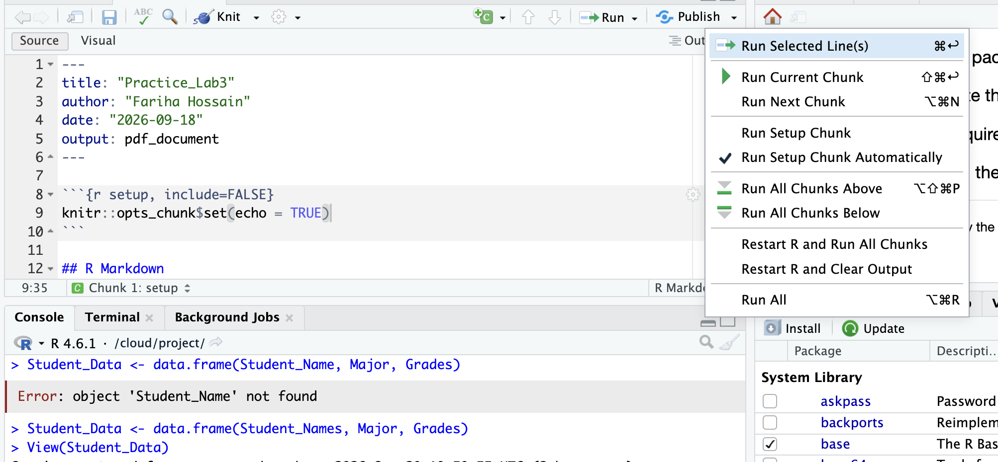
Posit Cloud Pro Tip
If you are having difficulties running code or knitting PDFs, one solution is to restart R and run all the code chunks in order. Click the Run button and select “Restart R and Run All Chunks”.

Slide 24
Final Reminders on Posit Cloud
Students will not be required to write R code for HW8. The optional practice is encouraged but not graded.
Optional practice tips: insert a new chunk (Ctrl+Alt+I on Windows, Cmd+Option+I on Mac), paste the Q1 line, and try alternative='less' or remove the alternative argument for a two-tailed test.
If you edit or delete something in a markdown file, you can always start over by opening the original link to the Project posted on BrightSpace.
If your markdown file is NOT changed or edited, but you still run into errors, use the restart R and run all code chunks option to reset the session.

Slide 25
Review: Lecture Concepts
One-tailed vs. two-tailed · One-sample vs. two-sample · Type I and Type II errors

Slide 26

Review: Lecture Concepts
Recap: hypothesis testing in a nutshell
To perform a hypothesis testing is to compare a hypothesized population parameter (a guess) to the sample statistic (deemed as “ground truth”).
If they are significantly different, i.e., the test statistic (the Z/t-score of the sample mean/proportion) falls outside the critical value interval → the probability of observing this sample mean is very low (below 5% or 1%) if H0 were true → reject H0 and “accept” H1.
If the test statistic falls within the critical value interval, we fail to reject (“accept”) H0.
Two methods, same decision: by hand, compare the test statistic to the critical values (Z/t-scores). With R, compare the p-value to the alpha level (0.05 or 0.01). Use one or the other, not both.
Quick check: a sample mean has a Z-score of 1.32 / −2.06 / 2.79 at the 95% level, two-tailed. Which ones reject H0?
Notes:
Answers: 1.32 within → fail to reject; -2.06 outside → reject; 2.79 outside → reject. Professor's lecture slide 5.

Slide 27
Review: Lecture Concepts
Extension 1: one-tailed vs. two-tailed tests
Two-tailed (non-directional)
H1: the two values are not equal. We do not care about the direction of the difference. The rejection region is split: 2.5% in each tail. More common.
One-tailed (directional)
H1: the sample statistic is greater (or smaller) than the hypothesized parameter. All 5% sits in one tail, so the critical value moves in.
Alpha | Two-tailed | One-tailed, upper (“greater than”) | One-tailed, lower (“smaller than”)
.05 | [−1.96, 1.96] | > 1.65 | < −1.65
.01 | [−2.58, 2.58] | > 2.33 | < −2.33
Notes:
Professor's table from lecture slide 15. Note: the exact one-tailed .05 value is 1.645, which the course rounds to 1.65.

Slide 28
Review: Lecture Concepts
One-tailed tests: which end, and how to tell R
Question says… | H1 | Critical value interval (α = .05) | Reject H0 if… | R argument
“smaller than” / “less than” | x̄ < μ | [−1.65, positive infinity] | test statistic < −1.65 | alternative='less'
“greater than” / “more than” | x̄ > μ | [negative infinity, 1.65] | test statistic > 1.65 | alternative='greater'
“different from” / “not equal” | x̄ ≠ μ | [−1.96, 1.96] | outside the interval | (leave it out)
Reading the t-table for one-tailed tests (lecture slide 37): use the FIRST header row (one-tailed), find the alpha column, then the df row. The table shows positive numbers only: take the negative value for “smaller than,” the positive value for “larger than.” Z-score = t-score when n ≥ 100.

Slide 29
Review: Lecture Concepts
Lecture Example 1: a one-tailed test by hand
100 coin flips: 45 heads, 55 tails. Can we accept the hypothesis that the coin has LESS than a 50% chance of landing on heads, at the 0.05 alpha level?
(0) Sample: p = 45%, N = 100. Population: π = 50%. α = 0.05.
(1) H0: p = π (same as π = 50%). H1: p < π (same as π < 50%).
(2) N ≥ 100 → Z. “Smaller than” → lower end. Critical value interval = [−1.65, positive infinity].
(3) Test statistic = (45 − 50) / √(45 × 55 / 100) = −5 / 4.97 ≈ −1.0
(4–5) −1.0 > −1.65 → within the interval → fail to reject H0 (find support for H0).
(6) Interpretation (lecture wording)
At the 0.05 significance level (OR: with a 95% confidence level), we fail to reject the null hypothesis and conclude that the sample percentage (45%) of landing on heads in the 100 coin-flips we took is NOT significantly smaller than the hypothesized percentage (50%). In other words, we are 95% confident that the true probability of a coin flip landing on heads is 50%.
If we had rejected H0: “…is smaller than 50%.”
Notes:
FLAG FOR PROFESSOR: lecture slide 20 shows the test statistic as -1.0006. Recalculated: SE = sqrt(45*55/100) = 4.975, so (45-50)/4.975 = -1.005. Using the hypothesized 50% in the SE gives exactly -1.00. Either way the decision is the same, so the slide shows ≈ -1.0.

Slide 30
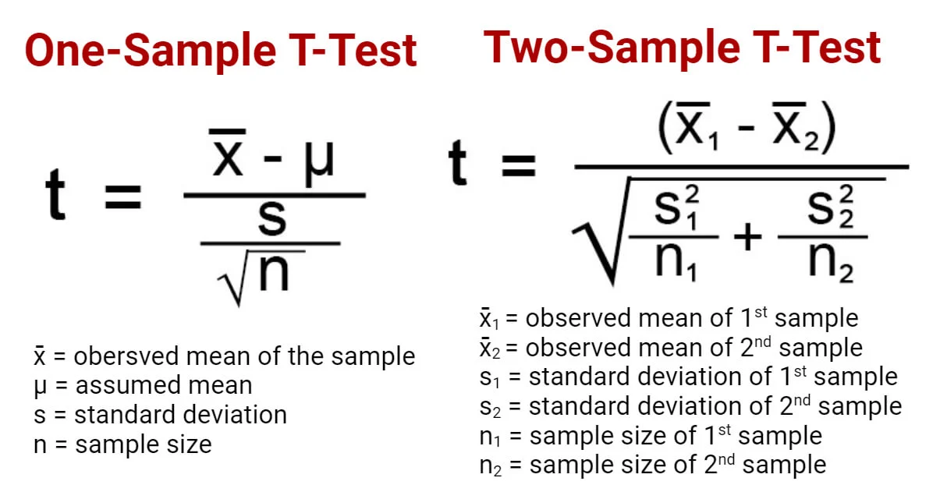
Review: Lecture Concepts
Extension 2: one-sample vs. two-sample tests (A/B tests)
One-sample test: compare one sample statistic to a hypothesized population parameter.
Two-sample test: compare sample 1 to sample 2. Is there a significant difference between two groups on the population level? E.g., boys’ vs. girls’ heights; home page design A vs. B.
Step 1: H0: no significant difference between the two groups (diff = 0). H1: a significant difference (diff ≠ 0). A two-sample test is usually two-tailed.
Step 2: the test statistic is a t-score (Student’s t-test).
Step 3: df = (n1 − 1) + (n2 − 1); look up the t-table. In R, you only need the p-value.
In this class: one-sample tests by hand AND with R; two-sample tests with R only.
Notes:
R's Welch test uses a different df formula (534.82 in HW8, not 540). The critical value is 1.96 either way for samples this large. Mention it only if asked.

Slide 31
Review: Lecture Concepts
Lecture example: two-sample test in R (educ by sex)
> t.test(gss$educ[gss$sex=='Female'], # group x
gss$educ[gss$sex=='Male']) # group y
Welch Two Sample t-test
t = -1.3095, df = 812.54, p-value = 0.1907
alternative hypothesis: true difference in
means is not equal to 0
95 percent confidence interval:
-0.7090340 0.1415686
mean of x mean of y
13.33934 13.62308
H0: no diff. between F and M’s educ level.
H1: significant diff. b/t F and M’s educ level.
p-value: 0.19 >> 0.05
Decision: fail to reject H0.
Interpretation: With a 95% confidence level (OR: at the 0.05 significance level), we fail to reject the null hypothesis and conclude that there is NO significant gender difference in terms of educational levels in the American population in 2006.
Compare with HW8 Q2: same structure, but p = 0.015 < 0.05, so there we reject H0.

Slide 32
Review: Lecture Concepts
Type I and Type II errors
Type I error (α, false positive)
Rejecting H0 when it is actually true: believing there is a pattern in the population when there isn’t. Probability = the α-level (0.05 or 0.01). Example: sending an innocent person to jail.
Type II error (β, false negative)
“Accepting” H0 when it is actually false: believing the pattern does not exist when it does. Probability = the β-level (often 0.2). Example: letting a guilty person go free.
Decision \ State of nature | H0 is true | H0 is false
Do not reject H0 | GOOD | β error (Type II)
Reject H0 | α error (Type I) | GOOD
Notes:
Tie to HW8: in Q2 we rejected H0. If liberals and conservatives really have equal SEI, that rejection would be a Type I error; the chance of that is capped at 5%.

Slide 33
Review: Lecture Concepts
Recap: types of hypothesis tests
Types of test | Two-tailed | One-tailed | Test statistic
One-sample test | H1: mean ≠ hypothesized value; critical values ±1.96 (or ±2.58) | H1: greater or smaller; critical value 1.65 (or 2.33), one side | t-score (z-score is a special case of t-score)
Two-sample test (A/B test) | H1: diff ≠ 0 (the usual case) | rarely used in this class | t-score
By hand: compare the test statistic to the critical values at the 95% (or 99%) level.
With R: compare the p-value to 0.05 (or 0.01). p < 0.05: reject H0. p >= 0.05: fail to reject H0 (“accept” H0).

Slide 34
Check Your Understanding
You run t.test(gss$hrs1, mu=43, alternative='less') and get p-value = 0.2055. What is your decision at the 0.05 level?
Hint: Compare p to alpha; direction is already built into the p-value
1
In Q2, the p-value is 0.01508. What would your decision be at the 0.01 significance level?
Hint: Is 0.01508 smaller than 0.01?
2
In Q2 we rejected H0. If liberals and conservatives really have the same average SEI, what kind of error did we make?
Hint: Rejecting a true H0 is…
3
Notes:
ANSWERS: (1) 0.2055 >= 0.05, fail to reject. (2) 0.01508 is NOT < 0.01, so fail to reject at the 0.01 level; the result is significant at 0.05 but not at 0.01. (3) A Type I error (false positive).

