Slide 1
Lab Section #12: Bivariate Categorical Analysis
Homework 9 walkthrough · Contingency tables · Chi-squared tests

Slide 2
Today’s Content
Review Homework
Assignment 9
Right & Wrong
Wordings
Reminders about
Posit Cloud
Review Lecture 12
Concepts

Slide 3
Homework 9 Walkthrough
Bivariate association between ideological stance and attitudes toward gun control

Slide 4

Demonstration of HW9
Link: [insert HW9 Posit Cloud project link]
Use the link to the project & save it as a permanent project in your account
Rename the project
Open the markdown file (HW9.Rmd) and resize the panes
Read all comments and follow the steps in the markdown file:
First code chunk will load two packages (tidyverse, readxl)
Second code chunk will read in the GSS file and count rows & columns
Third code chunk will create a cross-tab of libconsv and gunlaw
Fourth code chunk will remove the “Moderate” category
Fifth code chunk will calculate ROW proportions
Sixth code chunk will calculate COLUMN proportions
Seventh code chunk will run a chi-squared test
You need to run ALL code chunks in the exact order provided.

Slide 5

Demonstration of HW9
Link: [insert HW9 Posit Cloud project link]
Change the author (line 3) and date (line 4) of the markdown file
Do NOT change any other lines in the header — HW9 uses latex_engine: xelatex, and editing it may stop the PDF from knitting
Answer Q1–Q7 on BrightSpace
Knit the Markdown file as a PDF and save it to your computer/device
Upload the PDF as a response to HW 9. Failure to submit the correct PDF = −0.5 points

Slide 6
HW9: New R Code at a Glance
Code | What it does | Key detail
table(gss$libconsv, gss$gunlaw) | Makes a cross-tab (joint frequency table) | 1st variable → rows, 2nd variable → columns
gss[gss$libconsv != 'Moderate', ] | Keeps only rows that are NOT “Moderate” | != means “not equal to”; the empty spot after the comma keeps all columns
prop.table(..., margin = 1) | Turns counts into ROW proportions | Each row adds up to 1 (100%)
prop.table(..., margin = 2) | Turns counts into COLUMN proportions | Each column adds up to 1 (100%)
chisq.test(x, y, correct = FALSE) | Runs a chi-squared test | Look for X-squared, df, and the p-value
Students will not write this code — but knowing what each line does makes the output much easier to read.

Slide 7
HW9: Reading the Cross-Tab
A joint frequency table shows how many cases fall into each combination of categories.
table(gss$libconsv, gss$gunlaw)
How to read it
The first variable in table() becomes the rows → libconsv
The second variable becomes the columns → gunlaw
Each cell is a count: e.g., 270 liberals favor gun control
libconsv has three categories: liberal, moderate, conservative
##
## Favor Oppose
## Conservative 204 52
## Liberal 270 16
## Moderate 355 103
Total = 1000 respondents. R lists categories in alphabetical order, so Conservative appears before Liberal.
Notes:
Point at the output and trace one cell aloud: row = ideology, column = gun law attitude. Ask: how many conservatives oppose gun control? (52). How many moderates favor it? (355).

Slide 8
HW9: Question 1
What is the specific level of measurement (nominal, ordinal, interval, ratio) of each of the two variables?
Ask: are the values categories or numbers? If categories, can they be put in a natural order?
libconsv
Respondent’s ideological stance
Categories: Liberal · Moderate · Conservative
Natural order? Yes (liberal → moderate → conservative)
Level of measurement: Ordinal
gunlaw
Respondent’s attitudes towards gun control
Categories: Favor · Oppose
Natural order? No (named categories, no low/high end)
Level of measurement: Nominal
Notes:
ANSWER KEY (confirm with professor): libconsv = ORDINAL (liberal → moderate → conservative has a natural left-to-right order). gunlaw = NOMINAL (favor/oppose are named categories with no low/high end). Common mix-up: students call libconsv nominal because it has words, not numbers. Remind them: ordinal is still categorical.

Slide 9
HW9: Question 2
Which variable should be the independent variable X (cause / inherent characteristics), and which should be the dependent variable Y (effect / outcome)?
Use the logic of causal order:
The cause should come before the effect.
X is a broader, more stable characteristic of a person.
Y is a specific attitude or outcome we want to explain.
Which is more likely to shape the other: a person’s overall ideology, or their opinion on one policy?
Role | Variable
X (independent) | libconsv
Y (dependent) | gunlaw
Ideology is a broader, earlier worldview that shapes a specific policy opinion like gun control.
Notes:
ANSWER KEY: X = libconsv (ideological stance), Y = gunlaw (attitude toward gun control). Ideology is the broader worldview that comes first and shapes specific policy opinions.

Slide 10
HW9: Removing the “Moderate” Category
To simplify the question, we compare only liberals vs. conservatives.
gss2 <- gss[gss$libconsv != 'Moderate', ] # exclude "moderate"
nrow(gss2)
ncol(gss2)
Piece of code | Meaning
gss2 <- | Save the result as a NEW data frame
!= 'Moderate' | Keep rows that are not Moderate
, ] | Keep all columns
Check your work
Rows before: 1000
Rows after (nrow(gss2)): 542
Columns stay the same: 55
All later chunks use gss2, not gss. Skipping this chunk will cause errors.
Notes:
1000 − 458 moderates = 542 (256 conservatives + 286 liberals). Ask students why the number of rows went down but the number of columns did not.

Slide 11
HW9: Row vs. Column Proportions
Same table, two ways to calculate percentages. Proportion × 100 = percentage.
ROW proportions (margin = 1)
COLUMN proportions (margin = 2)
prop.table(table(gss2$libconsv,
gss2$gunlaw), margin = 1)
prop.table(table(gss2$libconsv,
gss2$gunlaw), margin = 2)
## Favor Oppose
## Conservative 0.79687500 0.20312500
## Liberal 0.94405594 0.05594406
## Favor Oppose
## Conservative 0.4303797 0.7647059
## Liberal 0.5696203 0.2352941
Check: each ROW adds up to 1 (100%)
Conservatives: 79.7% + 20.3% = 100%. Liberals: 94.4% + 5.6% = 100%.
Check: each COLUMN adds up to 1 (100%)
Favor: 43.0% + 57.0% = 100%. Oppose: 76.5% + 23.5% = 100%.
Notes:
Have students add across a row in the margin=1 table and down a column in the margin=2 table to see 1.00 each time. This is the single most useful self-check for Q3 and Q4.

Slide 12
HW9: Question 3
Based on your identification of X and Y, which table layout (row percentage or column percentage) is better for analyzing the association?
Rule from lecture: look for your X
If X is in the row, use row percentages; each row adds up to 100%
If X is in the column, use column percentages; each col adds up to 100%
Identifying X and Y is important, and the table layout does NOT matter.
table(gss2$libconsv, gss2$gunlaw)
Where is libconsv (X)? in the rows
So we use: row percentages
margin = 1 (each ideology group adds up to 100%)
Notes:
ANSWER KEY: libconsv is the first argument, so it is in the ROWS. Use ROW percentages (margin = 1). Each ideology group (all liberals, all conservatives) should add up to 100%.

Slide 13
HW9: Question 4
Is there an association between libconsv and gunlaw? Describe 1) the pattern, 2) the strength based on the rule of thumb, and 3) the specific % point difference.
Fill in from the ROW-percentage table:
Among all the liberals, 94.4% favor gun control.
Among all the conservatives, 79.7% favor gun control.
There is a 14.7% points difference (94.4 − 79.7). (3: % point difference)
Interpretation:
There is a moderate association between ideological stance and attitudes toward gun control. (2: strength)
Liberals are more likely to favor gun control than conservatives. (1: pattern)
% point difference | Rule of thumb
0–9 | little to no association
10–30 | moderate association
31+ | strong association
Address all three parts for full credit.
Notes:
From the row-proportion output: liberals 0.944 → 94.4% favor; conservatives 0.797 → 79.7% favor. 14.7 falls in the 10–30 band, so 'moderate' by the lecture rule of thumb. Comparing 'Oppose' gives the same gap (20.3 − 5.6 = 14.7). Subtract the two 'favor' percentages to get the % point difference, then apply the rule of thumb.

Slide 14
HW9: Reading the Chi-squared Output
chisq.test(gss2$libconsv, gss2$gunlaw, correct=FALSE)
Reading scientific notation
e-06 means: move the decimal point 6 places to the left (e-07: 7 places).
8.688e-06 = 0.000008688
HW9: 2.414e-07 = 0.0000002414
If R shows p-value < 2.2e-16, the p-value is smaller than R can display. Report it as p < 0.001.
Note: R does not generate H0 and H1 for the chi-squared test. It’s your responsibility.
##
## Pearson's Chi-squared test
##
## data: gss2$libconsv and gss2$gunlaw
## X-squared = 26.67, df = 1,
## p-value = 2.414e-07
Part of output | What it is
X-squared | the χ² test statistic (always ≥ 0)
df | (# rows − 1) × (# columns − 1) → 2×2 table: df = 1
p-value | what we compare to the alpha level
Notes:
Many students misread scientific notation as a large number (e.g., read 8.688e-06 as 8.688). Do one example on the board before Q6.

Slide 15
HW9: Question 5
What is the null hypothesis, and what is the alternative hypothesis for the test? State both for full credit.
Using the template from lecture:
H0
There is no relationship between ideological stance and attitudes toward gun control in the population, i.e., they are independent.
H1
There is an association between ideological stance and attitudes toward gun control in the population, i.e., they are not independent.
Hypotheses are always about the population, not the sample.
Notes:
ANSWER KEY (professor's template): H0: There is no relationship between ideological stance and attitudes toward gun control in the population, i.e. they are independent. H1: There is an association between ideological stance and attitudes toward gun control in the population, i.e. they are not independent.

Slide 16
HW9: Question 6
What is the p-value of the test, which value should you compare the p-value to, and what is your decision regarding the null hypothesis? Answer all three parts.
1. p-value
2.414e-07 = 0.0000002414
2. Compare to
alpha = 0.05
3. Decision
Reject H0
Decision rule from lecture:
P-value < 0.05: reject H0, conclude that the two variables are associated.
P-value >= 0.05: failed to reject H0, conclude that the two variables are independent.
HW9: 0.0000002414 < 0.05, so we reject H0 and conclude the two variables are associated.
Notes:
0.0000002414 < 0.05, so reject H0 and conclude that ideological stance and attitudes toward gun control are associated in the population. Remind students to write the p-value as a decimal, not just copy the e-notation. See the 'Right & Wrong Wordings' section for an alternative phrasing of the fail-to-reject conclusion.

Slide 17
HW9: Question 7
Write a paragraph summarizing all of your findings. Follow the template in the lecture slides.
Template: strength + pattern + significance
Our sample data indicates that there is a moderate association [strength] between ideological stance and attitudes toward gun control. Particularly, liberals are more likely to favor gun control than conservatives [pattern]. A chi-squared test shows that this association is statistically significant in the population at the 0.05 significance level, with a p-value of 0.0000002414 [significance].
Checklist: strength ✓ pattern ✓ significance (p-value + 0.05 level) ✓ Optional: add “a 14.7 percentage-point difference” after the strength.
Notes:
Professor's template, adapted to HW9 variables. Students may also add the % point difference from Q4 for completeness.

Slide 18
Right & Wrong Wordings
Three alternative wordings that also work, and three common errors to avoid

Slide 19
Wordings That Also Work
Topic | Lecture wording | Alternative that also works | Why it works
What the p-value means | “P-value in chi2 test = the probability of independence.” | “The p-value is the probability of seeing an association this strong in a sample if the two variables were independent in the population.” | The test assumes independence, then asks how surprising our sample is.
Failing to reject H0 | “P-value >= 0.05: failed to reject H0, conclude that the two variables are independent.” | “P-value >= 0.05: failed to reject H0; the sample does not provide enough evidence of an association in the population.” | A non-significant result is a lack of evidence, not proof that there is no association.
Size of the difference | “50% − 20% = 30% difference” | “a 30 percentage-point difference” | 50% is 150% higher than 20%; “percentage points” avoids that confusion.
Both versions in each row are acceptable; the alternative is more precise.
Notes:
TA NOTE — CONFIRM WITH PROFESSOR BEFORE PRESENTING. These three rows mirror the wording-alignment items: (1) p-value definition, (2) fail-to-reject conclusion, (3) percent vs. percentage points. If the professor prefers students use only the lecture wording, present the right column as 'deeper understanding' rather than an answer option.

Slide 20
Common Errors to Avoid
Common error | ✗ What students write | ✓ Write this instead | Why
Percentages in the wrong direction | “57.0% of people who favor gun control are liberals.” | “Among all the liberals, 94.4% favor gun control.” | Percentages must be calculated along X (ideology) so we compare liberals with conservatives.
Treating significance as strength | “The p-value is very small, so the association is very strong.” | “The % point difference shows the strength; the p-value shows whether it holds in the population.” | Strength and significance are separate measures. Large samples can make small differences significant.
Claiming causation | “Being liberal causes people to support gun control.” | “Liberals are more likely than conservatives to favor gun control.” | Association ≠ causation. A cross-tab and chi-squared test show association only.
Each of these errors can cost points on Q4, Q6, or Q7.
Notes:
TA NOTE — CONFIRM WITH PROFESSOR. These are the three errors most likely on HW9 Q4 and Q7. Error 1 happens when students read the column-proportion table (margin = 2) instead of the row table: 0.5696 = 57.0% of those who favor gun control are liberal.

Slide 21
Reminders about Posit Cloud
Running chunks, knitting, and starting fresh

Slide 22
Review: R Markdown Files
Markdown files are advantageous for a lot of reasons but they can be a little tricky to work in:
Be careful not to type inside a code chunk unless you are intentionally altering the code within it.
Be mindful that functions/commands/code are case sensitive, so are the names of saved objects (gss vs. gss2).
Be mindful about spelling and the use of parentheses and quotation marks.
When changing the author and date in the header, be sure NOT to delete the quotation marks or write outside of the quotation marks.
Knitting starts R fresh, so every package and object must be created inside the markdown file — that is why the first code chunk loads packages.
Be sure to run all code chunks in the exact order provided to avoid errors.
After running all code, you need to “knit” the Markdown file to a PDF, and download the PDF for HW submission.

Slide 23
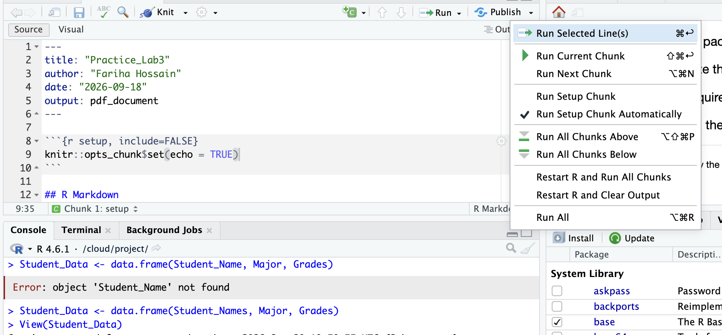
Posit Cloud Pro Tip
If you are having difficulties running code or knitting PDFs, one solution is to restart R and run all the code chunks in order. Click the Run button and select “Restart R and Run All Chunks”.

Slide 24
Final Reminders on Posit Cloud
Students will not be required to write R code for HW9.
Be sure to run all code chunks in the exact order provided. Skipping the “remove Moderates” chunk means gss2 will not exist and later chunks will fail.
If you edit or delete something in a markdown file, you can always start over by opening the original link to the Project posted on BrightSpace.
If your markdown file is NOT changed or edited, but you still run into errors, use the restart R and run all code chunks option to reset the session.

Slide 25
Review: Lecture 12 Concepts
Measuring association with categorical variables

Slide 26

Review: Lecture 12 Concepts
From one variable to two
Univariate analysis
Looks at one variable at a time: its frequency distribution and summary statistics (mean, %), and uses the sample to predict the population (e.g., sample mean → population mean).
Bivariate analysis
Explores the association between two variables in a sample and makes inferences about their relationship in the population.
Parameter: characteristics of the population
Descriptive statistics: characteristics of the sample
Inferential statistics: predictions about the population

Slide 27
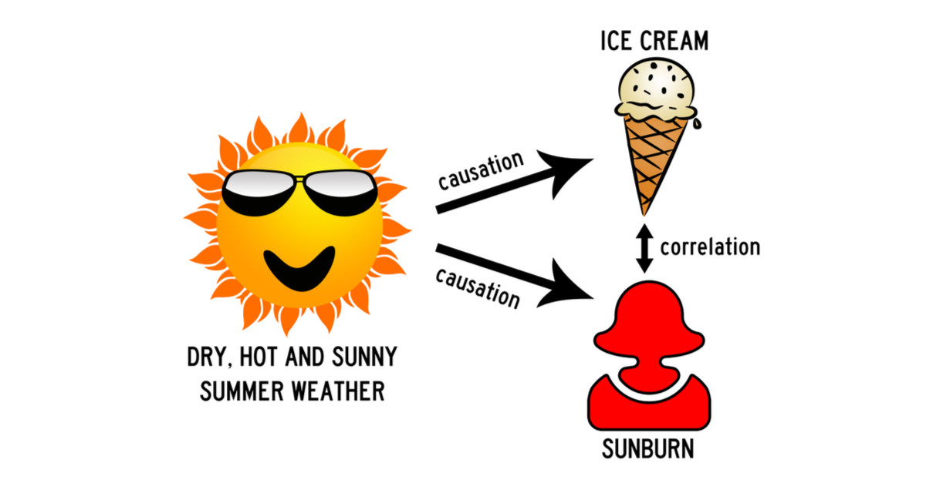
Review: Lecture 12 Concepts
Association ≠ Causation
Association: a systematic pattern between variables; the values of one variable tend to go with the values of the other.
Causation: a change in X produces/causes a change in Y.
Association: a change in X coincides with a change in Y.
Correlation is more specific: it measures the strength of association between two variables.
Hot weather causes both ice cream sales and sunburns, so the two are associated without one causing the other.

Slide 28
Review: Lecture 12 Concepts
Three measures of association
Measure | Question it answers | Tool for two categorical variables
Direction / pattern | Do Y and X go together? Which group is more likely? | Contingency tables
Strength | To what extent does Y go with X? | Roughly: % point difference (precisely: odds ratio, risk ratio)
Statistical significance | Does the association in the sample hold in the population? | Chi-squared tests
Which method to use depends on the levels of measurement: bivariate categorical data, bivariate numerical data, or categorical and numerical variables (not the focus of this course).

Slide 29
Review: Lecture 12 Concepts
1. Direction / Pattern: Contingency Tables
A contingency table displays the joint frequency distribution of two categorical variables.
i.e., the number of observations falling under different combinations of the possible categories.
It shows the distribution of one variable contingent on the other.
Also called cross tabulations or cross-tabs.
Contingency table of sex and housework (N = 200)
 | Male | Female | Total
Housework (yes) | 20 | 50 | 70
Housework (no) | 80 | 50 | 130
Total | 100 | 100 | 200

Slide 30
Review: Lecture 12 Concepts
Column and row percentages
Column % = cell ÷ column total × 100%
Row % = cell ÷ row total × 100%
 | Male | Female | Total
Yes | 20 (20%) | 50 (50%) | 70
No | 80 (80%) | 50 (50%) | 130
Total | 100 (100%) | 100 (100%) | 200
 | Male | Female | Total
Yes | 20 (28.6%) | 50 (71.4%) | 70 (100%)
No | 80 (61.5%) | 50 (38.5%) | 130 (100%)
Total | 100 (50%) | 100 (50%) | 200 (100%)
Distribution of housework, contingent on sex
Distribution of sex, contingent on housework
Which is better? It depends on your X. Sex is X and is in the column, so column percentages are more appropriate here.

Slide 31
Review: Lecture 12 Concepts
How to analyze a contingency table
1
Identify X and Y
2
Calculate % along X
3
Compare across X
Which is the cause, and which is the effect?
X in the row → row %; X in the column → column %. Each category of X adds up to 100%.
Compare the percentages across the categories of X.
Who is more likely to do housework? Female 50% − 20% = 30% points difference
Who is more likely NOT to do housework? Male 80% − 50% = 30% points difference

Slide 32
Review: Lecture 12 Concepts
Interpreting strength: rule of thumb (not a precise measure!)
0–9
10–30
31+
% points: little to no association
% points: moderate association
% points: strong association
Example: Among all the males, 20% did housework yesterday. Among all the females, 50% did. There is a 30% points difference.
Interpretation: There is a moderate to strong association between biological sex and doing housework (strength). Females are more likely to do housework than males (pattern).
Notes:
Lecture wording kept as-is ('moderate to strong'). By the lecture's own bands, 30 falls in 'moderate (10–30)'. Flag for professor alignment.

Slide 33
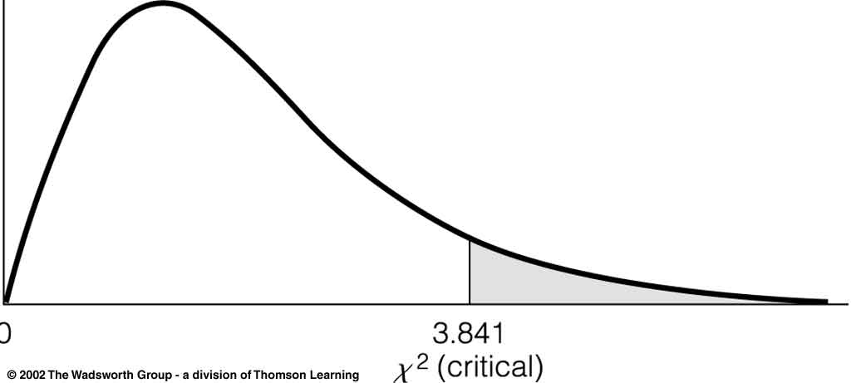
Review: Lecture 12 Concepts
Significance: the Chi-squared test
Compares the observed frequency (f₀, our table) to the expected frequency (fₑ, what would happen if the two variables were independent).
fₑ = (Row Total × Column Total) ÷ Grand Total
df = (# of rows − 1)(# of columns − 1)
Try it: expected count for Male & Housework (yes) = 70 × 100 ÷ 200 = 35. We observed 20, so the gap is 15.
It is a one-tailed test: is the difference “greater than” a critical value? (3.841 for df = 1, alpha = 0.05)
Notes:
Expected frequencies for the housework table: yes row = 35 and 35; no row = 65 and 65. chi-square = sum of (fo - fe)^2 / fe = 225/35 + 225/35 + 225/65 + 225/65 = 19.78, matching the R output.

Slide 34
Review: Lecture 12 Concepts
4 Steps of Chi-squared Tests, with R
(1) Construct H0 and H1
H0: There is no relationship between the two variables in the population, i.e. they are independent. H1: There is an association between the two variables in the population, i.e. they are not independent.
(2) Get the p-value from the R output
P-value in chi2 test = the probability of independence.
(3) Compare p-value to the alpha level
Usually 0.05 (or 0.01).
(4) Make a decision about H0
P-value < 0.05: reject H0, the variables are associated. P-value >= 0.05: failed to reject H0, the variables are independent.
Notes:
Professor's wording. See 'Wordings That Also Work' for the alternative phrasing of steps 2 and 4.

Slide 35
Review: Lecture 12 Concepts
Worked example: sex and housework
> chisq.test(df$housework, df$sex, correct=FALSE)
Pearson's Chi-squared test
data: df$housework and df$sex
X-squared = 19.78, df = 1, p-value = 8.688e-06
Interpret the three measures
1. Pattern: Females are more likely to do housework than males.
2. Strength: Moderate to strong (30% points).
3. Significance: p < 0.05, the association is statistically significant in the population.
(1) H0: no relationship between sex and doing housework in the population. H1: there is an association.
(2) p-value = 0.000008688
(3) 0.000008688 << 0.05
(4) Reject H0.

Slide 36
Review: Lecture 12 Concepts
Finally, write a summary. Template: strength + pattern + significance
Our sample data indicates that there is a moderate to strong association [strength] between sex and the habit of doing housework. Particularly, females are more likely to do housework than males [pattern]. A chi-squared test shows that this association is statistically significant in the population at the 0.05 significance level, with a p-value of 0.0000087 [significance].
This is the exact structure HW9 Q7 asks for.

Slide 37
Review: Lecture 12 Concepts
Recap: Bivariate Categorical Analysis
Association between | Direction / pattern | Strength | Significance
Two categorical variables | Contingency table: which one is X and which is Y? Calculate row or col % along X. Compare % point difference across X categories. | Roughly: % point difference. Precisely: odds ratio, relative risks, etc. (advanced stats course) | Chi-squared test: p-value >= 0.05: no association. p-value < 0.05: significant association.

Slide 38
Check Your Understanding
In table(gss$sex, gss$happy), which variable is in the rows, and which percentages would you use if sex is X?
Hint: Think: 1st variable in table() = ?
1
A chi-squared test gives p-value = 0.32. What is your decision about H0 at the 0.05 level?
Hint: Compare p to alpha
2
In the housework table, what is the expected count for Female & Housework (yes)?
Hint: fₑ = row total × column total ÷ grand total
3
Notes:
ANSWERS: (1) sex is in the rows, so use row percentages (margin = 1). (2) 0.32 >= 0.05, so fail to reject H0. (3) 70 x 100 / 200 = 35.

