Slide 1

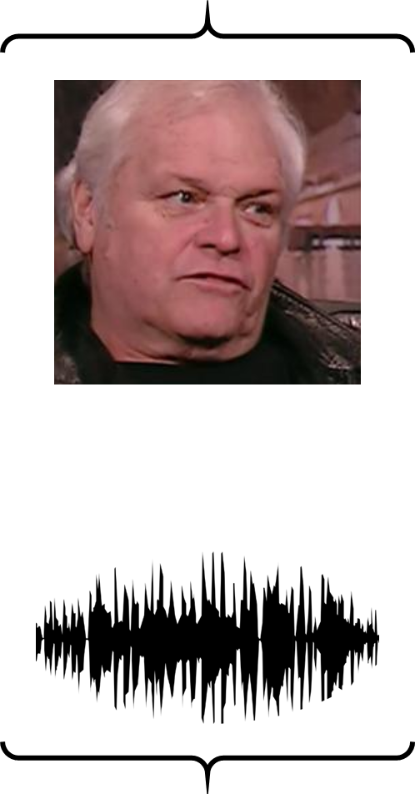





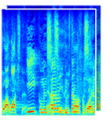

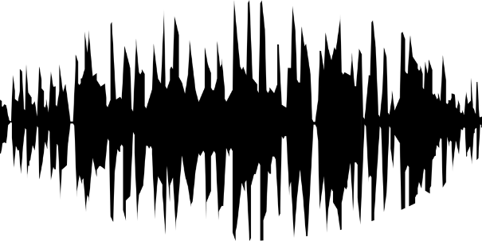
Millions of natural videos
Face Recognition
4096-D Face Feature
0
1
5
8
76
6
: Pre-trained & fixed
Loss
: Trainable
Speech-Face pairs
Voice Encoder
Face Decoder
Recon. Face
Spectrogram
Waveform
4353764
Speech2Face Model

