Slide 1
Computational Statistics
Midterm project
Delafontaine F., Micheli P. & Maliki N.

Slide 2
Project midterm
Kaggle dataset (House Prices)
Data exploration
Data cleaning/transformation
Feature selection
Model test (linear regression)

Slide 3
Project midterm
Data:
1460 datapoints (training set), 79 features (+id)
Continuous dependent variable (‘SalePrice’)
33 numeric variables (including dates, surfaces, scales…), 46 categorical variables (including scales…)

Slide 4
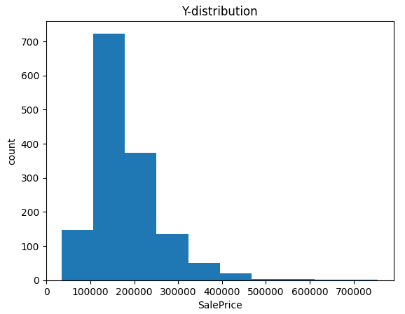
Project midterm
No ‘NaN’ value to clean.
‘SalePrice’ is skewed => log-scale
Applied to ‘LotArea’ as well.
y = np.log(df[‘SalePrice’])
X.insert(0, "log_LotArea", np.log(X['LotArea’])) X = X.drop('LotArea', axis=1)

Slide 5
Project midterm
Some categorical features turned to numeric scales
d = {'Po':1, 'Fa':2, 'TA':3, 'Gd':4, 'Ex':5} X['n_ExterQual'] = [d[k] for k in X['ExterQual']]; X = X.drop('ExterQual', axis=1) …
‘Neighborhood’ especially, using increments of ~20k.
d_neigh = { 'CollgCr': (197965.77, 6), 'Veenker': (238772.72, 8), …, 'SWISU': (142591.36, 3), 'Blueste': (137500.0, 2) } X['n_Neighborhood'] = [d_neigh[k][1] for k in X['Neighborhood']] X = X.drop('Neighborhood', axis=1)
Partly to avoid dummy variables, partly to simplify the model.

Slide 6
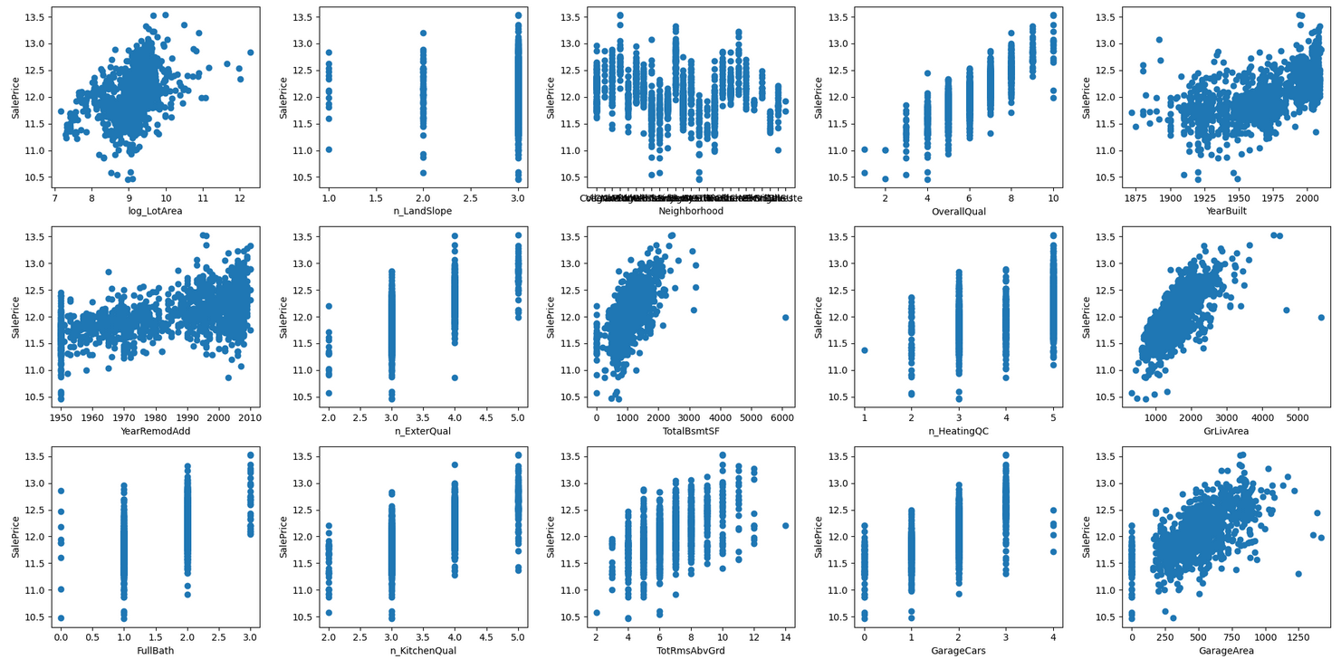
Project midterm
Feature selection
Simple visualisation of all 79 features
15 selected
(/!\ correlations, check model assumptions)
(Neighborhood not yet transformed...)

Slide 7
Project midterm
First model (linear regression)
X_tr, X_te, y_tr, y_te = skl_tts(nX, y, test_size=0.2) model = lm().fit(X_tr, y_tr) # R2 = 0.86 y_pred = model.predict(X_te) # MSE = 0.02
Too early: feature selection remains priority
All relations seem linear
Avoid correlations among independent variables

