Slide 1
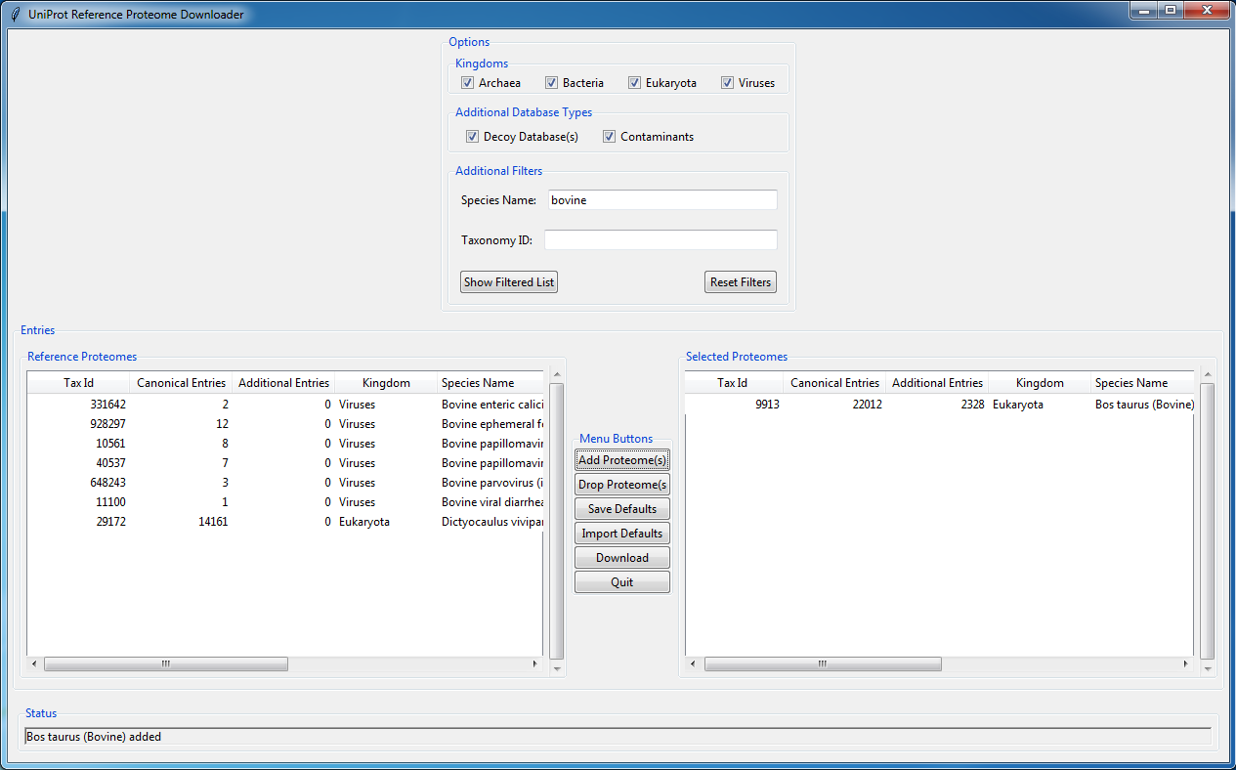
User Guide “reference_proteome_manager.py”

Slide 2
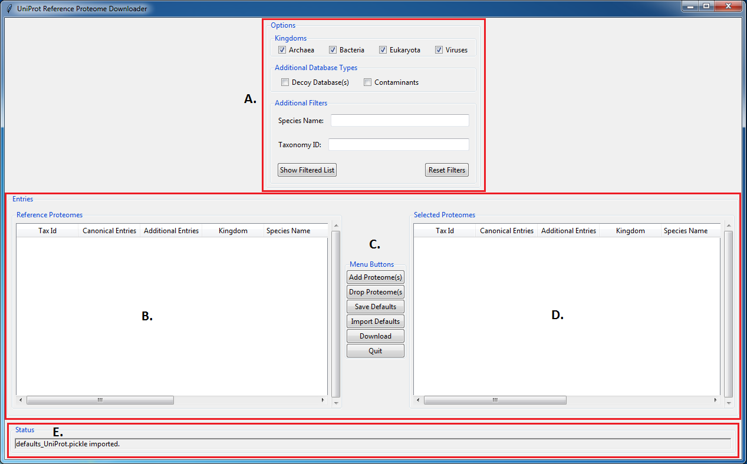
Overview
The general program flow is as follows:
Select kingdom filters and type in any partial word/phrase and taxonomy number into respective search bars and press the “Show Filtered List” button to display all relevant databases into the left display table. You can also select whether or not you want decoy databases and/or common contaminants in your fasta files
Here you can then select databases and using the “Add Proteome(s)” button add databases to the right display table. This table represents all databases that are to be downloaded.
Notable buttons here include the “Save Defaults” and “Import Defaults” buttons. These buttons allow the user to save current selections in the right display table to a defaults file, or import databases from a previously saved defaults file.
This display table shows all selected databases that the user wants to download.
Press “Download Databases” to download all fasta files.
F. This status bar will display any changes made to either display box including adding/dropping proteomes, refiltering the database list, and downloading files.

Slide 3
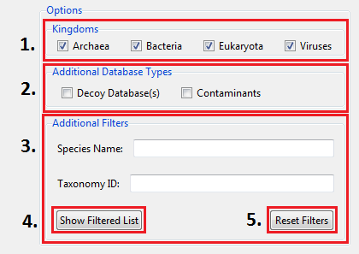
Filters Description
The “Kingdoms” checkboxes allow the user to narrow database list by the kingdom their species belongs to.
The “Additional Database Types” checkboxes allow the user to decide whether or not downloaded fasta files should include reverse sequences and/or common contaminants.
The “Species Name” search bar allows the user to type in either a partial word/phrase or complete word/phrase that match the name of the desired species. The “Taxonomy ID” search bar allows the user to type in either a full or partial taxon number that matches their desired species.
The “Show Filtered List” button will output all species that match the desired filters.
The “Reset Filters” button will clear all search bars and re-select all kingdoms.
Note: It is completely valid to have empty search bars including kingdoms. Also, if “Decoy Database(s)” is selected, “*_rev” will be appended to the file name. If “Contaminants” is selected, “*_for” will be appended. If both are selected, “*_both” will be appended.

Slide 4
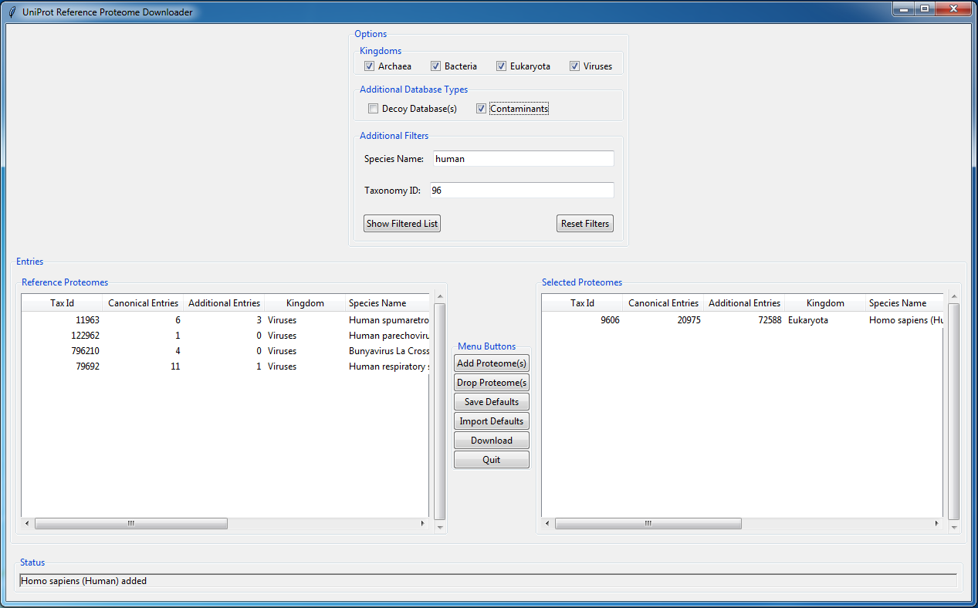
Filters Example
Here I have left all kingdoms selected and searched with keyword “human” and “96” as a partial taxon number. I also selected the “Homo sapiens” database to be downloaded, and the resultant fasta file will include common contaminants.

Slide 5
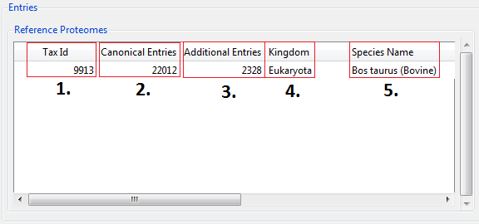
Display Tables Description
“Tax Id”: outputs the taxonomy number of the species.
“Canonical Entries”: outputs the number of canonical sequences in the database
“Additional Entries”: outputs the number of isoform sequences in the database
“Kingdom”: outputs the kingdom the species belongs to
“Species Name”: outputs the species name
Note: All of these headers can be extended. Furthermore, clicking on the header will sort the database list either alphabetically or numerically depending on the header. Also, all of these descriptions are the same for both display tables (Reference Proteomes and Selected Proteomes)

Slide 6
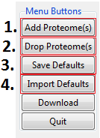
Menu Buttons
“Add Proteome(s)”: moves database(s) from the left display table to the right display table (Reference Proteomes → Selected Proteomes).
“Drop Proteome(s): moves database(s) from the right display table to the left display table (Reference Proteomes ← Selected Proteomes).
“Save Defaults”: saves all databases in the right display table (Selected Proteomes) to a defaults file in the directory the user selects.
“Import Defaults”: imports the databases stored in a defaults file to the right display table (Selected Proteomes)

Slide 7
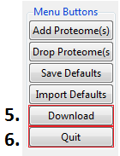
Menu Buttons cont’d
“Download Databases”: downloads all of the databases shown in the Selected Proteomes display table to the user selected folder. Currently, “reference_proteome_manager.py” is configured to download only *.fasta.gz and *_additional.fasta.gz files from the UniProt FTP download site.
The program will save all selected databases into a common “UniProt_(date)” folder, where “date” is the release date of the databases ie. 2017.07.
Each database will have its own folder named in the following convention “(date)_(proteome ID)_(Species Name)”.
The *.gz files are then unzipped and a *_all.fasta file and *_canonical.fasta file are placed in the common UniProt folder.
The naming convention for these files is “(proteome ID)_(taxonomy ID)_(species name)_all.fasta” or “(proteome ID)_(taxonomy ID)_(species name)_canonical.fasta”.
*_all.fasta file includes both canonical and isoform sequences.
“Quit”: will quit out of the program. If any changes have been made to the Selected Proteomes display table, the user will be prompted to save the current databases to a new defaults file.

Slide 8
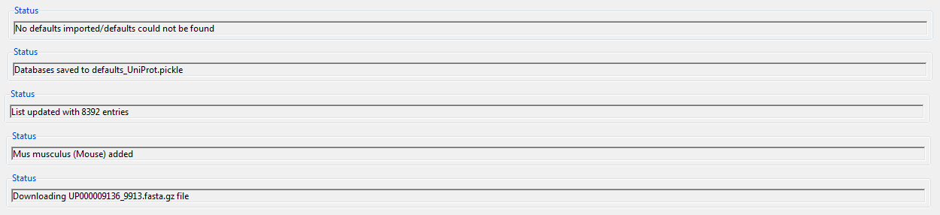
Status Bar Updates
These are some common messages that the status bar will provide as the user interacts with the program.

