Slide 1
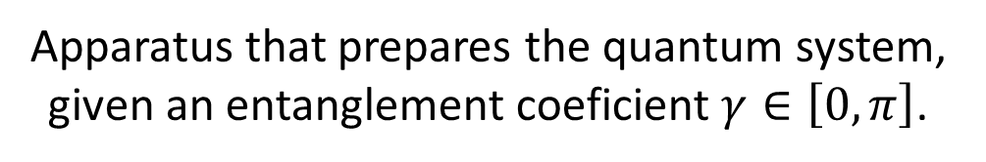


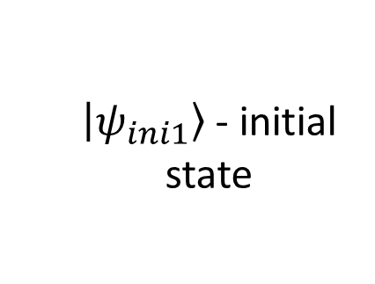







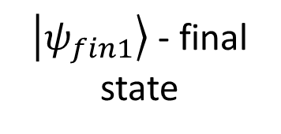




$\left.\left|ψ_{ini1}\right.\right\rangle$ - initial state
Each player chooses an operator
$\left.\left|ψ_{fin1}\right.\right\rangle$ - final state
$$\left.\left|φ_{1}\right.\right\rangle$$
$$\left.\left|φ_{1}\right.\right\rangle$$
$${𝒰 }_{1}$$
C
D
$$\left.\left|φ_{2}\right.\right\rangle$$
$$\left.\left|φ_{2}\right.\right\rangle$$
$${𝒰 }_{2}$$
C
D
$$\left.\left|φ_{3}\right.\right\rangle$$
$${𝒰 }_{3}$$
$$\left.\left|φ_{3}\right.\right\rangle$$
C
D
Apparatus that prepares the quantum system, given an entanglement coeficient $γ∈\left[0, π\right]$.

Slide 2
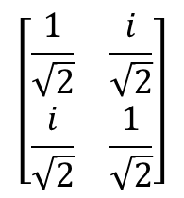
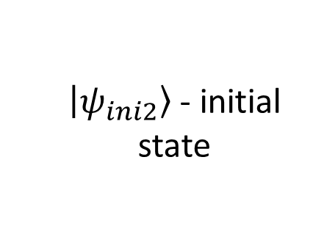

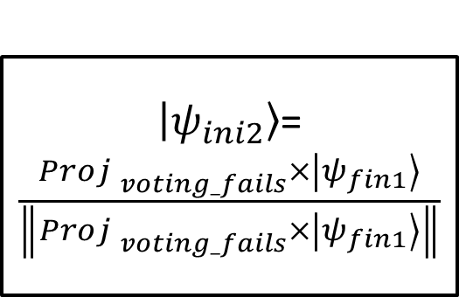
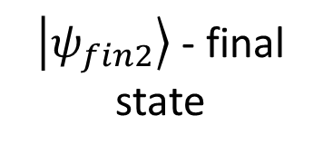
$\left.\left|ψ_{ini2}\right.\right\rangle$ - initial state
Each player chooses an operator
$\left.\left|ψ_{fin2}\right.\right\rangle$ - final state
$$\left[\begin{matrix}\frac{1}{\sqrt{2}} & \frac{i}{\sqrt{2}} \\ \frac{i}{\sqrt{2}} & \frac{1}{\sqrt{2}}\end{matrix}\right]$$
$$H$$
$\left.\left|ψ_{ini2}\right.\right\rangle$=$\frac{{Proj }_{voting_fails}×\left.\left|ψ_{fin1}\right.\right\rangle }{\left\|{Proj }_{voting_fails}×\left.\left|ψ_{fin1}\right.\right\rangle \right\|}$
$$\left.\left|φ_{2}\right.\right\rangle$$
$${𝒰 }_{2}$$
C
D
Lüder’s Rule is used to perform an intermediate measuring.
$${𝒰 }_{3}$$
$$\left.\left|φ_{3}\right.\right\rangle$$
C
D

Slide 3
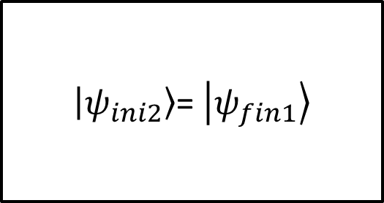
$\left.\left|ψ_{ini2}\right.\right\rangle$ - initial state
Each player chooses an operator
$\left.\left|ψ_{fin2}\right.\right\rangle$ - final state
$$\left[\begin{matrix}\frac{1}{\sqrt{2}} & \frac{i}{\sqrt{2}} \\ \frac{i}{\sqrt{2}} & \frac{1}{\sqrt{2}}\end{matrix}\right]$$
$$H$$
$\left.\left|ψ_{ini2}\right.\right\rangle$= $\left.\left|ψ_{fin1}\right.\right\rangle$
$$\left.\left|φ_{2}\right.\right\rangle$$
$${𝒰 }_{2}$$
C
D
Lüder’s Rule is used to perform an intermediate measuring.
$${𝒰 }_{3}$$
$$\left.\left|φ_{3}\right.\right\rangle$$
C
D

Slide 4







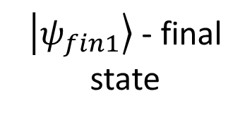



$\left.\left|ψ_{fin1}\right.\right\rangle$ - final state
$${𝒰 }_{2}$$
$$\left.\left|φ_{2}\right.\right\rangle$$
C
D
$$\left.\left|φ_{1}\right.\right\rangle$$
$${𝒰 }_{3}$$
Measurement
$$\left.\left|φ_{3}\right.\right\rangle$$
C
D
$$\left.\left|φ_{2}\right.\right\rangle$$
$$\left.\left|φ_{2}\right.\right\rangle$$
No Measurement
$$\left.\left|φ_{3}\right.\right\rangle$$
$$\left.\left|φ_{3}\right.\right\rangle$$

Slide 5
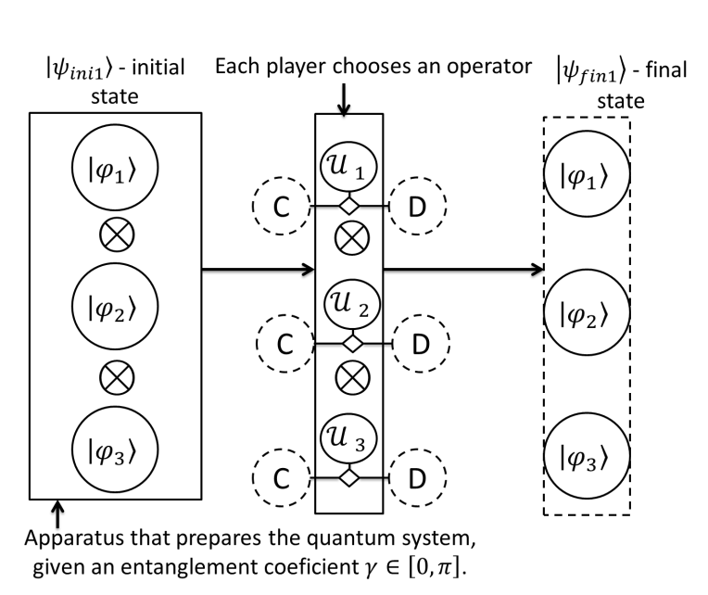
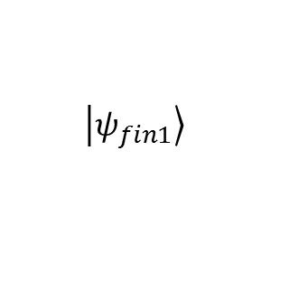
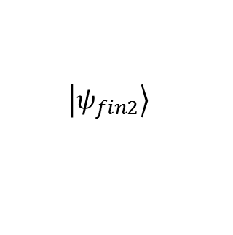
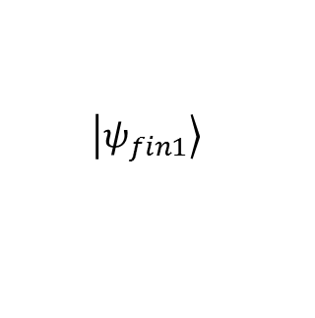
Step 1: 3 pirates, the player 1 makes a proposal by specifying $(α_{1},α_{2},α_{3})$
Player 1 payoff
Player 2 payoff
Player 3 payoff
Measure
$$\left.\left|ψ_{fin1}\right.\right\rangle$$
Step 2: 2 pirates, the player 2 makes a proposal by specifying $(α_{2},α_{3})$
Subgame with 2 players after an intermediate measuring step.
Player 2 step 2 payoff
Player 3 step 2 payoff
Measure
$$\left.\left|ψ_{fin1}\right.\right\rangle$$
Subgame with 2 players without an intermediate measuring step.
$$\left.\left|ψ_{fin2}\right.\right\rangle$$

Slide 6
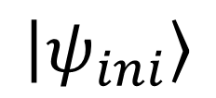
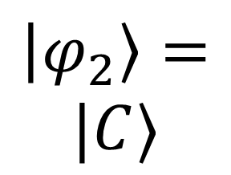
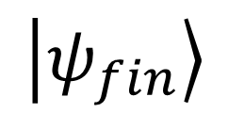
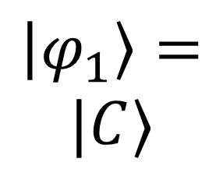


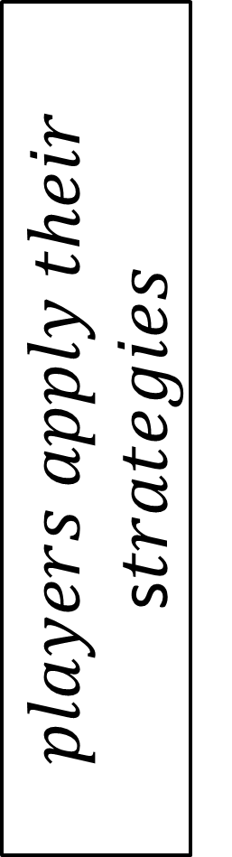
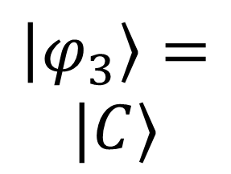

$$𝒥$$
$$players apply their$$
s$trategies$
$${𝒥 }^{†}$$
$$measurement$$
$$\left.\left|φ_{1}\right.\right\rangle =$$
$$|C〉$$
$$\left.\left|ψ_{ini}\right.\right\rangle$$
$$\left.\left|ψ_{fin}\right.\right\rangle$$
$$\left.\left|φ_{2}\right.\right\rangle =$$
$$|C〉$$
$$\left.\left|φ_{3}\right.\right\rangle =$$
$$|C〉$$

Slide 7

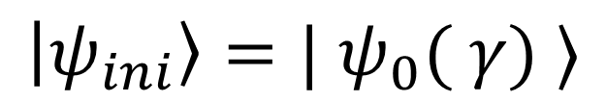

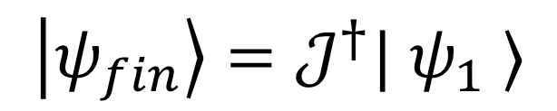
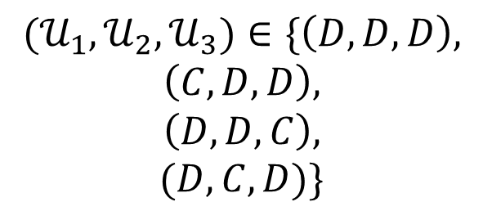
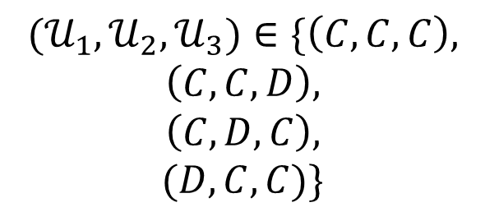

$$\left.\left|ψ_{ini}\right.\right\rangle =| ψ_{0}( γ) 〉$$
$$\left.\left|ψ_{1}\right.\right\rangle ={(𝒰}_{1}⊗𝒰_{2}⊗𝒰_{3})| ψ_{ini}〉$$
$${(𝒰}_{1},𝒰_{2},𝒰_{3})∈\{\left(C,C,C\right),$$
$$\left(C,C,D\right),$$
$$\left(C,D,C\right),$$
$$(D,C,C)\}$$
$${(𝒰}_{1},𝒰_{2},𝒰_{3})∈\{\left(D,D,D\right),$$
$$\left(C,D,D\right),$$
$$\left(D,D,C\right),$$
$$(D,C,D)\}$$
$$\left.\left|ψ_{2}\right.\right\rangle =(H⊗𝒰_{2}⊗𝒰_{3})| ψ_{1}〉$$
$$\left.\left|ψ_{fin}\right.\right\rangle =𝒥^{†}| ψ_{1} 〉$$
$$\left.\left|ψ_{fin}\right.\right\rangle =𝒥^{†}| ψ_{2} 〉$$
$$measure final state$$

Slide 8
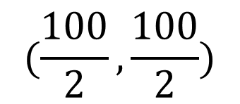
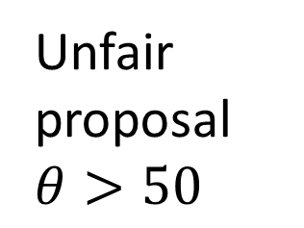



Player 1
Fair proposal
Unfair proposal $θ>50$
Player 2
Player 2
Accept
Reject
Accept
Reject
$$(\frac{100}{2},\frac{100}{2})$$
$$(θ,100−θ)$$
$$(0,0)$$
$$(0,0)$$

Slide 9
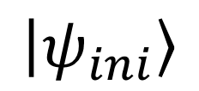
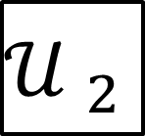
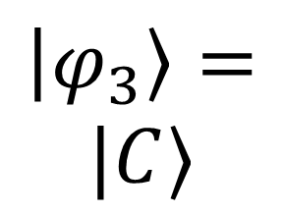
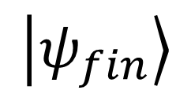
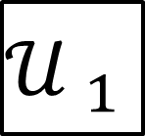
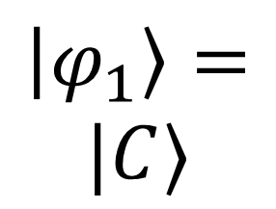
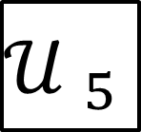

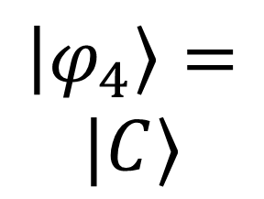

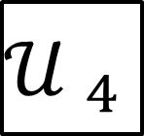
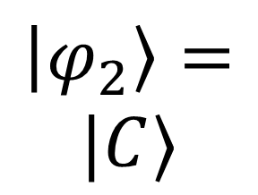
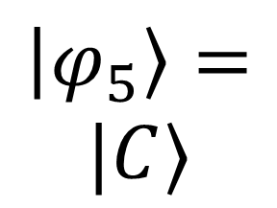
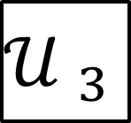
$$\left.\left|φ_{1}\right.\right\rangle =$$
$$|C〉$$
$$𝒥$$
$${𝒥 }^{†}$$
$${𝒰 }_{1}$$
$$measurement$$
$$\left.\left|ψ_{ini}\right.\right\rangle$$
$$\left.\left|ψ_{fin}\right.\right\rangle$$
$$\left.\left|φ_{2}\right.\right\rangle =$$
$$|C〉$$
$${𝒰 }_{2}$$
$$\left.\left|φ_{3}\right.\right\rangle =$$
$$|C〉$$
$${𝒰 }_{3}$$
$$\left.\left|φ_{4}\right.\right\rangle =$$
$$|C〉$$
$${𝒰 }_{4}$$
$$\left.\left|φ_{5}\right.\right\rangle =$$
$$|C〉$$
$${𝒰 }_{5}$$

