Slide 1
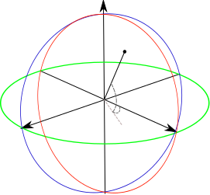




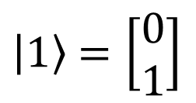






$$\left.\left|0\right.\right\rangle =\left[\begin{matrix}1 \\ 0\end{matrix}\right]$$
$$\hat{z }$$
$$\frac{1}{\sqrt{2}}\left[\begin{matrix}1 \\ −1\end{matrix}\right]$$
$$\frac{1}{\sqrt{2}}\left[\begin{matrix}1 \\ −i\end{matrix}\right]$$
$$α$$
$$\hat{y }$$
$$\hat{x }$$
$$β$$
$$\frac{1}{\sqrt{2}}\left[\begin{matrix}1 \\ i\end{matrix}\right]$$
$$\frac{1}{\sqrt{2}}\left[\begin{matrix}1 \\ 1\end{matrix}\right]$$
$\left.\left|1\right.\right\rangle$ $=\left[\begin{matrix}0 \\ 1\end{matrix}\right]$

Slide 2

$$\left.\left|0\right.\right\rangle =\left[\begin{matrix}1 \\ 0\end{matrix}\right]$$
$$\hat{z }$$
$$\frac{1}{\sqrt{2}}\left[\begin{matrix}1 \\ −1\end{matrix}\right]$$
$$\left.\left|ψ\right.\right\rangle$$
$$\frac{1}{\sqrt{2}}\left[\begin{matrix}1 \\ −i\end{matrix}\right]$$
$$α$$
$$\hat{y }$$
$$\hat{x }$$
$$β$$
$$\frac{1}{\sqrt{2}}\left[\begin{matrix}1 \\ i\end{matrix}\right]$$
$$\frac{1}{\sqrt{2}}\left[\begin{matrix}1 \\ 1\end{matrix}\right]$$
$\left.\left|1\right.\right\rangle$ $=\left[\begin{matrix}0 \\ 1\end{matrix}\right]$

