Slide 1
RESTful Ontology Metadata Extractor/Storage System
Alireza Khatamian
Delaram Rahbarinia
Zhe Jin

Slide 2
Introduction
Problem
Inconvenient process of manually navigate through ontologies to find out about their schema
The need of knowledge about the entities and their relations
Solution
A web-based ontology storage and SPARQL query interface too lookup schema vocabularies
Ontology Browser

Slide 3
Overall Goal
Implementing RESTful ontology metadata extractor/storage system (RESTOMES)
Using existing ontologies in the system or loading a new ontology to browse for:
Classes
Sub Classes
Disjoint Classes
Object Properties
Domain
Range
Inverse of
Datatype Properties
Domain
Range

Slide 4
Tools and Technologies
RESTful Web Service
JAX-RS
JAVA
JBOSS
HTML
Apache Jena
SPARQL

Slide 5
RESTOMES Architecture
Browser Client
Client Side
HTTP
Server Side
Application Server
Resources

Slide 6
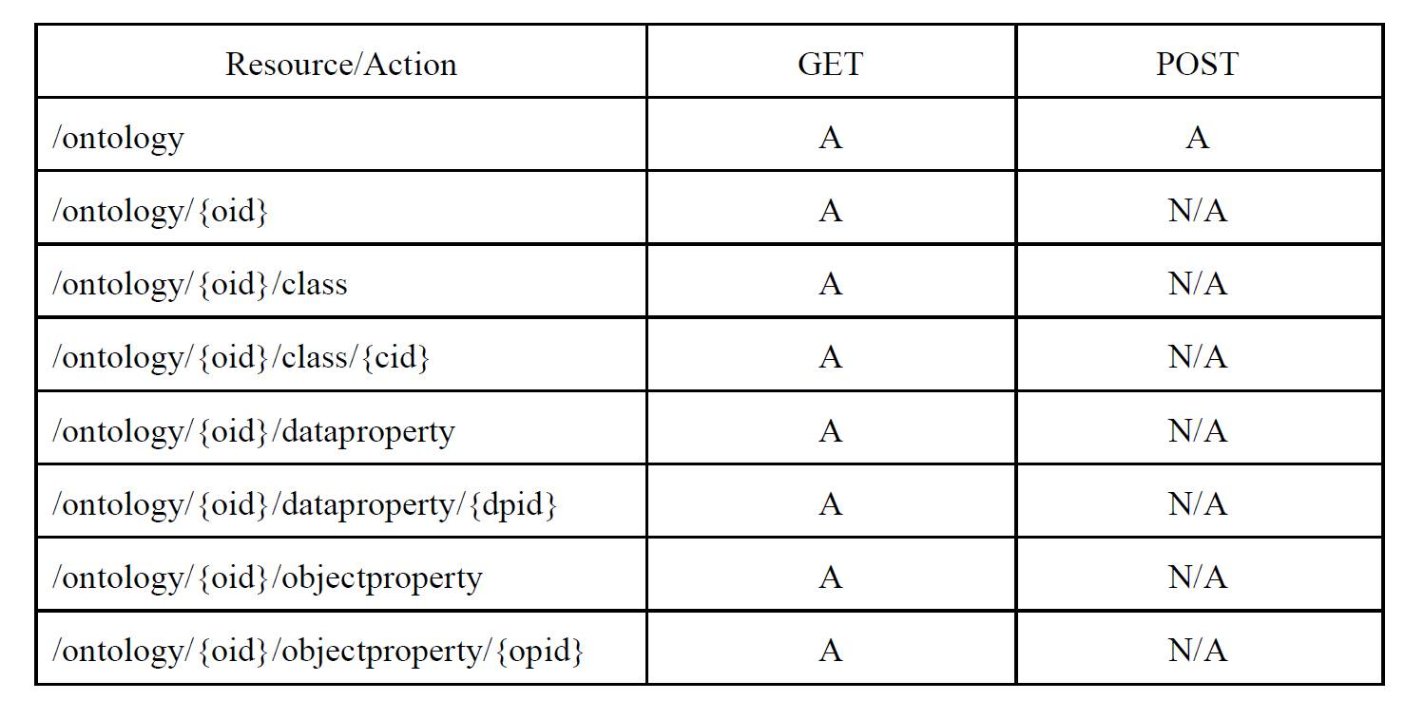
Resource/Action

Slide 7
Quick demo of the system…

Slide 8

Thank You!

