Slide 1
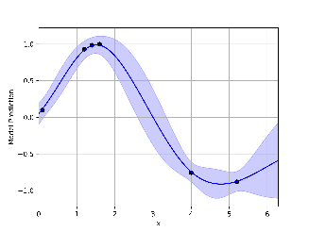

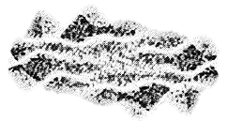






Model Repertoire
Gaussian Process
Overlap Kernel
Transformed Overlap Kernel
Diffusion Kernel
SSK Kernel
Linear Regression
MLE
Bayes
Horseshoe Prior
Sparse Horseshoe Prior
Optimiser
Fit Model
Data Buffer
observe
$$y_{next}$$
$$(x_{1}, y_{1})$$
$$…$$
Task
$$(x_{n}, y_{n})$$
Construct
Acquisition
Optimise Acquisition
suggest
$$x_{next}$$
Acquisition Function Repertoire
Acquisition Optimiser Repertoire
Task Repertoire
Synthetic Task
21 SFU test Functions
Pest Control
TSP
Real-World Tasks
Antibody Design
Inverse RNA Folding
3 Logic Synthesis
Lower Confidence Bound
Expected Improvement
Thompson Sampling
Local Search
Simulated Annealing
Trust-Region-Based Local Search
Genetic Algorithm

