Slide 1
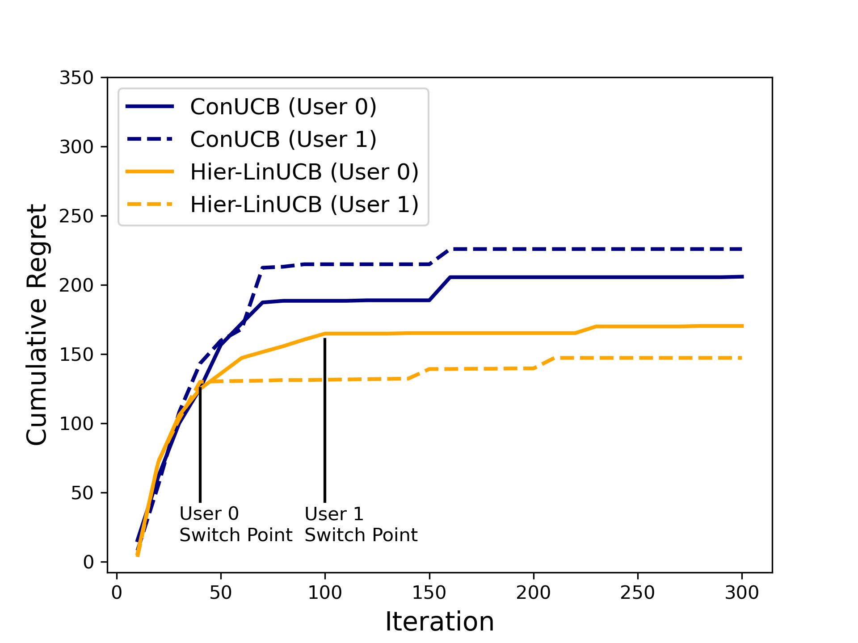
Key-term
Recommendation

