Slide 1
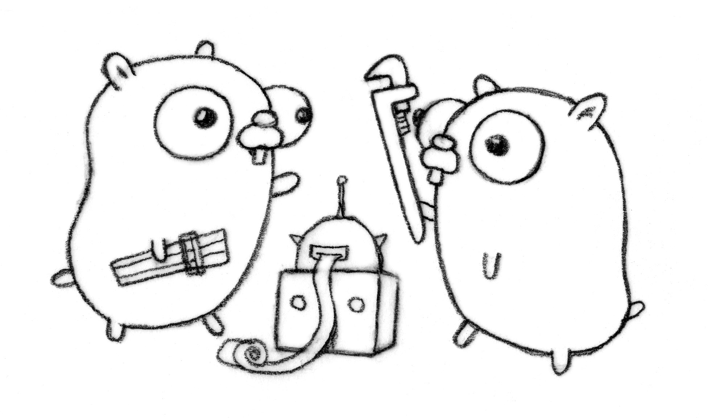

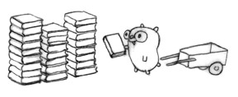
Go language banter
Good design
Wow
Much wonderful
<numéro>

Slide 2


Entry points
nice online tutorial
74 steps
online compiler
all documentations
tour.
play.
doc.
golang.org
„Effective Go“ : a must-read
<numéro>

Slide 3
Language features
Compiled
Statically-typed
Fast compilation,
fast execution
Garbage collection
Interfaces
Pointers
Slices
Maps
Concise syntax
readable
Easy to learn
Concurrency with goroutines and Channels
Functions are first-class
Reflection
<numéro>

Slide 4
Community
Designed by a
small committee of rockstars
Lots of official packages
  Networking
  Encoding
  Templating
  etc.
  etc.
Lots of user packages
Already used in production
Available on Google App Engine
Mailing list
Forums
<numéro>

Slide 5
Multiple results
A function can return any number of values
http://tour.golang.org/#9
http://play.golang.org/p/0po_GGkrLz
func donaldsNephews() (string, string, string) {
return "Huey", "Dewey", "Louie"
}
func main() {
a, b, c := donaldsNephews()
...
<numéro>

Slide 6
Variable declaration and initializer
Declaration var
Assignment =
Declaration,
type inference
and initialization :=
var i, j int = 1, 2
i = 4
k := 3
c, python, java := true, false, "no!"
http://tour.golang.org/#13
<numéro>

Slide 7
For
for i := 0; i < 10; i++ {
sum += i
}
for sum < 1000 {
sum += sum
}
for k, v := range myMap {
fmt.Printf("myMap[%v]=%v \n", k, v)
}
Just for !
http://tour.golang.org/#18
<numéro>

Slide 8
If
if a == b {
return true
}
if v := math.Pow(x, n); v < lim {
return v
}
http://tour.golang.org/#23
<numéro>

Slide 9
Struct
type Vertex struct {
X int
Y int
}
v := Vertex{1, 2}
w := Vertex{
Y:4,
X:3,
}
http://tour.golang.org/#26
<numéro>

Slide 10
Pointer
var q *Vertex
p := Vertex{1, 2}
q = &p
q.X = 1000
Symbols * and &
Indirection through the pointer is transparent.
http://tour.golang.org/#28
<numéro>

Slide 11
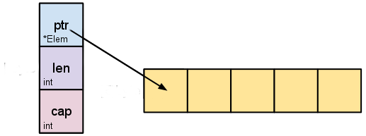
Arrays
[10]int is a type
Cannot be resized
Boring
Slices
lightweight
(like a "smart pointer")
safe access
http://tour.golang.org/#31
http://blog.golang.org/go-slices-usage-and-internals
<numéro>

Slide 12
Slicing
a := make([]int, 5)
b := make([]int, 0, 5)
p := []int{2, 3, 5, 7}
q := p[1:3]
p = append(p, 11)
len, cap
shared underlying array
reallocation auto
(sometimes needed, sometimes not)
http://tour.golang.org/#32 and following
<numéro>

Slide 13
Map
Built-in type
Typed keys and values
Values : any type
Keys : any comparable type
var m map[string]Vertex
m = make(map[string]Vertex)
m["Bell Labs"] = Vertex{
40.68433, -74.39967,
}
v, ok := m["Bull"]
http://tour.golang.org/#39 and following
<numéro>

Slide 14
Function
func square(x float64) float64{
return x*x;
}
hypot := func(x, y float64) float64 {
return math.Sqrt(x*x + y*y)
}
z := hypot(3, 4)
First-class
Typed
As argument
As return value
Named parameters and return values
(optional)
Closures
http://tour.golang.org/#44 and following
<numéro>

Slide 15
Switch
Multi-purpose :
  over variable value
  over arbitrary conditions (like if-then-else chains)
  over types
os := runtime.GOOS
switch os {
case "darwin":
fmt.Println("OS X.")
case "linux":
fmt.Println("Linux.")
default:
fmt.Printf("%s.", os)
}
http://tour.golang.org/#47
<numéro>

Slide 16
Method
http://tour.golang.org/#52
struct
or (preferably) pointer
or slice, map, func ! (as renamed types)
Receiver
type Vertex struct {
X, Y float64
}
func (v *Vertex) Abs() float64 {
return math.Sqrt(v.X*v.X + v.Y*v.Y)
}
<numéro>

Slide 17
Interface
Lean OO-style
Implicit implementation !
Great decoupling
http://tour.golang.org/#55
type Writer interface {
Write(p []byte) (n int, err error)
}
<numéro>

Slide 18
Error
Idiomatic : return an error as last value
  then the caller checks if the error is nil
Or use panic/recover
  like a try/catch
  rare
  defer can be useful
x, err := Sqrt(-1)
if err != nil {
fmt.Println(err)
}
http://tour.golang.org/#57
<numéro>

Slide 19
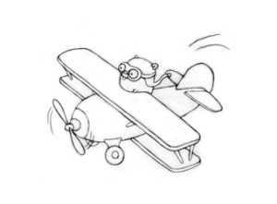
Concurrency
Concurrency is not parallelism
A model for software construction :
Communicating Sequential Processes
http://talks.golang.org/2012/concurrency.slide
<numéro>

Slide 20
Goroutine
Concurrent
Parallel (or not!)
Lightweight
Cheap (kind of)
var delay = 100 * time.Millisecond
func say(s string) {
for i := 0; i < 5; i++ {
time.Sleep(delay)
fmt.Println(s)
}
}
func main() {
go say("world")
say("hello")
}
http://tour.golang.org/#65
<numéro>

Slide 21
Channel
func worker(in chan *A, out chan *B){
for {
a := <- in
b := transform(a)
out <- b
}
}
Producer-consumer
  Sending values
  Receiving values
Proper synchronization
Blocking, or buffered
in := make(chan *A)
out := make(chan *B)
for i := 0; i < NumWorkers; i++ {
go worker(in, out)
}
go sendLotsOfWork(in)
receiveLotsOfResults(out)
fmt.Println("Done.")
http://tour.golang.org/#66
http://play.golang.org/p/a18jzvsFC2
<numéro>

Slide 22
Select
Wait for event
Syntax
  like a switch
Channels
  input and/or output
Timeout
func fibonacci(c, quit chan int) {
x, y := 0, 1
for {
select {
case c <- x:
x, y = y, x+y
case <-quit:
fmt.Println("quit")
return
}
}
}
http://tour.golang.org/#69
<numéro>

Slide 23
Templating
Template "compilation"
Actions
Pipelines
{{define "sub"}}
{{range .}}>> {{.}} {{end}}
{{end}}
*The great GopherBook*
(logged in as {{.User}})
[Most popular]{{template "sub" .Popular}}
[Most active] {{template "sub" .Active}}
[Most recent] {{template "sub" .Recent}}
http://golang.org/pkg/text/template
http://golang.org/pkg/html/template
<numéro>

Slide 24
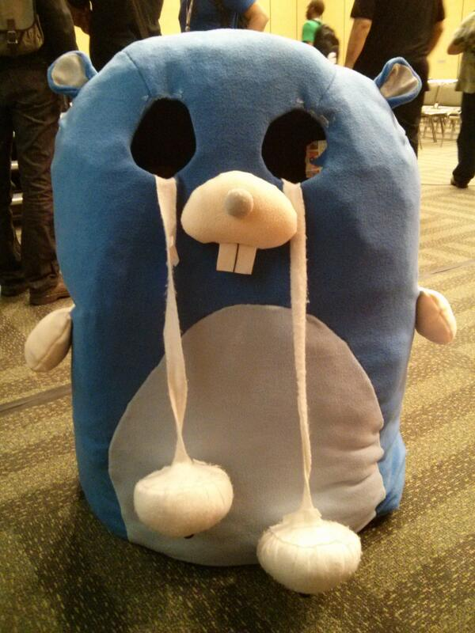
What is missing
generics
  but interfaces do the job !
i18n
browser runtime
  go is not a competitor of javascript for client-side,
  but translators exist
a good debugger
enforced immutability
<numéro>

Slide 25

Thank you
Text: WTFPL
Pics: CC3.0 R.F.
Go and have fun
Go and build servers

