Slide 1
A Data-driven Approach for Maximizing Traffic via Enhanced Recipe Selection
Ryan Maroun
4 September 2024

Slide 2
An Introduction
What motivates this project?
The clients informed us that the amount of engagement their website received was highly dependent on the recipe featured on their front page. Certain recipes caused an increase as high as 40%. This information can be leveraged to increase website traffic.

Slide 3
Aim
Given serving size, category, and nutritional information
→ predict whether or not a recipe would yield high traffic if featured on the front page.

Slide 4
01
03
Model Building
Cleaning
Data is cleaned and validated to ensure that downstream analysis is sound and lacks erroneous conclusions.
Machine Learning models are built with the purpose of predicting the potential of every recipe.
02
04
Preprocessing
Recommendation
Dataset is transformed and reformatted in ways that would be beneficial to model building.
The problem is viewed again from a business lens, and recommendations are made based on the data.

Slide 5
1- Data Cleaning
Missing values in the nutrition related columns were imputed with the median.
Recipes of the “Chicken Breast” category were changed to “Chicken”.
Servings “4 as a snack” and “6 as a snack” were converted to 4 and 6 respectively.
Recipes with discrepant nutritional values were found but kept.

Slide 6
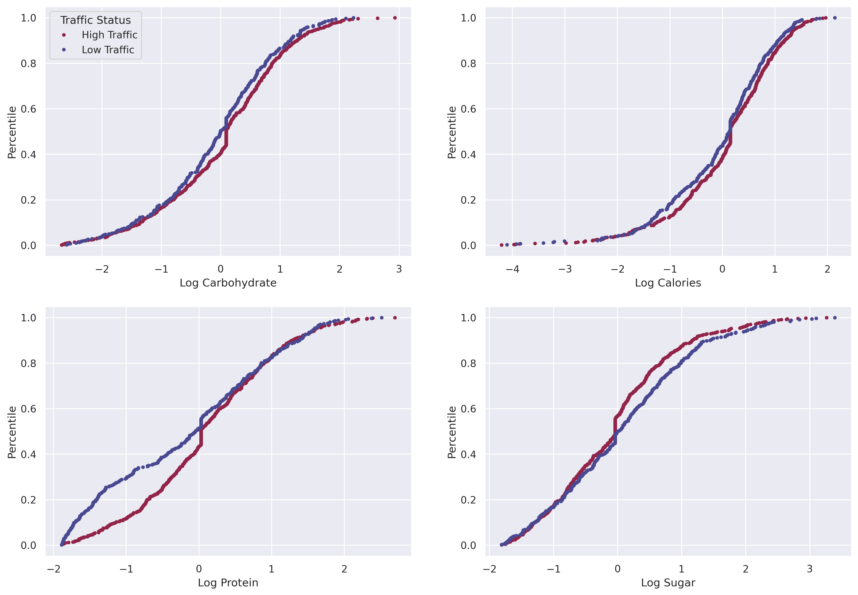
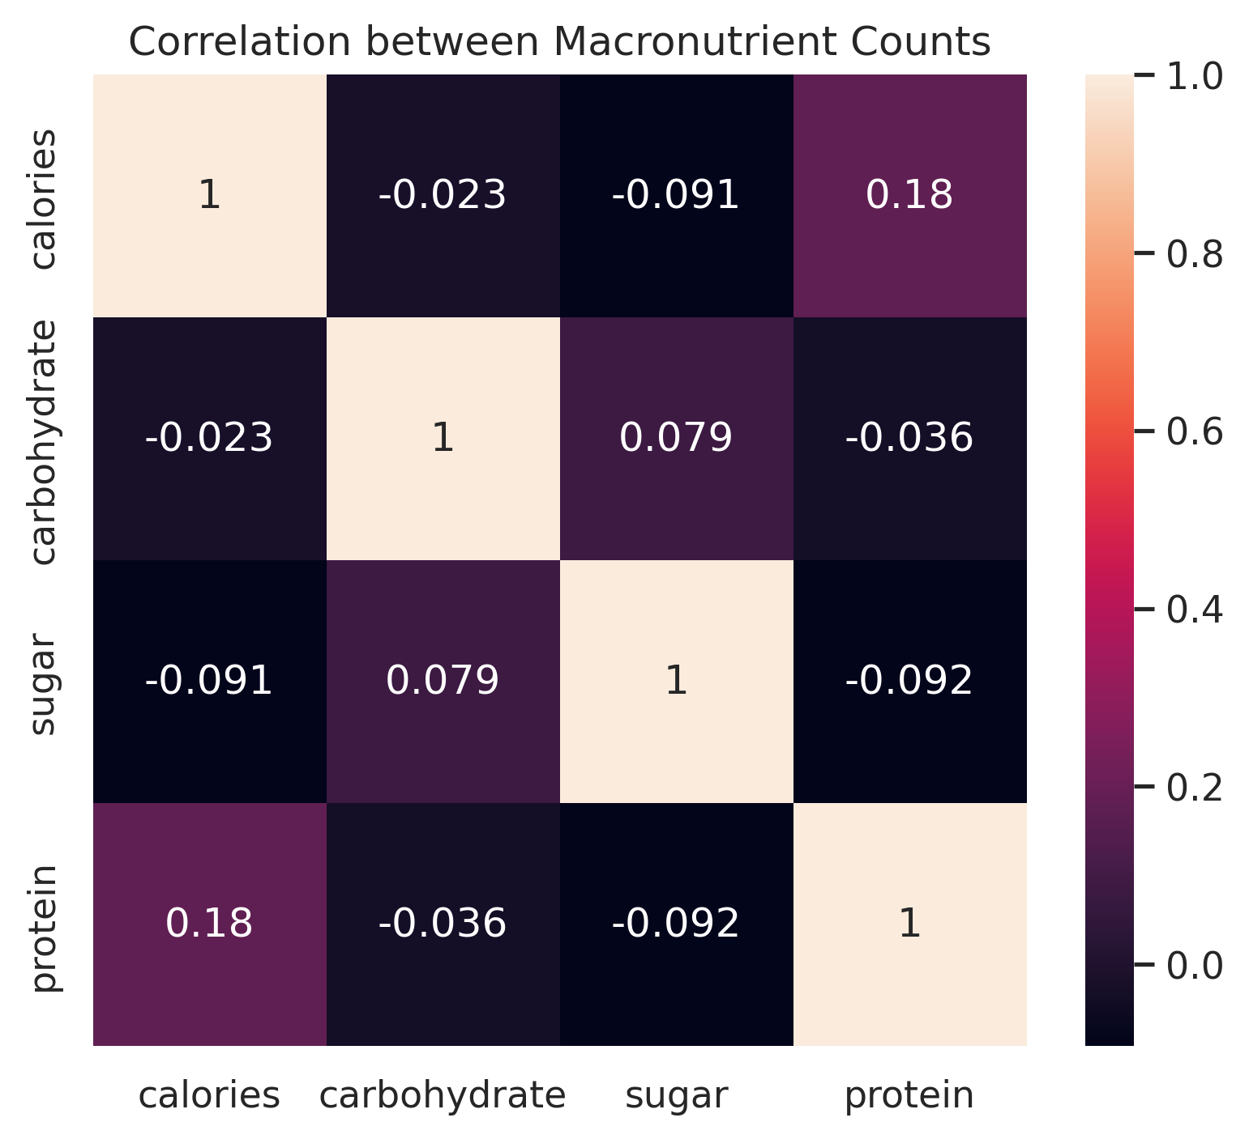
Dataset Features and Relationships

Slide 7
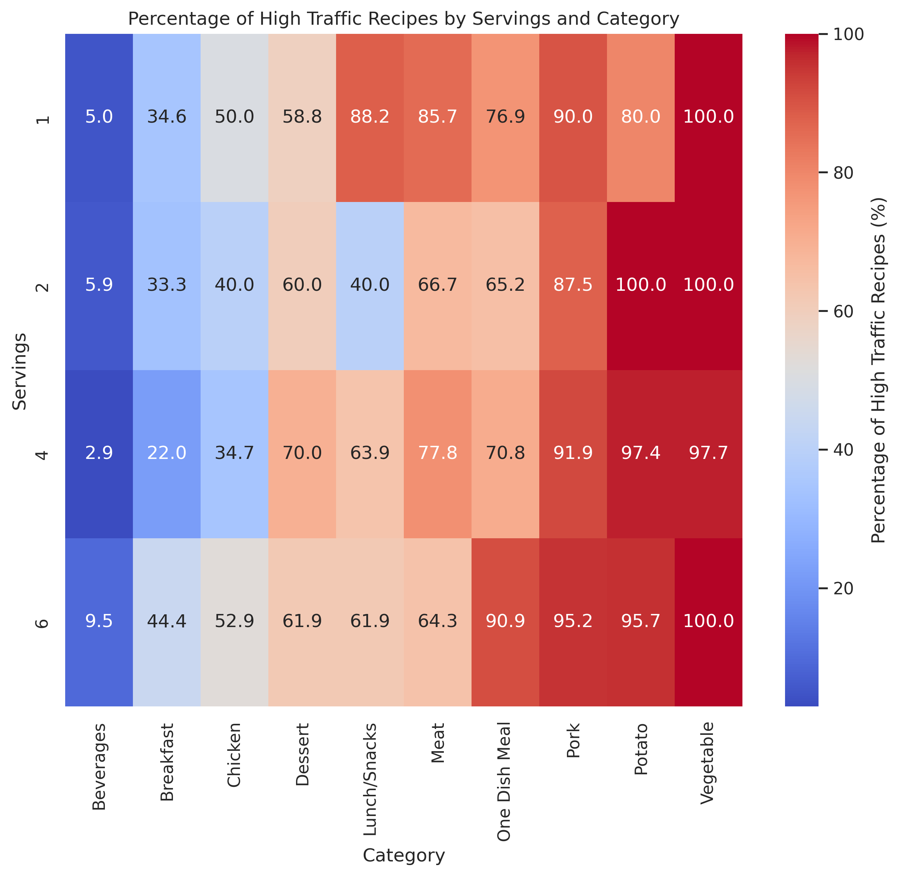
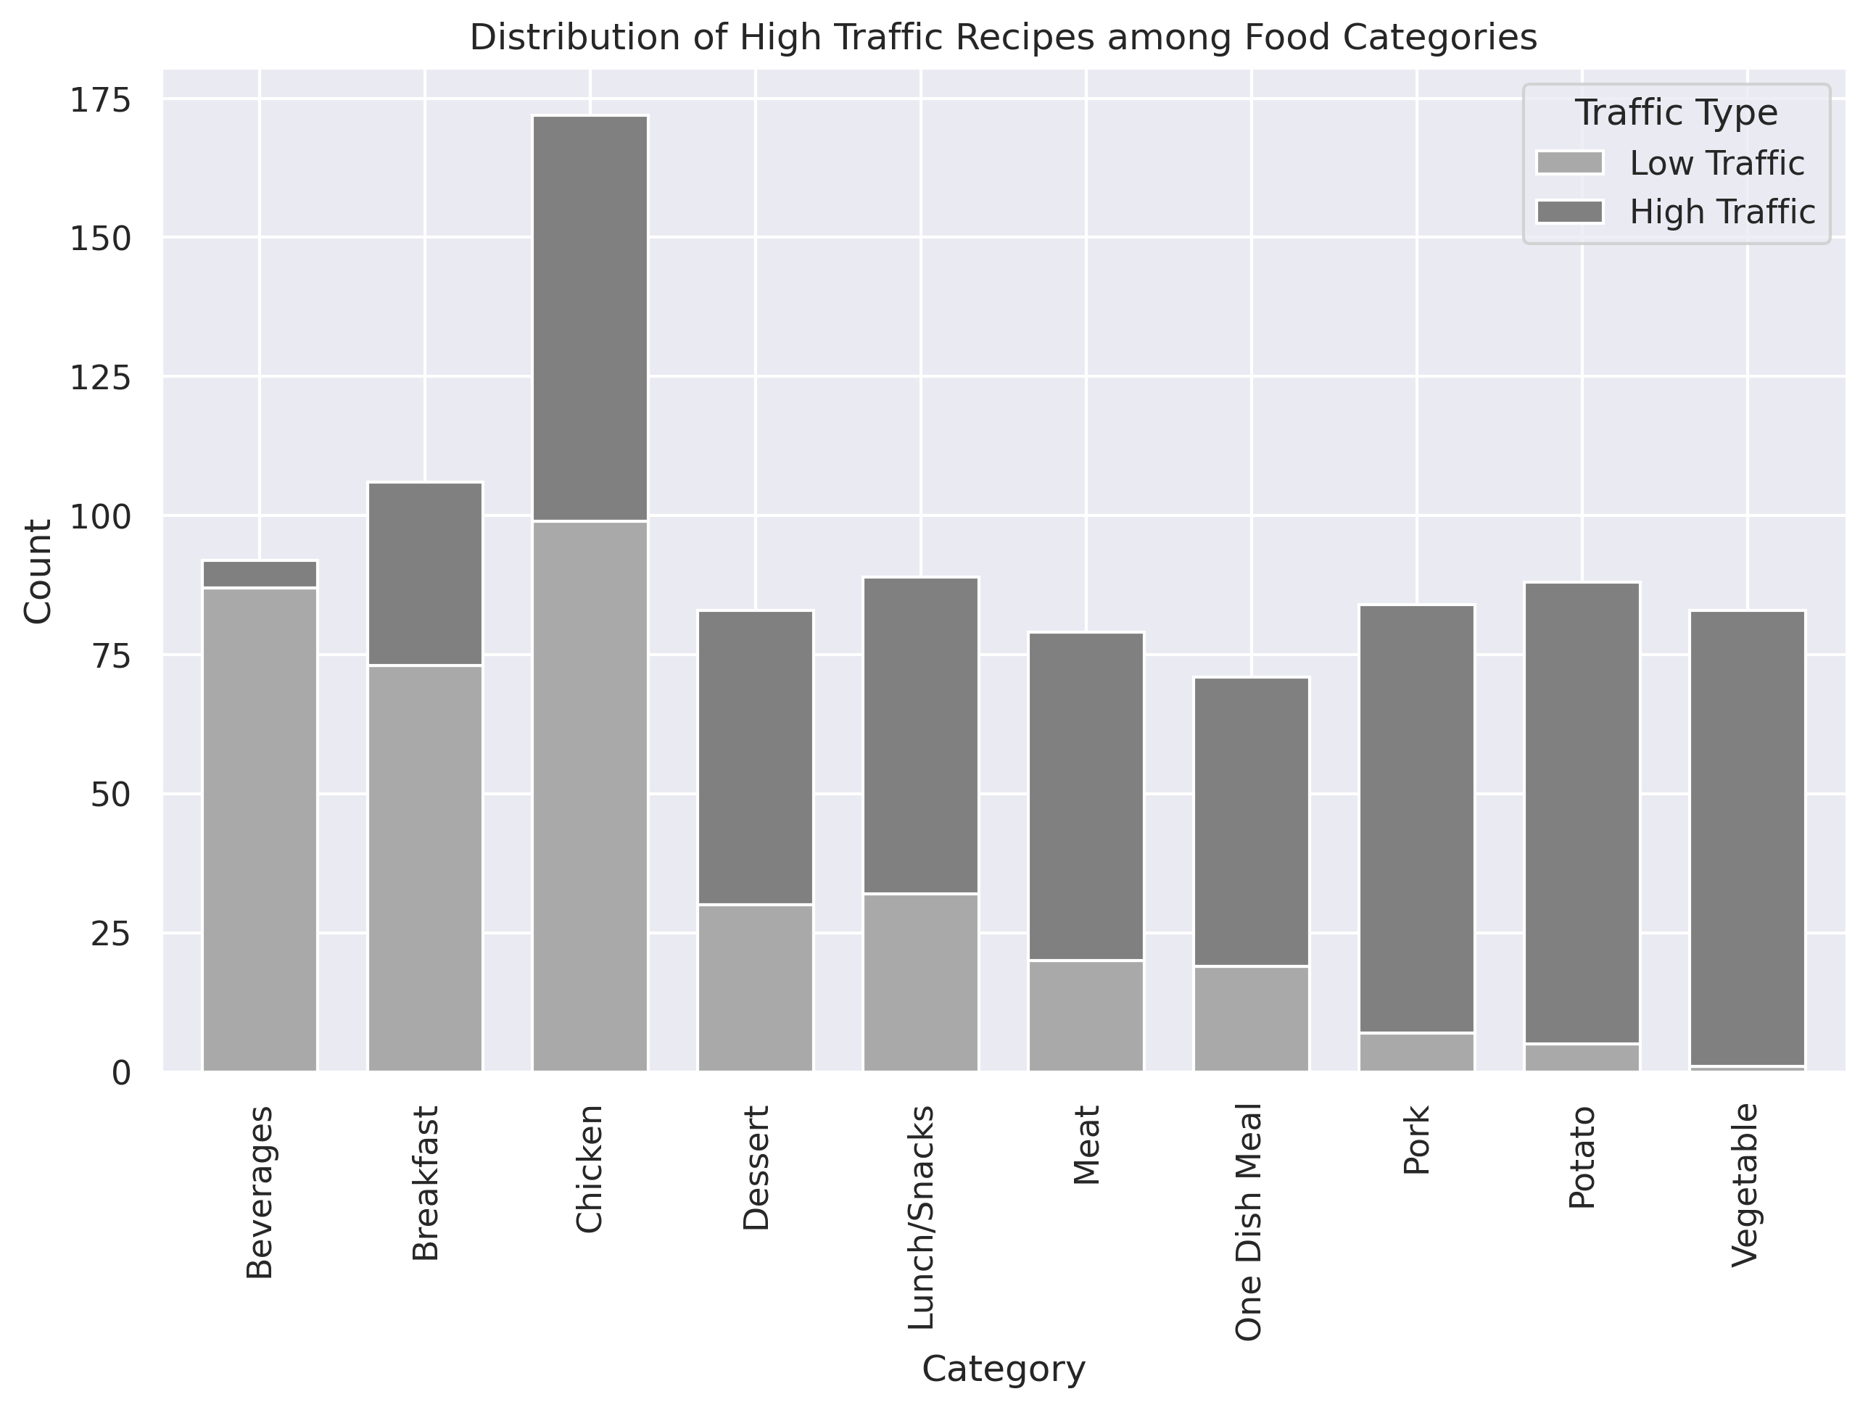
Dataset Features and Relationships

Slide 8
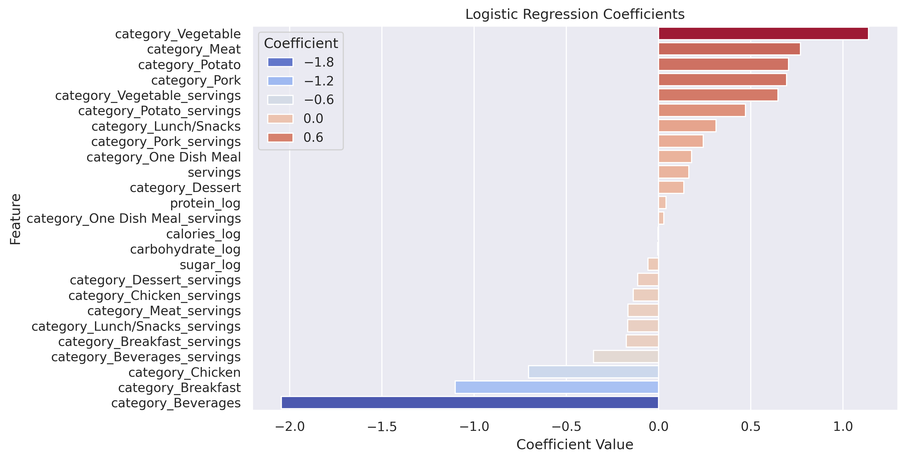
Feature Importance

Slide 9
2- Data Preprocessing
Log transformation was applied to nutrient variables
to reduce skew followed by scaling
New features were defined based on existing nutrient data:
  carb_to_cal: fraction of calories coming from carbohydrates
  protein_to_cal: fraction of total calories coming from protein
  sugar_to_carb: the sugar fraction of carbohydrates
  protein_to_carb: ratio of protein to carbohydrate
Dummy variable generation and train-test split (85/15)

Slide 10
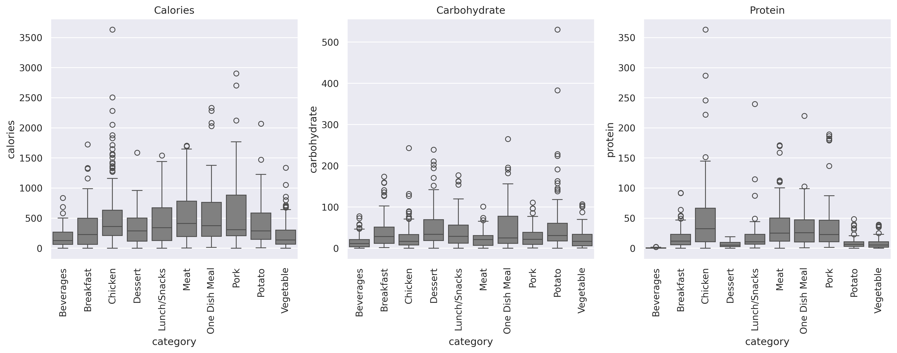
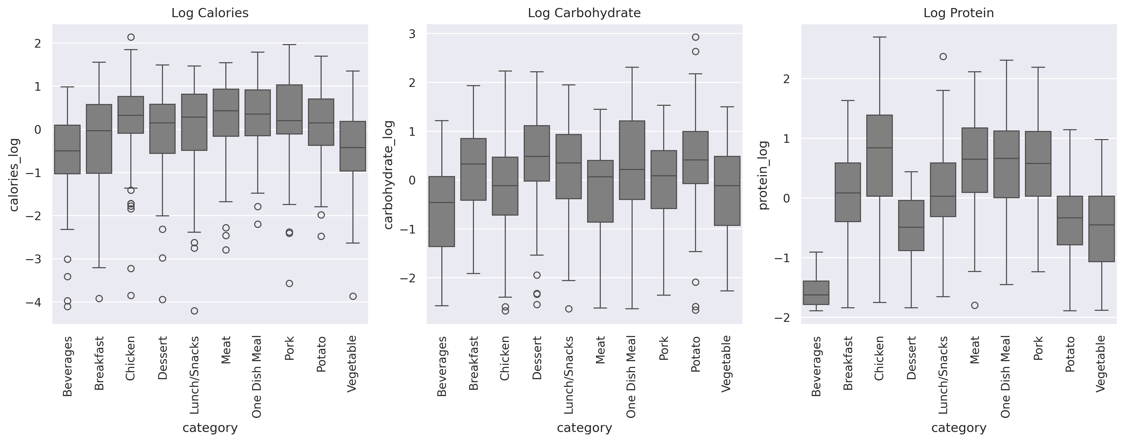
Log Transformation Justification

Slide 11
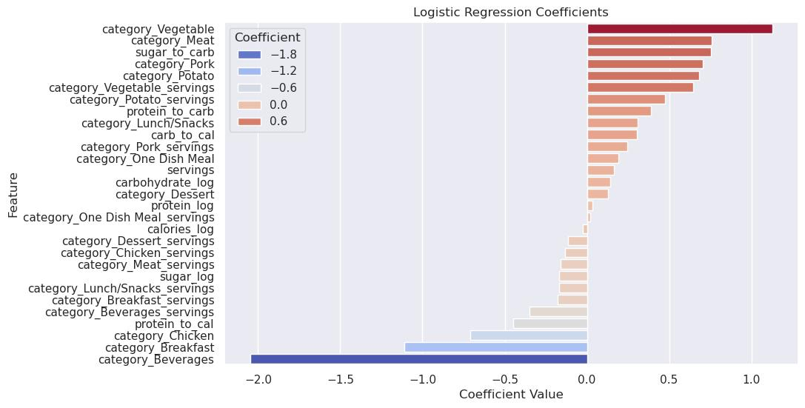
Updated Feature Importance

Slide 12
3- Model Building
Models are built using the predictors previously established:
  Model 1: Logistic Regression
  Model 2: XGBoost Model
The models are then evaluated using:
  Validation Set Approach
  K-fold Cross Validation

Slide 13
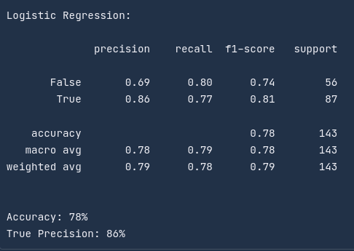
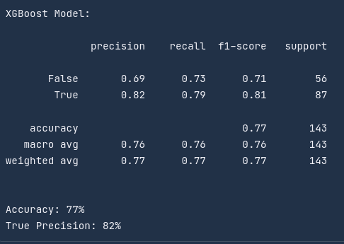
Model Evaluation

Slide 14
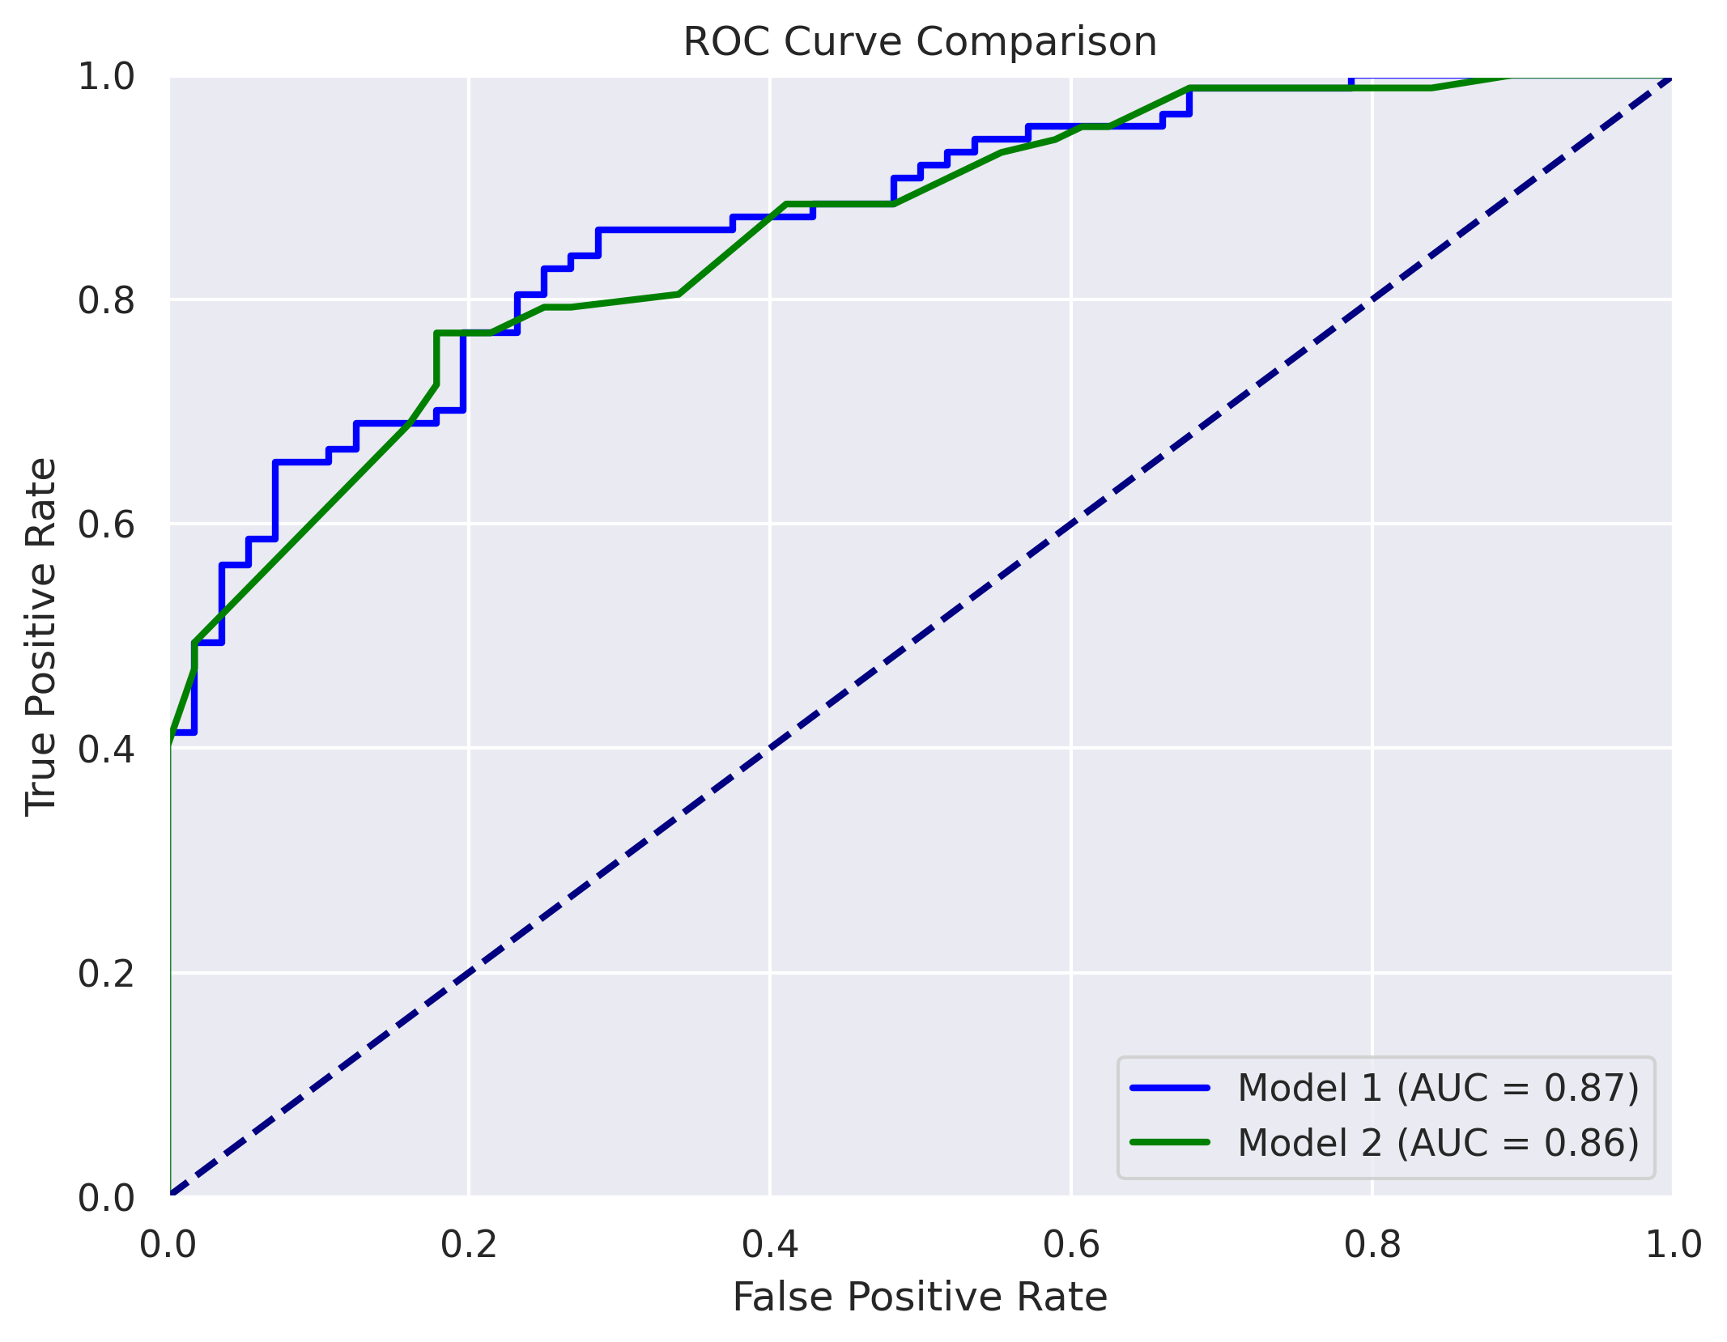

Slide 15
Interpretation
The logistic regression model appears to perform better than the XGBoost model in many metrics including true precision.
The ROC curve plot shows that the logistic regression model has a slight advantage over the XGBoost model.
The barplot shows the feature weights of the logistic regression model. The plot is consistent with the findings presented in the EDA section.

Slide 16
4- Business Recommendations
A good KPI for this problem would be true precision.
True precision is defined by the following formula:
This metric makes great sense for the business problem.
Given a high traffic recipe, the amount of times the model is correct
on average is equal to the precision.

Slide 17
4- Business Recommendations
As such, I would recommend the use of the Logistic Regression model
over the XGBoost model for three reasons. The Logistic Regression model:
  Has better general performance than the XGBoost model.
  Has a better performance on the KPI defined prior.
  Is simpler and more interpretable than the boosted tree model.

Slide 18
4- Business Recommendations
The Logistic Regression model, according to the classification report
shown previously, has a precision of 86%.
However, this estimate is generated with a validation set approach,
which is not the most robust method.
K-fold cross-validation estimate for precision is 83%.
Conclusion: Generally, if the model claims a recipe yields high traffic,
this assertion is correct 83% of the time.

Slide 19
4- Business Recommendations
Recommended Strategy:
  Deploy the model for efficient use, as a mobile app or API.
  Use adjacent heatmap as general guidance for recipe
  generation.
  Use the model to predict the recipe’s performance, and
  proceed accordingly.
  Continuously update the model with new data.
  Conduct A/B tests to compare the impact on traffic and
  refine the model based on real-world performance.

Slide 20
In Summary

