Slide 1


QUANTUM – A NFT TRADING PLATFORM VIA BANKS
Guided By,
Mrs S Hemalatha,
Associate Professor,
Sri Shakthi Institute of
Engineering and Technology
Presented by:
Akash M S (20CS005)
Aswin Sam M (20CS009)
Atchaya R Y (20CS010)
Delfihna A (20CS015)
Immanuel Derrin L (20CS029)
DEPARTMENT OF
COMPUTER SCIENCE AND ENGINEERING
SRI SHAKTHI INSTITUTE OF ENGINEERING AND TECHNOLOGY

Slide 2
TABLE OF CONTENT
Abstract
Introduction
Advantages
System requirement
Conclusion
Future work
References

Slide 3
ABSTRACT

Slide 4
Abstract:
One of the main advantages of NFTs is that they can be traded and sold in a decentralized and open marketplace.
In this project, the bank holds the NFTs as collateral and a loan will be sanctioned, this can be managed using smart contracts on a blockchain network which can automatically manage the loan process, including interest and repayment.

Slide 5
INTRODUCTION

Slide 6
INTRODUCTION
In traditional banking, collateral is an asset like land, house, jewels etc. that a borrower pledges to secure a loan. Collateral provides security to the lender in case the borrower defaults on the loan. Quantum allows the users to use NFTs as collateral in banks.
Keeping an NFT as collateral in a bank for a loan is a unique and exciting concept that as the potential to unlock value for both NFT holders and traditional financial institutions. For NFT holders, it provides access to traditional banking services and the ability to leverage the value of their digital assets to obtain loans. For traditional financial institutions, it opens up new opportunities to tap into the growing market of digital assets.

Slide 7
EXISTING SYSTEM
In the existing system, NFTs can only be used for trading with other NFTs. This means that NFT holders can only sell their NFTs to other people or exchange them for other NFTs.
This can be a limiting factor for NFT holders, as it may be difficult to find buyers or sellers for their NFTs.
Additionally, the NFT market is still relatively new and volatile, which can make it risky to trade NFTs.

Slide 8
PROPOSED SYSTEM
In the proposed system, users will be able to use Non-Fungible Tokens (NFTs) as collateral for loans with even greater flexibility. This will enable users to borrow money against their NFTs for a variety of purposes, such as financing projects or investments.
The process of using NFTs as collateral will be more streamlined and secure, with features such as automatic loan repayment and automated loan management.
Furthermore, users will be able to access loan funds quickly, as the process of using NFTs as collateral will be simplified and automated.

Slide 9
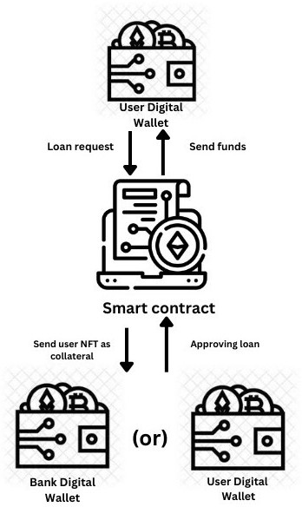
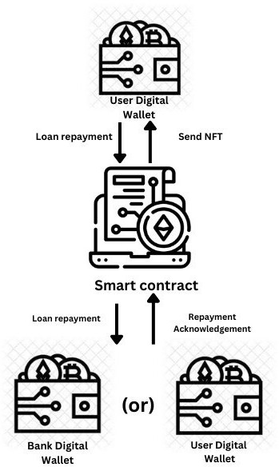
PHASES
PHASE - 1
PHASE - 2

Slide 10
SOFTWARE REQUIREMENTS

Slide 11
SOFTWARE USED:
React JS / Vite / Tailwind
Metamask
Hardhat
Ganache
Sepolia

Slide 12
REACT JS / VITE / TAILWIND
React.js is a popular JavaScript library for building user interfaces that allows developers to create interactive and dynamic web applications.
Vite is a build tool for JavaScript and TypeScript applications that offers fast development and building by leveraging ES modules and native ES imports.
Tailwind CSS is a utility-first CSS framework that simplifies web development by providing a set of pre-designed classes for building responsive and customizable user interfaces.

Slide 13
METAMASK
Metamask is a popular cryptocurrency wallet and browser extension that allows users to manage their Ethereum-based assets and interact with decentralized applications (DApps) on the Ethereum blockchain.
It provides secure storage of private keys, making it easy for users to access their digital assets and participate in the decentralized finance (DeFi) ecosystem.

Slide 14
HARDHAT
Hardhat is a developer-focused Ethereum development environment and tool suite used for building, testing, and deploying smart contracts and decentralized applications (DApps).
It offers features like built-in testing, debugging, and scriptable tasks, making it a popular choice for Ethereum developers.

Slide 15
GANACHE
Ganache is a local blockchain emulator designed for Ethereum developers to test and develop smart contracts and decentralized applications (DApps) in a controlled and sandboxed environment.
It offers features like deterministic blockchain simulation, customizable settings, and integrated Truffle suite compatibility, making it a valuable tool for Ethereum development and testing.

Slide 16
SEPOLIA
The Sepolia is a new Proof-of-Stake (PoS) testnet that developers can use to deploy and test their smart contracts for free.
Sepolia ETH can be obtained from a Sepolia testnet faucet, that allows anyone to send a small amount of fake Sepolia ETH to their wallet.

Slide 17
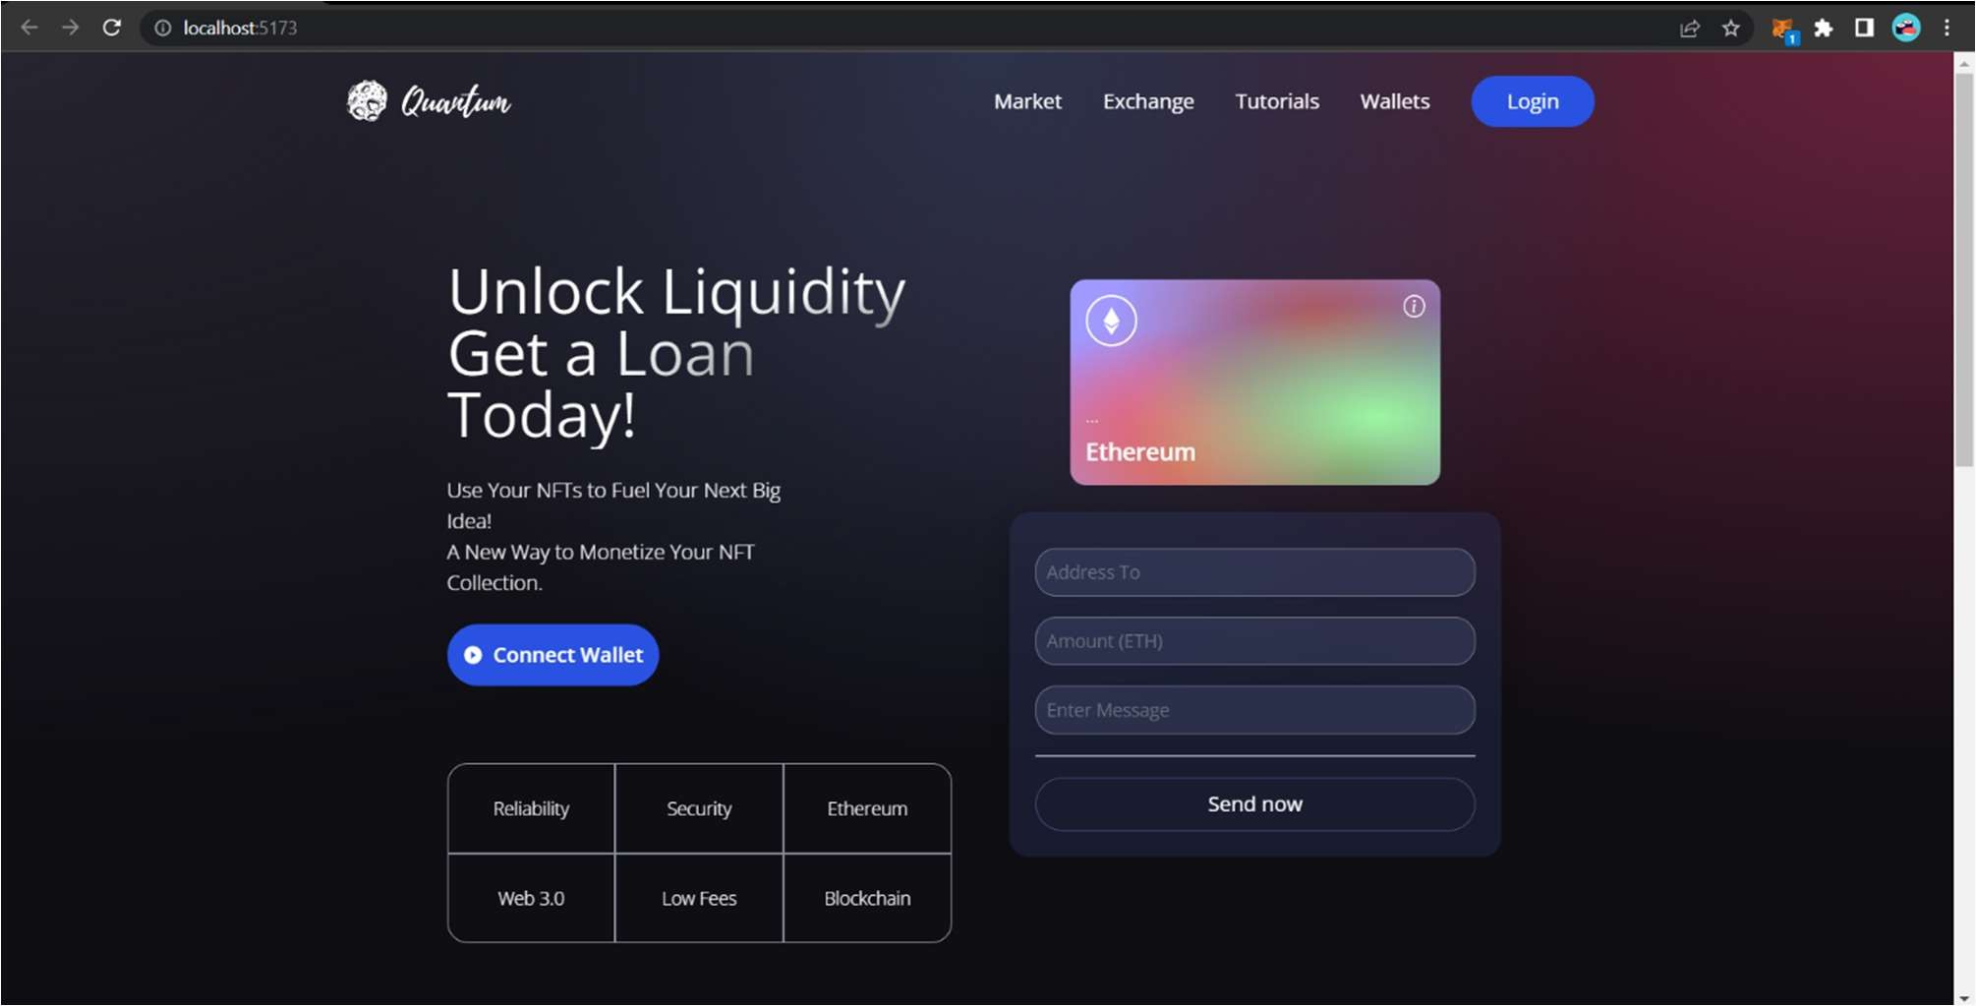
Overview

Slide 18
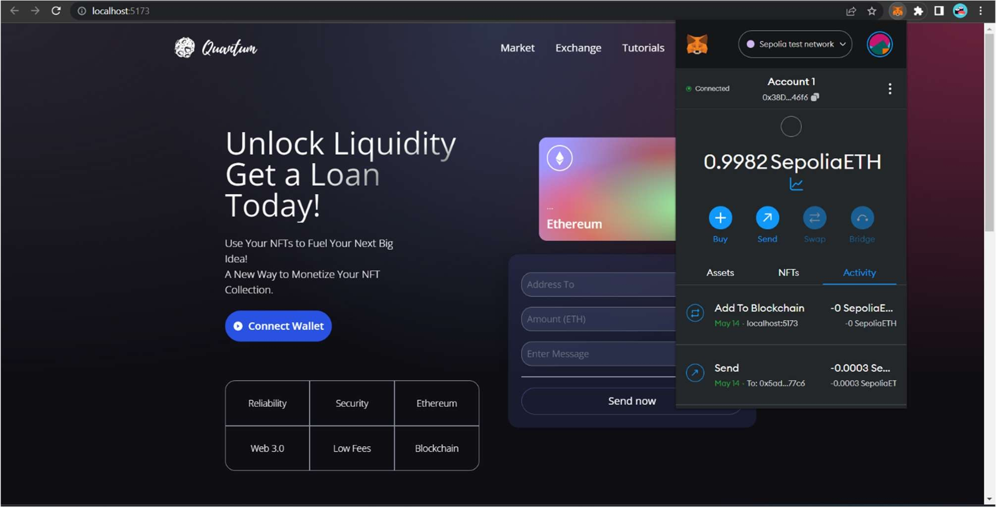

Slide 19
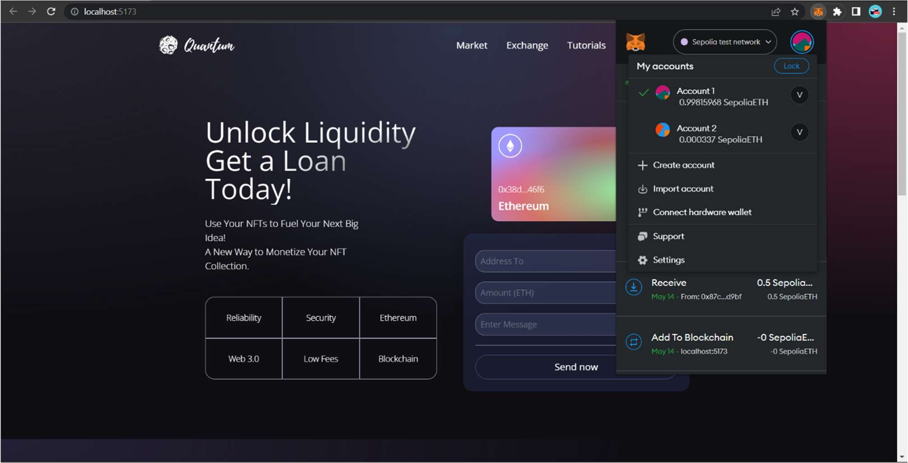

Slide 20
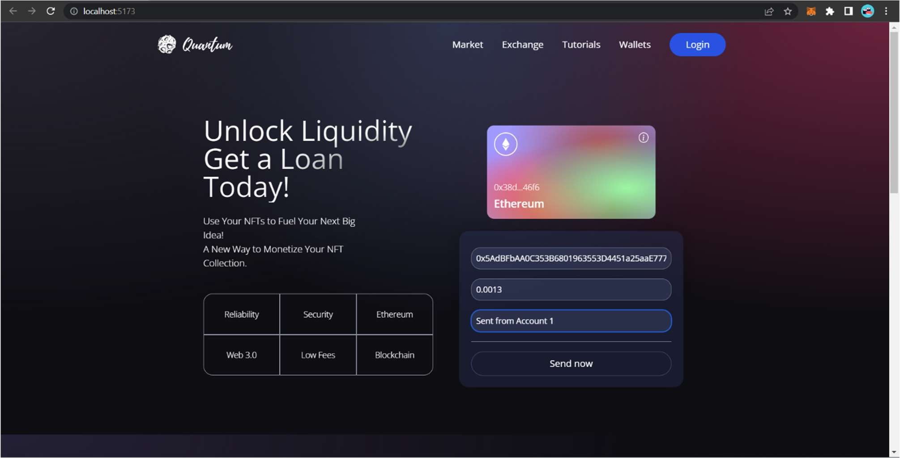

Slide 21
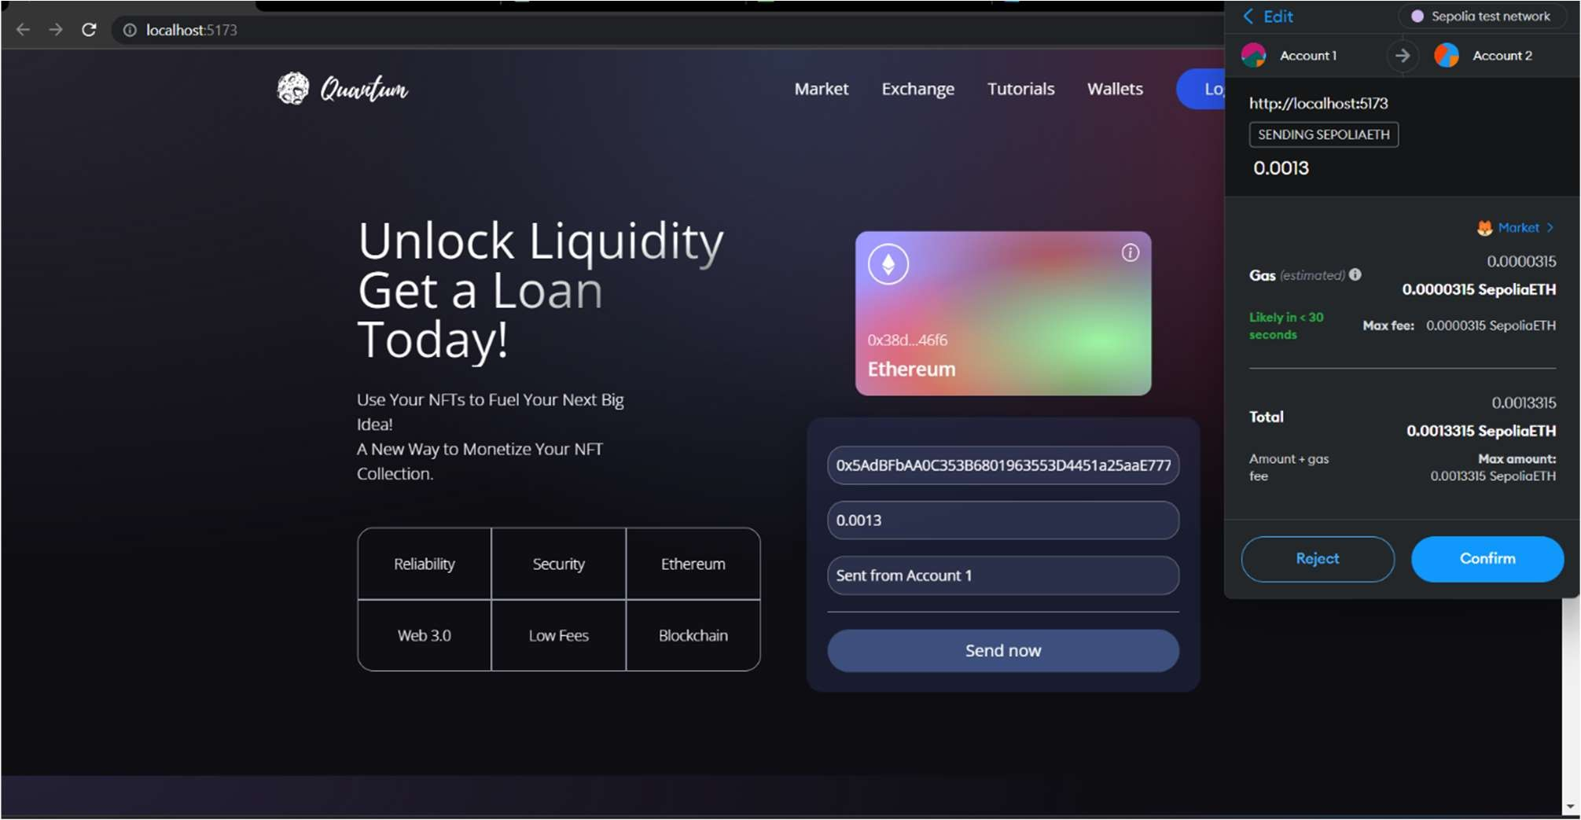

Slide 22
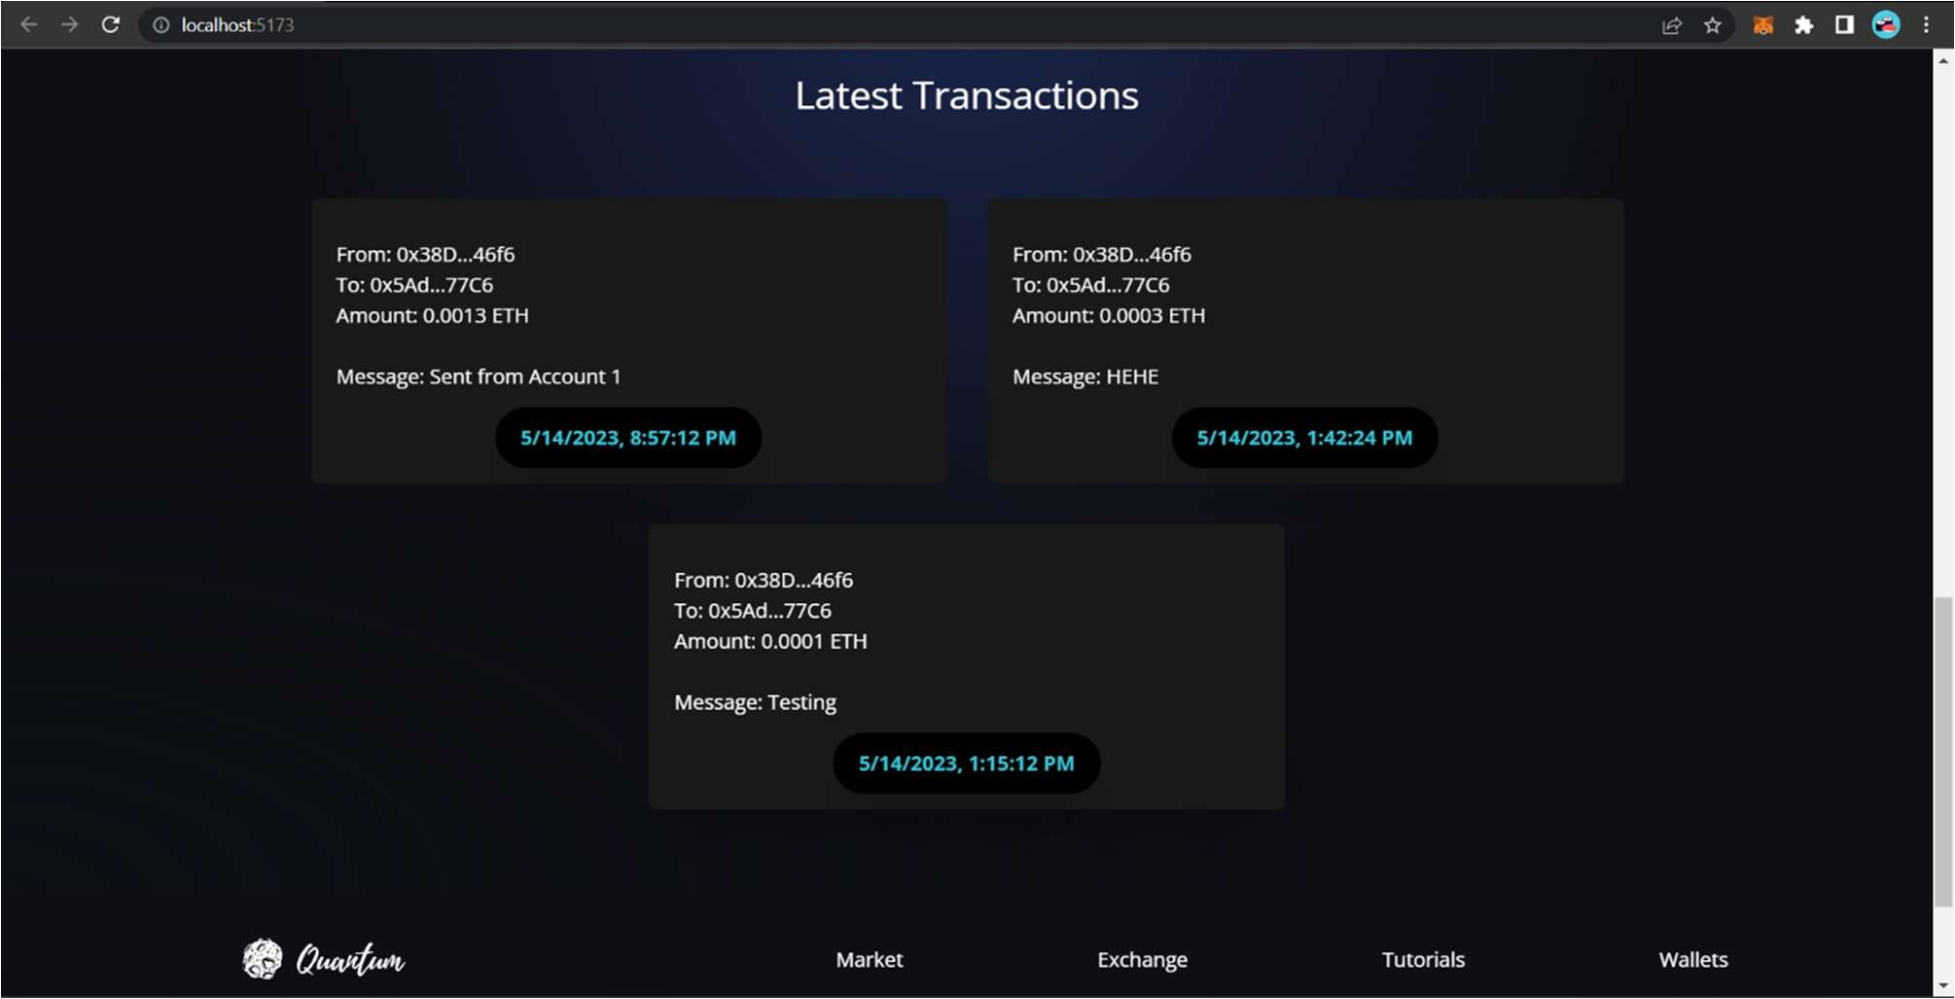

Slide 23
ADVANTAGES

Slide 24
ADVANTAGES:
NFTs, with the assistance of smart contracts, enable automated and transparent loan processes. This automation reduces the need for intermediaries, streamlines loan disbursement, and simplifies collateral management.
NFTs allow borrowers to use a wider range of assets as collateral. This expands the pool of eligible collateral, providing borrowers with more flexibility.
NFTs are built on blockchain technology, offering transparent and immutable records of loan agreements, payments, and collateral transfers. This transparency can reduce disputes and enhance trust in the lending process.

Slide 25
CONCLUSION

Slide 26
CONCLUSION
In conclusion, NFTs are a new and exciting technology that has the potential to revolutionize the way assets are traded and transferred in the financial system.
The use of NFTs in banking is still in its early stages, but there is significant potential for growth and innovation in this area. As more financial institutions recognize the benefits of NFTs, we can expect to see new financial products and services that leverage this technology.
However, there are also potential challenges and risks associated with NFT trading via banks, including security concerns, regulatory compliance, and liquidity issues. It is important for banks and other financial institutions to carefully consider these challenges and take steps to mitigate them.

Slide 27
FUTURE WORKS
In the future, The current limitations of blockchain technology, such as slow transaction and high fees, can make it difficult to scale NFT trading to large volumes.
Future enhancements could focus on developing new solutions to improve the scalability of NFT trading via banks. While blockchain technology is generally considered to be secure, there is always a risk of security breaches and hacks.
Future enhancements could focus on developing new security protocols and mechanisms to protect NFTs and ensure their safe and secure trading.

Slide 28
REFERENCE
M. Nofer, P. Gomber, O. Hinz and D. Schiereck, "Blockchain", Business & Information Systems Engineering, vol. 59, no. 3, pp. 183-187, 2017.
Q. Wang, R. Li, Q. Wang, and S. Chen, "Non-Fungible Token (NFT): Overview Evaluation Opportunities and Challenges", 2021, [online] Available:
Bakos Y, Marotta-Wurgler F. NFTs and their valuation: A primer. NYU Law and Economics Research Paper 2021; 21-02.
Kshetri N. An empirical study of the hype of NFTs and the factors influencing their price and trade volume. Journal of Business Research 2021; 135: 663-674.
Sodhi MS, Tang CS. Blockchain technology and intermodal supply chains: NFTs, trust, and transparency. Transportation Research Part E: Logistics and Transportation Review 2022; 157: 101935.
Yang H, Zhang H, Li C, et al. Blockchain-based non-fungible tokens in finance: A survey and research agenda. Journal of Financial Services Research 2021; 1-23.

Slide 29
Thank you

