Slide 1

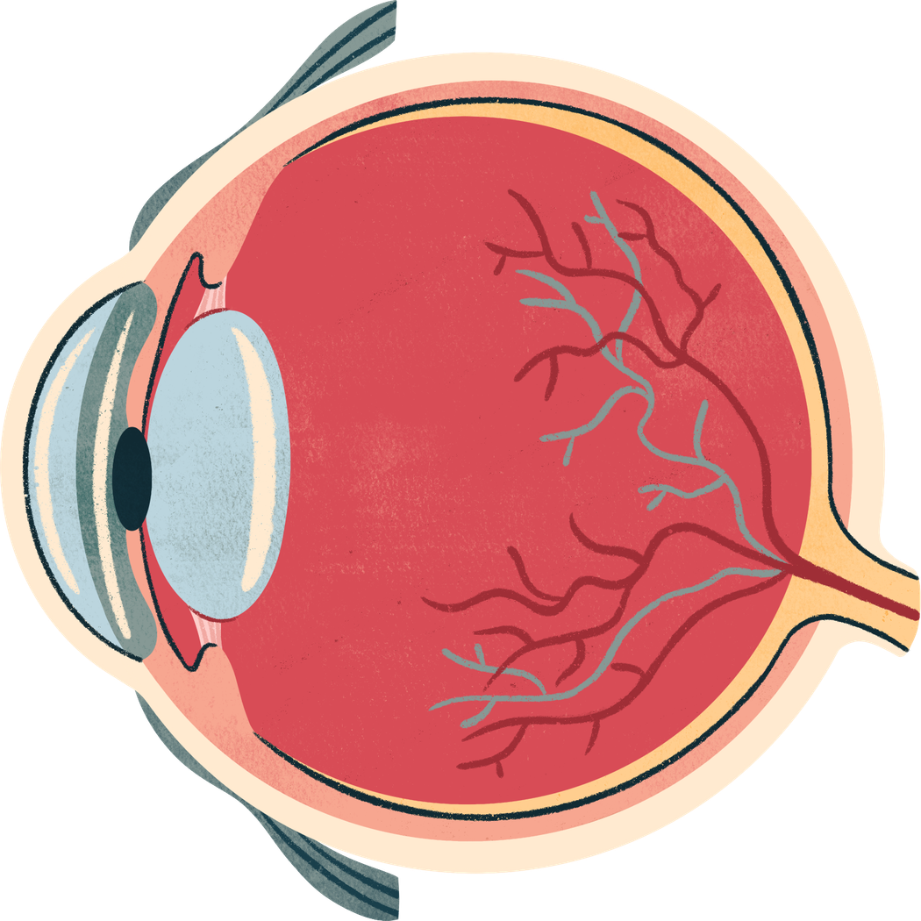


Optic Disc and Fovea Detection
using Classical Image Processing
Delfin Aksu

Slide 2
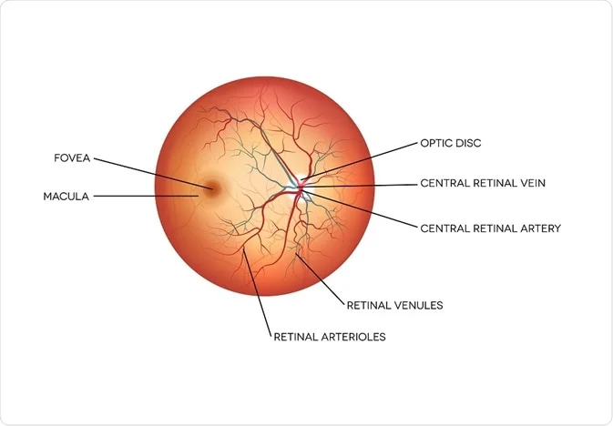
Why Optic Disc and Fovea?
  Optic Disc (OD) → entry point of vessels
  Fovea → center of vision
  Critical for:
    Glaucoma
    Diabetic Retinopathy
Accurate localization is essential

Slide 3
Dataset: IDRiD
  Fundus retinal images
  Resolution: 4288 × 2848
Used subsets:
  Localization → OD & Fovea coordinates
  Segmentation → OD masks

Slide 4
Preprocessing Pipeline
Resize
Color chanel Separation
CLAHE(Contrast Enhancement
Gaussian Smoothing

Slide 5
Resize
All images resized to 512 × 512
Reasons:
Faster processing
Consistent filter behavior
Suitable structure scale

Slide 6
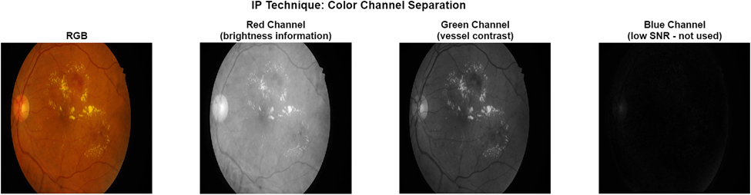
Color Chanel Analysis
Red channel → brightness info
Green channel → best vessel contrast
Blue channel → noisy
✔ Final choice:
Green channel used for vessel-based processing

Slide 7
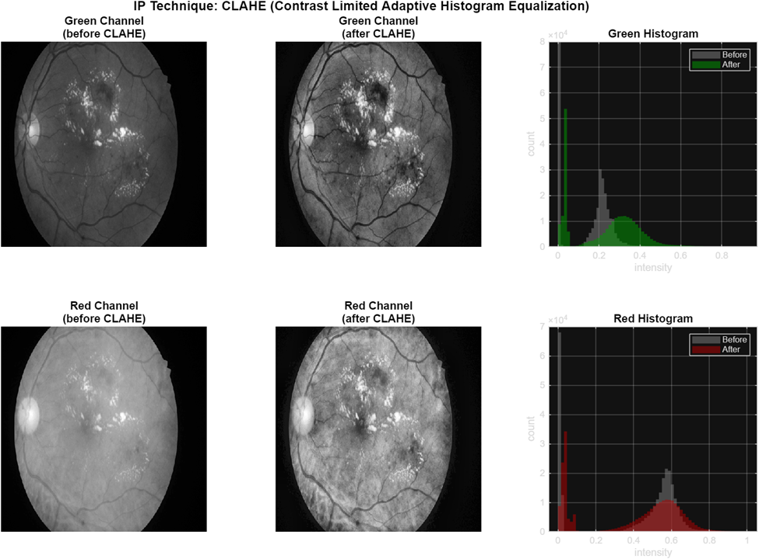
Contrast Enhancement (CLAHE)
Solves uneven illumination
Works locally (tiles)
Prevents noise amplification
✔ Result:
Improves vessel & optic disc visibility

Slide 8
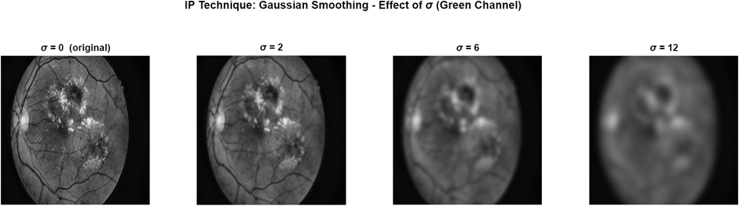
Gaussian Smoothing
Removes noise & small artifacts
σ = 6 used
Produces smooth illumination map
⚠ Problem: Also removes vessel details

Slide 9
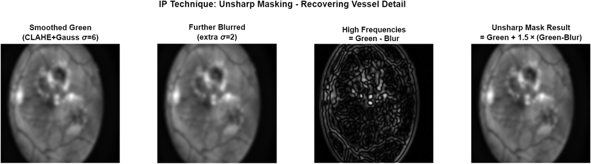
Unsharp Masking
Restores lost vessel details
Formula:
sharpened = original + k(high-frequency)
✔ Result:
Smooth background + clear vessels

Slide 10
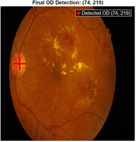
Optic Disc Center Detection
Challenging due to:
  Similar bright lesions
  Vessel structures
  Illumination variations

Slide 11
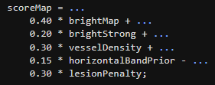
Optic Disc Localization Pipeline
Multi-step classical approach
Uses multiple feature maps:
  Brightness
  Vessel density
  Lesion suppression (penalty)
  Anatomical prior
Instead of relying on a single feature, combine multiple feature maps to make the detection more robust.
Final decision based on fused score map

Slide 12
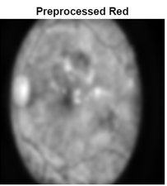
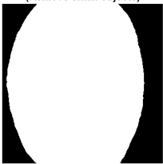
Field Mask Construction
Removes black background
Keeps only retinal region
Steps:
  Thresholding
  Hole filling
  Noise removal

Slide 13
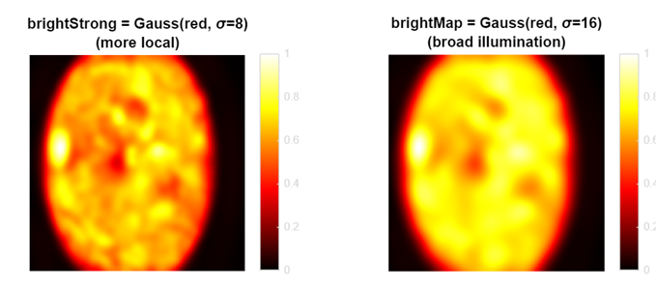
Multi-scale Brightness Maps
Captures local details and highlights small bright regions
Captures global structure and emphasize overall brightness

Slide 14
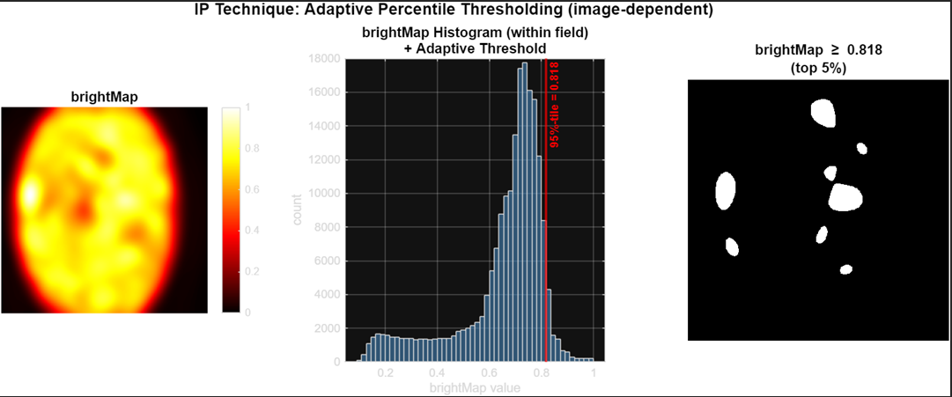
Adaptive Percentile Threshold
  Top 5% brightest pixels selected
  produces candidate regions for optic disc
! Image-specific threshold

Slide 15
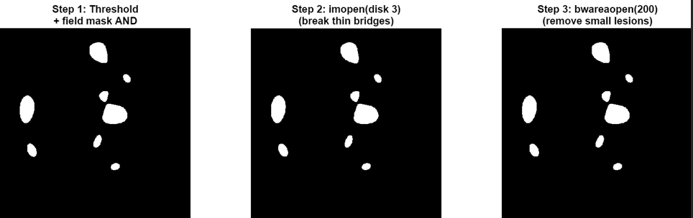
Bright Candidate Cleanup
Morphological opening
Remove small regions
Keep plausible disc candidates

Slide 16

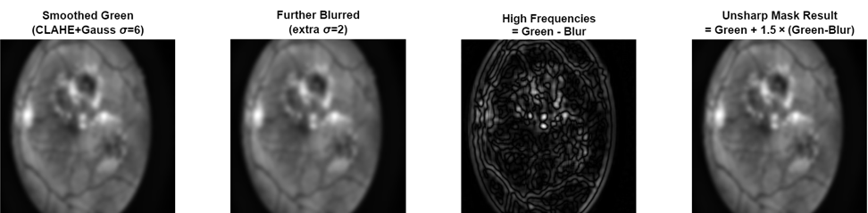
Vessel Enhancement (Unsharp Masking)
Restore vessel details
High-frequency enhancement
Improves vessel detection

Slide 17
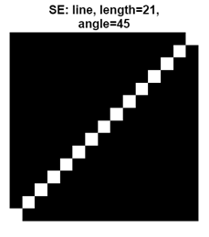
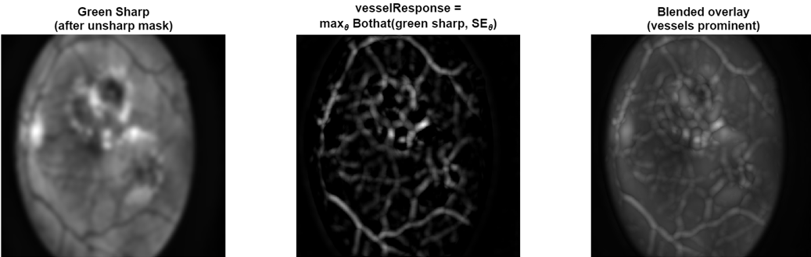
Multi-orientation Vessel Detection
Bottom-hat filtering
12 orientations detect vessels in all directions
Each orientation captures vessels aligned with that direction, and we combine them using a pixel-wise maximum.

Slide 18
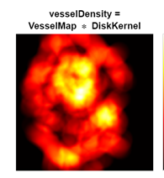
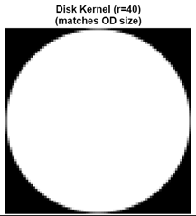
Vessel Density Map
Disc has highest vessel density
Disk kernel convolution
Peak indicates OD region
bright area => more vessels
dark area => less vessel
Disk-kernel convolution of the binary vessel map. The kernel size matches the expected optic disc area, so the convolution peaks at the disc center.

Slide 19
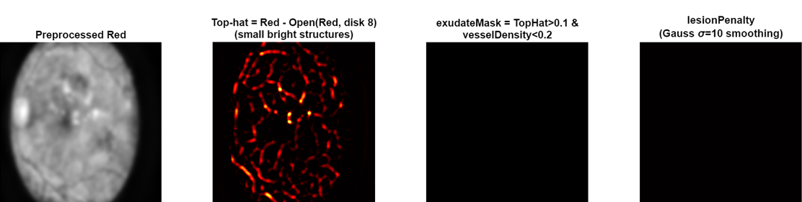
Lession Penalty
Removes bright lesions (false positives)
White top-hat
Penalizes isolated bright spots

Slide 20
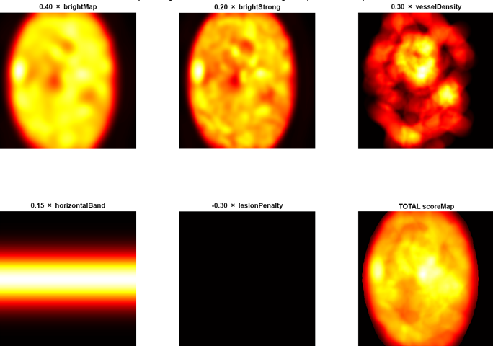
Score Fusion
Combine all features:
Brightness
Vessel density
Anatomical prior
Lession Penalty

Slide 21
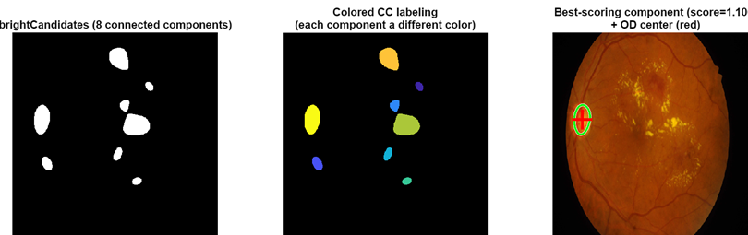

Final Detection
Connected component analysis
Best region selected
Optic Disc Detection

Slide 22
Optic Disc Segmentation
Segmentation Pipeline
ROI extraction
Vessel removal
Adaptive thresholding
Morphological refinement
Component selection

Slide 23
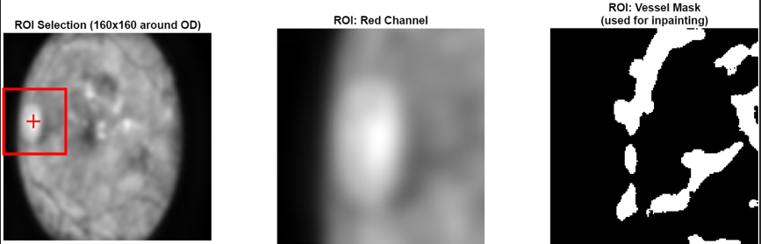
ROI Extraction
Region of Interest (ROI)
Focus on 160×160 region
Centered at detected OD
Reduces noise and computation
reduce the problem to a small region

Slide 24
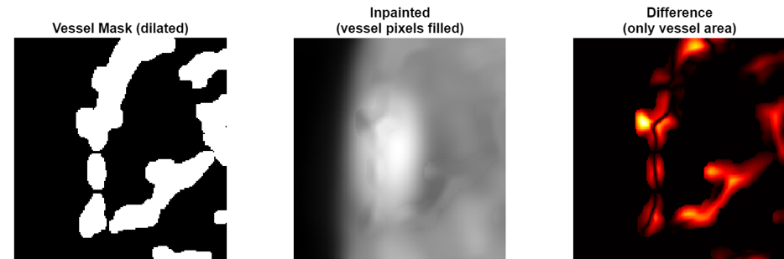
Vessel Removal
Vessels create dark artifacts
Mask + inpainting used
Produces smooth disc region

Slide 25
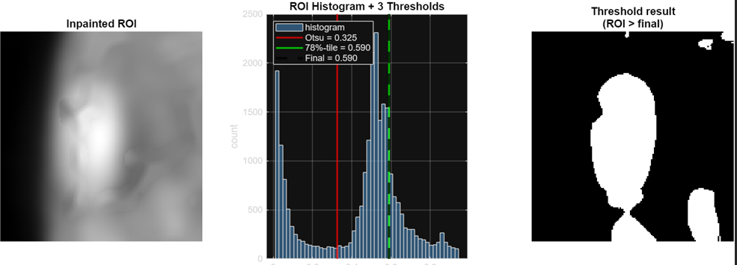
Adaptive Thresholding
Otsu + Percentile
Robust to intensity variations
Final mask from max threshold

Slide 26
Mask Refinement
  Close → fill gaps
  Fill holes
  Open → smooth boundary

Slide 27
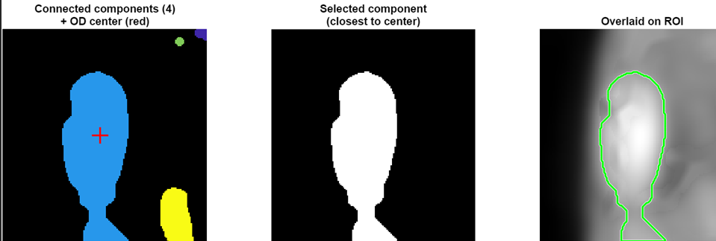
Final Component Selection
Multiple regions may exist
Select closest to OD center
Final disc mask

Slide 28
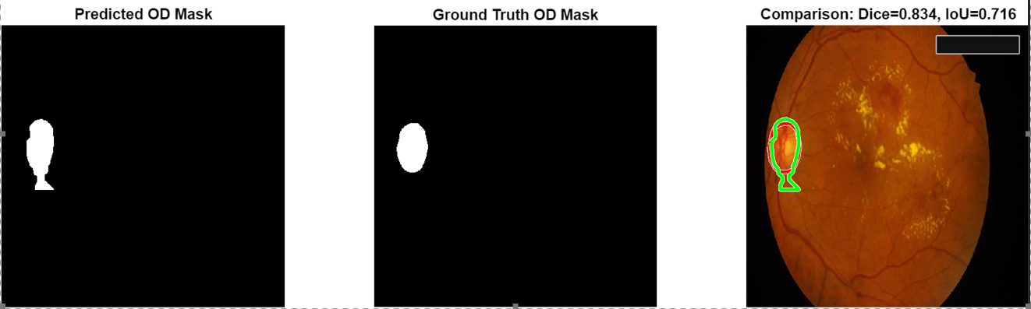
Final Result

Slide 29
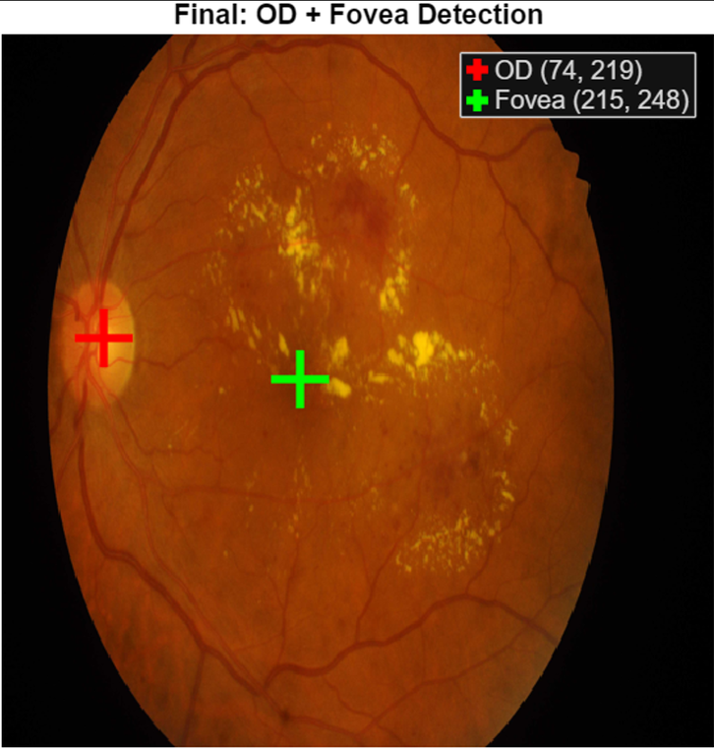
Fovea Detection

Slide 30
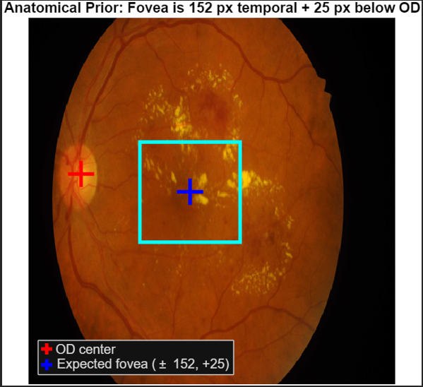
Anatomical Constraints
  152 pixels horizontal from OD
  25 pixels below OD
  Always on temporal side
Search Window
  140×140 window around expected position
  Reduces false detections
  Focused search

Slide 31
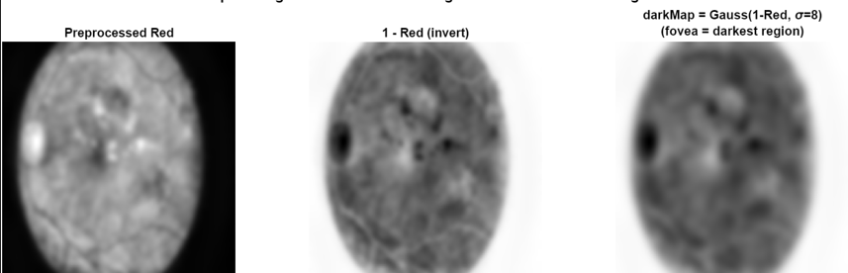
Anatomical Constraints
  Fovea = darkest region
  Image inverted
  Gaussian smoothing applied

Slide 32
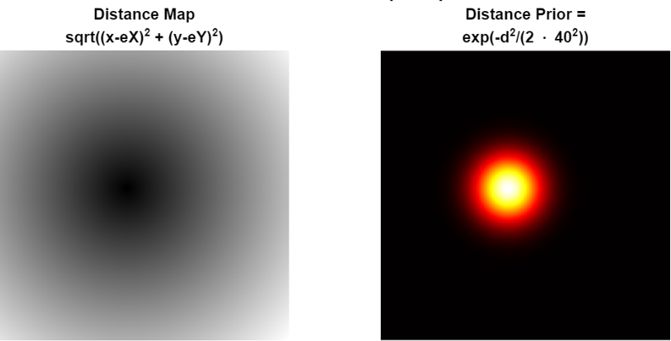
Distance Prior
  Gaussian prior centered at expected position
  Penalizes far regions
  Encodes anatomical knowledge

Slide 33
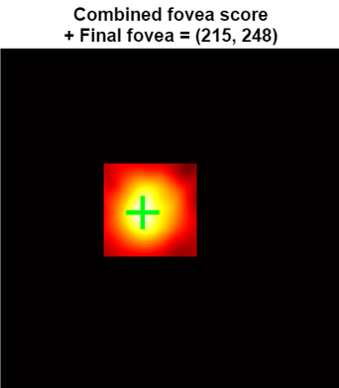
Score Fusion
Combine Darkness Map and Distance Prior
foveaScore = 0.45 * darkMap + 0.55 * distancePrior

Slide 34
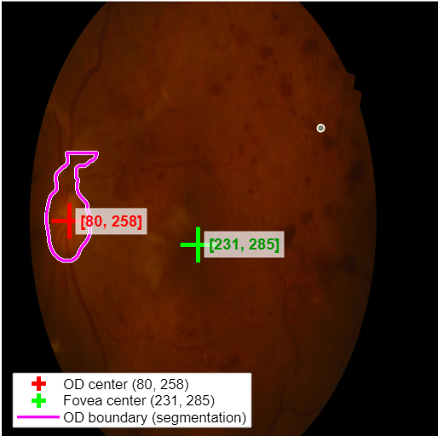

Slide 35
Evaluation Metric
F-score and Success Rate
Localization (OD & Fovea):
Error = Euclidean distance between predicted and ground truth centers
A prediction is correct if error < 40 px
Success Rate = correct predictions / total
Segmentation (OD):
Dice coefficient used
Measures overlap between prediction and ground truth

Slide 36
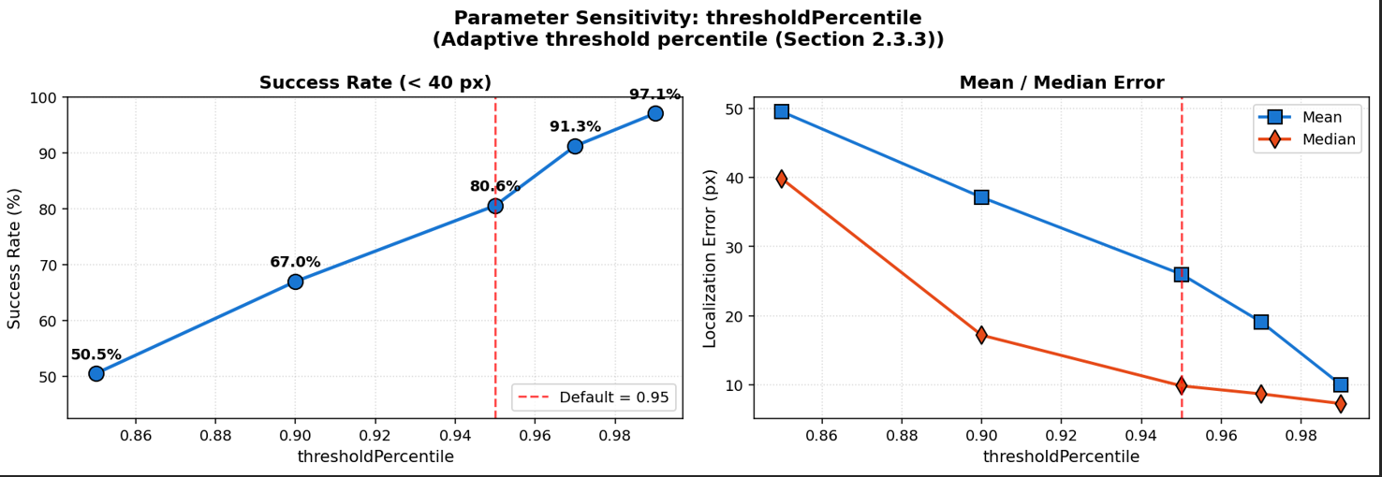
Experimental Study
Tested key parameters:
  Threshold percentile
  Vessel weight
  Lesion weight
  Threshold ↑ → performance ↑ (MOST IMPORTANT)
  Best value: 0.99
  Vessel weight → slightly harmful
  Lesion penalty → no effect

Slide 37
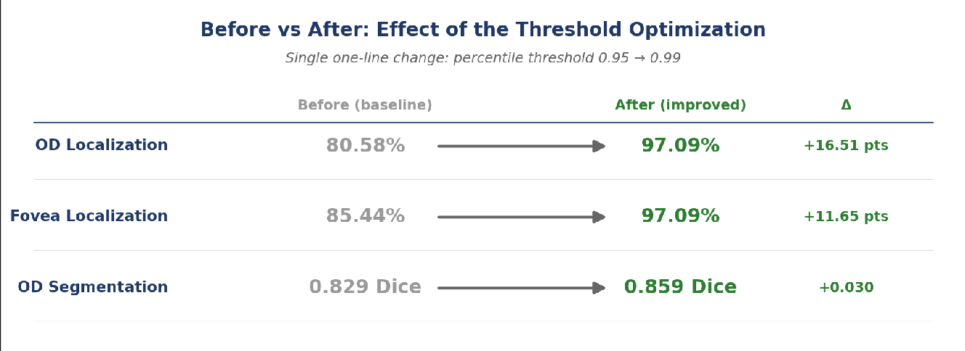
Performance Improvement
The improvement comes from tuning the adaptive threshold from 0.95 to 0.99

Slide 38
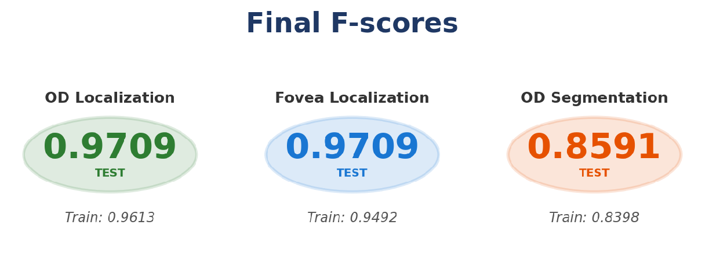
Final Performance

Slide 39
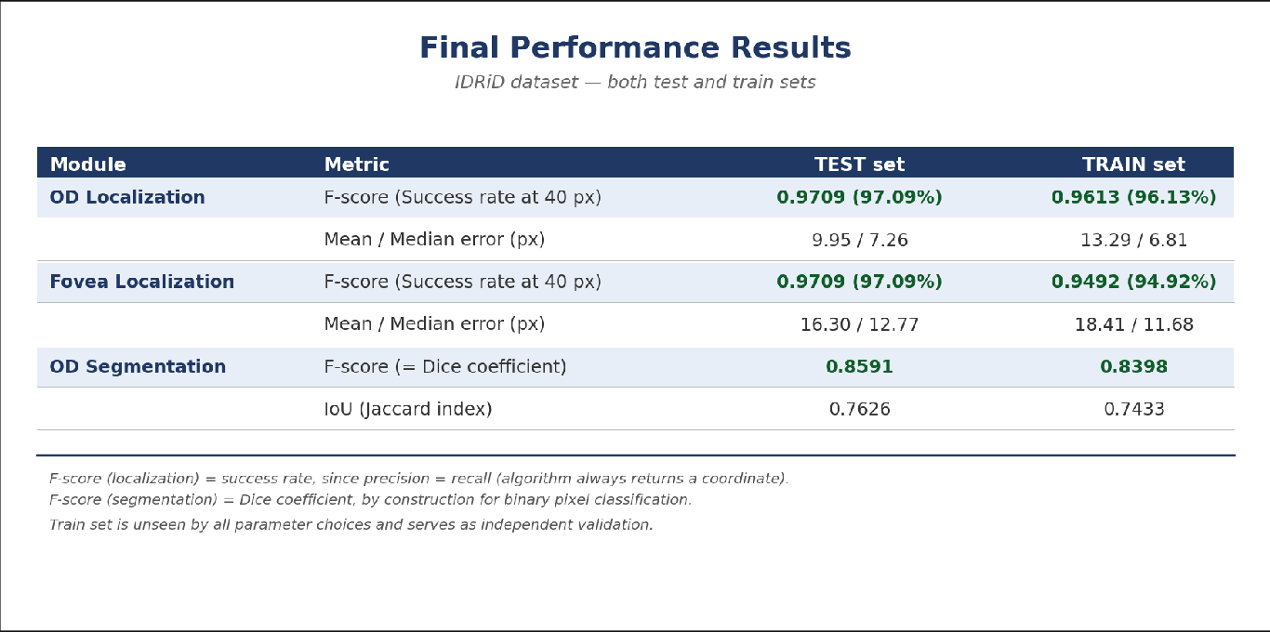

Slide 40
Teşekkür ederim.
Delfin Aksu

