Slide 1








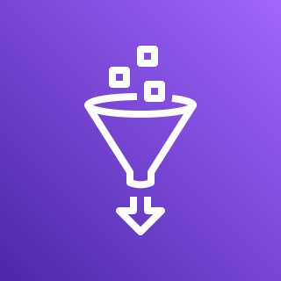



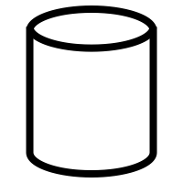
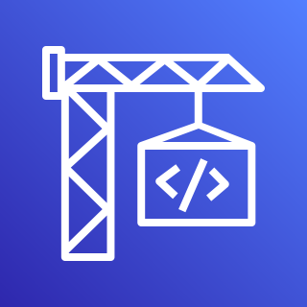
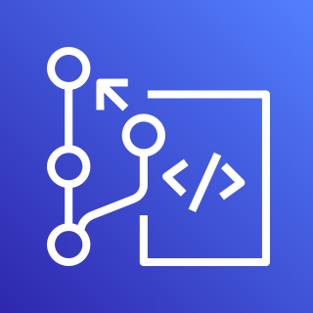





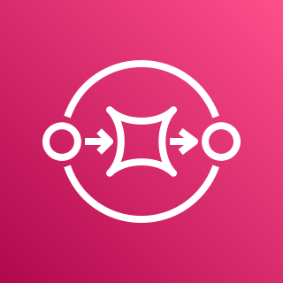

AWS Cloud
Analytics
Data Lake(Serverless DDK)
Client Management Service
Tenant Provisioning Service
AWS Lake Formation
AWS Glue Data Catalog
Amazon Athena
Amazon SageMaker Platform Management Notebook
Analysts
AWS Lambda
AWS Glue Job
Amazon QuickSight
End Consumers Business Stakeholders
Workflow Management Service
Amazon S3 ACM Bucket
Step Function
Amazon S3 Pre-Stage
Step Function
Amazon S3 Post Stage
Hydration
Data Lake Hydration Service
Amazon Marketing Cloud Detailed Advertising Data
AWS CodeBuild
AWS CodeCommit
AWS CodePipeline
AWS KMS
Amazon DynamoDB
AWS Lambda
Amazon CloudWatch
Amazon SNS
Amazon SQS
AWS Systems Manager

Slide 2


AWS CodePipeline
Pulls Code from Source Repository
Build Runs ‘cdk synth’ for cfn templates
Update Pipeline with app changes
Publishes file Assets
Deploys AMC Delivery Kit
AWS CodeCommit
AWS CodeBuild
AWS CodeBuild
AWS CodeBuild
AWS CodeBuild
Deployment
AWS CloudFormation
Foundations Stacks
Data Lake Stacks
Microservices Stacks
Notes:
Runs ‘cdk synth’ command to translate resources to CFN Template Definition

Slide 3
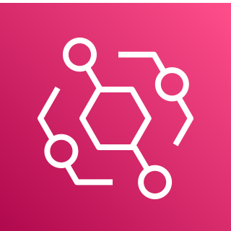
AMC Quickstart CICD Pipeline
Foundations
Data Lake
Microservices
Foundations Stack
Pipelines Stack
Datasets Stack
TPS Stack
WFM Stack
PMN Stack
Amazon DynamoDB
AWS Lambda
AWS Glue Job
Amazon DynamoDB
Amazon DynamoDB
Amazon
Sagemaker Notebook
AWS Lambda-Routing
Amazon S3 Shared Buckets
Step Function
AWS Glue Database
Amazon SQS – TPS
AWS Lambda
Amazon EventBridge
AWS Lambda
AWS Lambda-Routing
AWS Lake Formation
Amazon SQS – Stage A
Amazon SQS – Stage B
Step Function
Amazon
SNS
Amazon
Athena Workgroup
Amazon
SNS

Slide 4
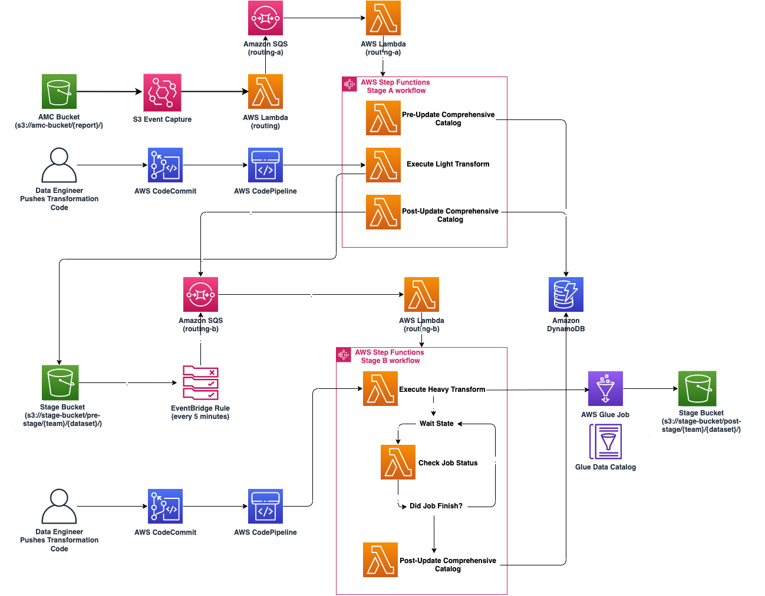

Slide 5
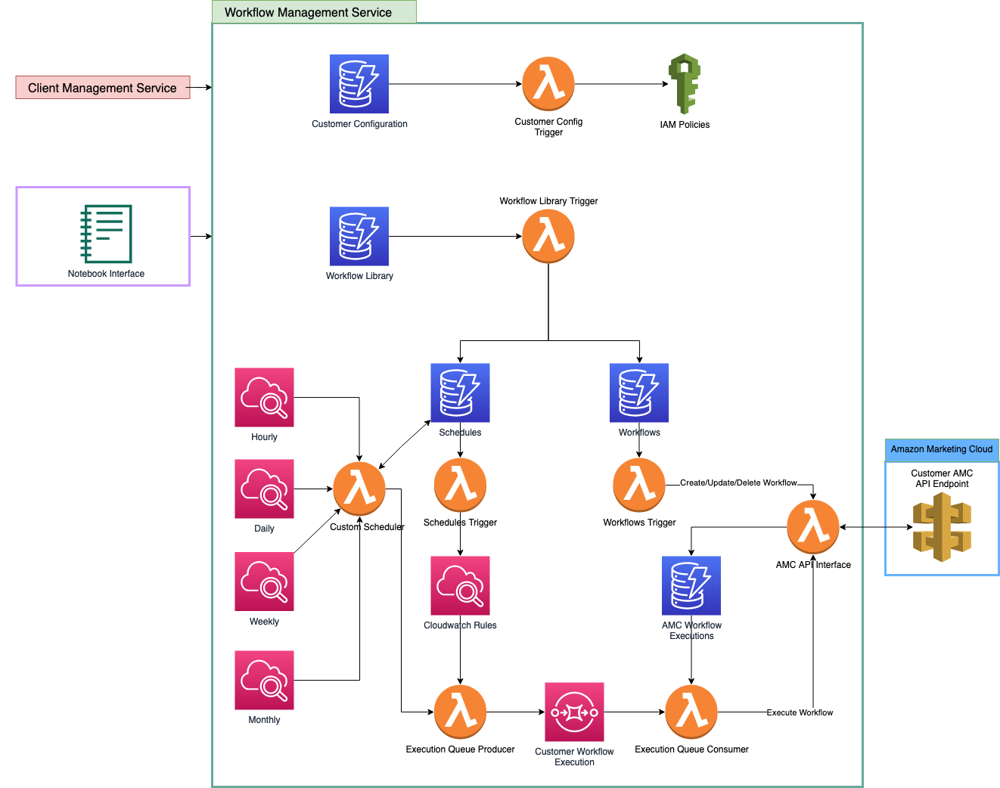

Slide 6
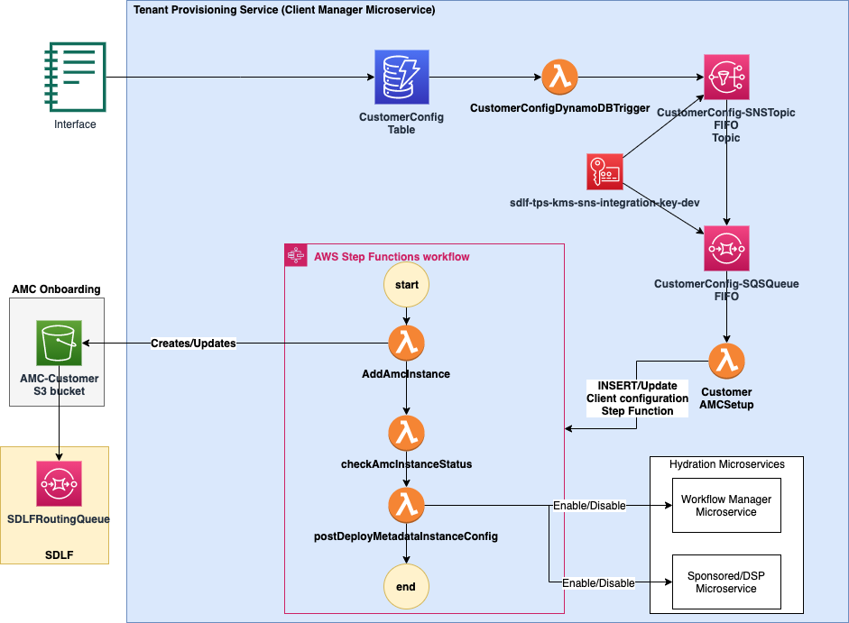

Slide 8
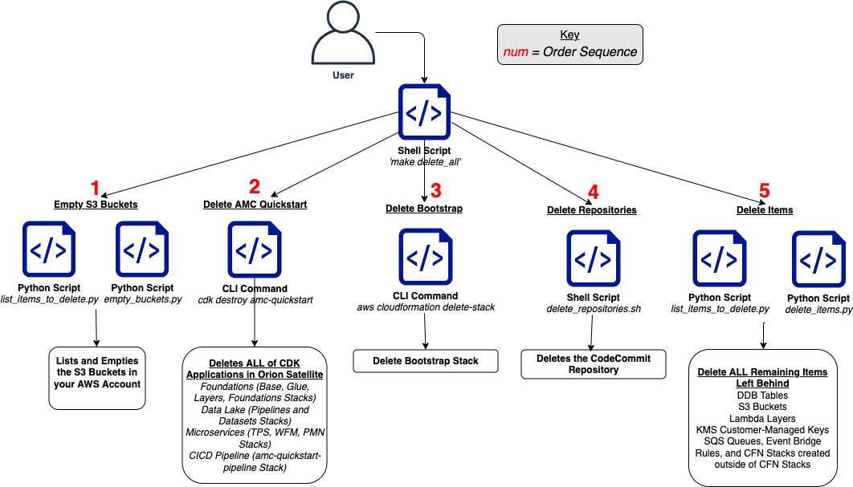

Slide 9
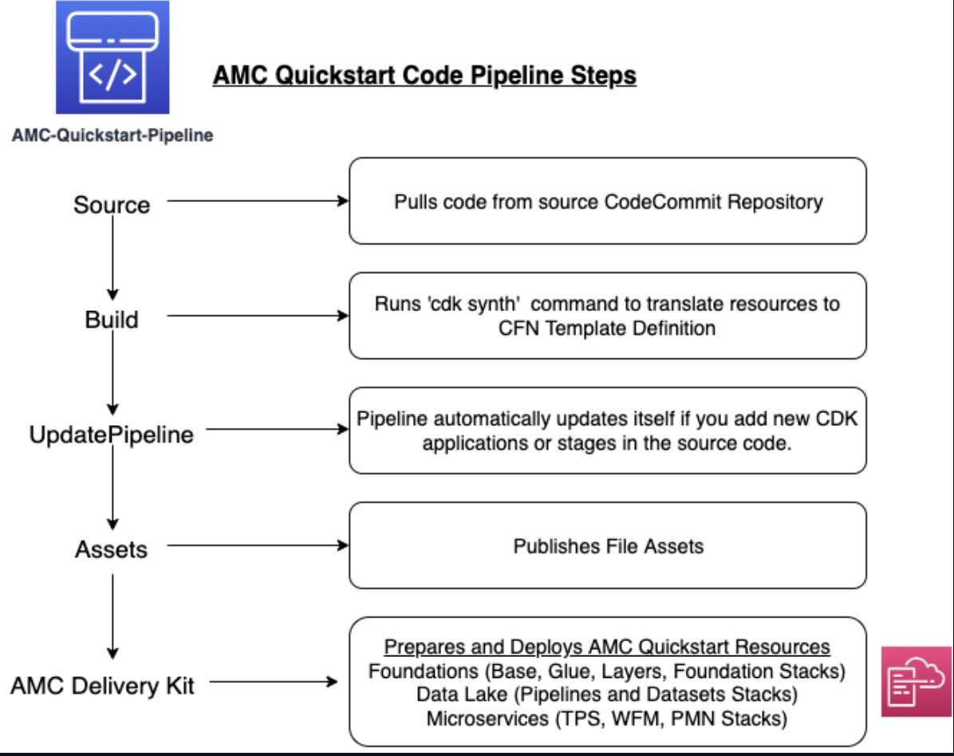
Notes:
Pulls code from source CodeCommit Repository
Runs ‘cdk synth’ command to translate resources to CFN Template Definition
Pipeline automatically updates itself if you add new CDK applications or stages in the source code
Publishes file Assets
Prepares and Deploys AMC Quickstart Resources
Foundations (Base, Glue, Layers, Foundation Stacks) Data Lake (Pipelines and Dataset Stacks)
Microservices (TFS, WFM, PMN Stacks)

Slide 10
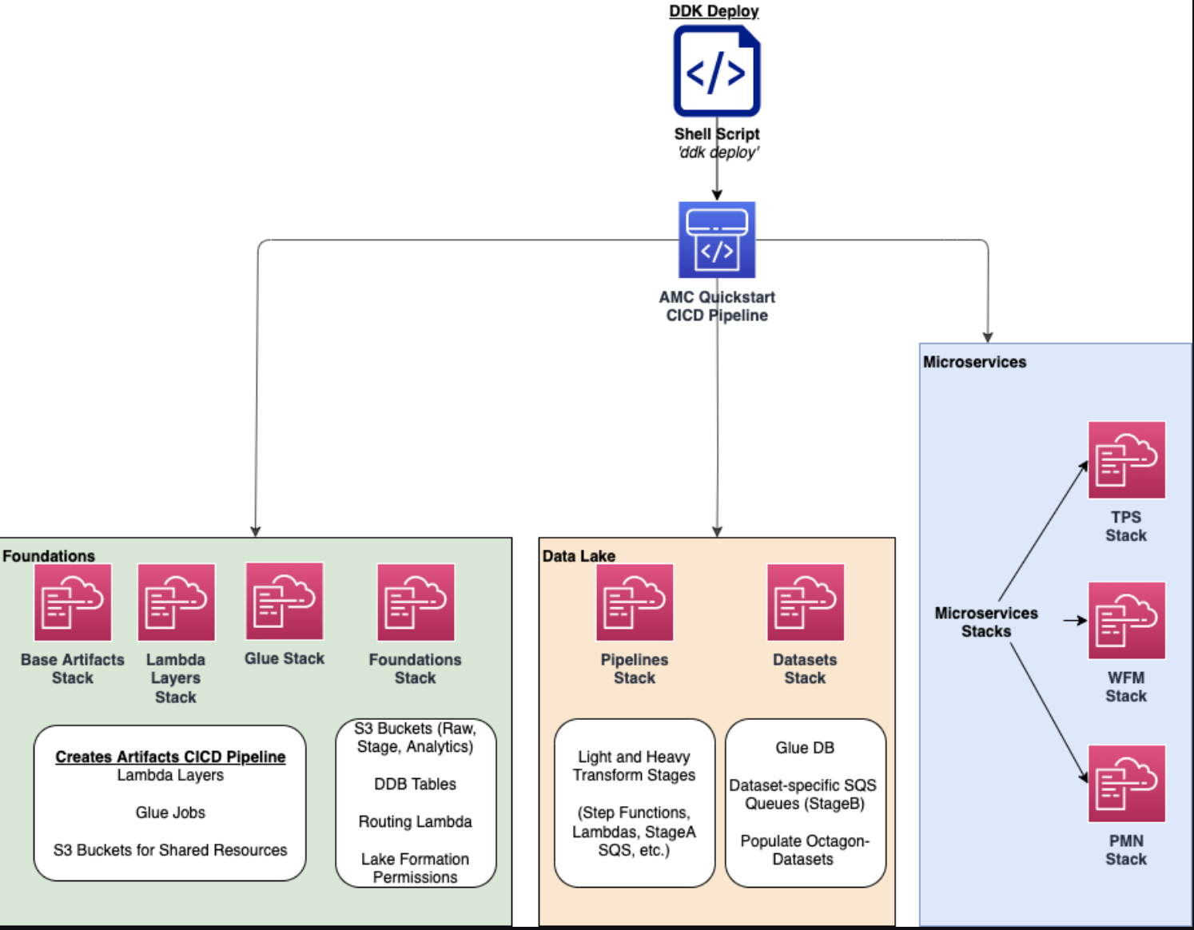

Slide 11
