Slide 1
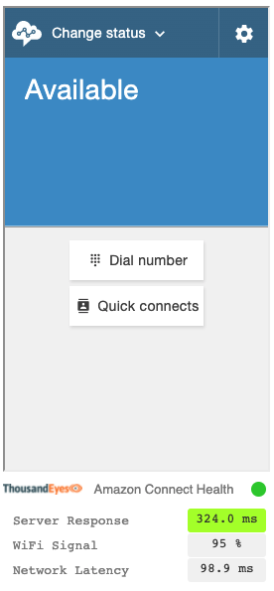







AWS Cloud
Amazon Connect
Streams API
Amazon Connect Contact Control Panel
(CCP)
Amazon Connect
IAM role:
Lambda execution
Amazon API Gateway
Lambda functions:
http, network, connection, agentInfo, status
Amazon S3
ThousandEyes Amazon Connect Health widget
End-user metrics
Endpoint Agents application
API

Slide 2
AWS Cloud
Amazon Connect
Streams API
Contact Control Panel
(CCP)
Amazon Connect
IAM Role
(Lambda Execution)
ThousandEyes Metrics Service
AWS Lambda Functions:
http, network, connection, agentinfo, status
Amazon Simple Storage Service (Amazon S3)
Endpoint Agents
ThousandEyes Health Widget
End User Metrics
API

