Slide 1
CNN
Convolutional Neural Networks

Slide 2
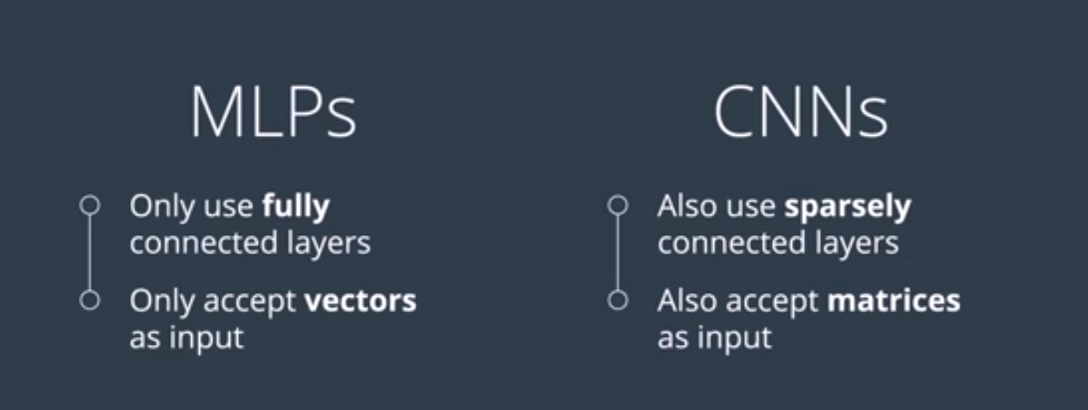

Slide 3
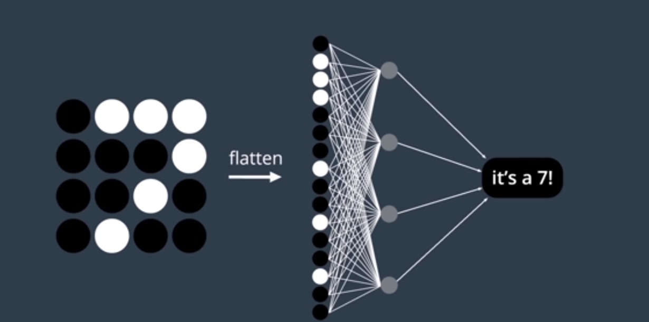

Slide 4
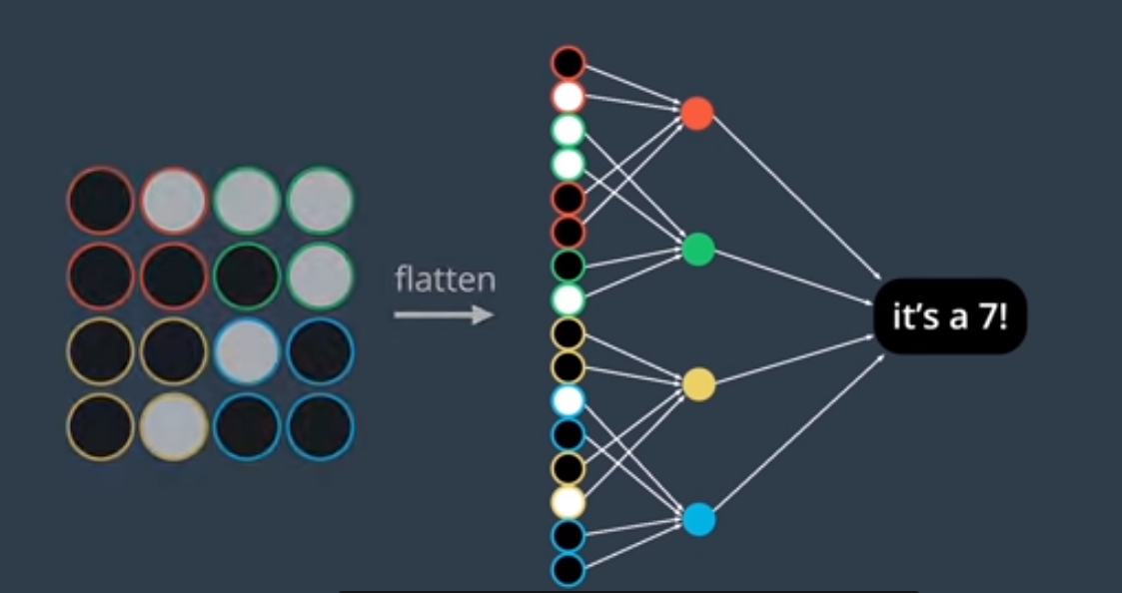

Slide 5
Convolutional Layer
Used to capture the spatial patterns in the image
Spatial Patterns:
Color
Shape: Patterns of intensity. Intensity can be light or dark
Uses filters:
Remove irrelevant data
Amplify important features

Slide 6
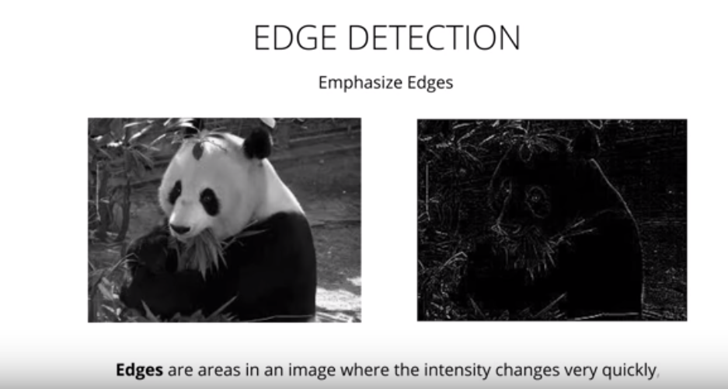

Slide 7
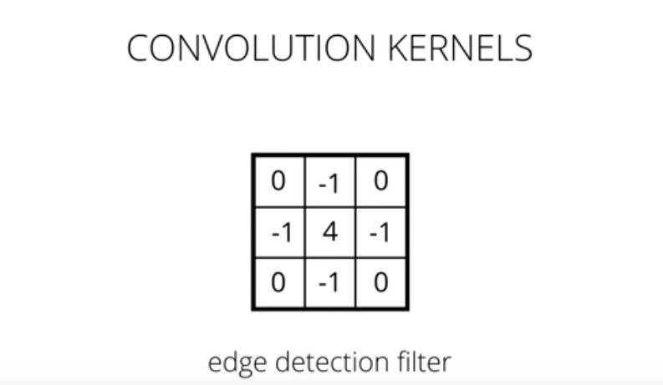

Slide 8
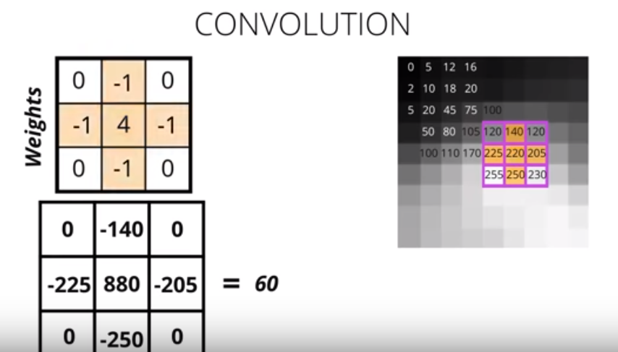

Slide 9
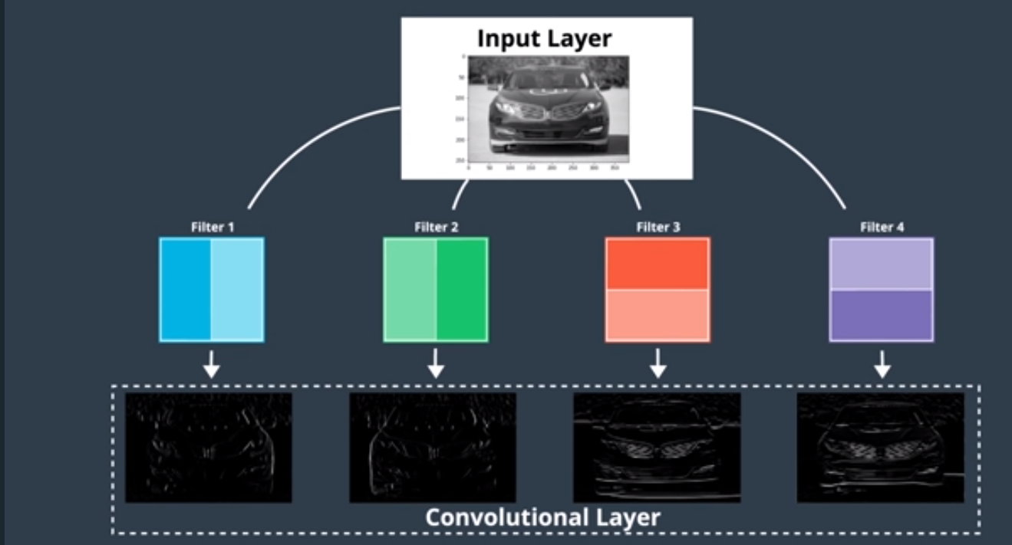

Slide 10
Convolution in RGB images

Slide 11
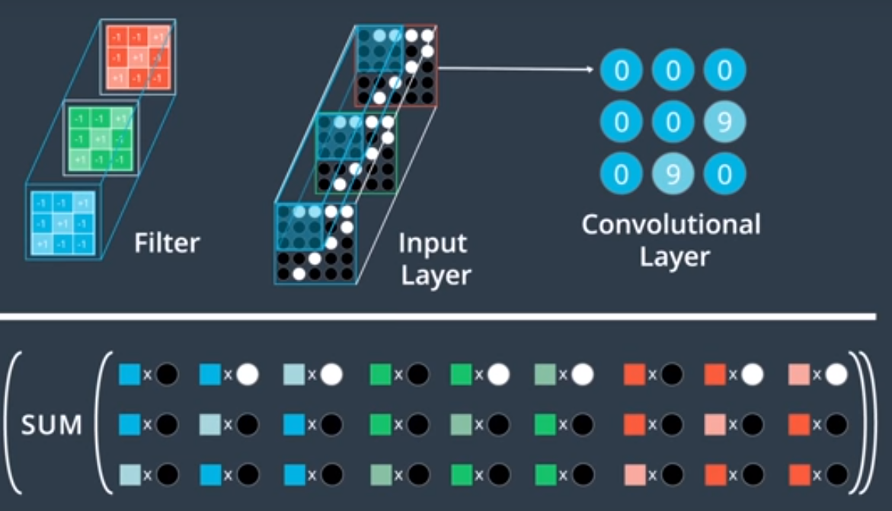

Slide 12
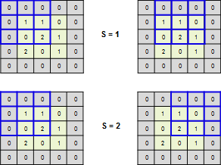
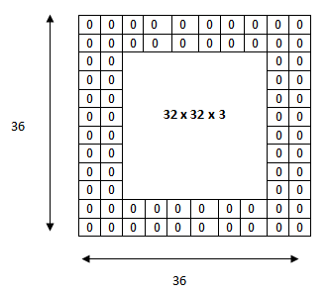
STRIDE AND PADDING

Slide 13
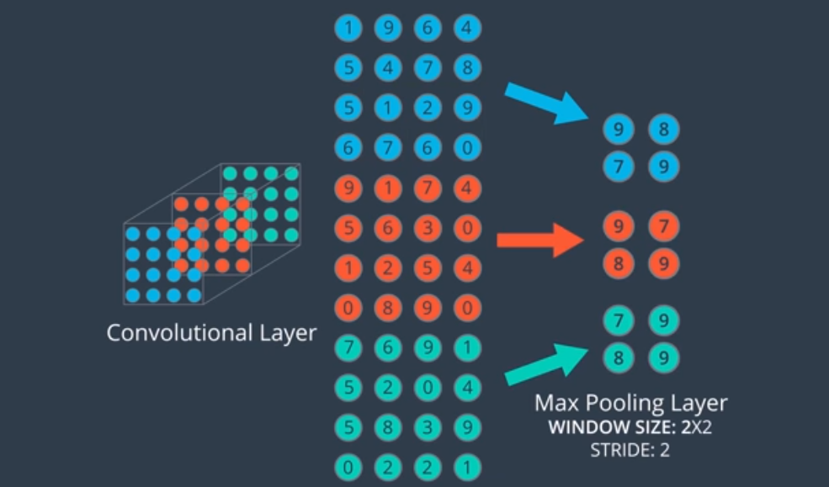

Slide 14
