Slide 1
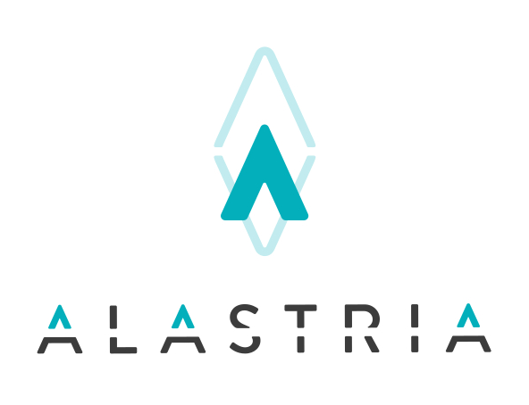
Identidad
Definición operativa del modelo de Identidad Alastria
Casos de uso

Slide 2
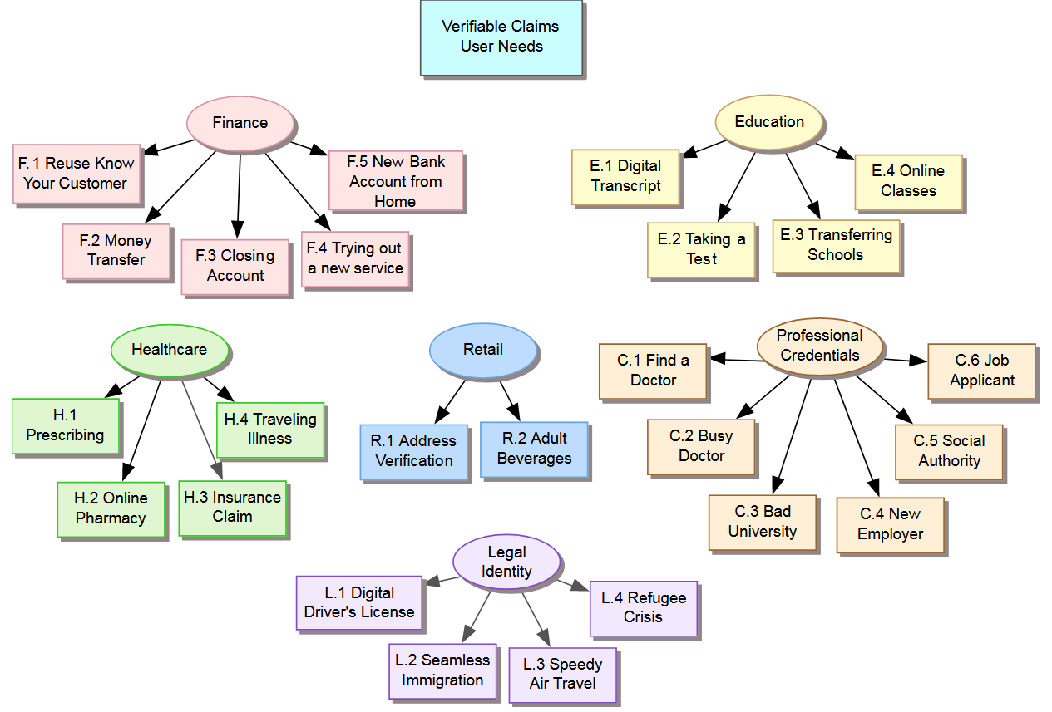
Casos de uso: W3C

Slide 3
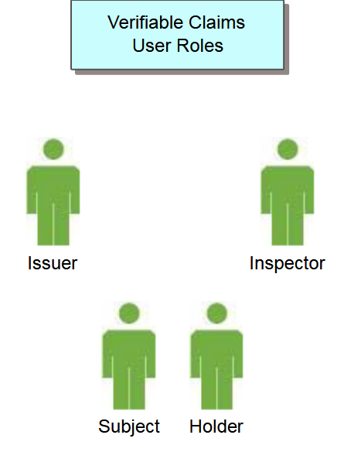
Casos de uso: W3C Roles
Attester
Certificador
Relaying Party
Consumidor de identidad
https://www.w3.org/TR/verifiable-claims-use-cases/

Slide 4
W3C – Finance Reuse KYC
Jane is opening an account at MidBank in Finland. As part of that process, the bank asks her to provide two from a variety of possible sources to confirm her identity - a so called "Know Your Customer" check. She selects government-supplied verifiable claims that confirm she receives postal mail at a certain address and that she has a national ID card. Confirming these allows the bank to open her account and be confident in her identity when she conducts transactions.
Now that the account is open, Jane is issued a digitally signed credential for her checking account at MidBank. This credential verifies that Jane has an account at MidBank and has access to her associated checking account. Since MidBank (and all banks in Finland) are required to perform "Know Your Customer" checks on accounts, this credential can also be used as sufficient verification by other financial institutions. This can help Jane assure destination banks that she is verified, thereby allaying concerns about misdirected transactions and money laundering.

Slide 5
W3C – New Employer
Jessica is a medical doctor practicing in the United States. She has a variety of digital claims that explain her qualifications, schooling, continuing education achievements, and board certifications. These are all stored in the credential repository provided by her employer. When she is offered a position with another health provider network, she can automatically transfer all of these claims to her new employer.

Slide 6
W3C – User Task
Issue claim
Assert claim
Verify claim
Store / Move claim
Retrieve claim
Revoke claim

Slide 7
Sho Card Use Cases
ShoBadge SSO
Password-less Login
Financial Services Credentialing
Improving customer’s travelling experience at airports & hotels
Call Center Authentication
Identity Verification
Automated Registration
Proof of Age
https://shocard.com/shocards-use-cases-2/

Slide 8
Sho Card Use Cases: Traveller Experience
A traveler that is embarking on a journey can obtain a single travel token for the entire duration of their trip.
The initial check occurs at the ticket counter, where the individual would be positively identified and issued the travel token. A photo/selfie is also taken for verification purposes.
The personally identifiable information, the travel token, and the photo are all stored secure on the individual’s mobile device.
When the traveler approaches any gate or checkpoint, they can present the travel token via a QR code on the SITA Traveler App.
The Agent or a kiosk would scan the code, validate the travel token and check that the individual matches the selfie. If the checks pass, the traveler is permitted through the checkpoint.
A travel token would be persistent for the entire duration of the journey. The traveler can use the same token through the airport to their destination, during their trip, and as well on their journey back to their point of departure.
Additional Features:
During the trip itself, the travel token could contain additional fields of information, allowing travel to be encapsulated with preferences and service levels be shared from the airport, through baggage claim, to customized transportation, to tailored accommodation and hospitality.
This would extend traveler-identification to industries outside of air the transport without compromising user privacy yet enhancing the user experience.
https://shocard.com/wp-content/uploads/2016/11/travel-identity-of-the-future.pdf

Slide 9
Web of Trust. Use Cases.
Use Cases
1. Selective Disclosure: Proof of Age
2. Short-term Contracts with Memory: Distributed AirBnB
3. Bootstrapping Long-Term Identity: Creating A Record of Credit
4. Concerns in Non-G20 Nations
5. Starting From Zero: Refugee
6. Human Trafficking: Exiting Safe Houses

Slide 10
Web of Trust. Selective Disclosure: Proof of Age
Beth wants to go to the club with her friends, but doesn´t want to share her complete ID that gives not only their exact age but also their name, address and other information that's unneeded in this context.
The involved parties have the following goals:
Beth wants to get into the club while providing the minimum information required: proof that she is over 21 years of age.
The club owner wants to be able to later prove that all attendees were over 21 years of age if needed.
The club owner doesn't want to incur the liability of securing irrelevant personally identifying information (PII).
The local government wants to establish a minimum degree of verifiability of the club's records without creating undue liability issue for the club owner.
Selective disclosure can meet all these goals.
It's a process by which a credential holder like Beth offers only the information needed by a service provider, for only the scope (the amount of time) needed to serve its purpose.
Typically, this involves the substitution of a verifiable claim for the actual credential itself; in the case of "proof of age", Beth could submit a one-time claim that her age is in fact over 21 in response to a request from the club. The club owner need only check that the claim is valid.

Slide 11
Web of Trust. Selective Disclosure: Proof of Age
Process – User Experience
1. Beth receives a request from the club owner containing a unique random number generated for this purpose ("nonce").
2. Beth supplements the nonce with a description of the claim she wants to make (i.e., "birthdate earlier than 21 years prior to now") and signs it, creating a"digest".
3. Beth submits the digest through secure channels to an independent, decentralized store whose record of truth (and therefore credibility) is out of the control of any one actor, whether government or business. The only guarantee the store needs externally provided is availability (i.e., uptime).
4. A state agency connects with the store from its end (perhaps by polling for requests), sees if the request is valid (that it came from Beth and makes sense as a request), and then signs the result and the nonce, inserting them both into the data store as a new digest available to Beth.
5. Beth provides the new digest to the club owner, who can verify that the result was signed by the right authority.

Slide 12
Alastria Id. Use Cases.
Social Net Passwordless Sign On
Onboarding – Automatically Filling in certified information
Online Service Passwordless Sign On
Employee Company Paswordless Single Sign On
KYC – Investor profile
Proof of Age (>18, >21, >60)
Proof of residence, qualification, etc.
Call Center authentication
Single Token Traveller Experience
Contract Signature

Slide 13
Alastria Id. User Stories.
Creación de identidad
Uso de múltiples identificadores por usuario para dificultar la trazabilidad
Creación de Atributos con validez legal. Fuentes.
Creación de Atributos “aportados” (attested) por terceros.
Creación de Atributos “aportados” (attested) por el usuario.
Autenticación/identificación
Consulta (claim) sobre atributos (Edad) autorizada por el usuario.
Consulta (claim) sobre cumplimiento de condiciones (<18 años) autorizada por el usuario.
Gestión de atributo: borrado, actualización, renovación
Recuperación segura de claves en caso de pérdida.

Slide 14
Alastria Id. User Stories
Soy… (usuario, atestador, consumidor de identidad,…)
Quiero… (Identificarme, autenticarme, presentar atributos, solicitar atributos, …)
Para… (crear identidad, acceder a un servicio, presentar datos, …)
Estoy usando… (móvil propio, ordenador propio, terminal ajeno)

