Slide 1
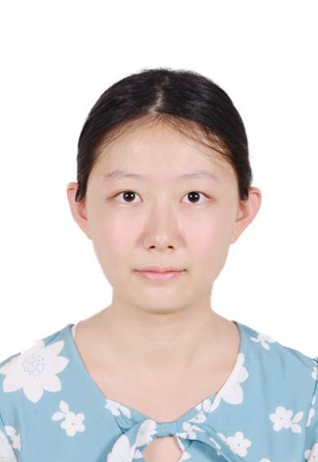
{insert profile picture}
Name: Zhang Jinjing, BSc student
Project type: laboratory project (önlab) Topic: Line association using neural network
Supervisors: Mrad Mohamed Azouz, Sik David
The goal of this project is to implement an association method for tracking lane lines across consecutive video frames.
​
The task is to determine whether a line in frame 't+1' corresponds to a line in frame 't'. A neural network is used to learn this association based on geometric features such as angle, length, and position.​
The system is developed in Python using PyTorch and is compared against a classical rule-based approach in terms of accuracy and runtime. Training data is generated from the dataset using pseudo labels.

Slide 2
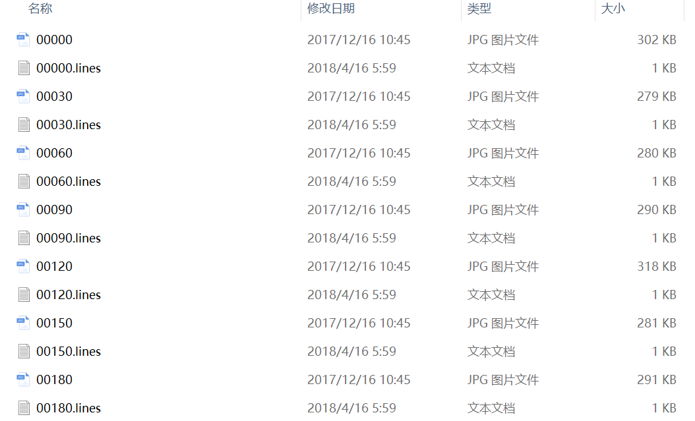
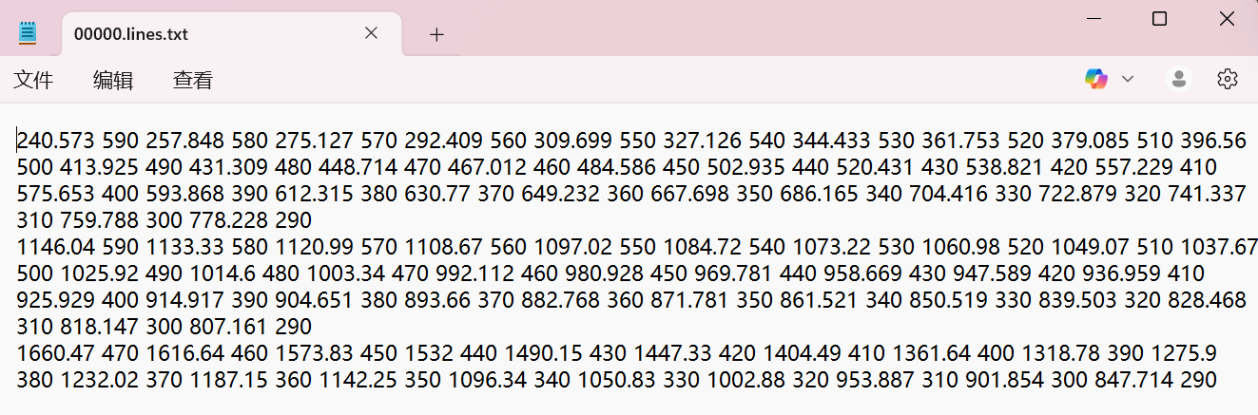
{insert picture/gif related to experiments}
CULane Dataset:
Real-world driving video frames for lane detection,which include 133,000 frames
Each image is annotated with a corresponding .lines.txt file, where each line contains a sequence of (x, y) points representing a lane line.
70% of CUlane data used for training
15% of CUlane data used for validation
15% of CUlane data used for testing

Slide 3
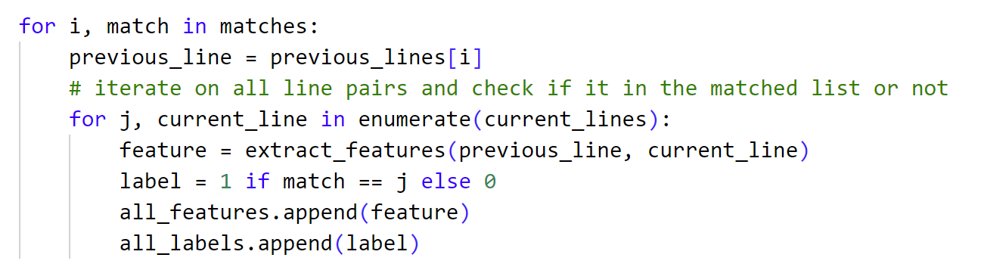
Usage Pipeline: From Annotations to Matching Dataset
1. Used CULane `.lines.txt` files to extract the start and end points of each lane line.
2. Compared lane lines across consecutive frames to form line pairs.
3. For each line pair, computed 7 geometric features (e.g., direction similarity, distance, and length difference).
4. Labeled line pairs as either matched (1) or unmatched (0)
5. Generated custom train, validation, and test datasets (features + labels) for training, evaluating, and visualizing the neural association model.
def extract_features(previous_line, current_line):
x1_1, y1_1, x2_1, y2_1 = map(float, previous_line)
x1_2, y1_2, x2_2, y2_2 = map(float, current_line)
v1 = np.array([x2_1 - x1_1, y2_1 - y1_1])
v2 = np.array([x2_2 - x1_2, y2_2 - y1_2])
cos_sim = np.dot(v1, v2) / (np.linalg.norm(v1) * np.linalg.norm(v2) + 1e-6)
c1 = np.array([(x1_1 + x2_1) / 2, (y1_1 + y2_1) / 2])
c2 = np.array([(x1_2 + x2_2) / 2, (y1_2 + y2_2) / 2])
center_dist = np.linalg.norm(c1 - c2)
len1 = np.linalg.norm(v1)
len2 = np.linalg.norm(v2)
length_diff = abs(len1 - len2)
delta_x1 = x1_2 - x1_1
delta_y1 = y1_2 - y1_1
delta_x2 = x2_2 - x2_1
delta_y2 = y2_2 - y2_1
return [cos_sim, center_dist, length_diff, delta_x1, delta_y1, delta_x2, delta_y2]

Slide 4
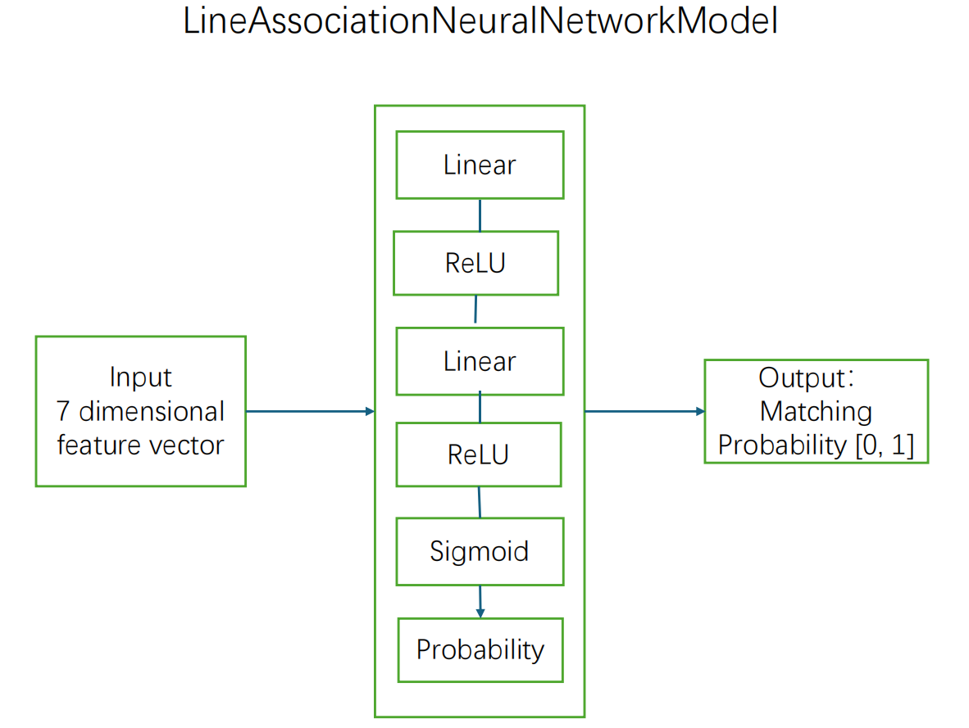
Line association neural network model:
class LineAssociationModel(nn.Module):
def __init__(self, input_dim=7, hidden_dim=64):
super(LineAssociationModel, self).__init__()
self.model = nn.Sequential(
nn.Linear(input_dim, hidden_dim),
nn.ReLU(),
nn.Linear(hidden_dim, hidden_dim),
nn.ReLU(),
nn.Linear(hidden_dim, 1),
nn.Sigmoid()
)
def forward(self, x):
return self.model(x).squeeze(1)
{insert picture/gif related to experiments}

Slide 5
Training workflow with early stopping and loss monitoring
• Input: Feature vectors (7D)
•Label: Binary labels (1 = match, 0 = non-match)
• Model: 3-layer feedforward neural network (Linear → ReLU → Linear → ReLU → Linear → Sigmoid)
• Loss: Binary Cross-Entropy
• Optimizer: Adam (learning rate = 1e-3)
• Epochs: 50 | Early stopping: patience = 7
• Training and validation features were extracted from line pairs between current and previous frame
• Best model weights are saved when validation loss improves.Training stops if no improvement for 7 consecutive epochs (patience = 7)
association_model = LineAssociationModel().to(device)
criterion = nn.BCELoss()
optimizer = torch.optim.Adam(association_model.parameters(), lr=1e-3)
best_val_loss = float('inf')
no_improve_epochs = 0
for epoch in range(num_epochs):
association_model.train()
for features, labels in association_train_loader:
features, labels = features.to(device), labels.to(device)
optimizer.zero_grad()
outputs = association_model(features)
loss = criterion(outputs, labels)
loss.backward()
optimizer.step()
val_loss, val_acc = validate_model(association_model, val_loader, criterion)
if val_loss < best_val_loss:
best_val_loss = val_loss
best_model_wts = copy.deepcopy(association_model.state_dict())
no_improve_epochs = 0
else:
no_improve_epochs += 1
if no_improve_epochs >= patience:
print("Early stopping")
break

Slide 6
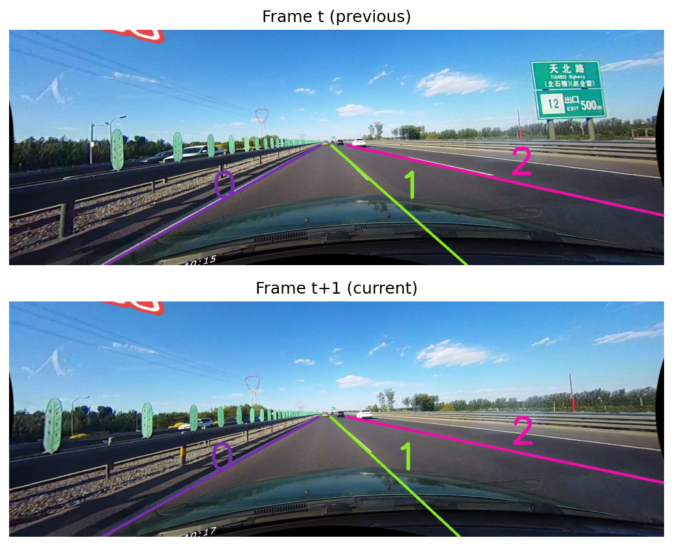
Visualization of Line Matching on Test Data
We use the testing dataset to visually verify that the trained model can correctly match lane lines on unseen frames, not just those seen during training.
For each matched line pair, the same color and ID are assigned in frame t (previous) and frame t+1 (current).
Visualization can used both on trained neural model and
Rule-based matching
{insert picture/gif related to experiments}

Slide 7
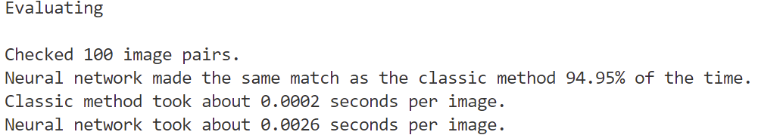
Evaluating:
Compare rule-based and neural model line matching methods on unseen data from the CULane test dataset
• Evaluation metrics:
- Match accuracy
- Runtime per frame (in seconds)
• Evaluation procedure:
- For each pair of consecutive frames:
1. Predict matches using both methods
2. Compare predicted matches (index pairs)
3. Measure agreement rate
4. Record time taken for each method
• Outcome:
- Neural model achieves comparable accuracy
- rule-based matching is generally faster in runtime than
neural network matching
Neural model produced the same match result as the rule-based method in 94.95% of 100 test frame pairs.

Slide 8
Future work
1.Add a line detection module before the association model
→ Achieve end-to-end matching from raw images to line pairs
2.Optimize the current line association model architecture
→ Try deeper networks, new activation functions, or regularization
3. Explore alternative models (e.g., GNNs, Siamese networks)
→ Improve matching accuracy and generalization
4.Extend from frame-by-frame tracking association (t ↔ t+1) to global multi-frame tracking
→ Track line IDs across longer sequences to improve temporal consistency

