Slide 1
IDE {
For
Beginners }
Pitch Presentation
2025
</
} /> [
/>

Slide 2
</ Backlog
Presentation
Story
Features
Our app is an easy-to-use, beginner-friendly IDE tailored for writing, running, editing C/C++ files.
Our app has an intuitive design, a lot of interesting features which improve your quality-of-life.
Our app is targeted to new coders, who want to explore the world of programming through a fun and engaging environment.
Our app actually makes C++ fun!
Our app merges the best part of what you find in other IDEs, for a smoother and easier coding session!
You can write code, edit files, run your code in C/C++, use an AI tool, autocomplete functions and many more!
</>

Slide 3
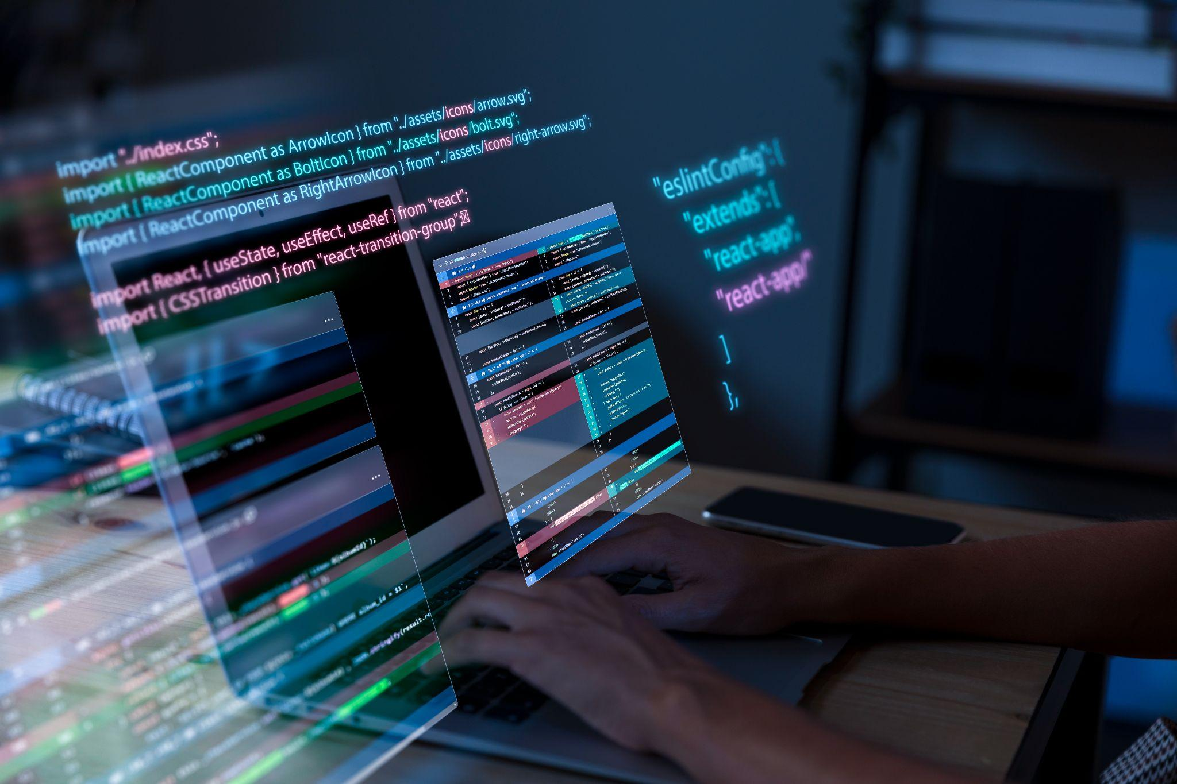
</ User Stories
We want our users to be able to:
Use our app easily
Be able to open, create, save files and folders
Write and edit text
Change the formatting of the text
Have syntax and error highlighting
Use an AI chatbot for improving code
Run and compile C/C++ code
Customize the editor
Open a terminal
Use already written frequent functions (QuickSort, Binary Search, DFS etc.)
cpp>

Slide 4
</ Architecture
In the process of developing our app, we used:
PYTHON 3.12.2
LLVM Compiler Infrastructure
For Clang, Clangd
Language Server Protocols
For autocomplete, syntax errors etc.
PyQt5 Framework
For the overall implementation of the app
} /> [
/>

Slide 5
</ Interesting Aspects
Already Written Functions
Intuitive File System
Funky Syntax Highlighting
Autocomplete
Our app offers our users the ability to use pre-written (by experienced programmers!) frequently-used functions and data types - like Binary Search, Stacks, DFS.
Our users can open folders and files in multiple tabs.
Done with RegEx, our syntax highlighting is fun and visible and we plan on making it fully customizable.
Written through a series of notifications sent from and to the Language Server, which are then interpreted.

Slide 6
</ Difficulties
/> **
} /> [
File System
LSP Integration
The difficulty laid in the synchronisation of the files - we had to verify their saved state, select their path, matching the methods among them.
The difficulty laid in researching the best way to implement these features and in synchronising the notifications with the app.

Slide 7
</ What’s left?
AI Chatbot Implementation
Design Implementation
Bug Fixing
Automatic Tests
Customizability
} /> [
/>

Slide 8
Thanks!
Pitch Deck
20xx
</
} /> [
Do you have any questions ? :)
/>
GitHub
Please keep this slide for attribution

