Slide 1
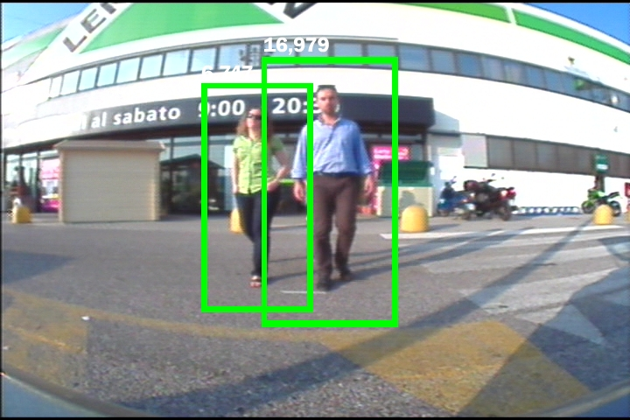
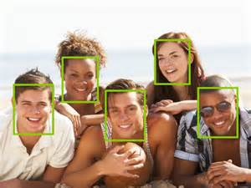
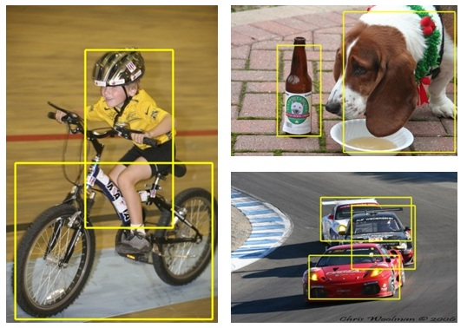
Object Detection (目标检测)
What’s object detection?

Slide 2

One way of detection
Detection by doing sliding window search
Cut many small images from big one
Appending a classifier for each small image
Get detection result
Face
Classifier

Slide 3
Two Classes of Object Detection
Specific Object Detection
Face Detection
Pedestrian Detection
Car Detection
…
General Object Detection
Pascal VOC
ImageNet

Slide 4
Specific Object Detection
Face Detection (You can find paper link in fddb website)
Faceness , ICCV 2015, Best, Tang Xiaoou组
http://personal.ie.cuhk.edu.hk/~ys014/projects/Faceness/Faceness.html
upsampling featrue -> ranking windows->detect
CassacdeCNN, CVPR 2015, adobe
https://github.com/Bkmz21/FD-Evaluation
CNN Cassacde From small to big filiter windows
Joint Cascade, ECCV 2014
Detection and alignment in the same cascade framework
HeadHunter, ECCV 2014
http://markusmathias.bitbucket.org/2014_eccv_face_detection/
Cascade, divide train of models by 23 poses, than join all
MultiresHPM, CVPR 2014
Manage occlusion in train.
CCF, ICCV 2015
Pertrain CNN to genrente feature -> detect
Dense Box
http://arxiv.org/abs/1509.04874/

Slide 5
Specific Object Detection
Face Detection Dataset
FDDB (Face Detection Data Set and Benchmark)
2845 images with a total of 5171 faces
http://vis-www.cs.umass.edu/fddb/results.html
AFW
207 images with 337 face
http://www.ics.uci.edu/~xzhu/face/
AFLW
25k annotated faces
https://lrs.icg.tugraz.at/research/aflw/
Baiduyun: http://www.thinkface.cn/thread-1735-1-1.html
CelebA (CelebFaces Attributes Dataset)
202,599 number of face images
http://mmlab.ie.cuhk.edu.hk/projects/CelebA.html
Baiduyun: http://pan.baidu.com/s/1mgF3IJ2
None face image for negative sample
Pacal voc none face class
http://host.robots.ox.ac.uk:8080/pascal/VOC/

Slide 6
Specific Object Detection
Pedestrian Detection
Survey: Ten Years of Pedestrian Detection, What Have We Learned
http://rodrigob.github.io/documents/2014_eccvw_ten_years_of_pedestrian_detection_with_supplementary_material.pdf
Pedestrian detection at 100 frames per second
http://rodrigob.github.io/documents/2012_cvpr_pedestrian_detection_at_100_frames_per_second.pdf
Filtered channel features for pedestrian detection
http://arxiv.org/abs/1501.05759

Slide 7
Specific Object Detection
Pedestrian Detection Dataset
INRIA: http://pascal.inrialpes.fr/data/human/
ETH: https://data.vision.ee.ethz.ch/cvl/aess/dataset/
TUD-Brussels: http://www.d2.mpi-inf.mpg.de/tud-brussels
Daimler: http://www.gavrila.net/Research/Pedestrian_Detection/Daimler_Pedestrian_Benchmark_D/Daimler_Mono_Ped__Detection_Be/daimler_mono_ped__detection_be.html
Caltech-USA: http://www.vision.caltech.edu/Image_Datasets/CaltechPedestrians/
KITTI's page(car,pedestrian, etc.): http://www.cvlibs.net/datasets/kitti/eval_object.php/

Slide 8
Specific Object Detection
Car Detection
Dense Box
http://arxiv.org/abs/1509.04874/
Car Detection Dataset
KITTI's page(car,pedestrian, etc.): http://www.cvlibs.net/datasets/kitti/eval_object.php/
UIUC: https://cogcomp.cs.illinois.edu/Data/Car/

Slide 9
General Object Detection
Survey: What makes for effective detection proposals?
http://arxiv.org/abs/1502.05082/
Edge Boxes: Locating Object Proposals from Edges
http://research.microsoft.com/pubs/220569/ZitnickDollarECCV14edgeBoxes.pdf
Faster R-CNN
http://arxiv.org/abs/1506.01497
Dataset:
Imagenet:
http://image-net.org/challenges/LSVRC/2015/index#maincomp
PASCAL VOC:
http://host.robots.ox.ac.uk/pascal/VOC/

Slide 10
Source Code
行人100帧的代码
https://bitbucket.org/rodrigob/doppia/overview
http://vision.ucsd.edu/~pdollar/index.html
Integral Channel Features以及特征估计的提出者主页，是后来行人100帧的奠基，他们是用Matlab代码的。
EdgeBoxes
https://github.com/pdollar/edges
Faster-RCNN
https://github.com/ShaoqingRen/faster_rcnn/

Slide 11
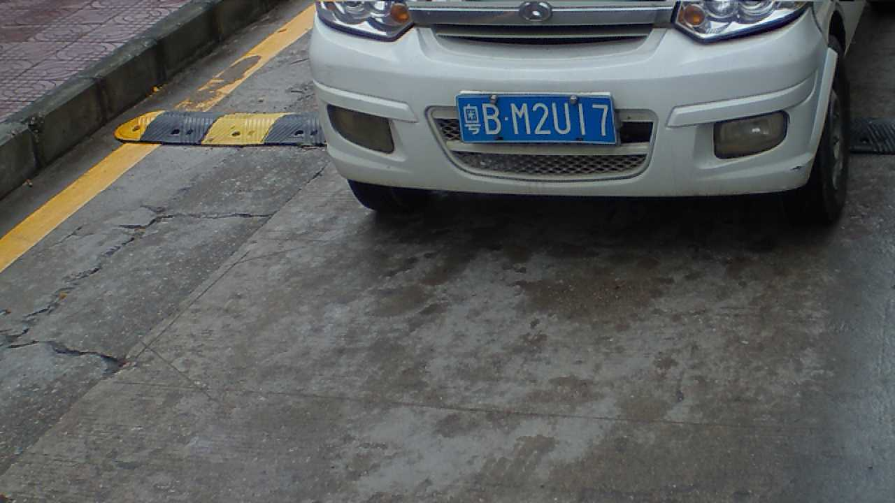
车牌检测与识别
问题描述：
输入一张图片，有可能没有车牌，有可能有车牌，有可能有多个车牌
检测出所有的车牌，并识别出上面的文字。
输入图片
输出结果：一个车牌，粤BM2U17

Slide 12
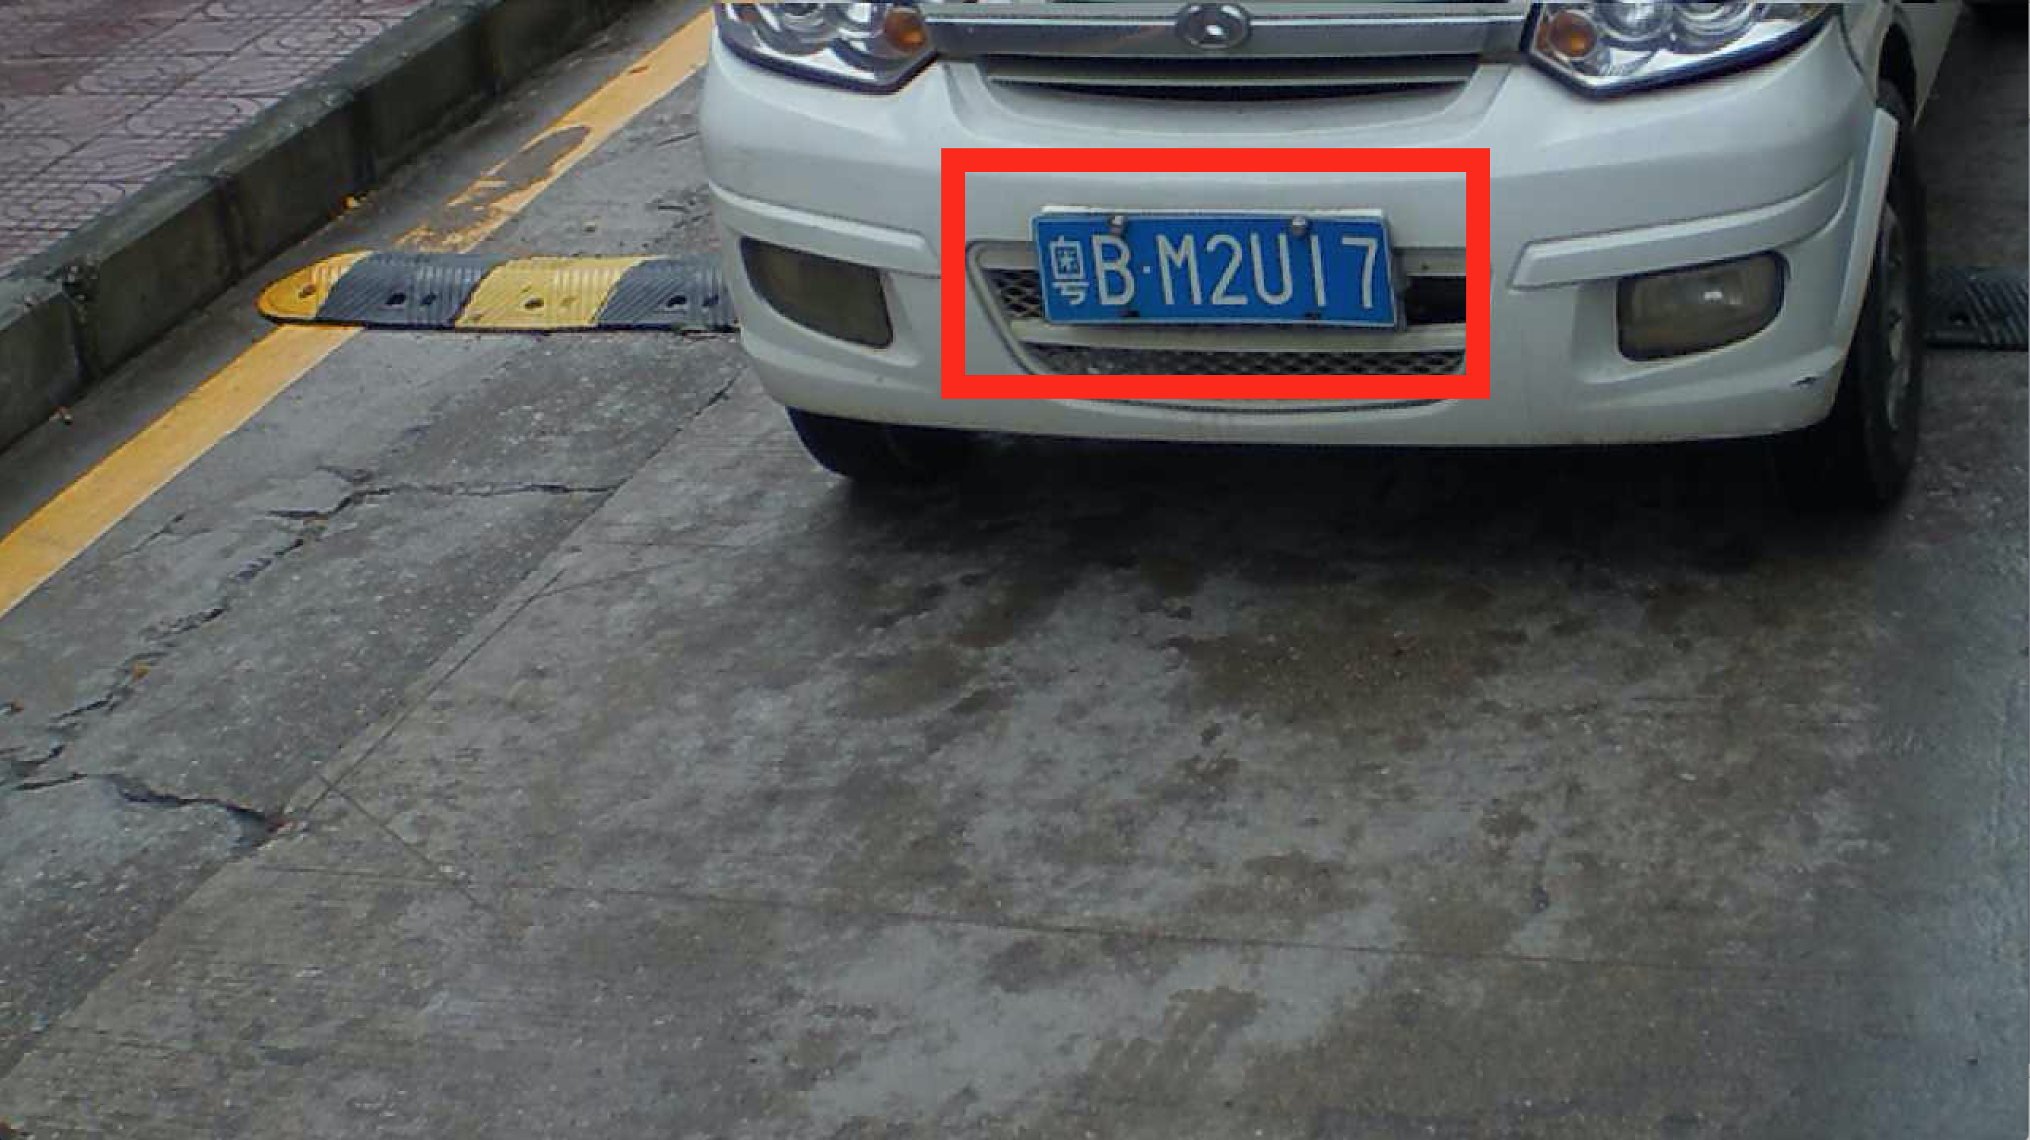
基本流程
车牌初步检测
输入图像
车牌精确定位
车牌字符分割
检测出所有车牌（框出车牌所在位置）
字符识别

Slide 13

基本流程
输入上一步检测到的车牌图像
车牌初步检测
找到四个关键点
车牌精确定位
车牌字符分割
通过将关键点连线，
字符识别
得到准确的车牌图像

Slide 14
基本流程
车牌初步检测
车牌精确定位
输入上一步得到的精确车牌图像
车牌字符分割
字符识别
分割得到一个一个独立字符图像

Slide 15
基本流程
车牌初步检测
车牌精确定位
车牌字符分割
字符识别
对每个字符图像进行识别
粤
B
M
2
U
1
7

Slide 16
数据集描述
数据下载：
链接：http://pan.baidu.com/s/1i3CLJLV 密码：idie
有v1和v2两个压缩包，可以把一个当作训练集合，一个当作测试集合。（还会有更多样的数据提供）
每一张图片的文件名有8个数字，是车牌对应4个点在图片中的坐标，按右上/右下/左下/左上这个顺时针方向给出
这个数据可以检验流程的前三步：
直接可以做车牌初步检测这个问题
处理一下（针对车牌位置，随机产生一个较大的包含车牌的矩形），可以用来做精确定位问题
处理一下（直接取出包含车牌的最小矩形），可以用来做字符分割问题。

Slide 17
任务描述及要求：
可以选择车牌检测和识别流程前三步中任意一步作为任务，设计方法加以解决，
数据就用上面提供的数据，也可以自行采集更多的数据或者向我要求更多的数据。

