Slide 1
Big Mountain Resort Business Strategy Development
Guided Capstone Project

Slide 2
Background – Big Mountain Resort
Location: Flathead National Forest, Montana
No. of Trails: 105
No. of Lifts: 11
Skiable Terrain: 3000 acres
No. of Visitors: 350,000
Adult Weekend Ticket price: $81
Adding a new chair lift: $1.54M increase in operating cost

Slide 3
Problem Statement – Stay Profitable
Implementation of a Data-Driven Approach:
Revise resort ticket price
Revise existing business strategies on facilities maintenance and addition

Slide 4
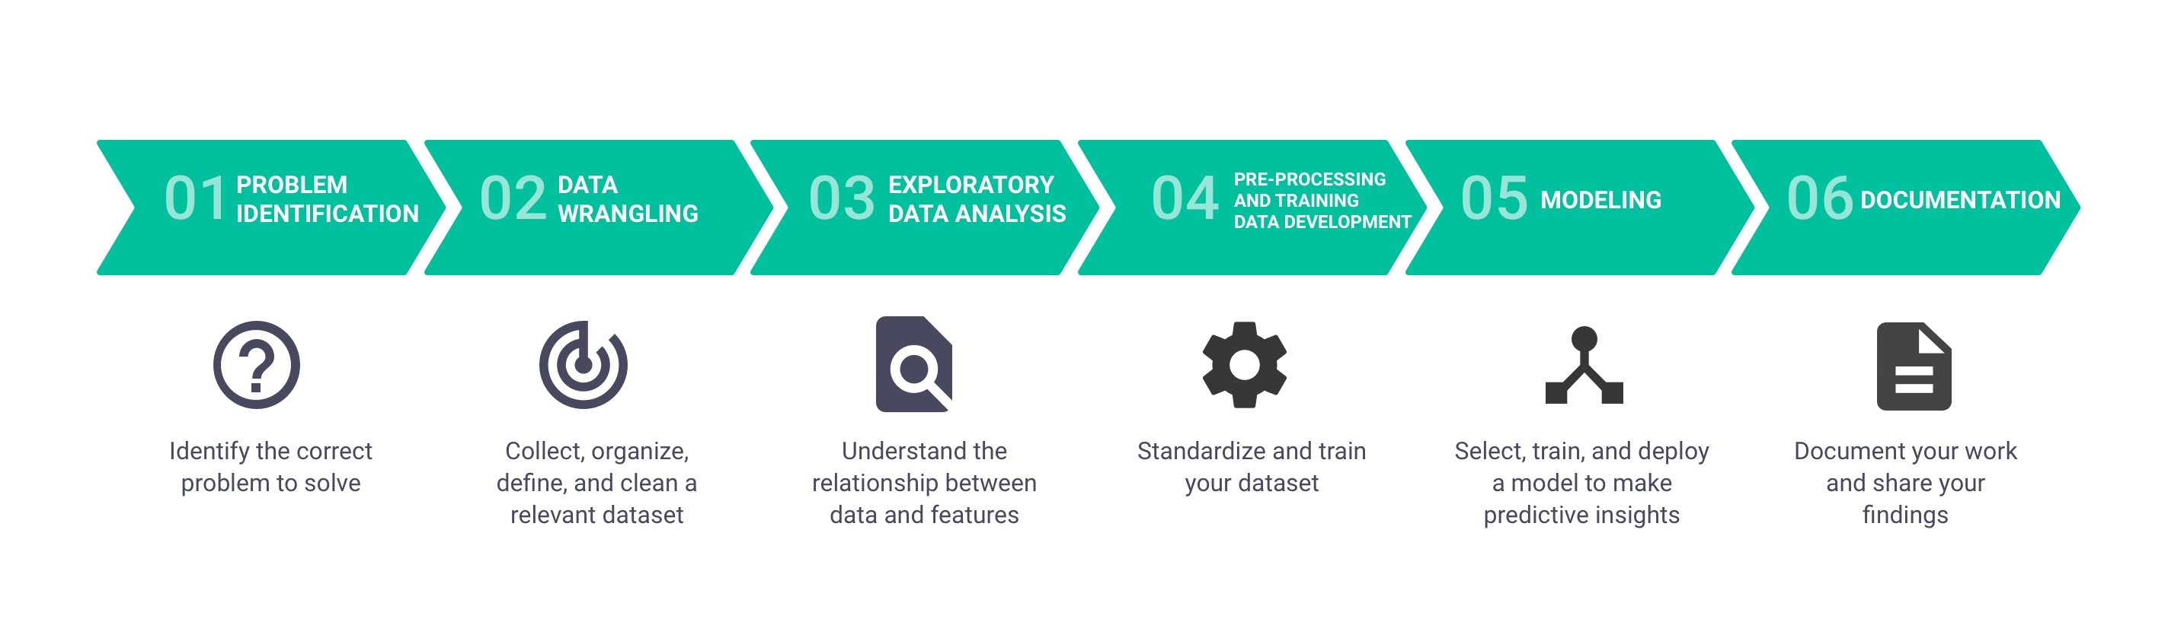
Data Science Method

Slide 5
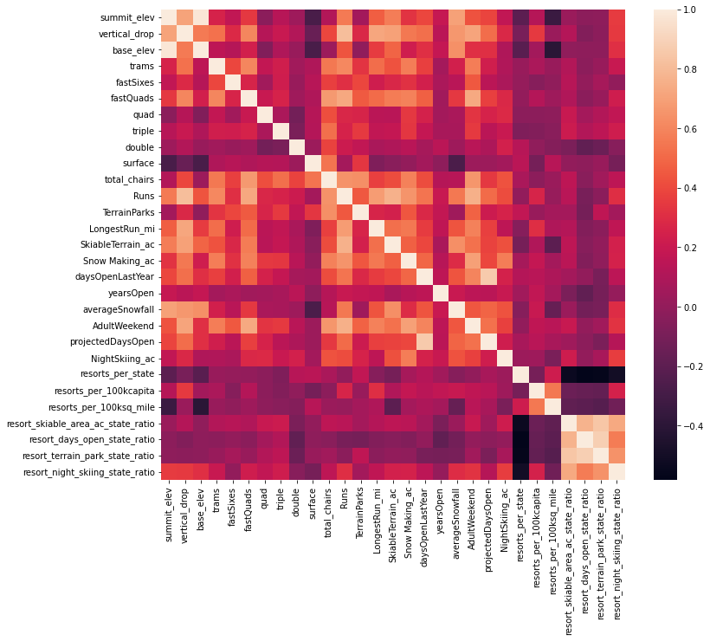
Key Findings
Features correlated with Ticket Pricing
No. of Fast Quads
No. of Runs
Total Snow Making Area
No. of Total Chairs
Vertical Drop

Slide 6
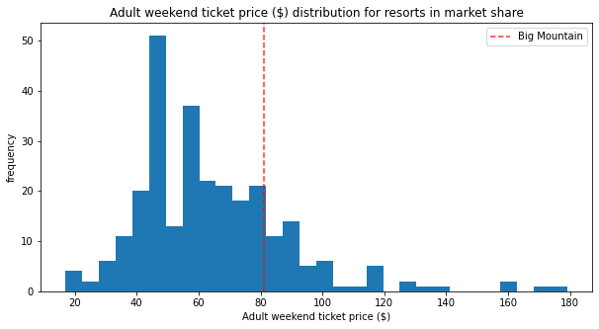
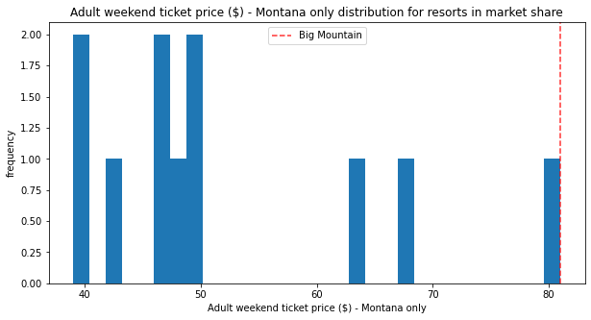
Big Mountain Resort Positioning – Pricing

Slide 7
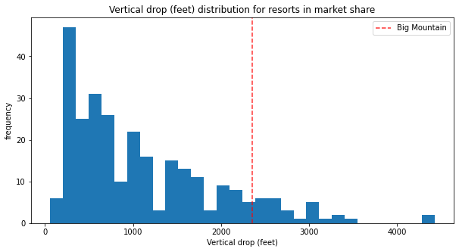
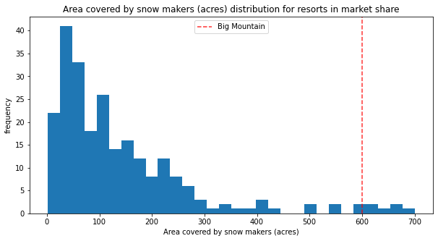
Big Mountain Resort Positioning – Features

Slide 8
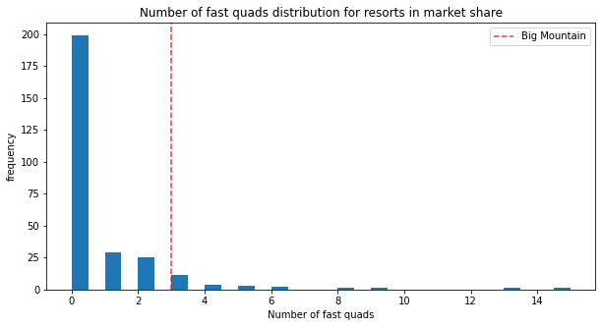
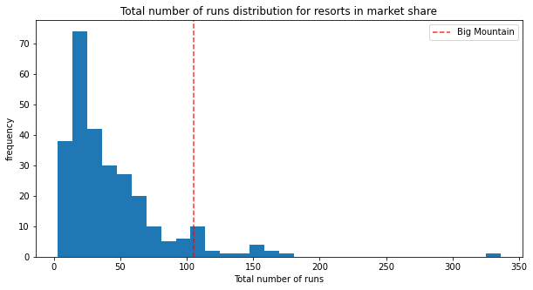
Big Mountain Resort Positioning – Features

Slide 9
Recommendations – Ticket Pricing
Recommended Pricing Range
$96 ± $10
Current Pricing
$81

Slide 10
Recommendations – Business Strategy
Runs vs. Revenue/Ticket Pricing
Closing runs can reduce support for ticket price & revenue
Option 1: Increase vertical drop by 150 feet, add 1 chair lift
Estimated $1.99 increase in Ticket Pricing
Option 2: Option 1 + 2 more acres of snow making cover
No change in Ticket Pricing on top of Option 1
Option 3: Increase run by 0.2 mile, add 4 more acres of snow making cover
No change in Ticket Pricing

Slide 11
Questions?

