Slide 1


Self-Supervised Learning 02 Auto-Encoder Yizhen Lao

Slide 2
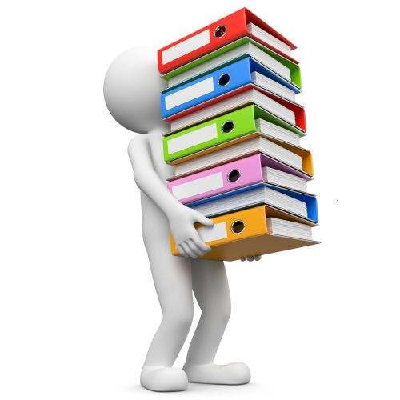
Self-supervised Learning Framework
Auto-encoder
Self-supervised
Self-supervised Learning
Learned by tasks not requiring label data
Pre-train
data
Model for Task 1
Model for Task 2
Model for Task 3
Downstream Tasks
Notes:
Pretext 藉口
===
Auto-encoder is old
Even older than self-supervised
Does it belong to self-supervised?

Slide 3
Outline
Basic Idea of Auto-encoder
Feature Disentanglement
Discrete Latent Representation
More Applications

Slide 4












Auto-encoder
Unlabeled
Images
Sounds familiar?
We have seen the same idea in Cycle GAN. ☺
As close as possible
(reconstruction)
high dim
NN
Encoder
NN
Decoder
vector
old feature
low dim (bottleneck)
Dimension reduction
Embedding, Representation, Code
New feature for downstream tasks

Slide 5
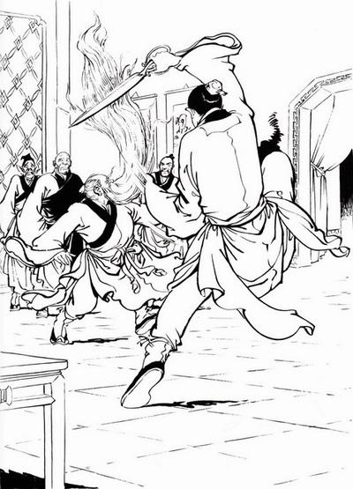
Why Auto-encoder?
《神雕侠侣》
Notes:
本為絕情谷主公孫止的大弟子 樊一翁

Slide 6

Why Auto-encoder?
As close as possible
(reconstruction)
NN
Encoder
NN
Decoder
3 x 3
Find pattern, and then compress
2 dim
3 x 3

Slide 7
Why Auto-encoder?
NN
Encoder
《神雕侠侣》

Slide 8
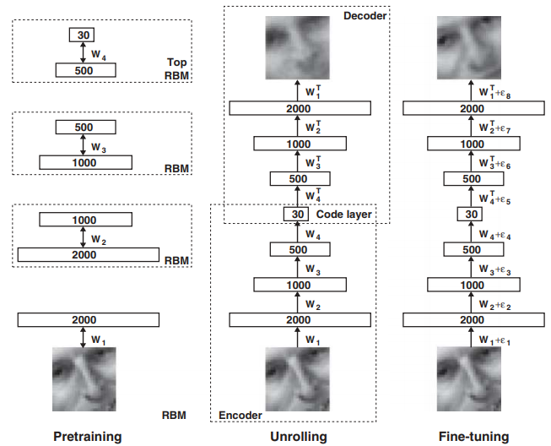
Auto-encoder is not a new idea
Hinton, Geoffrey E., and Ruslan R. Salakhutdinov. "Reducing the dimensionality of data with neural networks." Science 313.5786 (2006): 504-507

Slide 9

De-noising Auto-encoder
As close as possible
Add noises
NN
Encoder
NN
Decoder
vector
The idea sounds familiar? ☺
Vincent, Pascal, et al. "Extracting and composing robust features with denoising autoencoders." ICML, 2008.

Slide 10
Review: BERT
Reconstruction
A de-noising auto-encoder
minimize cross entropy
softmax
南
Decoder
Linear
Embedding
BERT
Encoder
Add noise
湖
灣
大
学
Notes:
Something different … embedding is not bottleneck ……

Slide 11
Outline
Basic Idea of Auto-encoder
Feature Disentanglement
Discrete Latent Representation
More Applications

Slide 12
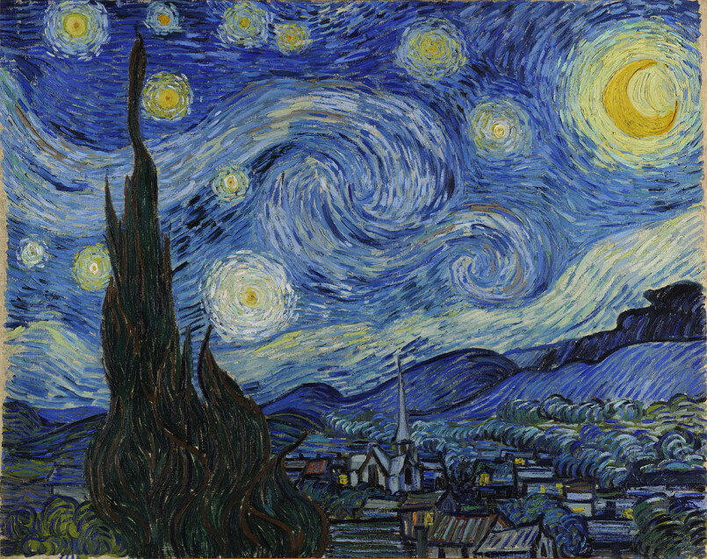
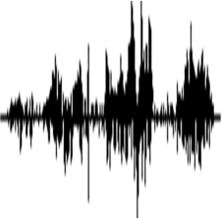
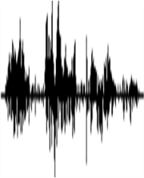

Representation includes
information of different aspects
Encoder
Decoder
input image
reconstructed
object, texture ….
Encoder
Decoder
input audio
reconstructed
content, speaker …
Encoder
Decoder
input sentence
reconstructed
syntax, semantic …

Slide 13
Feature Disentangle
Encoder
Decoder
input audio
reconstructed
content, speaker …
content information
Encoder
Decoder
input audio
reconstructed
speaker information
https://arxiv.org/abs/1904.05742
https://arxiv.org/abs/1804.02812
https://arxiv.org/abs/1905.05879

Slide 14

Application: Voice Conversion

Slide 15
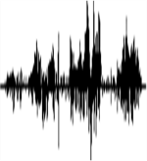



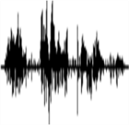

In the past
Speaker A
Speaker B
How are you?
How are you?
Good morning
Good morning
Today
Speaker A
Speaker B
一二三四五
How are you?
上山打老虎
Good morning
Speakers A and B are talking about completely different things.

Slide 16
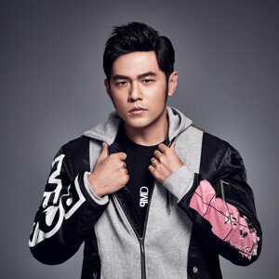
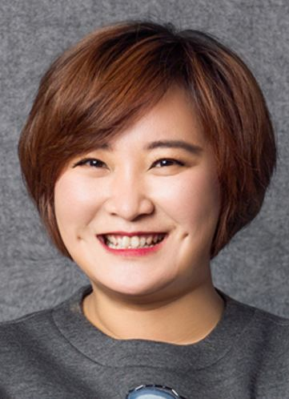
Application: Voice Conversion
How are you?
Encoder
Decoder
How are you?
How are you?
Hello
Encoder
Decoder
Hello
Hello

Slide 17
Application: Voice Conversion
How are you?
Encoder
How are you?
How are you?
Decoder
Hello
Encoder
How are you?
Hello

Slide 18
Outline
Basic Idea of Auto-encoder
Feature Disentanglement
Discrete Latent Representation
More Applications

Slide 19
Discrete Representation
Real numbers
NN
Encoder
0.9
0.1
0.3
0.7
NN
Decoder
Binary
NN
Encoder
1
0
0
1
NN
Decoder
glasses
female
One-hot
NN
Encoder
0
0
1
0
NN
Decoder
class
Notes:
https://arxiv.org/pdf/1611.01144.pdf
Easier to interpret or clustering

Slide 20
Discrete Representation
https://arxiv.org/abs/1711.00937
Vector Quantized Variational Auto-encoder (VQVAE)
NN
Encoder
NN
Decoder
vector
vector 3
(c.f. attention)
Codebook
(a set of vectors)
Compute similarity
vector 1
vector 2
vector 5
vector 3
vector 4
The most similar one is the input of decoder.
Learn from data
For speech, the codebook represents phonetic information
https://arxiv.org/pdf/1901.08810.pdf

Slide 21

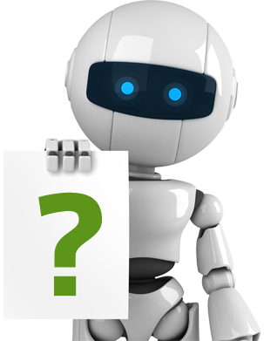

Text as Representation
https://arxiv.org/abs/1810.02851
Only need a lot of documents to train the model
seq2seq2seq
auto-encoder
Unsupervised Summarization
not readable …
word
sequence
document
document
En
De
Summary?
Seq2seq
Seq2seq

Slide 22
Text as Representation
This is cycle GAN ☺
Human written summaries
Real or not
Let discriminator considers my output as real
Di
Discriminator
word
sequence
document
document
Readable
En
De
Summary?
Seq2seq
Seq2seq

Slide 23
Text as Representation
Document:澳大利亚今天与13个国家签署了反兴奋剂双边协议,旨在加强体育竞赛之外的药品检查并共享研究成果 ……
Summary:
Human:澳大利亚与13国签署反兴奋剂协议
Unsupervised: 澳大利亚加强体育竞赛之外的药品检查

Slide 24
Text as Representation
Document:安徽省合肥市最近为领导干部下基层做了新规定:一律轻车简从,不准搞迎来送往、不准搞层层陪同 ……
Summary:
Human:合肥规定领导干部下基层活动从简
Unsupervised:合肥领导干部下基层做搞迎来送往规定:一律简

Slide 25
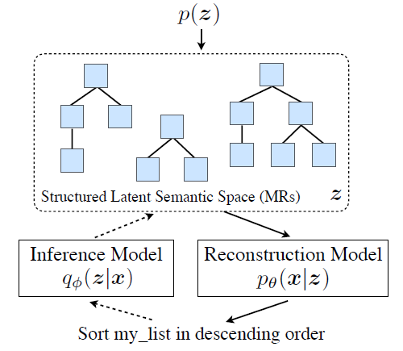
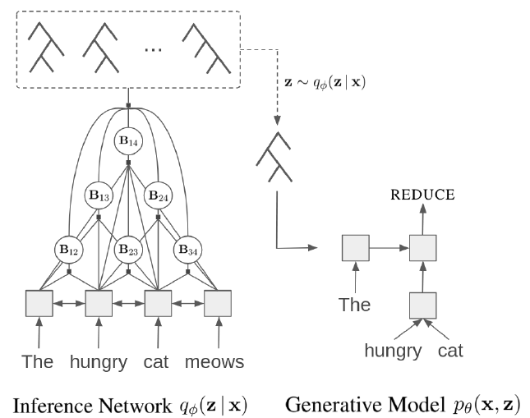
Tree as Embedding
https://arxiv.org/abs/1806.07832
https://arxiv.org/abs/1904.03746
Notes:
https://vimeo.com/285800885

Slide 26
Outline
Basic Idea of Auto-encoder
Feature Disentanglement
Discrete Latent Representation
More Applications

Slide 27

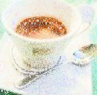
Generator
As close as possible
NN
Encoder
NN
Decoder
vector
Is it a generator?
Randomly generate a vector from a distribution
NN
Decoder
vector
Image ?
With some modification, we have variational auto-encoder (VAE).

Slide 28
Compression
As close as possible
NN
Encoder
NN
Decoder
vector
Low-dim
Compression
Decompression
https://arxiv.org/abs/1708.00838
https://arxiv.org/abs/1703.00395
Lossy

Slide 29



Anomaly Detection
Given a set of training data $\left\{x^{1},x^{2},⋯,x^{N}\right\}$
Detecting input $x$ is similar to training data or not.
$x$ similar to training data
Anomaly
Detector
normal
outlier, novelty, exceptions
$x$ different from training data
Anomaly
Detector
anomaly

Slide 30








Anomaly Detection
Training Data:
anomaly
Training Data:
anomaly
Training Data:
anomaly

Slide 31
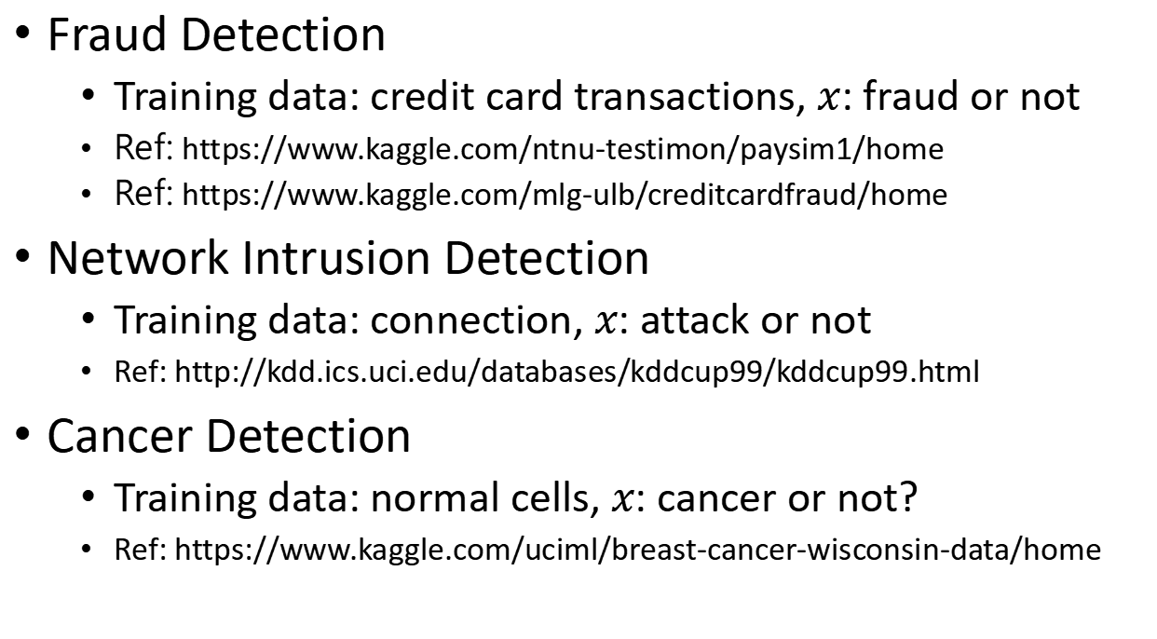
Anomaly Detection
Binary Classification?
We only have one class.
Training auto-encoder
Fraud Detection
Training data: credit card transactions, $x$: fraud or not
Ref: https://www.kaggle.com/ntnu-testimon/paysim1/home
Ref: https://www.kaggle.com/mlg-ulb/creditcardfraud/home
Network Intrusion Detection
Training data: connection, $x$: attack or not
Ref: http://kdd.ics.uci.edu/databases/kddcup99/kddcup99.html
Cancer Detection
Training data: normal cells, $x$: cancer or not?
Ref: https://www.kaggle.com/uciml/breast-cancer-wisconsin-data/home
Notes:
https://zhuanlan.zhihu.com/p/42267652
Time series data
https://github.com/numenta/NAB
Lots of data set?
http://odds.cs.stonybrook.edu/

Slide 32
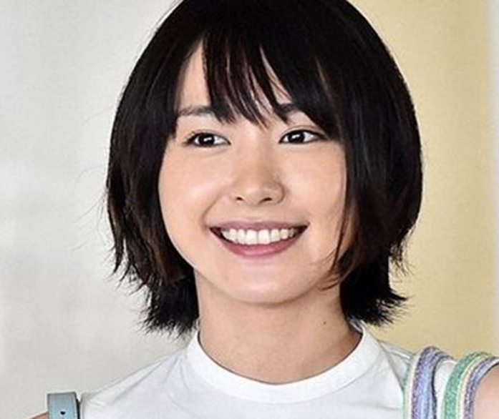
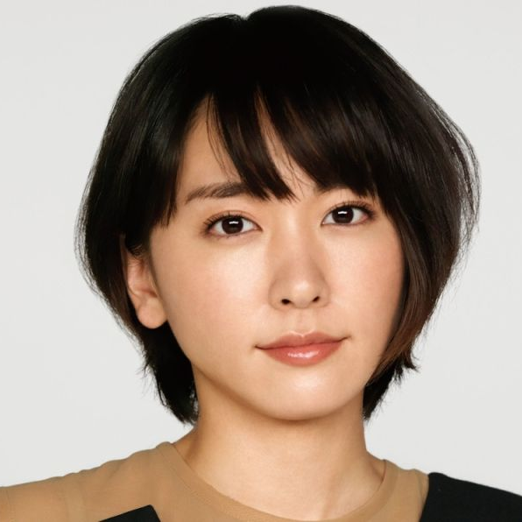
Approach: Auto-encoder
Training
Using real human faces to learn an autoencoder
As close as possible
Encoder
Decoder
Training data
Training data
Testing
Can be reconstructed
Encoder
Decoder
normal

Slide 33


Approach: Auto-encoder
Training
Using real human faces to learn an autoencoder
As close as possible
Encoder
Decoder
Training data
Training data
Testing
Large reconstruction loss $→$ anomaly
cannot be reconstructed
Encoder
Decoder
anomaly

Slide 34
Concluding Remarks
Basic Idea of Auto-encoder
Feature Disentanglement
Discrete Latent Representation
More Applications

