Slide 1
Efficient Net
arXiv: 1905.11946 [code]
Rethinking Model Scaling for Convolutional Neural Networks
Mingxing Tan, Quoc V. Le

Slide 2
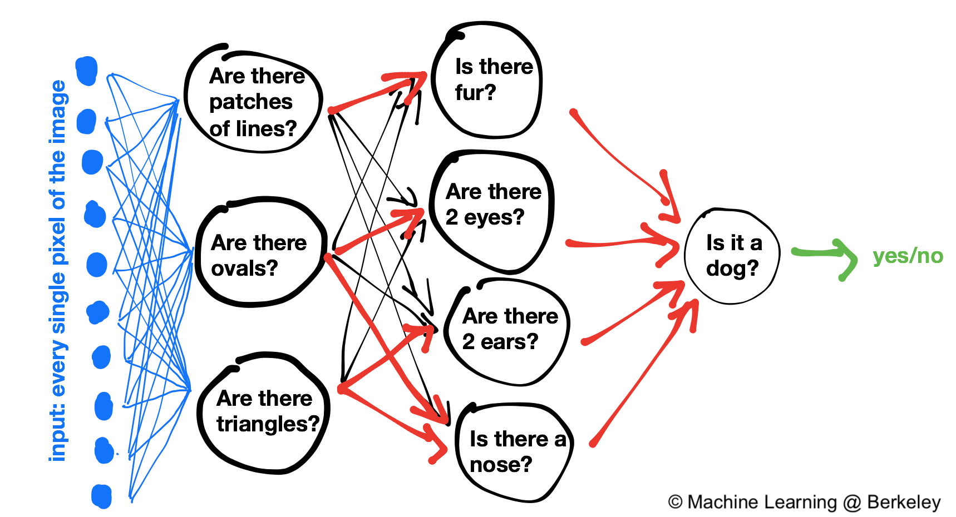


Cat or Dog ?
YES ！
I need a smarter Neural Network…
Notes:
Tell a story

Slide 3

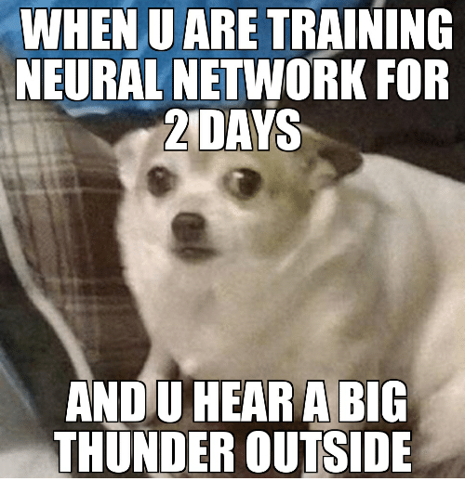

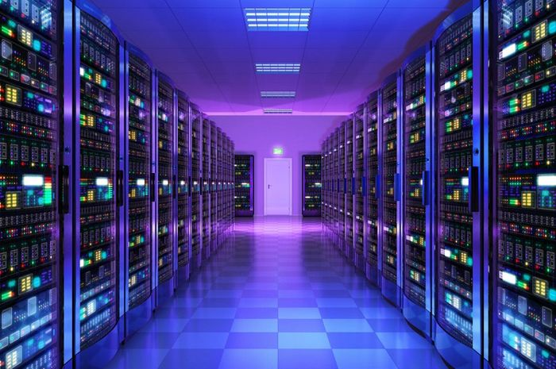

Me too
Scale up for better accuracy
if more resources are available !
I hope for better accuracy, efficiency and low costs …

Slide 4




Intro
ResNet can be scaled up from ResNet-18 to ResNet-200
by using more layers.
GPipe achieved 84.3% ImageNet top-1 accuracy
by scaling up a baseline model 4 time larger.
Is there a principled method to scale up
ConvNets that can achieve better accuracy
and efficiency?
Scaling up ConvNets is widely used to achieve better accuracy.
In previous work, it is common to scale only one of the
three dimensions – depth, width, and image size.
Arbitrary scaling requires tedious manual tuning and still
often yields sub-optimal accuracy and efficiency
The most common way is to scale up ConvNets by depth , width or resolutio.

Slide 5
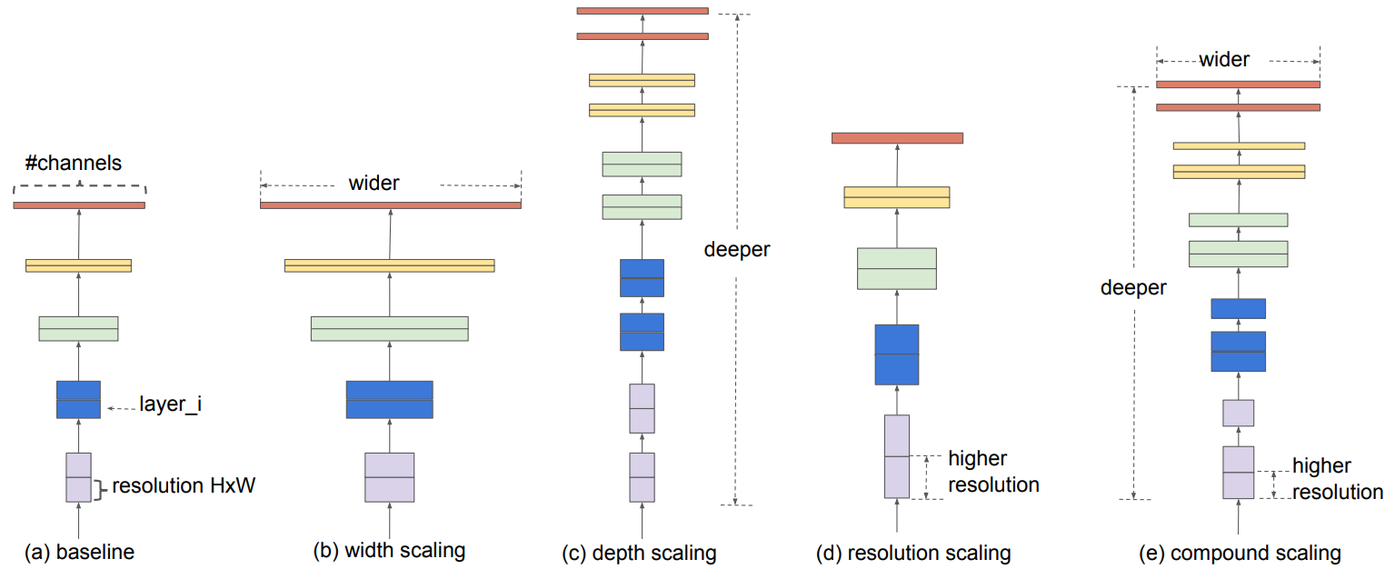
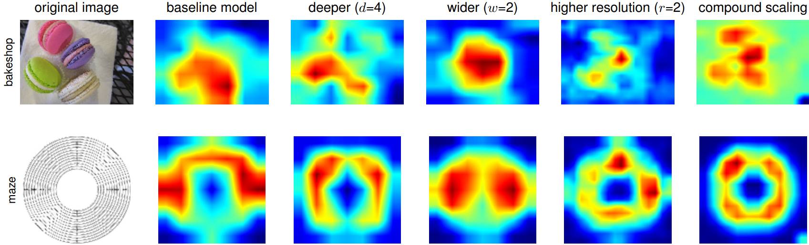
Compound scaling
Propose a effective compound scaling method to uniformly scales network width, depth and resolution with a set of fixed scaling coefficients.
A new family of models called EfficientNet
we use neural architecture search to develop a new baseline network, and scale it up to obtain a family of models, called EfficientNets.
Faster & Smaller
Our EfficientNet-B7 achieves state-of-the-art 84.3% top-1 accuracy on ImageNet,
while being 8.4x smaller and 6.1x faster on inference than the best existing ConvNet.
Class Activation Map with different scaling methods

Slide 6

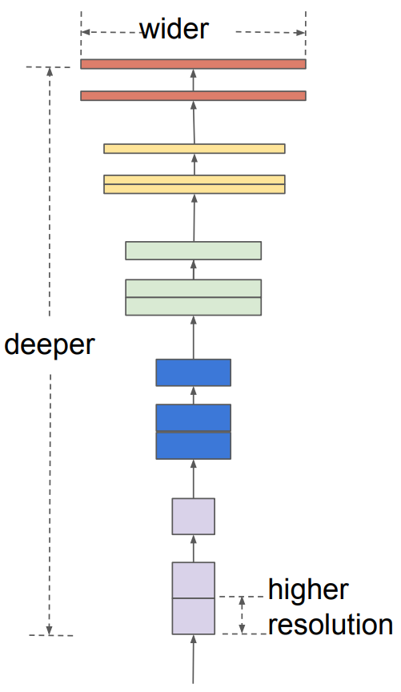
Relate works
ConvNet Accuracy:
Szegedy, C., Liu, W., Jia, Y., Sermanet, P., Reed, S., Anguelov, D., Erhan, D., Vanhoucke,
V., and Rabinovich, A. Going deeper with convolutions. CVPR, pp. 1–9, 2015.
…
ConvNet Efficiency:
Han, S., Mao, H., and Dally, W. J. Deep compression: Compressing deep neural networks
with pruning, trained quantization and huffman coding. ICLR, 2016…
…
Model Scaling:
He, K., Zhang, X., Ren, S., and Sun, J. Deep residual learning for image recognition. CVPR,
pp. 770–778, 2016.
…

Slide 7
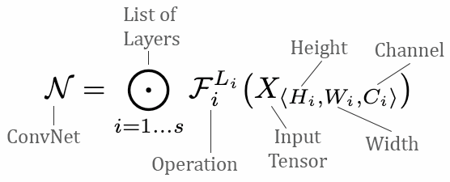
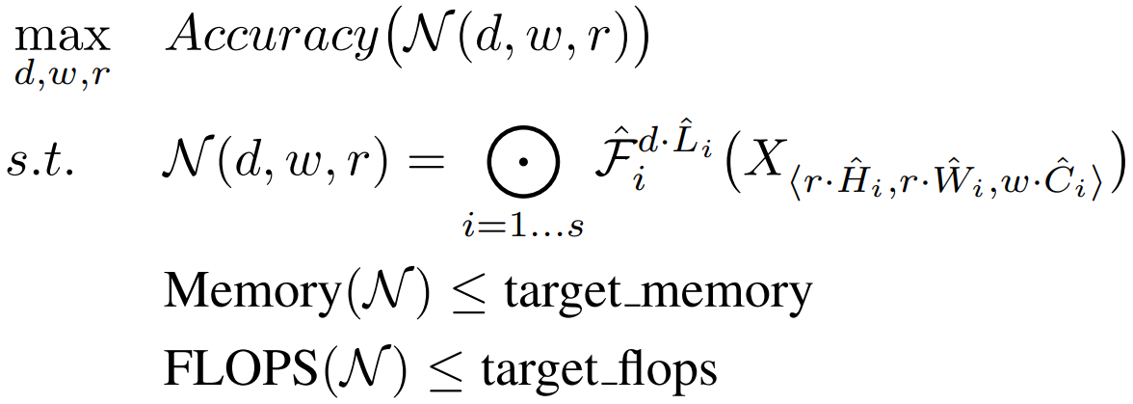
Problem Formulation
Define a ConvNet as
Our target is to maximize the model accuracy
X
Feature Matrix

Slide 8
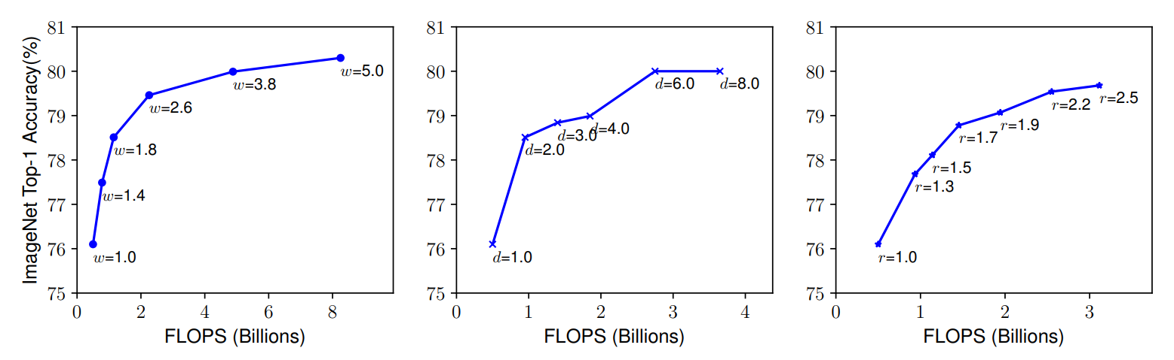
Observation 1
Scaling Up a Baseline Model with Different Network Width, Depth, and Resolution Coefficients
The result shows scaling up the depth, width and resolution of a network improves accuracy, but the accuracy diminishes for deeper and bigger models.

Slide 9
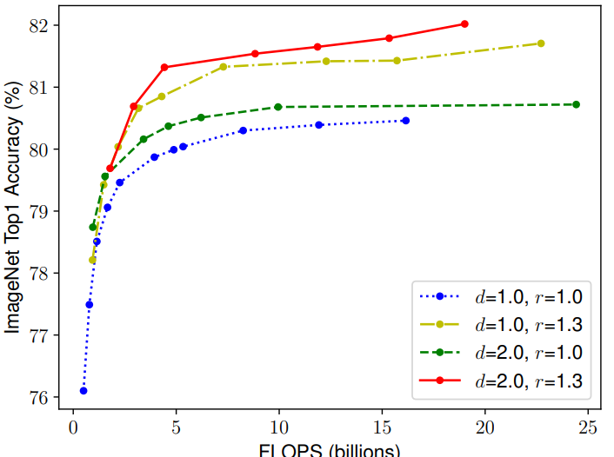
Observation 2
Scaling Up a Baseline Model with Different Network Width, Depth, and Resolution Coefficients
The result shows that to obtain better model accuracy and efficiency, it is important to balance for all the dimensions of the network during scaling.
Notes:
EfficientNet网络详解_霹雳吧啦Wz-CSDN博客_efficient网络

Slide 10
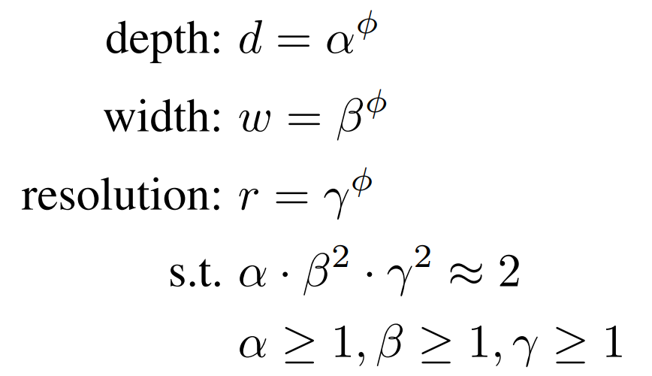


compound scaling method
use a compound scaling coefficient Φ to uniformly scale the network dimensions
scaling a ConvNet with the equation will approximately increase total FLOPS by
Constraint it to increase
$${\left(α⋅β^{2}⋅γ^{2}\right)}^{Φ}$$
$${\left(2\right)}^{Φ}$$

Slide 11
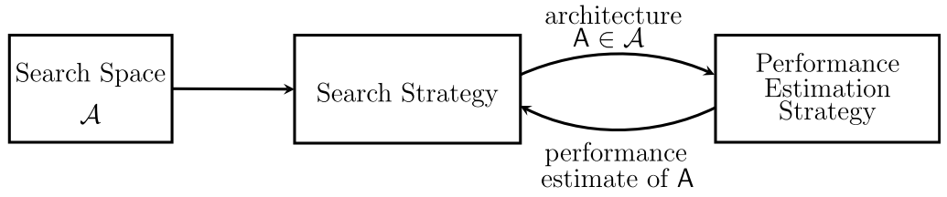
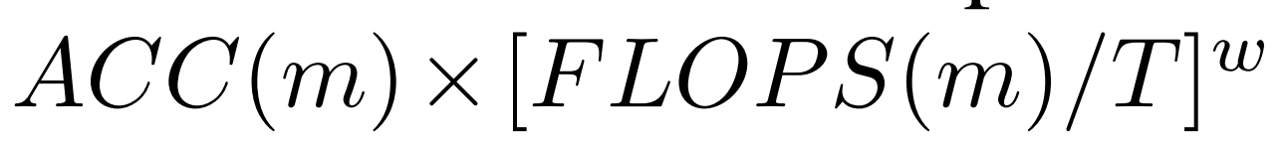
EfficientNet Architecture
Use neural architecture search (NAS) to find an optimum baseline network
Performance Estimation
Search space: https://arxiv.org/pdf/1807.11626.pdf
Notes:
Since model scaling does not change layer operators Fi in baseline network, having a good baseline network is also critical
Use an algorithm called neural architecture search (NAS) to find an optimum baseline network
Strategy:
Fix Φ to 1. Perform a grid search of α, β and γ. They find the best values for EfficentNet-B0 are α = 1.2, β = 1.1 and γ = 1.15.
Fix α, β and γ as constants and scale up the baseline network with different Φ to obtain EfficientNet-B1 to B7.

Slide 12
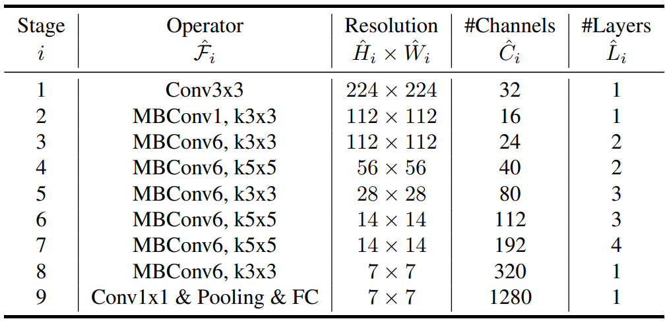
search Strategy:
Fix Φ to 1. Perform a grid search of α, β and γ.
Fix α, β and γ as constants and scale up the baseline network with different Φ to obtain EfficientNet-B1 to B7.
EfficientNet-B0 baseline network
Notes:
这里之所以仅在小的基线网络(MBnet)上使用网格搜索（步骤 1）然后直接将参数扩展到大的模型上（步骤 2）是因为如果直接在大模型上进行参数搜索是非常昂贵且不可行的，因此作者采用了这种两步走的方法确定模型的扩展参数。

Slide 13
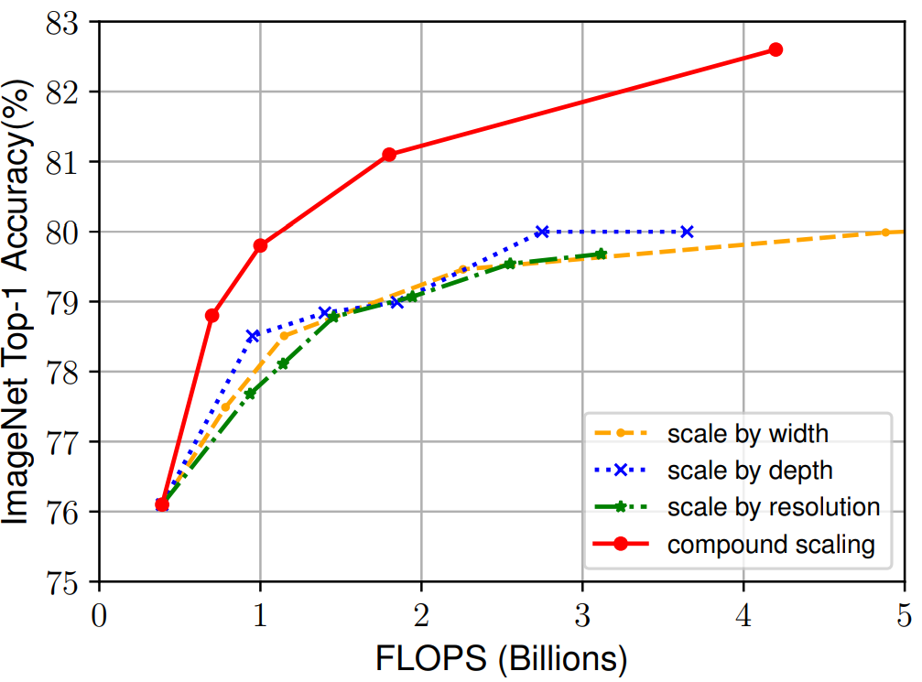
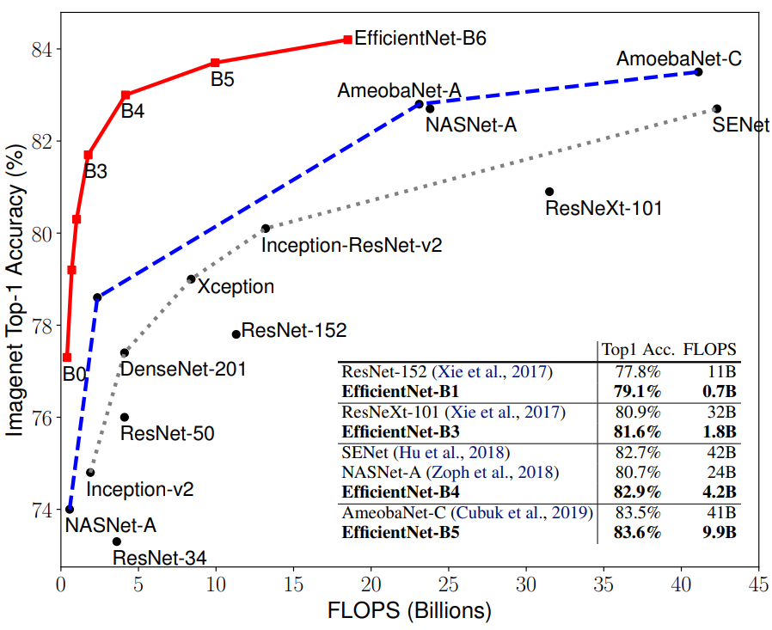
Performance
In particular, our EfficientNet-B7 achieves state-of-the-art 84.3% top-1 accuracy on ImageNet,
while being 8.4x smaller and 6.1x faster on inference than the best existing ConvNet.

Slide 14
Q&A
EfficientNetV2：https://arxiv.org/abs/2104.00298
Notes:
EfficientNet存在三个问题：
EfficientNet在非常大的图片上训练速度慢
浅层的深度可分离卷积导致训练速度变慢
每个stage的缩放系数相同导致结果次优

