Slide 1




LuncherBox
Placing orders has never been faster.
Project by Delirium Products!
deliriumproducts.me

Slide 2

The problem
- Waiting too long just to have your order taken
- Waiting too long for customers to choose their food
- High turnover for waiters

Slide 3

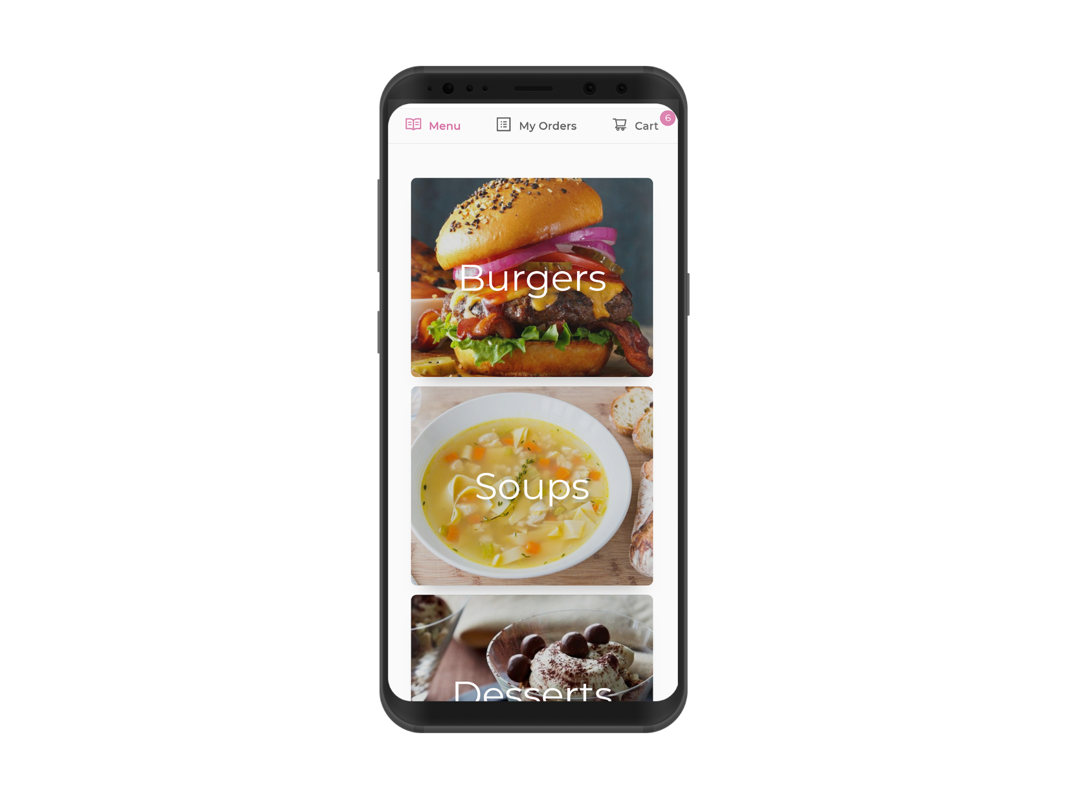
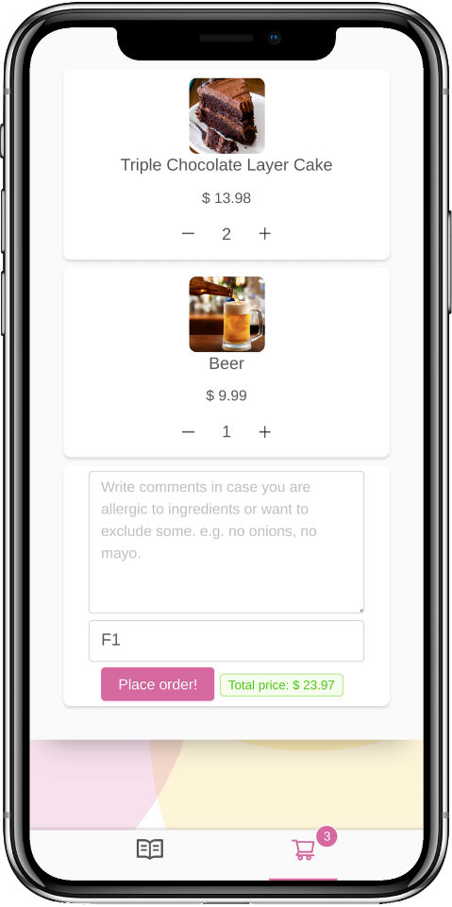
The solution
- Subscription based platform
- Fast, responsive and beautiful web app
- No registrations required
- Use on any device

Slide 4
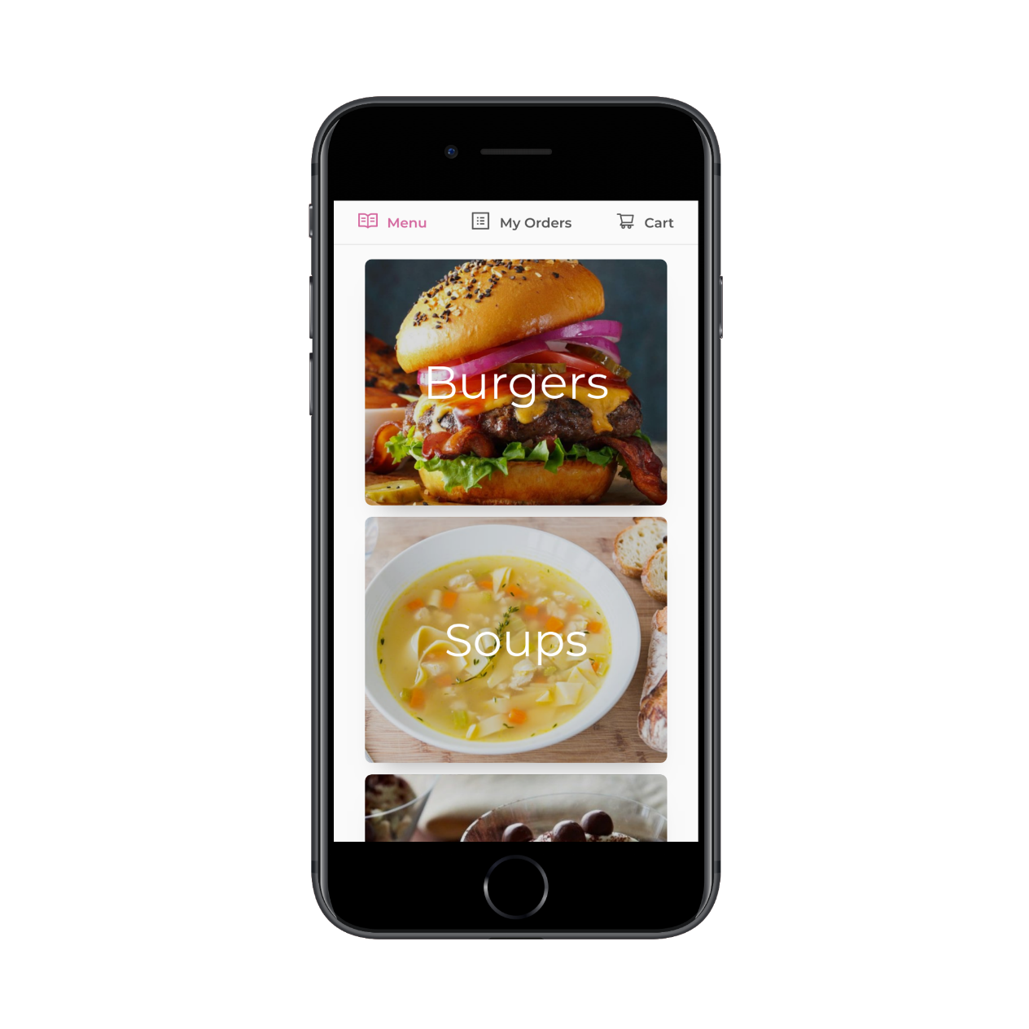
Features
Easy to use interface 📱
Navigate through the menu with ease!
📶 Fully web based
No need to download, just open in your browser and use it on any device!
Admin panel 🔧
Easily create, edit and delete products, ditch the paper menu!
🍴 Instruct the chefs
Provide special instructions to the chefs about your order!
Order status ⌛
Check your order status in real time!
🏃 PWA
Built with the latest and greatest technologies, providing you with a blazing fast experience!

Slide 5












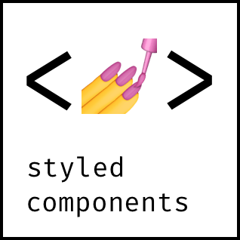





Technology Stack

Slide 6




















Architecture
Restaurant 1
Restaurant 2
Restaurant 3
K8s Master Node

Slide 7
Demo

Slide 8

Business model - B2B
- Owners will pay a monthly fee to use the service
- They will get a fully customized restaurant menu and admin panel
- No hardware required

Slide 9
Pricing plans
$ 59.99
$ 39.99
$ 149.99
per month
per month
per month
For medium restaurants
For small restaurants
For large restaurants
 Up to 100 people
 Up to 50 people
 Up to 200 people

Slide 10




Roadmap
Q4 2018
Q1 2019
Q2 2019
Q3 2019
Research
MVP
Beta
Pilot

Slide 11
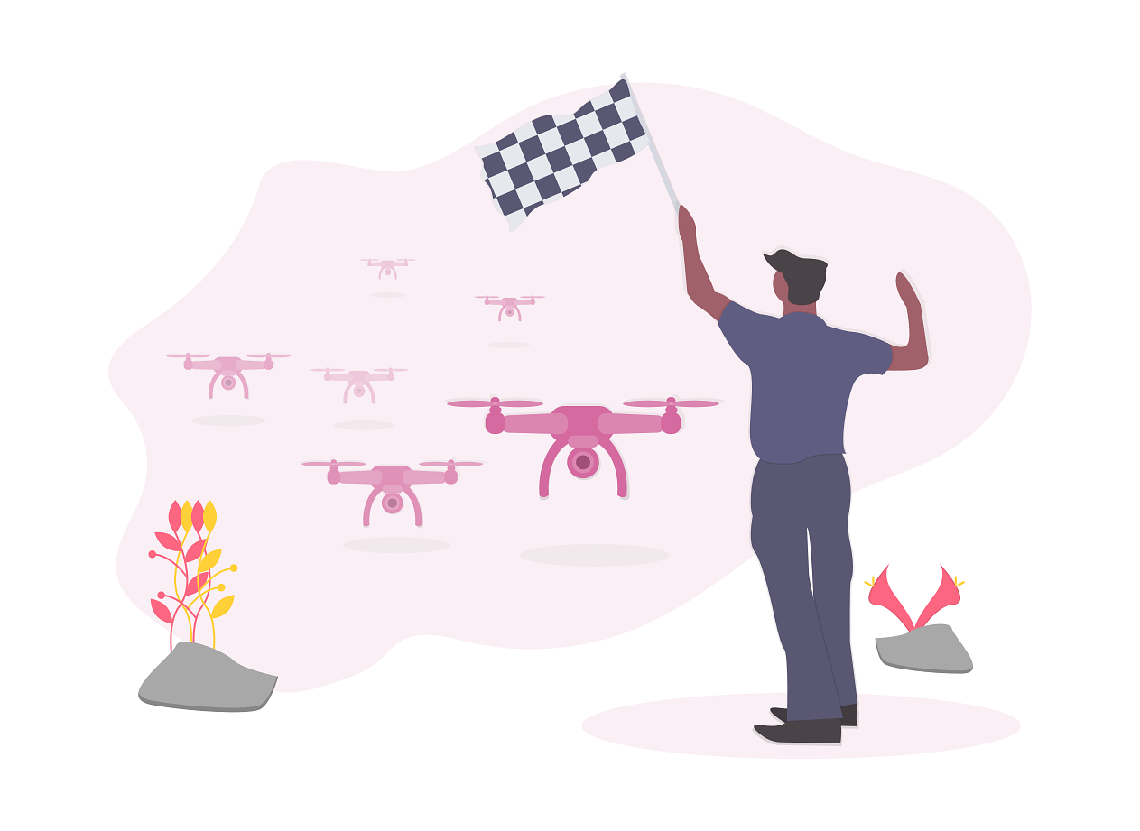
Competition
- We don’t require any specific hardware
- Use on any device
- No need to download
- Cheaper
- Better UI

Slide 12
What we learned
- Typescript
- CSS-in-JS
- Less
- Webpack
- Babel
- CSS Flexbox - Advanced React Patterns
- React SSR / Next.js
- Input validation
- Realtime connection
- PWAs
- Authentication
- Docker
- Writing docs
- LaTeX
- A basic
understanding of
Serverless & GraphQL
- Git workflow
- Kanban Board
- Agile-like methodology
- Linux
- OOP
- Deployment
- Express.js
- Passport.js
- TypeORM
- Jest / Testing
- Rate limiting
- Writing API docs
- Redis
- MySQL
- Caching
- Sessions
- Error handling
- Decorators

Slide 13

Conclusion and future
- Implement more features, such as payment
- Integrate the app in existing restaurants
- Improve based on the feedback from them
- Implement i18n

Slide 14

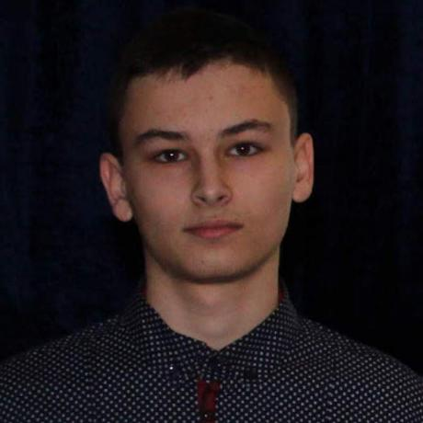
Delirium Products!
Simo Aleksandrov
Lyubo Lyubchev
@fr3fou
@impzero

Slide 15
Thanks for your attention!
luncherbox.deliriumproducts.me

