Slide 1




LuncherBox
Placing orders has never been faster.
Project by Delirium Products!
deliriumproducts.me

Slide 2

The problem
- Waiting too long just to have your order taken
- Waiting too long for customers to choose their food
- High turnover for waiters

Slide 3

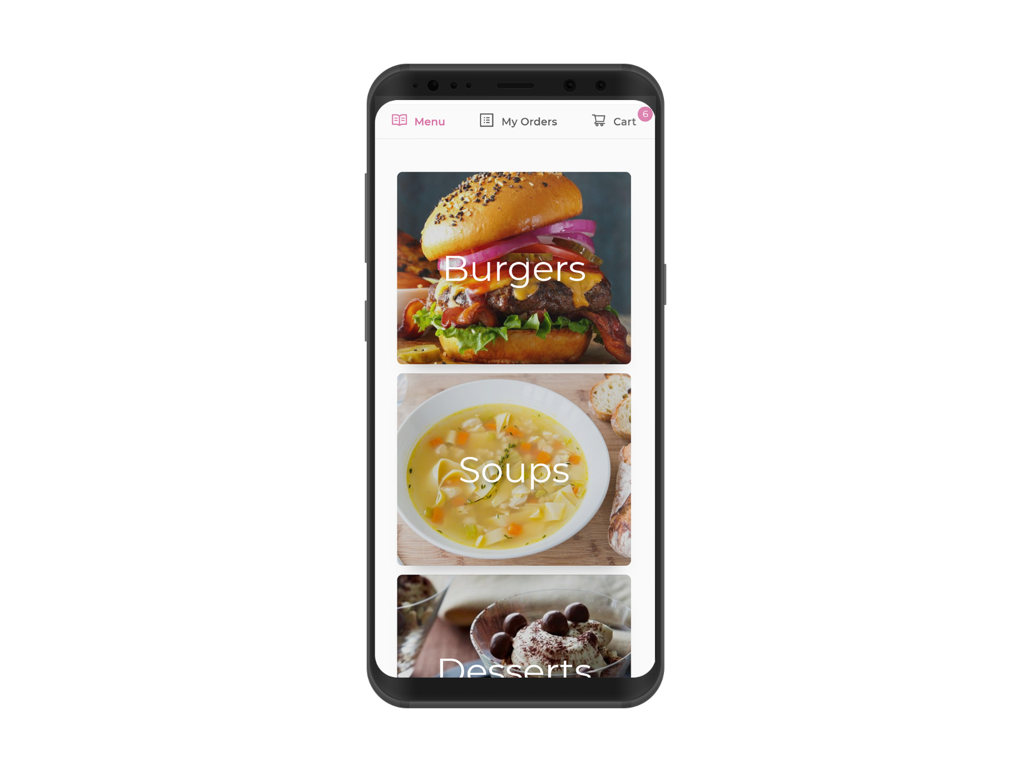
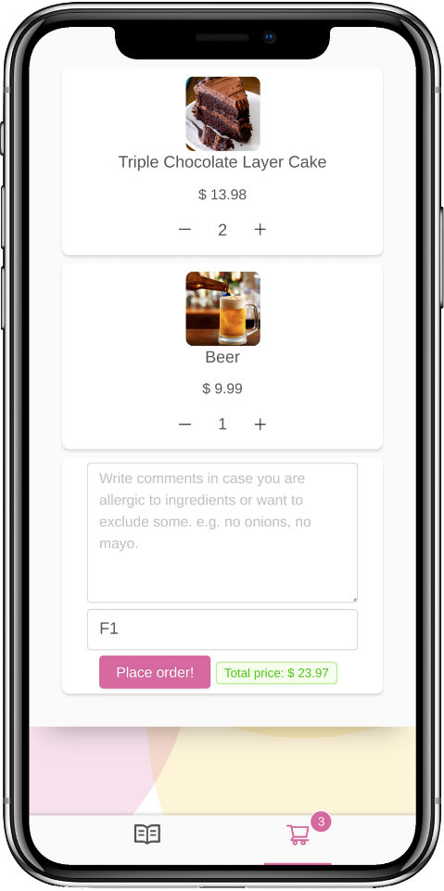
The solution
- Subscription based platform
- Fast, responsive and beautiful web app
- No registrations required
- Use on any device

Slide 4

Business model
- Owners will pay a monthly fee to use the service
- They will get a fully customized restaurant menu and admin panel
- No hardware required

Slide 5




Roadmap
Q4 2018
Q1 2019
Q2 2019
Q3 2019
Research
MVP
Beta
Pilot

