Slide 1
AUDA — Automated EDA & Preprocessing
Can automated preprocessing beat manual EDA?
A rigorous benchmark — and an honest answer
Big Data Final Project • 32 datasets • RandomForest + SVM • 5 seeds

Slide 2
The Problem & Goal
• EDA + preprocessing is manual, slow, and depends on analyst skill.
• AUDA automates it: profile data, handle missing values, detect anomalies, transform features — in one call.
• Research question:
– Can AUDA's automated preprocessing match or beat a human analyst?
– Measured objectively: train ML models on AUDA- vs manually-preprocessed data, compare ROC-AUC.
• This talk: what AUDA does (in detail), how we tested it rigorously, the bugs we found, and the honest result.

Slide 3
What AUDA Does — Overview
4 understanding stages + 1 transforming stage
Stage | Purpose | Changes data?
1. Profile | Detect column types + numeric sub-types | No (understand)
2. Missing values | Impute or drop, per column | YES
3. Anomalies | Detect outliers (IQR / Z / Isolation Forest) | No (report)
4. Recommend | Feature-engineering suggestions (rules + optional LLM) | No (report)
Feature Transformer | Encode, cap outliers, log1p, scale, select features | YES — fed to model
Only Stage 2 and the Feature Transformer change the data the model sees. The next slides detail each step.

Slide 4
Stage 1 — Profiling: Understand Every Column
profiler.py
• Type-detection waterfall (first match wins):
– Empty column → text | True/False → boolean
– Real dates, or text where ≥80% parse as dates → datetime
– Numbers: only {0,1} → boolean ; ≤2 values → categorical ; else → numeric
– Text: ≤20 unique → categorical ; avg length >50 chars → text
• Numeric sub-type (makes later steps smart):
– id = unique & sequential (PassengerId) • ordinal = integer ≤10 values (rating 1-5)
– count = non-negative integers • continuous = floats / high-cardinality (income)
Why it matters: knowing a column is an ID or a 1-5 rating prevents harmful transforms later (e.g. don't log-scale a rating).

Slide 5
Stage 2 — Missing Values: One Decision per Column
missing_handler.py (this step CHANGES the data)
Condition | Action
No missing values | Do nothing
≥ 60% missing | Drop the whole column
< 5% missing | Drop those few rows
Numeric (else) | KNN imputation (5 nearest rows) if ≤10,000 rows, otherwise median
Categorical / boolean (else) | Fill with the mode (most common value)
Datetime (else) | Linear interpolation
Text (else) | Fill with constant "Unknown"
Checked top-to-bottom. KNN looks at the 5 most similar rows to estimate a missing number — smarter than a flat mean.

Slide 6
Stage 3 — Anomaly Detection (report only)
anomaly_detector.py • does NOT change the data
Method | Flags a value / row when…
IQR fence | outside [Q1 − 1.5·IQR , Q3 + 1.5·IQR]
Z-score | more than 3 standard deviations from the mean (|z| > 3)
Isolation Forest | an ML model can 'isolate' the whole row easily across all numeric columns (needs ≥10 rows)
• This stage only reports counts — outlier *handling* happens in the transformer (Step 6).

Slide 7
Stage 4 — Feature Transformer: The Real Preprocessing
feature_transformer.py • 8 ordered steps fed to the model
# | Step | Detail
1 | Drop zero-variance | column has only one unique value
2 | Drop near-constant categoricals | one value covers > 95% of rows
3 | Drop pure-ID columns | sequential IDs (+ all-unique integers on small data)
4 | Frequency-encode high-cardinality | > 20 unique → replace value with how often it appears
5 | One-hot encode (SVM / linear only) | low-cardinality categories → avoids fake ordering
6 | Cap outliers (IQR, k=5) | mild clip; skipped for ordinal / count / ID
7 | log1p skewed continuous | skew>1, all ≥0, wide range; skipped for ordinal/count/ID
8 | Scale + feature budget | RobustScaler (SVM) / StandardScaler (linear) / none (tree); keep top-K by SelectKBest
Steps 6 & 7 use the Stage-1 sub-types to avoid damaging ratings / counts / IDs.

Slide 8
One Transformer, Two Settings — RF vs SVM
The Feature Transformer runs for BOTH models — only the settings differ
Clean data
(after Stages 1–2)
FeatureTransformer — TREE settings
encode • cap outliers • log1p
NO scaling · NO one-hot · NO feature cap
FeatureTransformer — KERNEL settings
encode • cap outliers • log1p
+ scaling · + one-hot · + feature cap
RandomForest
SVM
Same component, applied twice. RF skips scaling / one-hot / feature-cap (trees don't need them); SVM uses all of them.

Slide 9
Manual EDA (Baseline) vs AUDA
Step | Weak baseline | Fair baseline | AUDA
Missing numbers | mean | median | KNN
Encode categories | ordinal (all) | one-hot + frequency | one-hot + frequency
Scaling (for SVM) | none | StandardScaler | RobustScaler
Outliers / skew | none | none | IQR cap + log1p
Drop ID / junk cols | no | no | yes
Knows column meaning | no | no | yes (sub-types)
A FAIR baseline already does the two things that matter most — proper encoding + scaling. That is what AUDA must beat.

Slide 10
The Experiment — How We Measure "Better"
• For each dataset: 80/20 train-test split, stratified.
• Preprocess two ways: Baseline vs AUDA.
• Train BOTH RandomForest (tree) and SVM (kernel); compare ROC-AUC.
• Delta = AUDA AUC − Baseline AUC. Positive = AUDA better.
• Rigor added during this project:
– 5 random seeds per dataset → mean ± std (not one lucky split)
– Wilcoxon signed-rank test → is the difference statistically real?
– Fair baseline + duplicate-dataset removal

Slide 11
The Original Claim — and the Red Flags
"AUDA wins, 88% no-loss rate"
• The first benchmark reported AUDA beating the baseline on most datasets.
• But the result rested on four hidden problems:
– Single train/test split — one lucky draw, no significance test
– Rigged baseline — ordinal-encoded everything & never scaled (sabotages SVM)
– Duplicate datasets — same files counted twice, inflating results
– Software bugs — scrambled labels & dropped predictive columns
• "If a result can't survive scrutiny, it isn't a result."

Slide 12
Building Rigor #1 — Multi-Seed + Significance
• One split = flipping a coin once. Change the seed, get a different score.
– Example (haberman, SVM): seed 42 → +0.10, seed 0 → +0.07. Same data!
• Fix: run 5 seeds, report mean ± std → exposes the noise.
• Wilcoxon signed-rank test across datasets → a p-value:
– p < 0.05 = real effect ; p > 0.05 = indistinguishable from baseline.
• Result: AUDA's win-rates dropped once luck was averaged out — single-seed numbers were optimistic.

Slide 13
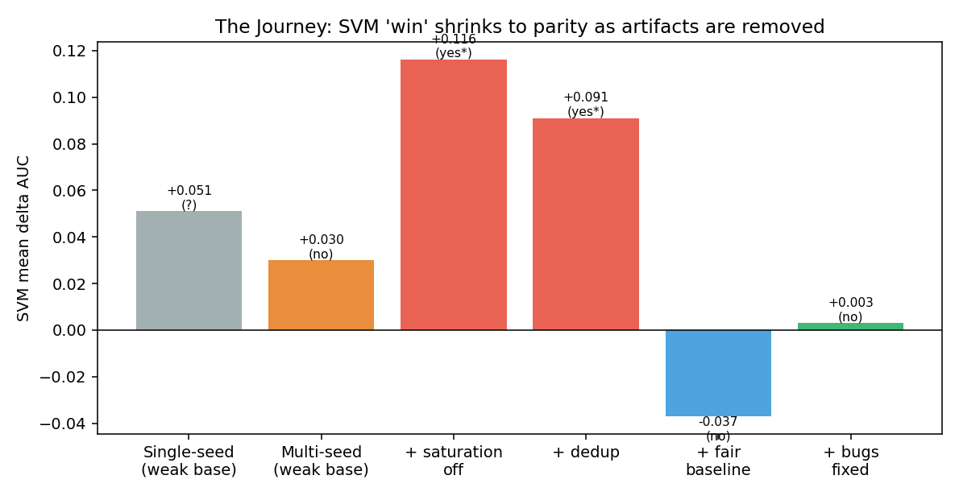
Building Rigor #2 — A Fair Baseline
• The weak baseline never scaled features — fatal for SVM.
• AUDA's big SVM 'wins' were just AUDA fixing that mistake.
• Fair baseline scales + one-hot encodes, like a real analyst.
As each artifact is removed, the SVM 'advantage' collapses from +0.05 to ~0.

Slide 14
Data Integrity — The Datasets Were Corrupted
• Hash check revealed 4 DUPLICATE pairs masquerading as different datasets:
– breast_cancer_wide = qsar_bio ; arcene = colon_cancer
– ionosphere = musk ; sonar = banknote
• Worse — filenames lied: all four 'wide' files were breast-cancer data; 'sonar' actually held banknote data.
• Cause: the dataset downloader saved wrong / duplicate files.
• Fix: removed duplicates (39 → 35); benchmark now de-dups by content hash.

Slide 15
Three Real Bugs Found & Fixed
Bug | Effect | Example fix
Label misalignment after row-drop | Training labels scrambled when AUDA dropped rows | flight_delay RF −0.35 → 0.00
Missing target became a junk class | Models trained to predict "missing" | weatheraus RF −0.13 → −0.01
Continuous floats dropped as 'IDs' (library) | Deleted predictive features on small data | vertebral RF −0.056 → 0.00
Two were measurement bugs (made AUDA look worse); the third was a genuine AUDA library bug — now improved.

Slide 16
The Results Journey — From False Claim to Truth
Stage | SVM mean Δ | Significant? | Reality
Original (single seed, weak baseline) | +0.051 | — (no test) | anecdote
Multi-seed, weak baseline | +0.030 | No (p=0.10) | noise
+ saturation off, deduplicated | +0.091 | Yes (p=0.02) | inflated by weak baseline
+ FAIR baseline | −0.037 | No (p=0.17) | win evaporates
+ all bugs fixed (FINAL) | +0.003 | No (p=0.94) | PARITY
Each step removed an artifact. The honest endpoint: AUDA neither beats nor harms a competent baseline.

Slide 17
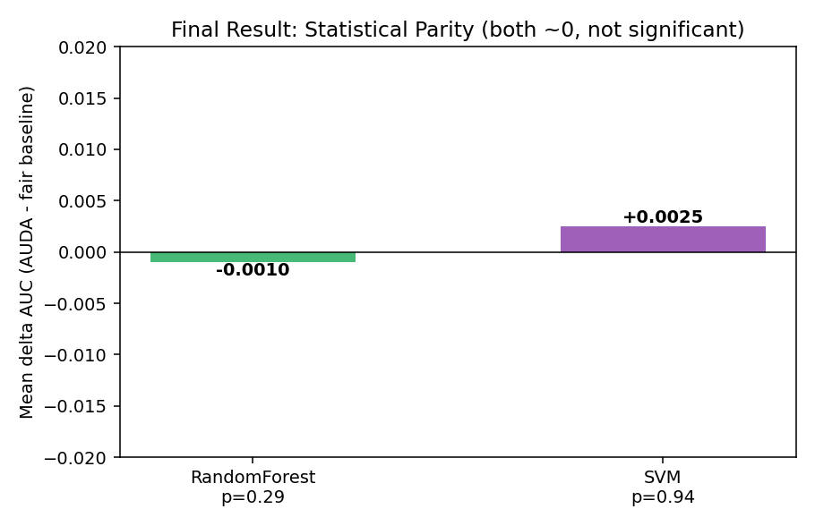
Final Result — Statistical Parity
• RandomForest: −0.001 (p = 0.29)
• SVM: +0.003 (p = 0.94)
• Both ≈ 0, neither significant.
• Across 32 datasets, 5 seeds.
• AUDA matches competent manual preprocessing — no significant difference.

Slide 18
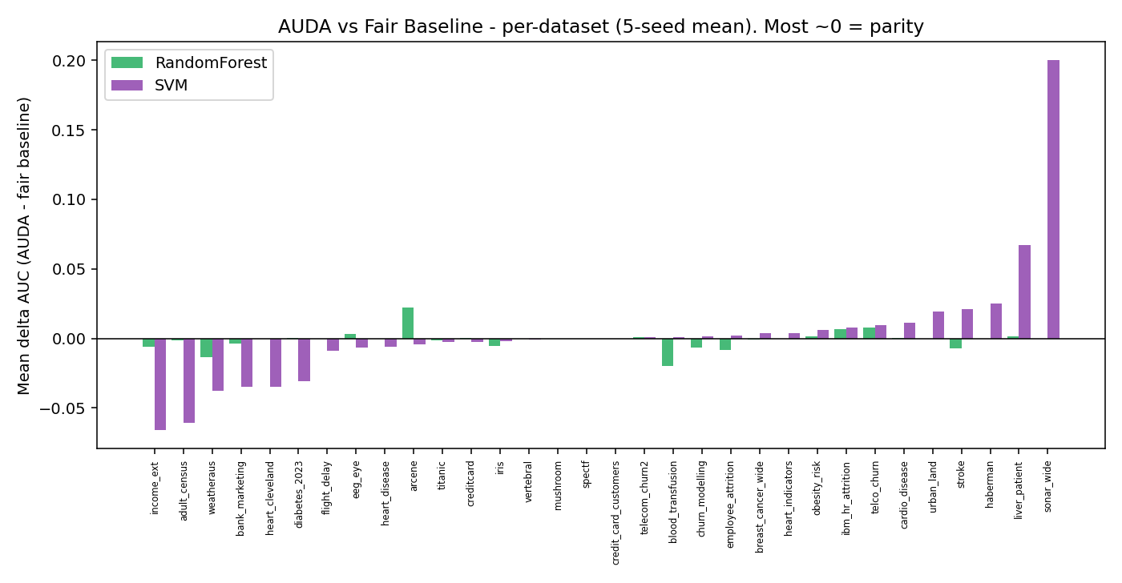
Per-Dataset View — Mostly Parity
Most datasets sit at ~0 (parity). A few small wins/losses roughly cancel — no systematic advantage either way.

Slide 19
Honest Conclusion
"AUDA matches the performance of competent manual preprocessing — no statistically significant difference on tree or kernel models across 32 datasets — while requiring zero human effort."
AUDA does not beat a skilled analyst — but it equals one, automatically.

Slide 20
Methodology Lessons
• Never trust a single train/test split — always multi-seed + a significance test.
• Your baseline must be fair — beating a deliberately weak baseline proves nothing.
• Validate your data — duplicates and mislabeled files silently corrupt results.
• A neutral result, honestly obtained, beats an impressive result that can't survive scrutiny.
• Bugs can masquerade as 'findings' — the −0.35 'AUDA is destructive' was a label bug.

Slide 21
Future Work — How AUDA Could Actually Win
Lever | Idea | Effort / payoff
Feature creation | Datetime decomposition, CV target encoding, interactions — features the baseline can't make | High / only real upside
Validation-driven preprocessing | Try several preprocessing variants per dataset, keep best by CV (AutoML-style) | High / highest ceiling
Apply LLM suggestions | Actually execute the LLM's feature ideas (currently report-only) | Medium / uncertain
Parity is already a complete, defensible result. These are paths to push AUDA from parity to advantage.

Slide 22
Summary
• Built AUDA: automated EDA + preprocessing pipeline.
• Tested rigorously: 32 datasets, RF + SVM, 5 seeds, significance test, fair baseline.
• Found & fixed 3 real bugs and corrupted datasets along the way.
• Result: AUDA achieves PARITY with competent manual preprocessing — automatically.
• A credible, defensible thesis — and a clean path forward.
Thank you — questions?

