Slide 1
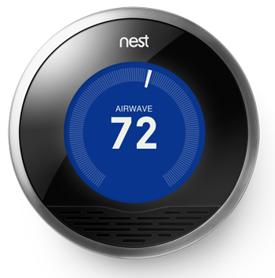
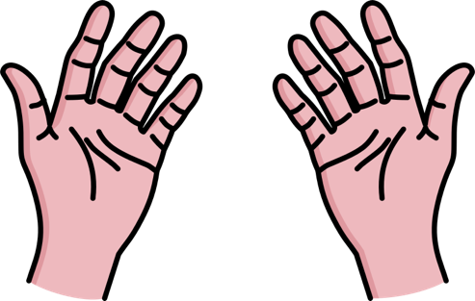
Thermo leap FiskHacks ii
10/23/16
Ardlan Khalili
Delkhaz Ibrahimi

Slide 2
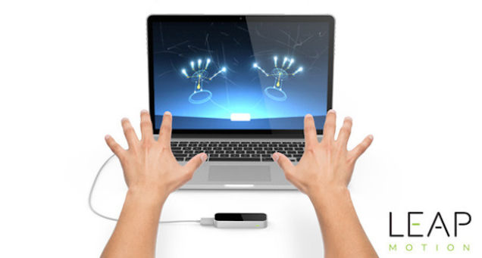
What is it?
Thermo Leap incorporates Leap Motion’s motion detector to acquire finger and hand movements from the user.
It then uses these certain movements to adjust the Nest thermostat or set the Nest unit to home/away.

Slide 3
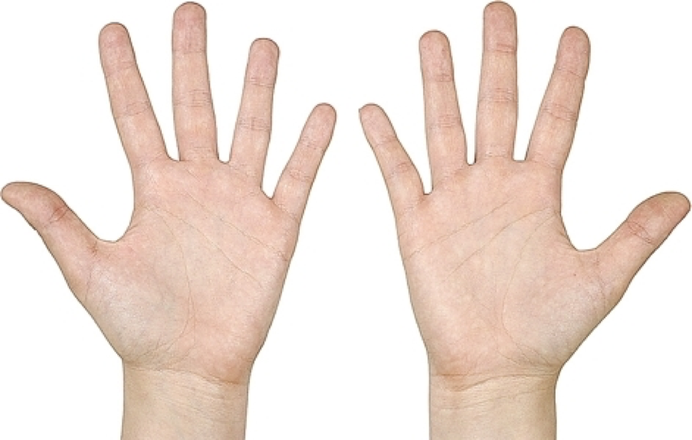


How to adjust the temperature

Slide 4
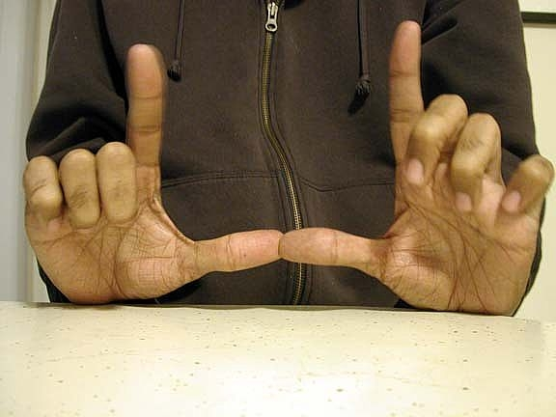

How to switch between home and away
Home
Away

Slide 5
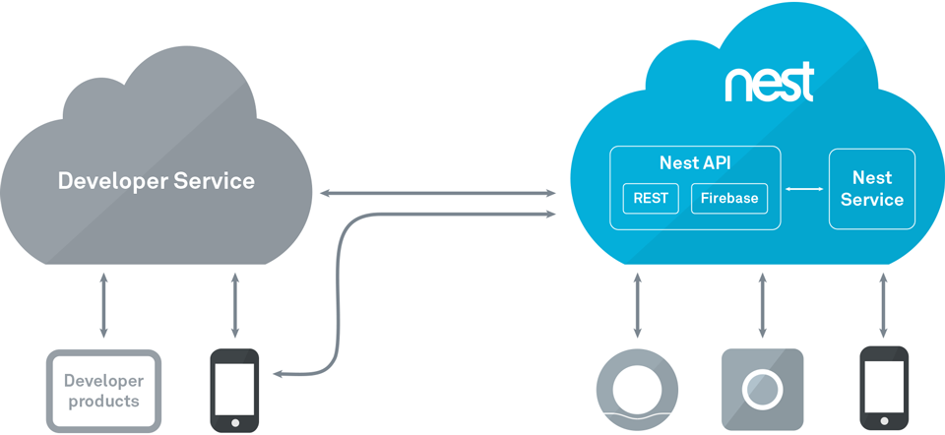
How it’s made
Nest & Leap Motion’s developer tools and APIs

Slide 6
Demo!

Slide 7



Thank you!

