Slide 1
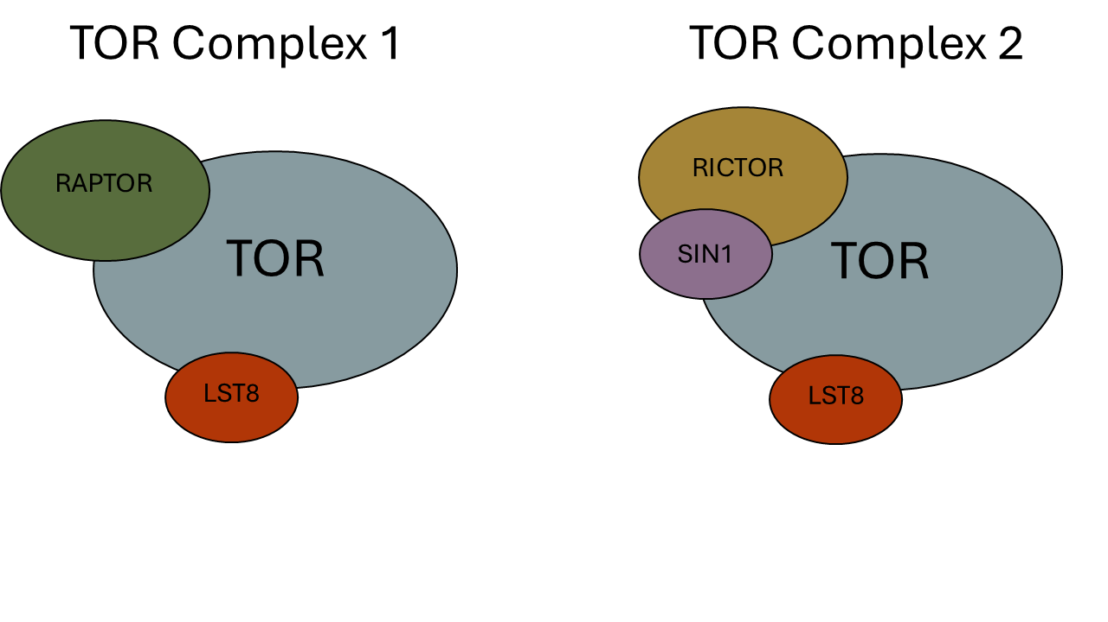
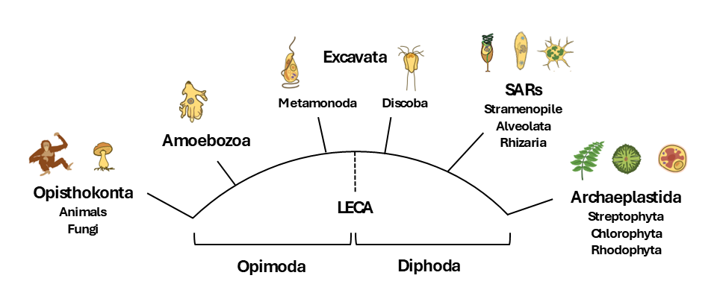
Figure 1
(A)
(B)
(C)
HMMER
ClustalO
Phylo Trees
NCBI/JGI
BLAST
Dataframe
Results
BUSCO
DIAMOND
Primary
Literature
Graphs

Slide 2
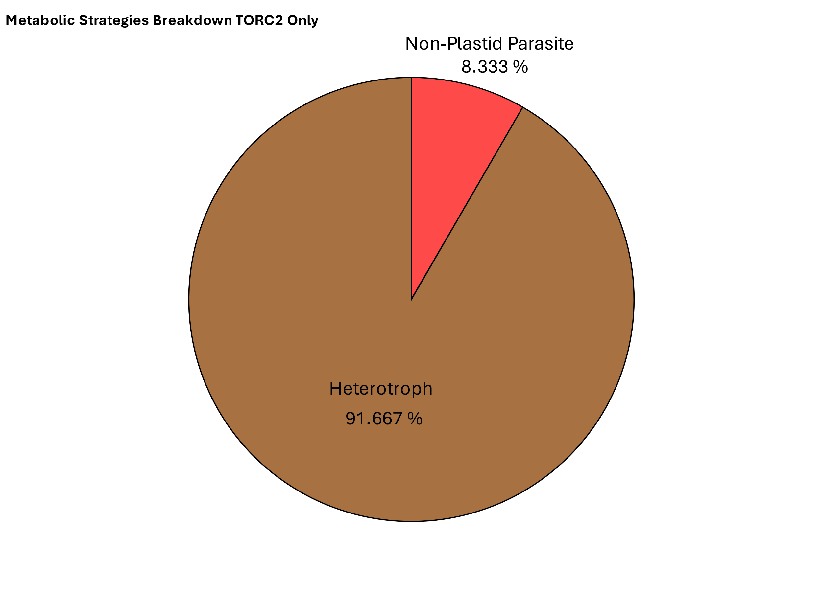
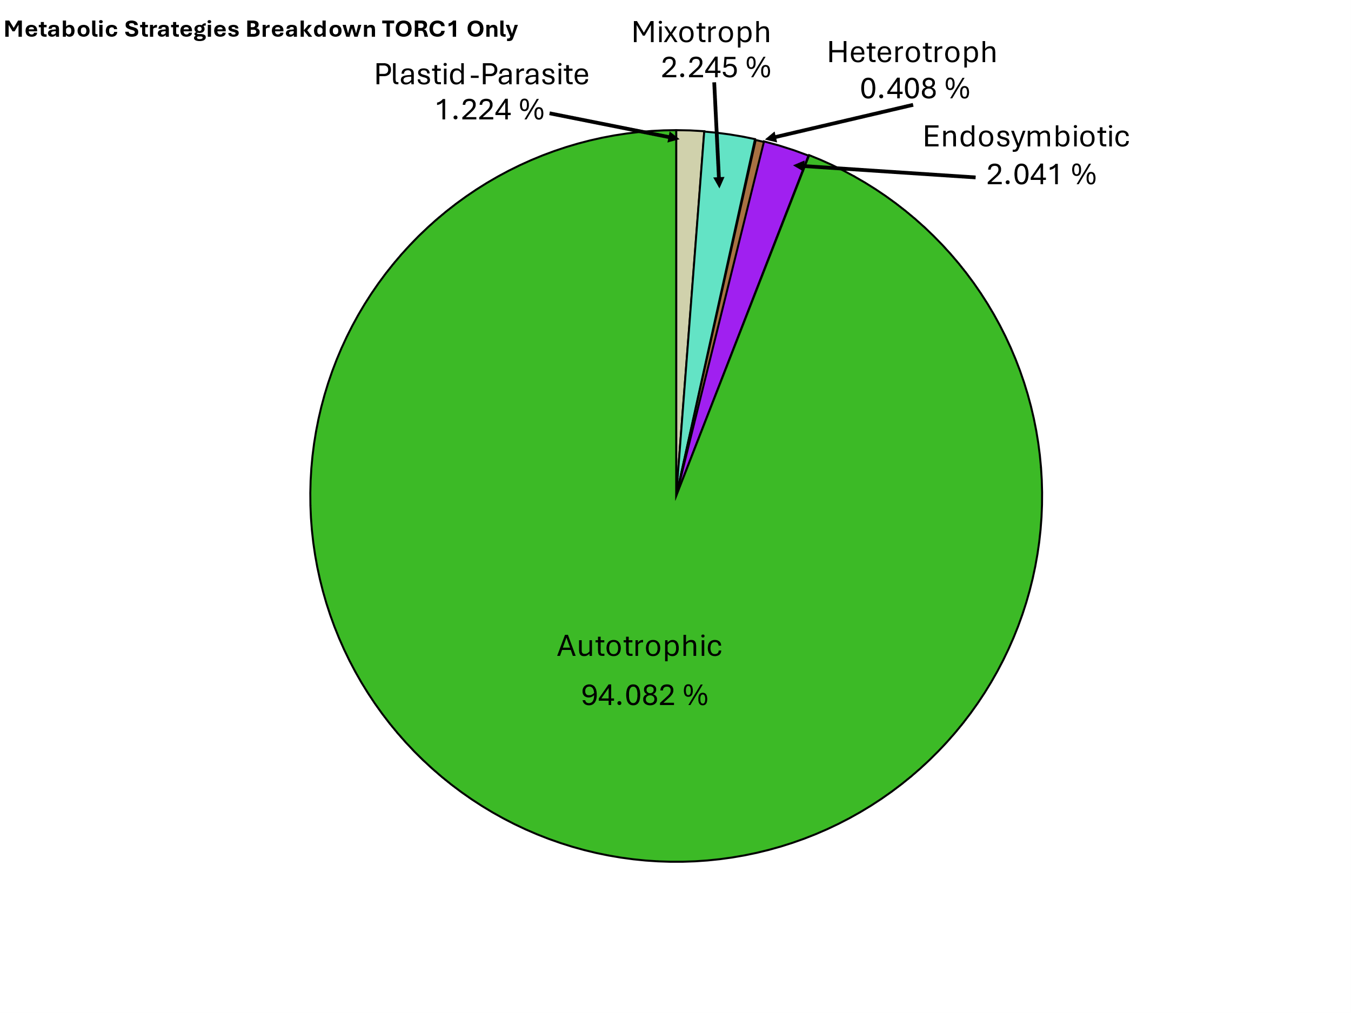
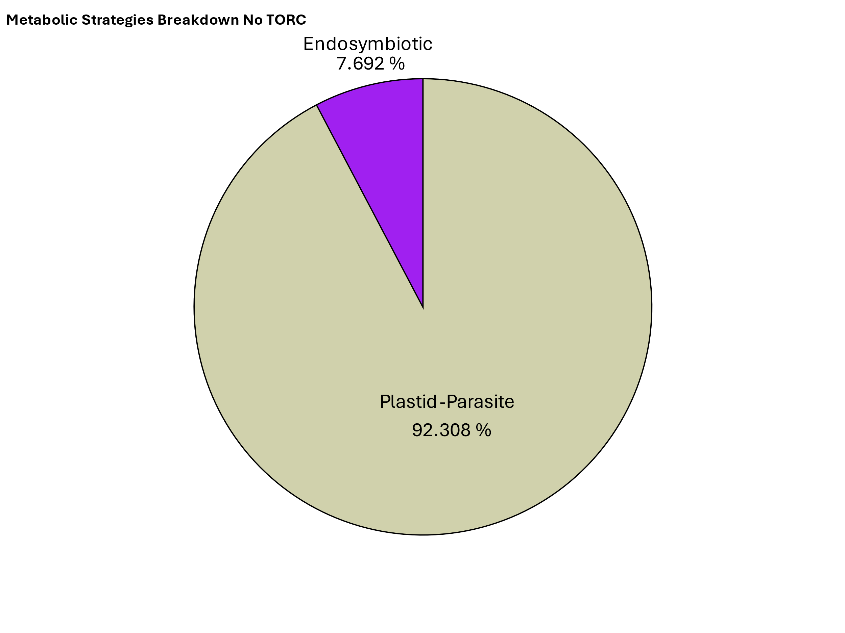
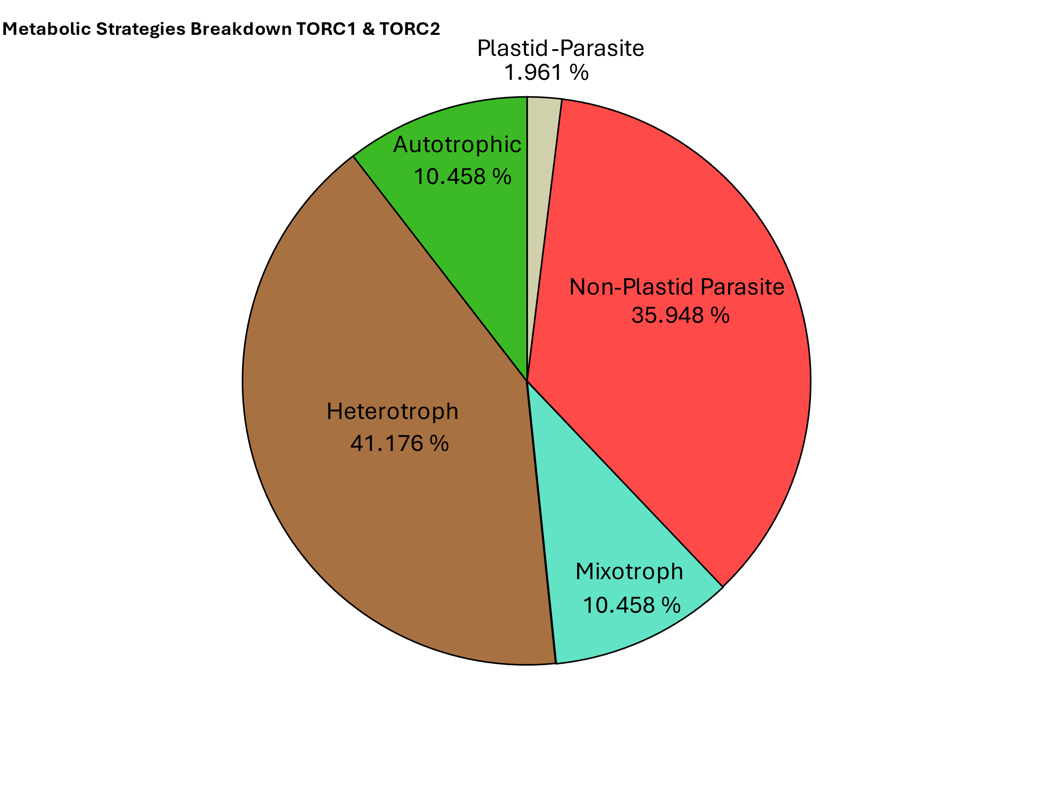
Figure 5
(A)
Rhodophyta
Archaeplastida
Chlorophyta
TORC1
Streptophyta
TORC1
Stramenopiles
TORC1 & TORC2
LECA
SAR
TORC1
Alveolata
TORC1 & TORC2
Rhizaria
TORC2
Excavates
Discoba
TORC1 & TORC2
Metamonada
TORC1 & TORC2
(B)

