Slide 1
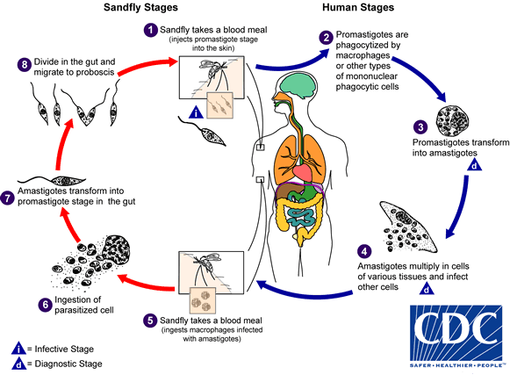
Notes:
Leishmaniasis

Slide 2
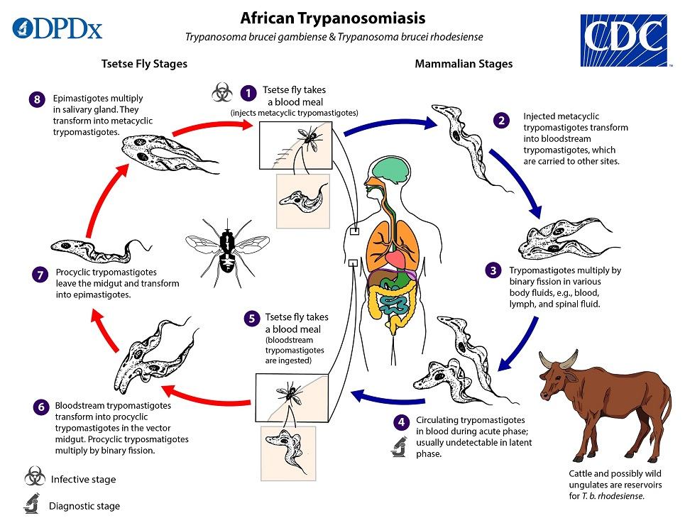
Notes:
Trypanosomiasis

Slide 3
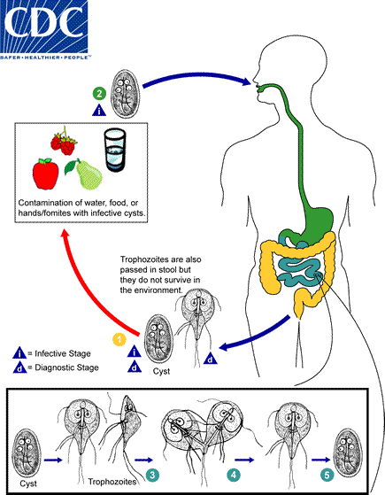
Notes:
Giardia

Slide 4
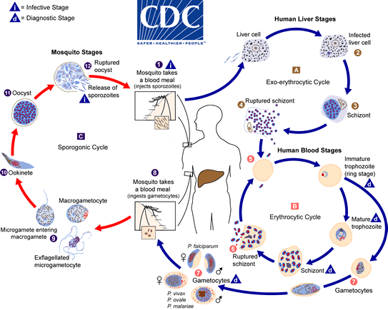
Notes:
Malaria (Plasmodium Falciparum)

Slide 5
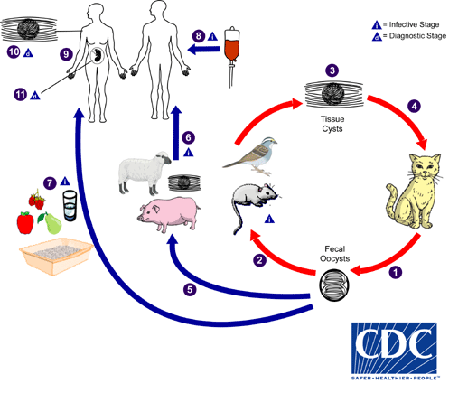
Notes:
Toxoplasmosis (Toxoplasma gondii)

Slide 6
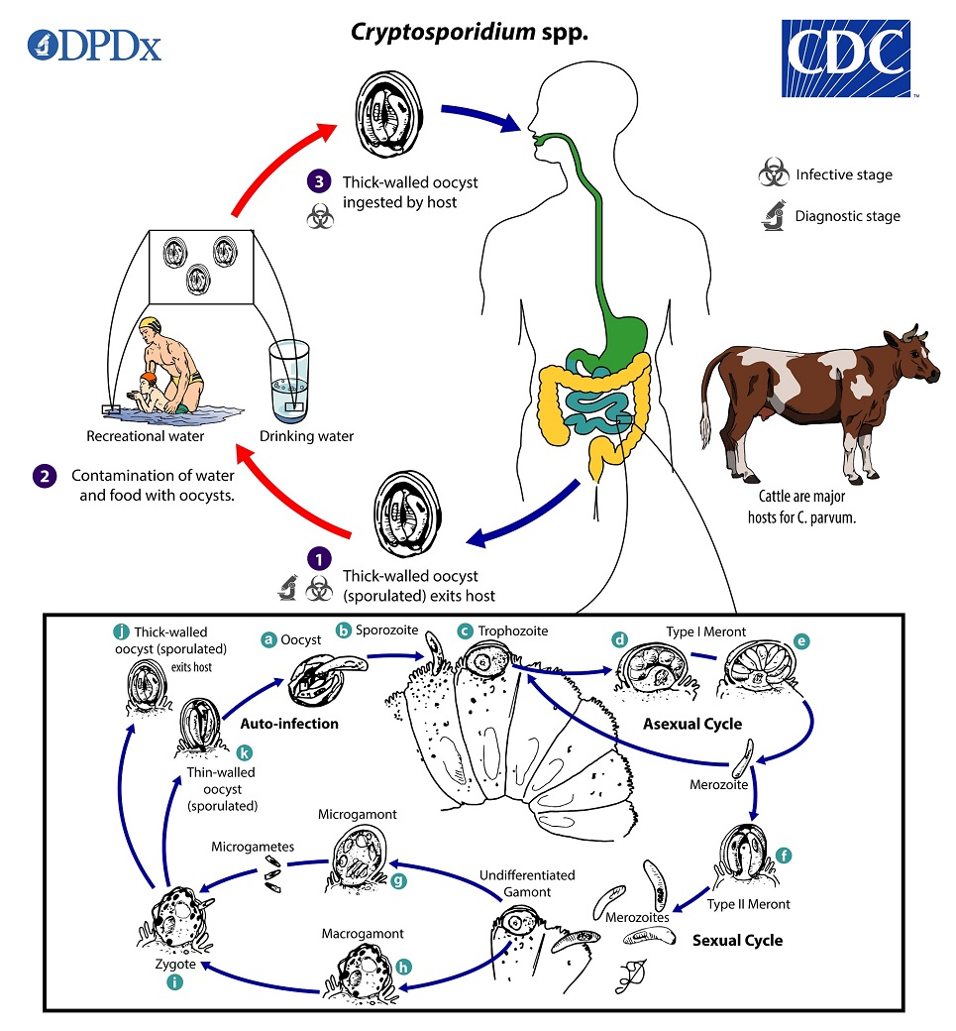
Notes:
Crpytosporidium

