Slide 1
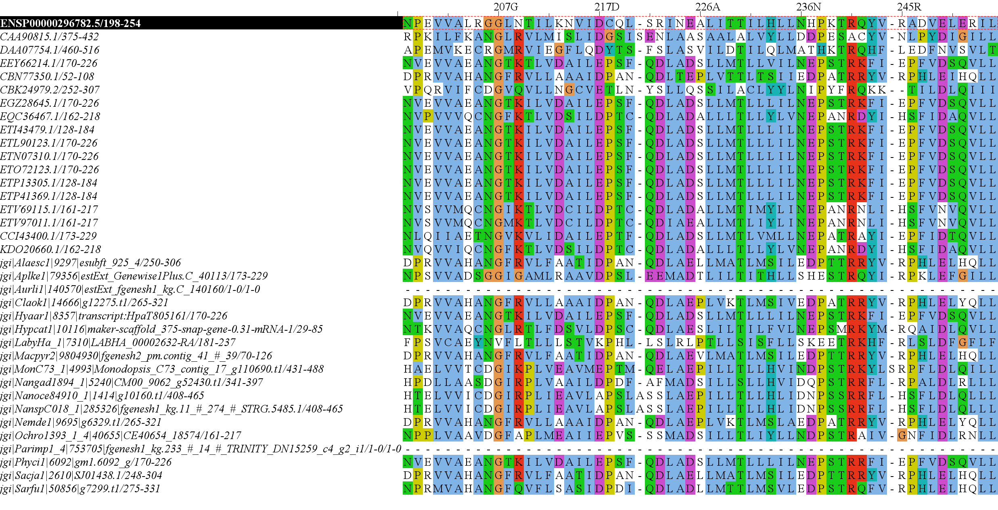
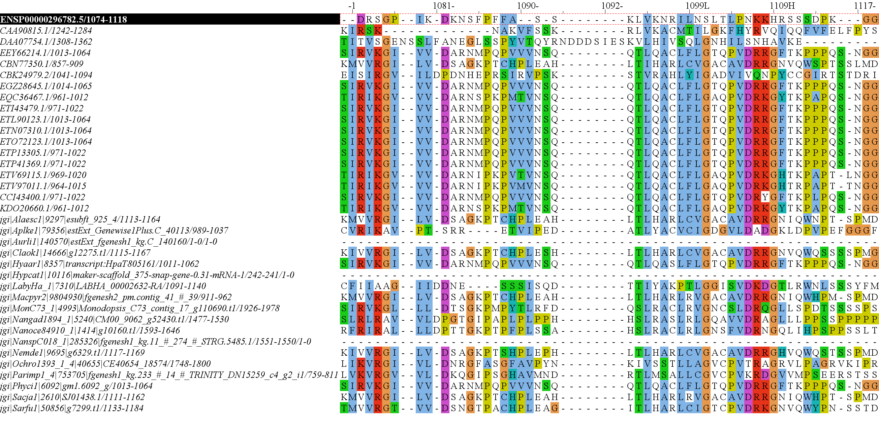
RICTOR Domain Diagram H.Sapiens Reference
57
439
743
857
1084
1190
RICTORN
RICTORM
RasGEF
Domain5
RICTOR Phosphorylation
523
742
926
992
ARM-Repeats

Slide 2
57
439
743
857
1084
1190
RICTORN
RICTORM
RasGEF
Domain5
RICTOR Phosphorylation
523
742
926
992
ARM-Repeats

Slide 3
RICTOR
RPTOR
MTOR
SIN1
MTOR
LST8
LST8
TOR Complex 1
TOR Complex 2

Slide 4
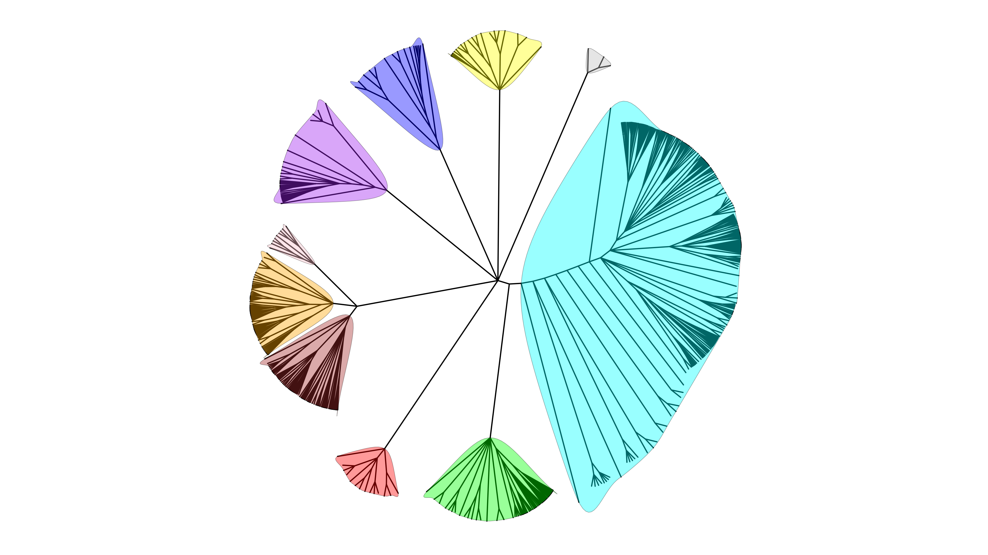
Metamonada
Opisthokonta
Amoebozoa
Discoba
Rhizaria
Streptophyta
Alveolata
Streptophyta
Stramenopiles
Rhodophyta
Chlorophyta

Slide 5
Secondary Endosymbiosis Event
SAR
Amorphea
Archaeplastida
Ciliates
Ochrophyta
Alveolata
Apusomonada
Chlorophyta
Stramenopiles
Breviates
Streptophyta
Rhizaria
Rhodophyta
Opisthokonta
Amoebozoa
Discoba
Secondary Endosymbiosis Event
Metamonada
Euglena gracilis
Primary Endosymbiosis
Event
Excavata

Slide 6
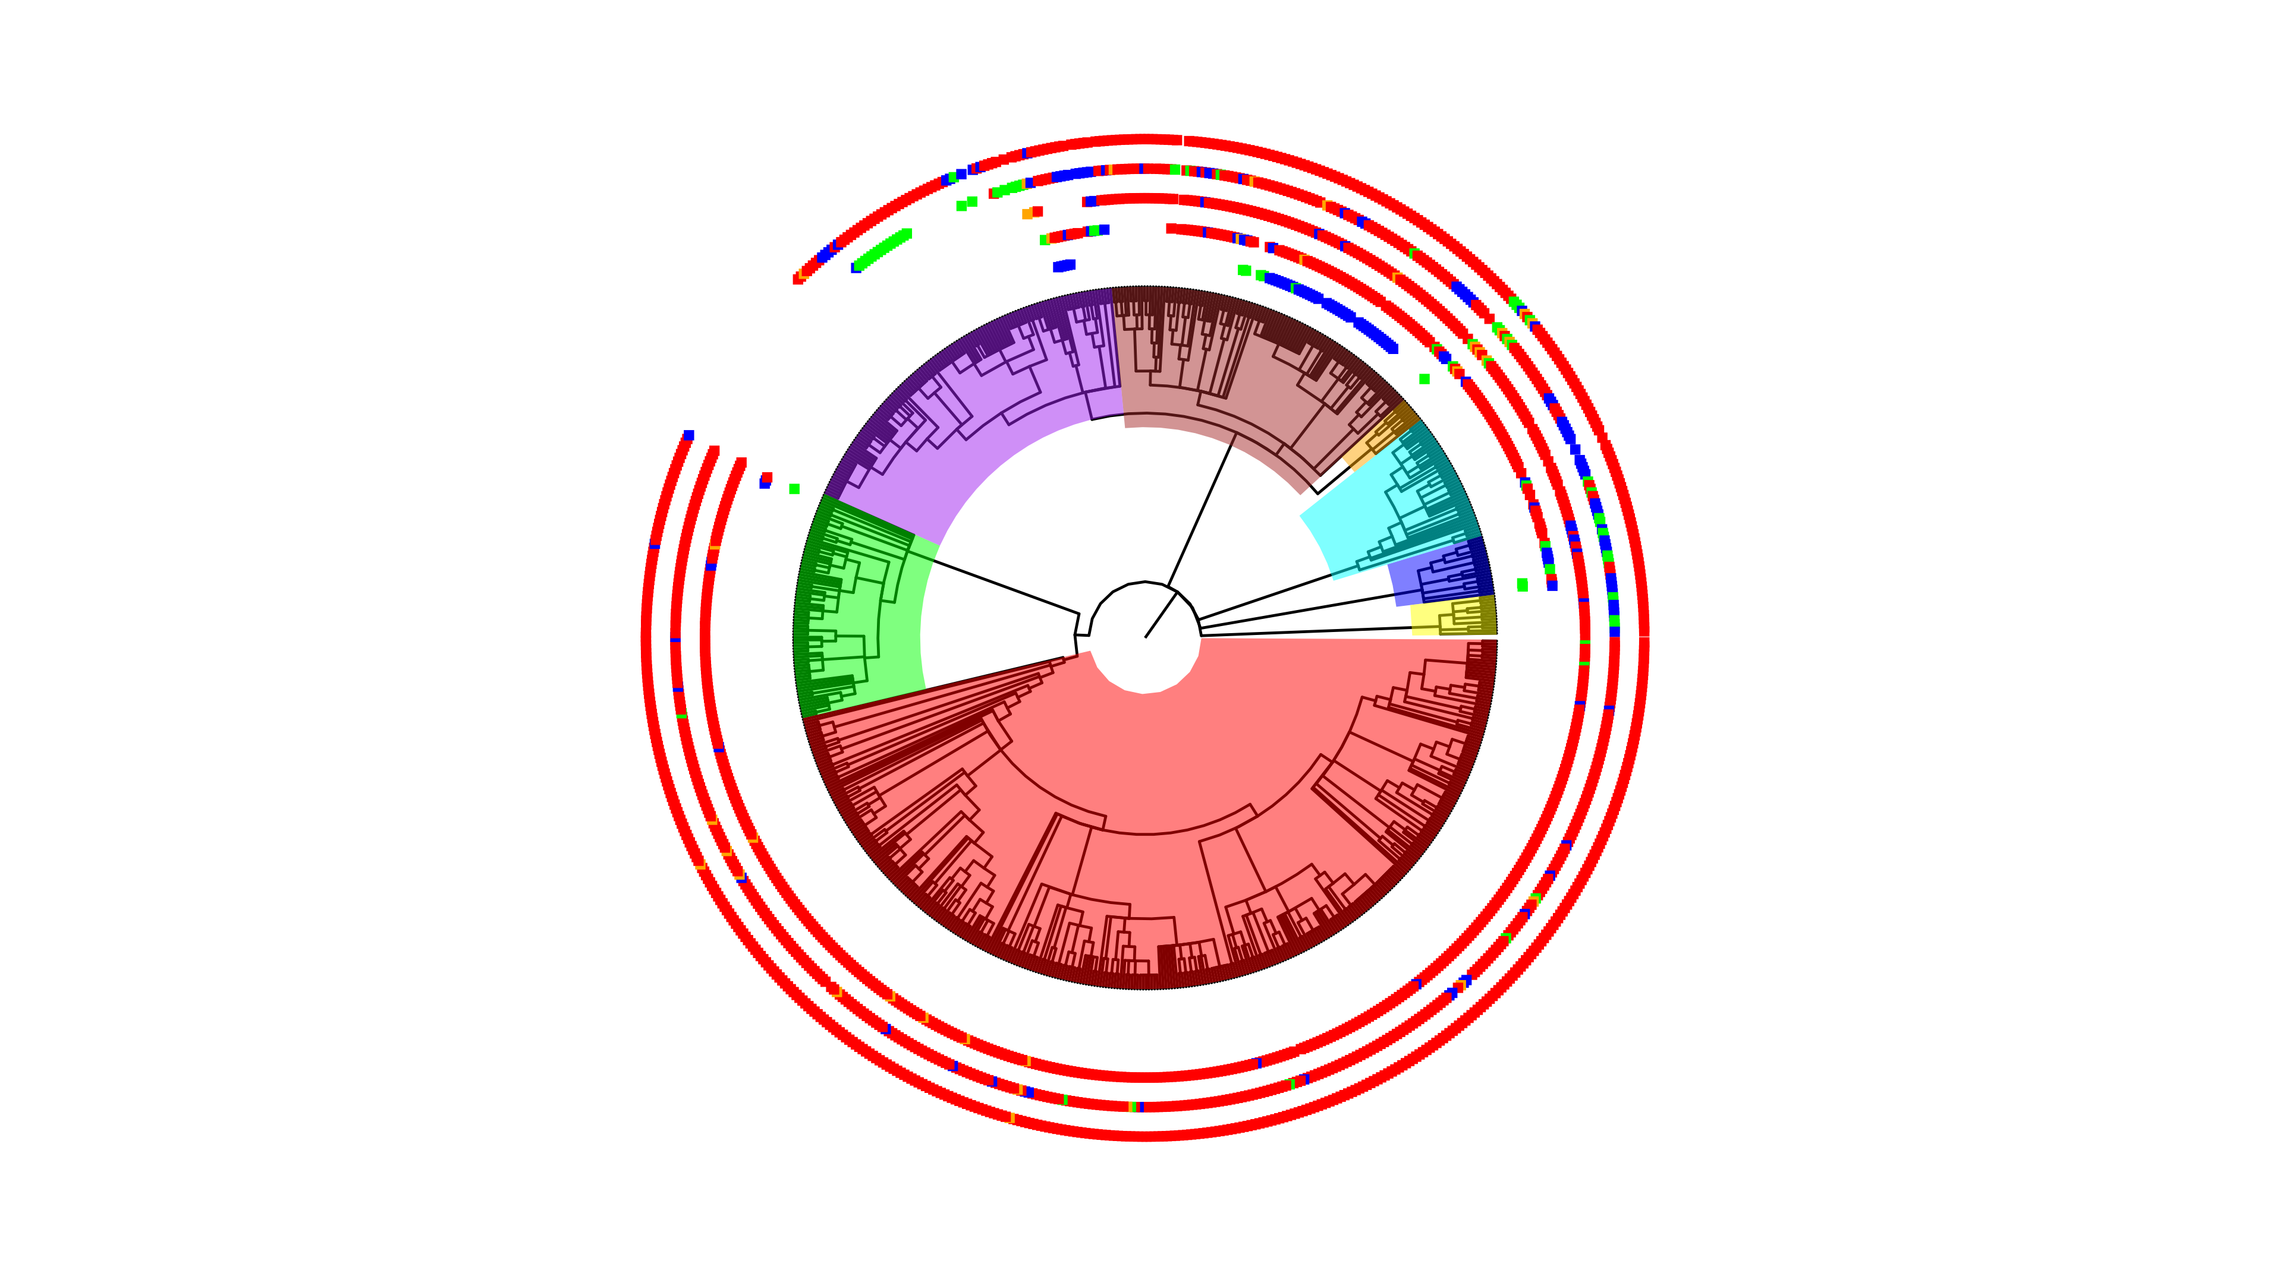
Super Groups
Alveolata
Chlorophyta
Discoba
Rhizaria
Rhodophyta
Stramenopiles

