Slide 1
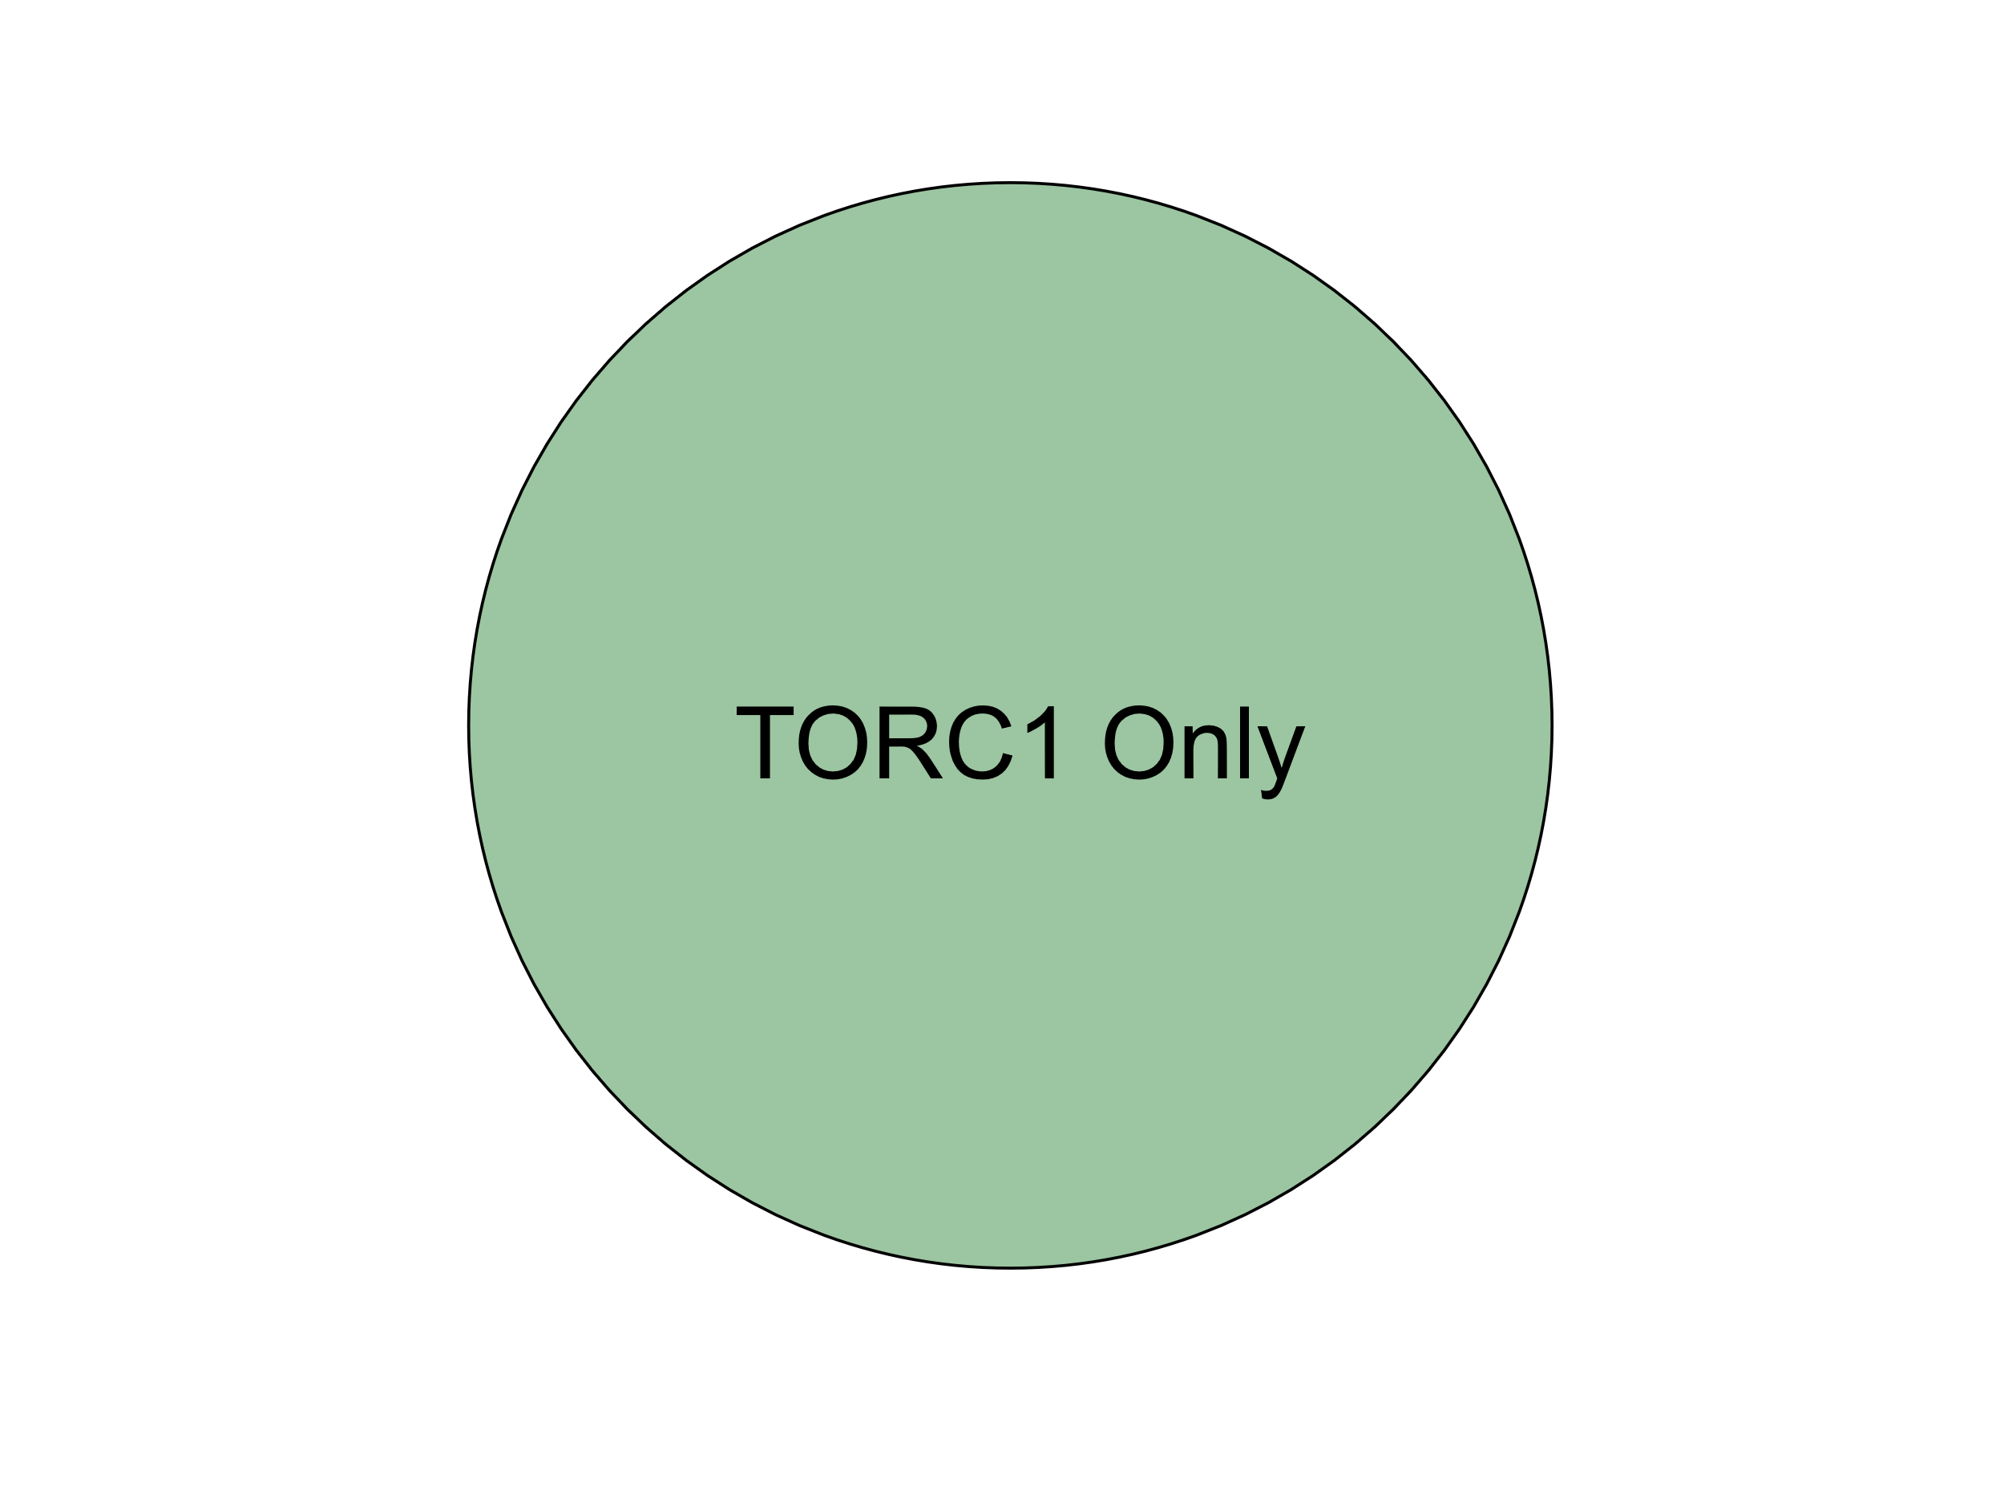
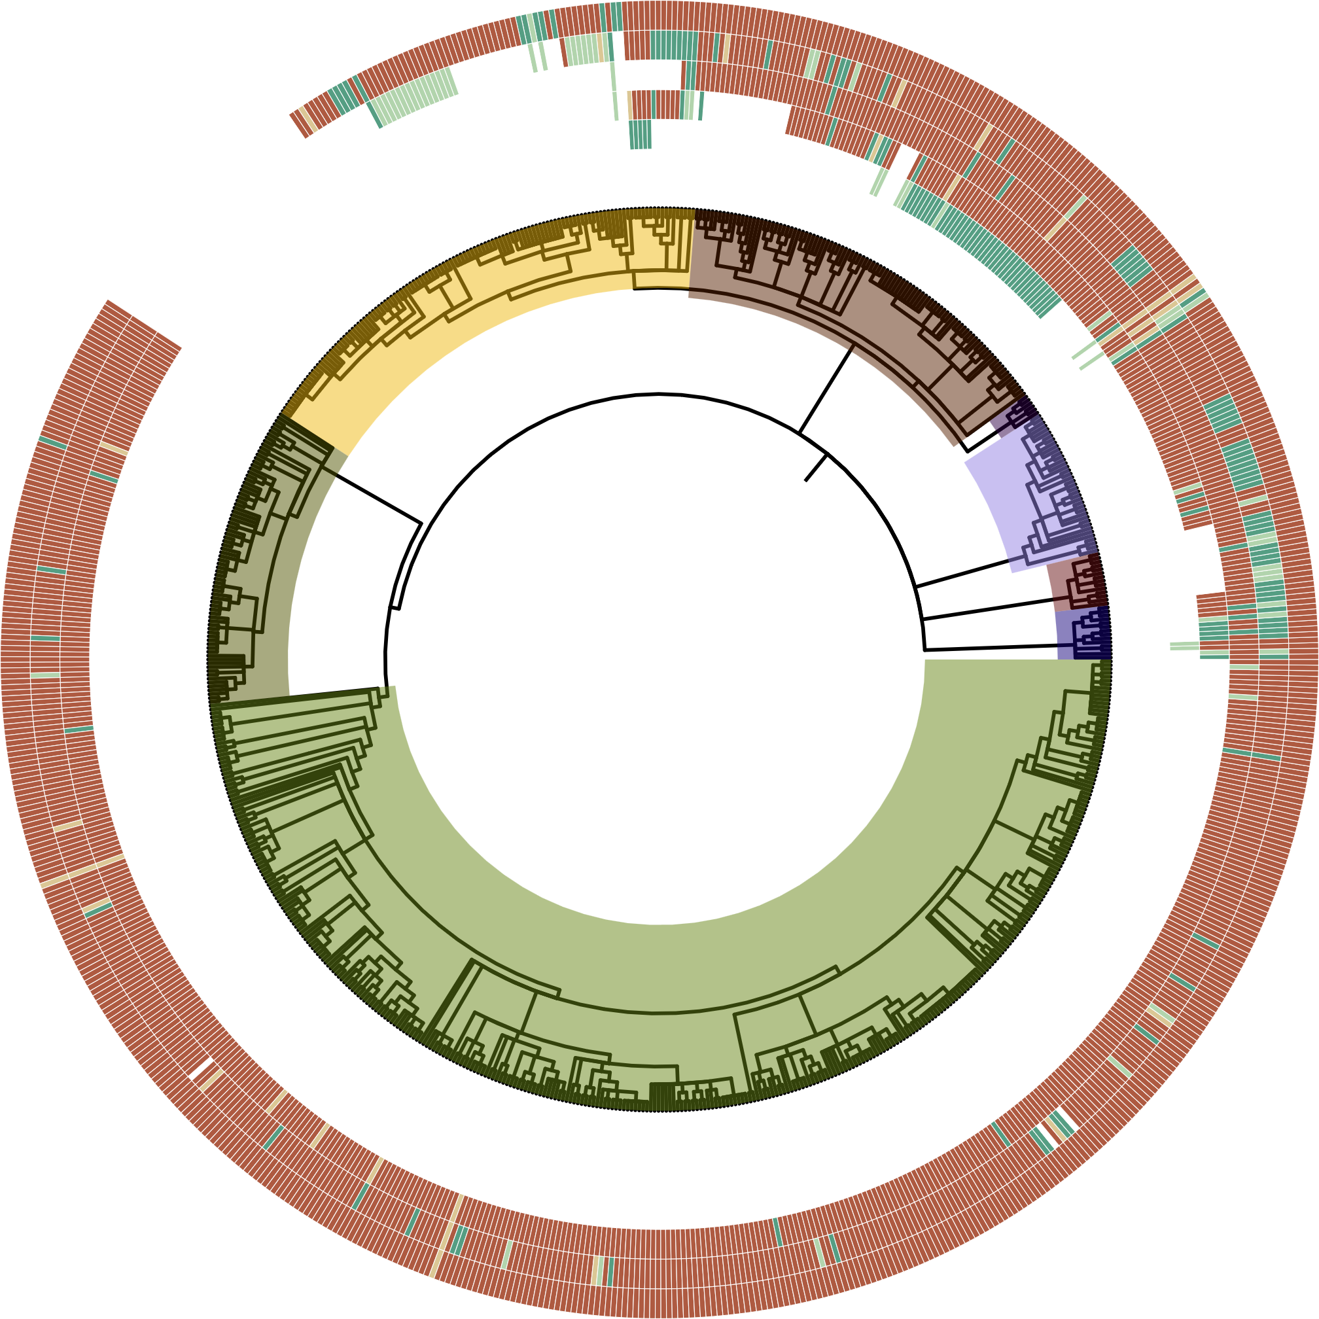
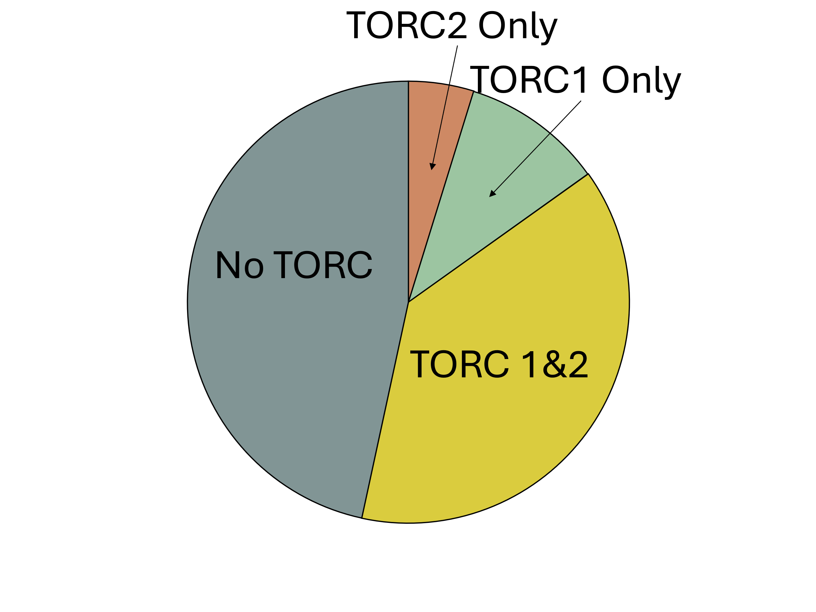
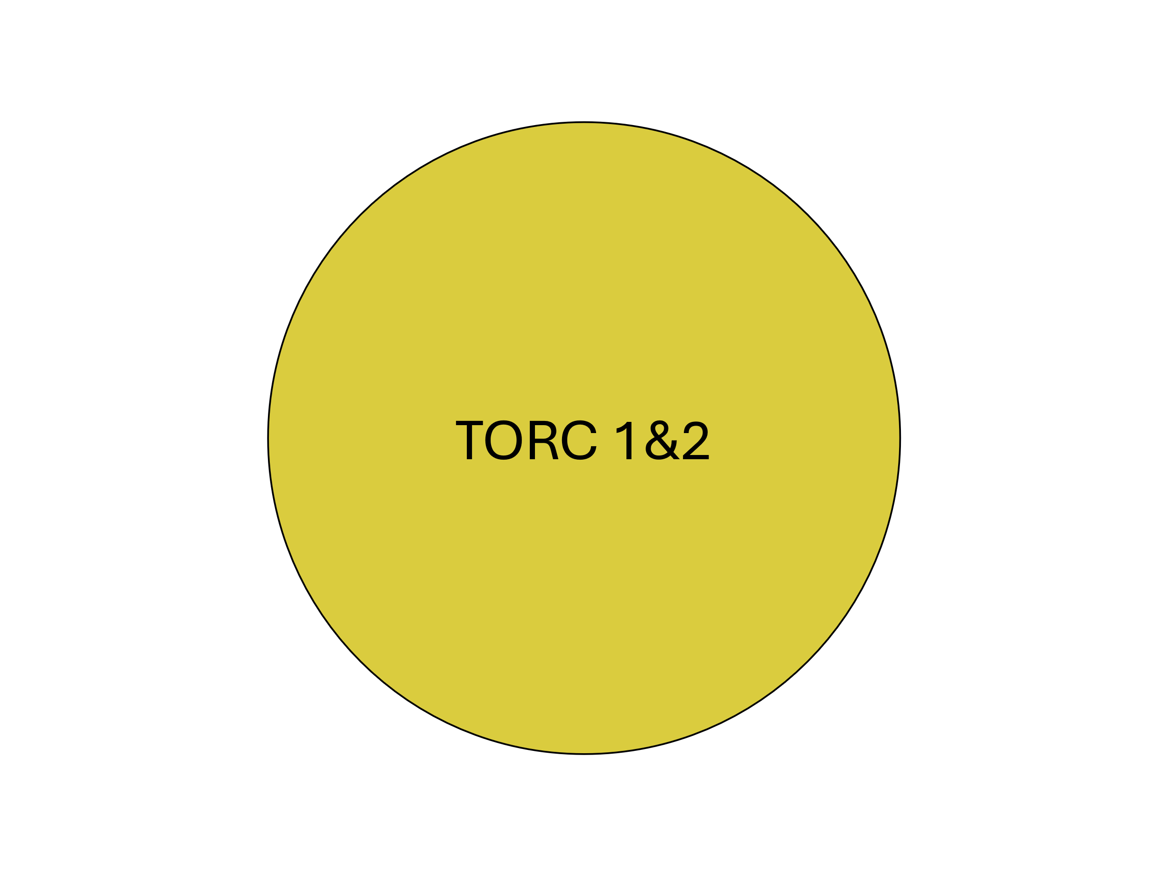
Figure 2
(B)
(A)
HMMER Score
-TOR-
-LST8-
-RAPTOR-
H
-RICTOR-
-SIN1-
M
L
Archaeplastida
P
ABS
Clade
Alveolata
Stramenopiles
Rhizaria
Streptophyta
SAR
Chlorophyta
Rhodophyta
Discoba
Metamonada
Excavata

Slide 2
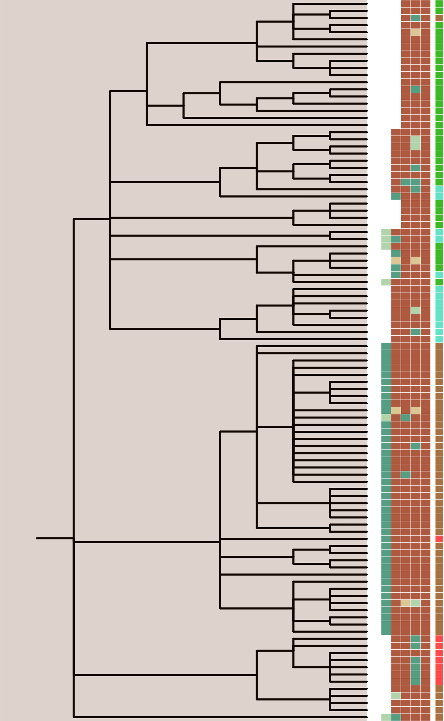
Figure 3
LST8
RICTOR
RAPTOR
SIN1
TOR
(B)
Completeness Score
(A)
Cylindrotheca closterium
100
Nitzschia inconspicua
Nitzschia putrida
Stramenopiles
Pseudo-nitzschia multiseries
75
Pseudo-nitzschia multistriata
Bacillariophyta
Fragilariopsis cylindrus CCMP1102
Entomoneis
50
Phaeodactylum tricornutum CCAP 1055/1
Seminavis robusta
Fistulifera solaris
25
Phaeophyceae
Mayamaea pseudoterrestris
Ectocarpus siliculosus
Ectocarpus sp. CCAP 1310/34
(C)
Ochrophyta
Pelagophyceae
Cladosiphon okamuranus
HMMER Score
Nemacystus decipiens
Alaria esculenta
Eustigmatales
Undaria pinnatifida
H
Macrocystis pyrifera
Saccharina japonica
Sargassum fusiforme
M
Tribonema minus
(D)
Parmales
Pelagomonas calceolata
L
Aureococcus anophagefferens
Chrysophaeum taylorii
Pelagophyceae sp. CCMP2097
(E)
P
Triparma columacea
Triparma strigata
ABS
Triparma verrucosa
Triparma laevis f. inornata
Triparma laevis f. longispina
Metabolic Strategy
Triparma retinervis
Tetraparma gracilis
Parmales sp. scaly parma
(F)
Autotroph
Phytophthora capsici
Heterotroph
Phytophthora cinnamomi var. cinnamomi
Oomycota
Phytophthora infestans T30-4
Phytophthora nicotianae CJ01A1
Mixotroph
Phytophthora nicotianae P10297
Phytophthora nicotianae P1569
Phytophthora nicotianae P1976
Plastid Parasite
Phytophthora megakarya
(G)
Phytophthora palmivora
Phytophthora cactorum
Non-Plastid Parasite
Blastocystis sp. ATCC 50177/Nand II
Blastocystis sp. subtype 4
Endosymbiont
Bigyra
Blastocystis sp. Blastoise
Blastocystis sp. BT1
Blastocystis sp. DL
Blastocystis sp. JDR
Blastocystis sp. NMH
Notes:
Updated

Slide 3
Alveolata
Completeness Score
100
Symbiodinium microadriaticum
Symbiodinium sp. KB8
Symbiodinium sp. CCMP2592
75
Symbiodinium natans
Durusdinium trenchii
Breviolum minutum
Cladocopium goreaui
50
Effrenium voratum
Fugacium kawagutii
Polarella glacialis
25
Chromera velia CCMP2878
Vitrella brassicaformis CCMP3155
HMMER Score
H
M
L
P
ABS
Metabolic Strategy
Paramecium primaurelia
Autotroph
Paramecium tetraurelia strain d4-2
Paramecium octaurelia
Paramecium pentaurelia
Heterotroph
Paramecium sonneborni
Ichthyophthirius multifiliis
Tetrahymena thermophila SB210
Mixotroph
Pseudocohnilembus persalinus
Stylonychia lemnae
Oxytricha trifallax
Blepharisma stoltei
Plastid Parasite
Non-Plastid Parasite
Endosymbiont
Notes:
Version that will have the Perkinsozoa

