Slide 1
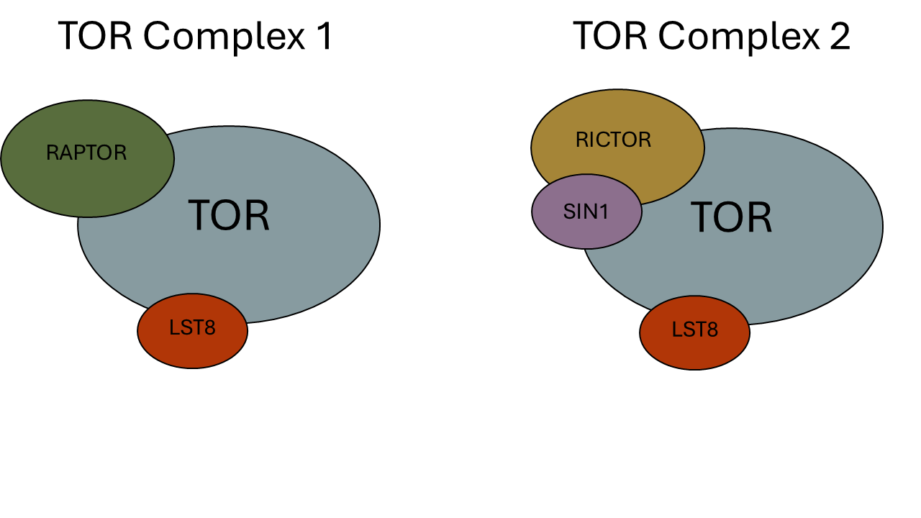
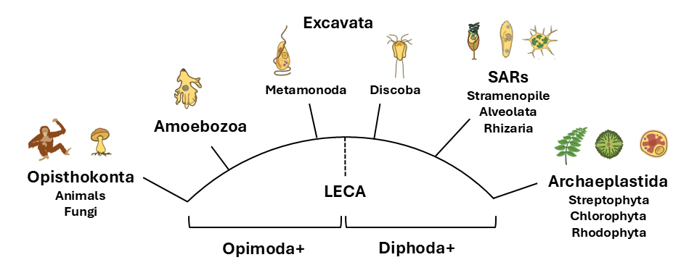
Figure 1
(A)
(B)
(C)
HMMER
ClustalO
Phylo Trees
NCBI/JGI
BLAST
Dataframe
Results
BUSCO
DIAMOND
Primary
Literature
Graphs

Slide 2
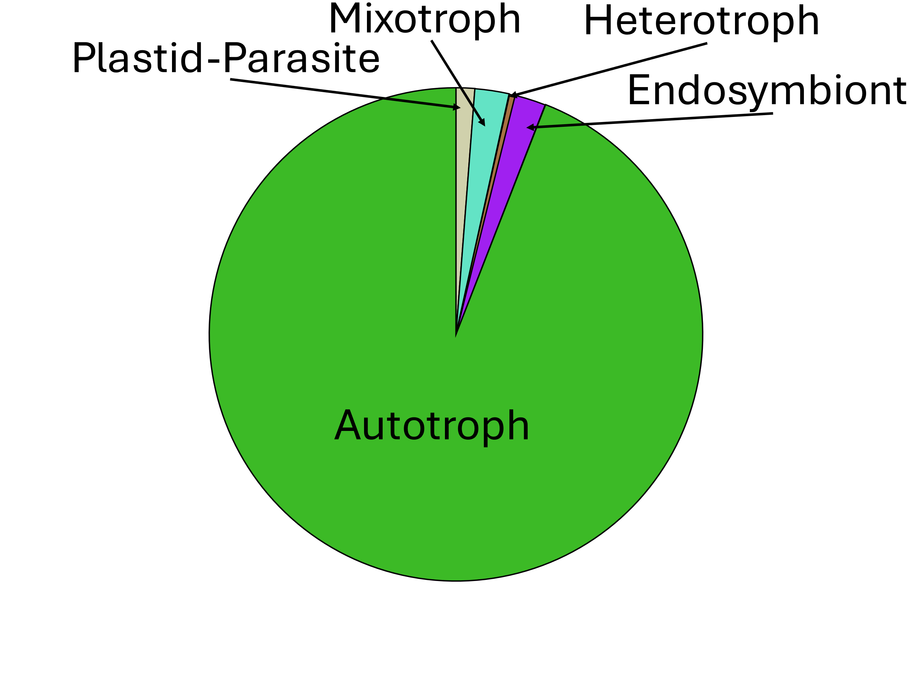
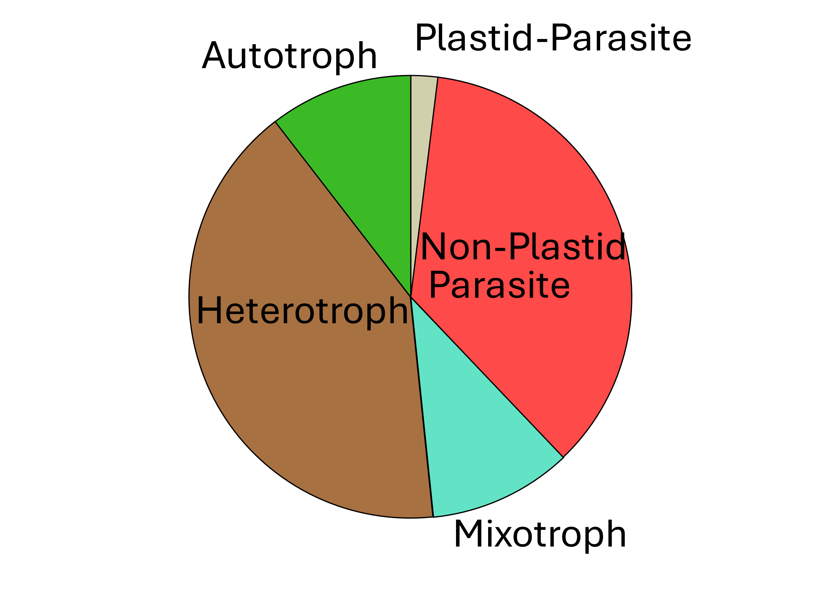
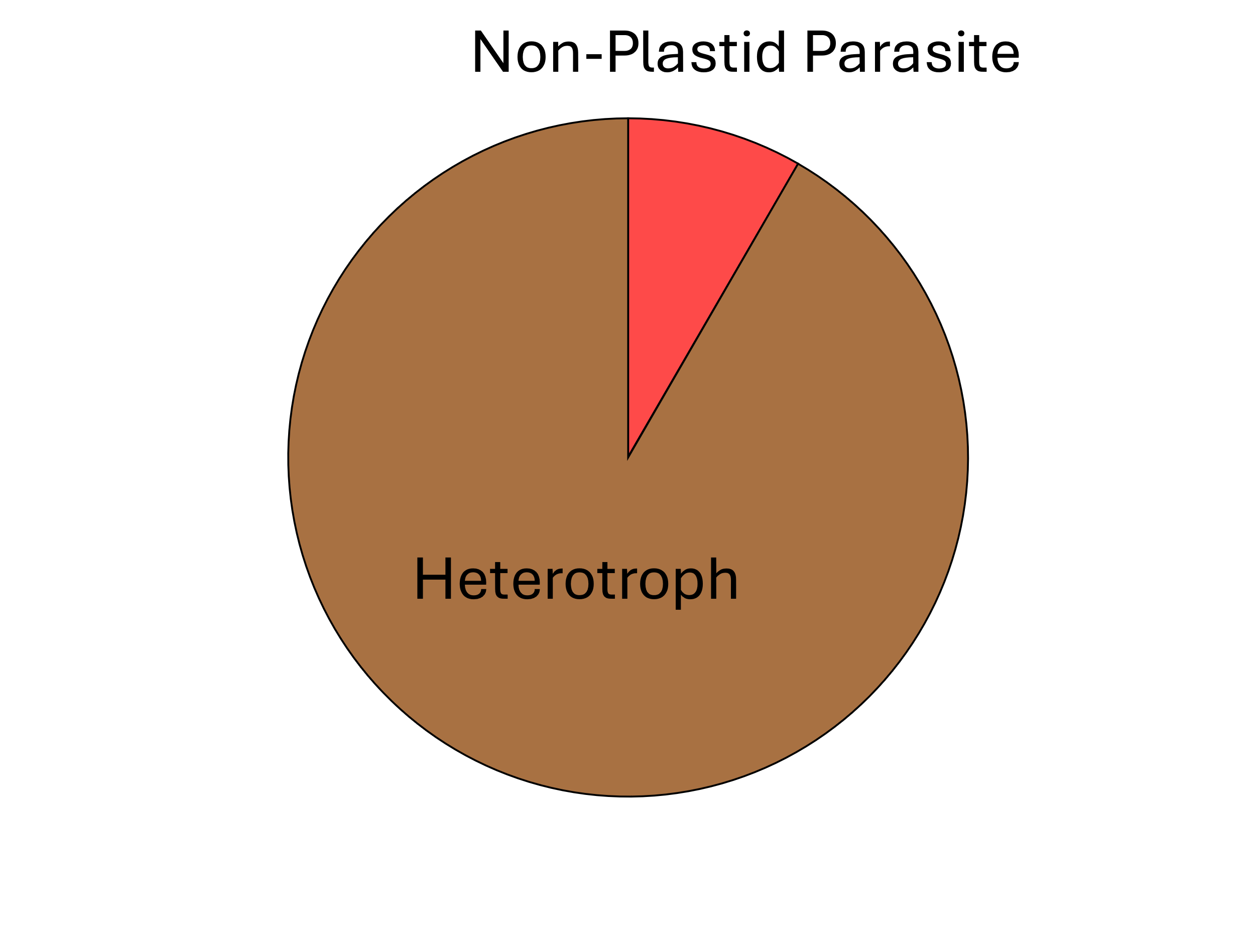
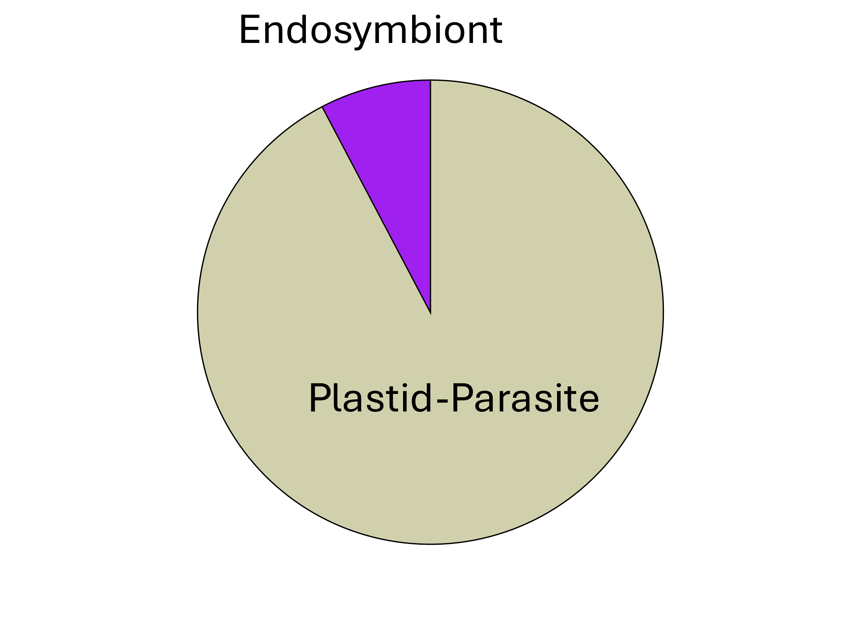
Figure 5
(A)
Rhodophyta
Archaeplastida
Chlorophyta
TORC 1
TORC 1
Streptophyta
Stramenopiles
TORC 1&2
TORC 1
LECA
SAR
Alveolata
TORC 1&2
Rhizaria
TORC 2
Discoba
TORC 1&2
Excavates
Metamonada
TORC 1&2
(B)
(C)
TORC 1
TORC 1&2
(D)
(E)
TORC 2
Missing TORC

