Slide 1
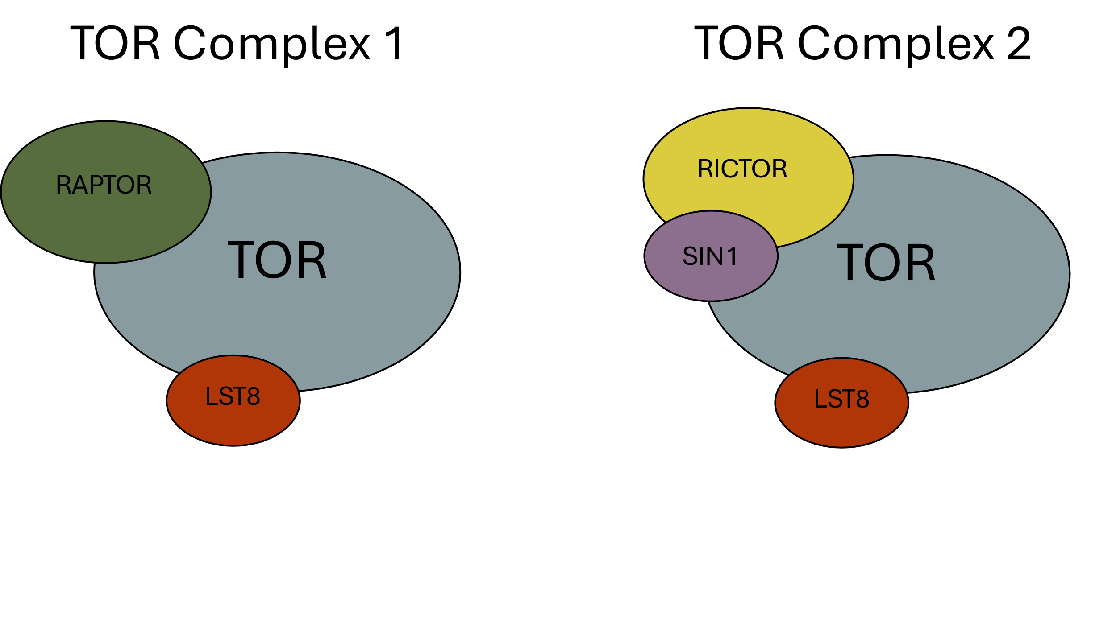
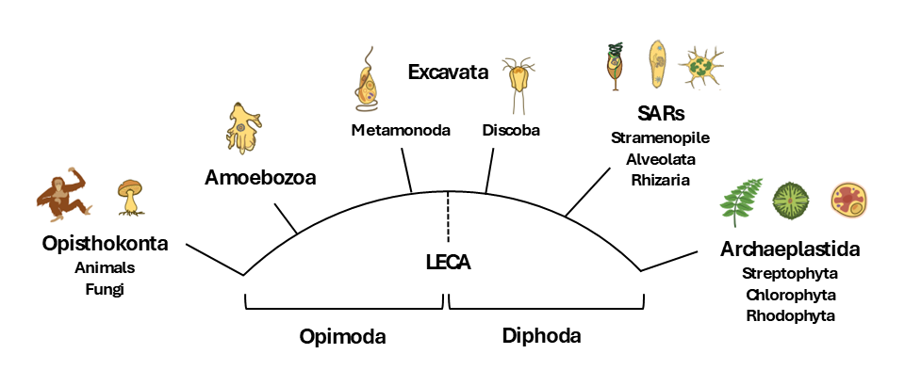
Figure 1
(A)
(B)
(C)
HMMER
ClustalO
Phylo Trees
NCBI/JGI
BLAST
Dataframe
Results
BUSCO
DIAMOND
Primary
Literature
Graphs

Slide 2
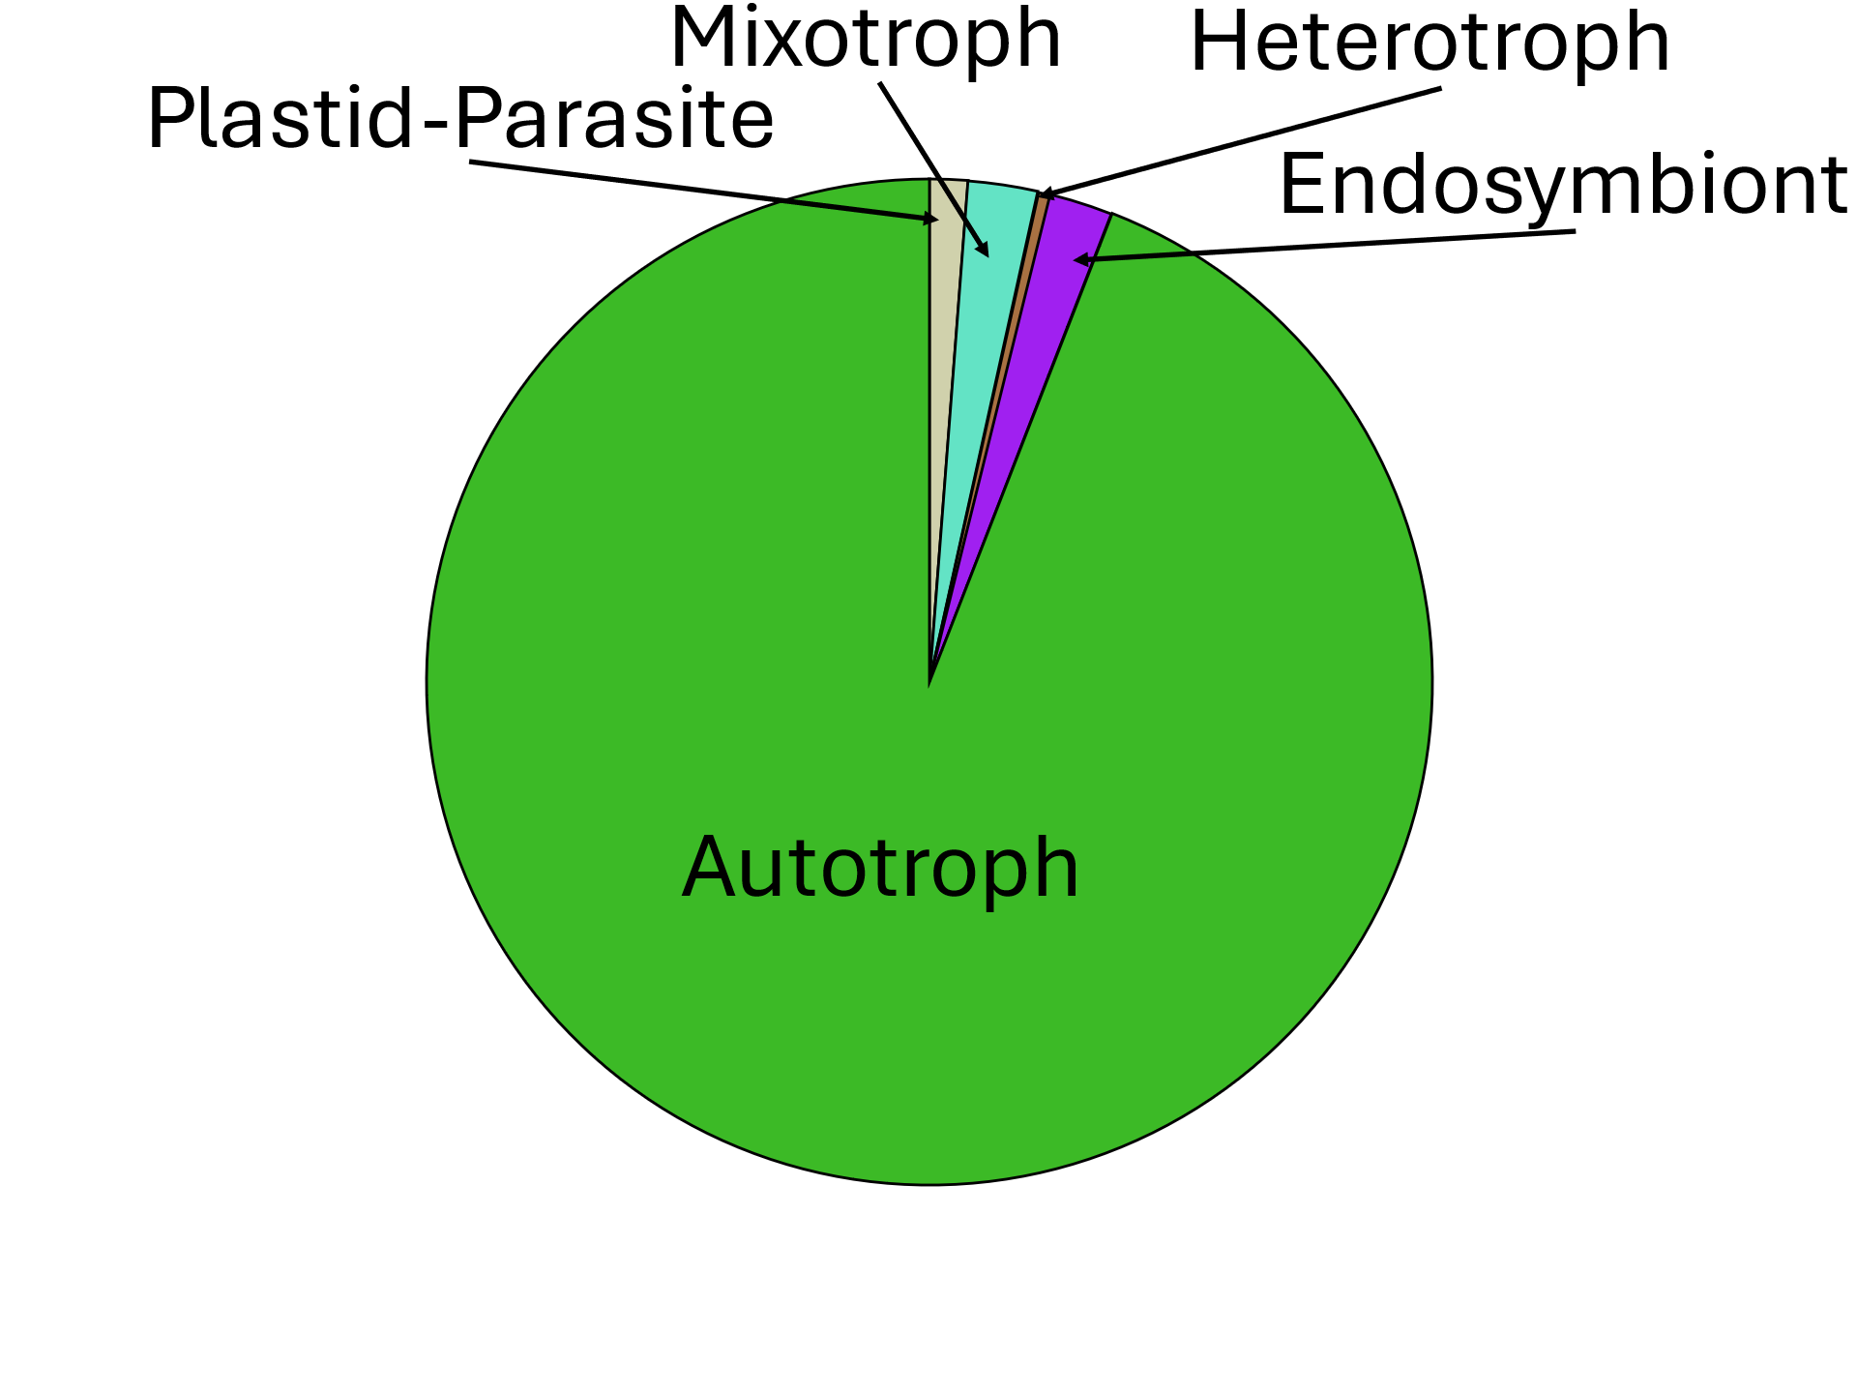
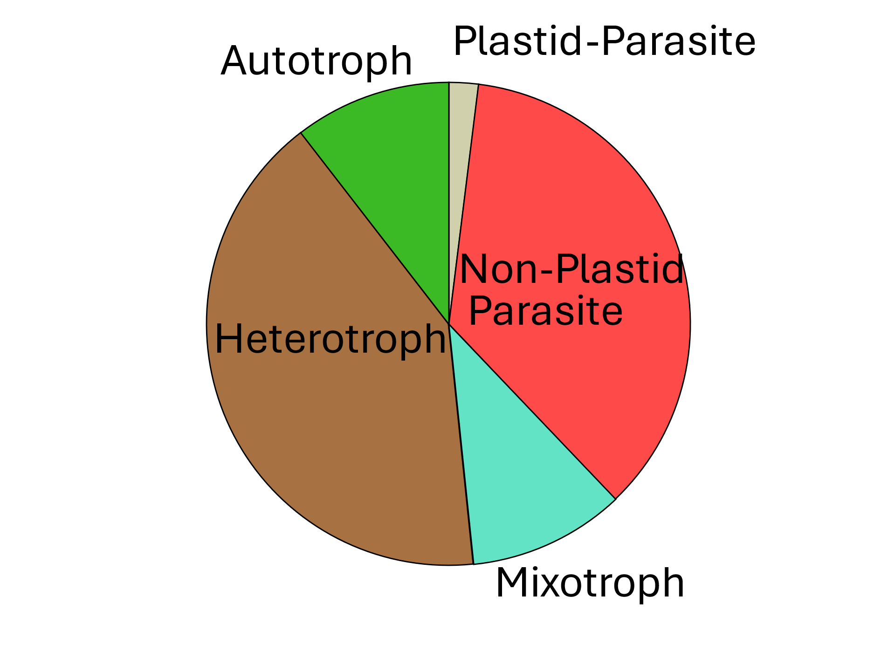
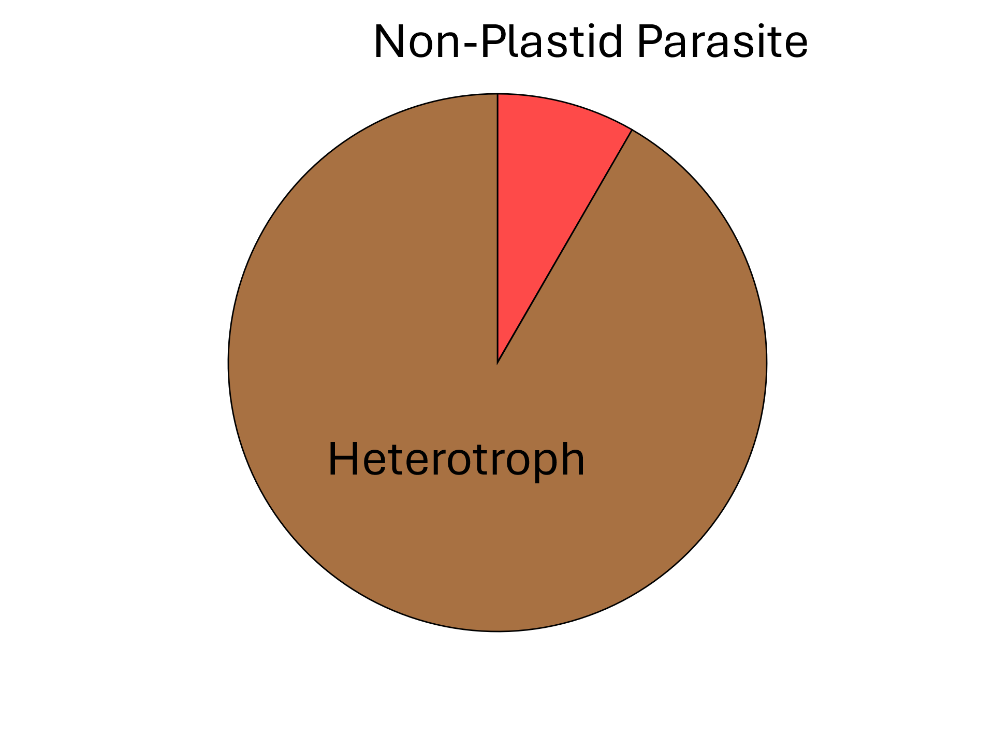
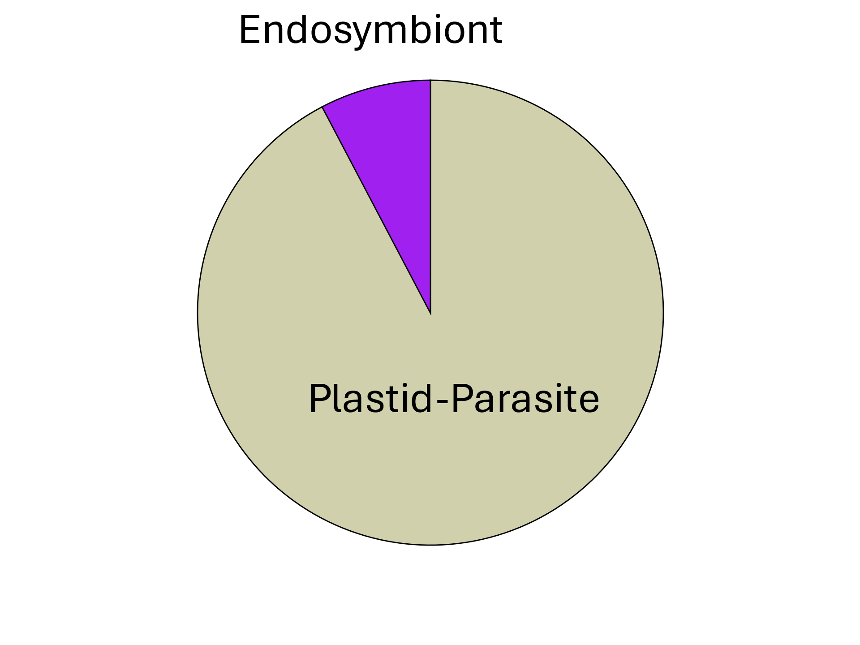
Figure 5
(A)
Rhodophyta
Archaeplastida
Chlorophyta
TORC1
TORC1
Streptophyta
Stramenopiles
TORC1&2
TORC1
LECA
SAR
Alveolata
TORC1&2
Rhizaria
TORC2
Discoba
TORC1&2
“Excavata”
Metamonada
TORC1&2
(B)
TORC1
TORC1 & TORC2
TORC2
No TOR Complexes

Slide 3
