Slide 1
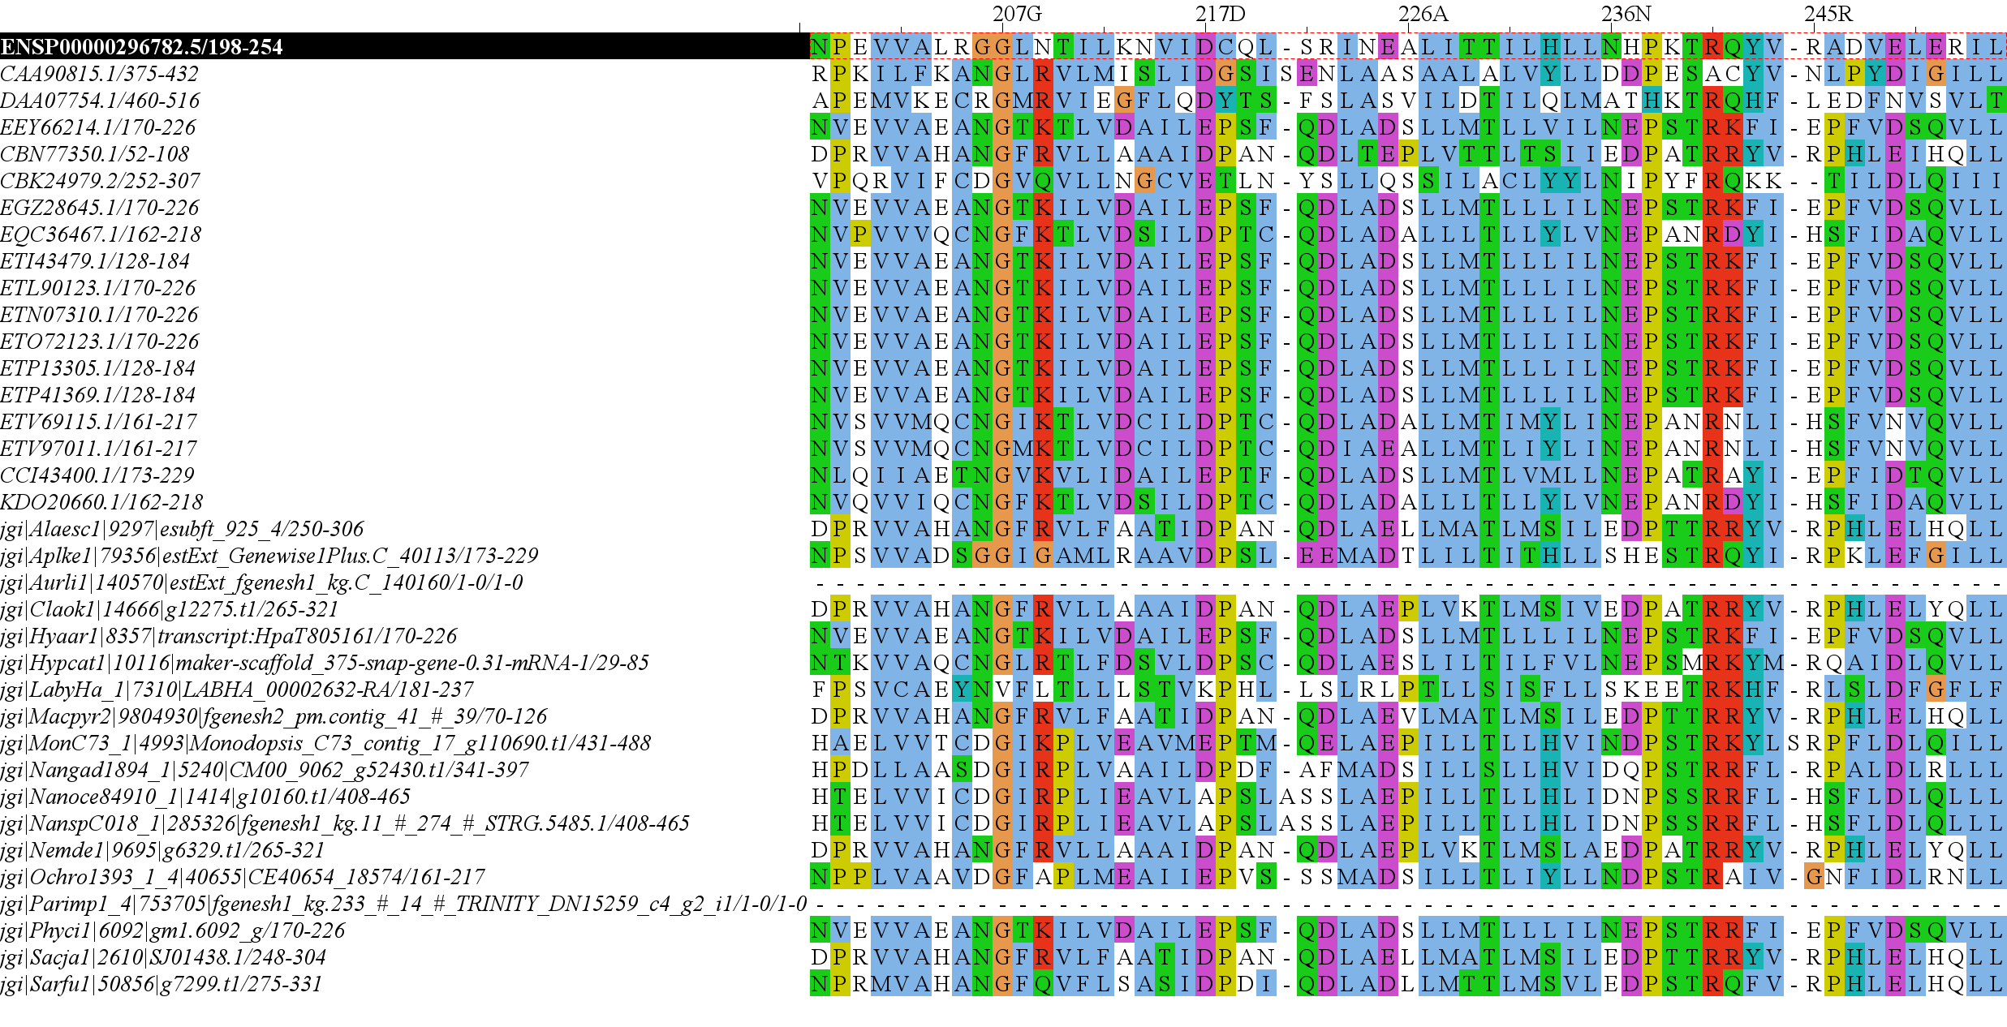
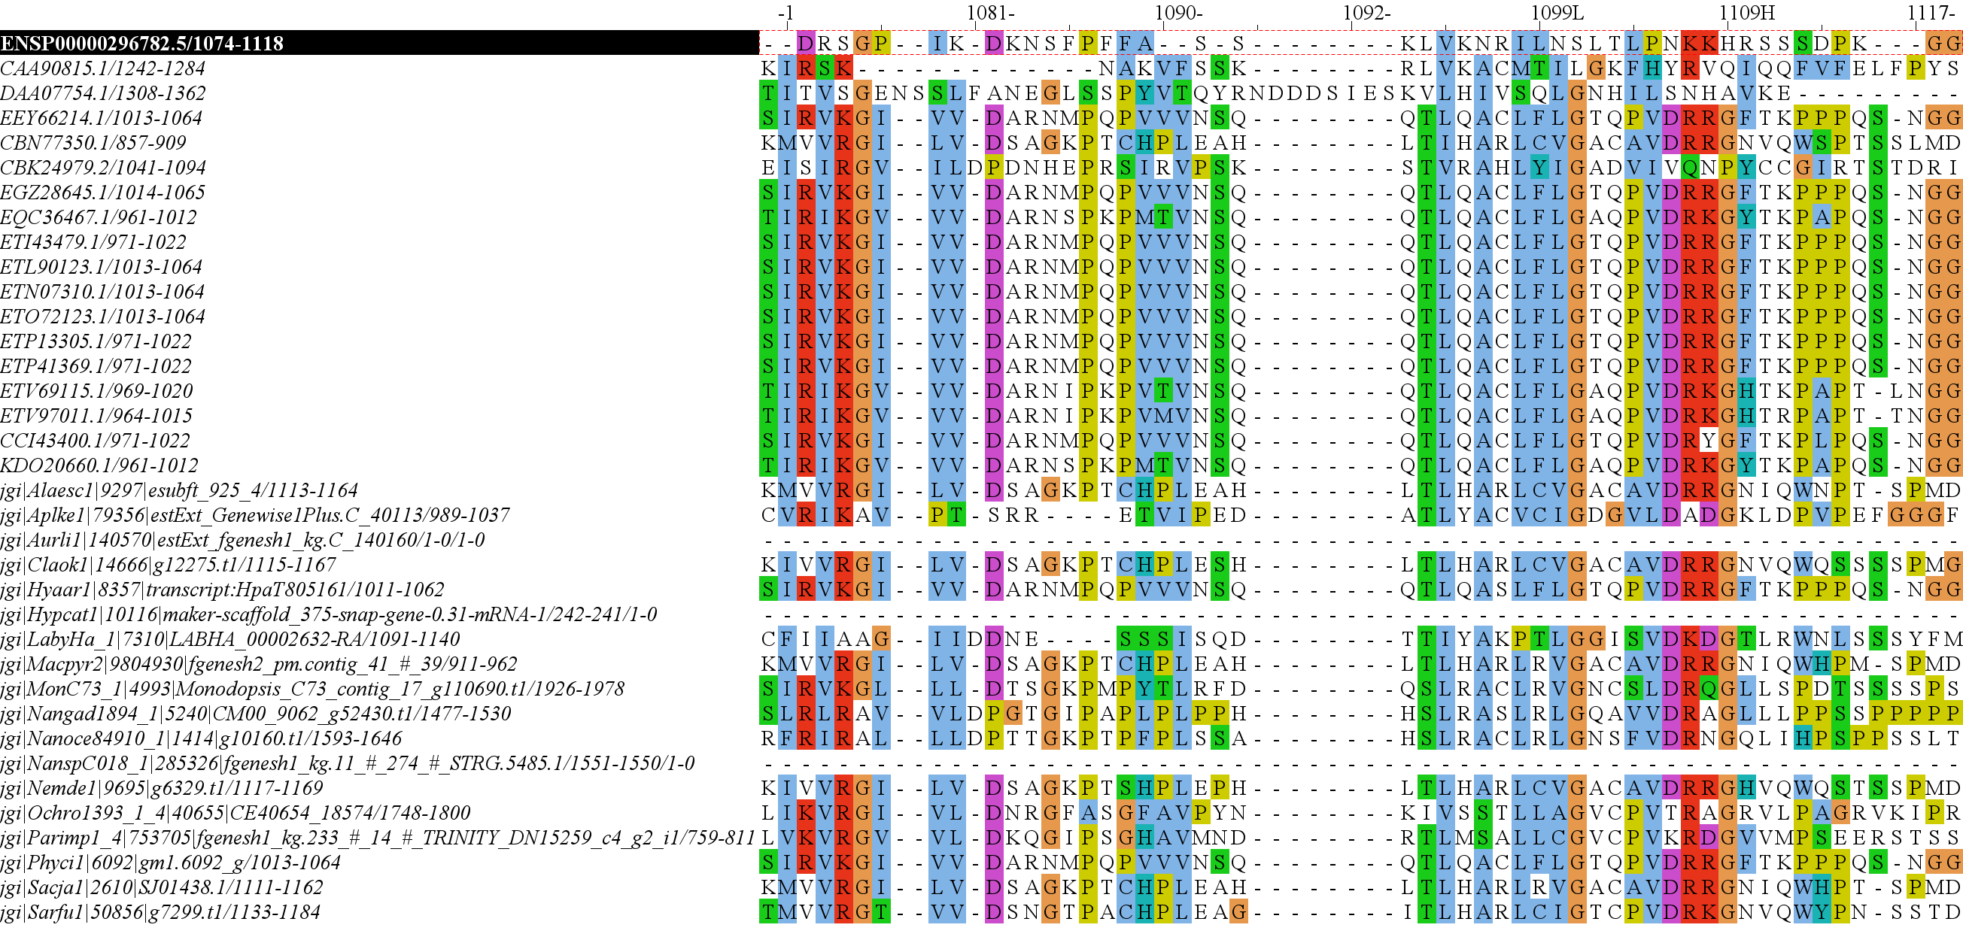
RICTOR Domain Diagram H.Sapiens Reference
57
439
743
857
1084
1190
RICTORN
RICTORM
RasGEF
Domain5
RICTOR Phosphorylation
523
742
926
992
ARM-Repeats

Slide 2
57
439
743
857
1084
1190
RICTORN
RICTORM
RasGEF
Domain5
RICTOR Phosphorylation
523
742
926
992
ARM-Repeats

Slide 3
Secondary Endosymbiosis Event
SAR
Amorphea
Archaeplastida
Ciliates
Ochrophyta
Alveolata
Apusomonada
Chlorophyta
Stramenopiles
Breviates
Streptophyta
Rhizaria
Rhodophyta
Opisthokonta
Amoebozoa
Discoba
Secondary Endosymbiosis Event
Metamonada
Euglena gracilis
Primary Endosymbiosis
Event
Excavata

Slide 4
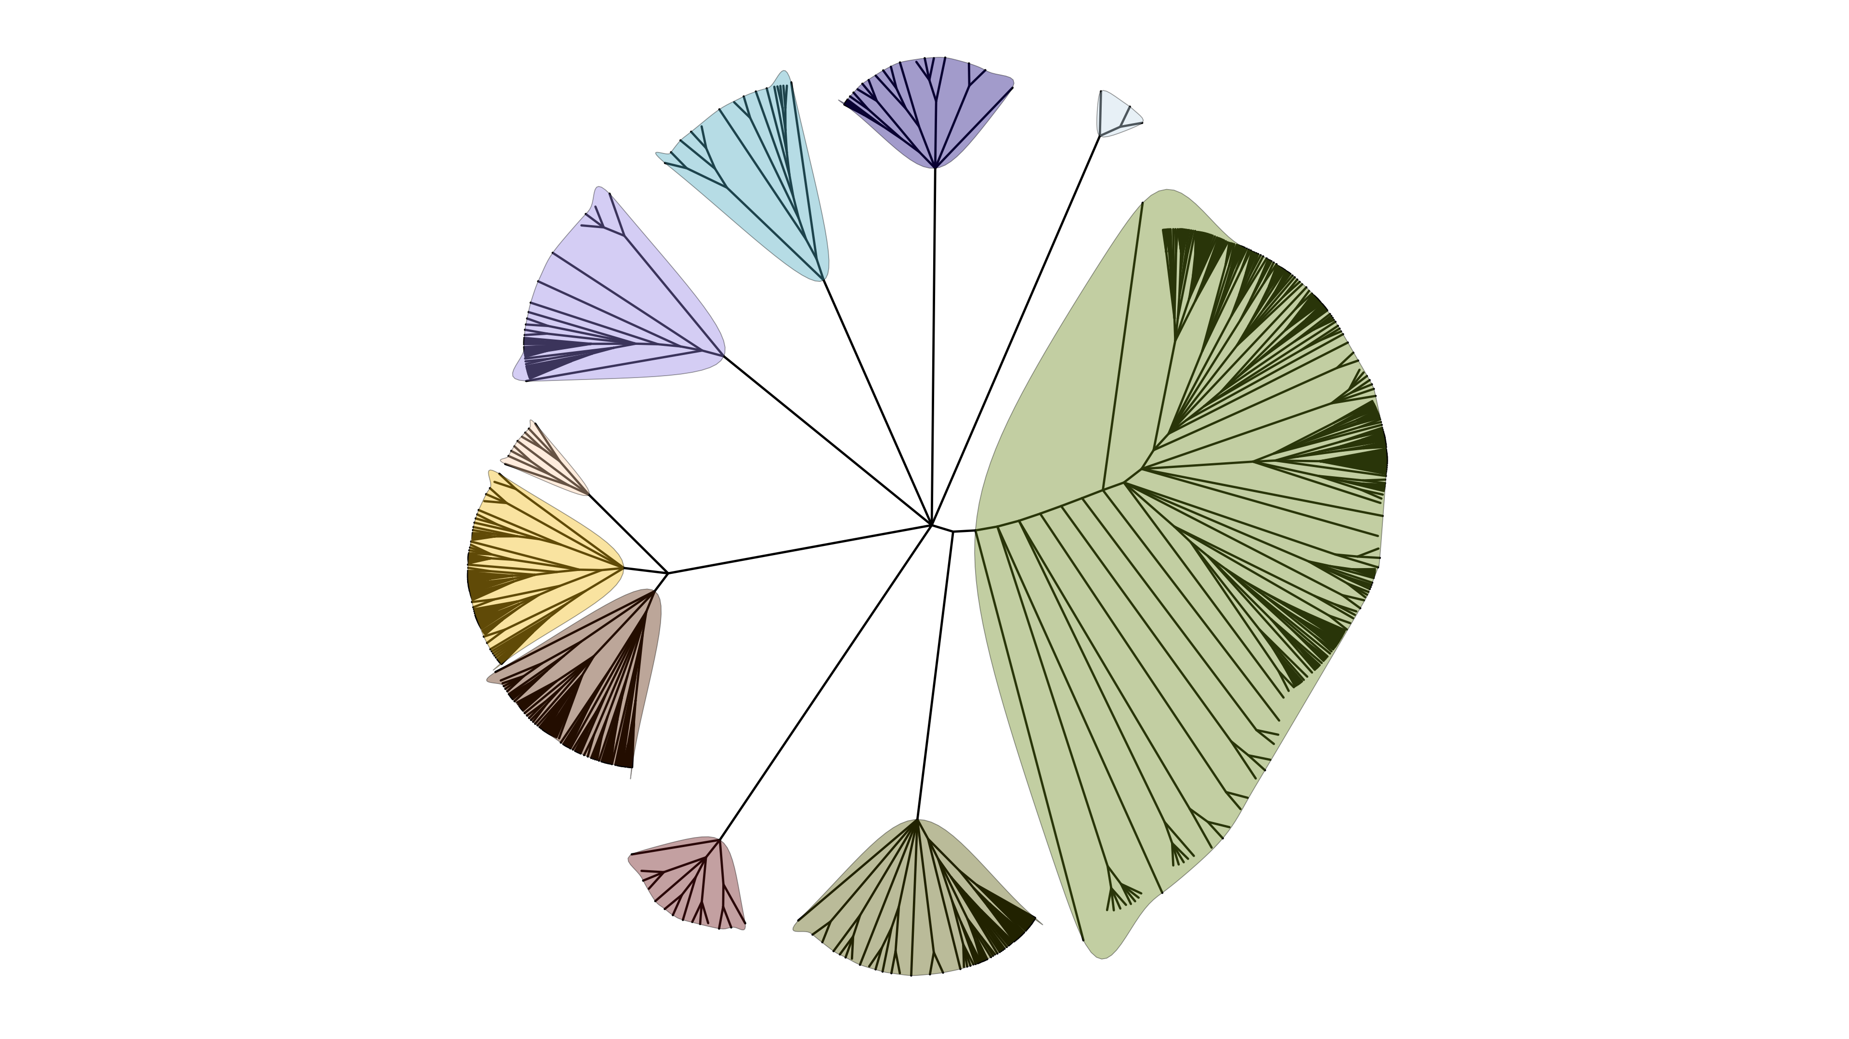
Metamonada
Opisthokonta
Amoebozoa
Discoba
Rhizaria
Streptophyta
Alveolata
Stramenopila
Rhodophyta
Chlorophyta

Slide 5
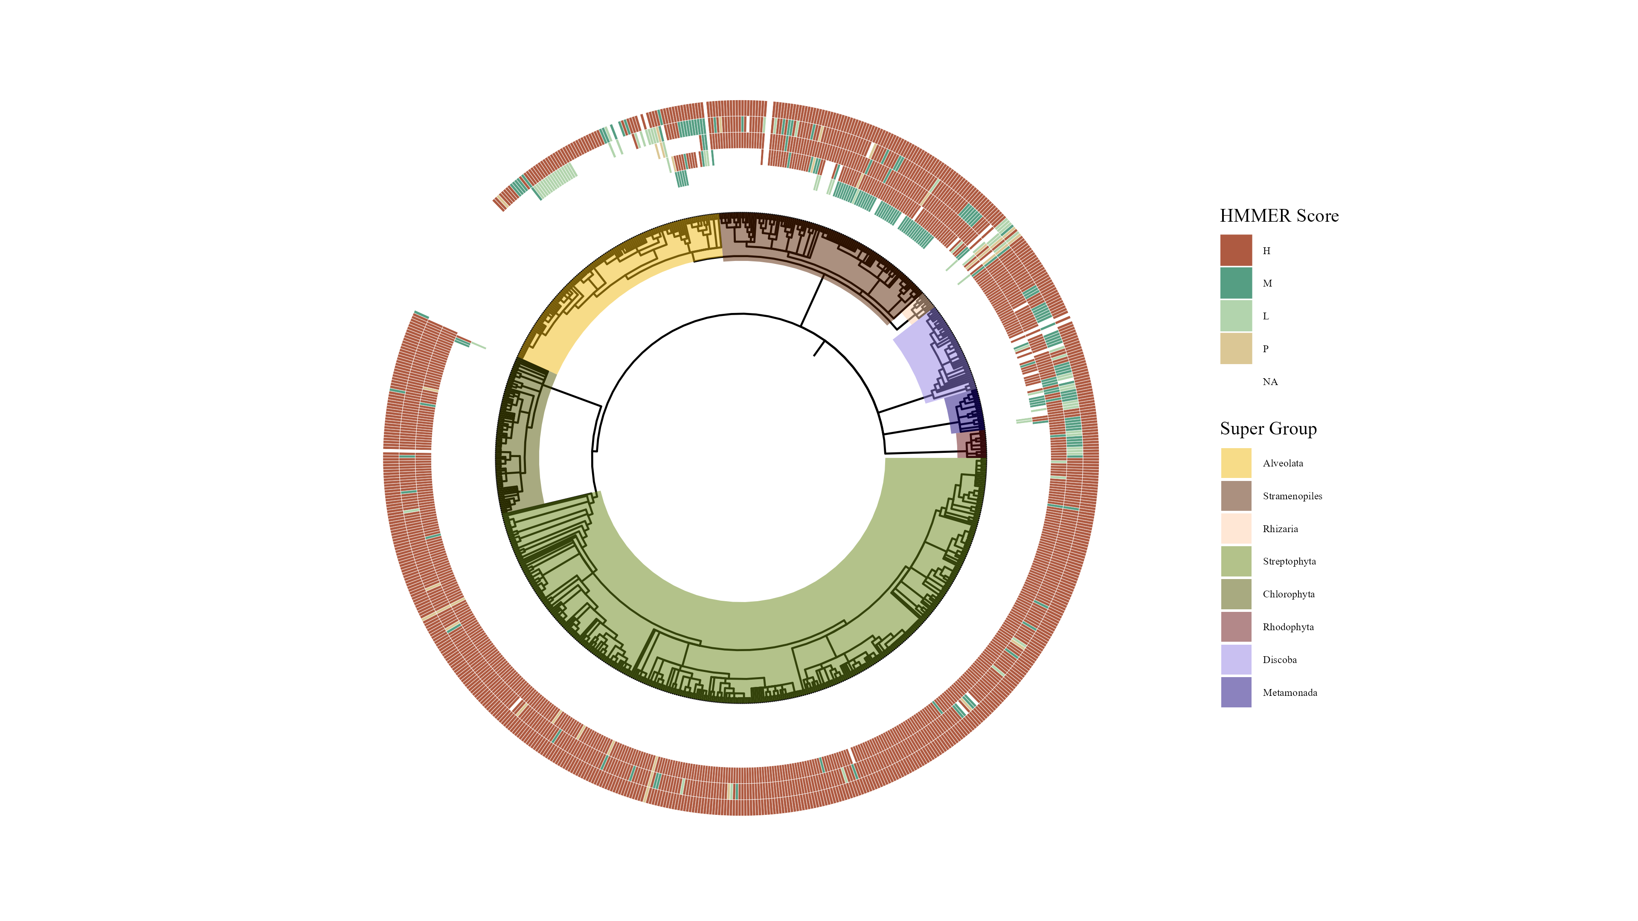

Slide 6
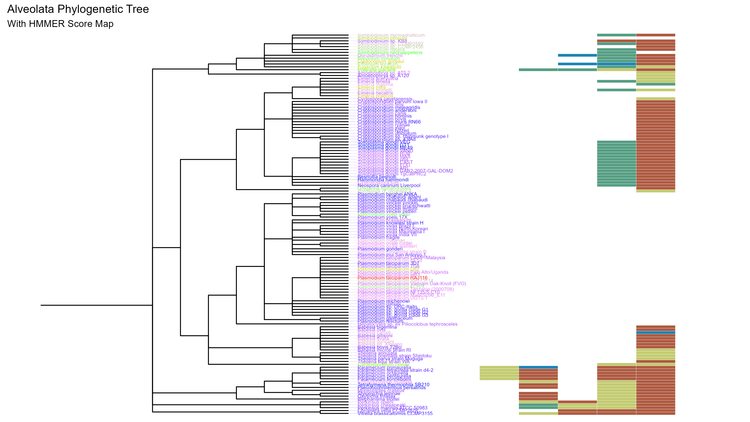
SIN1
RICTOR
RAPTOR
LST8
TOR

Slide 7
TOR Complex 1
TOR Complex 2
RICTOR
RAPTOR
TOR
SIN1
TOR
LST8
LST8

Slide 8
RICTORN
RICTORM
RasGEF
Domain5
RICTOR Phosphorylation
ARM Repeats

Slide 10
Workflow/Pipeline
Genome information from NCBI/JGI
MSA
Phylogenetic Tree(s)
Discern Patterns of component loss
BUSCO/HMMER/BLAST
R tables + Taxonomy tables
Graphs/Tables
SRA /Diamond alignment for missing components with low c scores

