Slide 1
Professor Course Scheduler Website
Team Apple
Taisann Kham
Dustin Cofer
Taylor Williams
Chris Jones

Slide 2
Client's Vision
Our client, Dr. Brannock, has envisioned a scheduler application that does the following:
The scheduler keeps track of the professors' accumulated hours.
The scheduler shows the professor’s accumulated hours to administrators.
There is a ranking system where professors allocate a certain preference level to the courses/sections they want to show how much they want it.
Professors with conflicting courses will be provided each other's information to solve the conflict.
The classes can be downloaded as a Microsoft Excel spreadsheet.

Slide 3
Requirements
User authentication and roles
Users must be able to search for specific course sections
Users must be able to see which courses have conflicts
Course sections must be presented in an easy to understand view
Professors must be able to choose classes they want
Professors must be able to set their available schedule
Administrators must be able to add, remove, and edit course sections
Administrators must be able to upload/download the course sections list
Administrators must be able to see which sections have no professor
The system should use up-to-date technologies and support most browsers
The system must track how many credit hours a professor is teaching

Slide 4
Team Breakdown and Agile Philosophy
Roles
Taisann Kham – UI/UX Lead & Documentation Lead
Taylor Williams – Testing Lead & Client Liaison
Dustin Cofer – Data Modeler & Testing
Chris Jones – Lead Programmer & Project Manager
Show client existing system and ask for new elements/changes
Work in small sprints to show the client designs, implementations, and demos
Multiple meetings a week with the team

Slide 5
Project Plan
First Sprint
First Sprint
Setup database
New UI
Second Sprint
Connect components
Database
Refine UI
Third Sprint
Finalize UI and components
Final feature pass and fixing
Final system testing
3 weeks (09/24/20)
New UI elements
Build database structure
Define testing standards
Define documentation standards
Update dependencies
Cleanup old code
Attach key webpages together

Slide 6






Technology
Github
Discord/Jira
Angular
NodeJS
Express
MongoDB
Protractor
Mongoose

Slide 7
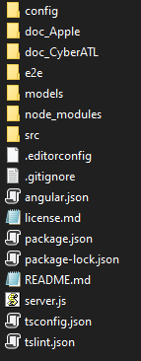
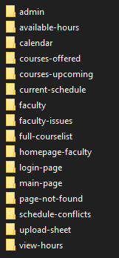
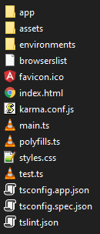
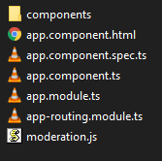
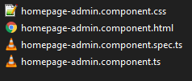
File Structure and Major Components
Project
components
src
app
admin

Slide 8
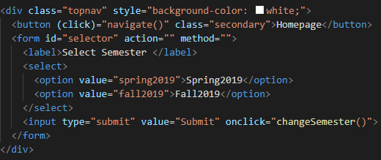
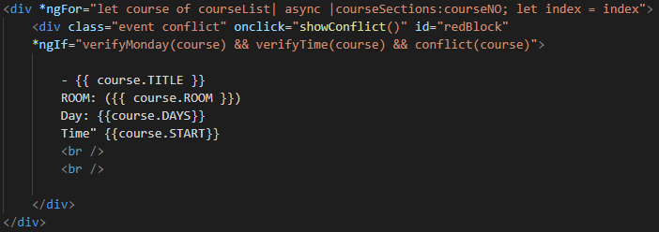
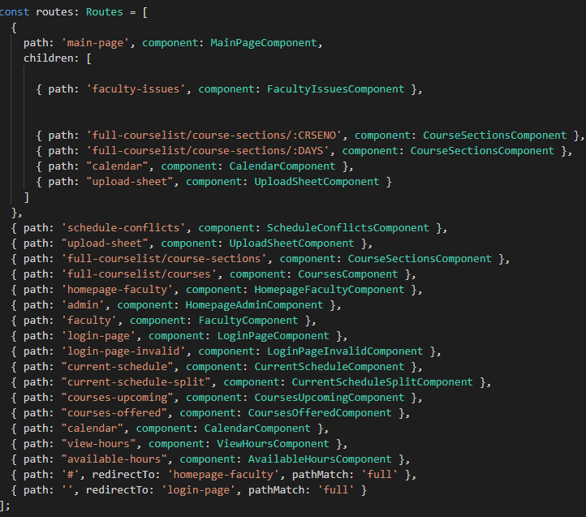
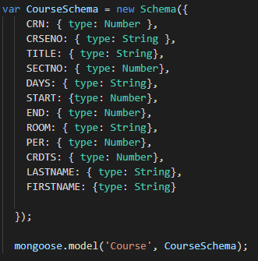
Code Examples

Slide 9
Future Coding
Pages
Add page routing to UI buttons
Filters
Add course search filters
Database
Attach database and use it for storing course and professor data
Authentication
Add user authentication
Angular
Add variable html with Angular
Testing
Add end-to-end testing with Protractor

Slide 10
Existing Interface and Proposed Changes
Existing Project
Proposed Changes
Documentation conventions already defined
Separate buttons for going to Current and Upcoming courses
No calendar showing conflicts
No input for Faculty to make changes to their courses, can only request for changes
Faculty cannot add available times
Current and Upcoming courses selectable from a dropdown menu
Conflicts shown on the calendars
Have screen show both registered courses and calendar
Faculty can register for courses and set/edit their preferences
Faculty can input the times they are available
Admins can see professor hours

Slide 11
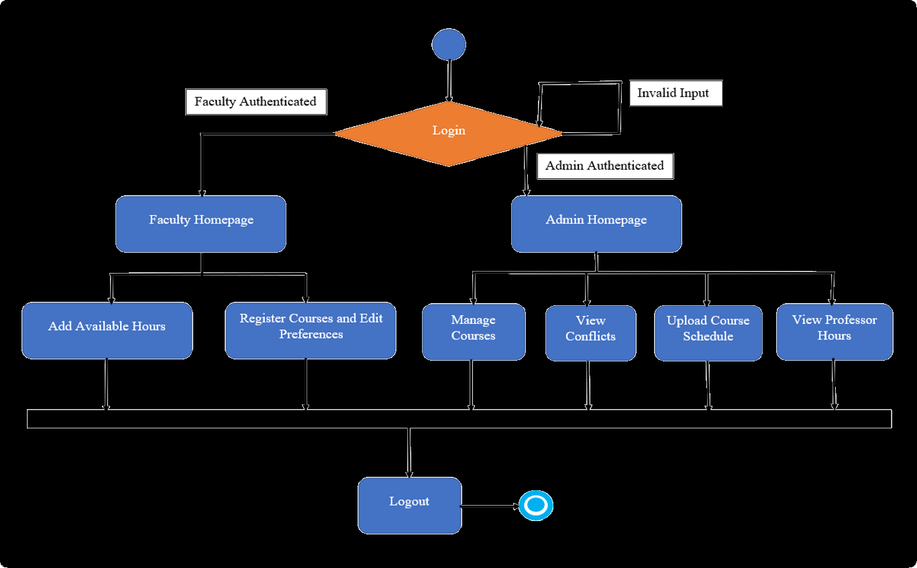
Activity Diagrams

Slide 12
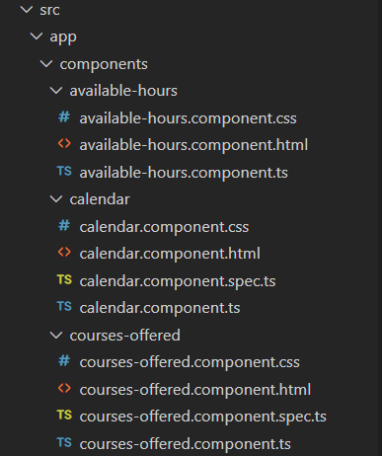
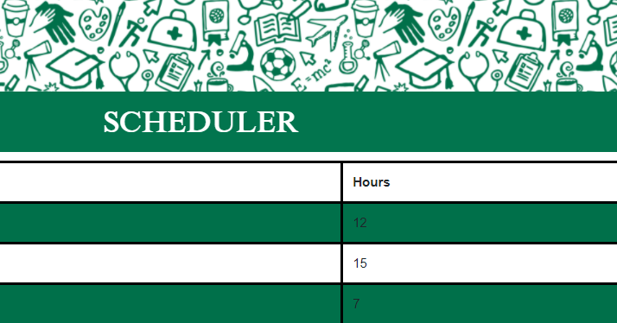
UI Principles
GGC Colors
Follow previous UI
Each page has its own
.css
.html
.ts

Slide 13
Future UI Direction
Switching between Current and Upcoming semester view for both Faculty and Admin calendar.
Allow professors to set priority for courses they register for.
Store professors' available hours and allows the addition of more lines or to remove additional lines for each day of the week.
Link Faculty's registered hours to Admin's view for faculty hours.
Have Admin calendar catch conflicting schedules between multiple professors that register for the same class and to give their contact.
Allow Admins to upload a schedule.

