Slide 1
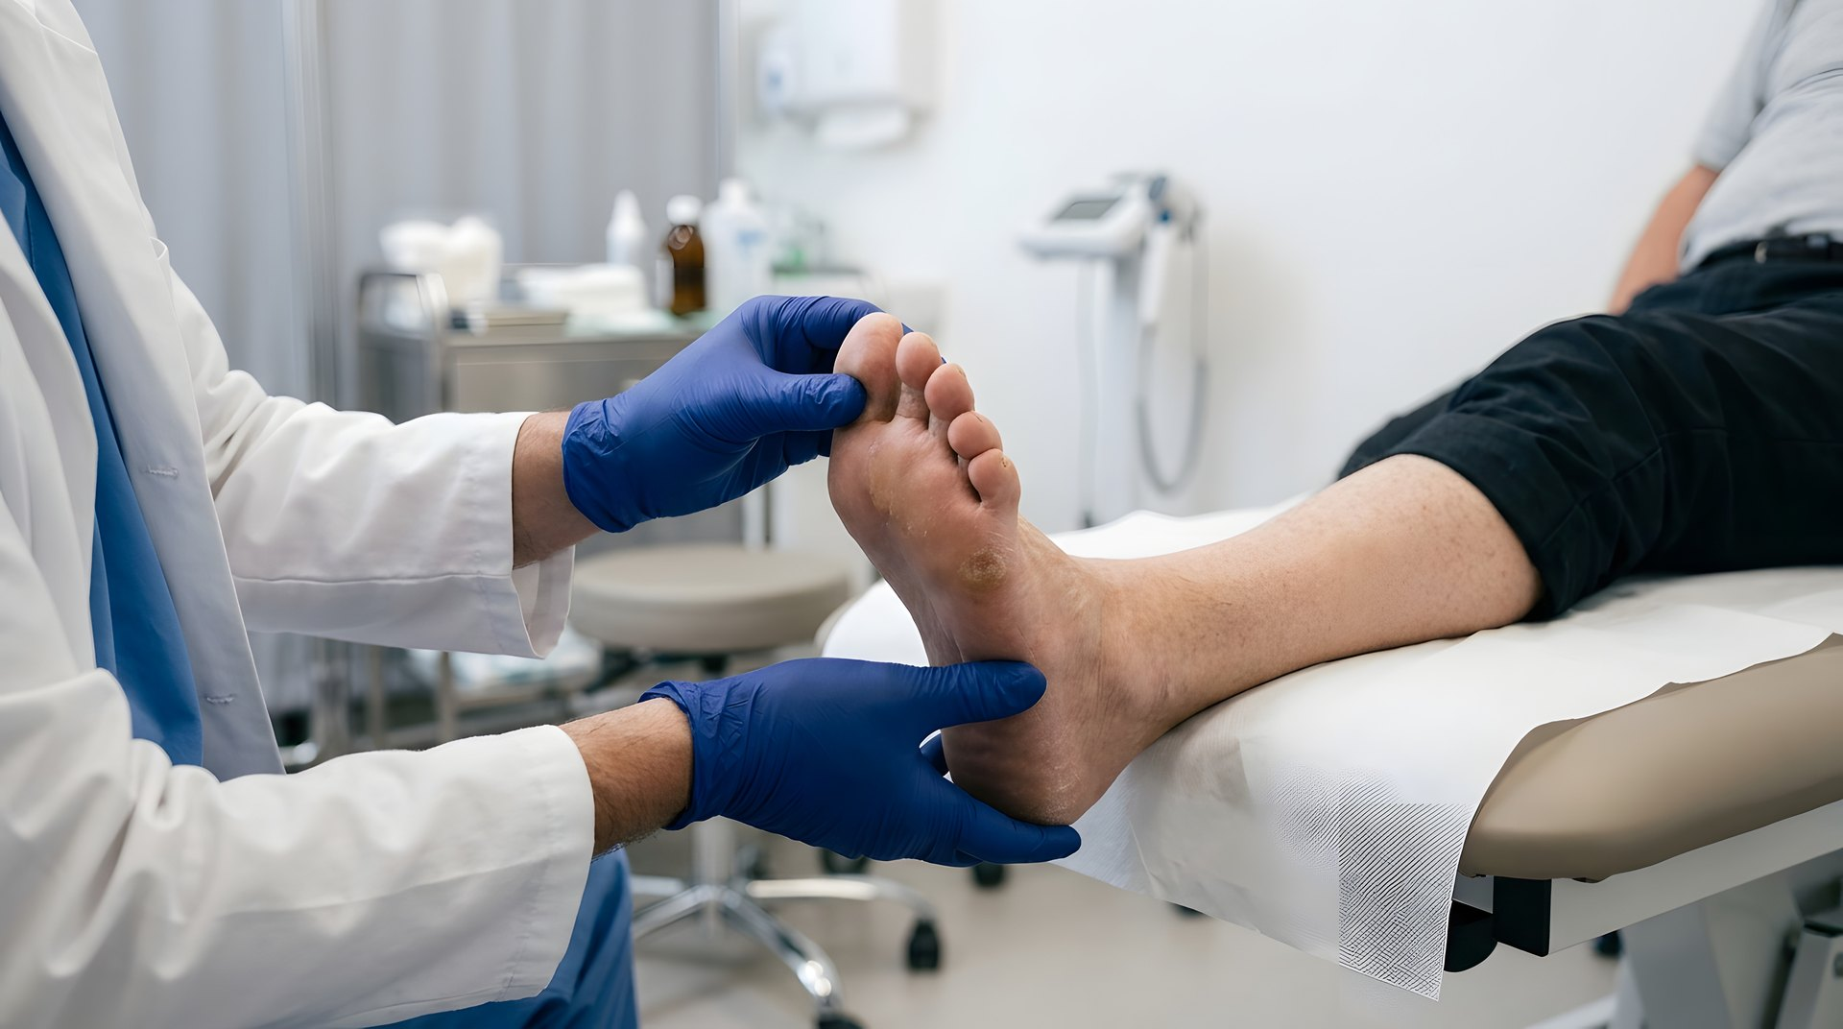



PARADISE
Trial design · scientific session
FWO
TBM T000226N
Protocol version 1.0 · 17 May 2026 · S71769
Notes:
WAT U ZEGT
PARADISE is not about healing. It is about coming back. Six Belgian foot clinics, one hundred and forty-four participants, eighteen months each. I will take you through the rationale, the measurement and the pathway.
PRESENTATIETIP
Het beeld draagt deze dia. Wilt u een ander beeld: zet het in beeld\stock\, draai verwerk_stock.py en zet de bestandsnaam hier. Liggend, koele tonen, en rustig onderaan — daar staat de titel.
INTERACTIE
Laat de dia staan terwijl de zaal binnenkomt. Zeg pas iets als iedereen zit.

Slide 2

WHERE WE STAND
144 participants, 24 per centre
72 PARADISE
72 GEBRUIKELIJKE ZORG
PER CENTRE
CONTROL ARM
24 participants — 12 PARADISE and 12 usual care
Usual care, unchanged
PRIMARY
POSITIVE
Recurrence at 18 months
Only if the endpoint is met
THE SIX PARTICIPATING FOOT CLINICS
AZORG
AZ Sint-Jan Brugge
AZ Groeninge
UZ Gent
UZ Leuven
UZ Antwerpen
02 / 33
Source 20 · Morbach 2016
Notes:
WAT U ZEGT
Every dot is a participant. Twenty-four come from each clinic, twelve in each arm. Six times twenty-four is one hundred and forty-four. If one centre falls behind, the trial does not get there.
PRESENTATIETIP
Wijs hun eigen centrum aan: 24 van die 144 stippen zijn van hen. Zes keer 24 is 144 — als één centrum achterblijft, haalt de studie het niet.
INTERACTIE
Vraag of ze de andere vijf centra kennen. Het maakt van zes losse klinieken één netwerk.

Slide 3
PARADISE does not test efficacy.
PARADISE tests translation.
Every component already exists. No component worked on its own.
Notes:
WAT U ZEGT
One sentence, then I move on. Every component of PARADISE already exists. Not one of them worked on its own. What we test is whether they work together, in ordinary clinics under ordinary caseloads.
PRESENTATIETIP
INTERACTIE

Slide 4
BLOCK 01
01
Why
Four numbers explain why there are two targets, not one.
04 / 33
Notes:
WAT U ZEGT
Chapter one. I will give you four numbers. After the fourth you will know why this trial has two targets rather than one, and why nobody has met both at once.
PRESENTATIETIP
INTERACTIE

Slide 5
40
%
65%
AT FIVE YEARS
2,5×
HIGHER MORTALITY
develop a new ulcer
within one year
> 70%
MORTALITY AFTER MAJOR AMPUTATION
Armstrong, Boulton & Bus · N Engl J Med 2017
05 / 33
Source 1 · Armstrong 2017
Notes:
WAT U ZEGT
Forty per cent develop a new ulcer within one year. At five years it is sixty-five. And mortality is two and a half times higher than in diabetes without an ulcer — after a major amputation above seventy per cent. This is not a wound problem. This is a survival problem.
PRESENTATIETIP
Dit is het probleem waar de hele studie op staat. Eén dia, dan door.
INTERACTIE
Geen. Dit is context, geen discussie.

Slide 6
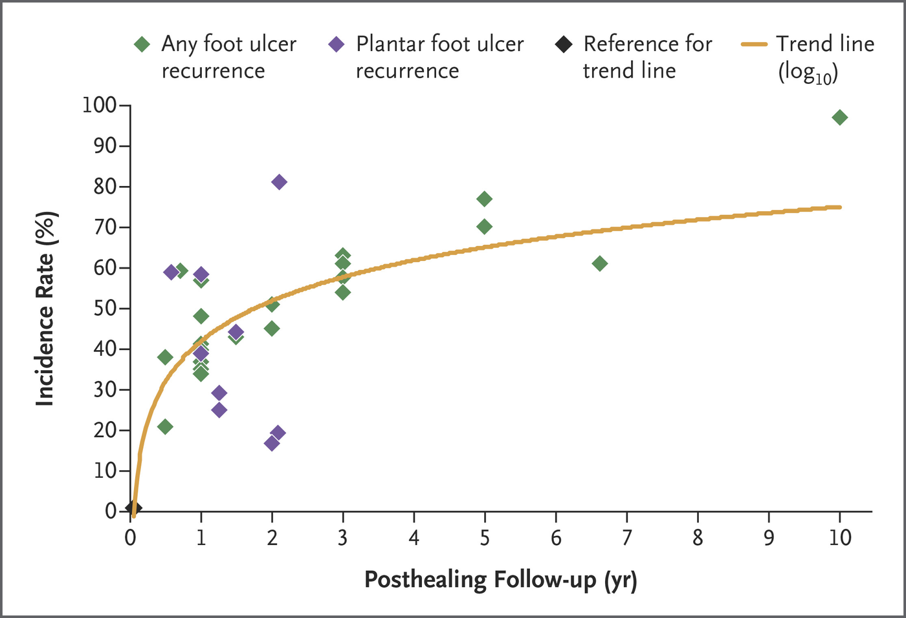
THE RISK AFTER HEALING
Two thirds recur within five years
Recurrence incidence against follow-up duration
AT 1 YEAR
40%
AT 5 YEARS
65%
Pooled data from nine prospective studies, one retrospective study and the control arms of nine RCTs
06 / 33
Source 1 · Armstrong 2017
Notes:
WAT U ZEGT
This is where those figures come from. Each point is a cohort; the line through them is the trend. Forty per cent at one year, sixty-five at five. The risk does not disappear, it accumulates.
PRESENTATIETIP
De vorige dia noemt de cijfers; deze laat zien waar ze vandaan komen. Wijs de trendlijn aan, niet de losse punten.
INTERACTIE
Geen. Laat de spreiding het werk doen.

Slide 7
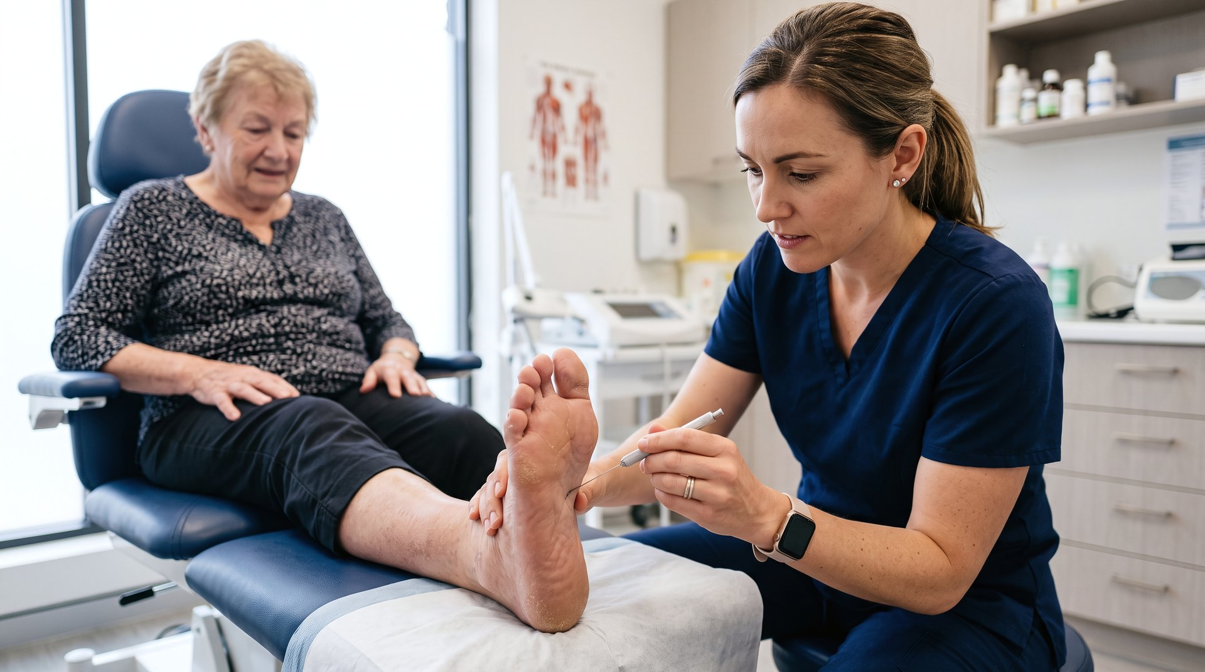
Three quarters are preventable.
Forty per cent come back.
Notes:
WAT U ZEGT
And then the number that makes it intolerable. Three quarters of these ulcers are preventable in principle. Yet forty per cent return within the year. That gap, between what is possible and what happens, is what this trial is about.
PRESENTATIETIP
Zeg dit traag en zwijg dan twee tellen. Dit is de enige dia in blok 1 waar de zaal niet leest maar luistert.
INTERACTIE
Geen. De stilte doet het werk.

Slide 8
WHAT HAS ALREADY BEEN TRIED
Three strategies, one pattern
Pressure-guided footwear
The pivotal multicentre trial missed its primary endpoint: 38.8% versus 44.2% recurrence. The difference was in who actually wore the footwear.
p = 0.48
Patient education
In the IWGDF review, stand-alone education showed no demonstrable preventive effect. The median treatment effect was negative.
median −13.4%
Continuous digital feedback
An intelligent insole with real-time alerts reduced recurrence — again mainly among those who kept using the device.
proof of concept
The pattern
Each component addresses a necessary condition. None addresses a sufficient one.
—
Not three disappointments but one: the effect is real every time, and conditional every time.
08 / 33
Source 9 · Bus 2013, DIAFOS | 10 · van Netten 2016 | 12 · Abbott 2019
Notes:
WAT U ZEGT
It is not that nobody has tried. Pressure-guided footwear missed its endpoint. Education alone had a negative median effect. Digital feedback worked, but again only among those who kept using the device.
PRESENTATIETIP
Dit is de dia die de zaal het argument geeft. Neem er tijd voor; de rest van de studieopzet volgt hieruit.
INTERACTIE
Geen.

Slide 9
THE SAME SHOE, TWO OUTCOMES
Why pressure alone is not enough
Everyone
intention-to-treat
Standard custom insole
44,2%
Pressure-optimised
38,8%
No difference — p = 0.48
Those who wore it
≥ 80% of steps
Standard custom insole
47,8%
Pressure-optimised
25,7%
Almost halved — p = 0.045
Bus et al. · Diabetes Care 2013 · DIAFOS, 171 participants
09 / 33
Source 9 · Bus 2013, DIAFOS
Notes:
WAT U ZEGT
This is the best attempt on record: pressure-optimised custom footwear, multicentre and randomised. Across everyone: no difference. Among those who wore it: almost halved. The difference was not in the shoe.
PRESENTATIETIP
Hier komt de tweede norm vandaan. Zonder deze dia is 80% draagtijd een willekeurig getal.
INTERACTIE
Geen.

Slide 10
71
%
ADHERENCE AGAINST THE 80% TARGET
Overall
71%
At home
61%
Outdoors
adherence — measured,
not asked
87%
80% target
Waaijman et al. · Diabetes Care 2013 · 107 patients
10 / 33
Source 13 · Waaijman 2013
Notes:
WAT U ZEGT
There it is. Seventy-one per cent adherence, measured by sensor and not asked for. At home it falls to sixty-one, and home is where most steps are taken. The footwear sat in the hallway while the patient walked through the house.
PRESENTATIETIP
Binnenshuis wordt het schoeisel het minst gedragen, en juist daar worden veel stappen gezet. Dat is uw belangrijkste gesprekspunt bij SEBIA.
INTERACTIE
Vraag wat zij schatten bij hun eigen patiënten.

Slide 11
THE MECHANISM
Loading is a product, not a sum
Peak pressure
Activity
Wear time
per step
×
steps per day
×
was it worn
MODIFIED
MEASURED
MODIFIED
One factor at zero makes the whole product zero. That is why PARADISE has two targets: one for pressure and one for wear time.
11 / 33
Source 14 · van Netten 2018 | 16 · Hulshof 2025
Notes:
WAT U ZEGT
Loading is a product, not a sum. Peak pressure times activity times wear time. One factor at zero makes the whole product zero. A perfect insole in the cupboard protects nothing.
PRESENTATIETIP
Dit is het scharnier van blok 1. Wie dit snapt, snapt waarom de meting én de sensor allebei moeten kloppen.
INTERACTIE
Morph: de drie tegels komen samen uit één punt.

Slide 12
WHY THIS TRIAL IS POSSIBLE ONLY NOW
Three things have changed
Adherence is measurable
The temperature sensor in orthopaedic footwear has been validated. Self-report systematically overestimates; wear time is now a testable target rather than an assumption.
sensor
The failure is explicable
Under COM-B, knowledge transfer addresses capability alone. Opportunity and motivation — what happens at home, for years, unseen — were left untouched.
COM-B
The setting exists
Belgium accredits multidisciplinary foot clinics with training requirements and minimum caseloads. That is where prevention ultimately has to land.
RIZIV-INAMI
That is why adherence here is a prespecified mediator, measured in full, rather than an assumption justified after the fact.
12 / 33
Source 18 · Lutjeboer 2018 | 19 · Michie 2011, COM-B | 20 · Morbach 2016
Notes:
WAT U ZEGT
Why is this trial possible only now? Three things have changed. The sensor makes adherence measurable, COM-B explains why education failed, and Belgium has accredited foot clinics with training requirements. The components are on the table.
PRESENTATIETIP
Drie redenen, drie zinnen. Dit is het scharnier naar de opzet.
INTERACTIE
Geen.

Slide 13
WHAT PARADISE DOES DIFFERENTLY
One service, not three separate measures
01
02
The insole méets the target
And it ís worn
< 200 kPa ór 25% lower
80% of the patient’s own waking time
Measured at delivery.
Modified until the target is met in each of the three target regions.
Repeated at months 6, 12 and 18.
A sensor in the insole records wear time continuously.
Read out every three months and reviewed together.
Five conversations resting on those data.
13 / 33
Source 6 · Bus 2011 | 7 · Bus 2020 | 17 · Waaijman 2014
Notes:
WAT U ZEGT
So we do it differently. Not three separate measures, but one service with two targets: the insole must méet the pressure target, and it must be wórn. Both measured, both corrected, both by the clinic’s own team. That has never been tested together.
PRESENTATIETIP
Dit is de kanteldia. Alles ervoor is het probleem, alles erna is de uitvoering. Zeg met zoveel woorden dat dit nog nooit samen getoetst is.
INTERACTIE
Vraag welke van de twee normen zij het moeilijkst achten. Het antwoord is bijna altijd de tweede.

Slide 14
BLOCK 02
02
The measurement
What is measured, how, and when it is good enough.
14 / 33
Notes:
WAT U ZEGT
Chapter two: the measurement. What is measured, how, and when it is good enough.
PRESENTATIETIP
INTERACTIE

Slide 15
BASELINE · IN-SHOE
Every sensor a number
312
kPa
peak pressure at metatarsal 2-3
Target: < 200 kPa or ≥ 25% lower
pedar® sensor insole placed in the shoe, three walking trials performed.
The middle twelve steps per foot are analysed; from these the software computes the mean peak pressure per foot.
kPa
0
200
400
eCRF document 09 · Plantar pressure measurement, baseline
15 / 33
Source 7 · Bus 2020 | 27 · Zwaferink 2024
Notes:
WAT U ZEGT
Every sensor gives a number. This is baseline, in-shoe: three hundred and twelve kilopascals under metatarsal two-three. Three walking trials per foot, of which the middle twelve steps count. Everything is referenced against this.
PRESENTATIETIP
De meest gemaakte fout is één loopproef per voet. Het protocol vraagt er drie, en het gemiddelde telt.
INTERACTIE
Vraag wie er vandaag al in de schoen meet.

Slide 16
ZOOMING IN ON THE FOREFOOT
Eight regions, three target regions
1
Metatarsal 1
4
under the great toe — second most affected site
5
2
Metatarsal 2-3
the hot spot in this measurement, and the classic ulcer site
3
Metatarsal 4-5
lateral forefoot, usually lower pressure
4
Hallux
1
5
Toes 2-5
2
3
16 / 33
Source 7 · Bus 2020
Notes:
WAT U ZEGT
The software divides the foot into eight regions. Three of them are designated target regions and written on the prescription. The target is tested there, and nowhere else.
PRESENTATIETIP
Uit deze acht kiest u er drie om te ontlasten: de regio met de ulcusvoorgeschiedenis, plus één of twee met de hoogste piekdruk. Die drie legt u vast — daarop wordt de norm getoetst.
INTERACTIE
Laat ze op deze dia aanwijzen welke drie zij zouden kiezen.

Slide 17
AFTER OPTIMISATION
When is it good enough
186
kPa
peak pressure in the target region after modification
40% lower · below 200 kPa · both criteria
The target applies per region: peak pressure below 200 kPa or at least 25% lower than the baseline value for that same region.
If the target is not met, modify and measure again. The form provides for two further offloading attempts.
kPa
0
200
400
eCRF document 24 · Pressure redistribution of the orthosis
17 / 33
Source 6 · Bus 2011 | 7 · Bus 2020
Notes:
WAT U ZEGT
Same foot, after modification. One hundred and eighty-six kilopascals: forty per cent lower and below two hundred. The target applies per region. If it is not met, you modify and measure again.
PRESENTATIETIP
Zeg expliciet: "óf". Twee wegen naar dezelfde norm, geen dubbele eis. En de vergelijking gebeurt per regio, niet over de hele voet.
INTERACTIE
Vraag de pedorthisten hoeveel aanpassingsrondes realistisch zijn.

Slide 18
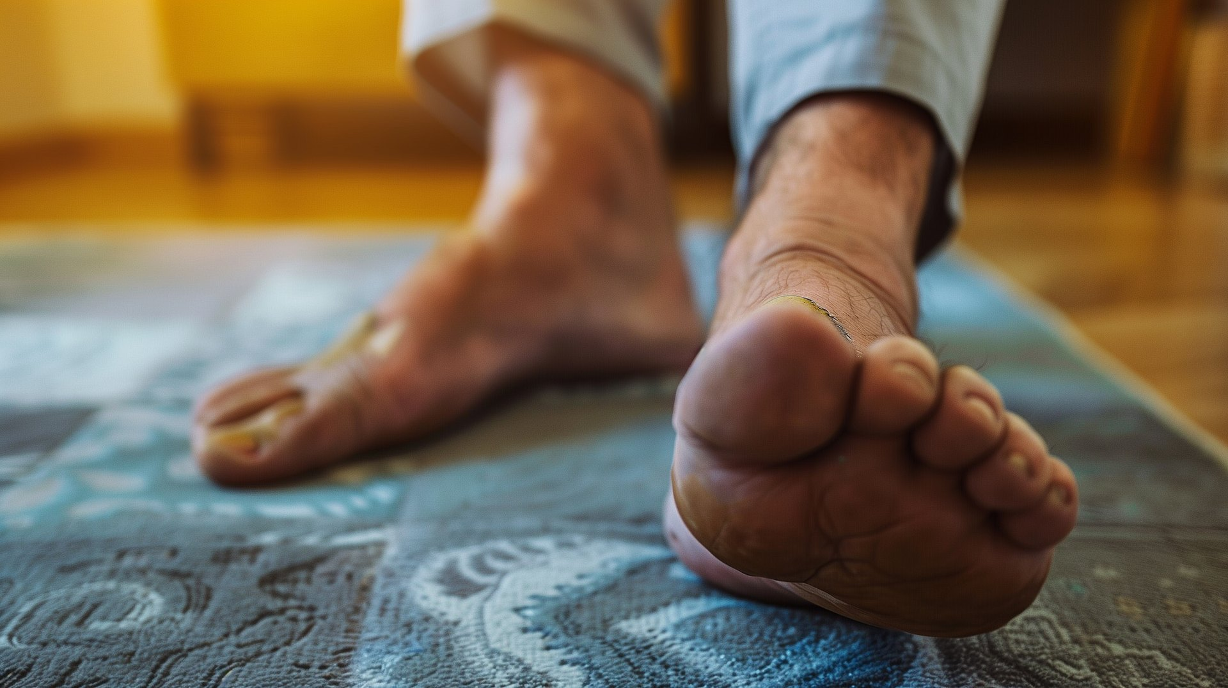
Not less loading.
Loading where the tissue can take it.
Notes:
WAT U ZEGT
A moment on this one. The aim is not less loading. The aim is loading where the tissue can take it. That is the entire intervention.
PRESENTATIETIP
Zeg deze twee zinnen en zwijg dan. Laat de dia staan tot iemand ongemakkelijk wordt. Dit is het enige moment in blok 2 waarop de zaal niets te lezen heeft.
INTERACTIE
Geen. Bewust geen.

Slide 19
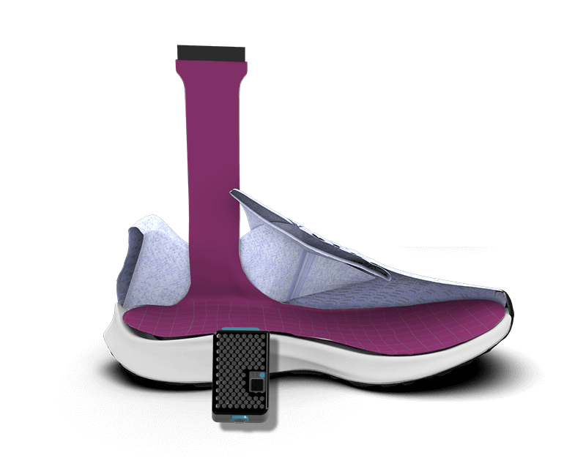
THE MEASUREMENT PROTOCOL
At delivery
In the shoe, wíth the insole
The measurement against which the target is tested, per target region.
eCRF document 24 · the target is tested per region, not across the whole foot
19 / 33
Source 7 · Bus 2020
Notes:
WAT U ZEGT
At delivery you measure in the shoe, wíth the insole. That is the measurement against which the target is tested, per target region. Nothing is measured barefoot; the comparator is the measurement without the insole for the same region at delivery, which remains the reference at months 6, 12 and 18.
PRESENTATIETIP
Alle metingen gebeuren in de schoen; er wordt niet blootsvoets gemeten. Dezelfde meting komt terug op maand 6, 12 en 18.
INTERACTIE
Vraag: "wie meet er vandaag al in de schoen?"

Slide 20
BLOCK 03
03
The pathway
Nine contacts. For each: what is done and what is recorded.
20 / 33
Notes:
WAT U ZEGT
Chapter three: the pathway. Nine contacts. For each one: what is done and what is recorded.
PRESENTATIETIP
INTERACTIE

Slide 21
THE PATHWAY
Screening plus nine visits
Screen
V0
V1
V2
M3
M6
M9
M12
M15
M18
eligibility
allocation
baseline
insole + sensor
follow-up
measure
follow-up
measure
follow-up
measure + end
measurement
behavioural support
start and completion
18
months, from screening to completion
Visits 0 to 2 fall close together: consent, baseline, and the insole within the month. After that the rhythm is three-monthly — the same rhythm as the review these patients already receive.
21 / 33
Notes:
WAT U ZEGT
Screening and nine visits across eighteen months. The first three fall close together. After that the rhythm is three-monthly, the same rhythm as the review these patients already receive.
PRESENTATIETIP
Geef eerst het overzicht. De volgende dia's lopen elk moment af.
INTERACTIE
Geen. De detaildia's komen hierna.

Slide 22
SCREENING
Who is eligible
ELIGIBLE
EXCLUDED
Adult, understands Dutch
Diabetes type 1 or 2
IWGDF risk category 3 with a healed plantar ulcer, or partial amputation or resection of a metatarsal head — the first included — between 18 months and 2 weeks ago
Walks barefoot independently, without walking aids
Has protective footwear, or accepts it: fully custom-made, or custom insoles in semi-orthopaedic or extra-depth off-the-shelf footwear
Amputation proximal to the MTP joints
Active ulcer or Charcot deformity
Critical ischaemia — PEDIS grade 3
Immunosuppressive therapy
Renal replacement therapy
Survival < 18 months, in the judgement of the treating physician
Unable to consent or to follow instructions
A device preventing sensor application, e.g. an ankle-foot orthosis
Declines the prescribed footwear or the wear-time sensor
22 / 33
Source 8 · IWGDF 2023, preventie | 25 · IWGDF 2023, definities
Notes:
WAT U ZEGT
IWGDF risk category three: a healed plantar ulcer, or a minor amputation. On the left what admits, on the right what excludes. The logic throughout: offloading must be the appropriate treatment, so critical ischaemia and active Charcot are out.
PRESENTATIETIP
Twee criteria worden het vaakst gemist: een resectie van de eerste metatarsaalkop komt wél in aanmerking, en een enkel-voetorthese sluit uit omdat de sensoren er niet in passen.
INTERACTIE
Vraag per criterium of het in hun patiëntenbestand vaak voorkomt.

Slide 23



THE TECHNOLOGY
Three devices
Orthotimer
WEAR TIME
15 minutes
In the insole, 9 × 13 × 4.5 mm
Memory 100 days
YOUR TEAM MEASURES
Novel pedar
In-shoe, with the insole
Zeroing once per session
F-Scan GO: a separate study-team measurement
MoveMonitor
PRESSURE
8 foot regions
ACTIVITY
7 days
YOUR TEAM MEASURES
At the waist, on the lower back
Baseline and 6 months
YOUR TEAM MEASURES
23 / 33
Source 18 · Lutjeboer 2018
Notes:
WAT U ZEGT
Three devices, three jobs. The pedar measures pressure, the Orthotimer records whether the insole was worn, the MoveMonitor records how much walking is done. Only the pedar is operated at every measurement; the other two are fitted once and read out.
PRESENTATIETIP
Benoem dat de Orthotimer géén GPS, microfoon of camera heeft. Die vraag komt gegarandeerd.
INTERACTIE
Laat de toestellen rondgaan. Fysiek werkt beter dan een dia.

Slide 24
SEBIA · ECRF DOCUMENT 17
Five conversations
01
02
03
04
05
Baseline
3 mo
6 · 12 mo
9 · 15 mo
18 mo
Questionnaires first, then tailored education, with demonstration.
Teach-back, with the emphasis on índoor wear.
Self-assessment, then reviewing the data together.
Demonstration, comparing the printout with the previous visit.
Closing, and sharing the results.
24 / 33
Source 19 · Michie 2011, COM-B | 26 · Lincoln 2007, NAFF | 31 · Keukenkamp 2022
Notes:
WAT U ZEGT
SEBIA is five conversations, not one session. First knowledge and education, then teach-back at delivery, then two joint reviews of the sensor data, then demonstration, and closure at eighteen months. What separates it from conventional education: it repeats, and it stands on data.
PRESENTATIETIP
Het script begint met toestemming vragen voor het gesprek zelf, en duurt twintig tot dertig minuten. Wie nee zegt, krijgt de brochure mee en een nieuwe afspraak.
INTERACTIE
Rollenspel van twee minuten met een vrijwilliger uit de zaal.

Slide 25
THE ONE RULE THAT REALLY MATTERS
Measured values do
not go to the
control arm
EXCEPTION
Clinical findings are not measured values. Any lesion or skin defect is reported and treated immediately. In both arms.
They too undergo pressure measurement and wear a sensor, otherwise the groups cannot be compared. But those numbers stay with you. Discuss them and you have delivered the intervention, and that patient is no longer usable as a control.
25 / 33
Source 9 · Bus 2013, DIAFOS
Notes:
WAT U ZEGT
This is the one rule that really matters. The control arm is measured and wears a sensor too, but those numbers stay closed. Discuss them and you have delivered the intervention. Clinical findings are not measured values: a lesion is reported and treated immediately, in both arms.
PRESENTATIETIP
Dit is de dia waar u stilvalt. Geen haast. Vraag of het helder is voordat u doorgaat.
INTERACTIE
Laat iemand het in eigen woorden herhalen. Zo weet u of het zit.

Slide 26
BLOCK 04
04
Endpoints and analysis
One endpoint, and the mediator that explains it.
26 / 33
Notes:
WAT U ZEGT
Block four: the endpoint and the analysis. One endpoint, and the mediator that explains it.
PRESENTATIETIP
INTERACTIE

Slide 27
SAMPLE SIZE
Powered on recurrence
PRIMARY ENDPOINT
MEDIATOR
Ulcer recurrence at 18 months
Footwear adherence at 12 months
Assumed, control
50% recurrence
Assumed, control
71%, SD 25%
Assumed, intervention
25%, hazard ratio 0.42
Assumed, intervention
85%, effect size 0.56
Test
log-rank, two-sided, α = 0.05
Role
prespecified mediator
Power
80% → 41 events required
Own criterion
geen
Attrition
15%
Measured in full
7 days a week, every 3 months
108 → 127 with attrition → 130 stratified
amply covered at 144
SO WHY 144
Six centres times 24 is 144. That figure comes from per-centre recruitment capacity rather than from the calculation, and it exceeds the minimum of 130.
27 / 33
Source 9 · Bus 2013, DIAFOS | 13 · Waaijman 2013
Notes:
WAT U ZEGT
The sample size follows from one endpoint. On the left, recurrence: fifty against twenty-five per cent, which requires forty-one events and a hundred and thirty participants. On the right, adherence: measured in full, but without a success criterion of its own. A hundred and forty-four comes from per-centre capacity and exceeds the minimum.
PRESENTATIETIP
Eén eindpunt bepaalt de omvang. Zeg erbij dat de therapietrouw volledig gemeten wordt maar geen eigen succescriterium draagt — de volgende dia legt uit waarom.
INTERACTIE
Geen. Laat de vraag komen.

Slide 28
WHY ADHERENCE IS NOT A SECOND ENDPOINT
The mediator carries the explanation, not the verdict
The trial is positive if recurrence falls significantly. Adherence says whý.
POWER ON RECURRENCE
WHAT THE MEDIATOR IS FOR
84% — and 90% with complete follow-up
decomposing the effect into pressure and wear time, prespecified
ANALYSIS POINT
AT HALF THE EFFECT SIZE
12 months, with the full 18-month profile as a secondary summary
64% at 30% · 40% at 35%
Two co-primary endpoints would place the bar at the intersection and push joint power down to 74%. One endpoint plus a prespecified mediator tests the same causal model without that cost.
28 / 33
Source 9 · Bus 2013, DIAFOS
Notes:
WAT U ZEGT
And then the question you would otherwise get from the floor. On recurrence we have eighty-four per cent power. With two co-primary endpoints that would drop to seventy-four, because the bar then sits at the intersection. One endpoint plus a prespecified mediator tests the same causal model without that cost.
PRESENTATIETIP
Dit is de dia die u onderscheidt van de rest van het programma. Benoem dat de mediator geen achterdeur is: hij ligt vooraf vast en wordt volledig gemeten.
INTERACTIE
Geen.

Slide 29
ANALYSIS PLAN
How we test it
Recurrence
Cox regression stratified by centre, with allocation as the only covariate. Death is a competing risk, not censoring: Fine-Gray and cumulative incidence alongside.
primary
Adherence
Beta regression with a logit link, since it is a proportion with a ceiling, followed by causal mediation analysis on recurrence.
mediator
Intercurrent events
A recurrence is the intercurrent event for the mediator: a patient who ulcerates rightly stops wearing the insole. Hypothetical strategy for adherence.
estimand
Missing data
Multiple imputation, 50 datasets. A tipping-point analysis shows how extreme a departure would have to be to overturn the conclusion.
MAR
One primary endpoint, so no intersection-union and no multiplicity correction. The mediation analysis is explanatory and carries no success criterion of its own.
29 / 33
Source 21 · SPIRIT 2025 | 24 · CONSORT 2025
Notes:
WAT U ZEGT
The analysis plan in four lines. Recurrence with Cox, stratified by centre, with death as a competing risk. Adherence with beta regression, since it is a proportion with a ceiling, and then as a mediator. A recurrence is its intercurrent event: a patient who ulcerates rightly stops wearing the insole.
PRESENTATIETIP
Kort houden. Wie meer wil weten vraagt het, en dan hebt u het SAP.
INTERACTIE
Geen.

Slide 30
WHAT RUNS ALONGSIDE THE TRIAL
Two evaluations, in parallel
01
02
Health-economic evaluation
Process evaluation
Cost-utility, payer perspective
MRC framework, three domains
EQ-5D-5L every three months, valued with the Belgian value set.
Resource use collected prospectively with the iMCQ and iPCQ, plus diary and medical records.
Markov extrapolation to five years. Cost per ulcer prevented and cost per QALY, reported side by side.
Implementation: fidelity, dose, reach, adaptations.
Mechanisms and context: what governs delivery at each centre.
Interviews, structured observation and therapist diaries.
30 / 33
Source 33 · Bus 2026, kosten | 34 · CHEERS | 35 · Kostenhandleiding 2024 | 40 · MRC 2015
Notes:
WAT U ZEGT
Two evaluations run alongside the trial. The economic one reports cost per ulcer prevented and cost per QALY, with a Markov model out to five years. The process evaluation measures whether the intervention was actually delivered. That second one is not an appendix — under a null result it is the only thing separating mechanism from delivery.
PRESENTATIETIP
De procesevaluatie is geen bijlage. Bij een nulresultaat is zij het enige wat mechanisme van uitvoering onderscheidt.
INTERACTIE
Geen.

Slide 31
WHAT WE LEARN EITHER WAY
A null result is also a result
Adherence rises, recurrence does not
Adherence does not rise
—
Then the biomechanical premise fails: wearing optimised footwear is not enough. The field should stop attributing prevention failures to patient behaviour.
—
Then the behavioural component failed. The fidelity data distinguish inadequate design from inadequate delivery.
Both rise
Either way
—
Then an integrated service works under routine conditions — without our knowing which component did it. Decomposition would require a factorial design the Belgian network cannot supply.
—
Pressure, activity and wear time are recorded concurrently in 144 participants over eighteen months. That is the first dataset of that size, whatever the result.
31 / 33
Source 15 · Hulshof 2024 | 16 · Hulshof 2025
Notes:
WAT U ZEGT
I will close with what we learn either way. If adherence rises but recurrence does not, the biomechanical premise fails. If adherence does not rise, the behavioural component failed. Either way we learn which link in the chain gives way — and that is exactly what this field does not yet know.
PRESENTATIETIP
Sluit hiermee af. Dit is het antwoord op de vraag of de studie de moeite waard is als ze negatief uitvalt.
INTERACTIE
Geen.

Slide 32

WHO TO CONTACT
If something goes wrong
Janou De Buyser
DOCTORAL RESEARCHER · DAY-TO-DAY CONDUCT
Your first point of contact: inclusions, measurements, forms, sensors and anything that gets stuck in practice.
janou.debuyser@kuleuven.be
Spoorwegstraat 12 · Bruges
Prof. Dr Kevin Deschamps
PRINCIPAL INVESTIGATOR
Scientific questions, trial design, and arrangements at the level of your centre.
Rehabilitation Sciences
KU Leuven · Bruges Campus
Consortium: KU Leuven — Rehabilitation Sciences (Musculoskeletal Research Group) and Public Health and Primary Care · Vrije Universiteit Brussel — Medicine and Pharmacy. Co-promotors: Fabienne Dobbels, Maaike Fobelets and Koen Putman.
32 / 33
Notes:
WAT U ZEGT
Finally, who to contact. Practical questions — inclusions, measurements, forms, sensors — come to me. Scientific questions and arrangements at centre level go to Professor Deschamps. Thank you.
PRESENTATIETIP
Laat deze dia staan tijdens het napraten. Zeg erbij dat kleine dingen ook mogen — een sensor die niet uitleest is geen domme vraag.
INTERACTIE
Loop rond terwijl de dia staat. Wie een vraag heeft, komt naar het gezicht dat op het scherm staat.

Slide 33
WHERE THE NUMBERS COME FROM
References
1
Armstrong DG et al. N Engl J Med. 2017;376(24):2367–75.
14
van Netten JJ et al. Clin Biomech. 2018;53:86–92.
25
van Netten JJ et al. Diabetes Metab Res Rev. 2024;40(3):e3654.
5
Bus SA et al. Diabetes Metab Res Rev. 2016;32(Suppl 1):195–200.
15
Hulshof CM et al. Sensors. 2024;24(8):2411.
26
Lincoln NB et al. Pract Diabetes Int. 2007;24(4):207–11.
16
Hulshof CM et al. Diabet Med. 2025;42:e70099.
6
Bus SA et al. Diabetes Care. 2011;34(7):1595–600.
17
Waaijman R et al. Diabetes Care. 2014;37(6):1697–705.
27
Zwaferink JBJ et al. Sensors. 2024;24(6):1795.
31
Keukenkamp R et al. BMJ Open Diabetes Res Care. 2022;10(1):e002593.
7
Bus SA et al. Diabetes Metab Res Rev. 2020;36(S1):e3237.
18
Lutjeboer T et al. J Rehabil Med. 2018;50(10):920–6.
33
Bus SA et al. Diabetology. 2026;7(4):70.
8
Bus SA et al. Diabetes Metab Res Rev. 2024;40(3):e3651.
19
Michie S et al. Implement Sci. 2011;6:42.
34
Husereau D et al. Pharmacoeconomics. 2013;31(5):361–7.
9
Bus SA et al. Diabetes Care. 2013;36(12):4109–16.
20
Morbach S et al. Diabetes Metab Res Rev. 2016;32(Suppl 1):318–25.
35
Hakkaart-van Roijen L et al. Diemen: Zorginstituut Nederland; 2024.
10
van Netten JJ et al. Diabetes Metab Res Rev. 2016;32(Suppl 1):84–98.
21
Chan A-W et al. BMJ. 2025;389:e081477.
24
Hopewell S et al. BMJ. 2025;389:e081123.
40
Moore GF et al. BMJ. 2015;350:h1258.
12
Abbott CA et al. Lancet Digit Health. 2019;1(6):e308–18.
13
Waaijman R et al. Diabetes Care. 2013;36(6):1613–8.
Numbering follows the protocol manuscript.
33 / 33
Notes:
WAT U ZEGT
Deze dia laat u staan tijdens de vragen. Alles wat u genoemd hebt, staat hier met nummer en citaat, in dezelfde nummering als het protocolmanuscript.
PRESENTATIETIP
INTERACTIE

