Slide 1
Capstone Project
Insurance Premium Default Propensity Prediction
By: Andell Haughton

Slide 2
Executive Summary
Objective of the project:
Premium paid by the customer is the major revenue source for insurance companies. Default in premium payments results in significant revenue losses and hence insurance companies would like to know upfront which type of customers would default premium payments.
The objective of this project us to
Build a model that can predict the likelihood of a customer defaulting on premium payments (Who is likely to default)
Identify the factors that drive higher default rate (Are there any characteristics of the customers who are likely to default?)
Propose a strategy for reducing default rates by using the model and other insights from the analysis (What should be done to reduce the default rates?)

Slide 3
Brief Description of Methods
After accessing the dataset and conducting the preliminary evaluations, univariate analysis and bivariate analysis were employed to garner greater insight and understanding of the data.
Considering that the concern of the insurance company was primarily predicated on predicting the likelihood of a customer defaulting on premium payments, it was reasonable to opt for the implementation of a classification algorithm as a solution. With respect to the binary target variable, “default”, identified in the problem statement where a 0 indicated that customer had defaulted on premium while a 1 indicated that customer had not defaulted premium – the random variable and the Bernoulli defined – logistic regression was first implemented chiefly based on its ease of use in machine learning. The accuracy and precision of each variable in the dataset were evaluated with the model.

Slide 4
About the dataset
The dataset contains the following information about 79854 policy holders:
id: Unique customer ID
perc_premium_paid_by_cash_credit: What % of the premium was paid by cash payments?
age_in_days: age of the customer in days
Income: Income of the customer
Marital Status: Married/Unmarried, Married (1), unmarried (0)
Veh_owned: Number of vehicles owned (1-3)
Count_3-6_months_late: Number of times premium was paid 3-6 months late
Count_6-12_months_late: Number of times premium was paid 6-12 months late
Count_more_than_12_months_late: Number of times premium was paid more than 12 months late
Risk_score: Risk score of customer (similar to credit score)
No_of_dep: Number of dependents in the family of the customer (1-4)
Accommodation: Owned (1), Rented (0)
no_of_premiums_paid: Number of premiums paid till date
sourcing_channel: Channel through which customer was sourced
residence_area_type: Residence type of the customer
premium : Total premium amount paid till now
default: Y variable - 0 indicates that customer has defaulted the premium and 1 indicates that customer has not defaulted the premium

Slide 5
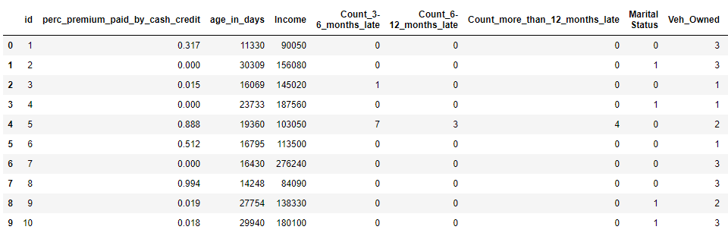
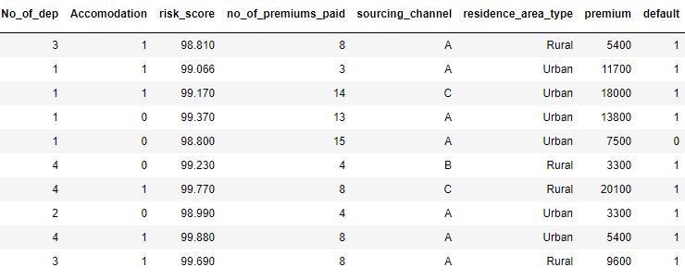
Head of Dataframe

Slide 6
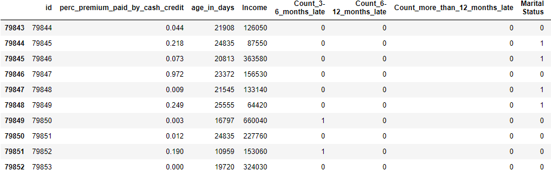
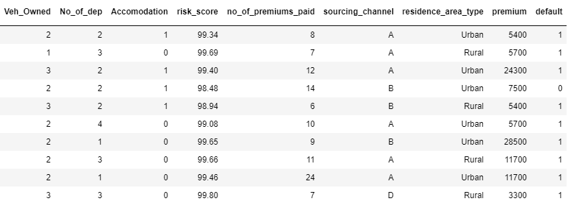
Tail of Dataframe

Slide 7
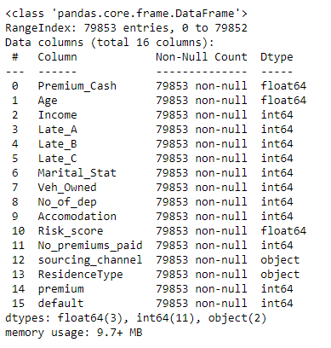
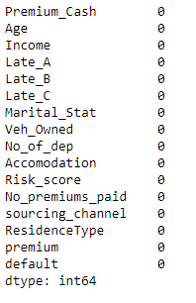
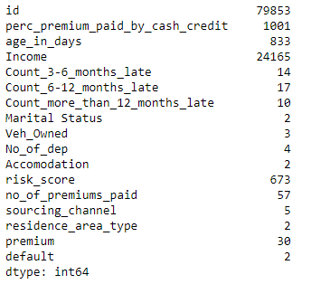
Shape of dataframe
Observation
The dataset contains 79853 rows and 17 columns
Column variables with Datatypes
Nunique Values in the Dataframe
Missing Values Assessed
Insight
We have two variables of type object that we will need to covert
Insight
The column id can dropped the as it is unique for each customer and will not add value to the model.
Insight
No missing values observed in the dataset

Slide 8
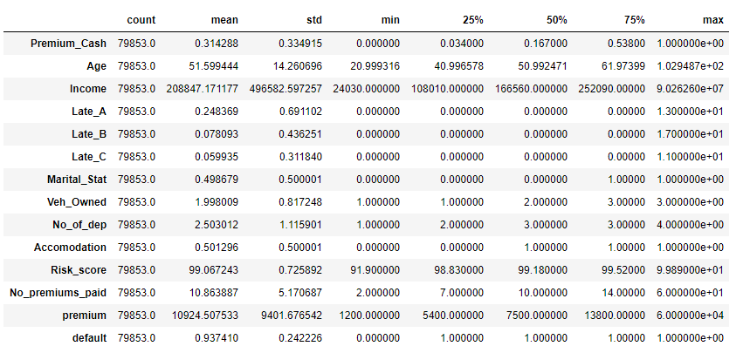
Description of Distribution of Variables in the Dataframe
Insight
The average Premium cash is approx 31
The average age of customers is approx 52 years
The average income of customers is approx 208847
The minimum income of customers is 24030 while the maximum income of customers is approx 90262600
Lowest age is approx 21 year while the maximum age is approx 102 years
The max Risk_score of approx 99.89 is almost equivalent to the maximum mean score of approx 99.07
The lowest vehicle owned is 1, the average vehicle owned is approx 2 while the maximum vehicle owned is 3
The minimum premium is 1200 while the maximum premium 60000
The mean default is approx 94

Slide 9
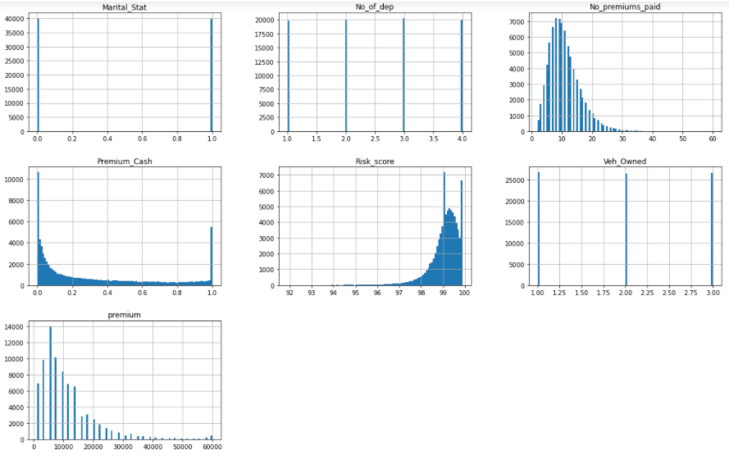
Histogram of 13 columns in the Dataframe
Insight
Accommodation indicates the basically a similar distribution for Owned (1) versus Rented (0)
There is a somewhat of normal distribution bell curve for the age of customers where the majority of
customers, roughly 2000, are approx 50 years of age.
Customer Marital Status seem to be equally distributed,4000 married, 400 unmarried
The number of Department (1-4) in the dataset each contain approx 20,000
Over 7000 customers have paid at least 10 premiums to date
Over 10000 customers paid 0% of the premium by cash while about 4800 customers paid at least 1% of the premium by cash as indicated by histogram Premium_cash graph
Risk score is negatively skewed with approx 7000 customers with Risk score of 99
Approx the same number of customers - 2700 - own, 1, 2 and 3 vehicles
Premium is positively skewed with 14000 customers with a high of approx 8000 premium

Slide 10
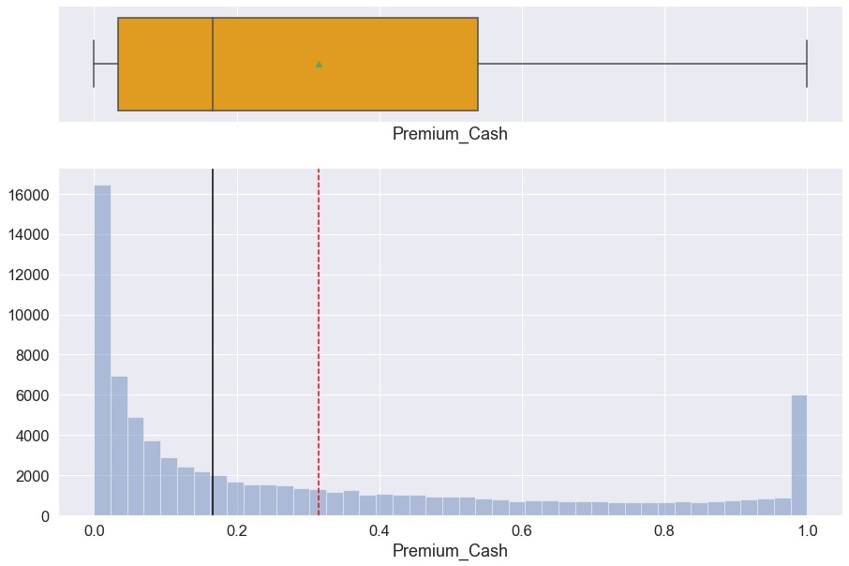
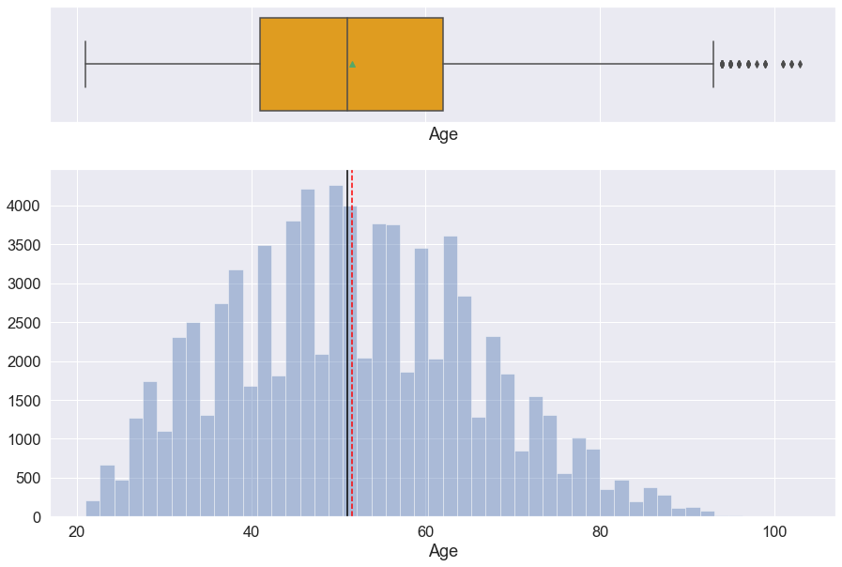
Histogram Boxplot on Premium Paid by Cash
Histogram Boxplot on Age of Customers
Insight
1% of premium was paid by cash by 6000 customers
Majority of customers, about 16000 did not pay premium by cash
Insight
The plot indicate a mainly normal distribution bell curve for the age of customers
Most customers are between the ages 50-60
There is indication of upper outliers in the boxplot

Slide 11
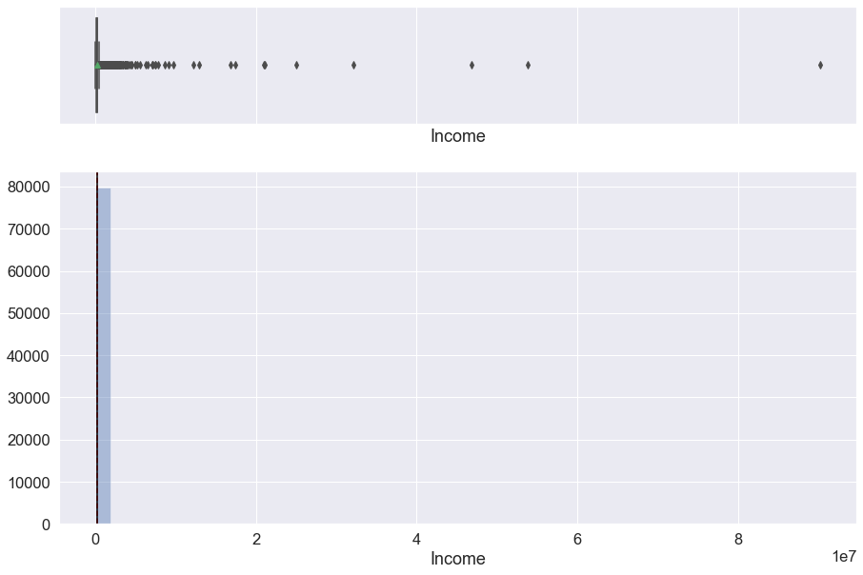
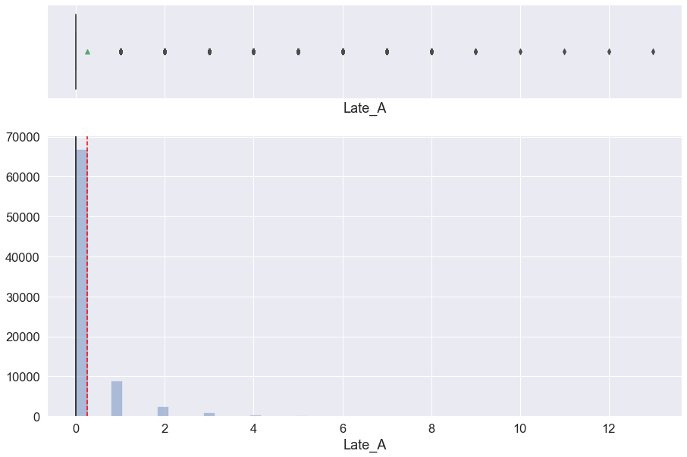
Histogram Boxplot on Income
Histogram Boxplot on 3 - 6 Months Late Payment (Late_A)
Insight
The histogram indicates that there is significant outliers in the spread of income
Insight
Less than 1000 customer were 3 - 6 late on payments
There is evidence of outliers in the boxplot

Slide 12
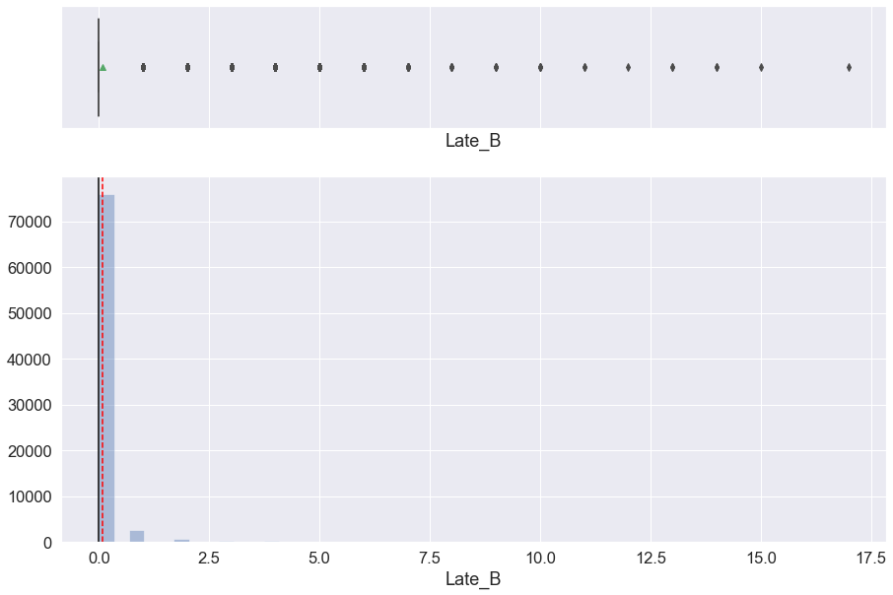
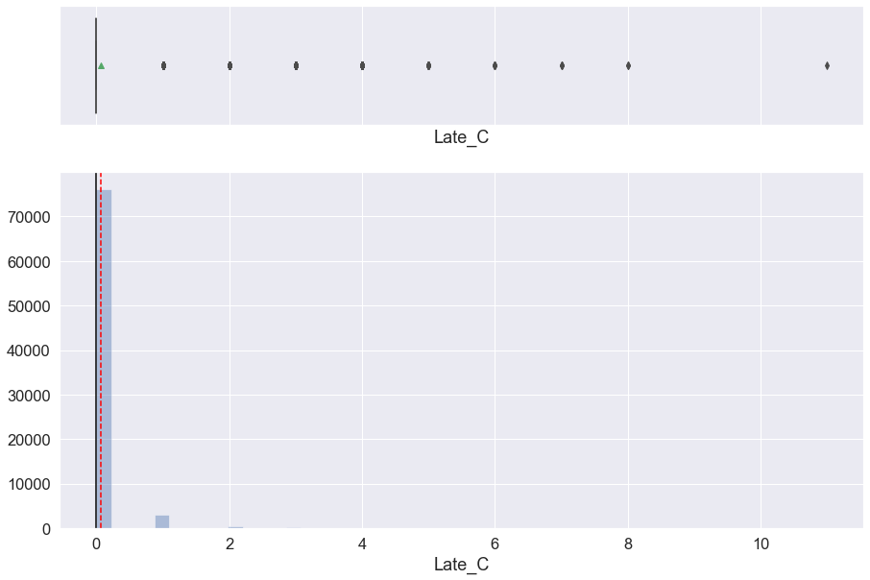
Histogram Boxplot on 6 - 12 Months Late Payment (Late_B)
Insight
Less than 400 customer were 6 - 12 months late on payments
There is evidence of outliers in the boxplot
Histogram Boxplot More than 12 Months Late (Late_C)
Insight
Less than 400 customer were more than 12 months late on payments
There is evidence of outliers in the boxplot

Slide 13
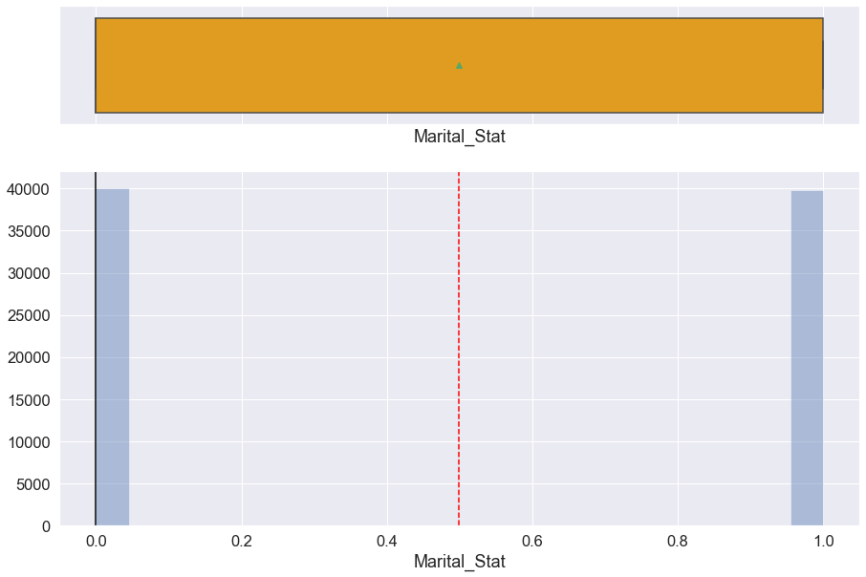
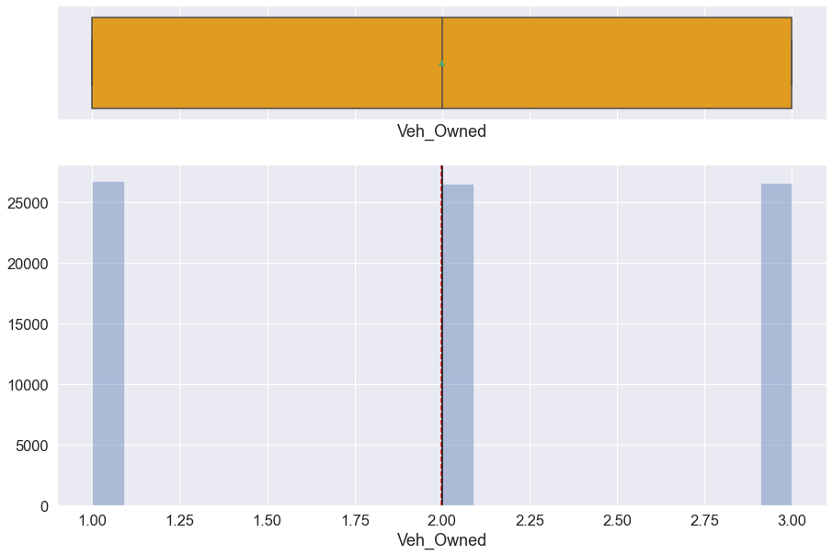
Histogram on Marital Status
Insight
Marital Status seem to be approx equally distributed with around 4000 married and around 4000 unmarried
Histogram on Vehicles Owned (Veh_Owned)
Insight
Approx 2700 of customers own 1 vehicle
Approx 2700 of customers own 2 vehicles
Approx 2700 of customers own 3 vehicles

Slide 14
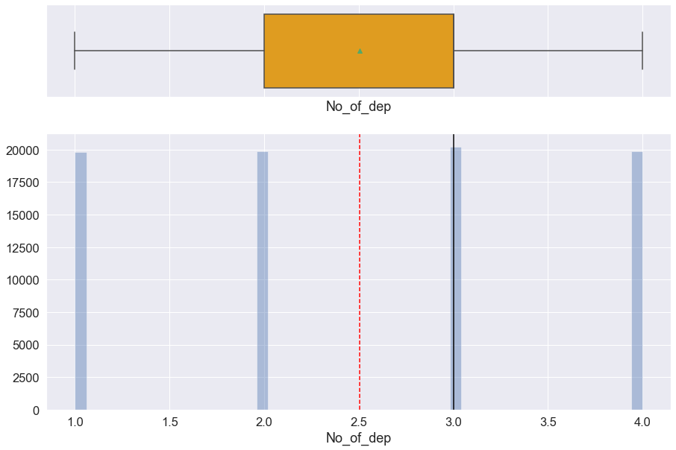
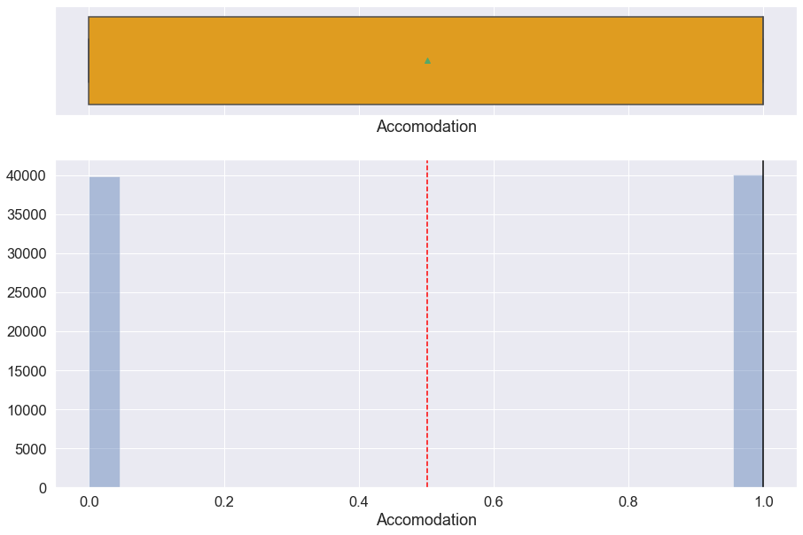
Histogram on Number of Departments (No_of_dep)
Insight
The number of departments are populated with approx the same number of customers (around 20000).
Department 3 however indicates largest amount of the set
Histogram on Accommodation
Insight
Own and Rented accommodation are approx equally distributed among customers (roughly 4000 each)

Slide 15
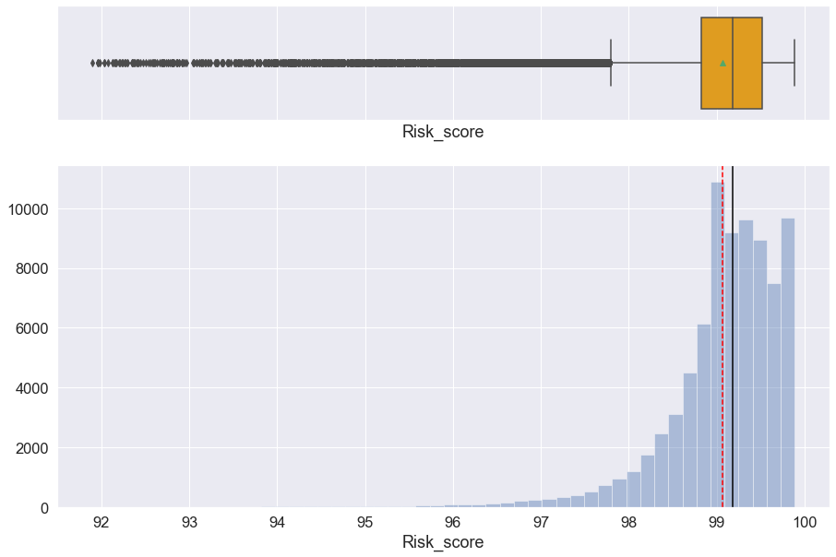
Histogram on Risk Score
Insight
Risk score is left skewed with over 8000 customers having 99-100 risk score
There is evidence of lower outliers in the boxplot

Slide 16
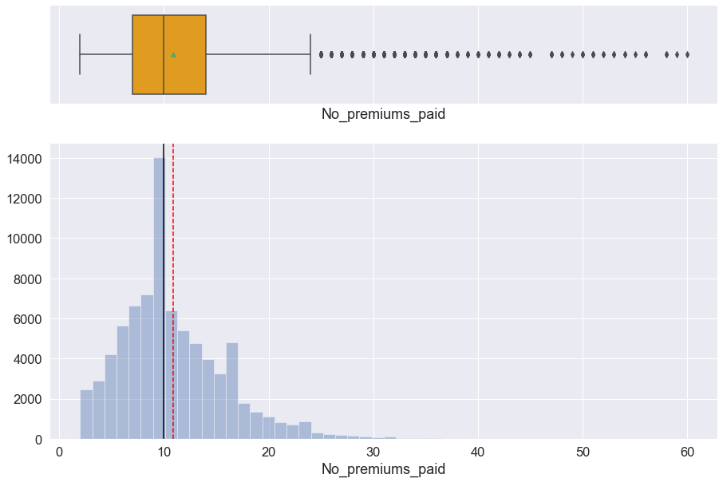
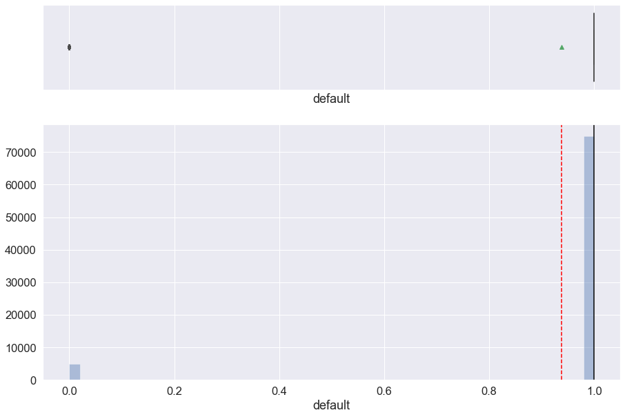
Histogram on Number of Premiums Paid
Insight
The number of premium paid to date indicates right skewed output with a maximum of approx 14000 paying 10 premiums to date
There is evidence of upper outliers in the boxplot
Histogram on Default
Insight
Note: 0 indicates that customer has defaulted the premium and 1 indicates that customer has not defaulted the premium
Evidently customers who have not defaulted the premium significantly outweighs customers who have. Over 75000 have not defaulted while approx 500 have

Slide 17
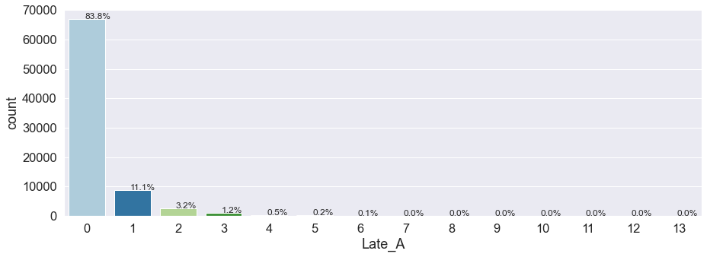
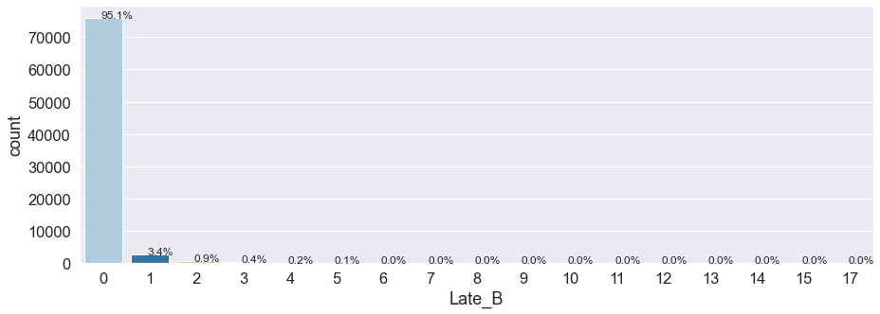
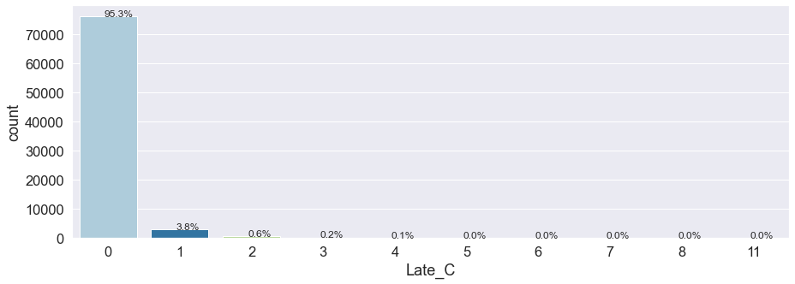
Barplot on Number of Times Premium was Paid 3-6 Months Late
Barplot on Number of Times Premium was Paid 6-12 Months Late
Insight
83.8% of customers have never paid premium 3-6 Months Late
A minimum of 0.1% have paid premium 3-6 Months Late 6 times
Barplot on Number of Times Premium was Paid more than 12 Months Late
Insight
A high of 95.1% of customers have never paid premium 6-12 Months Late
A minimum of 0.1% of customers have paid premium 6-12 Months Late 5 times
Insight
A high of 95.3% of customers have never paid premium more than 12 Months Late
3.8% of customers have paid premium more than 12 months late once
A minimum of 0.1% of customers have paid premium 6-12 Months Late 4 times

Slide 18
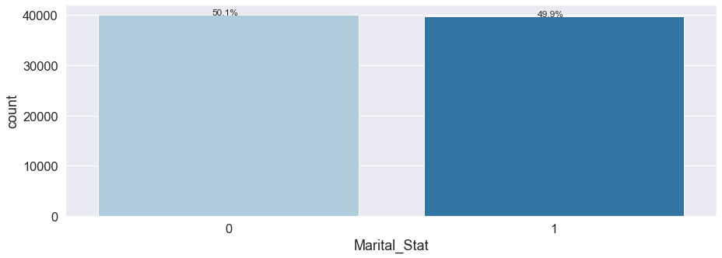
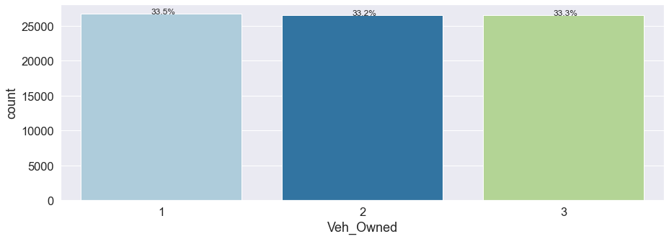
Barplot on Marital Status
Insight
Note: Married (1), unmarried (0)
The barplot indicates almost equal distribution of Marial status with 50.1% unmarried and 49.9% married
Barplot on Vehicles Owned (Veh_Owned)
Insight
The number of vehicles owned (1-3) across the customer base is approximately the same. 33.5% of customers own 1 vehicle, 33.2% of customers own 2 vehicles and 33.3% of customers own 3 vehicles

Slide 19
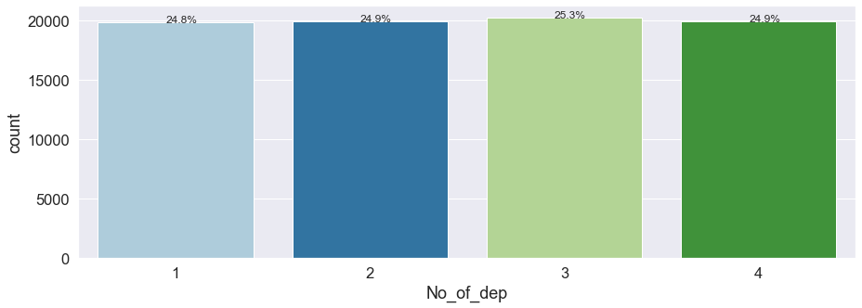
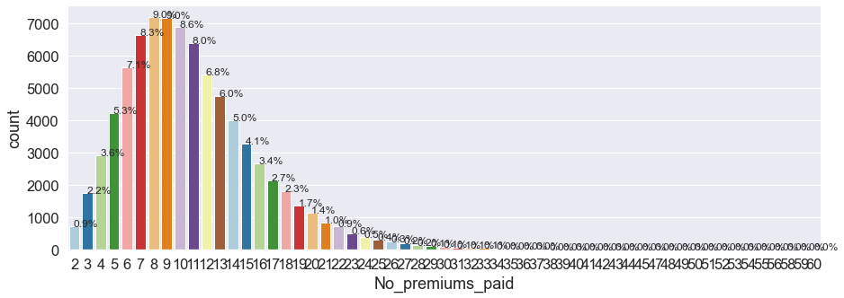
Barplot on Number of Departments (No_of_dep)
Insight
Of the department in the family of customers, department number 3 is marginally the largest of the set with 25.3% customers.
Department 1, 2 and 4 contain approx similar amount of customers
Barplot on Accomodation
Insight
The maximum of number of premiums paid till date is approx. 9%

Slide 20

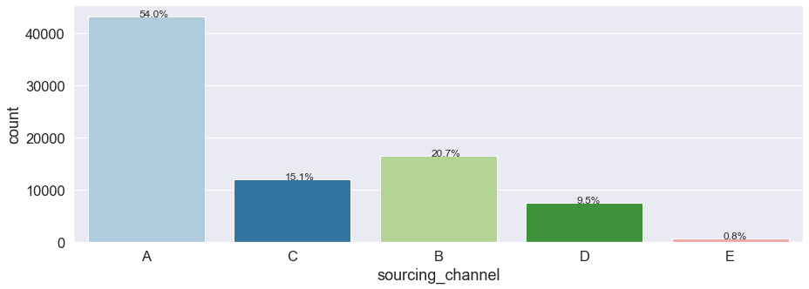
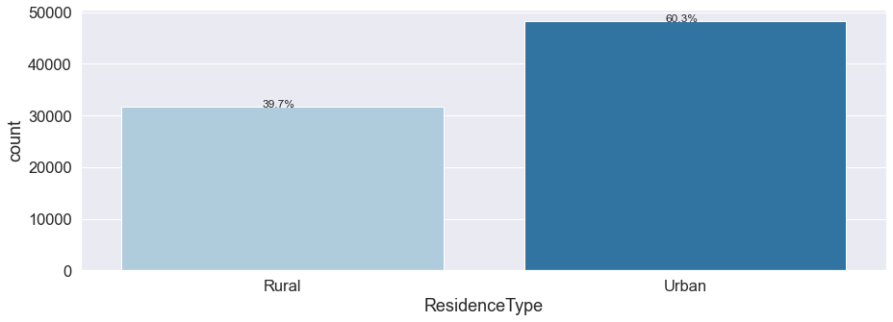
Barplot on Accommodation
Insight
Note: Owned (1), Rented (0)
The barplot indicates 49.9% of customers rent their accommodation while 50.1% own their accommodation
Barplot of Sourcing Channel
Insight
Sourcing channel A indicates a high of 54% of customers in the dataset while sourcing channel E accounts for a low of 8% of customers in the dataset. Sourcing channel is in second place with 20.7% of customers
Barplot on Resident Type
Insight
The lionshare of the customer base - 60.3% are urban residents while 39.7% are rural residents

Slide 21
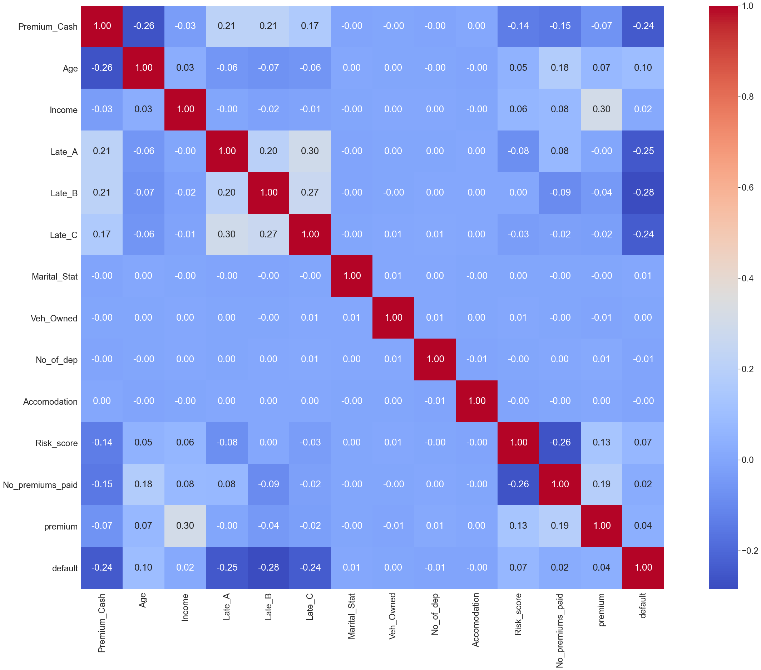
Heatmap on Correlation of Dataframe
Observation
There is no clear indication of correlated variables in the heatmap

Slide 22
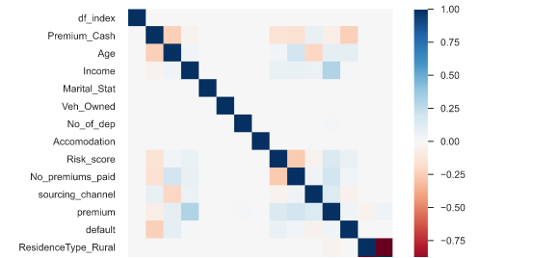
Heatmap on Correlation of Dataframe 2nd Check
Insight
The heatmap indicates approx 50% positive correlation between Age and Premium, between Income and Premium, between premium cash and default, between risk_score and premium_paid, between no premiums_paid and risk_score

Slide 23
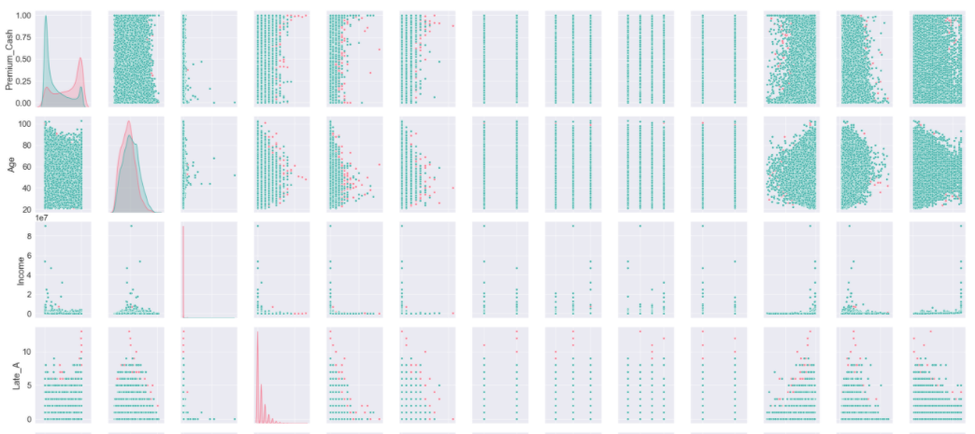
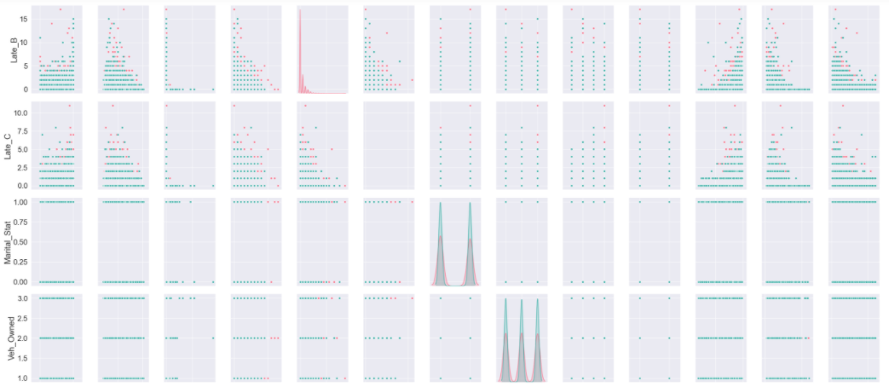
Distribution of Pairplot
Cont’d ->

Slide 24
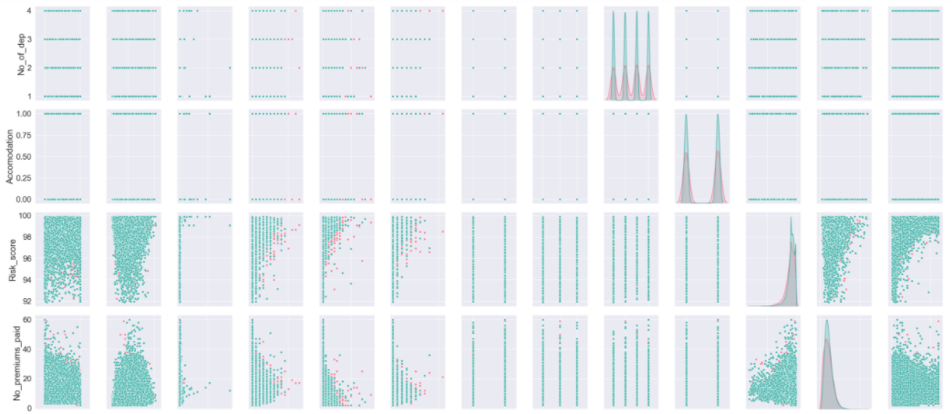
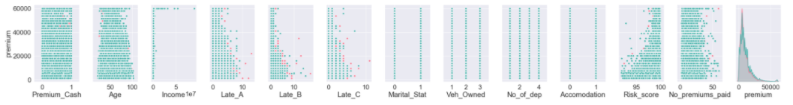
Distribution of Pairplot
Insight
There is evidence of overlaps in that there is no clear distinction in the distribution of variables for customers who default on premium payments
The dataset will be explored further with referencing other types of plots
Cont’d ->

Slide 25
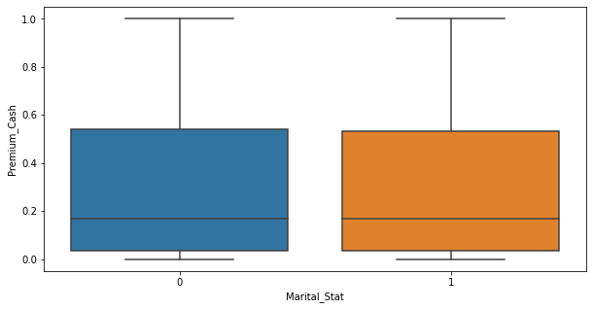
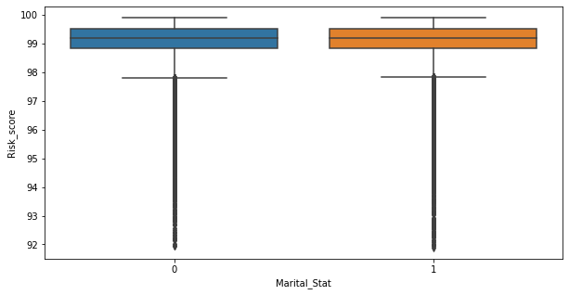
Boxplot Marital_Stat versus Premium_Cash
Insight
Unmarried and married customers pay approx the same amount of premium by cash
Boxplot Marital_Stat versus Risk_Score
Insight
Married and unmarried customers have the similar risk score
Outliers exist on both unmarried and the married plots

Slide 26
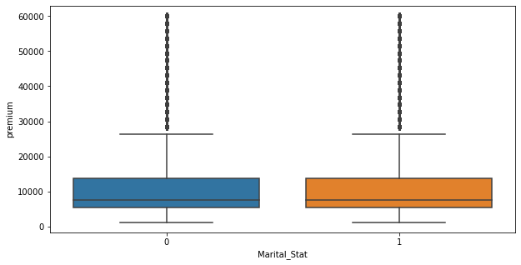
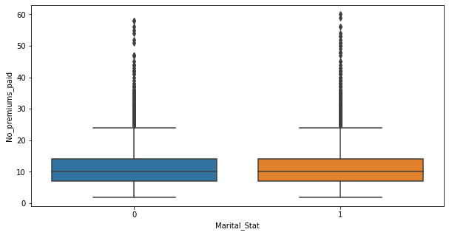
Boxplot Marital_Stat versus Premium
Insight
Total premium amount paid till now for Married and unmarried customers are approx the equal (about 15000)
Outliers exist on both unmarried and the married premium plots
Marital_Stat versus No_premiums_paid
Insight
Number of premiums paid till date for Married and unmarried customers have approx the equal (about 15)
Outliers exist on both unmarried and the married premium plots

Slide 27
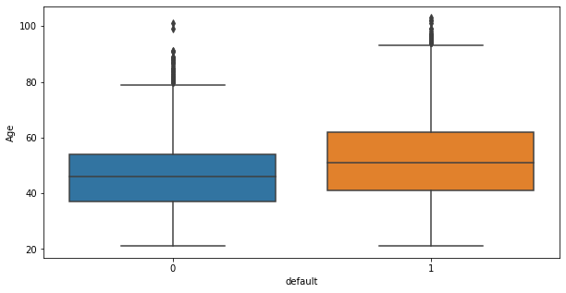
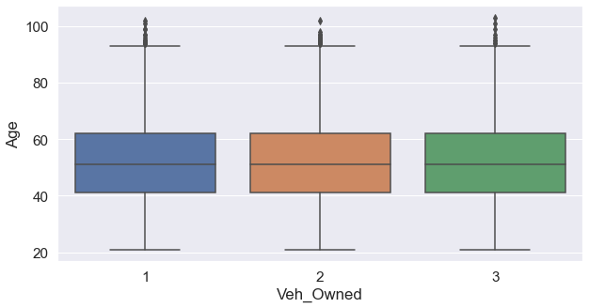
Default versus Age
Insight
A number of customers who have not defaulted are older than those who have defaulted. There is evidence of overlapping in default by age in the age range approx. 45-50
There is evidence of outliers in both default categories based on age
Veh_Owned versus Age
Insight
Customers approx ages 41-61 own 1 vehicle
Customers approx ages 41-61 own 2 vehicles
Customers approx ages 41-61 own 3 vehicles

Slide 28
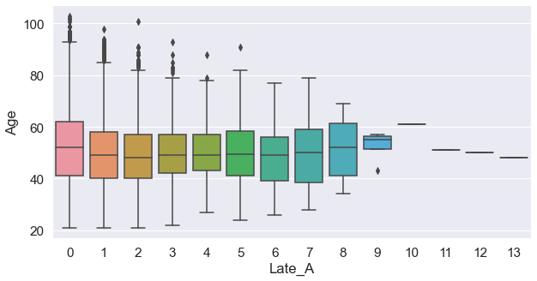
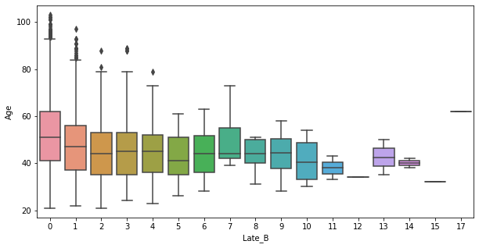
Late_A versus Age
Insight
Number of times premium was paid 3-6 months late over 10 time are consistent with customers approx 50 years old
Customers approx ages 41 - 61 who have never paid premiums 3-6 months late are equivalent to customers who have paid premiums 3-6 months late 8 times
There is evidence of upper outliers through the range 0-6 in the boxplot
Late_B versus Age
Insight
Number of times premium was paid 6-12 months late at least 12 and 15 times were made by customers approx 30-35 years old
Number of times premium was paid 6-12 months late 17 times were made by customers approx 65
There is evidence of upper outliers within the range 0-4 in the boxplot

Slide 29
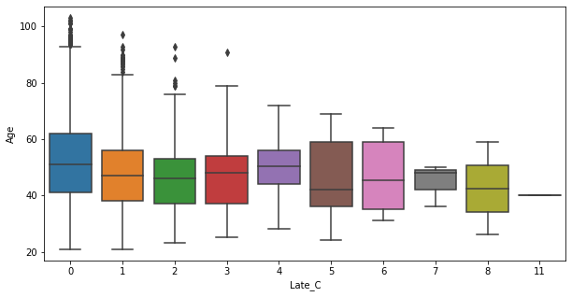
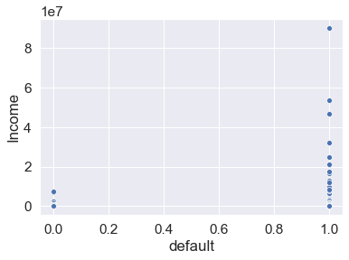
Late_C versus Age
Insight
Number of times premium was paid more than 12 months late was made 11 times by customers approx 40 years old
There is evidence of upper outliers in the range 0-3
Default versus Income
Insight
Higher income earners are far less likely to default.

Slide 30
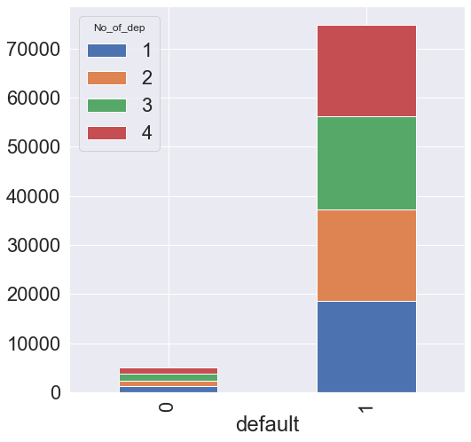
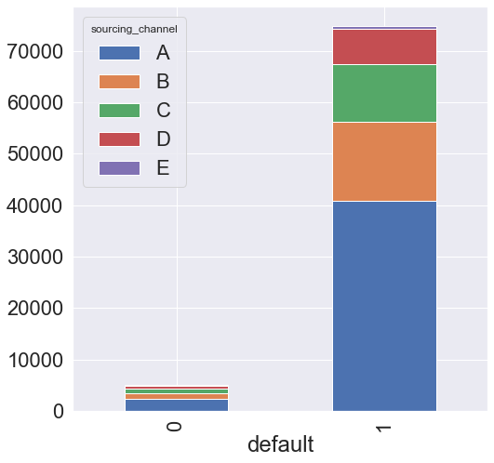
Default based on the Number of Dependent of each Customer
Insight
The cross-tab chart indicates the graphical distribution of default based on the no of dependent of each customer. Evidently those who have not defaulted are significantly more than those who have defaulted irrespective of no of dependents
Default based on Sourcing Channel
Insight
Channel A indicates the highest amount in terms of customers who have defaulted and customers who have not defaulted.

Slide 31
Focusing on the advantages of Logistic Regression for use in the Problem
A classification model that provides probabilities
Easily extended to multiple classes (multinomial regression)
Quick to train and vert fast at classifying unknown records
To improve the various sets, several other models were implemented. Decision tree algorithm (similar to a tree structure), a powerful algorithm that falls under the umbrella of supervised learning was selected because of its ability to adapt and capture various patterns in a dataset and because of its graphical representation of decisions process Decision nodes and leaf Node based on a question. The Decision nodes are used to make any decision and have multiple branches, while the Leaf nodes are the output of those decisions and do not contain any further branches. Decision trees are however prone to overfitting which was evident in the performance produced.

Slide 32
Focusing on the advantages of Logistic Regression for use in the Problem cont’d
To address the issue of overfitting, hypermeter using grid search was conducted on the decision tree model which unfortunately produced little to no change on set results. Hyperparameters are the parameters that govern the entire training process. The selection of optimal hyperparameters can lead to improvements in the overall model’s performance and can help in reducing both overfitting and underfitting.
The next step in the solution was to attempt ensemble techniques - Gradient Boost classifier, XGBoost classifier along with AdaBoost to improve the sets. Ensemble techniques are machine learning methods for combining predictions from multiple separate models. The rational for using ensembles is derived from their ability to improve poor models by performing significantly additional computation. The drawback however is that these deep additional computations require much greater memory and take up a lot more time.

Slide 33
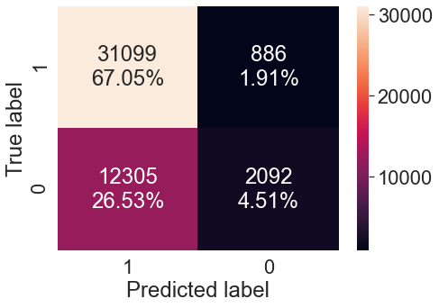

From AUC-ROC curve to get optimal threshold
Insight on train set
True positive is at 67.05.90
false positive is at 1.91
False negative is 26.53
True negative is lower at 4.51
Insight on test set
True positive is at 67.18
false positive is at 1.83
False negative is 26.58
True negative is lower at 4.41

Slide 34


AUC ROC curve
Insight
Area under the curve is 0.77
Recall is 0.71 on train and 0.71 which is not very good. Evidence of underfitting
Insight
Area under the curve is 0.54
Recall on train is at 1.0 and on 0.92 on test
Evidence of overfitting

Slide 35


Decision Tree Model Confusion matrix
Insight on train set
0 errors on train data, each sample has been classified correctly
A majority 93.71 True positive and 6.29 True negative
Insight on test set
True positive is lower at 86.90
false positive is at 5.46
False negative is 6.66
True negative is lower at 0.98

Slide 36


dTree
GBC_tuned
Observation
In dTree, Income, Premium_cash, Age and risk_score are the top 4 important features while the least 2 important features are
ResidenceType_Rural and ResidenceType_Urban
Observation
gbc_tuned indicated Premium_cash has the most feature importance feature by a very significant margin followed by Age and No premiums paid. ResidenceType_Rural and residence Type Urban have the least feature importance
Marketing team should consider the top 3-4 variables shown in a campaign to circumvent likely defaults

Slide 37

Model Performances
Insight
There are similarities in the performance of the models implemented, but decision tree indicated significant underfitting. The model selected for final use is logistic regression and decision tree pruned are strongly close in performance. A final section would be decision tree pruned as it employed hyperparameters. Again, model improvement can be arrived at with treating the unbalanced dataset.

Slide 38
Business insights and Recommendation
It is evident that premium cash, income, age, and risk score are significant in determining possible defaulters.
With premium cash less than or equal to 59, premium cash less than or equal to 30 and risk score less than 97.99 are likely to default.
The least amount of default is evident in the age range 80-100 while the most default is evident in the age range 40-50
Customers with 3 dependents and 4 dependents showed the most defaults respectively.
Of the sourcing channels, sourcing Channel A contains the highest amount customers who have defaulted.
No of vehicles owned and residenceType and marital status have very little impact on default.
Premium could be revised to facilitate a more manageable payment plans in the best interest of the customer thus mitigating the likelihood of defaulters.
Reminders in the form of text messages and phone calls should be sent out to defaulters reminding them of missed payments and possible penalties.

Slide 39
Business insights and Recommendation Cont’d
The dataset provided was unbalanced where the majority target variable showed a significantly higher majority class than the minority class which resulted in overfitting in the majority class in the models. This phenomenon could be addressed using several strategies. One such is undersampling where the ratio of instances in the majority and the minority levels could have been tailored to reflect a more favourably balanced observation (e.g. 50/50). In this case the K-NN (k-nearest neighbors algorithm) clustering technique could have been used to derive a downsampled dataset.
A second strategy for solving unbalance dataset is resampling. In resampling strategy, samples from the majority class (under-sampling) are removed and adding more examples to the minority class(over-sampling).
Based on the findings from the dtree and the GBC_tuned , Income, Premium_cash, Age and risk_score are the top four important features while the least two important features are ResidenceType_Rural and ResidenceType_Urban. The marketing team should consider suggestions for shaping policies based on these factors in order to mitigate the rate of defaults.

Slide 40
Approach: Logical steps to final model selection
Preliminary analysis, univariate analysis, bivariate analysis, and data preparation were carefully conducted. A comparison of the performance results on variables - Train_Accuracy, Test_Accuracy, Train_recal, Test_Recall, Train_Precision, Test_Precision, Train_f1_core and Test_f1_core on all models used was conducted to determine the model with best performance. Overfitting and underfitting were points to note in each model. If there was evidence significant overfitting an underfitting then the model would be deemed as performing poorly and, in that case, would need to be improved for optimal performance through measures such as hyperparameters. Hyperparameters are the parameters that govern the entire training process, and they have a significant effect on the performance of models.
After implementing logistic regression there was evidence of significant overfitting when evaluating each variable in the dataset. Decision tree was then used for improvement. After the little changes in the set produced, decision tree with Grid search is a technique used to for optimization. XGBoost, and gradient boosting tune were subsequently implemented to derive the best model performance

Slide 41
Relevance and Implementability of the Conclusions and Recommendations
For any company to thrive and compete in the today’s marketplace, measures must be in place to ensure profitability and at the same time ensure fairness to existing and potential customers. It is always better to retain your existing customers than it is to acquire new customers in any company. Against this background was incumbent upon this insurance company to identity measures to stem the attrition of their customer base and at the same time, attract additional customers as well as to mitigate defaults on premium.
The project modelling itself reflected coherency and made good use of univariate analysis (distribution and spread for every continuous attribute, distribution of the data in categories for categorical ones), bivariate analysis (that indicated relationship between different variables, correlations), and data preparation.
Based on the objectives outlined, the model presented was able to:
Predict the likelihood of a customer defaulting on premium payments (Who is likely to default).
Identify the factors that drive higher default rate (Are there any characteristics of the customers who are likely to default?)

Slide 42
Relevance and Implementability of the Conclusions and Recommendations cont’d
Based on the findings, propose a strategy for reducing default rates by using the model and other insights from the analysis (What should be done to reduce the default rates?)
While the model was able to address areas of concern for the insurance company, it is worth noting areas for improvement within the model. The dataset being unbalanced could have been adjusted (as outlined earlier) to achieve a more robust and objective analysis. In addition, one or more ensemble methods could also have been implemented used to determine whether better performance might have emerged on all sets examined
August 28, 2021

