Slide 1
Lend and Lease
A web application for Lending and Leasing items in your area
Group 3
Edvin, Basel, David, Daniel

Slide 2
Business Idea
Give purpose to unused items
Let people earn pocket-money easily
Earn money on ad-revenue as the user-base grows
Gradually add features for premium users

Slide 3
Overall system design

Slide 4
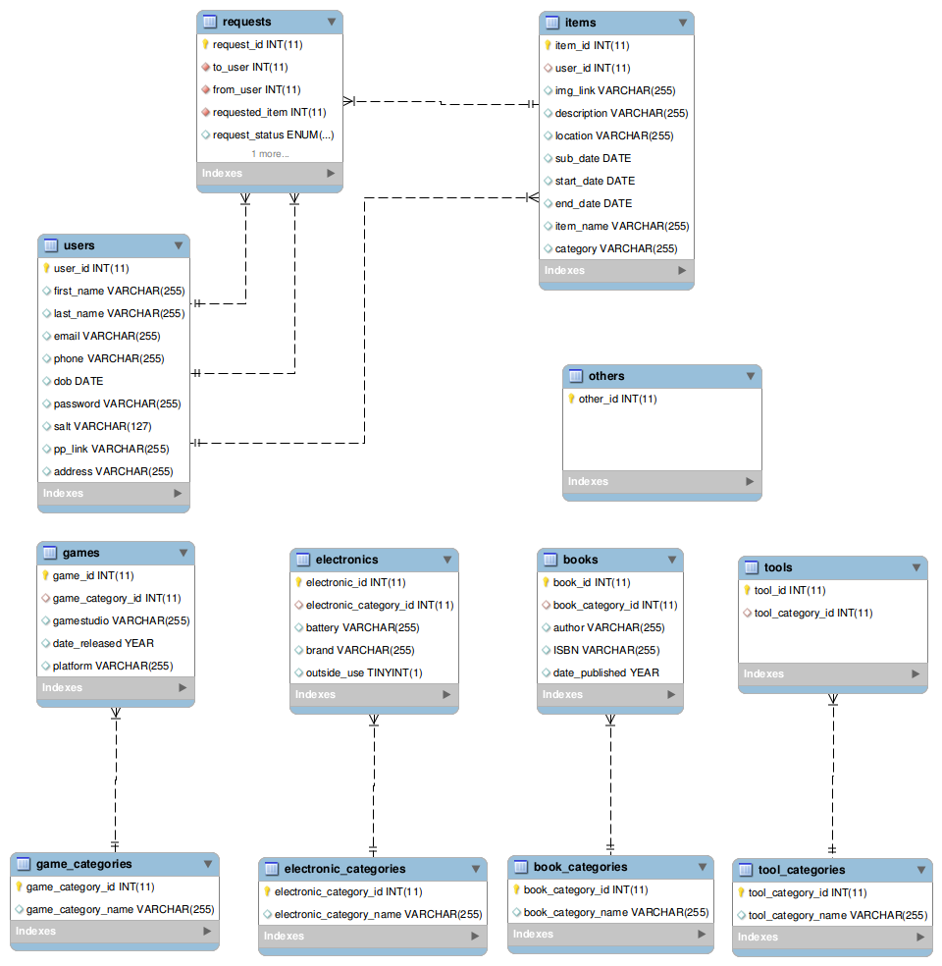
Data model

Slide 5
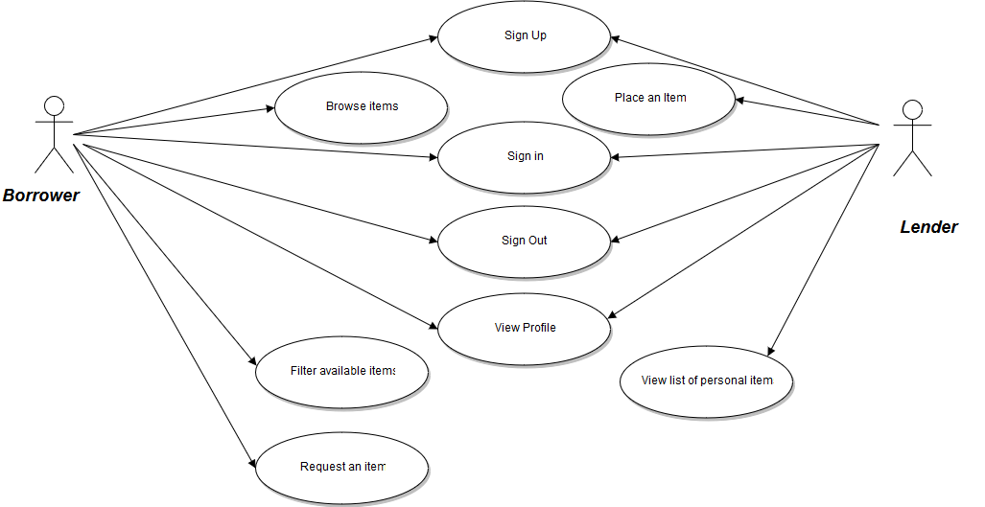
Use cases

Slide 6
Testing
Node
  Sinon.JS
  Chai
  mocha
Angular
  Jasmine
  Karma
MySQL
  Try to do MySQL injects
UserInterface
Personas

Slide 7
PROTOTYPE

Slide 8
Group dynamics
Work division
Communication
Administration
Tools

Slide 9
Technical aspects
Security
PassportJS
Code management
GitHub
Slack

Slide 10
Lessons Learned
NodeJS with passport
Everything was new to everyone (AngularJS, NodeJS, proper MYSQL database design)
Communication

Slide 11
Current Status and Future work
What’s working today..
  Displaying all items and specific items for the user
  Sending emails to notify user
  Profile pictures and images of items
What’s to be implemented..
  More interaction between the users(Implement requests fully)
  Improve search functions for maps
  Improve selecting location for items
  Add ability to lease-out items
  Fine tune email notifications
  nsiege for handling large amounts of http requests to the server

