Slide 1

CHEF
C2C Delphia & Thomson

Slide 2

On the menu for today:
Background
History
Structure
Code Example
Demonstration
Evaluation

Slide 3
Background
An “esoteric” language
Intended for or likely to be understood by only a small number of people with a specialized knowledge or interest
Imperative Paradigm
Manipulation of data values in stacks, most like assembly language
Provides little abstraction from computer’s instruction architecture

Slide 4
Background
Types of problems to solve
Basic problems involving integers or ascii values
Does NOT aid in IRL Cooking
Programming Environment
need a Chef interpreter written in Perl

Slide 5

History
Designed by David Morgan-Mar (Ph.D), web-comic author, optical engineer
Developed in 2003
Purpose
Create a language that was easy to prepare and delicious
Only “Ancestors” would be other esoteric languages
Haifu, Whenever, and ZOMBIE

Slide 6
Structure: Implementation
Ingredients are variables, their values are the quantity
Will print out as ascii value or integer
Preparation
Mixing bowls are used to represent stacks
“First mixing bowl, second…, etc.”
Baking dishes show results

Slide 7
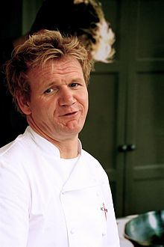
Structure: Design
All programs are as follows:
Recipe title
Comments – if any
Ingredient list (initializing variables)
Method
servings (print results)

Slide 8
Structure: Tradeoffs
Readability/Writeability
Have to know exactly what each “instruction” really does
Sift the flour. Put flour into mixing bowl. Serve with caramel sauce. Stir for 2 minutes. Remove egg. Rub the flour until sifted. Stir for 2 minutes. Fold the butter into the mixing bowl. Pour contents of the mixing bowl into the baking dish.
^^^Loop that puts a variable in a stack, calls another method, more stack manipulation, subtracts, pops, then prints.

Slide 9
Code Example
Hello World Souffle. This recipe prints the immortal words "Hello world!", in a basically brute force way. It also makes a lot of food for one person. Ingredients. 72 g haricot beans 101 eggs 108 g lard 111 cups oil 32 zucchinis 119 ml water 114 g red salmon 100 g dijon mustard 33 potatoes Method. Put potatoes into the mixing bowl. Put dijon mustard into the mixing bowl. Put lard into the mixing bowl. Put red salmon into the mixing bowl. Put oil into the mixing bowl. Put water into the mixing bowl. Put zucchinis into the mixing bowl. Put oil into the mixing bowl. Put lard into the mixing bowl. Put lard into the mixing bowl. Put eggs into the mixing bowl. Put haricot beans into the mixing bowl. Liquefy contents of the mixing bowl. Pour contents of the mixing bowl into the baking dish. Serves 1.

Slide 10
Code Example
Title
Hello World Souffle. This recipe prints the immortal words "Hello world!", in a basically brute force way. It also makes a lot of food for one person. Ingredients. 72 g haricot beans 101 eggs 108 g lard 111 cups oil 32 zucchinis 119 ml water 114 g red salmon 100 g dijon mustard 33 potatoes Method. Put potatoes into the mixing bowl. Put dijon mustard into the mixing bowl. Put lard into the mixing bowl. Put red salmon into the mixing bowl. Put oil into the mixing bowl. Put water into the mixing bowl. Put zucchinis into the mixing bowl. Put oil into the mixing bowl. Put lard into the mixing bowl. Put lard into the mixing bowl. Put eggs into the mixing bowl. Put haricot beans into the mixing bowl. Liquefy contents of the mixing bowl. Pour contents of the mixing bowl into the baking dish. Serves 1.

Slide 11
Code Example
Title
Comments
Hello World Souffle. This recipe prints the immortal words "Hello world!", in a basically brute force way. It also makes a lot of food for one person. Ingredients. 72 g haricot beans 101 eggs 108 g lard 111 cups oil 32 zucchinis 119 ml water 114 g red salmon 100 g dijon mustard 33 potatoes Method. Put potatoes into the mixing bowl. Put dijon mustard into the mixing bowl. Put lard into the mixing bowl. Put red salmon into the mixing bowl. Put oil into the mixing bowl. Put water into the mixing bowl. Put zucchinis into the mixing bowl. Put oil into the mixing bowl. Put lard into the mixing bowl. Put lard into the mixing bowl. Put eggs into the mixing bowl. Put haricot beans into the mixing bowl. Liquefy contents of the mixing bowl. Pour contents of the mixing bowl into the baking dish. Serves 1.

Slide 12
Code Example
Title
Comments
Hello World Souffle. This recipe prints the immortal words "Hello world!", in a basically brute force way. It also makes a lot of food for one person. Ingredients. 72 g haricot beans 101 eggs 108 g lard 111 cups oil 32 zucchinis 119 ml water 114 g red salmon 100 g dijon mustard 33 potatoes Method. Put potatoes into the mixing bowl. Put dijon mustard into the mixing bowl. Put lard into the mixing bowl. Put red salmon into the mixing bowl. Put oil into the mixing bowl. Put water into the mixing bowl. Put zucchinis into the mixing bowl. Put oil into the mixing bowl. Put lard into the mixing bowl. Put lard into the mixing bowl. Put eggs into the mixing bowl. Put haricot beans into the mixing bowl. Liquefy contents of the mixing bowl. Pour contents of the mixing bowl into the baking dish. Serves 1.
Variables, amount of each is ASCII

Slide 13
Code Example
Title
Comments
Hello World Souffle. This recipe prints the immortal words "Hello world!", in a basically brute force way. It also makes a lot of food for one person. Ingredients. 72 g haricot beans 101 eggs 108 g lard 111 cups oil 32 zucchinis 119 ml water 114 g red salmon 100 g dijon mustard 33 potatoes Method. Put potatoes into the mixing bowl. Put dijon mustard into the mixing bowl. Put lard into the mixing bowl. Put red salmon into the mixing bowl. Put oil into the mixing bowl. Put water into the mixing bowl. Put zucchinis into the mixing bowl. Put oil into the mixing bowl. Put lard into the mixing bowl. Put lard into the mixing bowl. Put eggs into the mixing bowl. Put haricot beans into the mixing bowl. Liquefy contents of the mixing bowl. Pour contents of the mixing bowl into the baking dish. Serves 1.
Variables, amount of each is ASCII
Puts variables on stack, liquefy makes them characters, poured into baking dish, prepare to print

Slide 14
Code Example

Slide 15
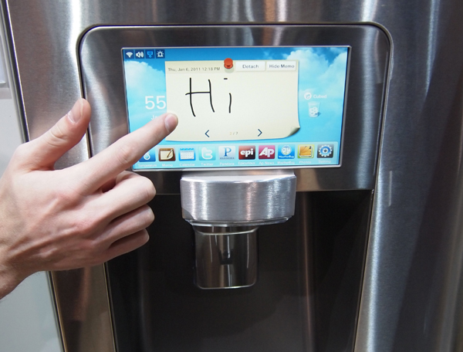
Evaluation
Professed purpose: Recipes should generate valid output, but also be easy to prepare and delicious
Met
General purpose: Meant to be a fun/joke language
met
Currently only used to
program kitchen appliances
Joke

Slide 16
Documentation
http://www.dangermouse.net/esoteric/chef_hello.html
http://www.dangermouse.net/esoteric/chef.html
http://en.wikipedia.org/wiki/Chef_programming_language
http://kottke.org/08/12/the-chef-programming-language

